Slide 1






















Unit 8
My Town
Lesson 3 – Task 7,8,9

Slide 2






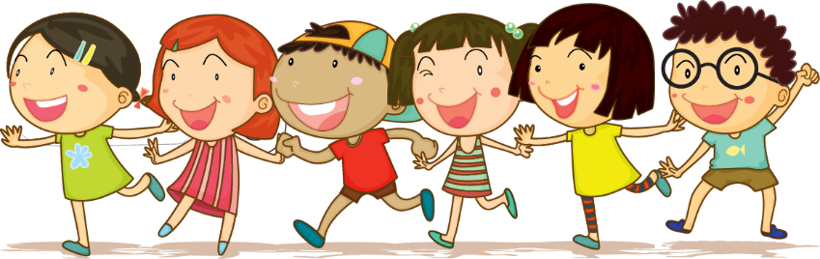



1 Warm-up

Slide 3


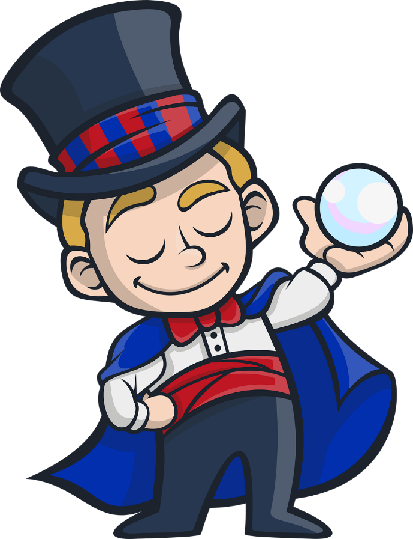
Next
WHEEL of FORTUNE
1 star
2 stars
1 star
1
2
2 stars
1 star
1 star
0 star
0 star
3
4
4 stars
3 stars
1 star
2 stars
5
Notes:
T clicks numbers to show the questions, clicks the wheel to show points

Slide 4

1. Which word is pronounced differently?
A. playground
B. park
C. market
Next

Slide 5
2. Which word is pronounced differently?
A. sit
B. library
C. drink
Next

Slide 6
3. Which word is pronounced differently?
A. fun
B. museum
C. sun
Next

Slide 7
4. Which word is pronounced differently?
A. pool
B. cool
C. look
Next

Slide 8
5. Which word is pronounced differently?
A. swim
B. sugar
C. sweet
Next

Slide 9
2 Presentation

Slide 10
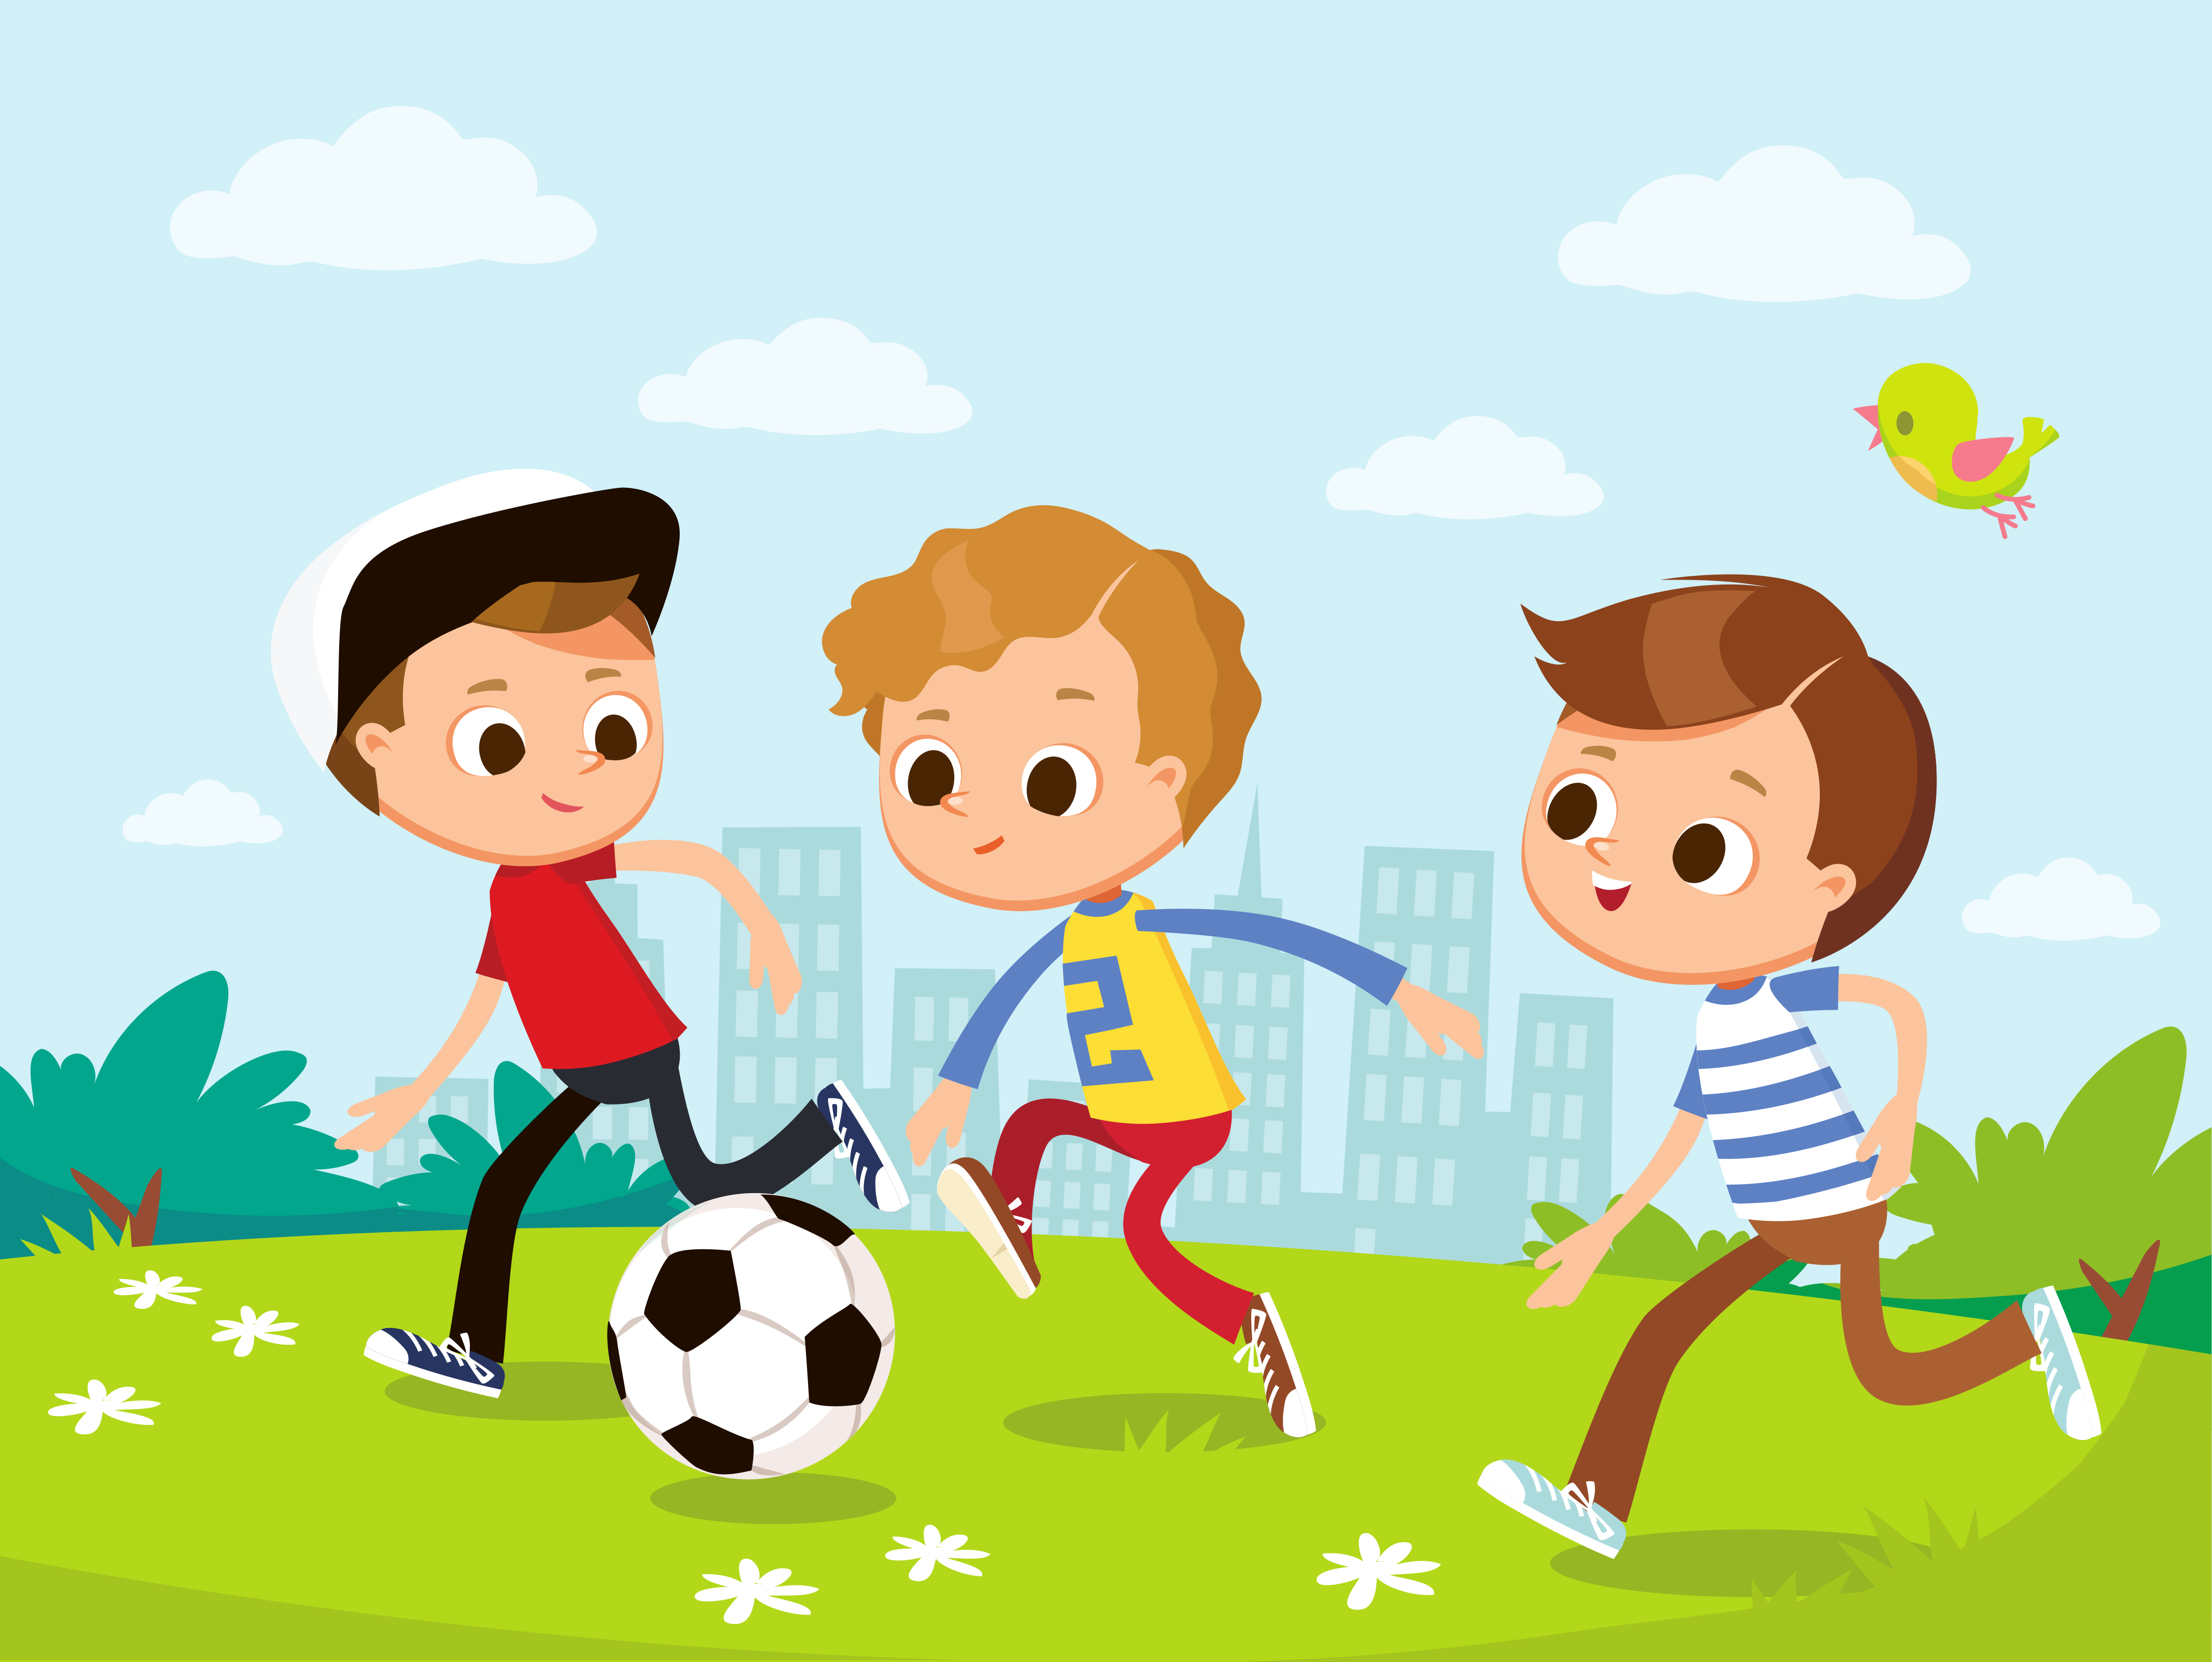



Words
tour | ou

Slide 11
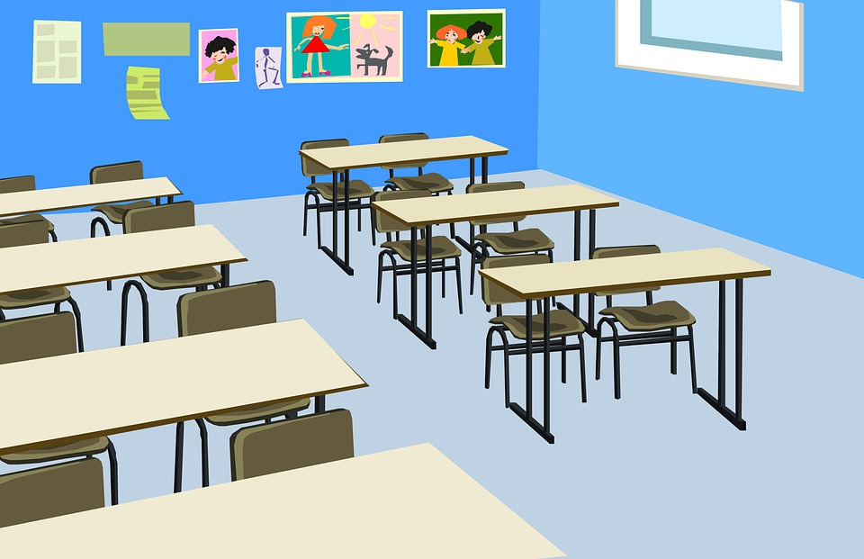

https://www.youtube.com/watch?v=nHSqluHrD-U

Slide 12
 | Words
ou
dour
journey
tournament
tourist

Slide 13
Words
theater | ea

Slide 14
https://www.youtube.com/watch?v=vC0h4S0YPJc

Slide 15
 | Words
ea
ear
tear
beard
fear

Slide 16


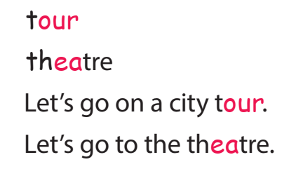
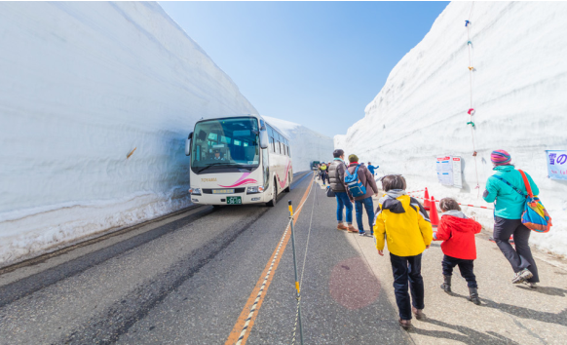
Task 7. Listen and repeat.

Slide 17
3 Practice

Slide 18
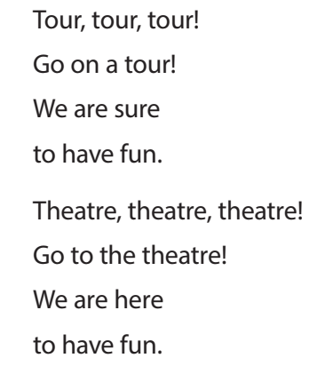
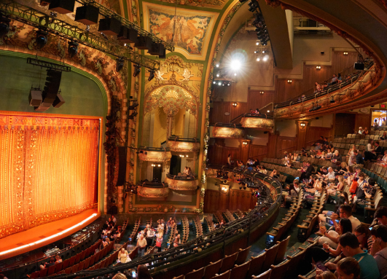
Task 8. Listen and chant.
Let’s listen and find!

Slide 19
Task 8. Listen and chant.

Slide 20
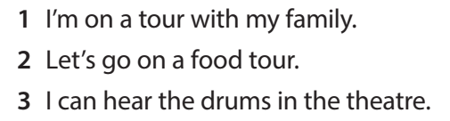
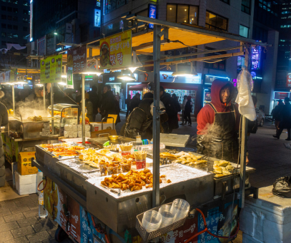
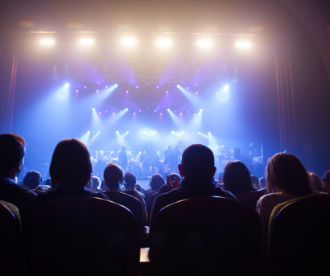
Task 9. Say it!
Let’s find ou and ea !

Slide 21
Task 9. Say it!

Slide 22
4 Production

Slide 23
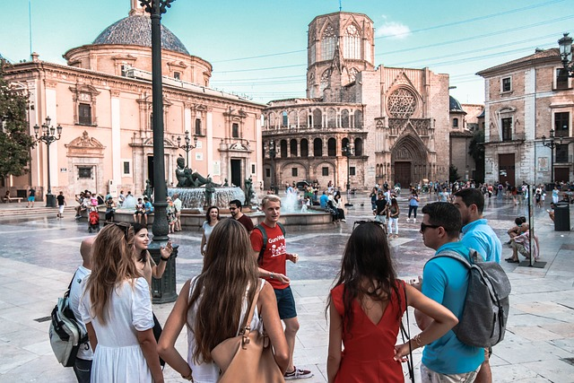

Look and write: ou or ea ?
ou
t__r

Slide 24
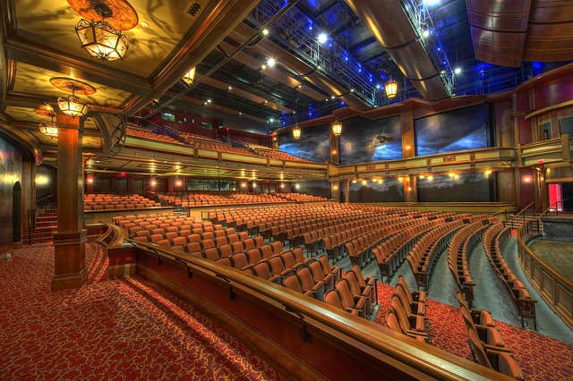
Look and write: ou or ea ?
ea
th__ter

Slide 25
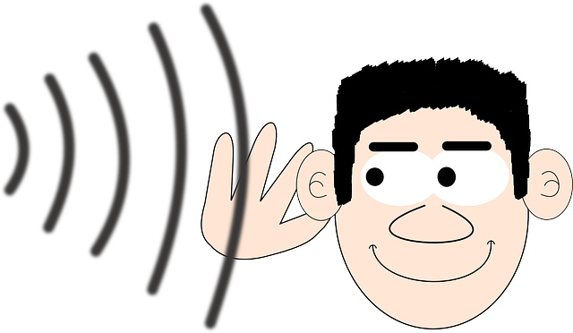
Look and write: ou or ea ?
h__r
ea

Slide 26
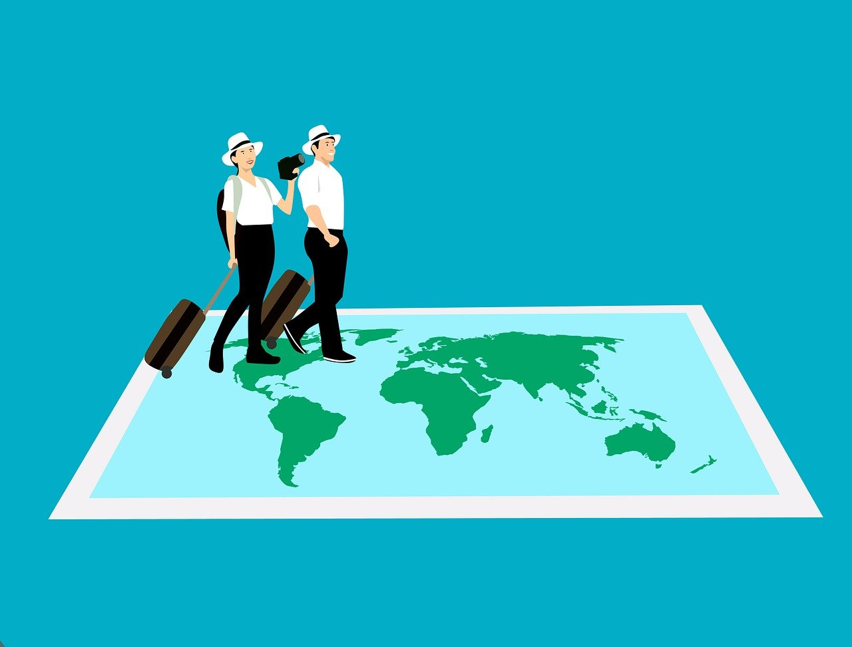
Look and write: ou or ea ?
ou
t__rist

Slide 27

Look and write: ou or ea ?
t__r
ea

Slide 28
5 Assessment

Slide 29

Listen and tick.
a. theatre
b. there
a. sure
b. sea
1
✓
2
✓
3
a. team
b. tour
a. house
b. here
✓
4
✓
5
a. bear
b. near
✓
Notes:
HOẠT ĐỘNG TƯƠNG TÁC

Slide 30




Thank you & goodbye!

