Slide 1



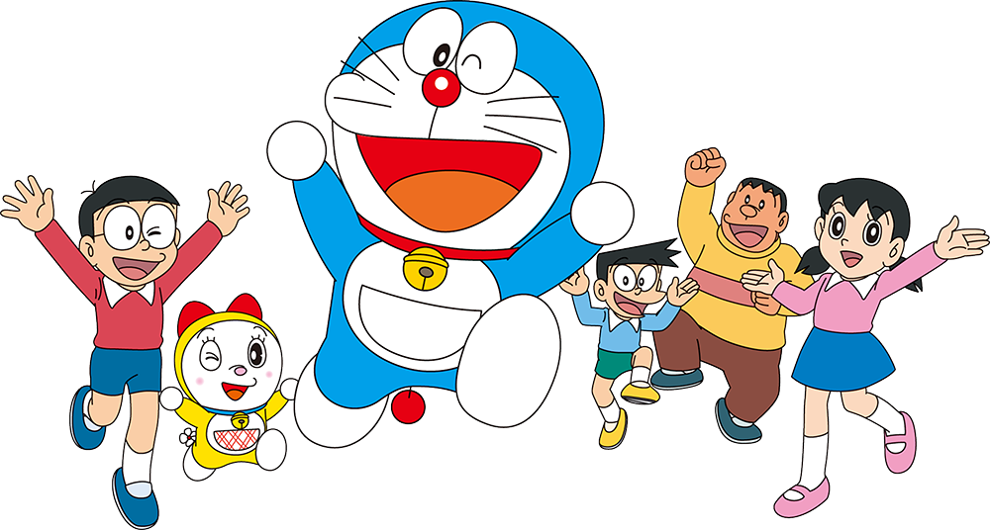
Puzzles

Slide 2
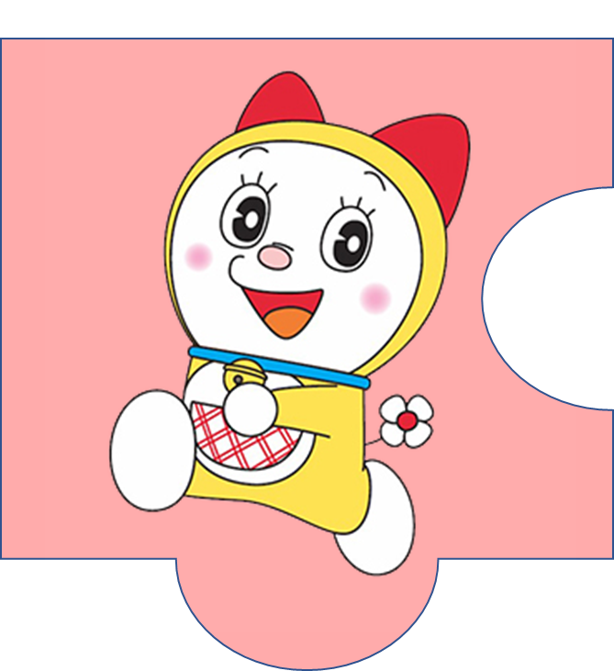

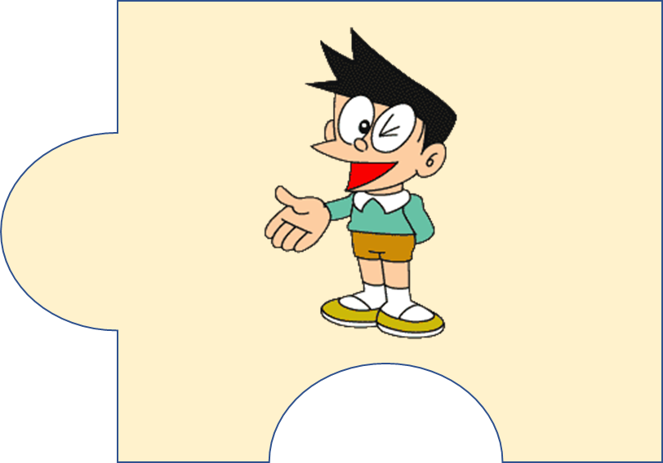
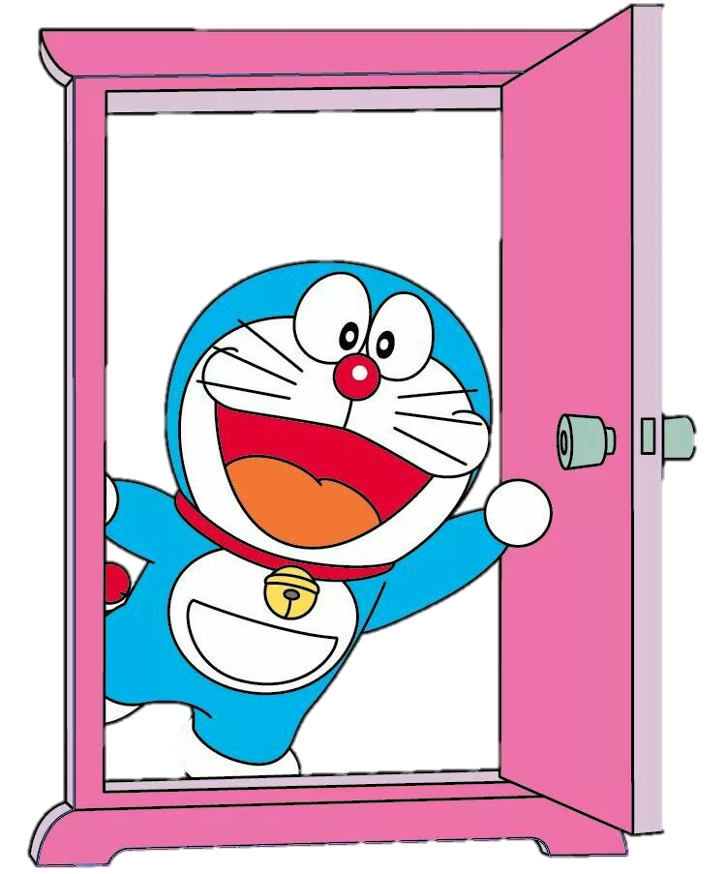



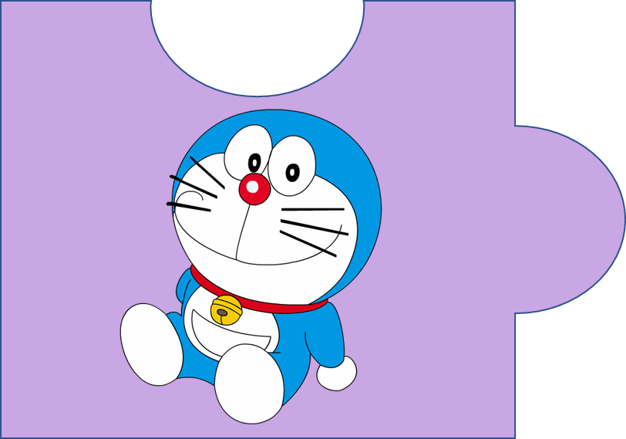


?
20
It’s a magic door.

Slide 3
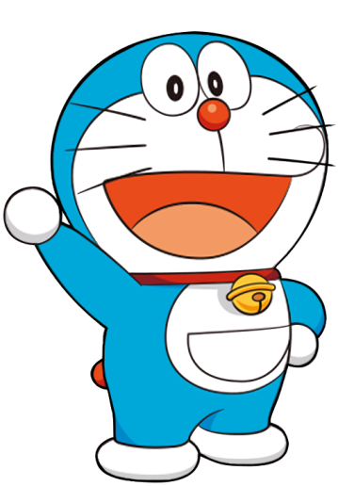
f c h u l r e e
  cheerful
4

Slide 4

p e s l a n t a
  pleasant
5

Slide 5

c l r e v e
  clever
3

Slide 6
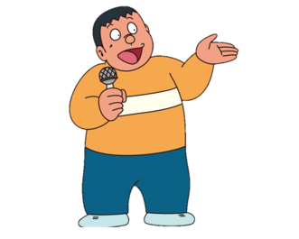
f r e d l n i y
  friendly
4

Slide 7
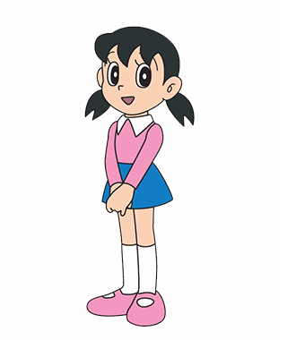
h a d r i n w o g r k
  hard-working
6

Slide 8
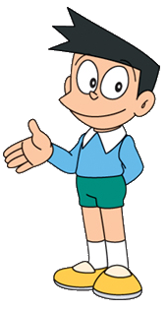
k n i d
  kind
2

