Slide 1









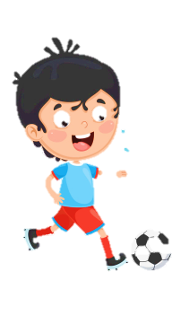












Slide 2










Unit 12: WEATHER AND NATURE
Lesson 2 – Task 4, 5, 6

Slide 3





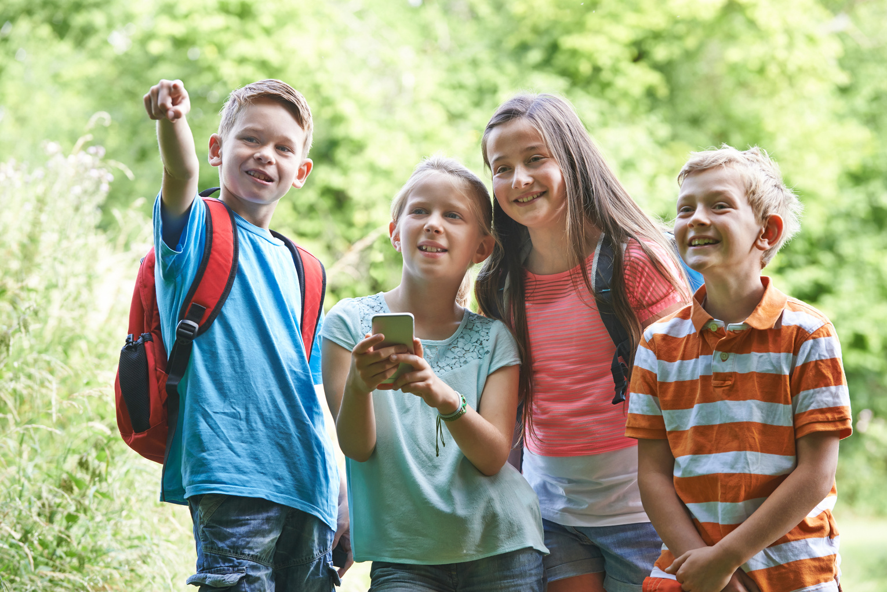



QUESTION 1
A. GPS
B. treasure
C. geocaching
D. geothermal energy

Slide 4
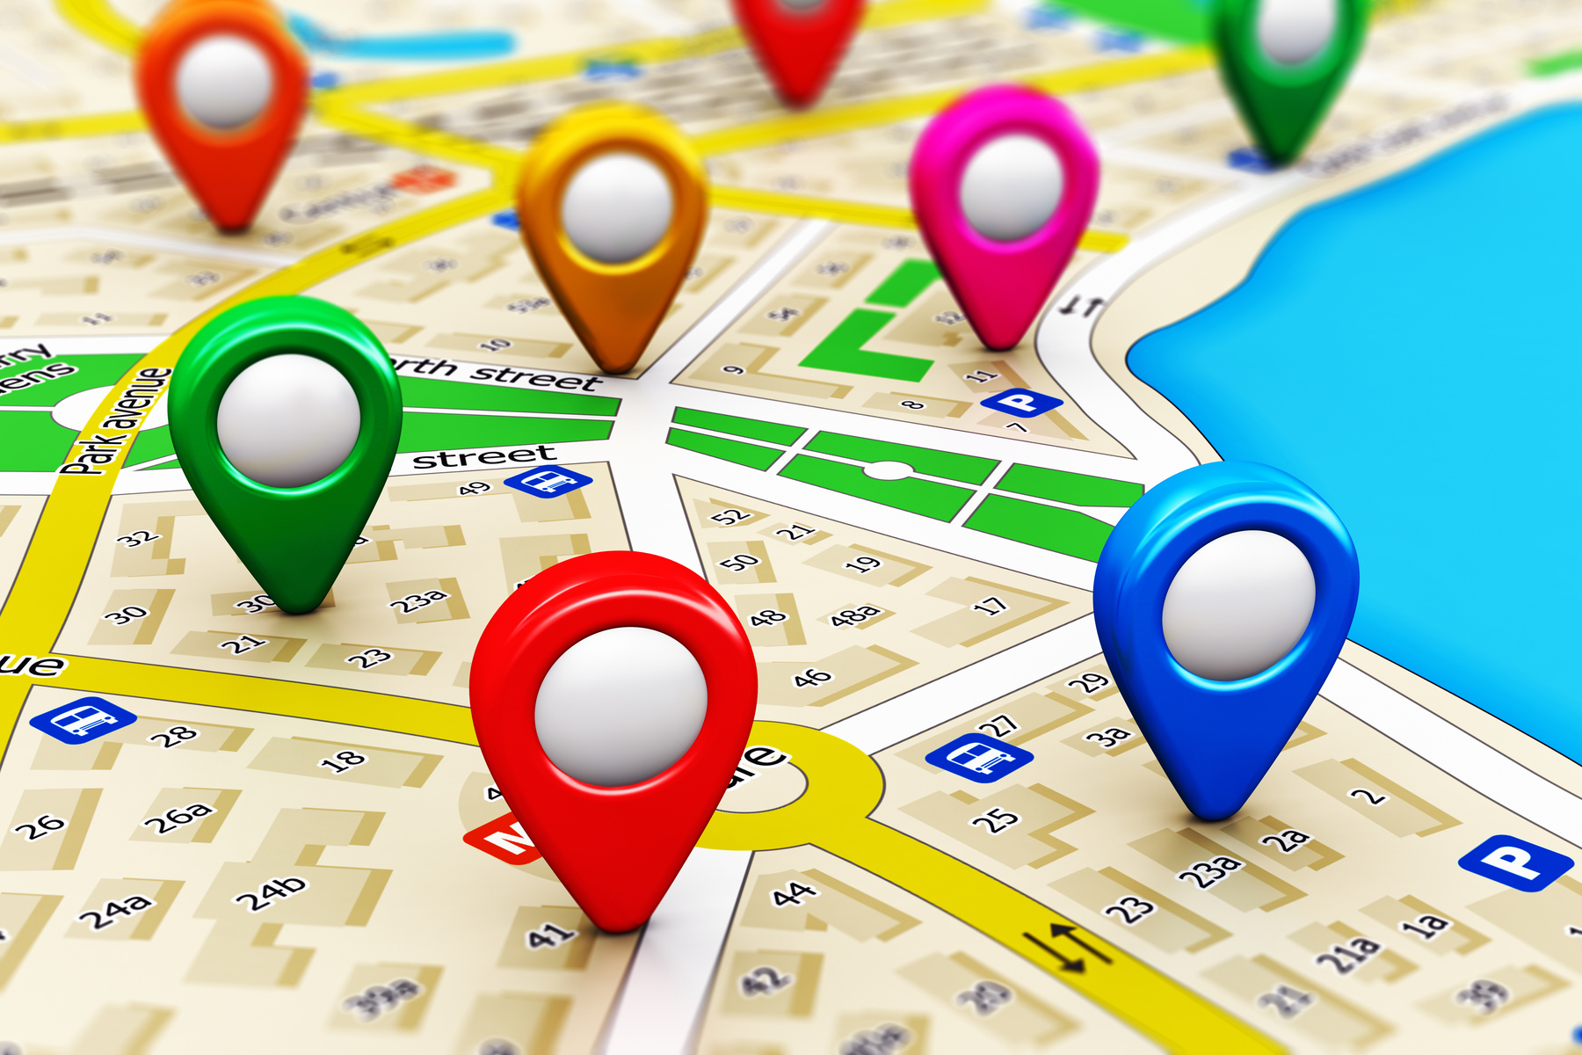
QUESTION 2
A. app
B. GPS
C. underground
D. geocaching

Slide 5
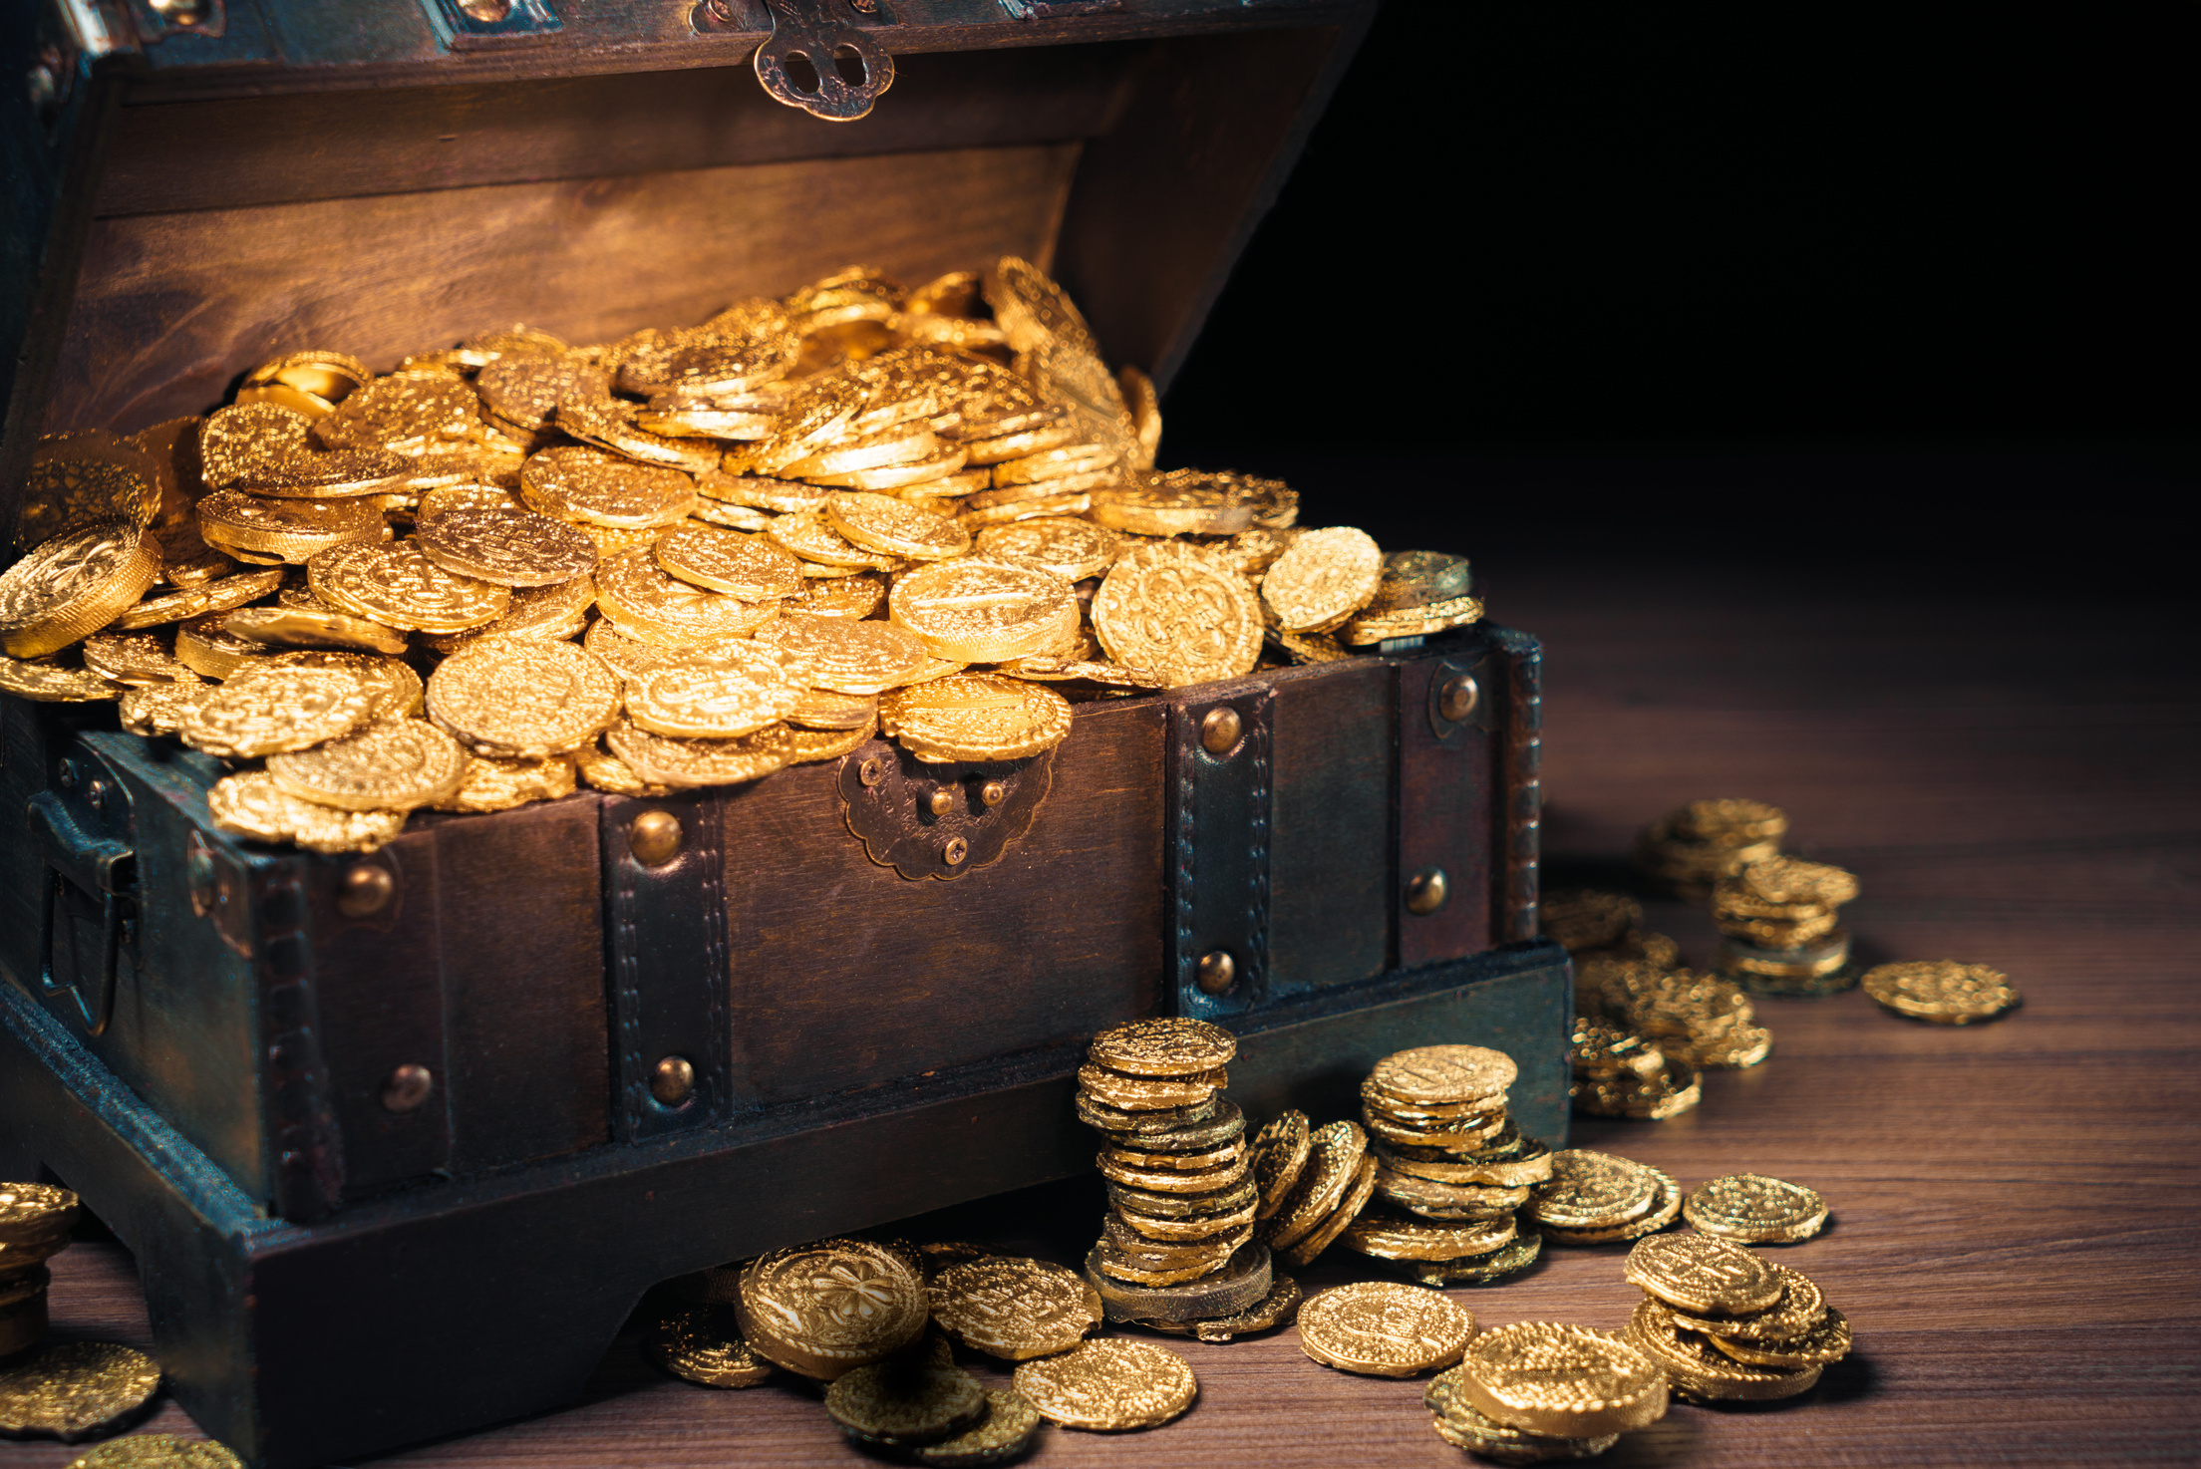
QUESTION 3
A. boiling
B. rainforest
C. app
D. treasure

Slide 6

QUESTION 4
A. app
B. underground
C. telephone
D. geothermal energy

Slide 7

will: negative and interrogative forms
Positive
Negative
Interrogative
I will go to school tomorrow.
I won’t go to school tomorrow.
Will you go to school tomorrow?
will go
won’t go
Will go
.
.
?

Slide 8
will: negative and interrogative forms
Positive
Negative
Interrogative
He will go on a picnic next week.
He won’t go on a picnic next week.
Will he go on a picnic next week?

Slide 9

will: time expressions for future
tomorrow
next week
next year
in 2050
in the future

Slide 10







2. We (drive) to the forest next Sunday. (✘)
will drive
don’t drive
won’t drive
won’t drive
drive

Slide 11


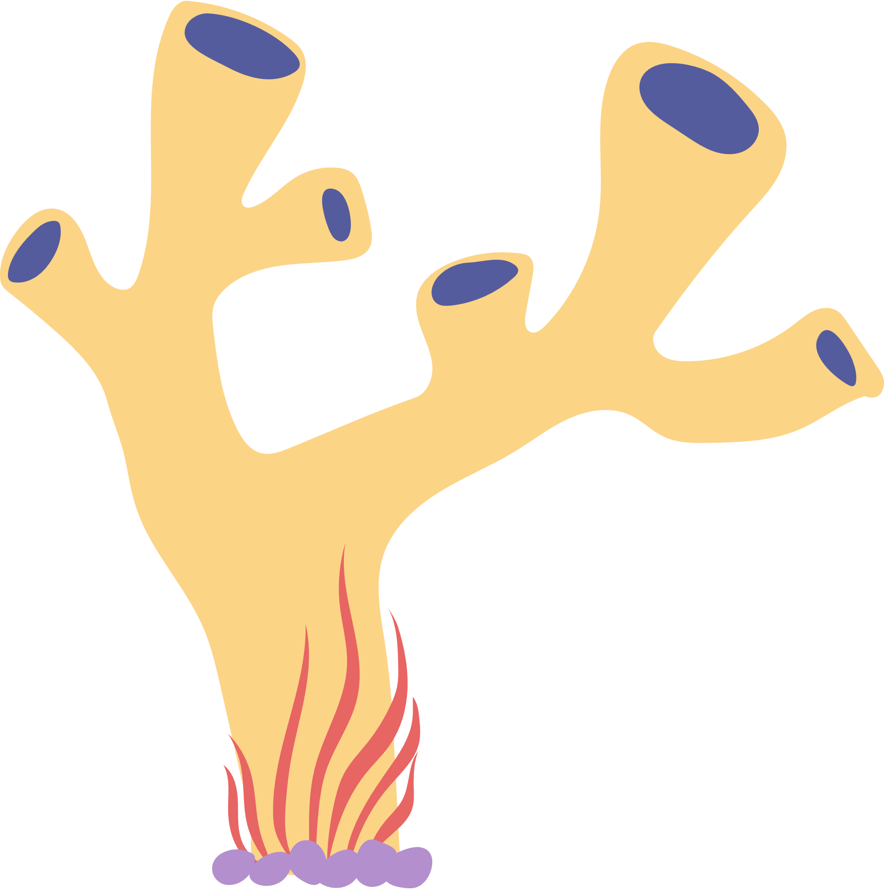




3. You and I (be) here next week. (✔)
will
were
are
will be
will be

Slide 12
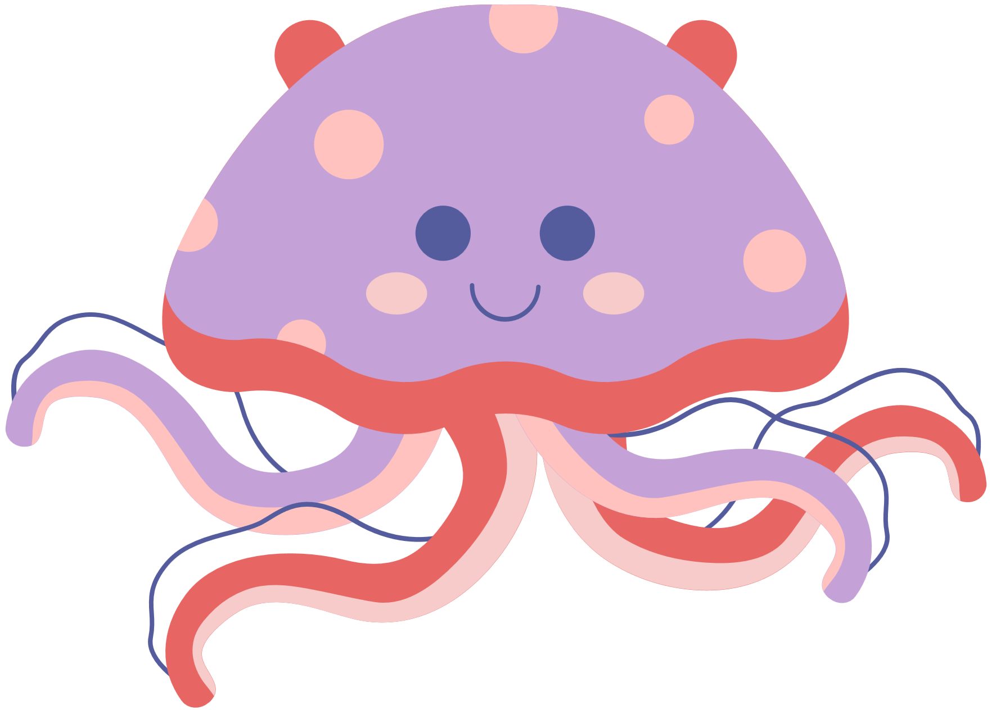




4. It (rain) tomorrow morning. (✘)
won’t rain
won’t rain
didn’t rain
doesn’t rain
isn’t raining

Slide 13
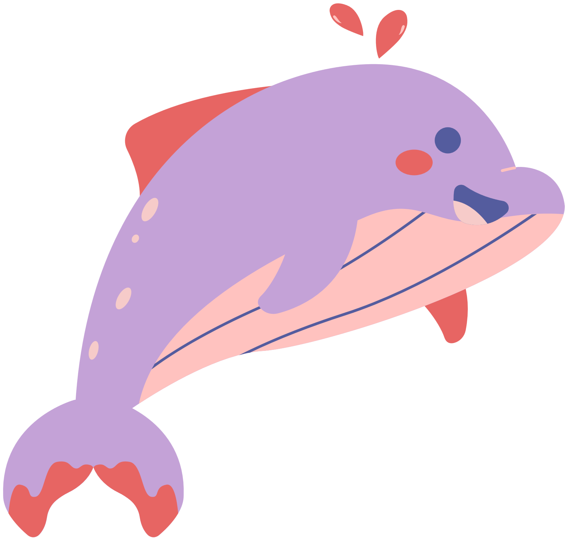
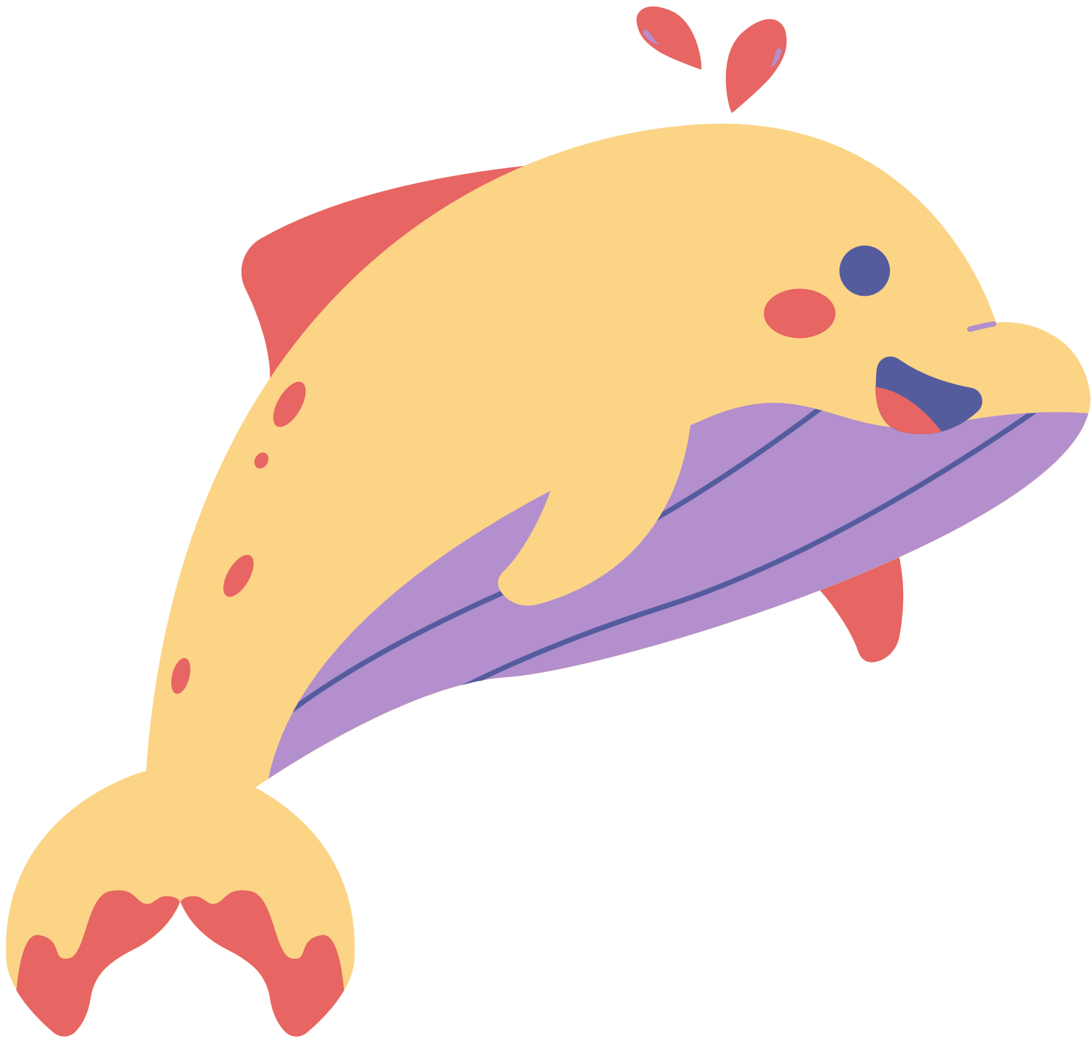


5. There (be) any clouds tomorrow. (✘)
weren’t
won’t be
won’t be
aren’t
didn’t be

Slide 14

5 Complete the sentences.
1. Amy / talk about / rainforests / tomorrow morning?
________________________________________________
Yes, ____________________________________________.
2. Juan and Cata / bring / photos / of waterfalls / this weekend?
________________________________________________
No, _____________________________________________.
Will Amy talk about rainforests tomorrow morning?
she will
Will Juan and Cata bring photos of waterfalls this weekend?
they won’t

Slide 15

5 Complete the sentences.
3. Susie and I / talk about / our holiday / next Monday?
________________________________________________
No, _____________________________________________.
4. Roberto / give / me / a book / about wild animals / tomorrow?
________________________________________________
Yes, ____________________________________________.
Will Susie and I talk about our holiday next Monday?
you won’t
Will Roberto give me a book about wild animals tomorrow?
he will

Slide 16

5 Complete the sentences.
5. Mum / walk / in the forest / with me / next Saturday?
______________________________________________
Yes, __________________________________________.
6. you / show us / pictures of the canyon / tomorrow night?
______________________________________________
No, __________________________________________.
Will Mum walk in the forest with me next Saturday?
she will
Will you show us pictures of the canyon tomorrow night?
I won’t

Slide 17
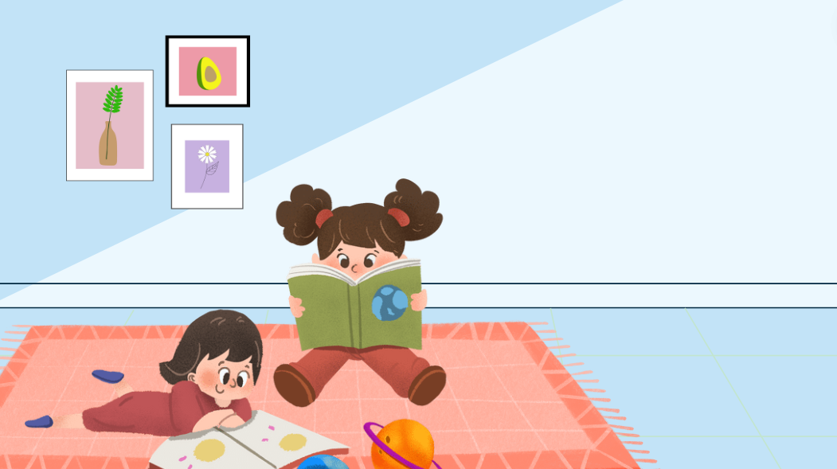
I will clean my house.
6 Let’s talk.
Work in pairs. Ask and answer about what you will do today and tomorrow.
What will you do tomorrow?

Slide 18

Say aloud these sentences in positive, negative and interrogative forms.
01
My teacher will talk about rainforests tomorrow afternoon.
02
His friend will give him a book about wild animals next week.
03
Will Amy talk about her holiday tomorrow?

Slide 19













Unit 12: Weather and nature
Lesson 2 – Part 4,5,6
What have we learnt today?
Review vocabulary: app, geocaching, GPS, treasure
Grammar: will
Time expressions for future: next week/ tomorrow/ next year/ in 2050/ in the future
Negative: I won’t go to school tomorrow.
Interrogative: Will you go to school tomorrow?

Slide 20

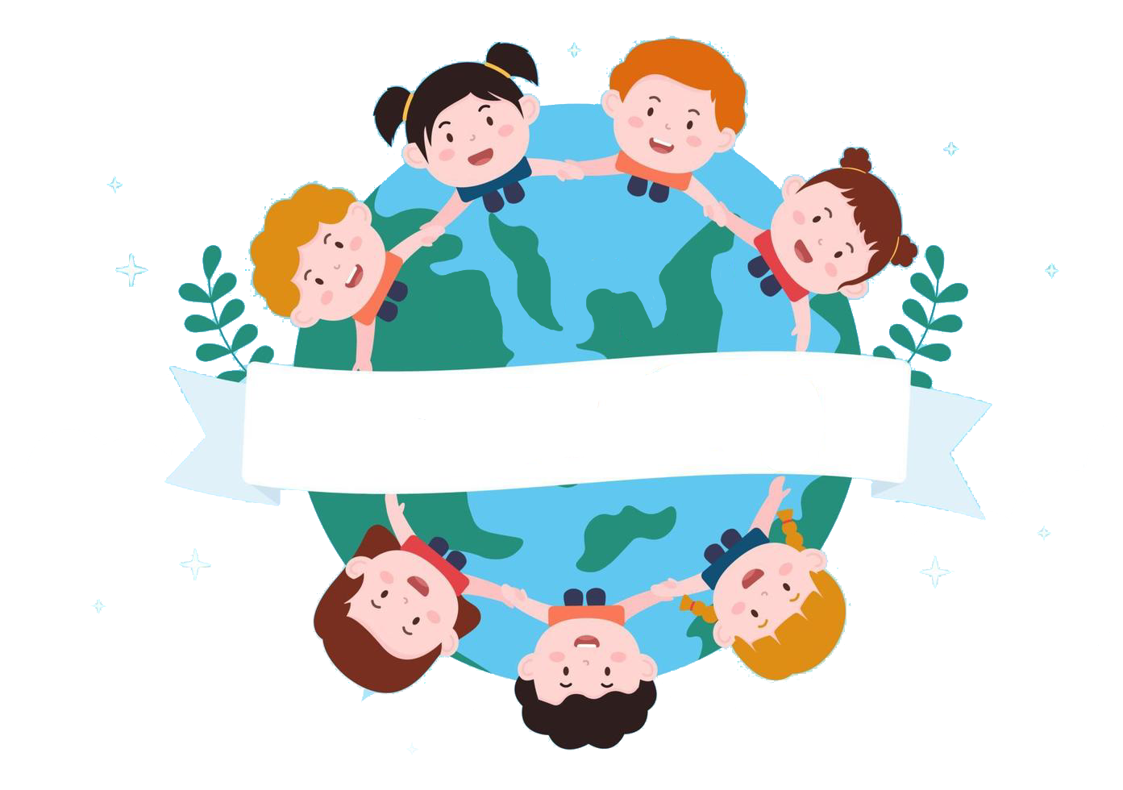
Thank you
& goodbye!

