Slide 1









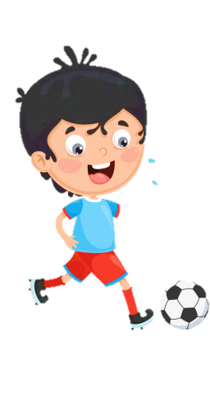
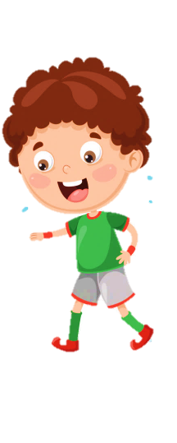











SCHOOL

Slide 2
Unit 12
Weather and Nature
Fun time & project
Period 2

Slide 3



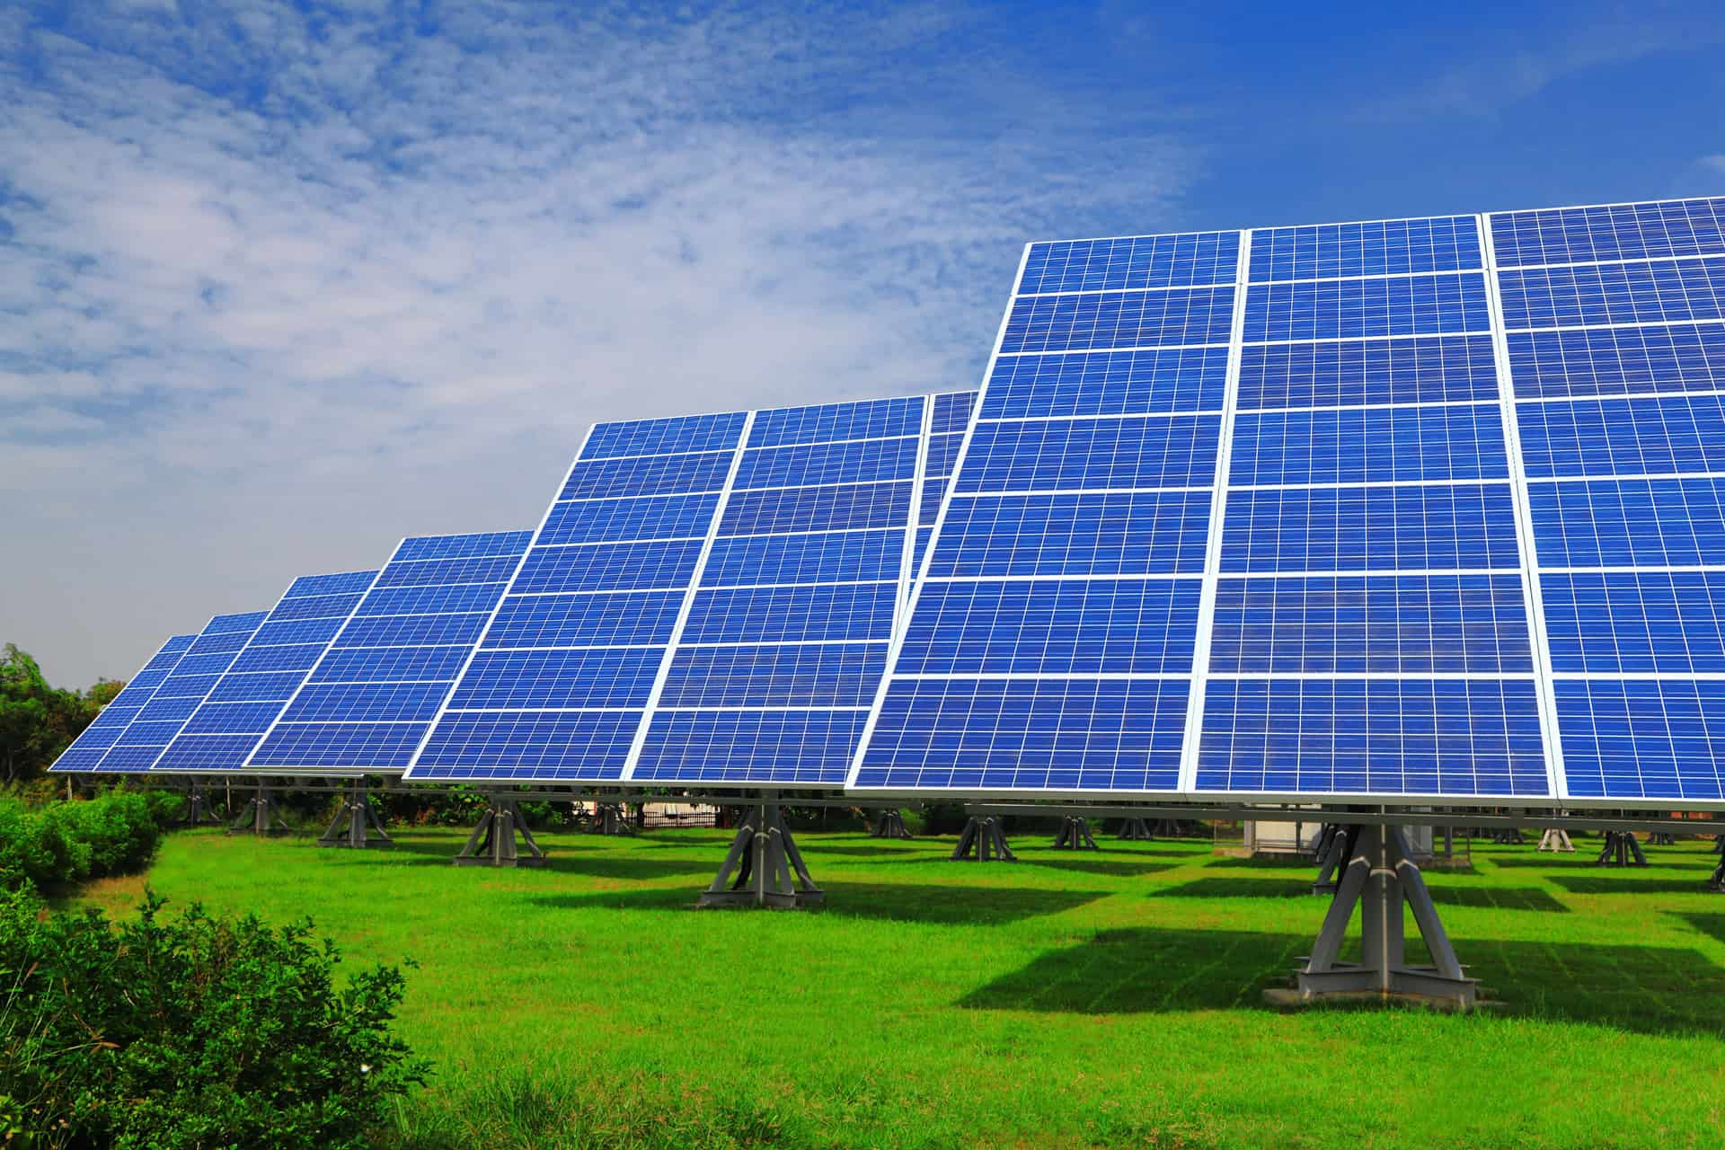

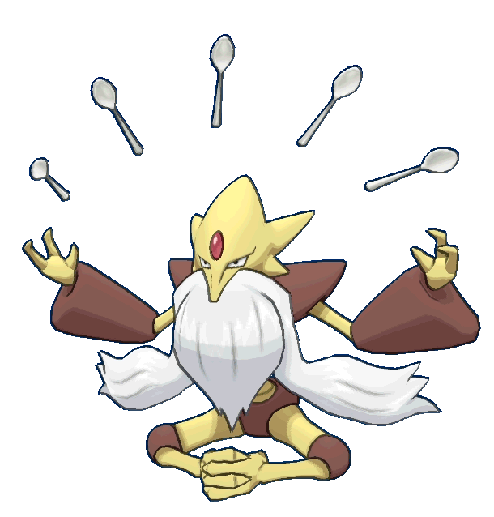


What kind of energy is it?
A. wind
B. solar
C. sun
NEXT
RETURN

Slide 4
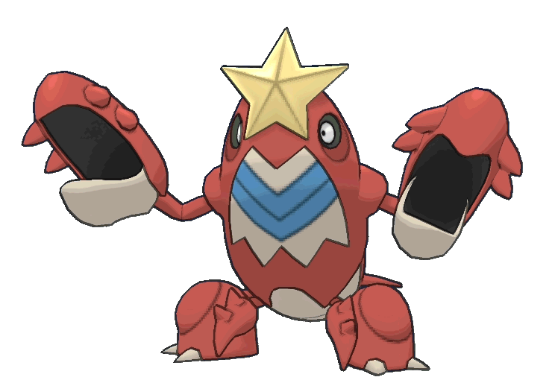
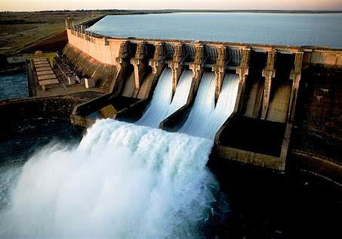
What kind of energy is it?
NEXT
A. light
B. storm
C. water
RETURN

Slide 5
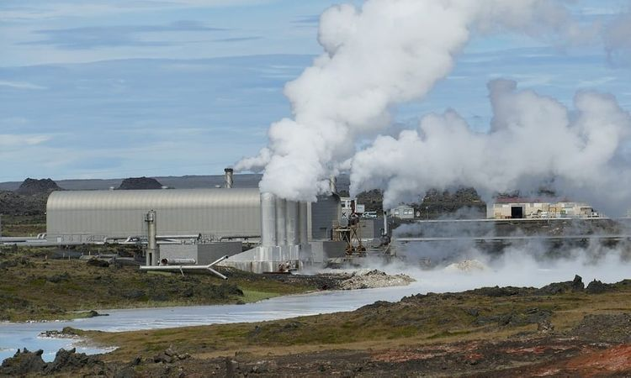

What kind of energy is it?
NEXT
A. smoke
B. geothermal
C. cloudy
RETURN

Slide 6
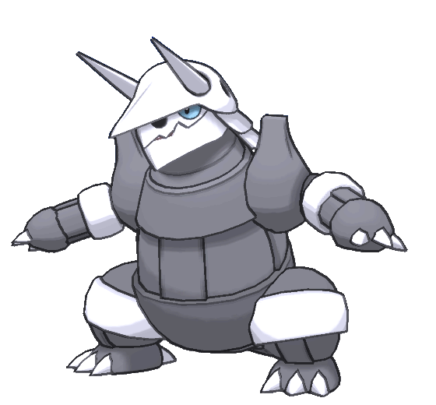
Why is wind energy important?
A. Because it is a clean resource of energy.
NEXT
B. Because it is a new resource of energy.
C. Because it is the energy obtained from the sun.
RETURN

Slide 7

Why is solar energy important?
A. Because it is the energy obtained from the wind.
NEXT
B. Because it is safe for environment.
C. Because it makes climate change.
RETURN

Slide 8
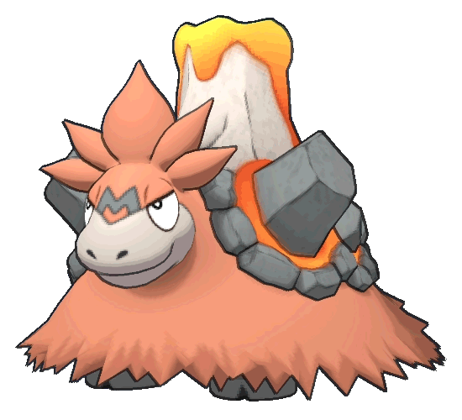
Why is geothermal energy important?
A. Because it is the energy obtained from the fire .
NEXT
B. Because it provides the energy for the vehicles.
C. Because it does not produce greenhouse gas.
RETURN

Slide 9
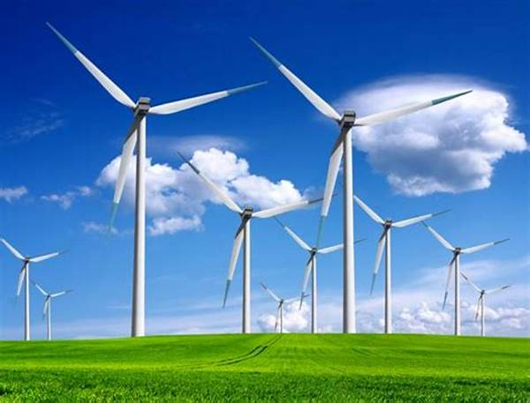

3 Project: Work with a partner. Find out about a kind of clean energy.
It is the wind energy.
It is the solar energy.
....
What kind of energy is it?

Slide 10
3 Project: Work with a partner. Find out about a kind of clean energy.
Because it is a clean resource of energy.
Because it does not produce greenhouse gas.
Because it is safe for environment.
…..
Why is it important?

Slide 11
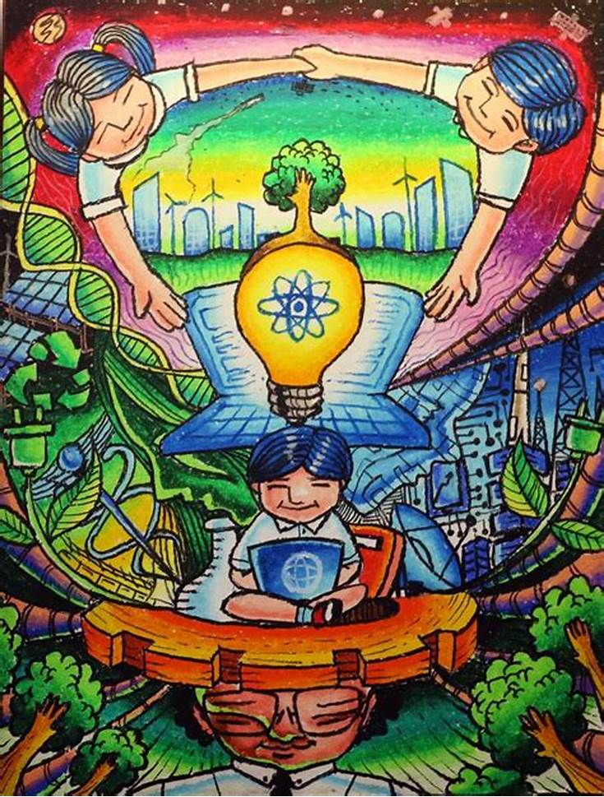
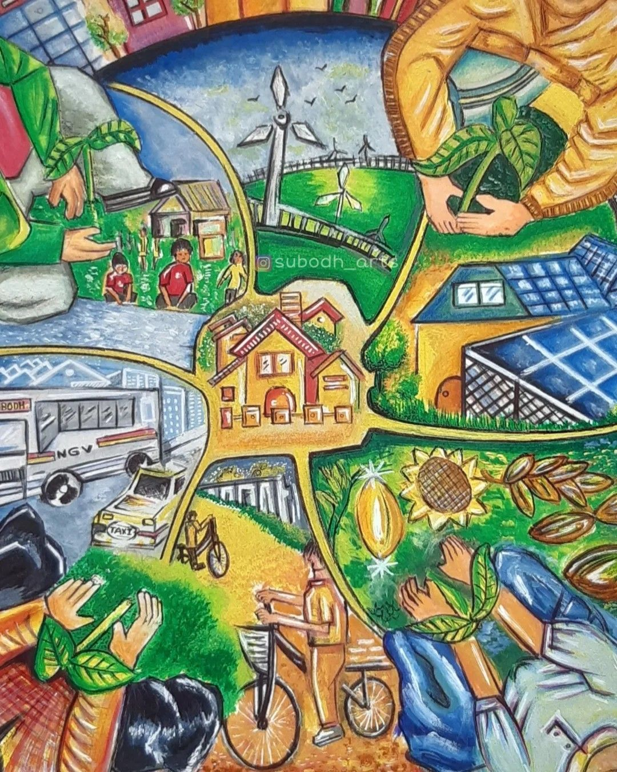
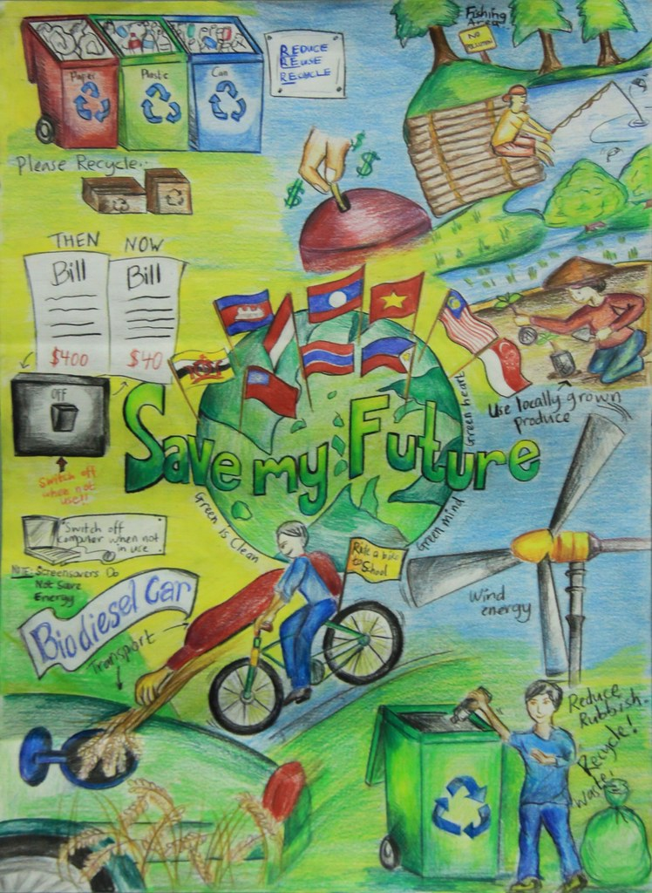
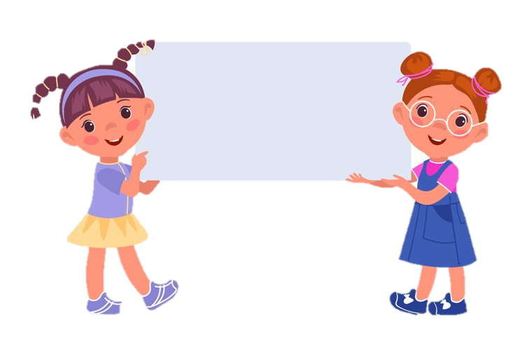
4 Make a poster about clean energy.
Bring your poster to school and display it. Look at your friends’ posters.
Which is the best?

Slide 12

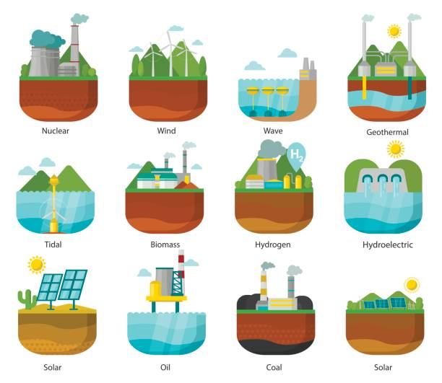

What kind of energy is clean energy?

Slide 13
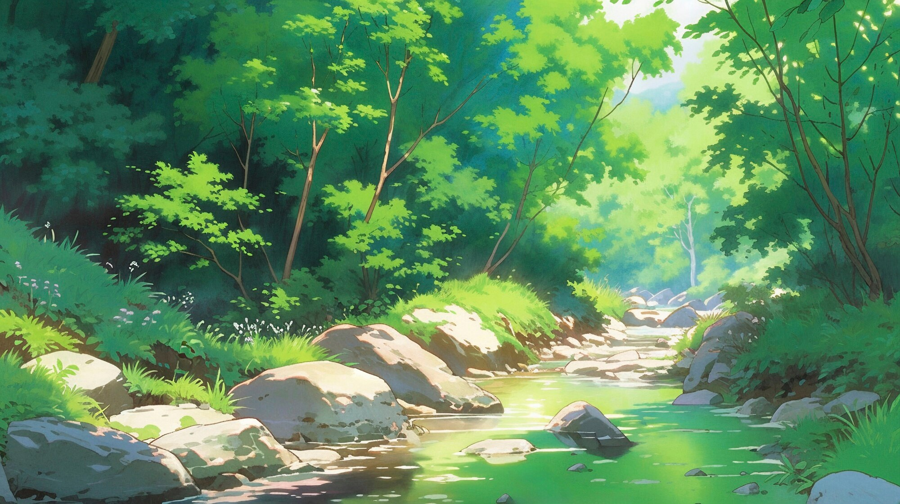

Unit 12: Weather and Nature
Fun time & Project
Period 2
What have we learnt today?
Vocabulary:
clean energy, wind, solar, water, geothermal...
Project:
Find out about a kind of clean energy and make a poster about it.

Slide 14


Thank you
& goodbye!

