Slide 1









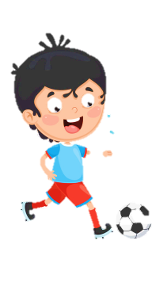












Slide 2




Table of contents
01
02
Warm - up
Review & Practice
04
03
Production
Wrap-up & Assessment

Slide 3

01
Warm up
Game
“Find the missing food”

Slide 4




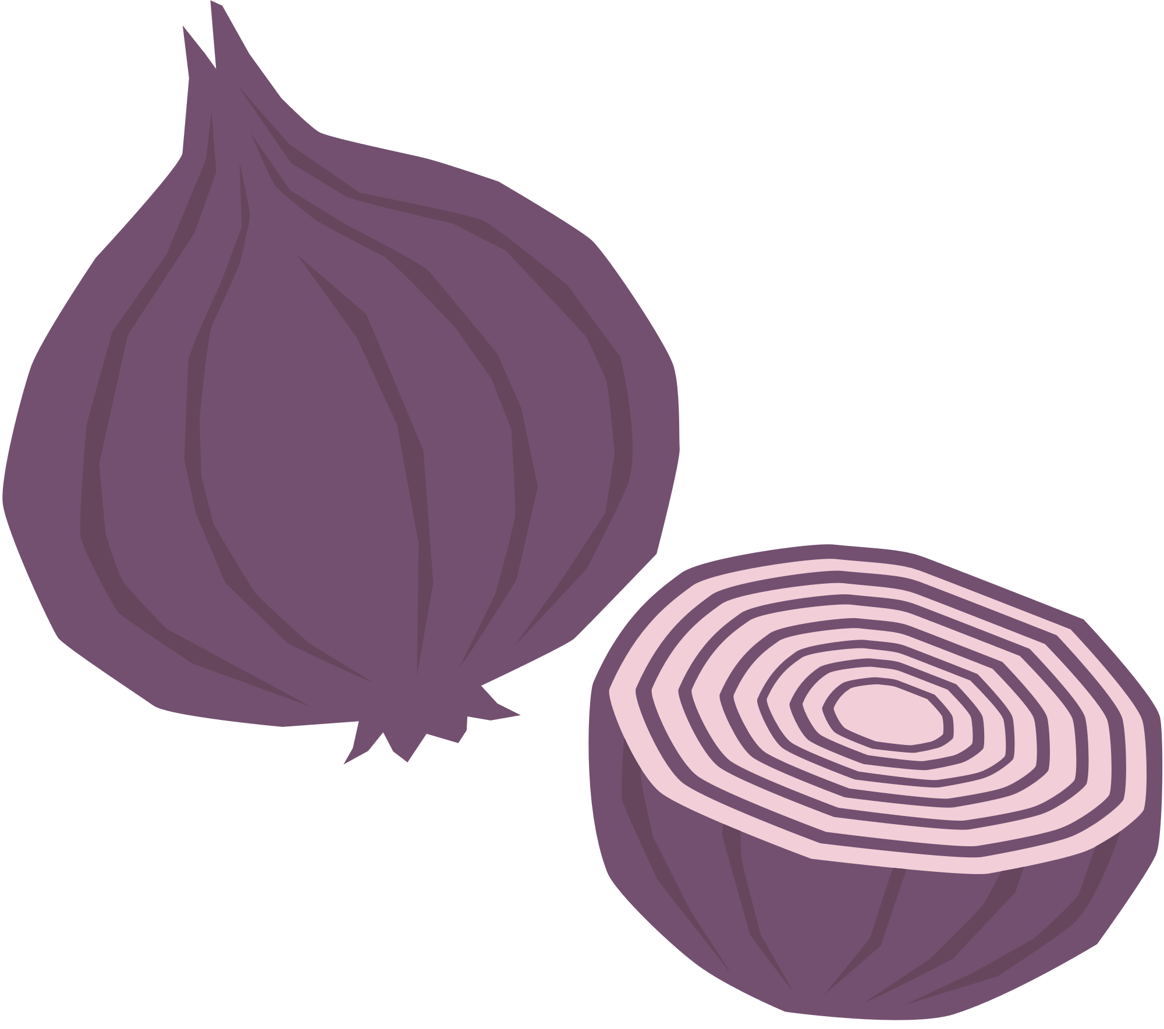











Notes:
- GV click để đếm ngược.

Slide 5

02
REVIEW & PRACTICE

Slide 6




SPACE RACE
Choose One:
Rocket Ship or Alien Ship?
Notes:
- Đội thắng chọn trước.

Slide 7











SPACE RACE
3
2
1
GO!
ROCKET SHIP WINS!
ALIEN SHIP
WINS!
Notes:
Sau khi countdown xong, GV click hình ngôi nhà để chuyển tới phần câu hỏi.
Với mỗi câu trả lời đúng, GV click hình tên lửa/alien ship để di chuyển.

Slide 8



SPACE RACE
1
2
3
4
5
6
7
8
9
10
11
12
13
14
15
16

Slide 9

Find and correct the mistake
There are a little cupcakes.
few
little → few
Notes:
- GV click trái đất => quay về slide đường đua.

Slide 10
Find and correct the mistake
There is a few butter.
little
few → little
Notes:
- GV click trái đất => quay về slide đường đua.

Slide 11
Find and correct the mistake
Pad Thai is delicious. It’s crispy.
spicy.
crispy → spicy
Notes:
- GV click trái đất => quay về slide đường đua.

Slide 12
Find and correct the mistake
Fish and chips is tasty. It’s sour.
crispy.
sour → crispy
Notes:
- GV click trái đất => quay về slide đường đua.

Slide 13
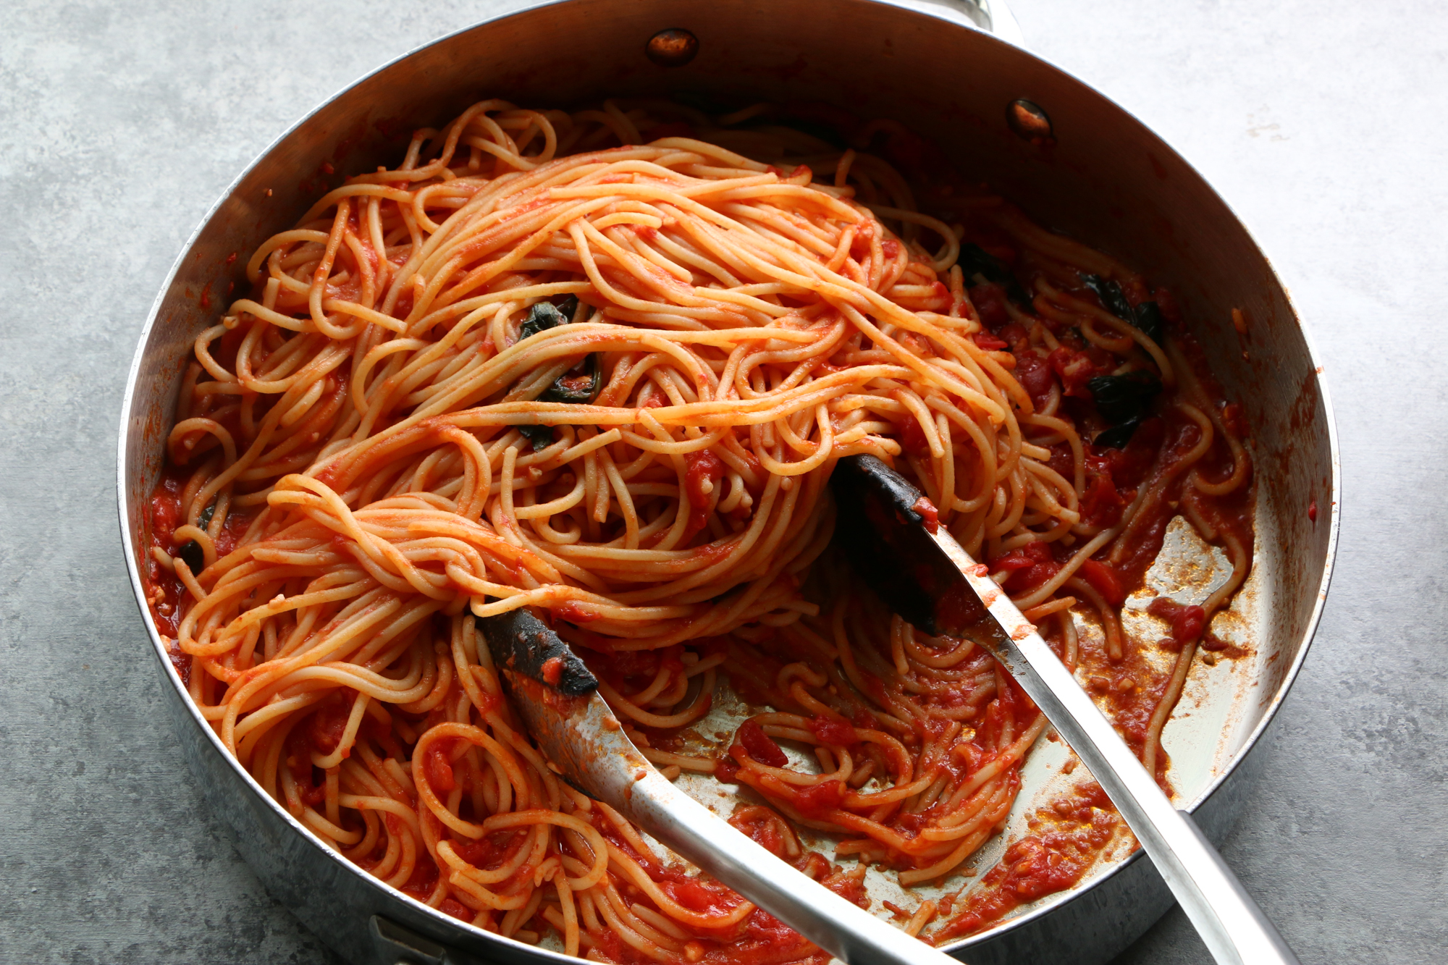
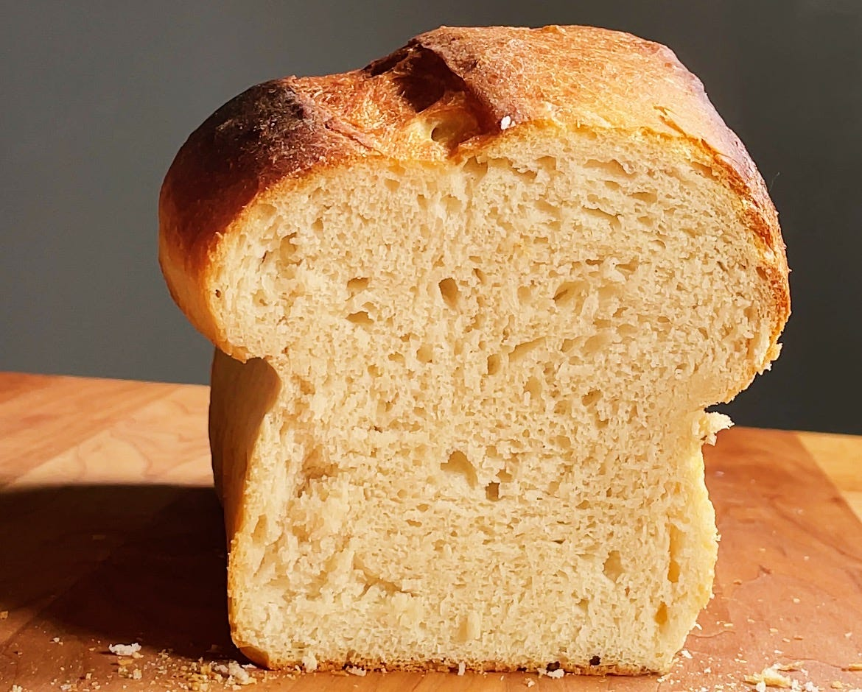
Fill in the correct answers
We have _______ spaghetti, but we don’t have _______ bread.
a lot of
much
Notes:
- GV click trái đất => quay về slide đường đua.

Slide 14
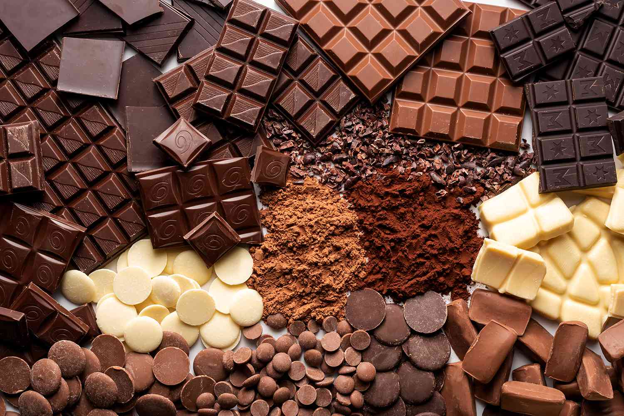
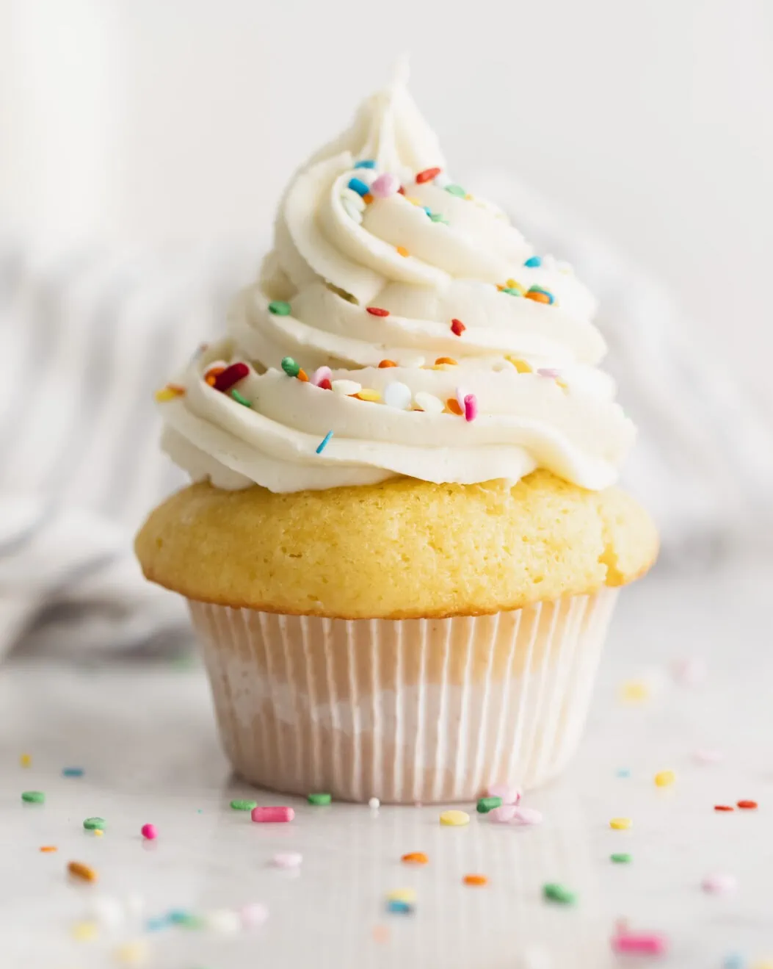
Fill in the correct answers
We have _______ chocolate, but we don’t have _______ cupcakes.
a lot of
many
Notes:
- GV click trái đất => quay về slide đường đua.

Slide 15
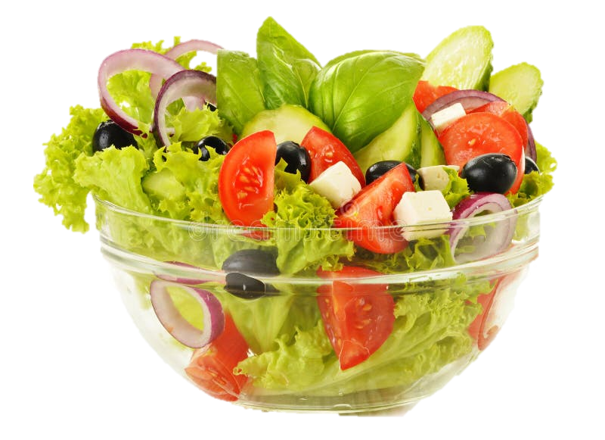
Look and fill in the correct answer
We love eating _____________.
(a bowl of) salad
Notes:
- GV click trái đất => quay về slide đường đua.

Slide 16
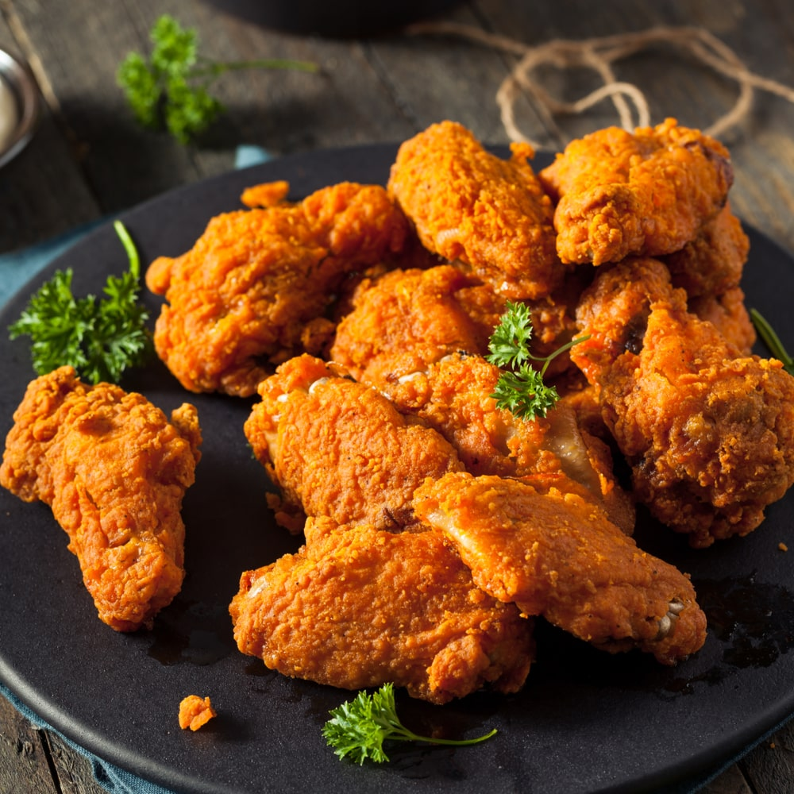
Look and fill in the correct answer
We like having
____________________.
some pieces of chicken
Notes:
- GV click trái đất => quay về slide đường đua.

Slide 17


I am cold and sweet.
You can eat me for dessert.
I am an ice cream.
Notes:
- GV click hình vuông chạy => quay về slide đường đua.

Slide 18
You can put me on a pizza.
I am light yellow and made from milk.
I am cheese.
Notes:
- GV click hình vuông chạy => quay về slide đường đua.

Slide 19
You eat me on your birthday.
I am a sweet dessert.
I am a cake.
Notes:
- GV click hình vuông chạy => quay về slide đường đua.

Slide 20
Rabbits love eating me.
I am an orange vegetable.
I am a carrot.
Notes:
- GV click hình vuông chạy => quay về slide đường đua.

Slide 21
You need me to make chips or French fries.
I am a brown vegetable.
I am a potato.
Notes:
- GV click hình vuông chạy => quay về slide đường đua.

Slide 22
I am a white drink.
I come from a cow.
I am milk.
Notes:
- GV click hình vuông chạy => quay về slide đường đua.

Slide 23
Monkeys love me.
I am a long and yellow fruit.
I am a banana.
Notes:
- GV click hình vuông chạy => quay về slide đường đua.

Slide 24
I am fast food.
I often have a slice of tomato inside.
I am a hamburger.
Notes:
- GV click hình vuông chạy => quay về slide đường đua.

Slide 25

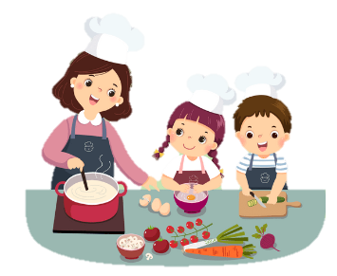
2 Listen and sing.
Fruits and veggies, sour and sweet, carrots and apples make a healthy treat.
Broccoli, mangoes and grapes, fruits and veggies make your meal complete.
Healthy food, we love to eat, keeps us strong from head to feet.

Slide 26
03
PRODUCTION

Slide 27



3
  Answer the questions and make a list. Then say.
What food do you often eat to be healthy?
What food shouldn’t you eat to be healthy?
What do you often drink to be healthy?
What shouldn’t you drink to be healthy?

Slide 28



LET’S TALK!
Time to present your ideas!

Slide 29
04
WRAP-UP & ASSESSMENT

Slide 30
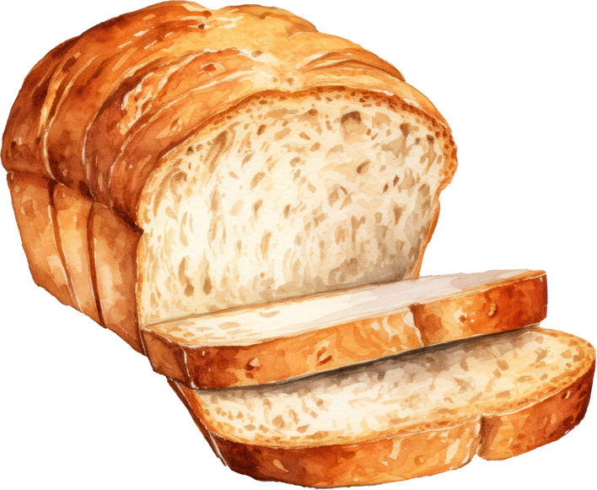
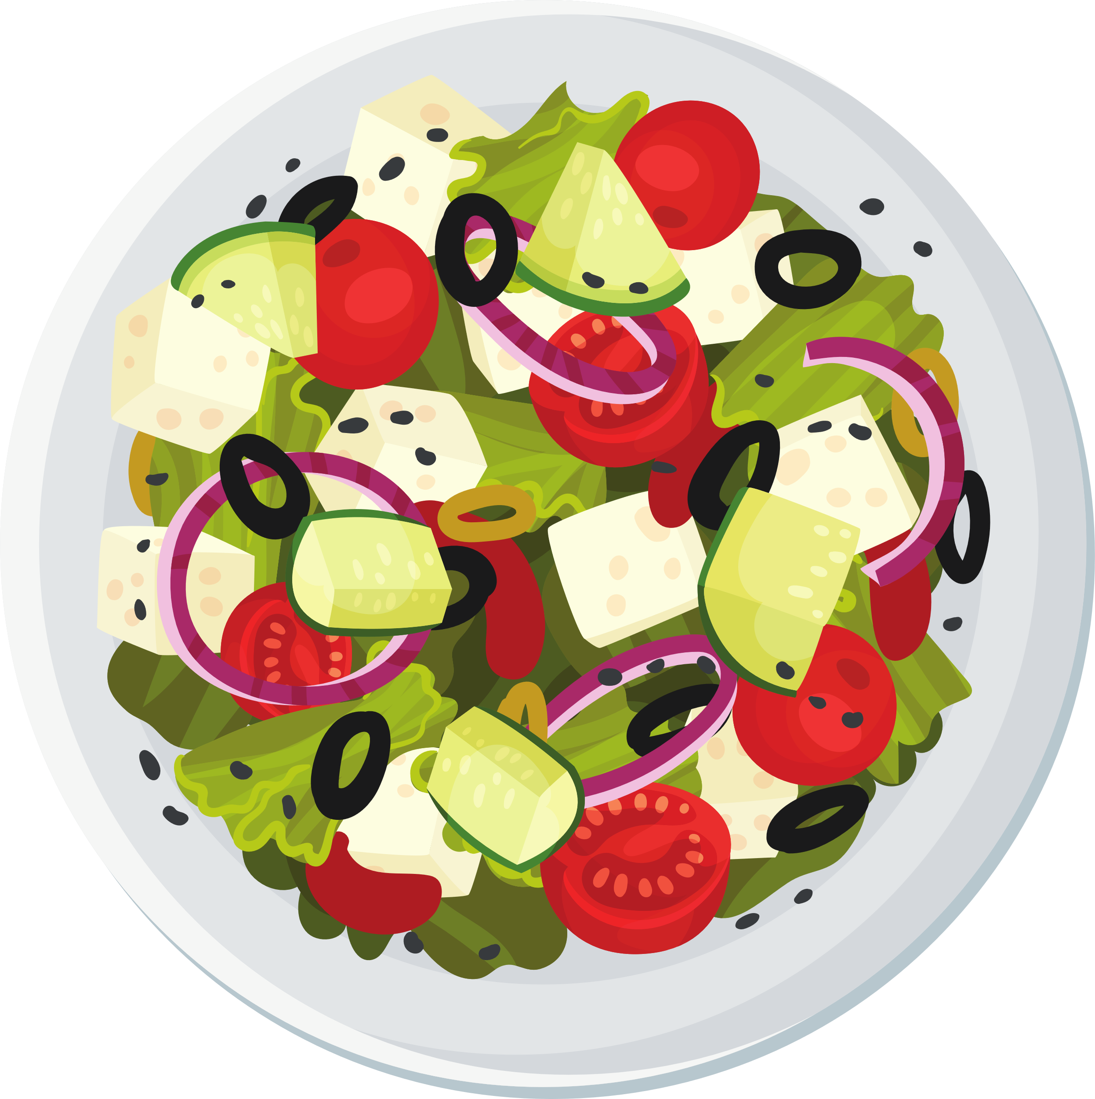
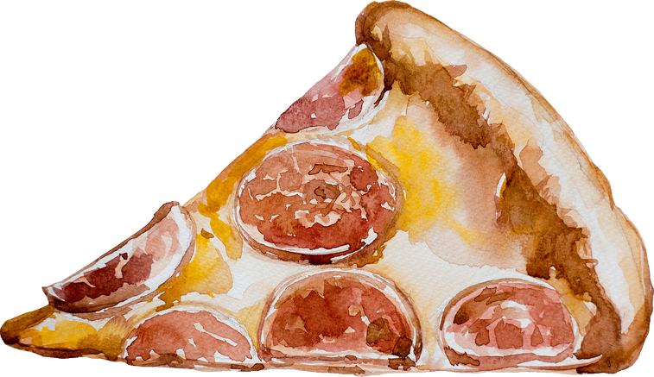
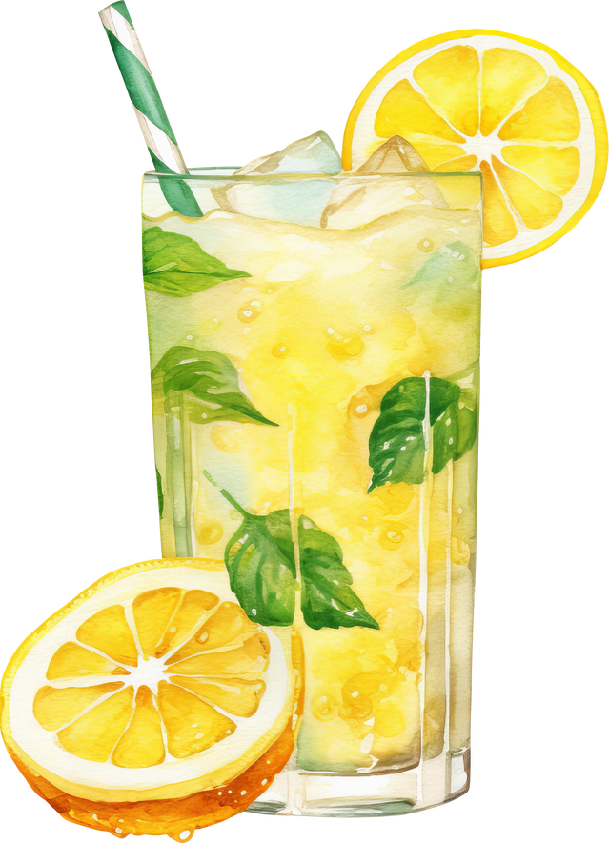
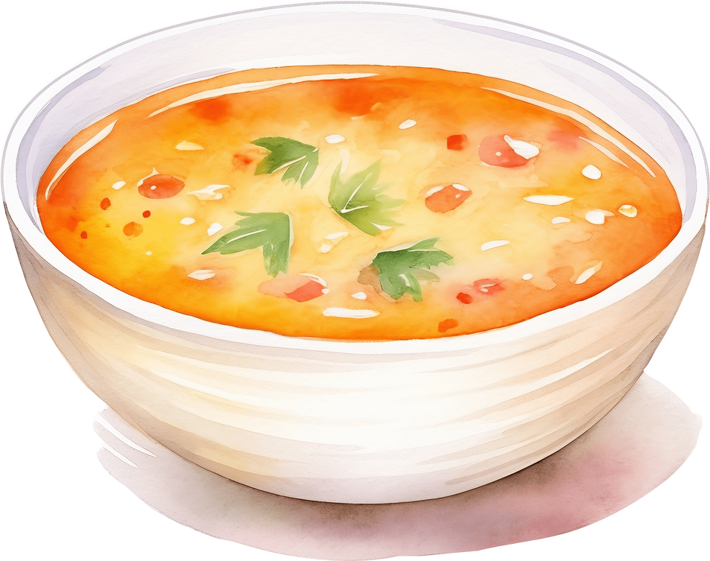
Match the food with its correct quantifier
a piece of pizza
a bowl of soup
some slices of bread
a plate of salad
three glasses of lemonade

Slide 31
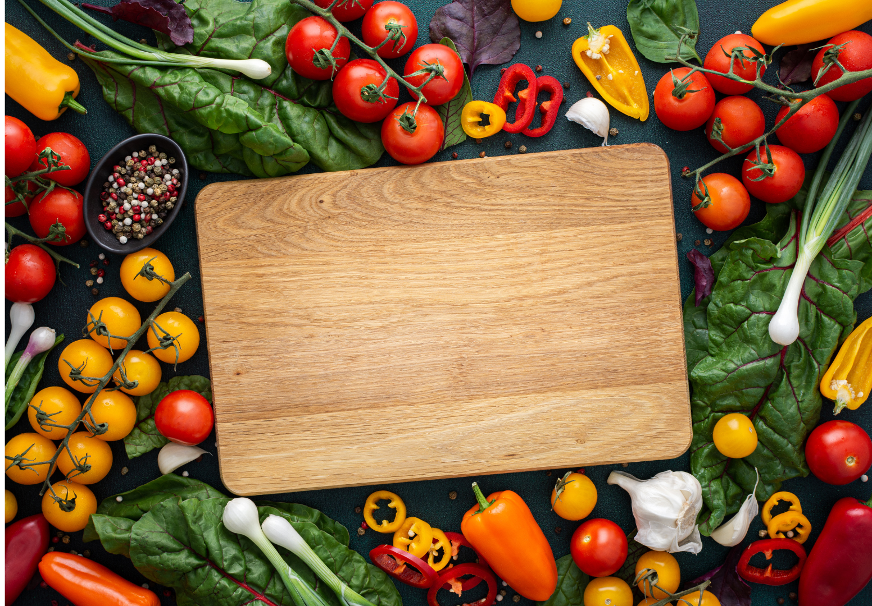
Unit 6: Food
Fun time & Project – Part 1,2,3
What have we learnt today?
Review vocabulary: Food riddles and game.
bread, butter, chocolate, cupcake, salad, spaghetti,
crispy, delicious, salty, sour, spicy, sweet, tasty
Song: Listen and sing about healthy foods

Slide 32


Thank you
& goodbye!

