Slide 1

















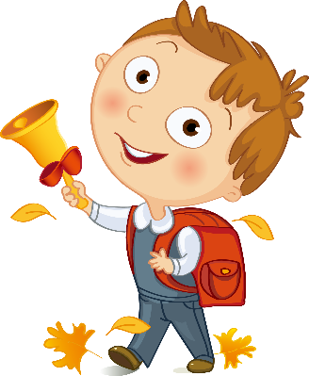


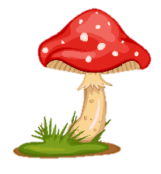
Notes:
Để nguyên trang bìa như này, chỉ thay đổi tên bài trong quá trình làm. Logo của sách Wonderful World

Slide 2


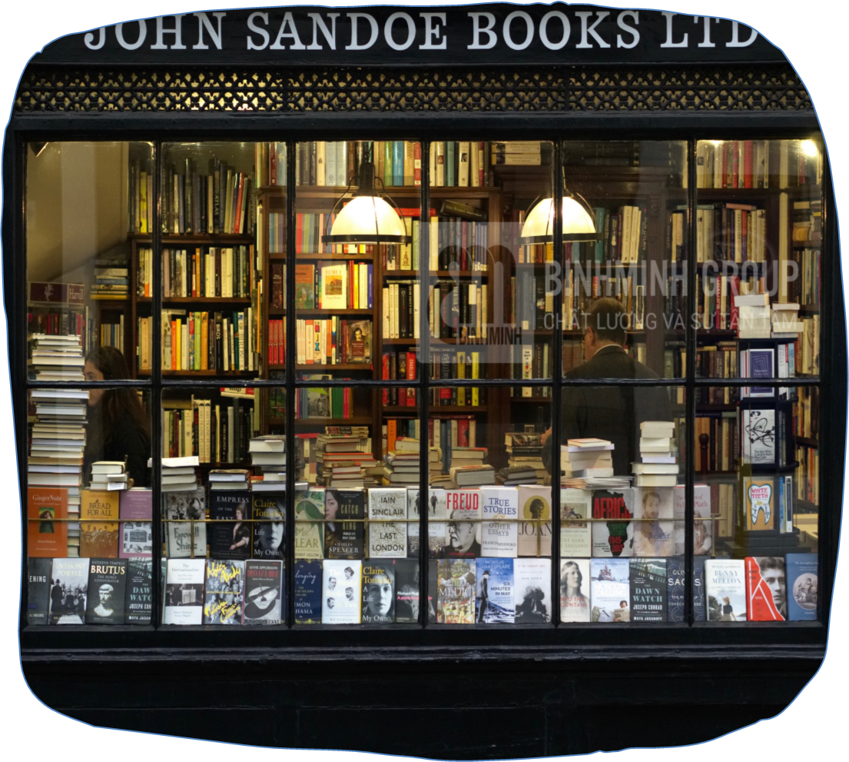

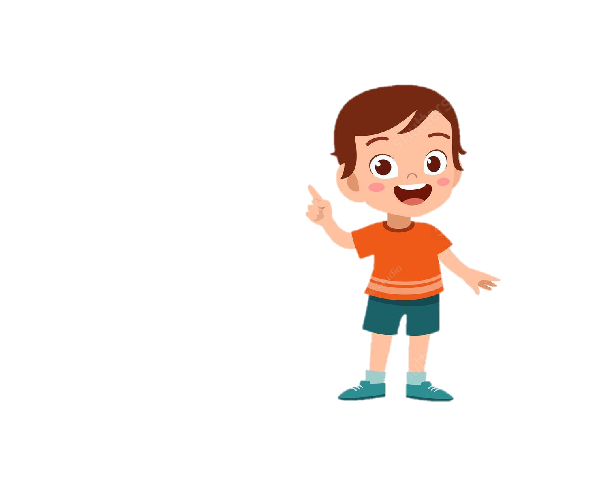
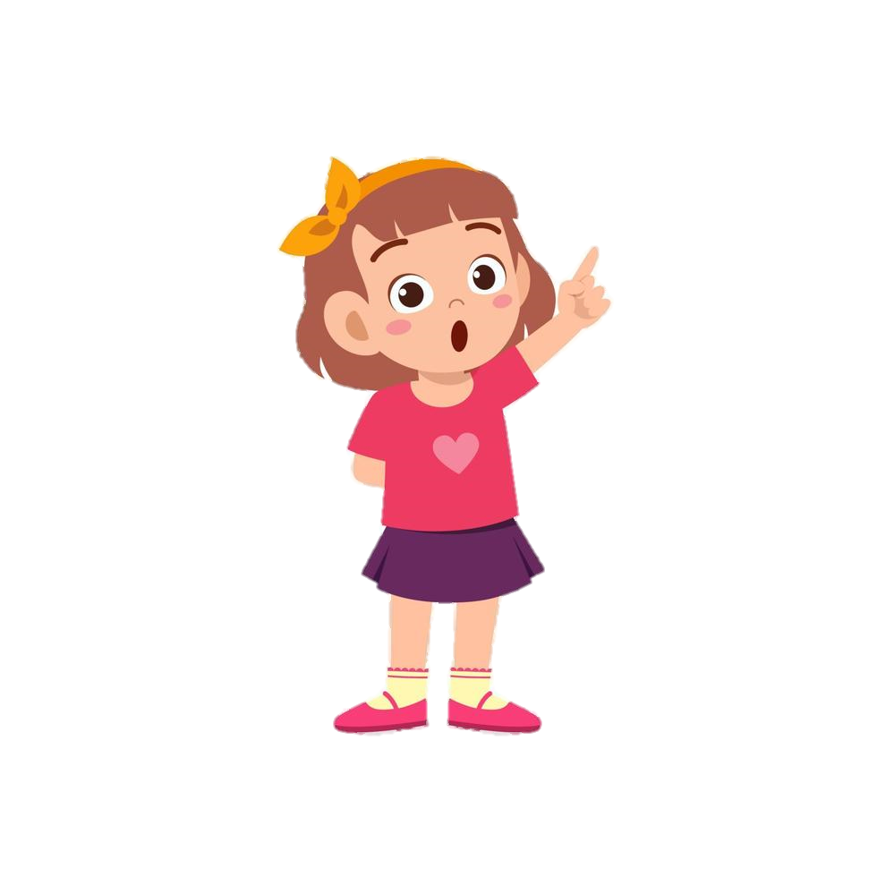
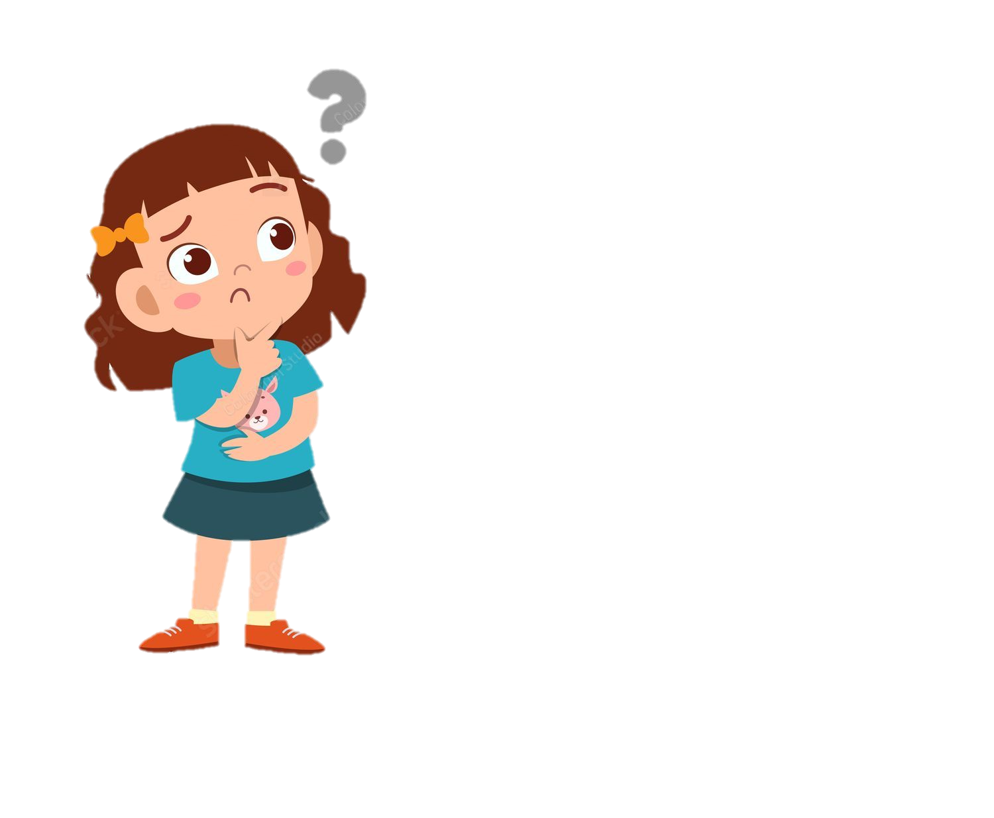
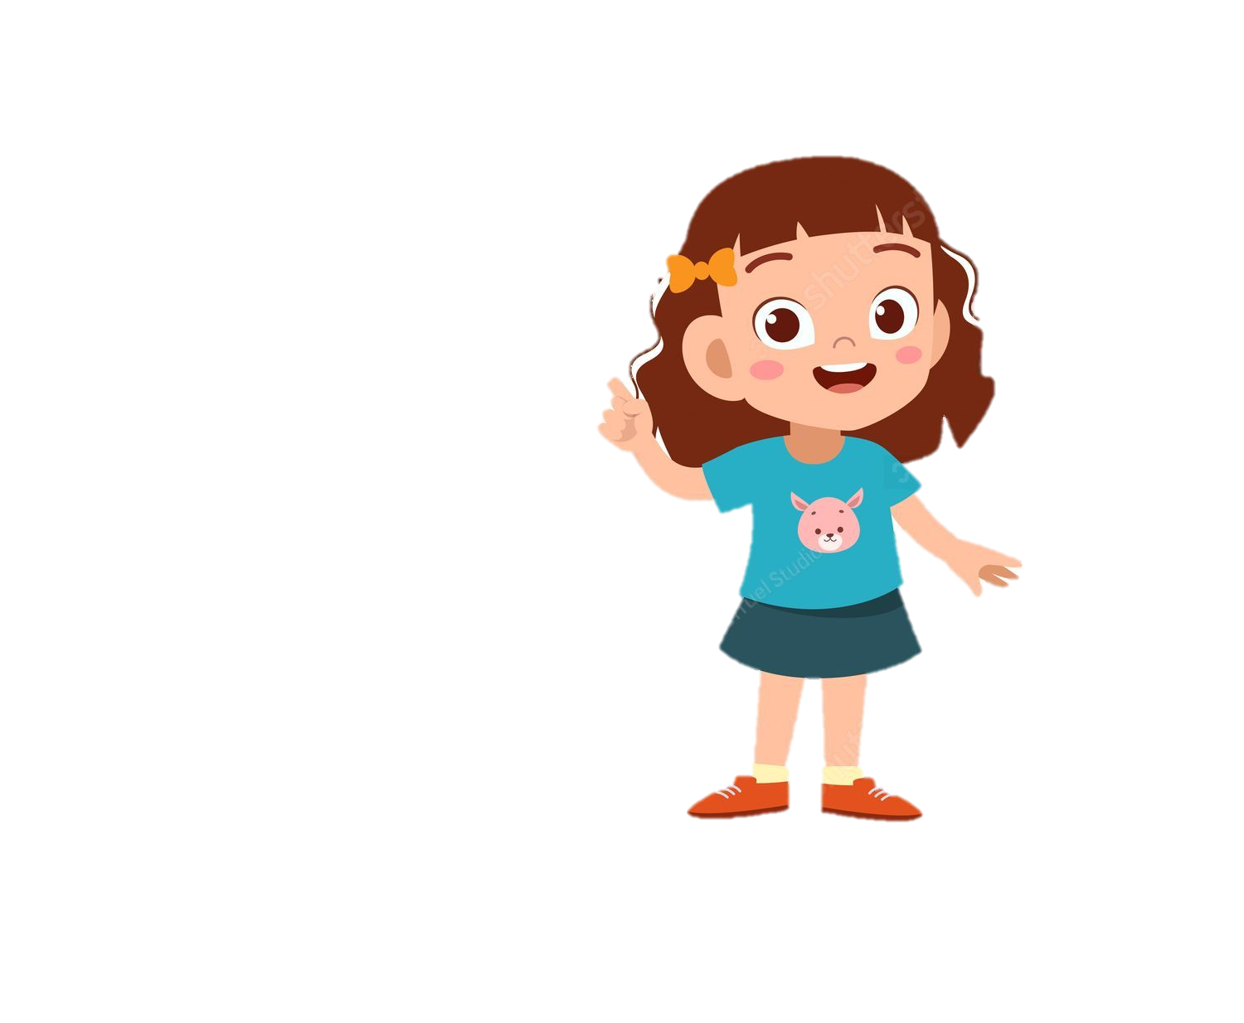
It’s a place where……
you can buy some comic books.
you can buy some school things.
a bookshop

Slide 3

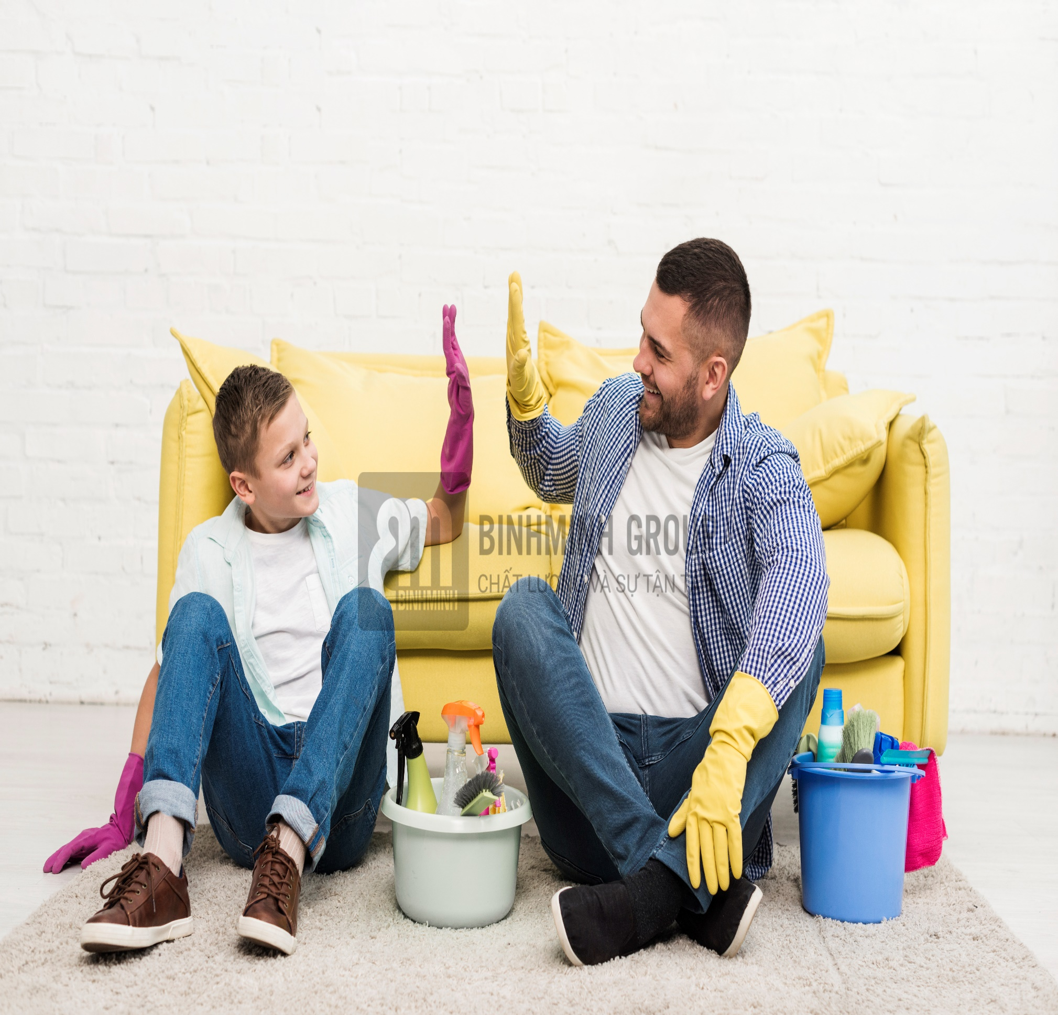

help Dad
/help Dæd/

Slide 4
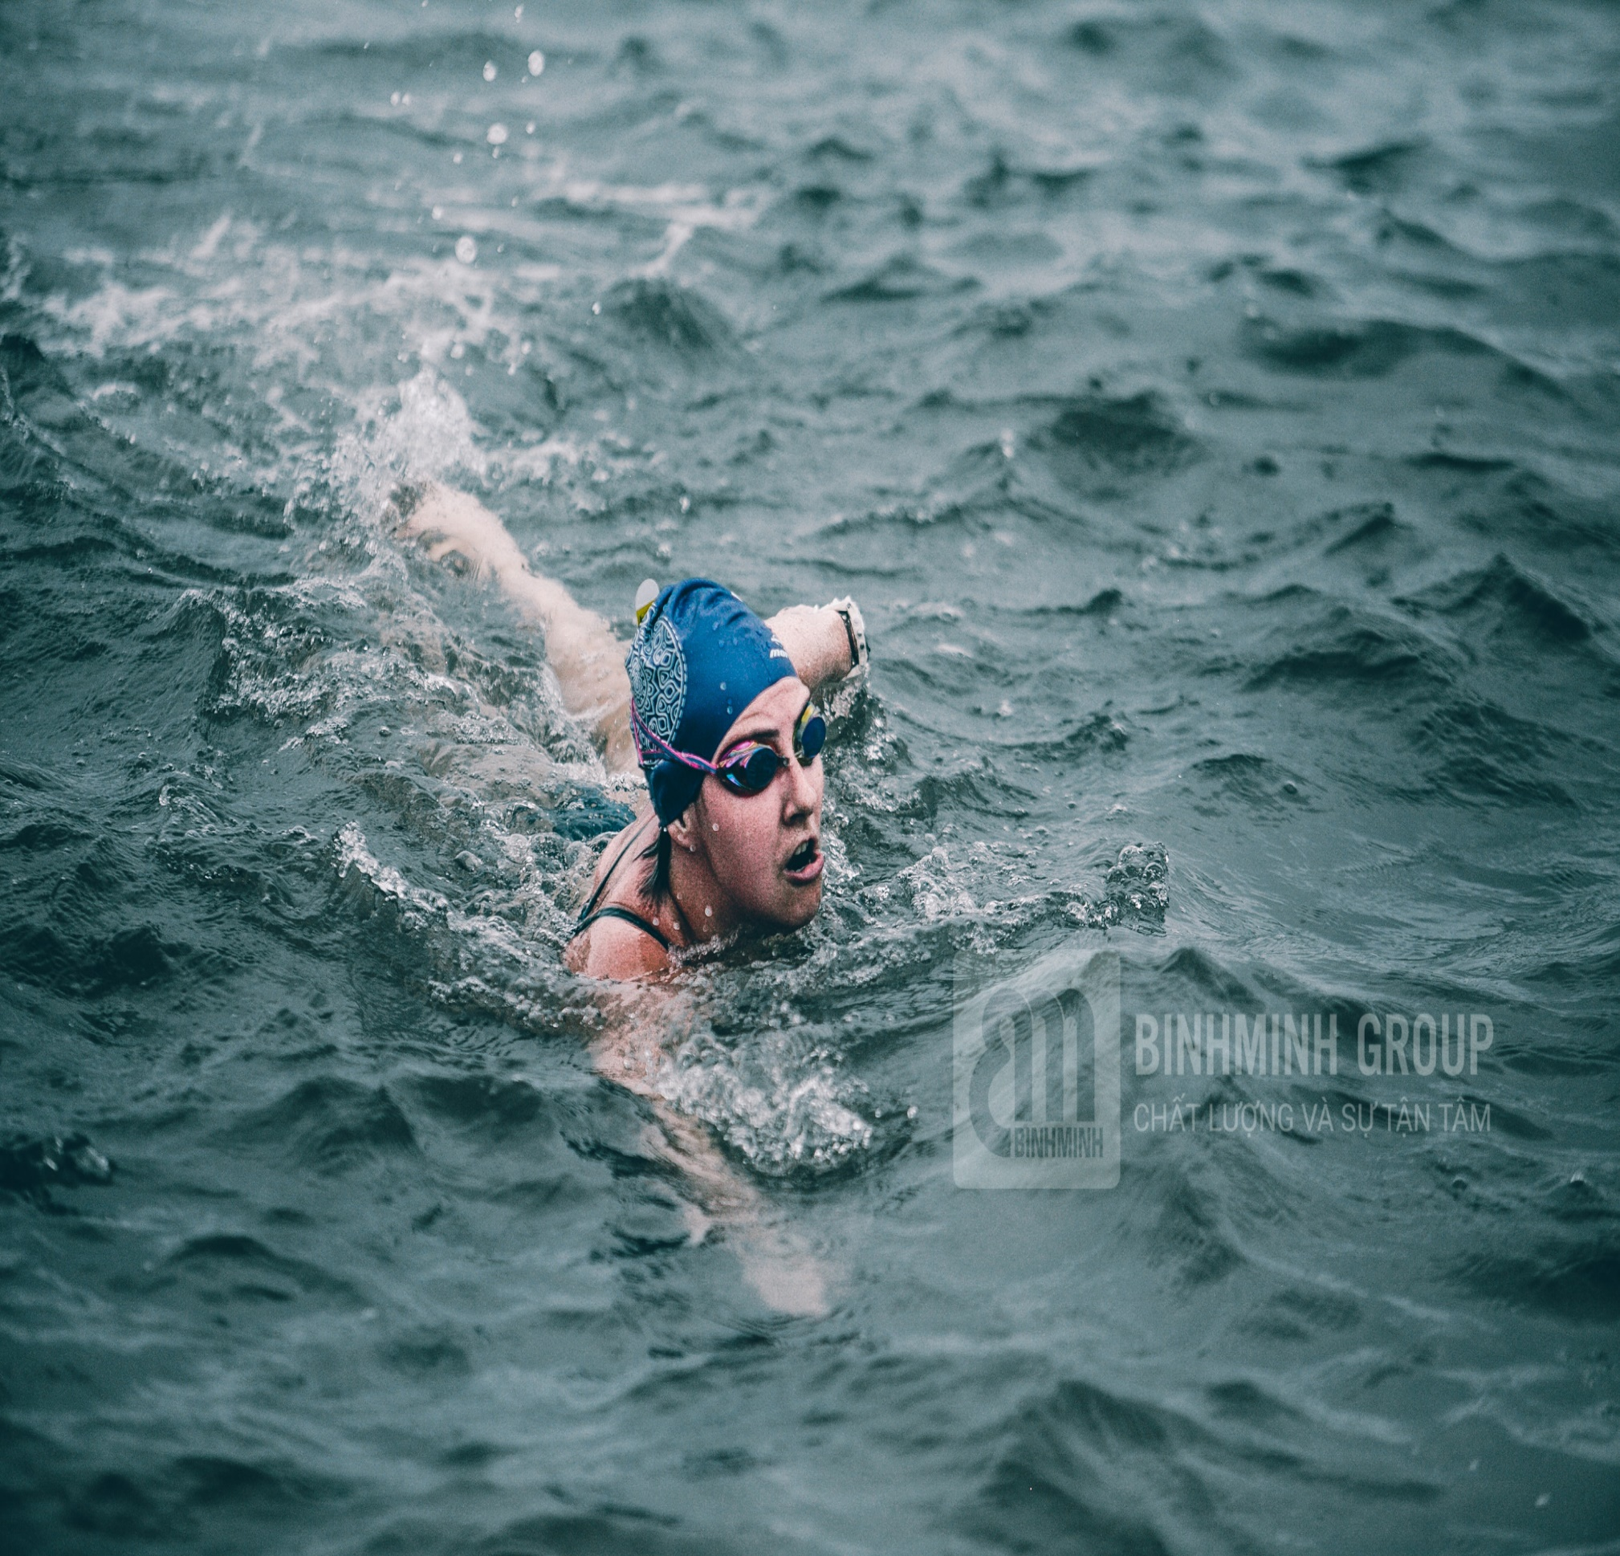
go swimming
/ɡəʊ ˈswɪmɪŋ/

Slide 5
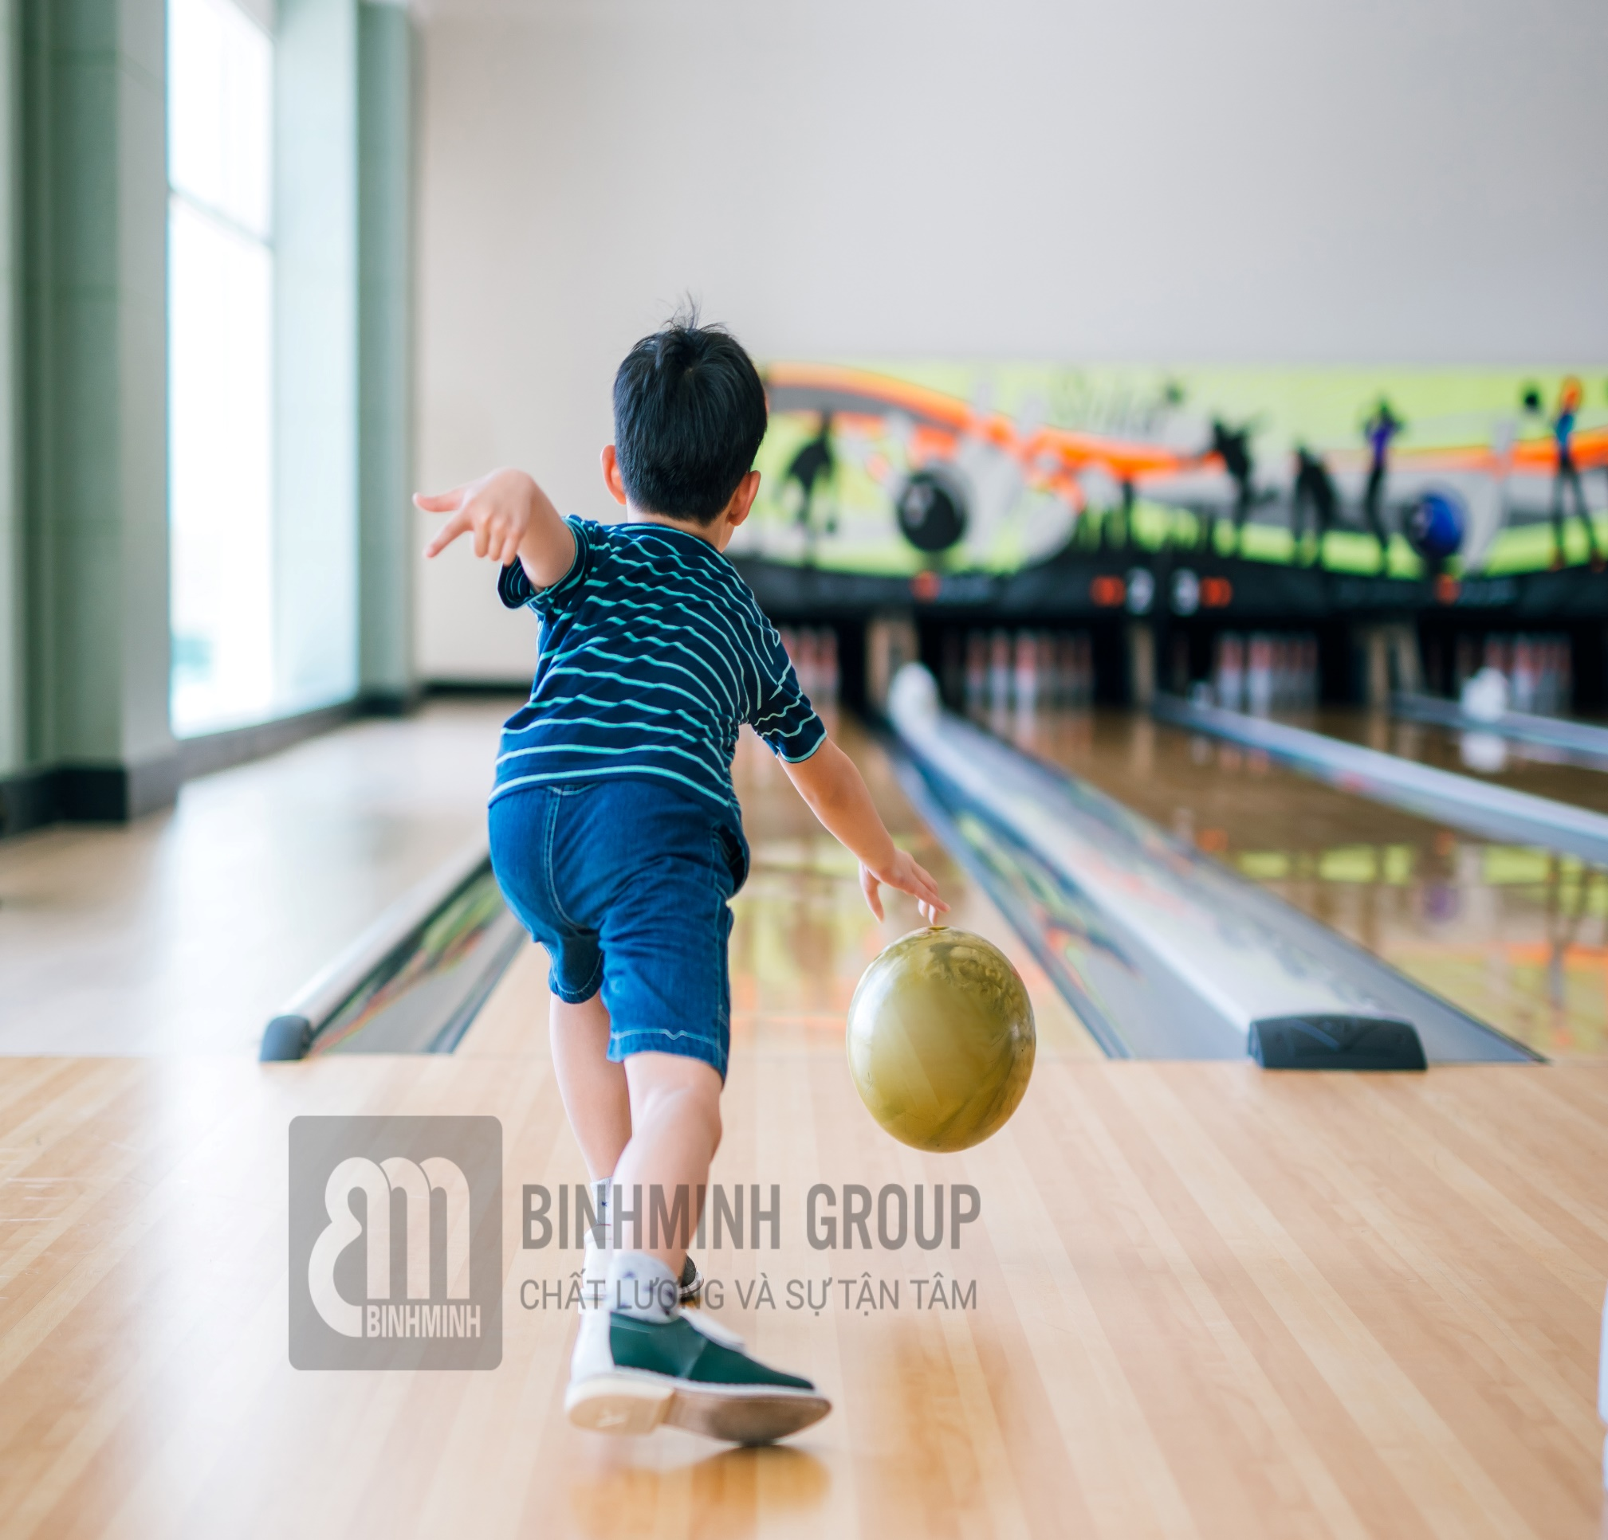
go bowling
/ɡəʊ ˈbəʊlɪŋ/

Slide 6
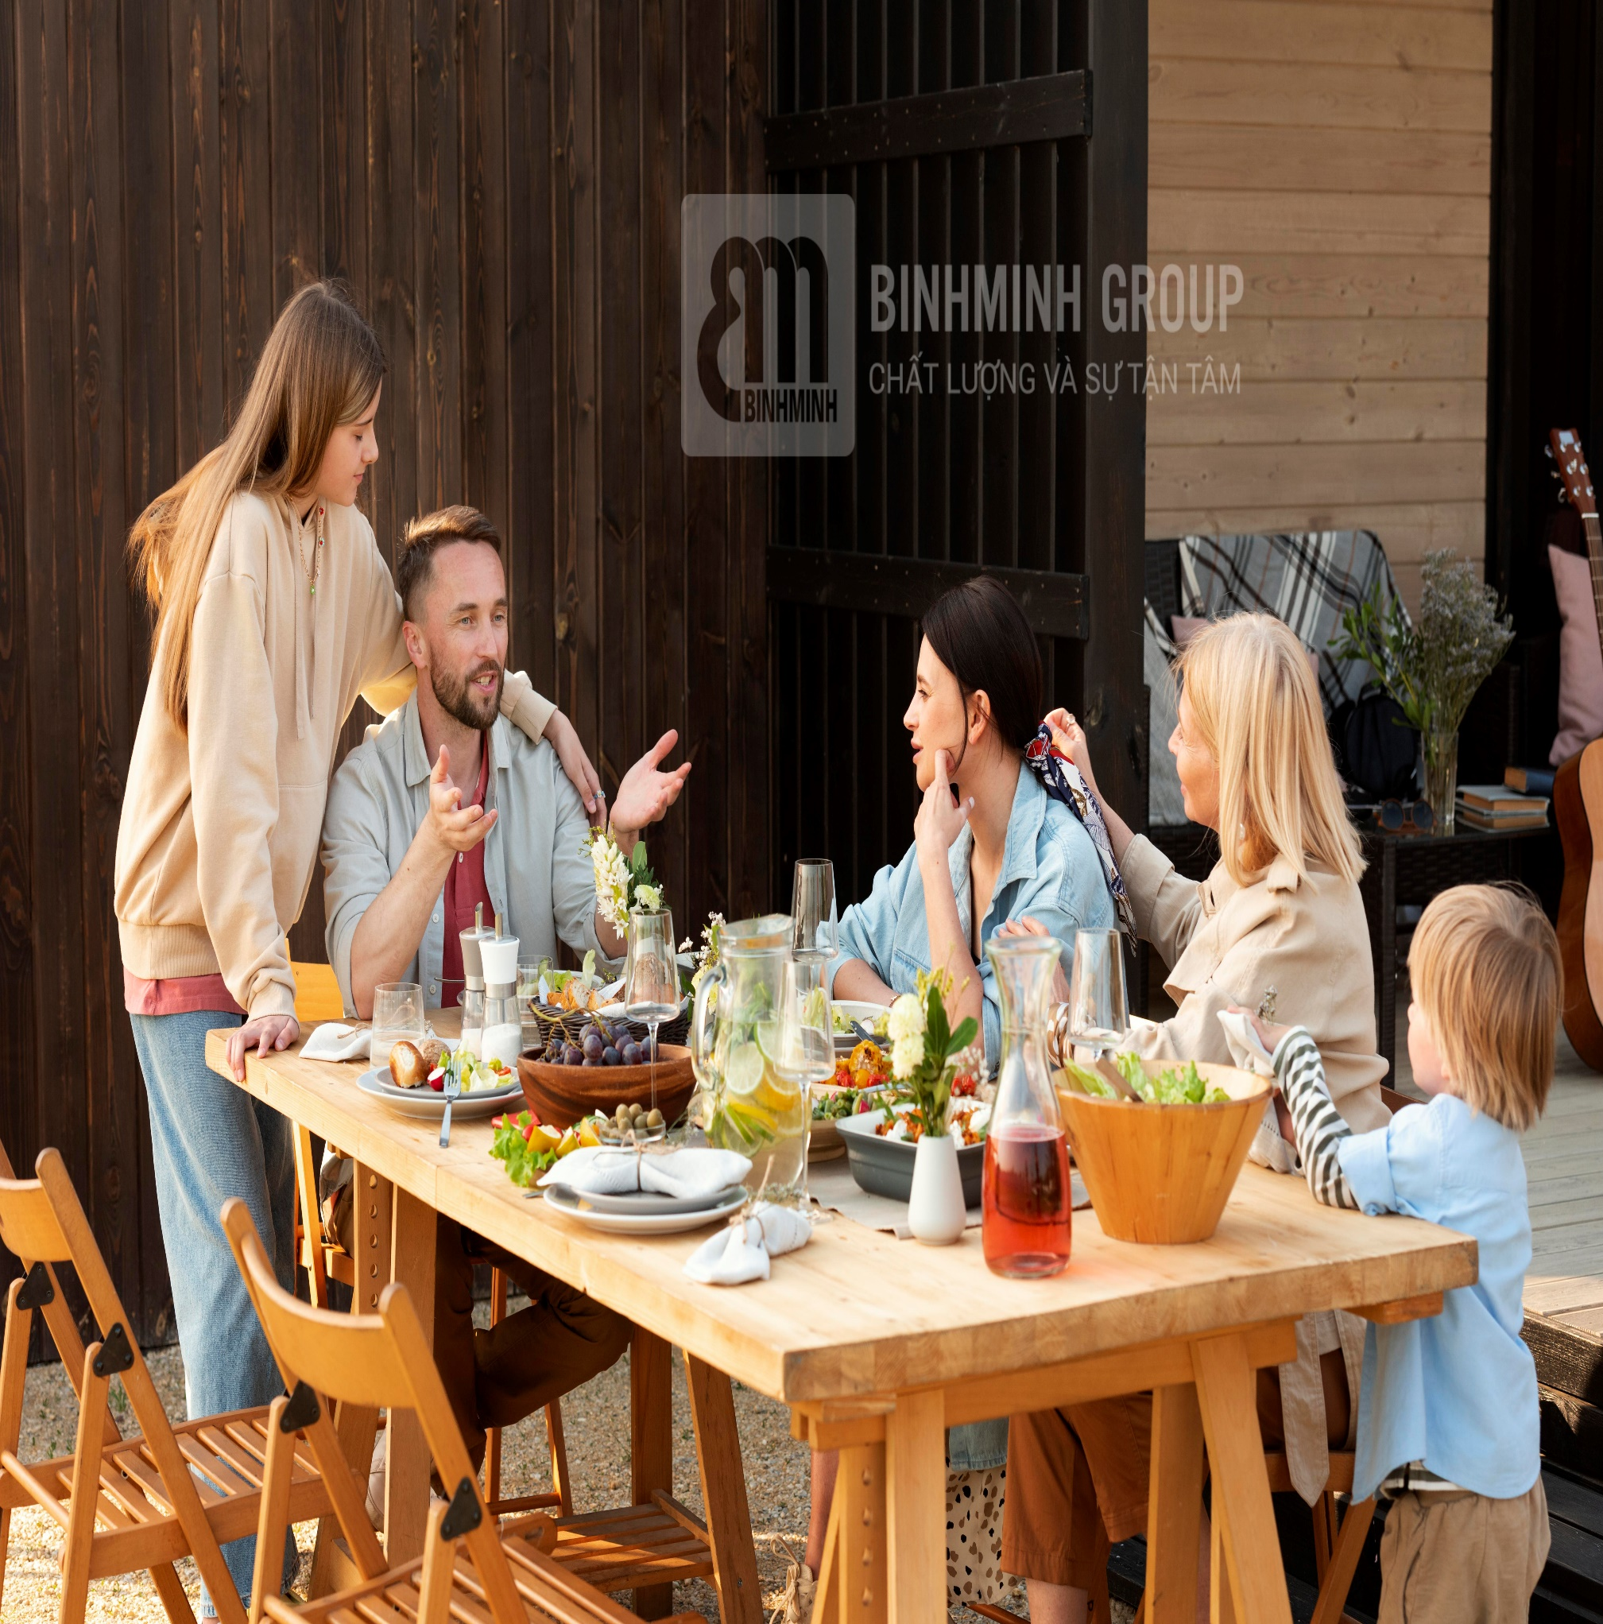
have dinner
/həv ˈdɪnə(r)/

Slide 7
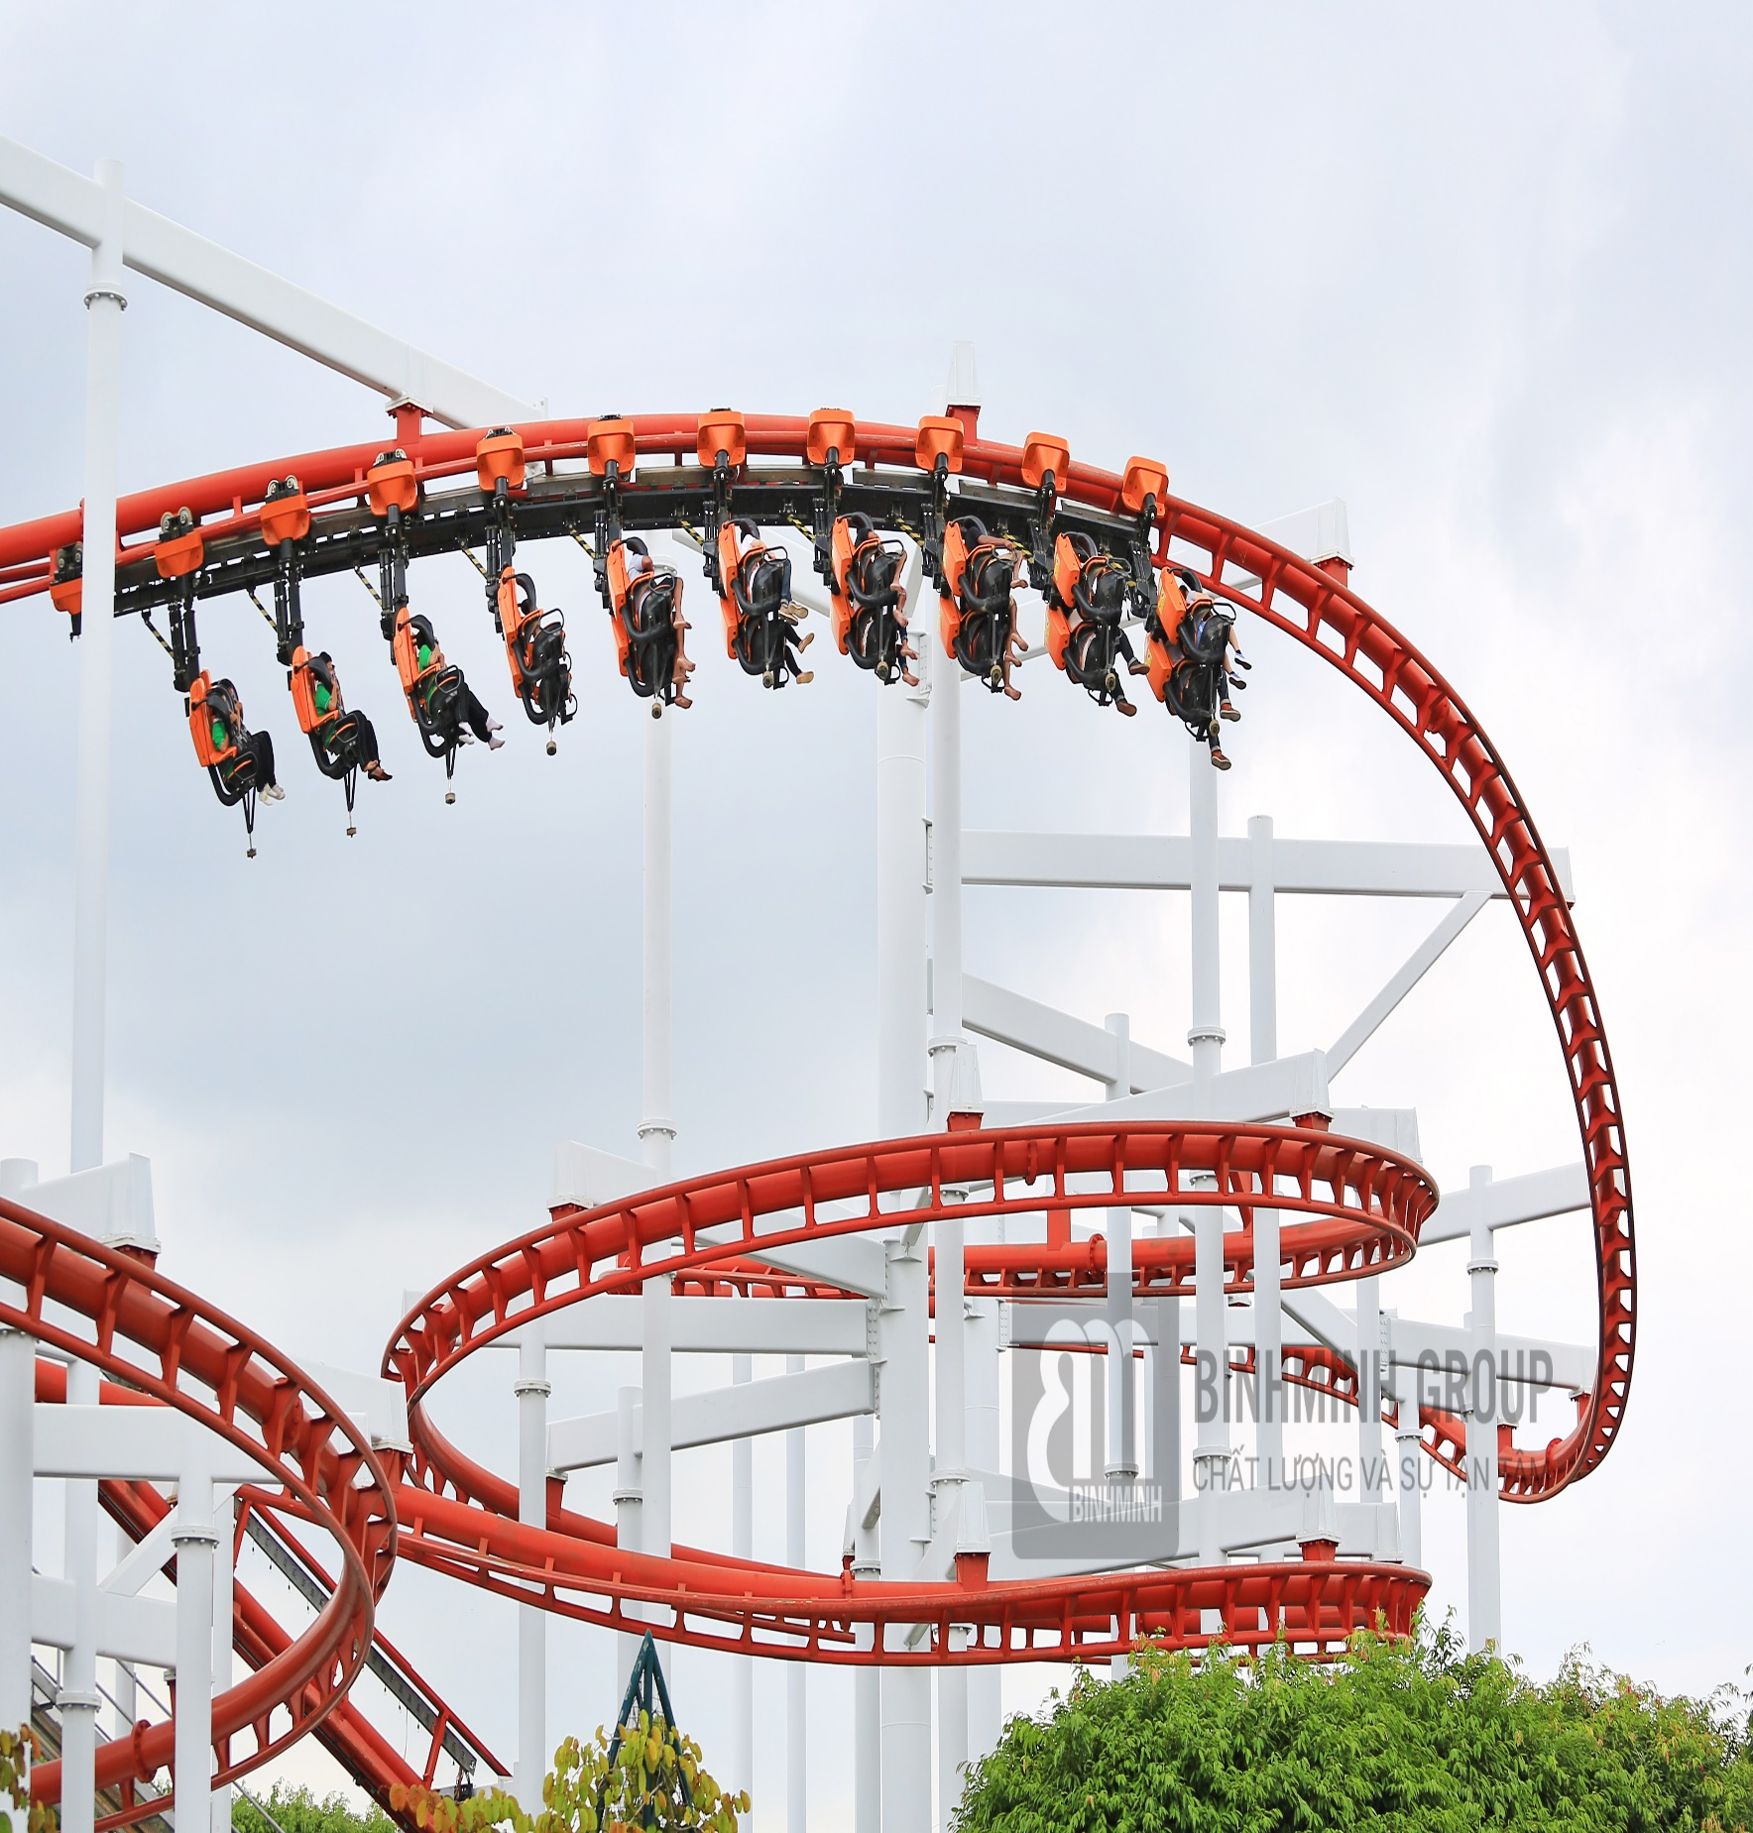
ride the
roller coaster
/raɪd ðə ˈrəʊlə kəʊstə(r)/

Slide 8

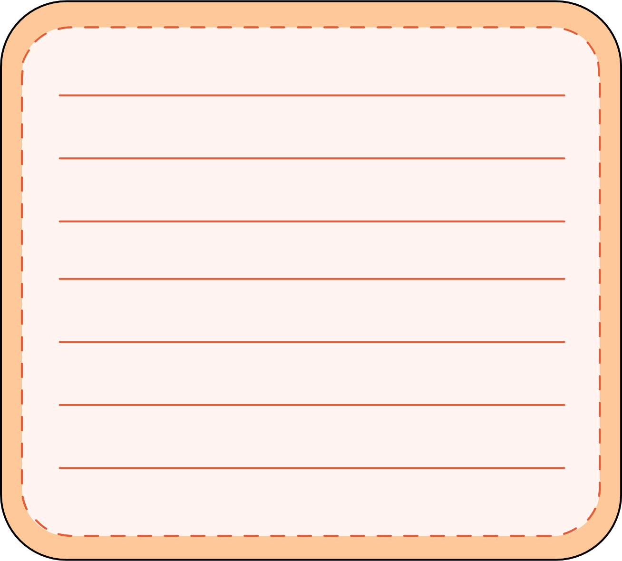

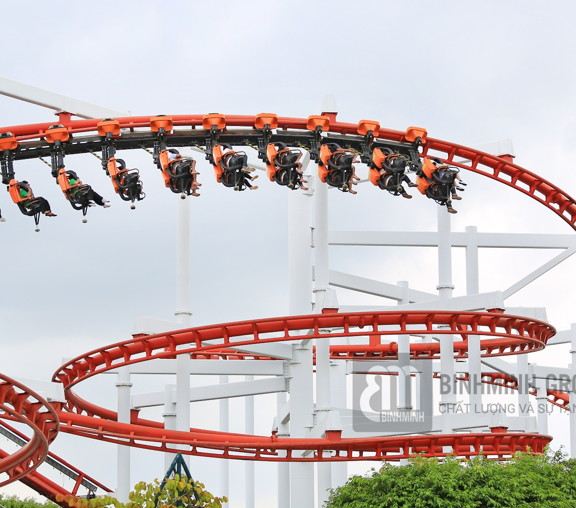


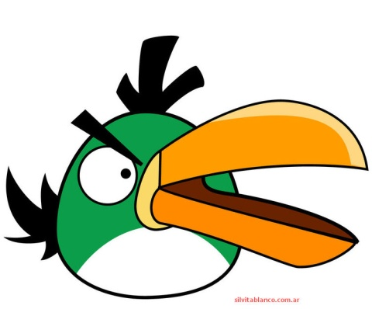


Fill in the blank:
ride the ____ coaster
roller

Slide 9
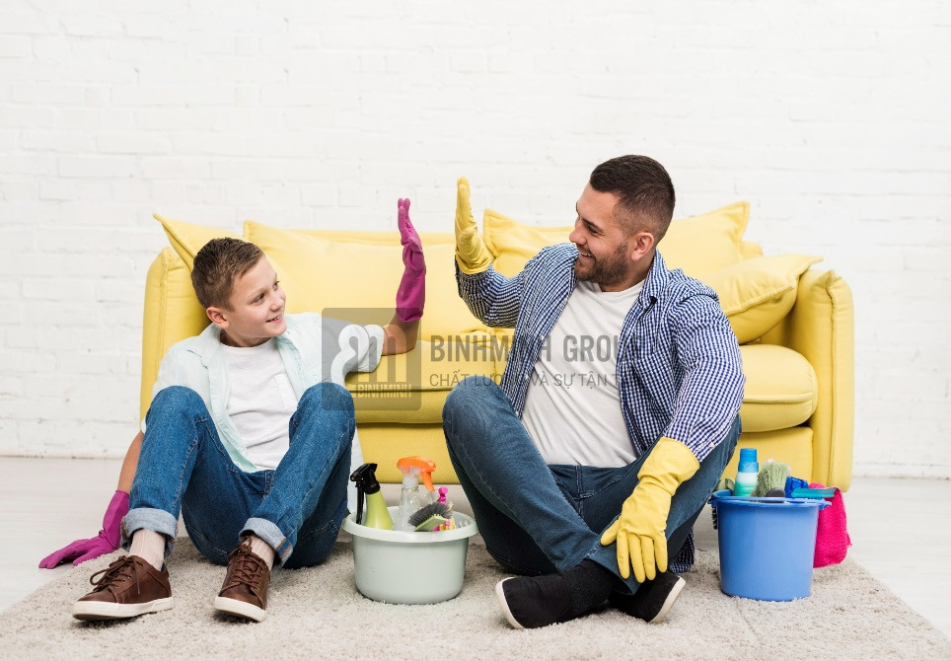

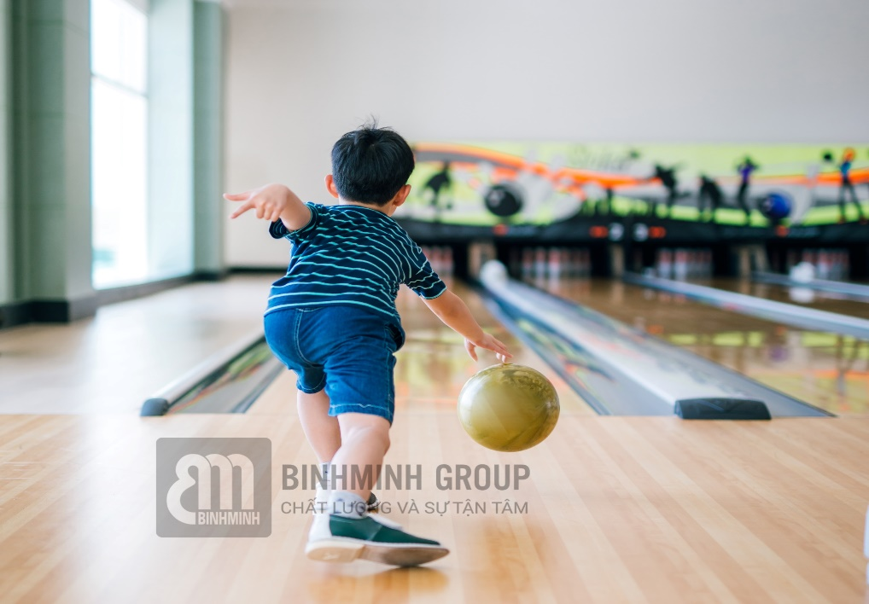
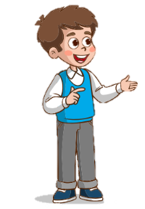
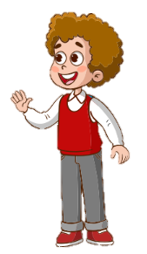


They are talking about free-time activities.
1
Look and guess. What are they talking about?
help Dad
go swimming
go bowling
Gustavo
have dinner
ride the roller coaster
Chet

Slide 10



2
Listen and check. Write G (Gustavo) or C (Chet).
1.
2.
helps his dad at the bookshop?
C
G
3.
eats a big meal with his family?
goes swimming?
G
4.
5.
goes to the sports centre with his friends?
C
C
6.
goes bowling?
G
rides the roller coaster?

Slide 11
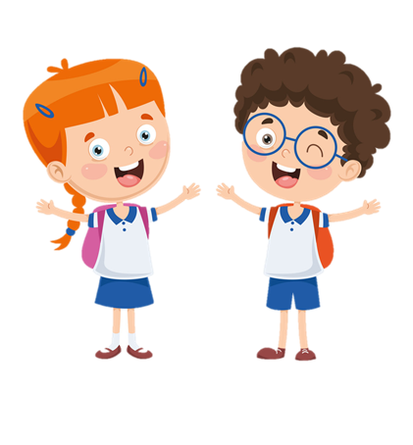

Let’s talk
I usually go to the bookshop
with my parents.
And you?
What do you usually
do on Saturdays?
Wow! That’s great!
Well, I often go swimming with my brother.

Slide 12

1
og inglwbo
go bowling
2
irde the erllor tercaos
ride the roller coaster
3
aveh nnredi
have dinner
4
pelh aDd
help Dad
5
smmignw og
go swimming

Slide 13

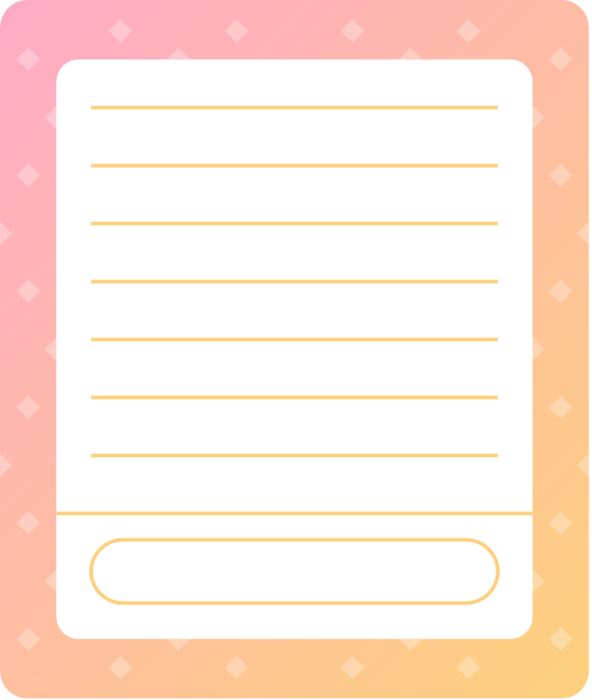
Wrap-up
Review:
help Dad, go swimming,
go bowling, have dinner,
Unit 4: Free time Lesson 3 – Part 1,2,3
What have we learnt today?
ride the roller coaster.
Listening & speaking skills:
Activities you do at the
weekend.
Thank You

Slide 14




Thank You

