Slide 1













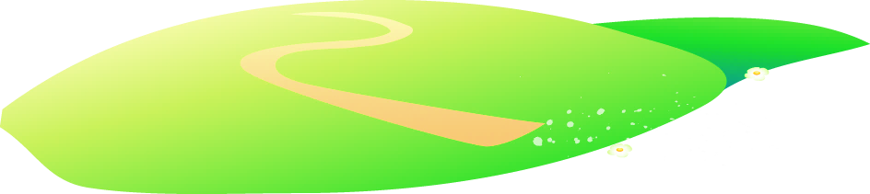






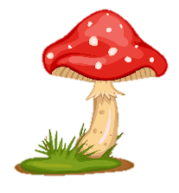
Notes:
Để nguyên trang bìa như này, chỉ thay đổi tên bài trong quá trình làm. Logo của sách Wonderful World

Slide 2
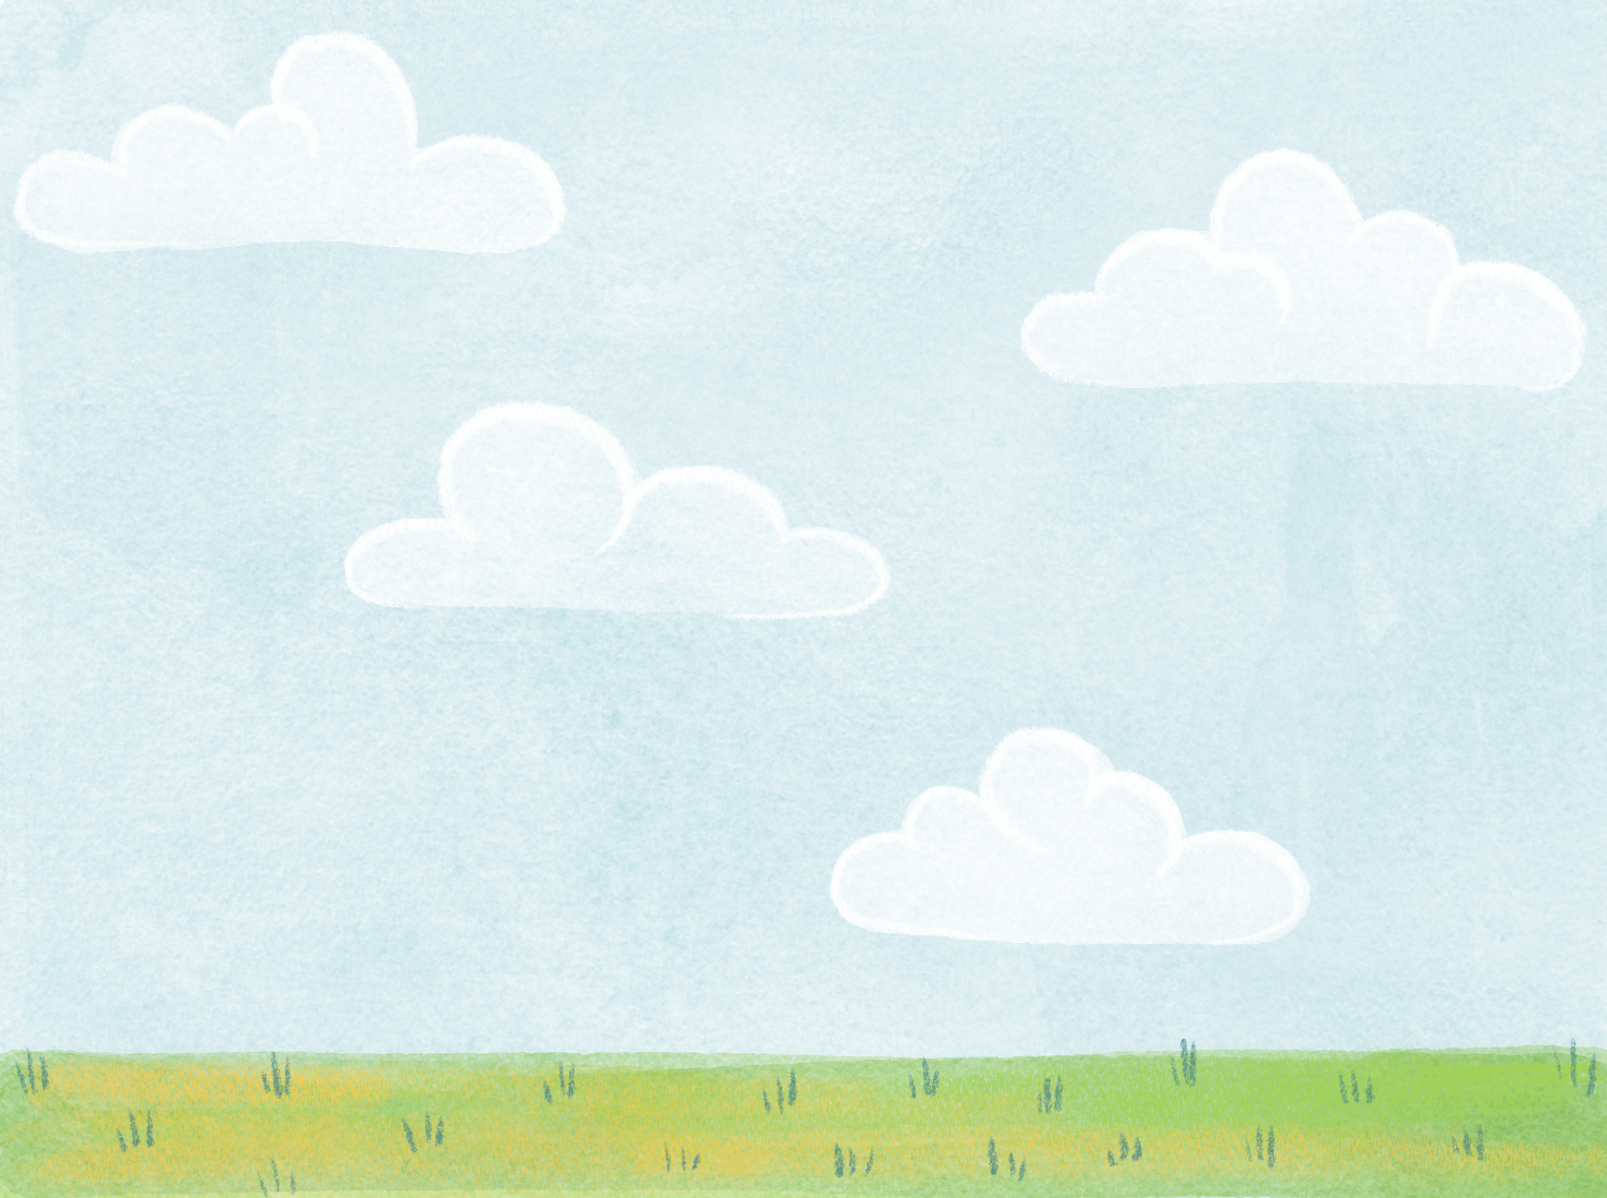

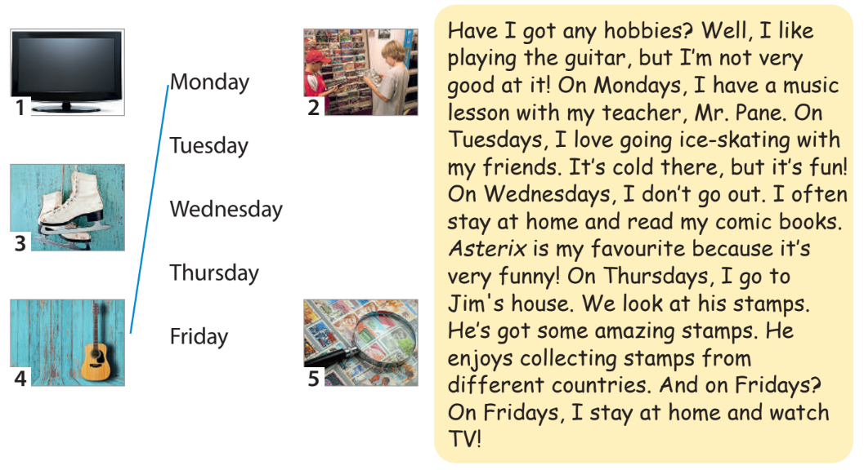
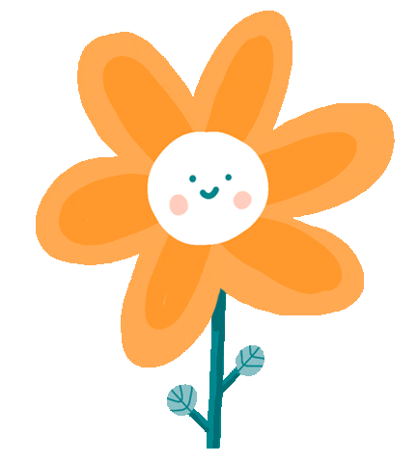
1 Listen and read about Adam’s hobbies. Match the pictures to the correct days. Track 4.1

Slide 3
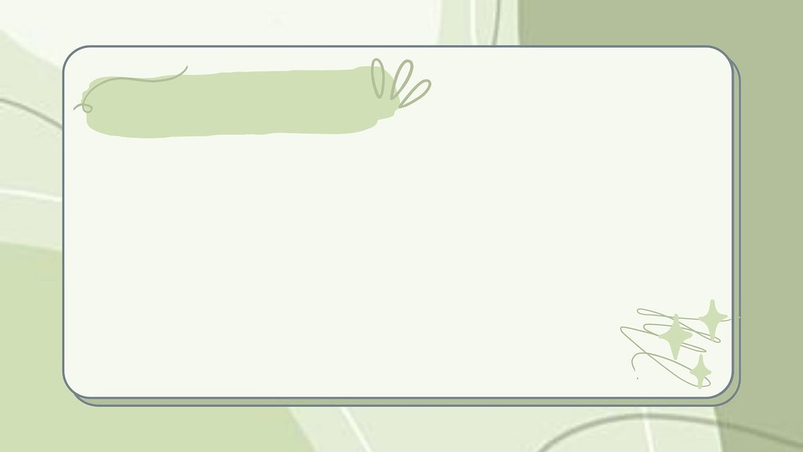
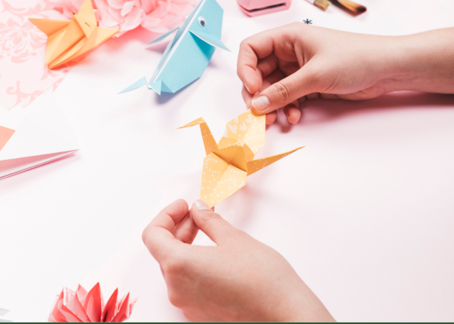
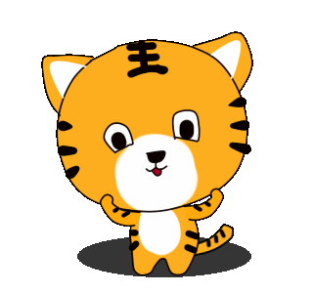
make a paper bird
/meɪk ə ˈpeɪ.pər bɜːd/

Slide 4
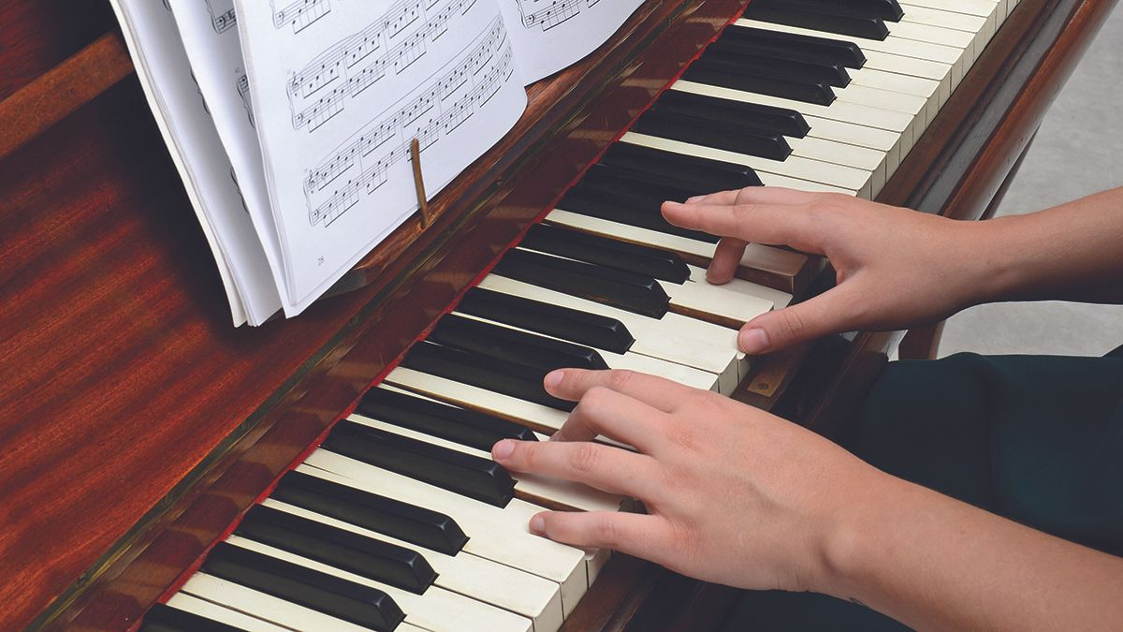
play the piano
/pleɪ ðə piˈæn.əʊ/

Slide 5
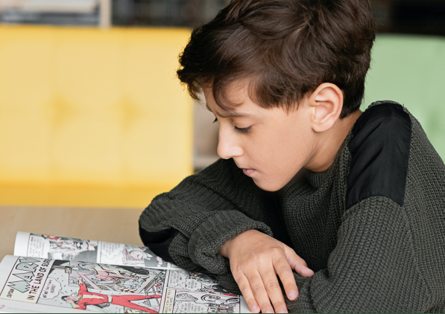
read comic books
/riːd ˈkɑm.ɪkˌbʊks/

Slide 6


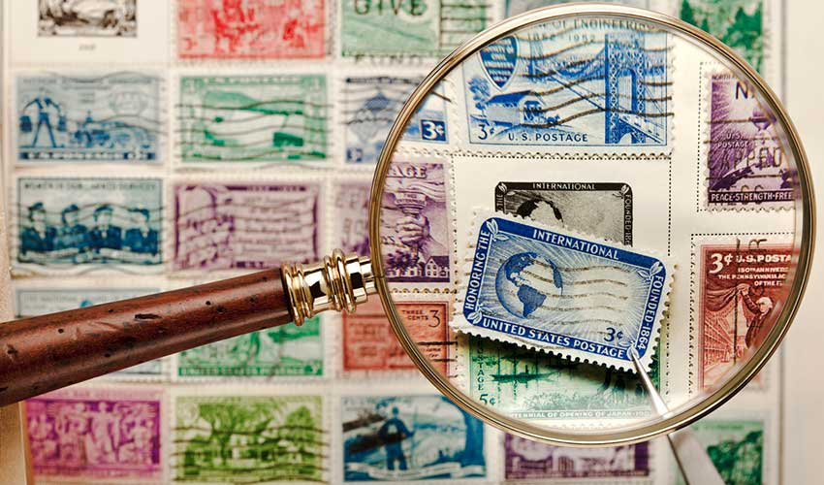
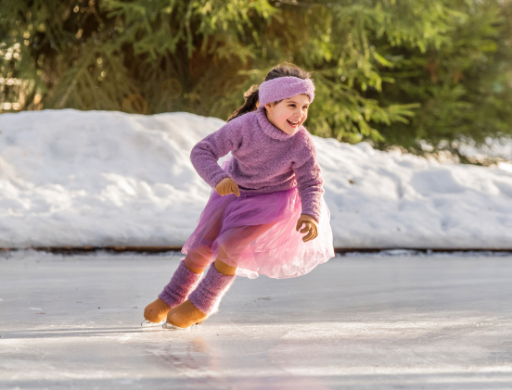
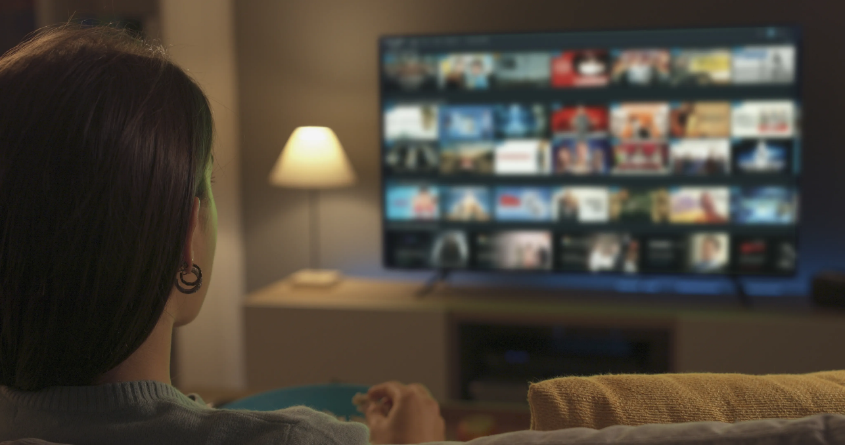
2 Listen, point and repeat.
collect stamps
go ice-skating
make a paper bird
play the piano
read comic books
watch movies

Slide 7




3 Circle the word that does NOT belong
1 watch ____
a TV b a story c a film
2 go ____
a coins b swimming c ice-skating
3 read ____
a a story b the guitar c a comic book
4 collect ____
a coins b stamps c the piano
5 play ____
a the flute b a film c the drums

Slide 8
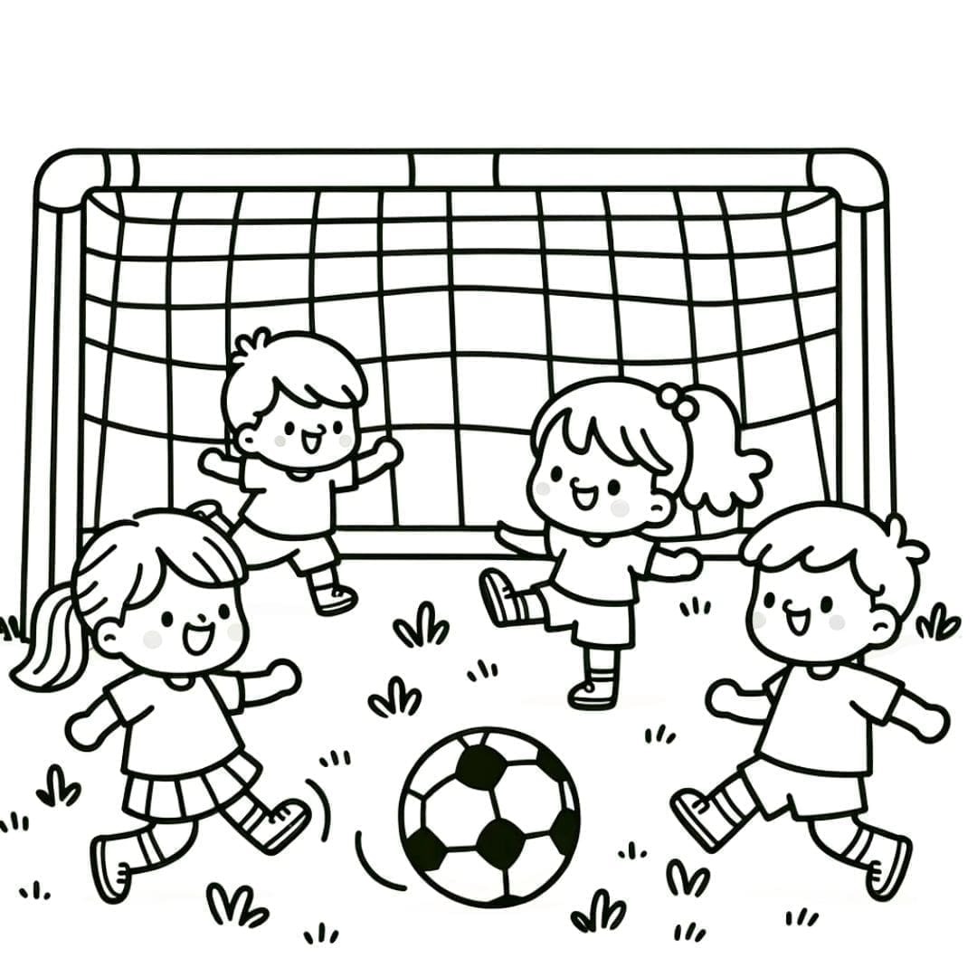
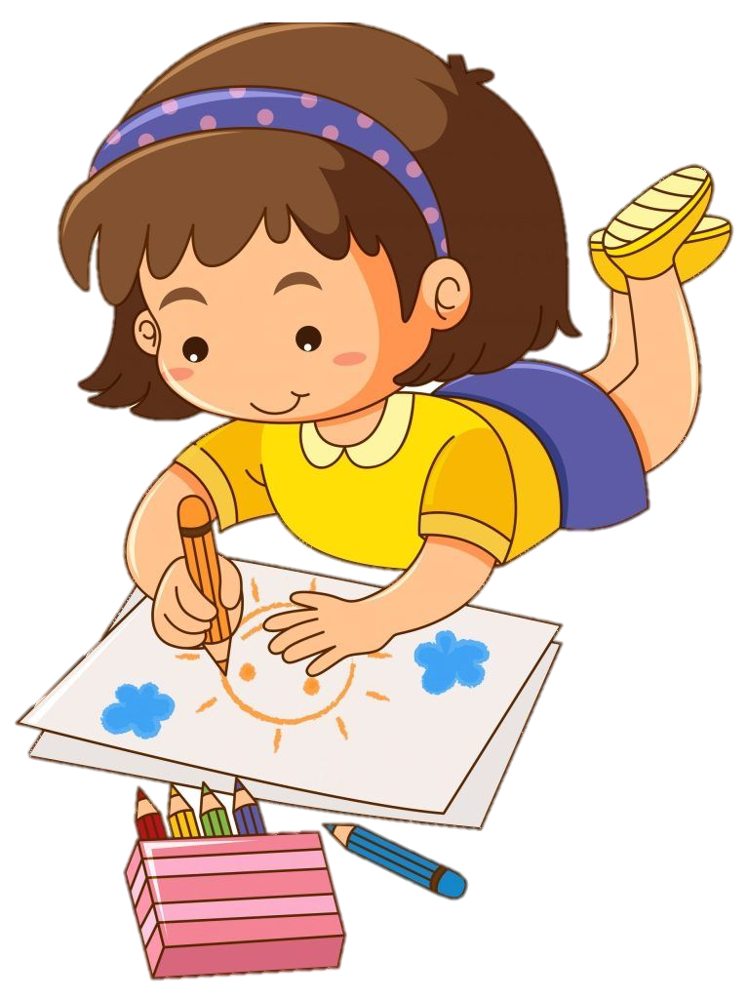
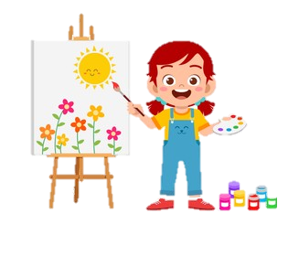
Draw a picture and talk about your free time.
Example:

Slide 9
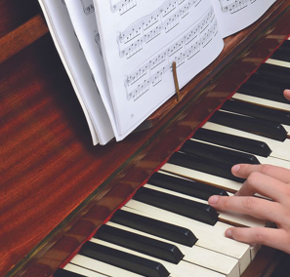
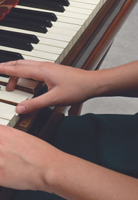
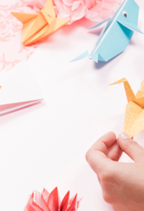
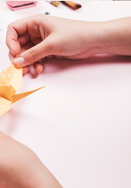
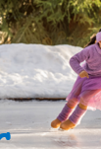

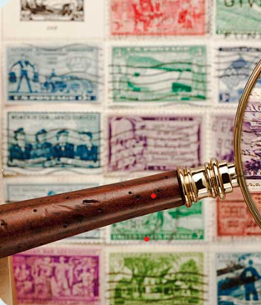
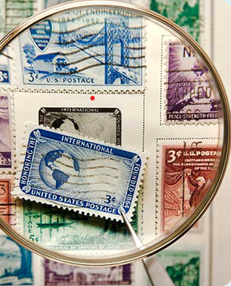
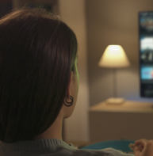
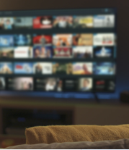
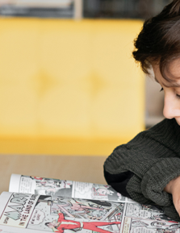
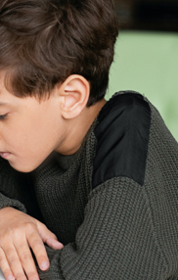
A
B
C
D
E
F
1. play the piano
2. make a paper bird
3. collect stamps
4. watch movies
5. read comic books
6. go ice-skating
Notes:
Click vào nửa bức tranh xuất hiện sau nó sẽ ra đáp án cụm từ

Slide 10

Unit 4: Free time Lesson 1 – Part 1,2,3
What have we learnt today?
Vocabulary:
collect stamps, go ice-skating, make a paper bird, play the piano, read comic books, watch movies.

Slide 11
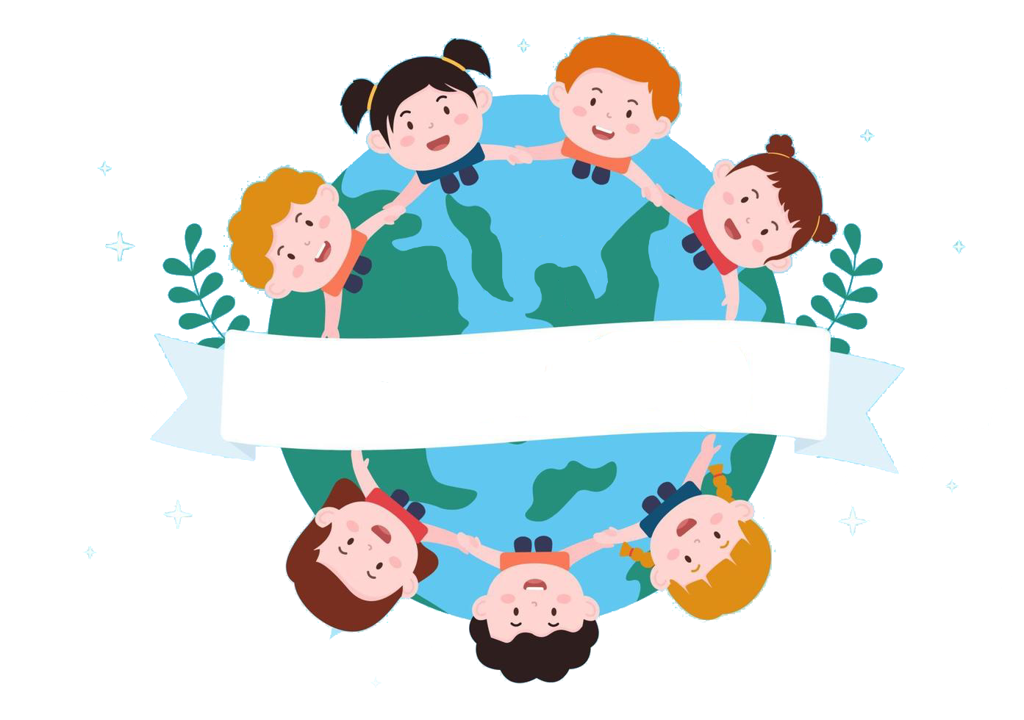
Thank you
& goodbye!

