Slide 1




















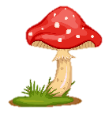
Notes:
Để nguyên trang bìa như này, chỉ thay đổi tên bài trong quá trình làm. Logo của sách Wonderful World

Slide 2




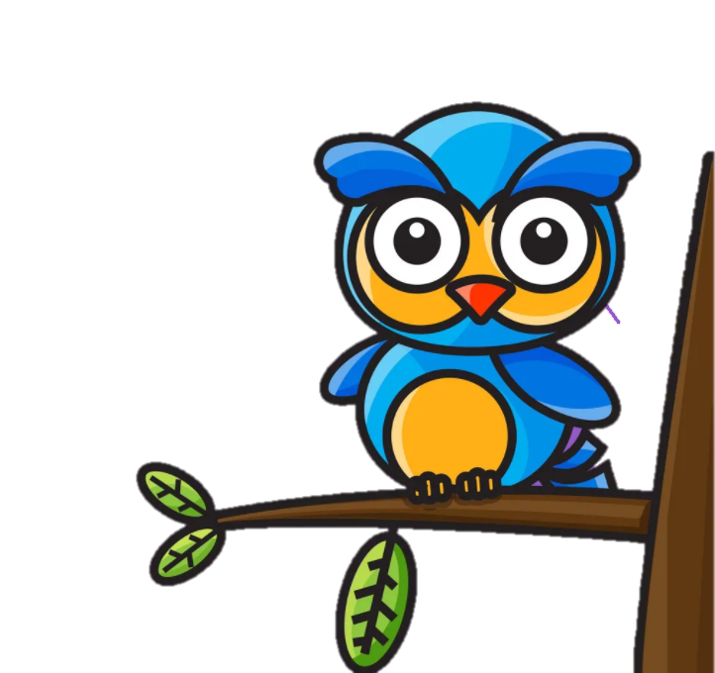


REVIEW 2: PART 1

Slide 3

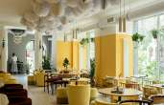
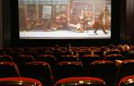
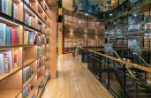
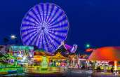
f
1. A place to buy books
2. A place to see a film
3. A place to eat a big meal
4. A place to go on a ride
a
b
restaurant
cinema
c
d
bookshop
amusement park

Slide 4
1. school / never / on Saturdays / go / We / to / .
2. my / I / write / diary / in / usually / .
3. isn’t / Geography / boring / always / .
4. karaoke clubs / sing / sometimes / We / in / .
5. scary / often / Roller coasters / are / .
6. have / you / lunch / Do / always / at school / ?
We never go to school on Saturdays.
I usually write in my diary.
Geography isn’t always boring.
We sometimes sing in karaoke clubs.
Roller coasters are often scary.
Do you always have lunch at school?

Slide 5

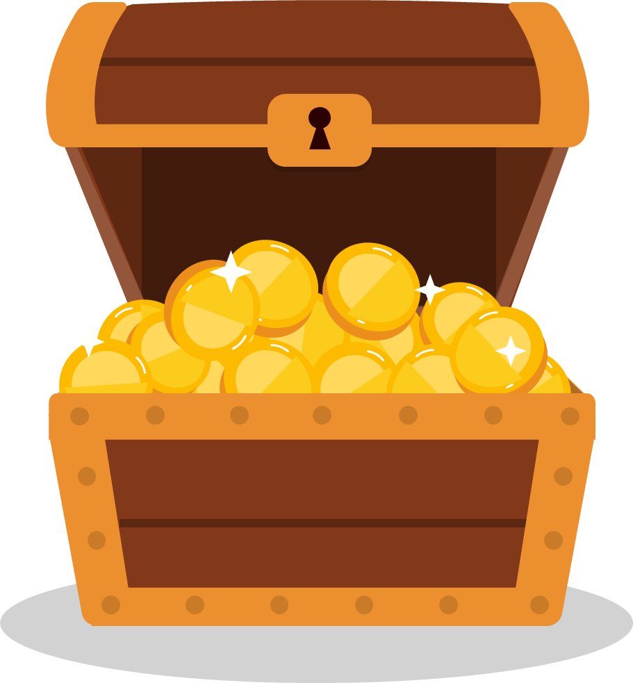




Can
A: Teacher,____ I go out for 5 minutes?
B: I’m sorry, you can’t.
Check
Back

Slide 6
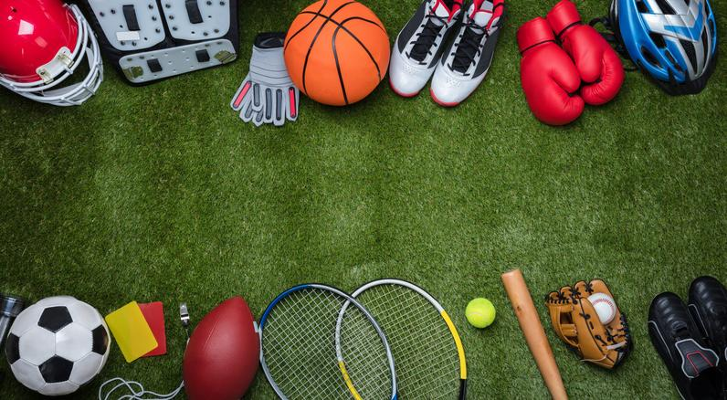

Sports Centre Open Day—Free!
Day: (1) ___________________
Morning
Sports to try: Hockey and (2) ___________
Afternoon
New activity at (3) ____________
Swimming for exercise—(4) __________to music
Competition: (5)_____________ flying at (6) __________p.m.
Saturday
basketball
3:30
swimming
kite
6

Slide 7

Talk about your family’s favourite activities. You should say:
How many people are there in your family?
What are their favourite activities?
How often do they do these activities?
What are they good at?
What activities does your family enjoy doing together?

Slide 8
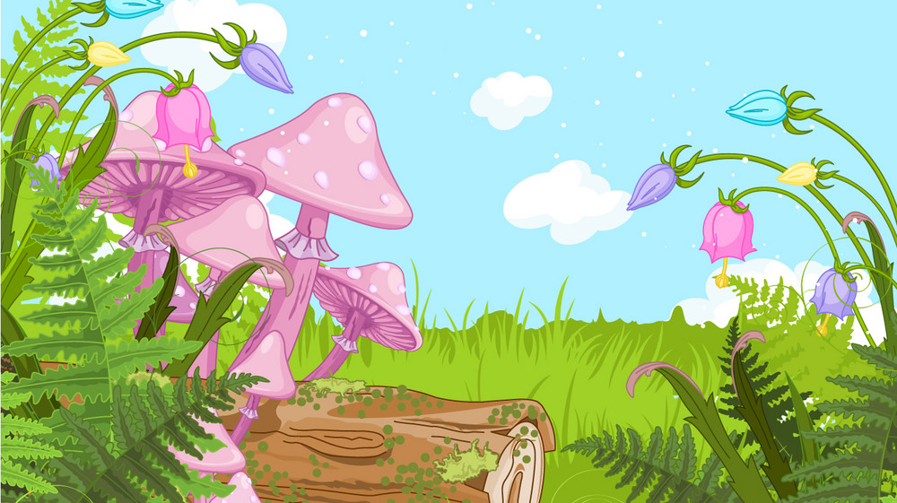
Review 2 Part 1
What have we learnt today?
Review vocabulary: Topic: Free time
Review grammar:
to be good at + V-ing
can (permission)
verb forms

Slide 9


Thank you
& goodbye!

