Slide 1









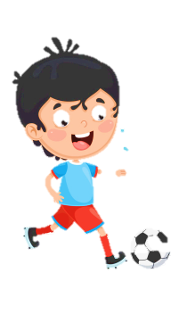


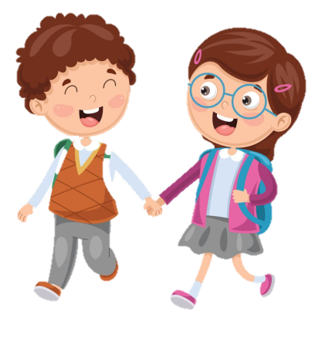



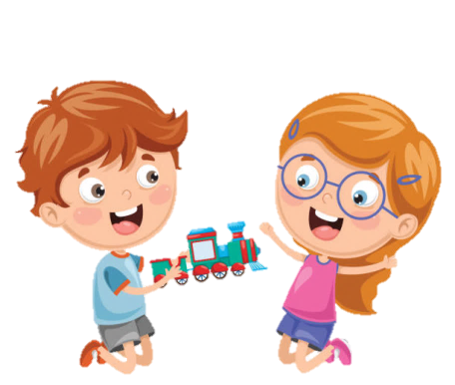






Slide 2
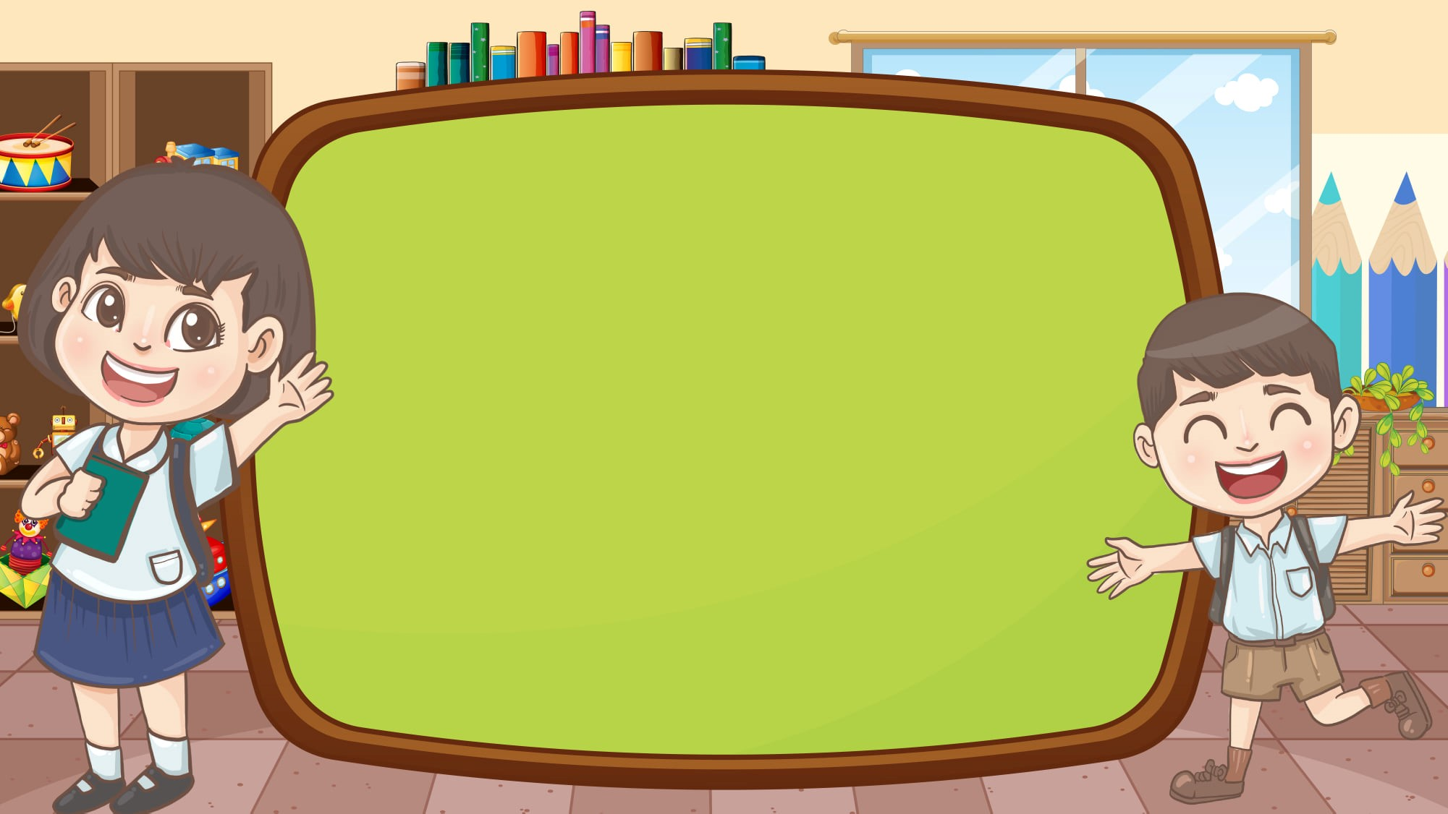
Unit 3
School life
FUN TIME & PROJECT

Slide 3





Table of contents
01
02
Review
Warm - up
05
04
Production
Wrap-up &
Assessment
03
Practice

Slide 4
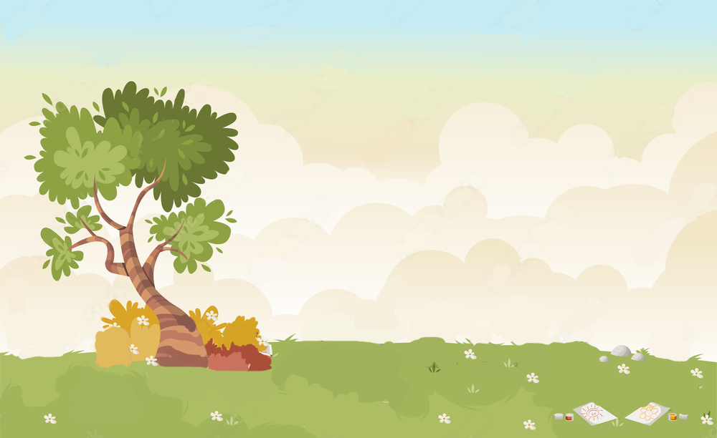











WARM UP
Let’s play “Memory game”

Slide 5



REMEMBER THAT!
You have 30 seconds to look at the pictures.
Try to remember what you see!
1 point for each item.
Notes:
Students see a bundle of pictures for 30 seconds, they then have 2 minutes to write down everything they can remember.

Slide 6

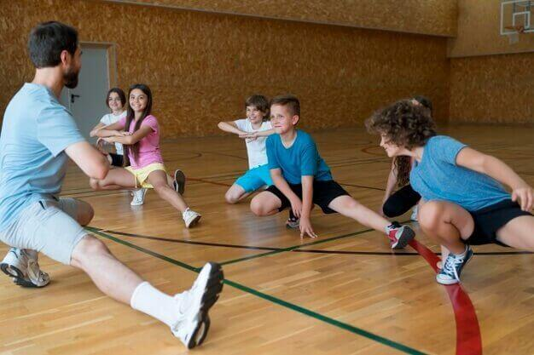
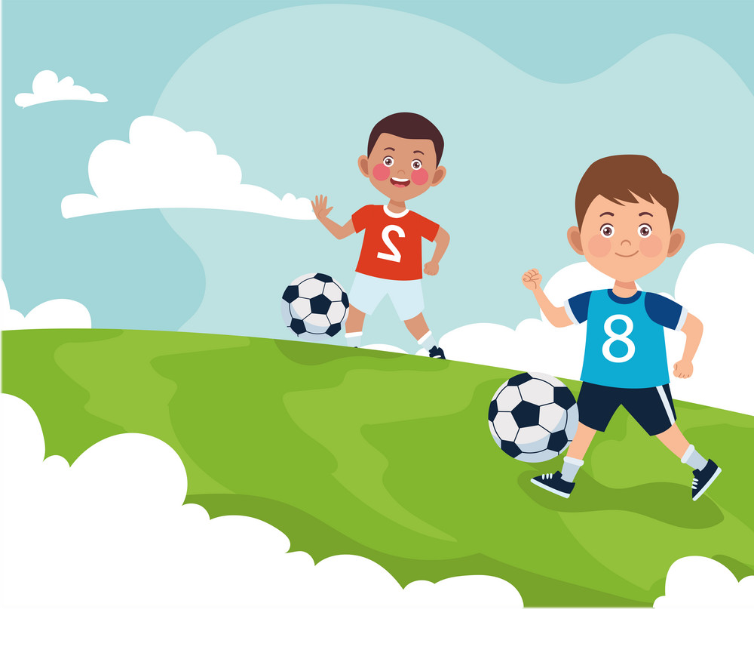
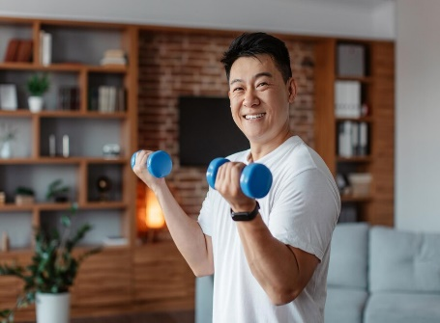
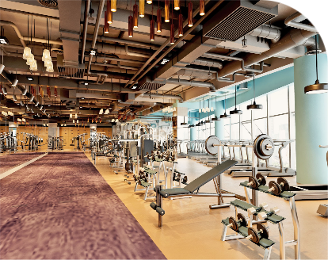

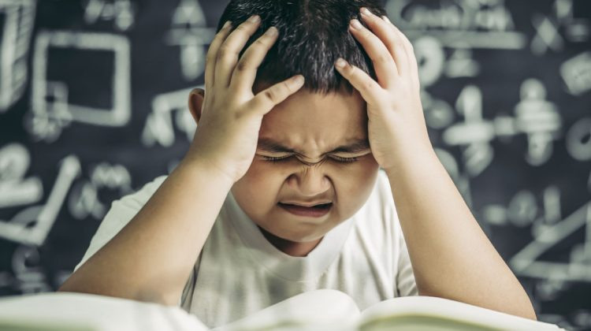
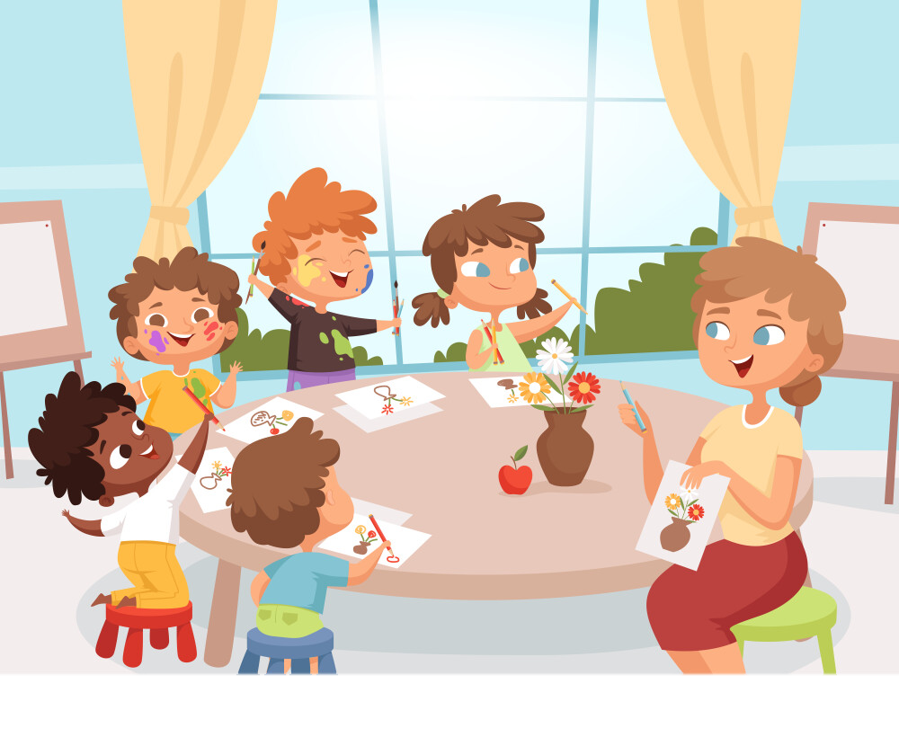

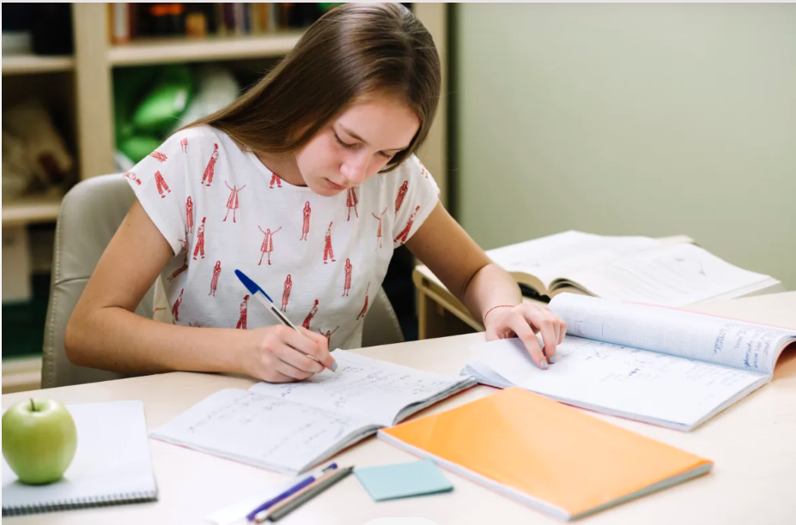
30 seconds

Slide 7
exercise
play football
practise
fitness centre
study English
problem
have art class
solution
do homework

Slide 8
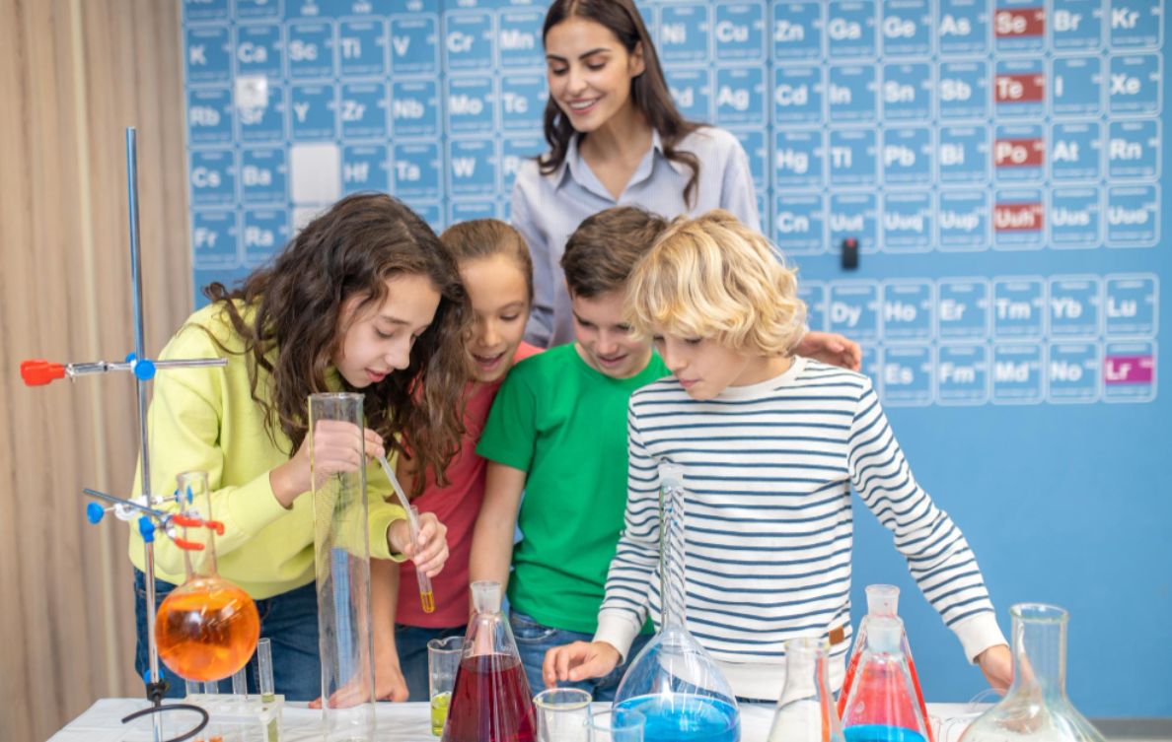
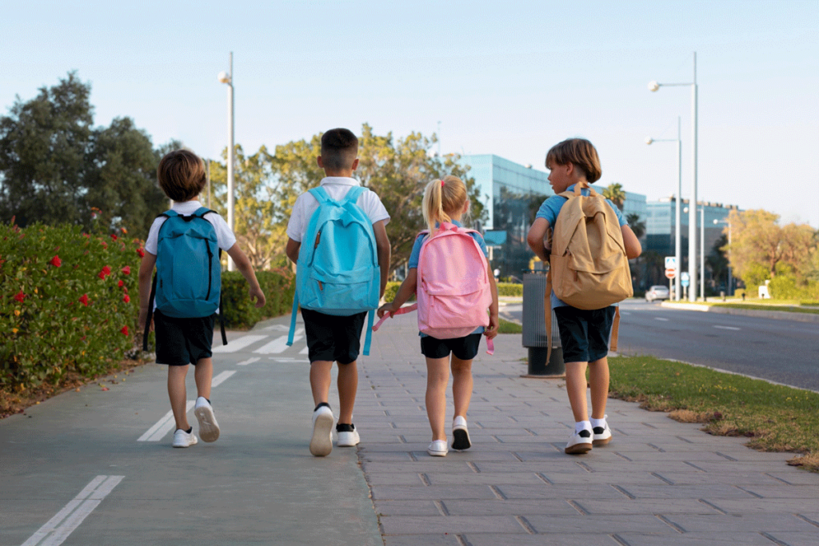
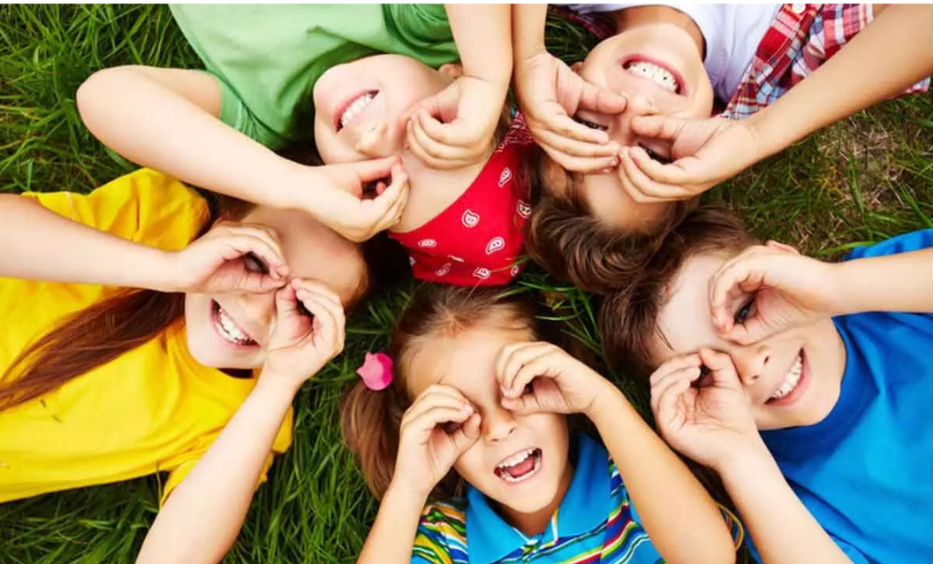
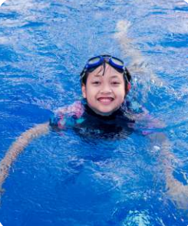
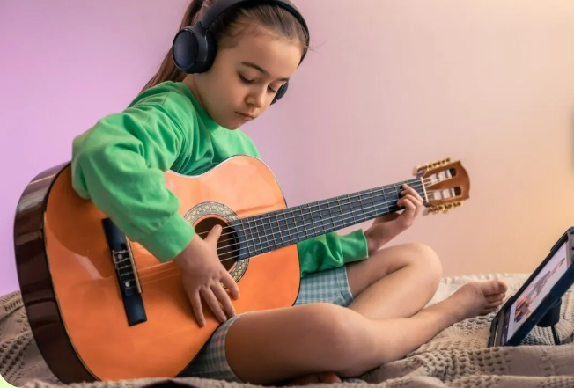
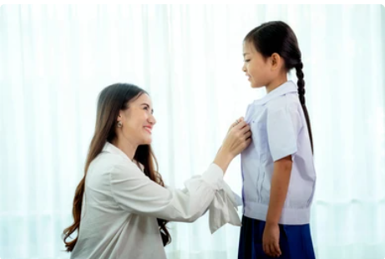
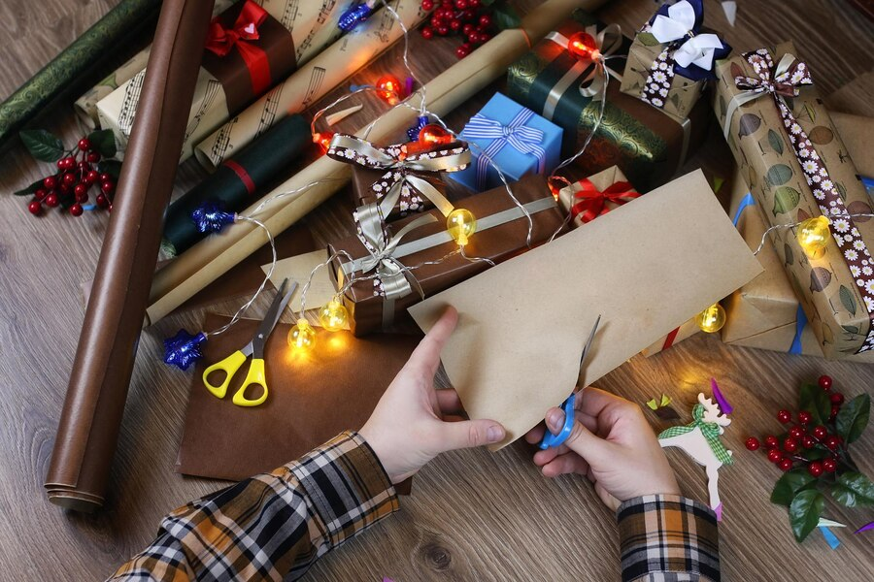
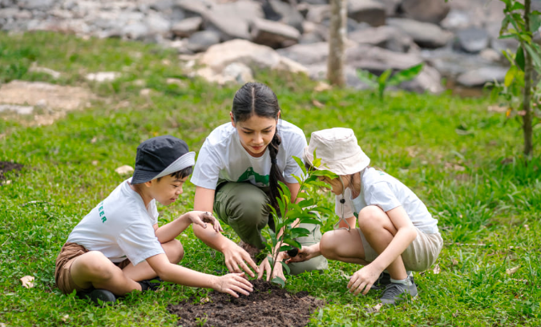
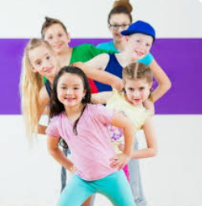
30 seconds

Slide 9
go to science clubs
walk to school
have fun
play a musical instrument
wear a uniform
go swimming
do arts and crafts
take care of plants
dance

Slide 10

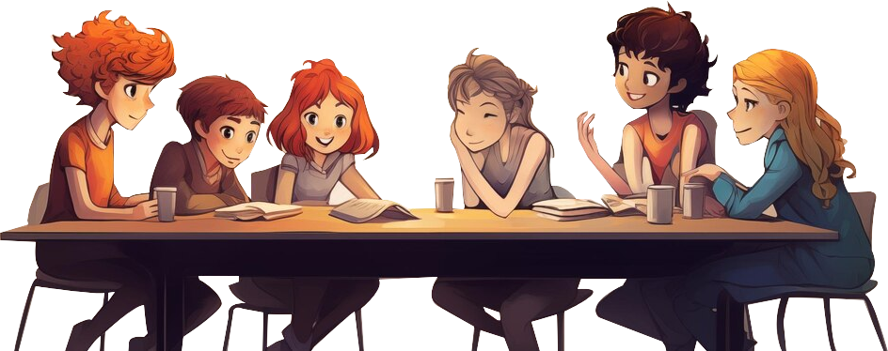


2. REVIEW

Slide 11
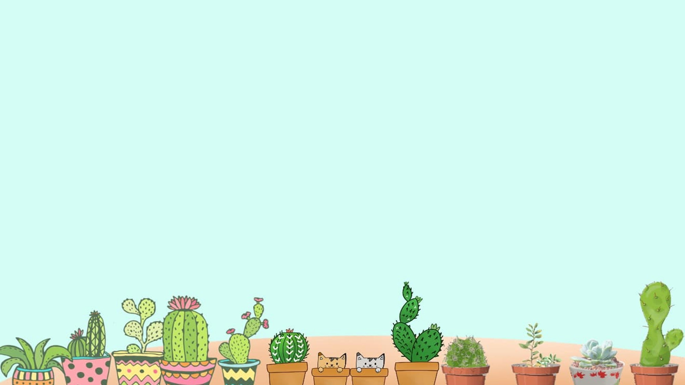

- … do you do in the morning?
- I always do morning exercise.
When
Where
What

Slide 12
- … do you walk to school?
How often
Does
What

Slide 13
- … Dara have English on Mondays?
- Yes, She does.
Do
Does
When

Slide 14

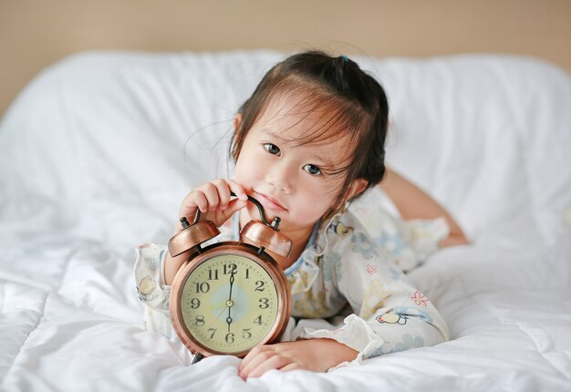
Read and choose the correct answers.
I get up at 6 o’clock.
a. usually
100 %
b. sometimes
c. always

Slide 15
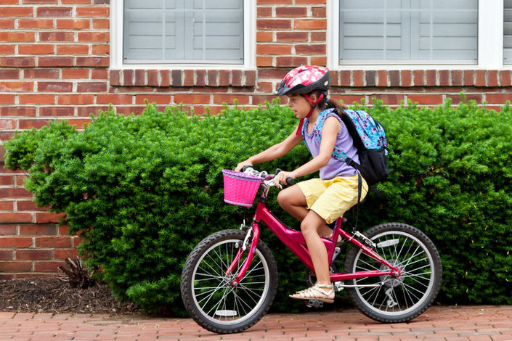
Read and choose the correct answers.
Ann rides her bike to school.
a. sometimes
50 %
b. always
c. often

Slide 16
Read and choose the correct answers.
Doug goes to any science clubs.
a. often
0 %
b. usually
c. never

Slide 17
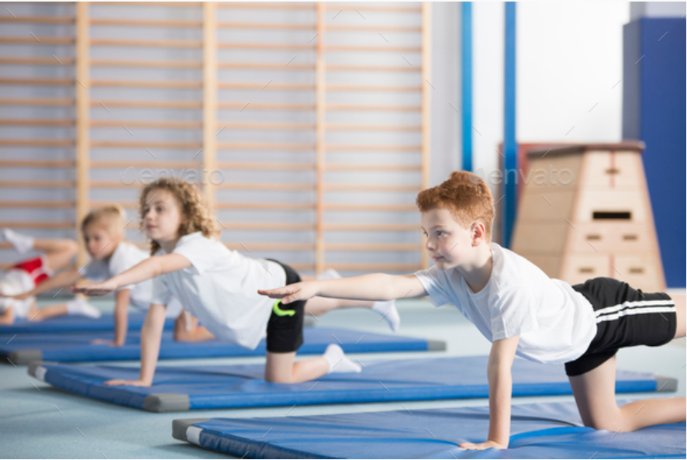
Read and choose the correct answers.
I practise sport.
a. usually
70 %
b. often
c. sometimes

Slide 18




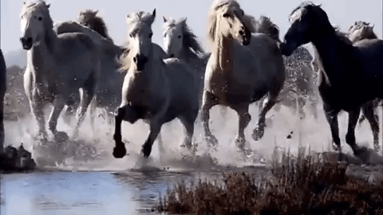

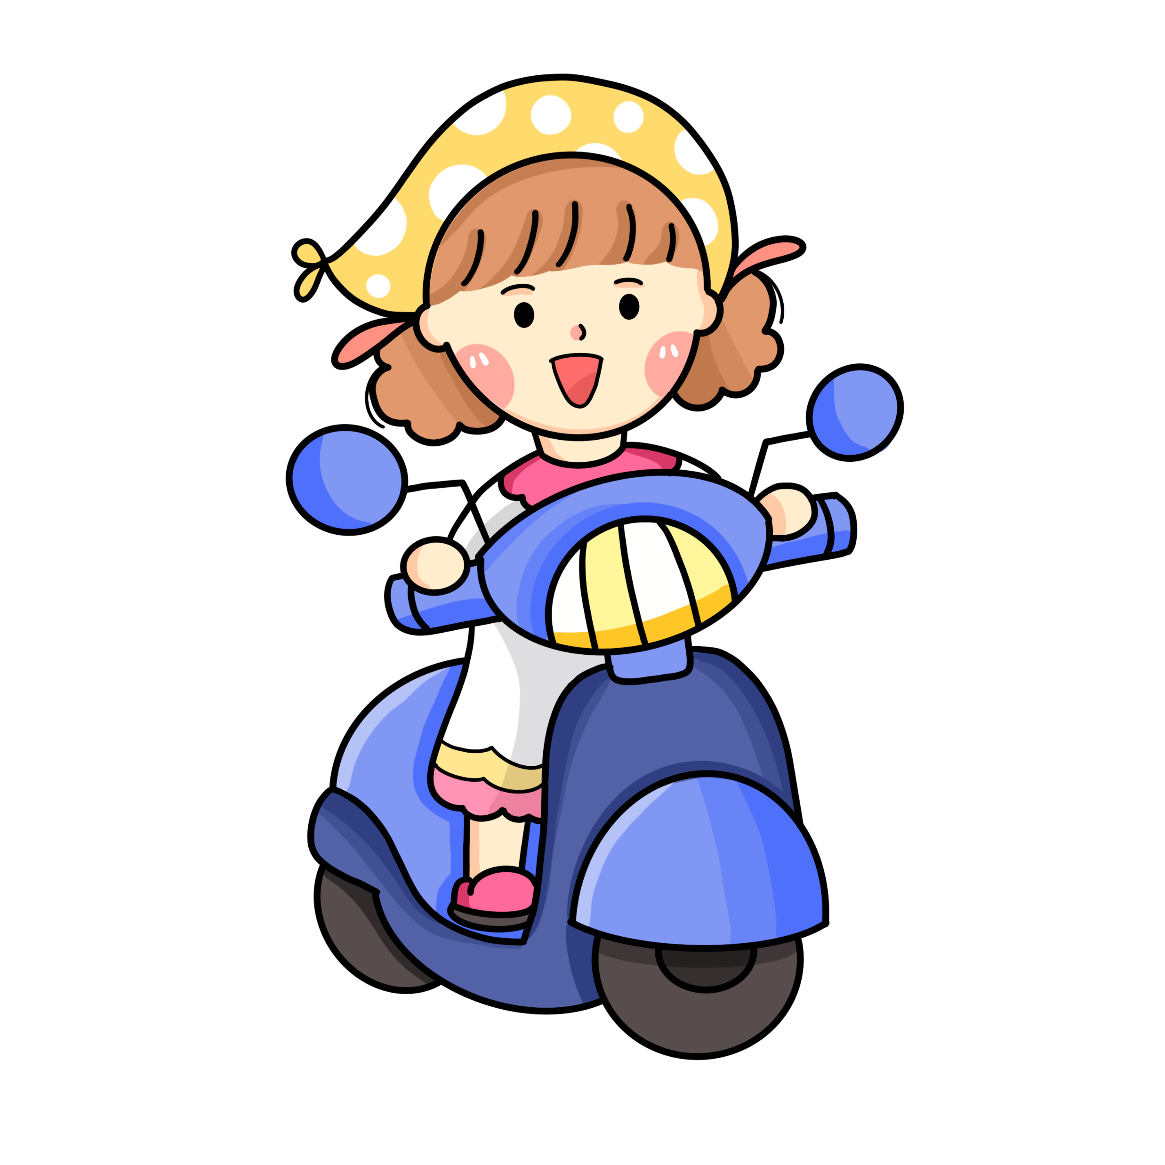

What is the final “s” sound?
iz - horses

Slide 19
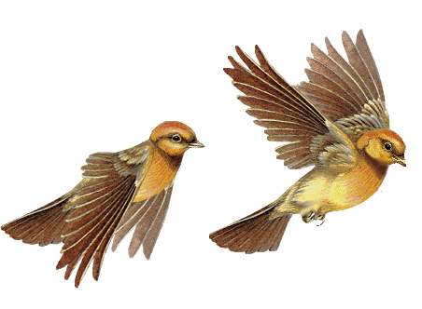
What is the final “s” sound?
z - birds

Slide 20
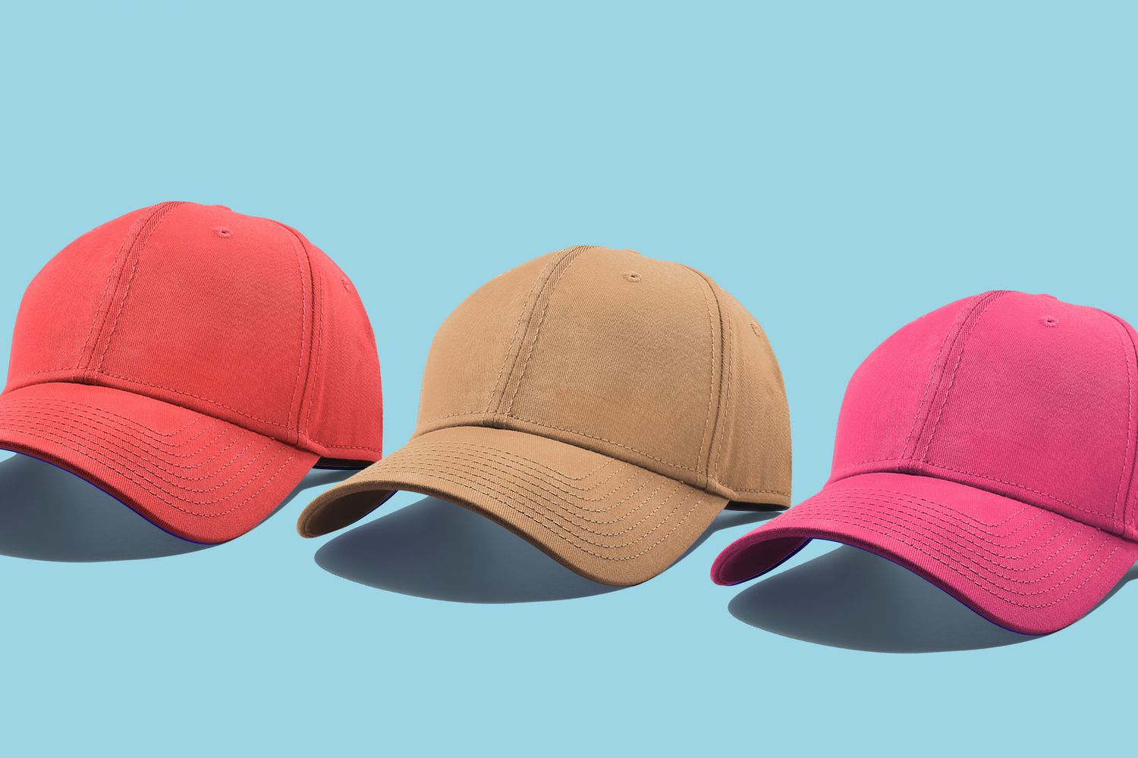
What is the final “s” sound?
s - caps

Slide 21
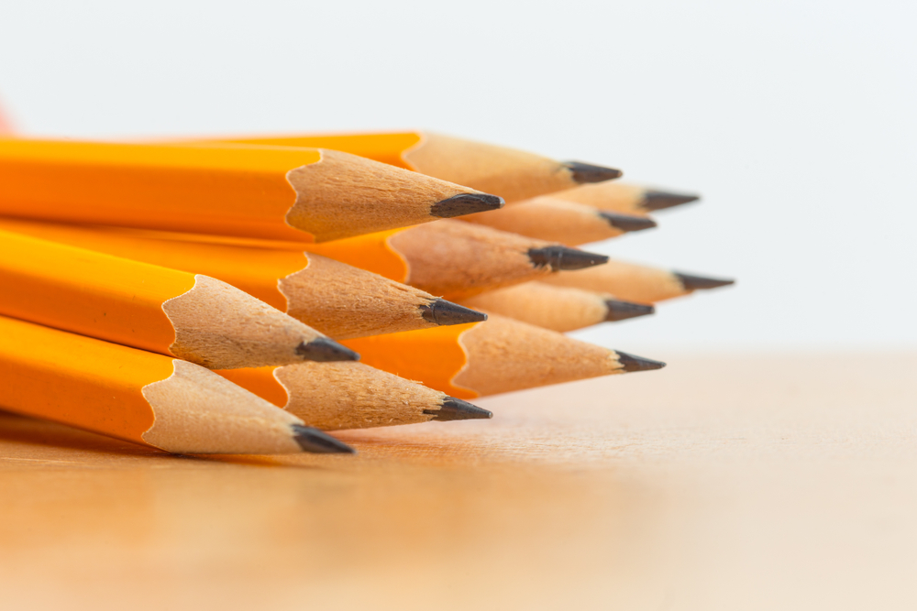
What is the final “s” sound?
z - pencils

Slide 22
3. PRACTICE

Slide 23
4. Ask and answer about your activities at school.
8 a.m.
9 a.m.
12 p.m.
2 p.m.
4 p.m.
What do you often do at school at 8 a.m.?
At 8 a.m., I start my lessons.

Slide 24
4. PROJECT

Slide 25
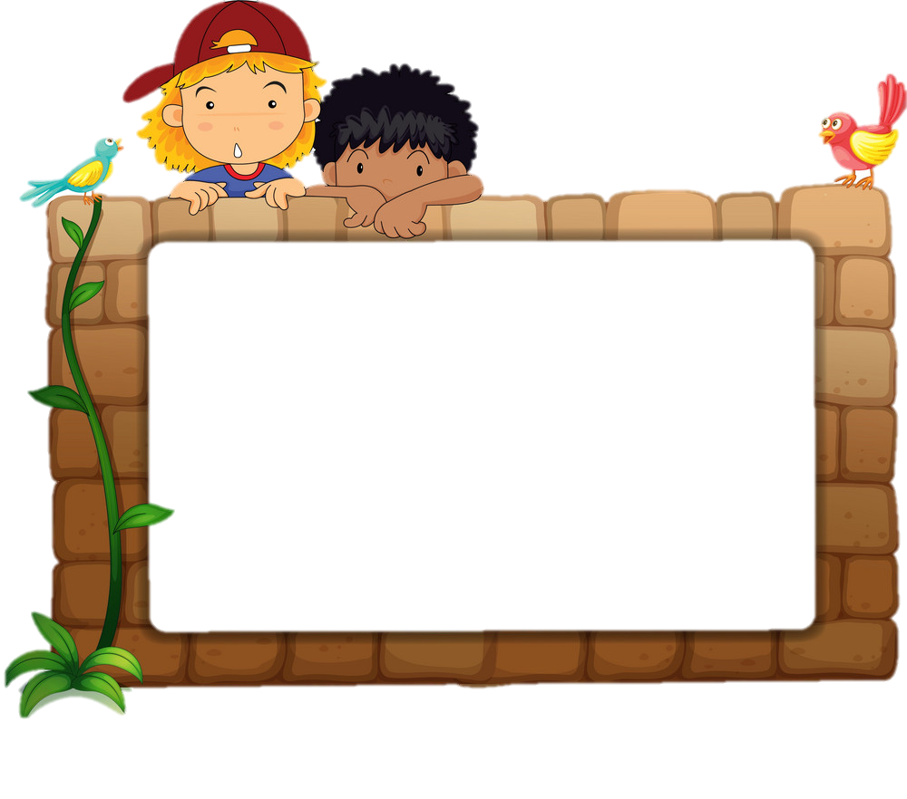
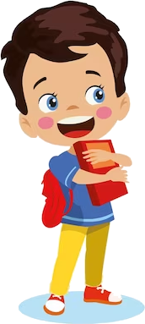
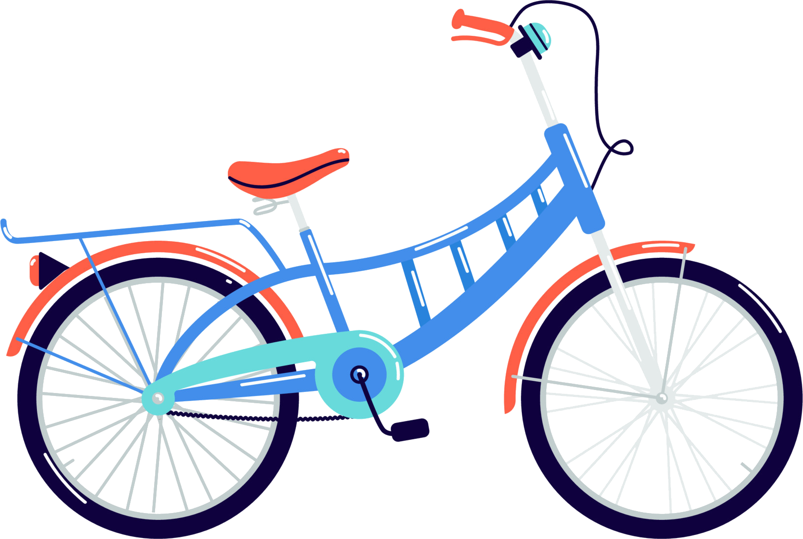
6. Do a class survey and report.
Monday is my favourite school day. At 7.30 a.m, I start my lesson. At 9 a.m, I have an English lesson. I have lunch and
rest at 11.30 a.m. At 2.30 p.m, I play badminton with my
friends. I go home at 4.00 p.m. I like that day because it has
English lessons. I love English very much.
Name | Favourite school day | Favourite suject
Mai
Hoa
Minh
Notes:
- Ask Ss to talk to their friends about favourite school day.
- Find out Who has got the same favourite school day as you?

Slide 26
4. Do a class survey and report.
Minh has got the same favourite school day as me. He likes……
Name | Favourite school day | Favourite suject
Mai | Monday | Maths
Hoa | Friday | English
Minh | Wednesday | Music

Slide 27
5. WRAP-UP & ASSESSMENT

Slide 28

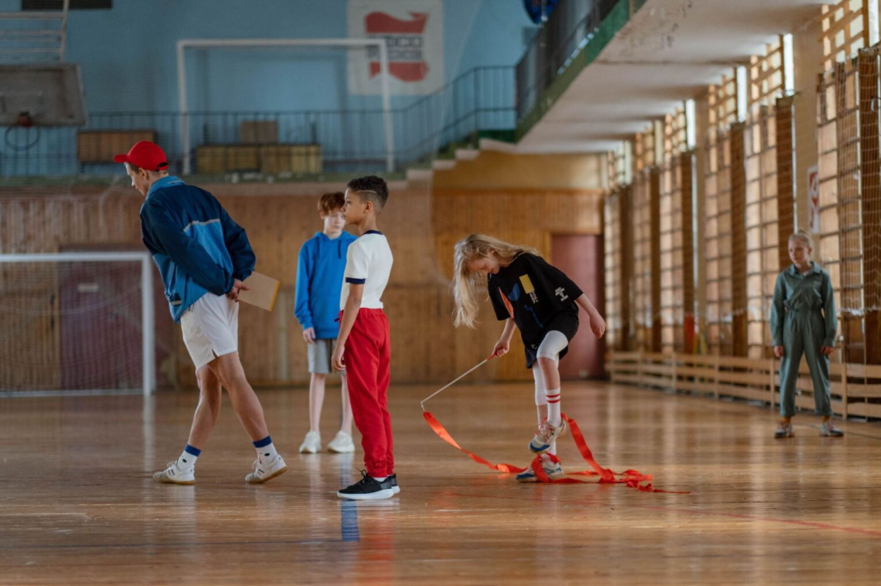
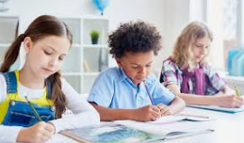
5. Complete the note about your favourite school day.
Say what you do, give the times, and why you like that day.
… is my favourite school day. At..., I usually ...

Slide 29
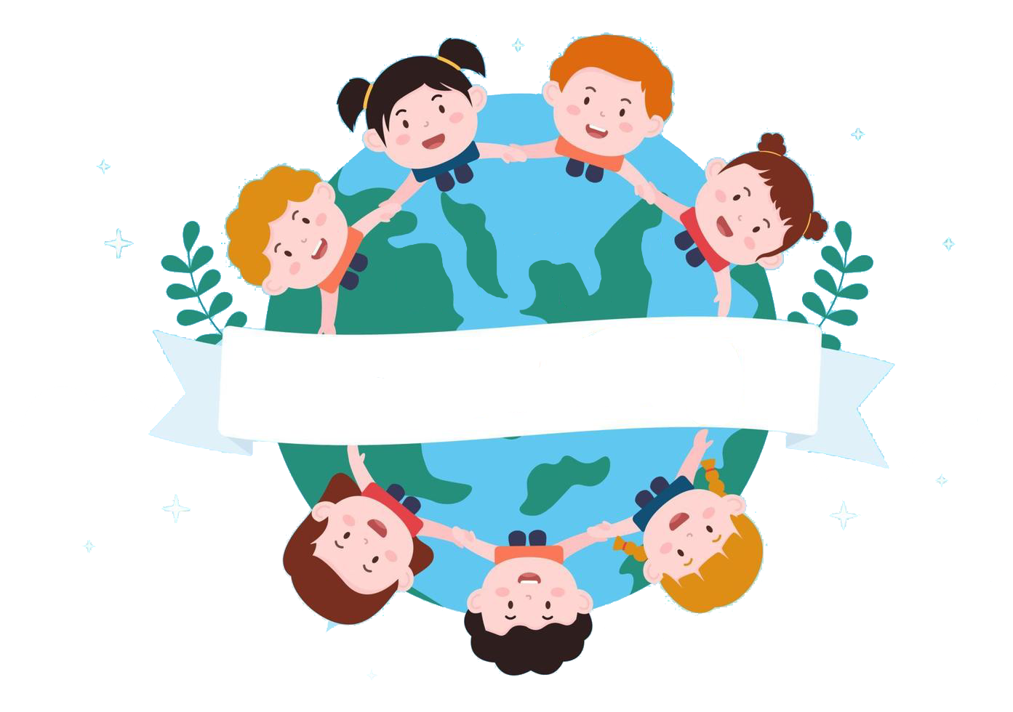

Thank you
& goodbye!

