Slide 1























Slide 2
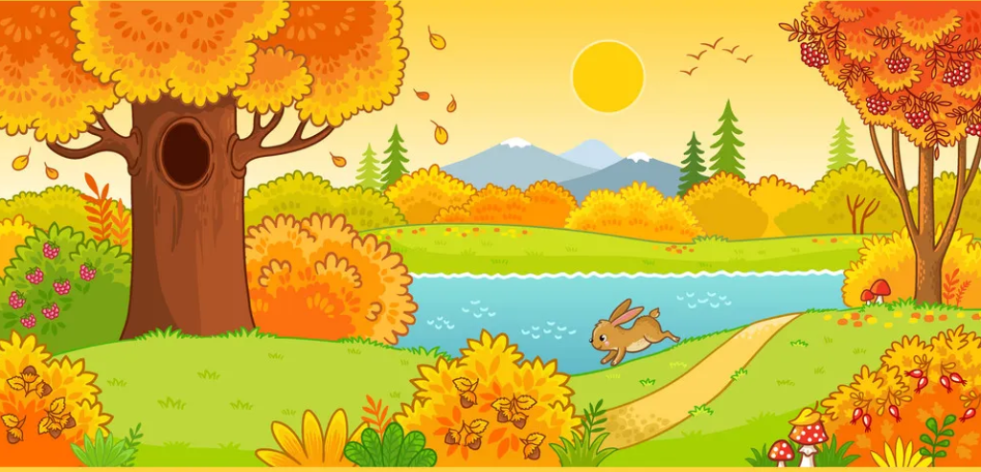



Unit 10
Our World
Lesson 3 – Task 1,2,3

Slide 3
1
Warm Up

Slide 4
Matching Game

Slide 5
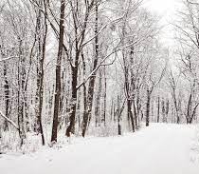
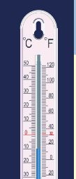
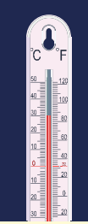


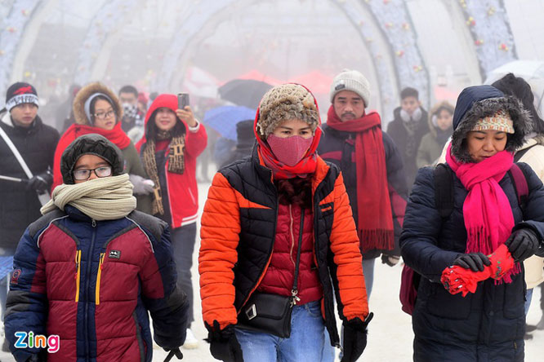
a
b
c
d
1.summer
2.hot
3.sunny
4.winter
5.cold
e
f
6.snowy

Slide 6
2
Presentation

Slide 7


How’s the weather like in each season?
How many seasons are there in a year?
What are they?

Slide 8


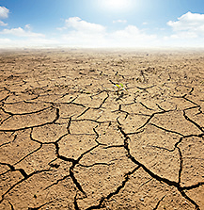
1
Listen and point. Repeat.
It’s …
It’s dry.
dry.

Slide 9
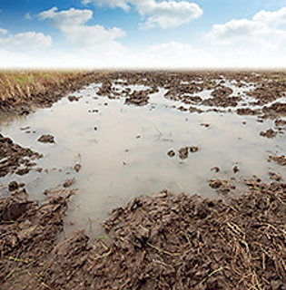
It’s …
It’s wet.
wet.

Slide 10

It’s …
It’s spring.
spring.

Slide 11
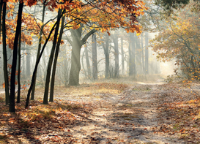
It’s …
It’s autumn.
autumn.

Slide 12
Listen and match game

Slide 13


Audio 1
Audio 2
1. It’s spring.
2. It’s wet.
3. It’s dry.
Audio 3
Audio 4
4. It’s autumn.

Slide 14
It’s …
dry.
wet.
spring.
autumn.

Slide 15
3
Practice

Slide 16

Season festival

Slide 17
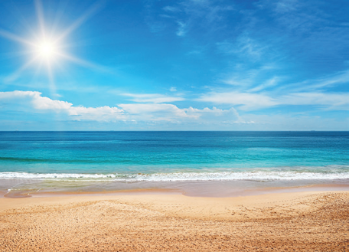
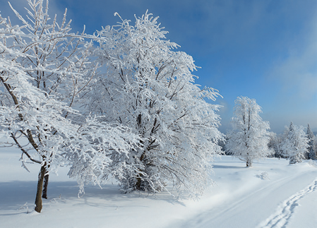
spring
summer
autumn
winter

Slide 18

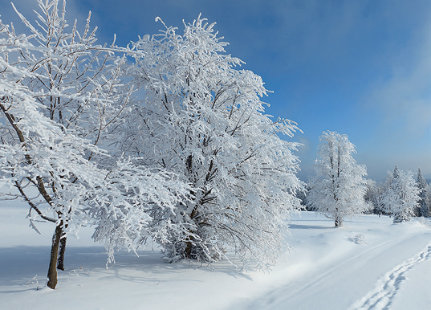

summer
winter
It’s dry and sunny.
It’s cold and wet.

Slide 19
2
Listen and match.
1. In spring,
a. I go to the sea.
2. In summer,
b. I go to school.
3. In autumn,
c. I go to the park.
4. In winter,
d. I play at home.

Slide 20

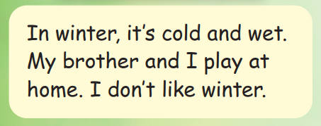
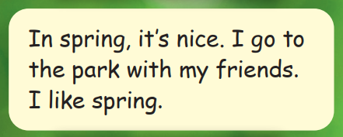
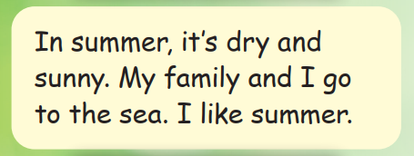
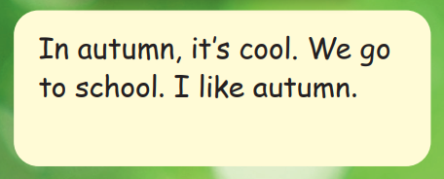
A
Read
and
match
B
C
D

Slide 21
4
Production
Speaking contest

Slide 22

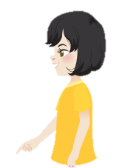
It’s spring.
I go to the park.

Slide 23
5
Assessment

Slide 24
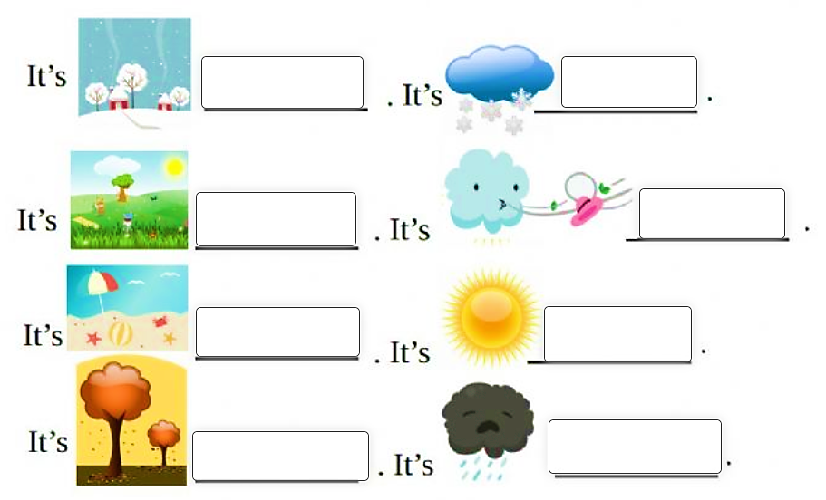
Fill in the blanks
winter
snowy
spring
windy
summer
sunny
autumn
rainy
Notes:
HOẠT ĐỘNG TƯƠNG TÁC

Slide 25




Thank you & goodbye!

