Slide 1

Presentation
Unit 1 – Lesson 1
Tell the time
Notes:
Our lesson today is: Unit 2 – Lesson 1: Tell the time

Slide 2
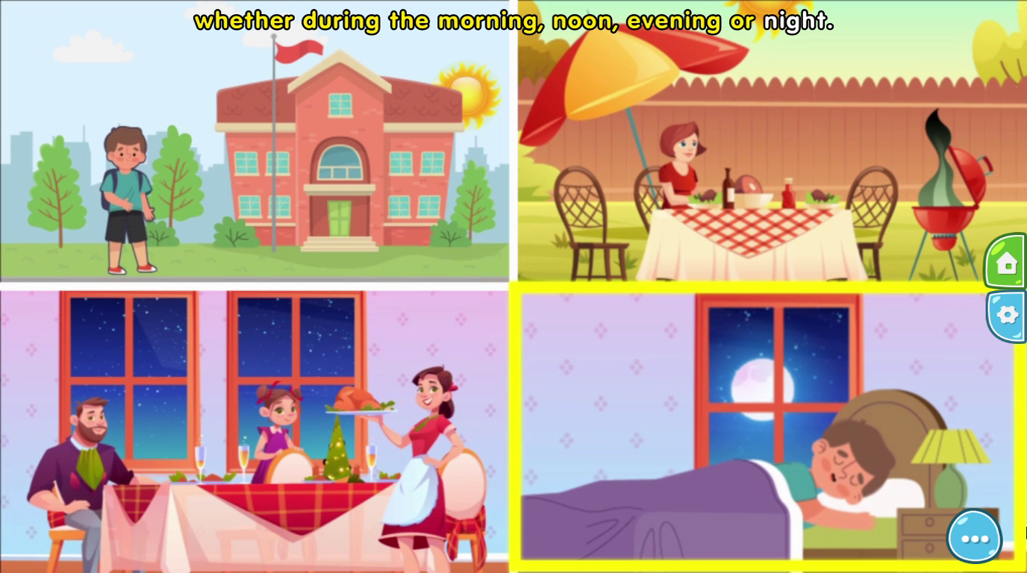
Tell the time
Notes:
Get started the lesson by reading the sentence in this picture.

Slide 3
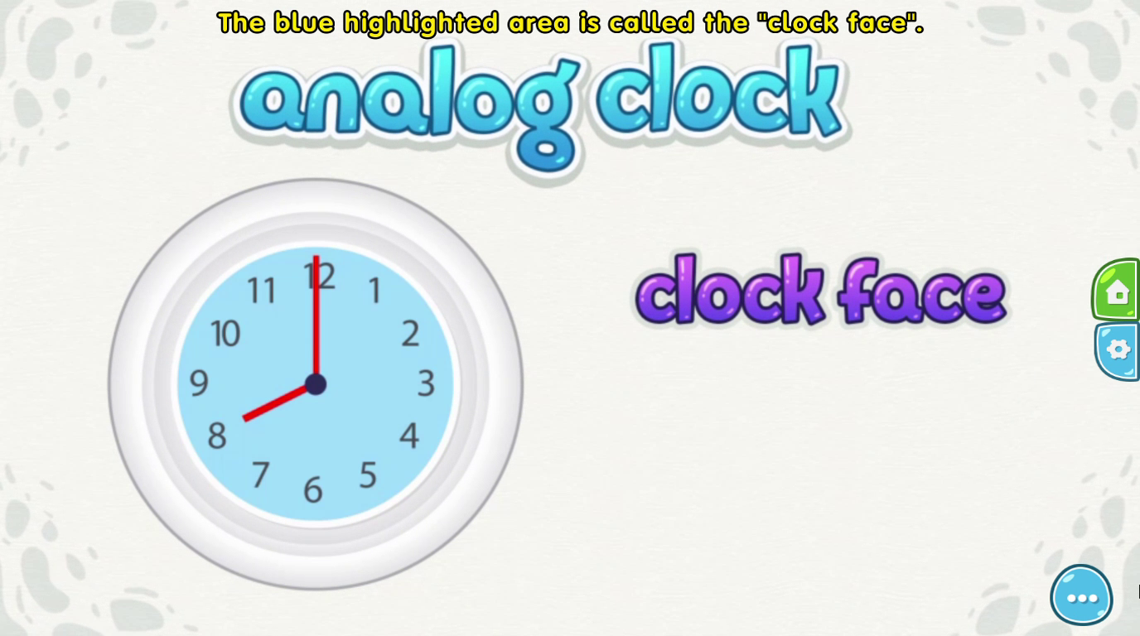
Tell the time
Notes:
(point and say the sentence) ------ invite the whole class say 2 times: clock face

Slide 4
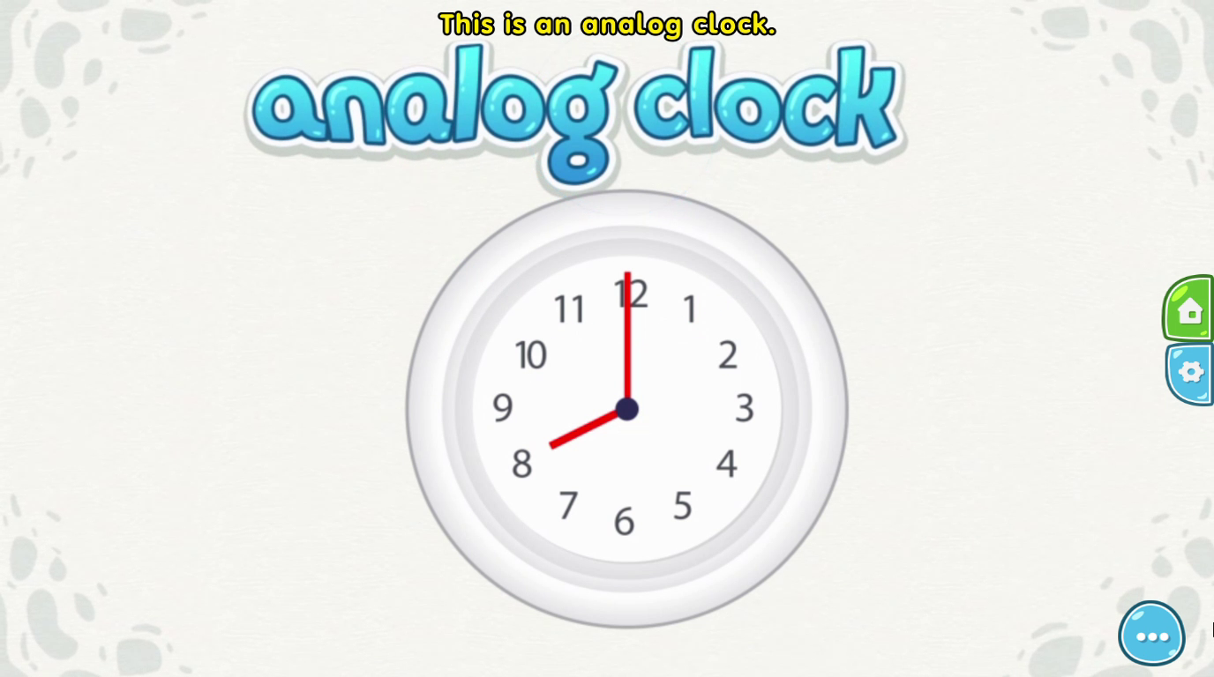
Tell the time
Notes:
Look! (point and say) This is an analog clock------ invite the whole class say 2 times

Slide 5
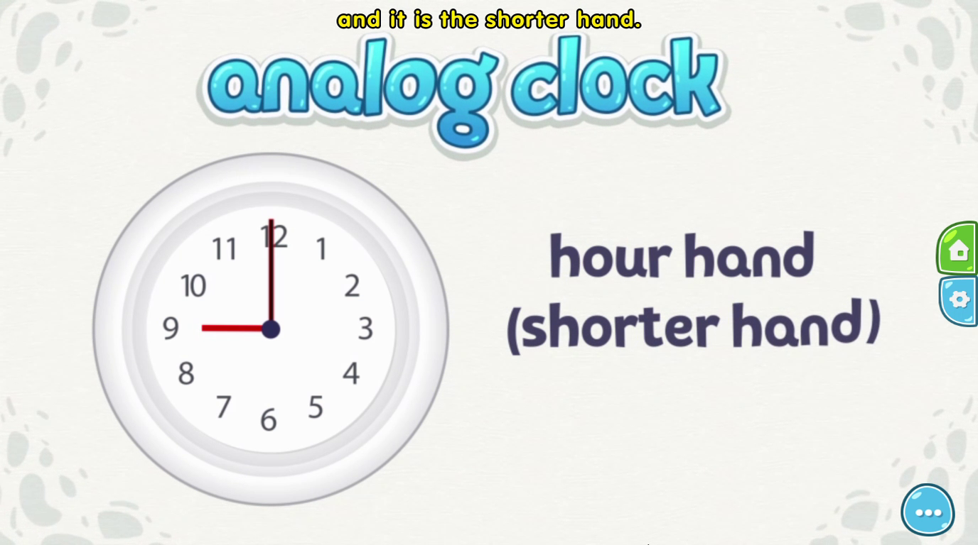
Tell the time
Notes:
Look! (point and say) This is an hour hand, and it is the shorter hand------ invite the whole class say 2 times

Slide 6
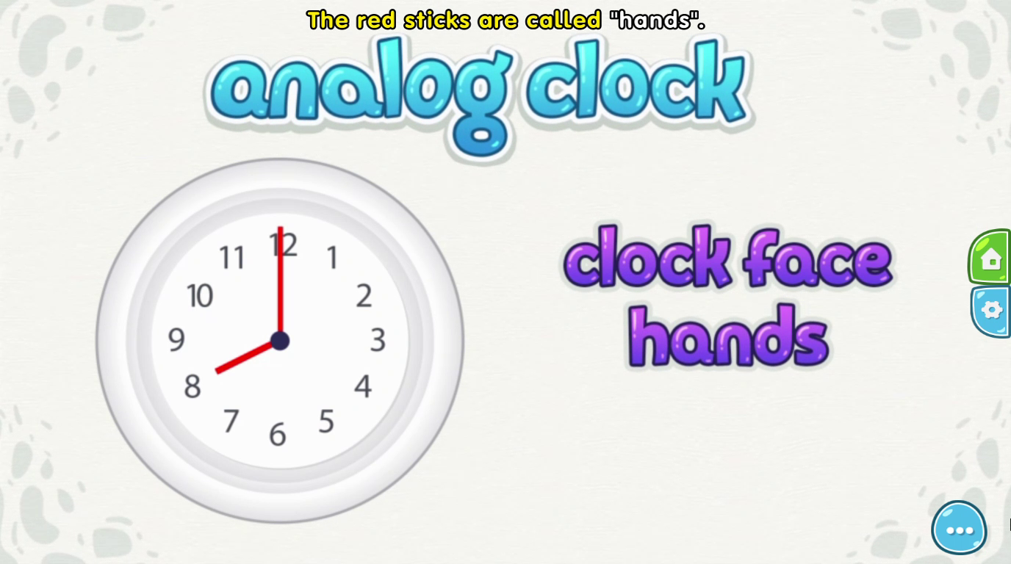
Tell the time
Notes:
(point and say) The red sticks are called “hands”------ invite the whole class say 2 times

Slide 7
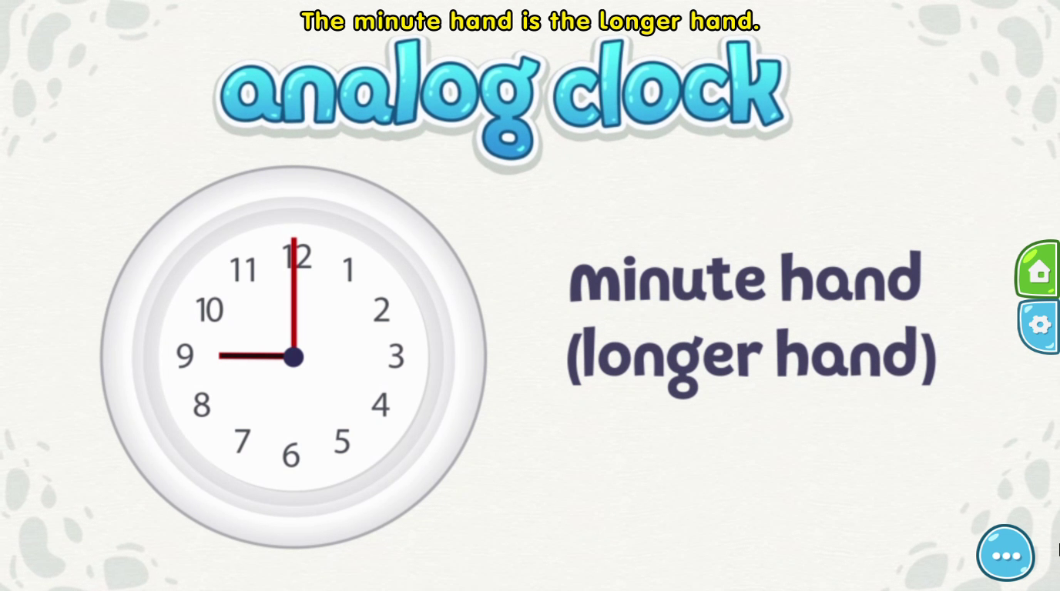
Tell the time
Notes:
(point and say) The minute hand is the longer hand

Slide 8
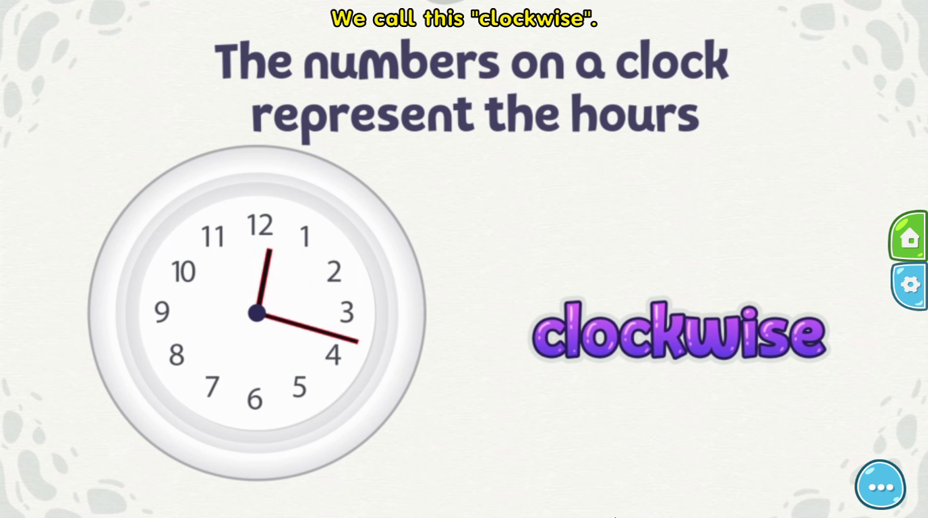
Tell the time
Notes:
Look! (point and say the sentence in the picture)----- invite the whole class say 2 times: clockwise------- invite some students

Slide 9
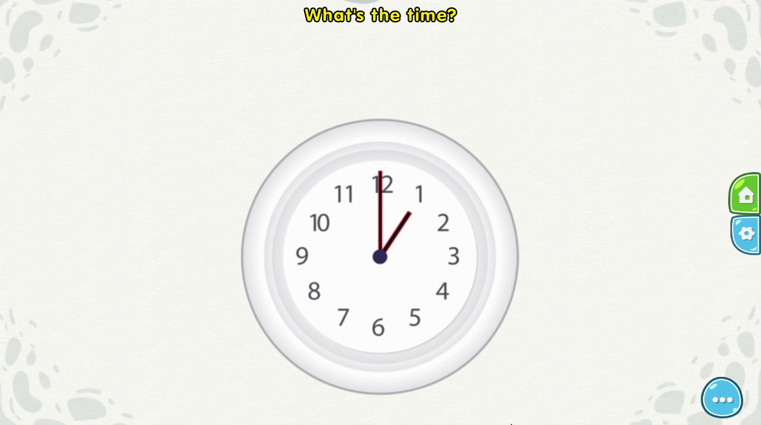

Tell the time
When the longer hand or the minute hand is pointing to the number 12 and the shorter hand or the hour hand is pointing to one of the hour numbers, we call this o’clock.

Slide 10

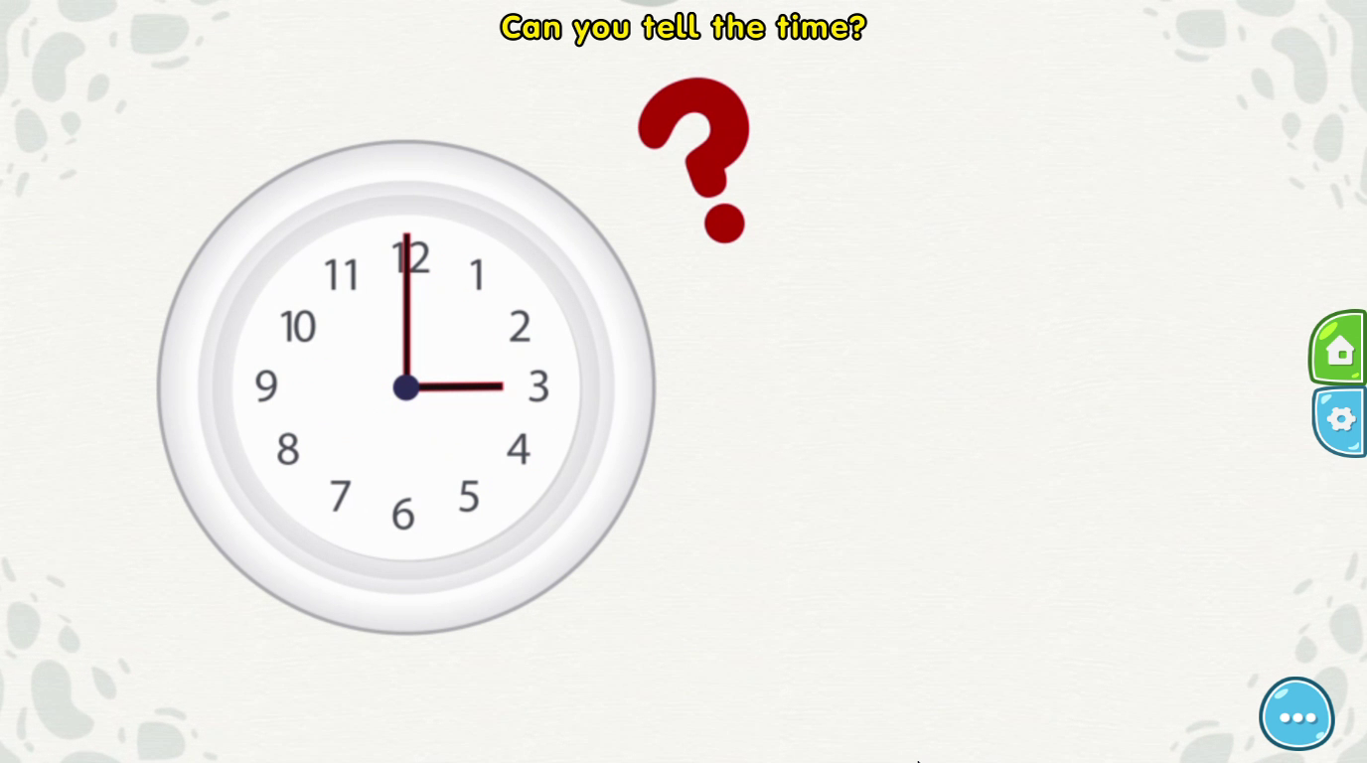
Tell the time
Notes:
Invite some students to answer the question

Slide 11
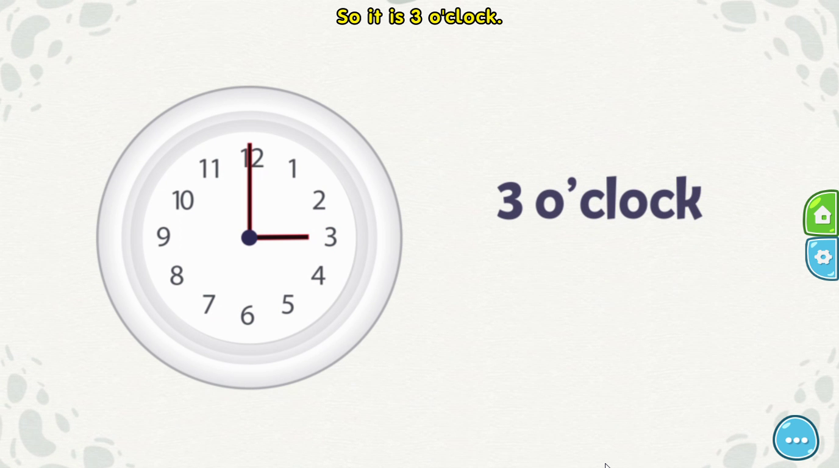
Tell the time
Notes:
Very good! It’s 3 o’clock (because the longer hand is pointing to the number 12 and the shorter hand is pointing to the number 3)

Slide 12
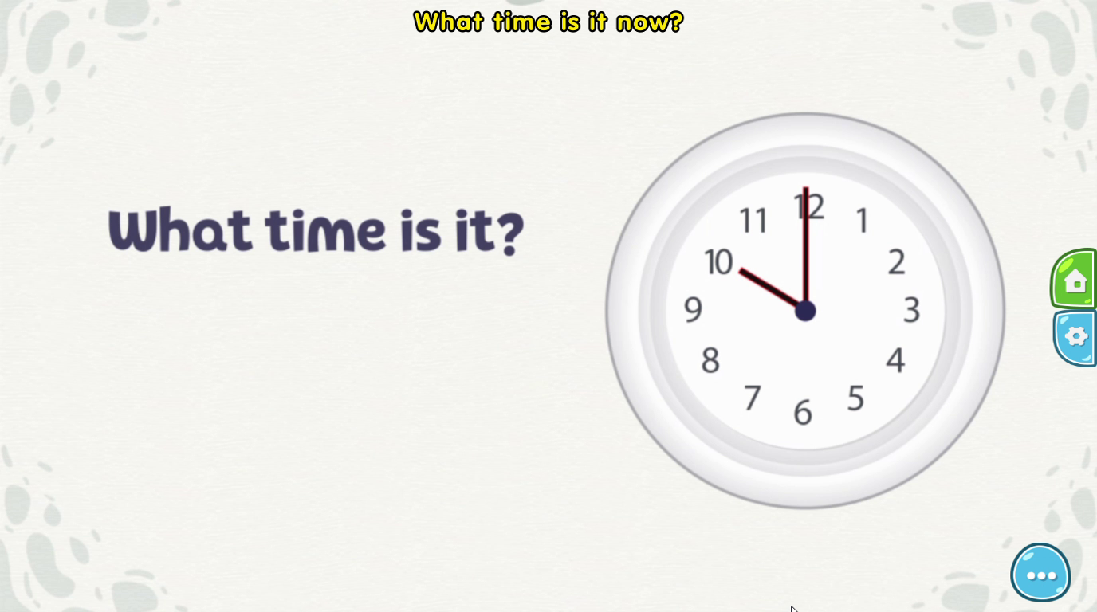

Tell the time
Notes:
Invite some students to answer the question (maybe explain)

Slide 13
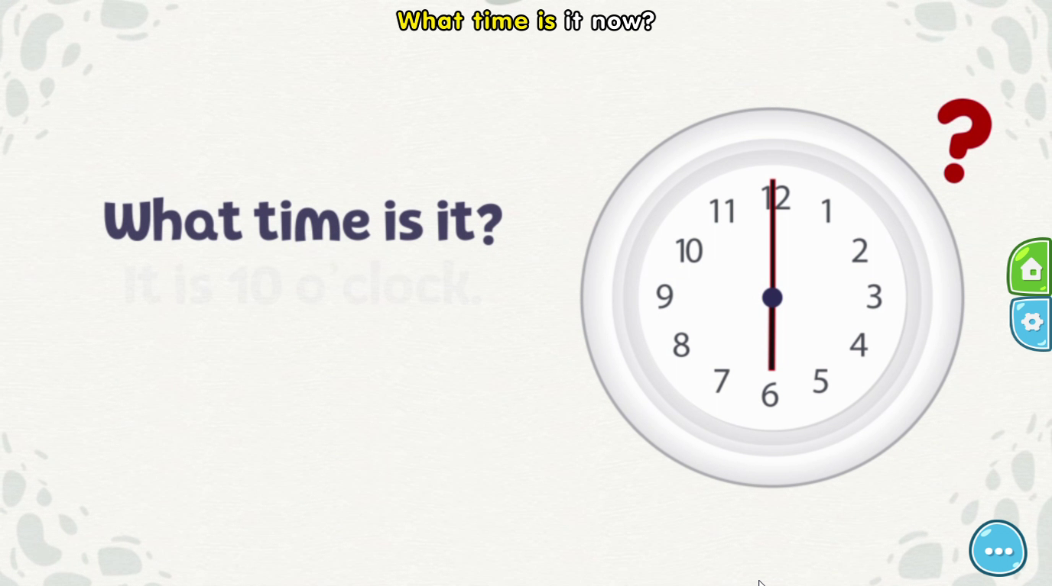

Tell the time
Notes:
Invite some students to answer the question (maybe explain)

Slide 14
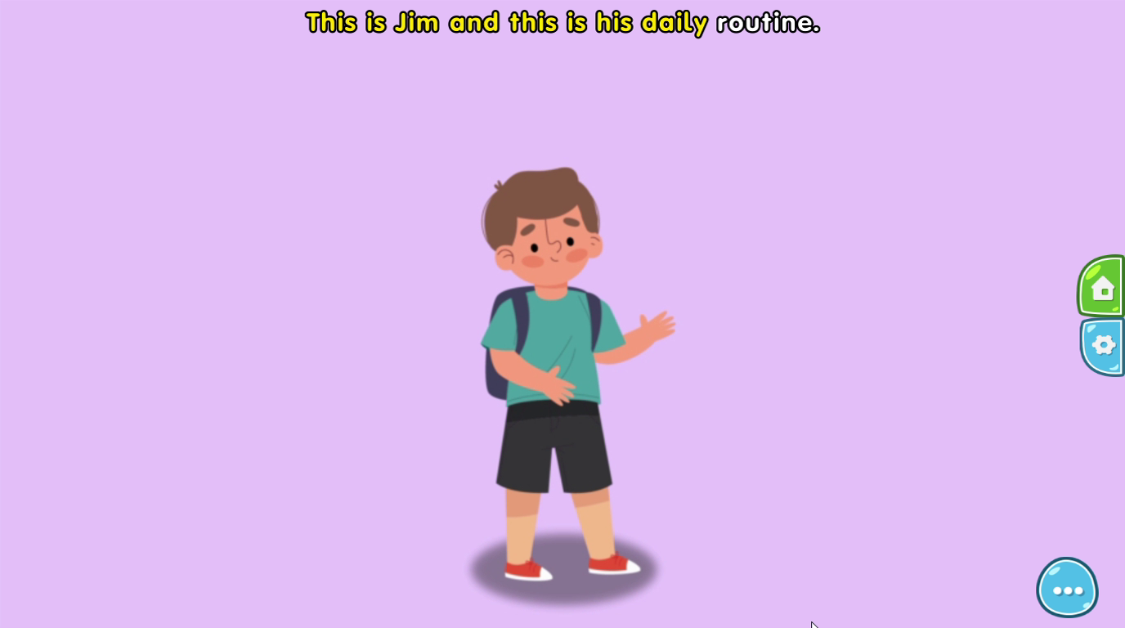
Tell the time
Notes:
Introduce and say hello to Jim

Slide 15
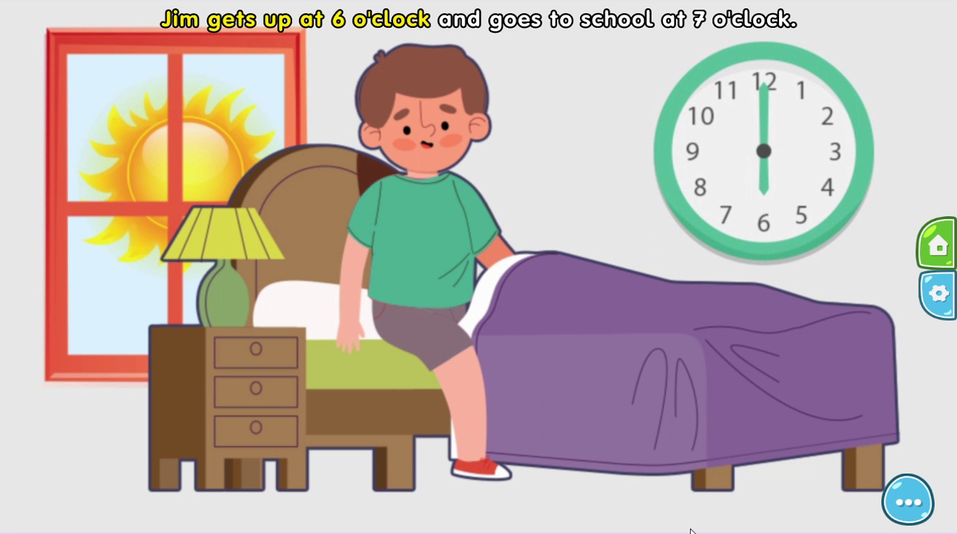
Tell the time
Notes:
Ask students what time does Jim get up? ----- invite some students

Slide 16
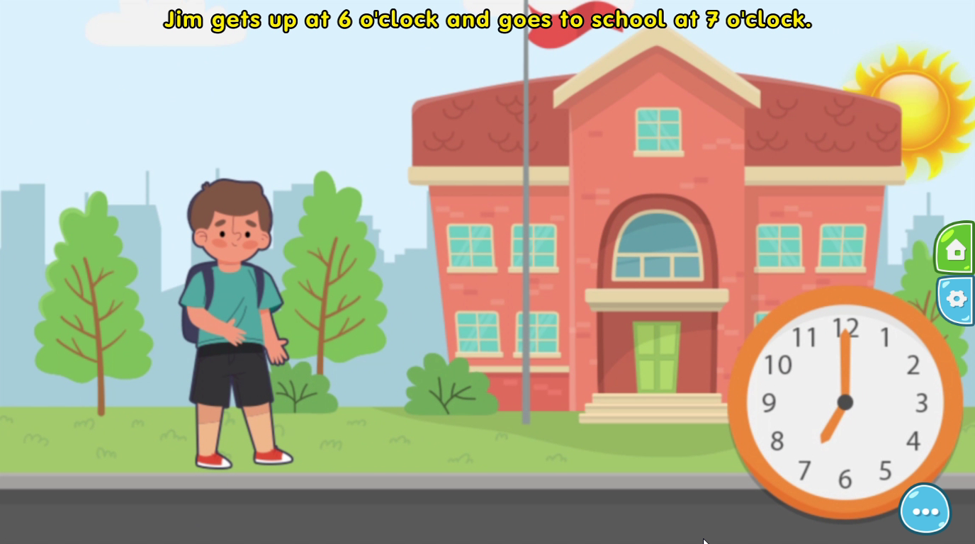
Tell the time
Notes:
Ask students what time does Jim go to school? ----- invite some students

Slide 17
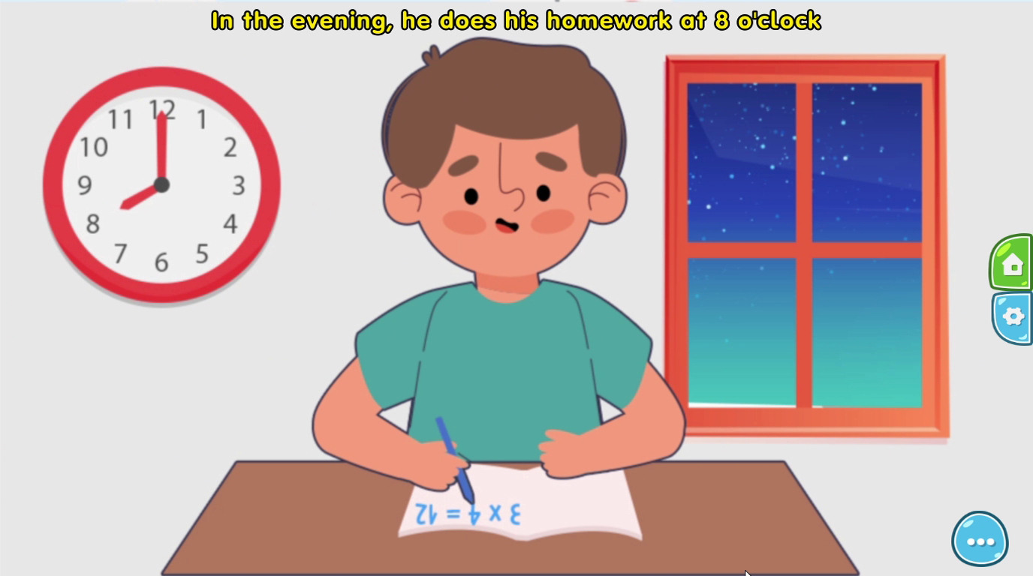
Tell the time
Notes:
Ask students what time does Jim do his homework? ----- invite some students

Slide 18
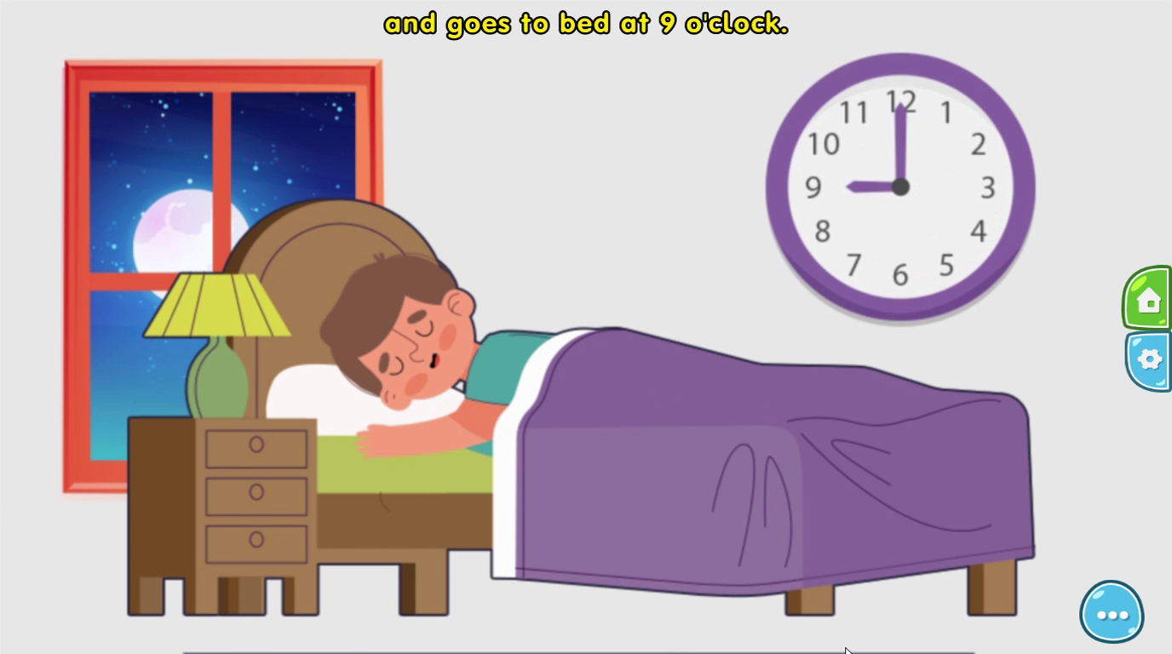
Tell the time
Notes:
Ask students what time does Jim go to bed? ----- invite some students

Slide 19
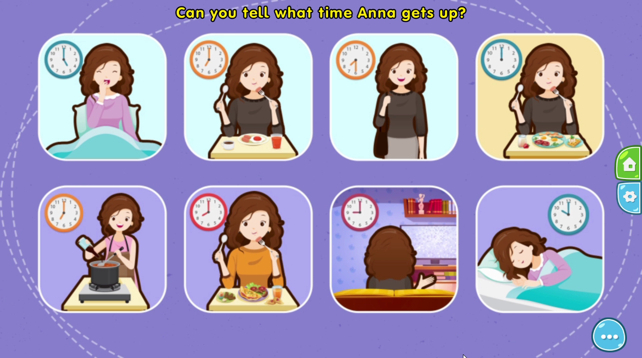
Tell the time
Notes:
Introduce and say hello to Anna. Ask students some question about Anna’s routine (point to the picture and ask)

Slide 20
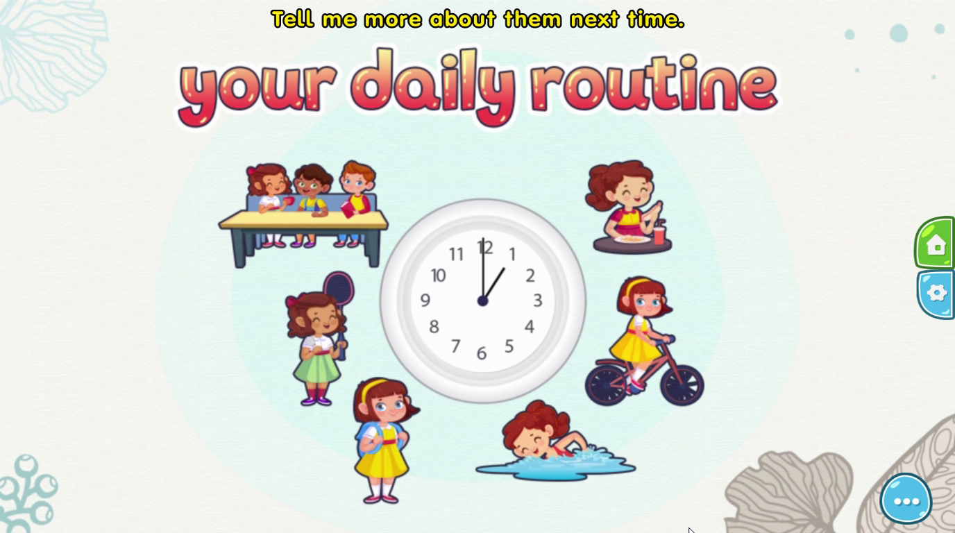
Tell the time
Notes:
Ask students about their daily routine

Slide 21
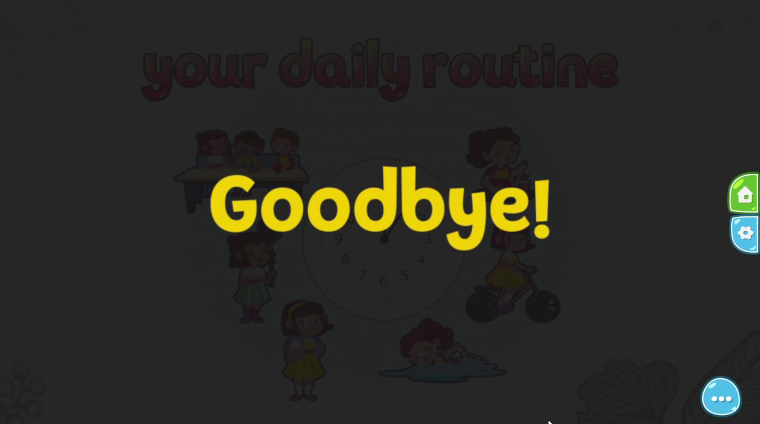
Tell the time
Notes:
Goodbye! Let’s go to the vocabulary part to practice more.

Slide 22
Vocabulary
Unit 2 – Lesson 1
Tell the time
Notes:
Let’s practice more in the vocabulary part.

Slide 23
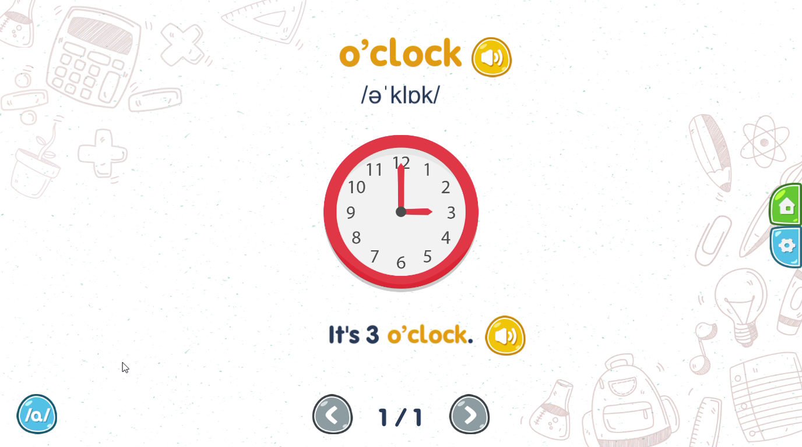
Vocabulary
Notes:
O’clock (point and say)-- very good. O’clock (x3). Point to the sentence and say: It’s 3 o’clock-----invite some students.

