Slide 1

Presentation
Unit 2 – Lesson 2
Measuring capacity

Slide 2
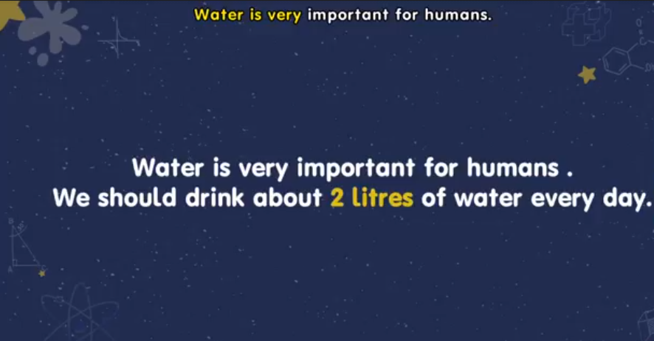
Measuring mass

Slide 3
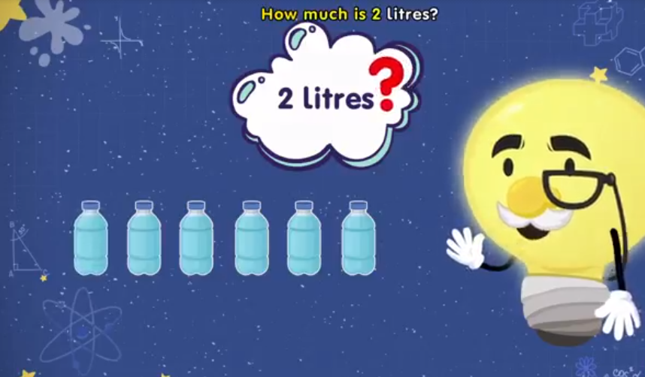
Measuring mass

Slide 4
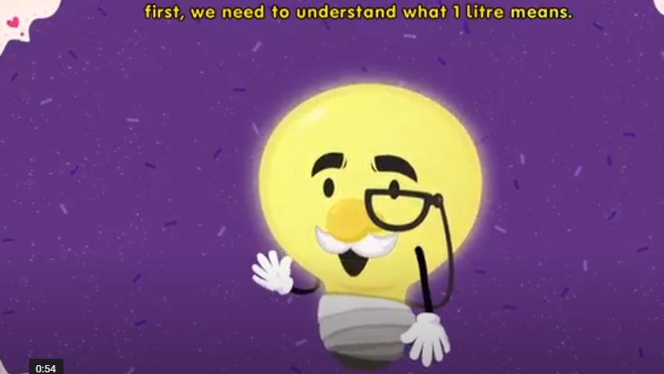
Measuring mass

Slide 5
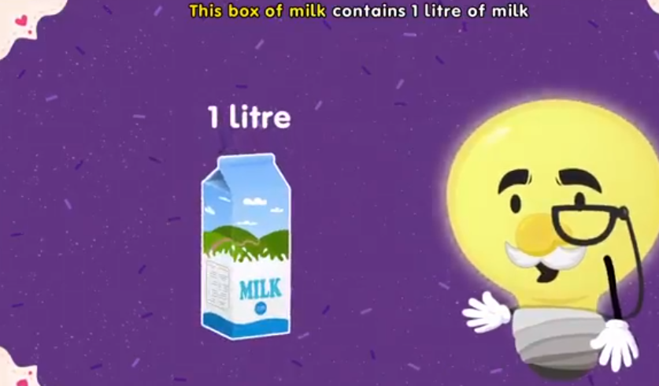
Measuring mass

Slide 6
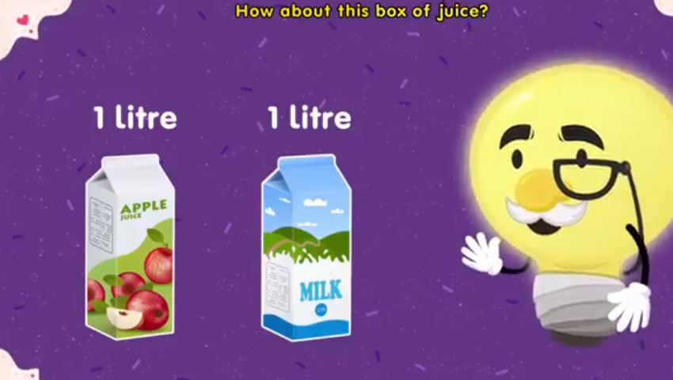
Measuring mass

Slide 7
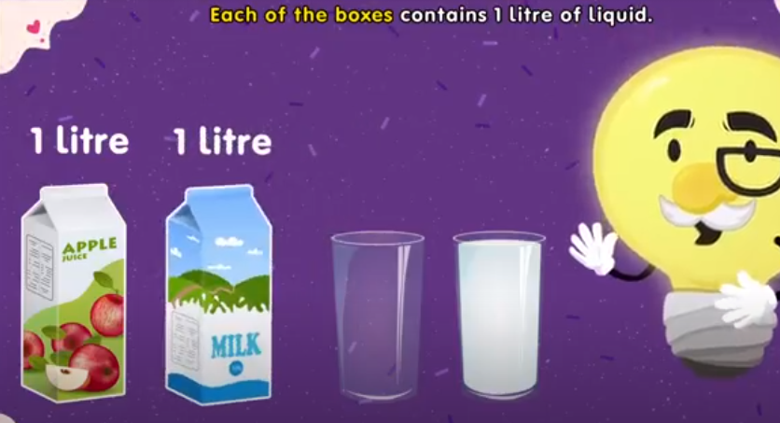
Measuring mass

Slide 8
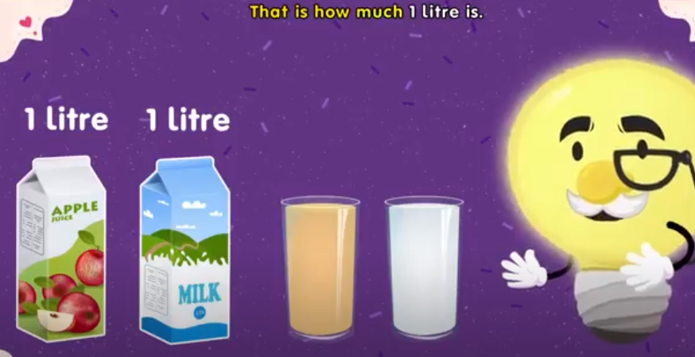
Measuring mass

Slide 9
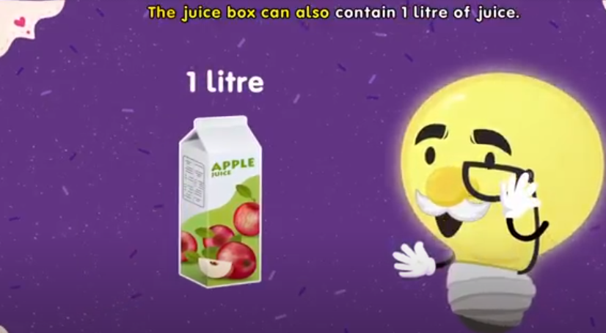
Measuring mass

Slide 10
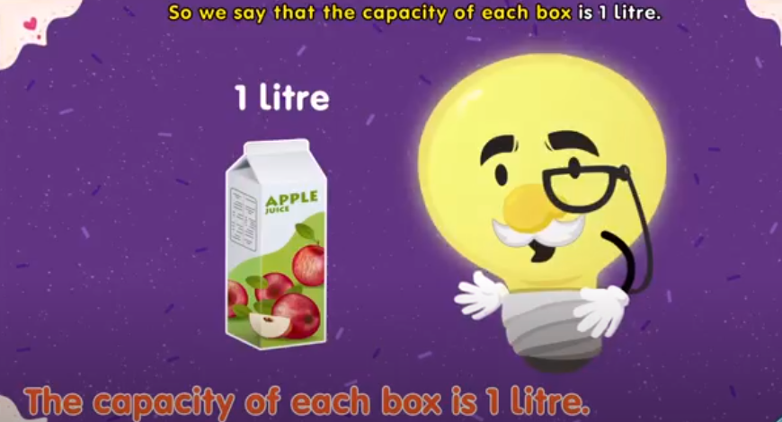
Measuring mass

Slide 11
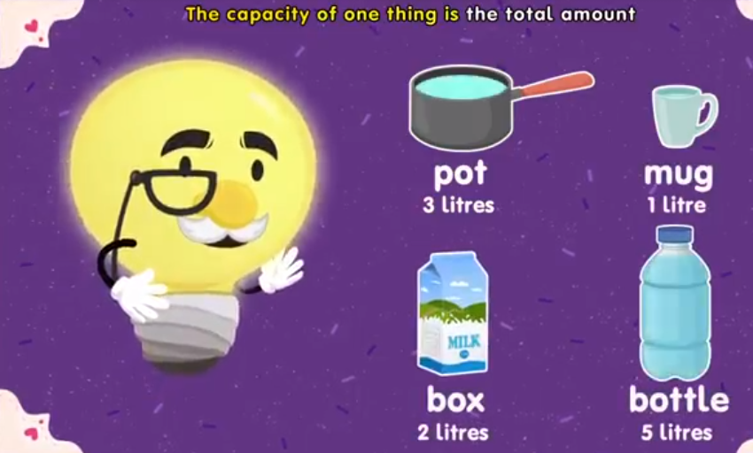
Measuring mass

Slide 12
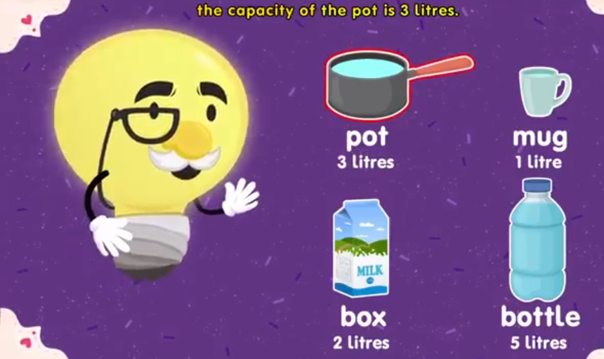
Measuring mass
The capacity of the … is…

Slide 13
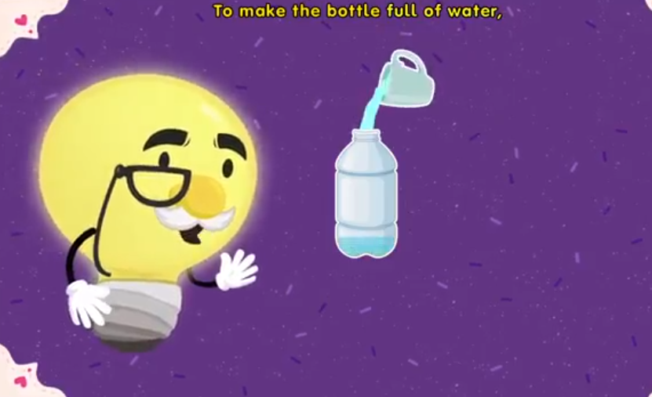
Measuring mass
How many mugs
do we need to
make full of water?

Slide 14
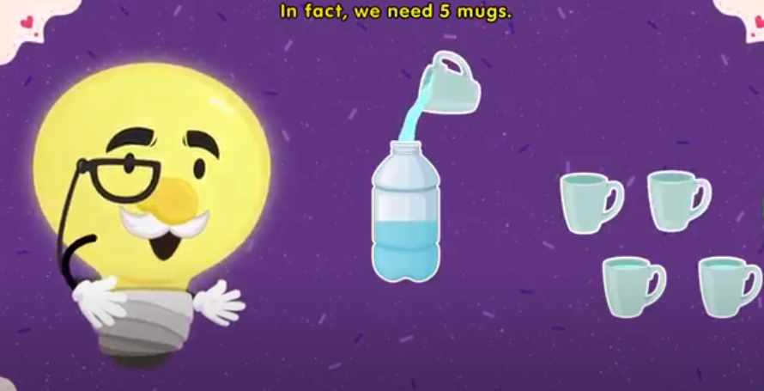
Measuring mass

Slide 15
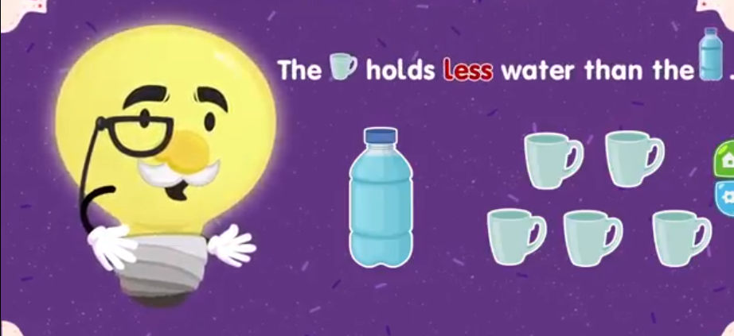
Measuring mass

Slide 16
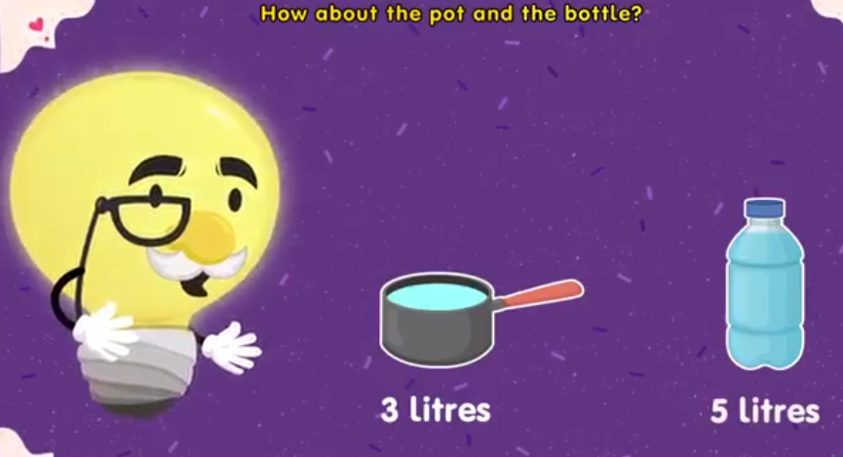
Measuring mass

Slide 17
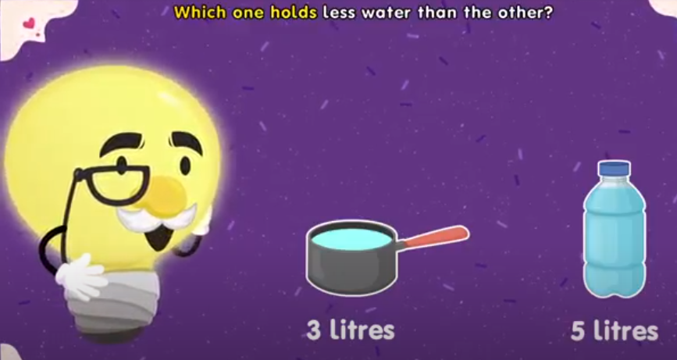
Measuring mass

Slide 18
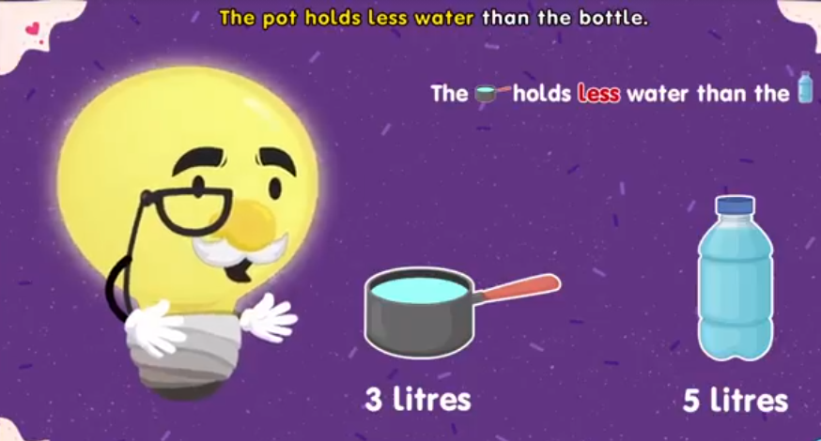
Measuring mass

Slide 19
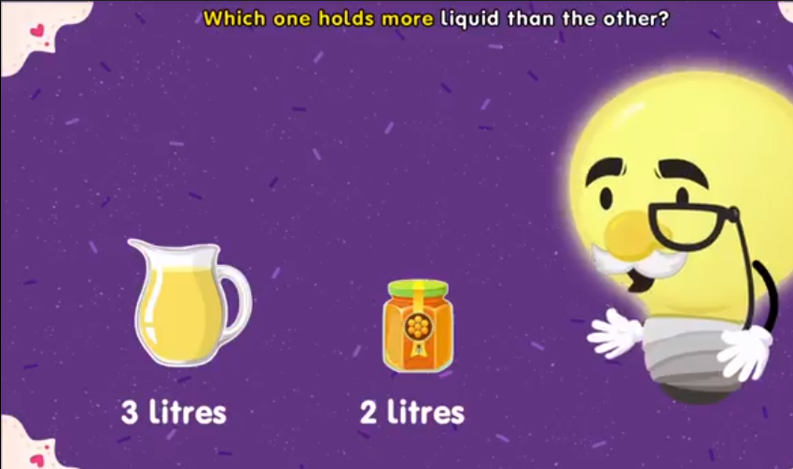
Measuring mass

Slide 20
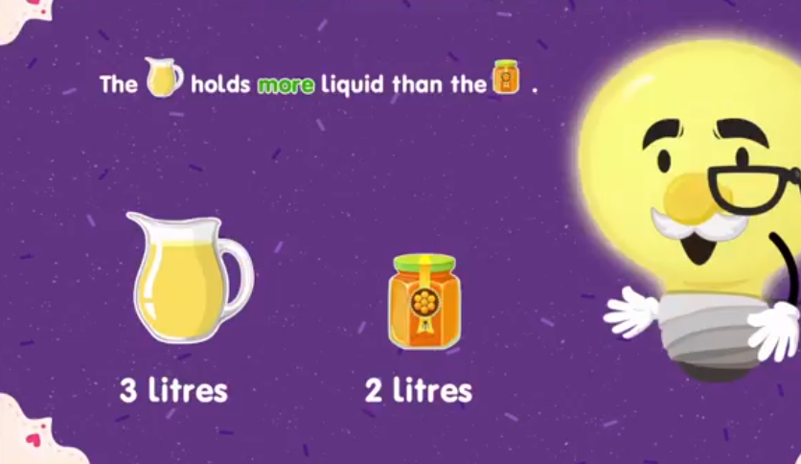
Measuring mass

Slide 21
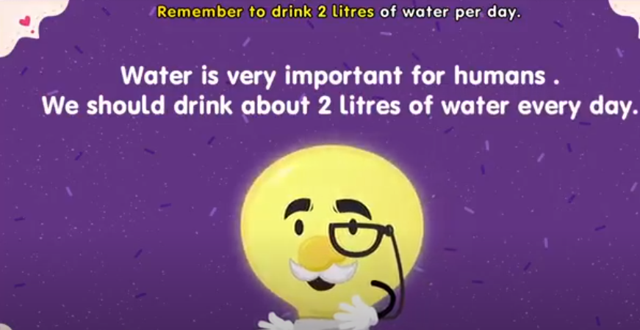
Measuring mass

Slide 22
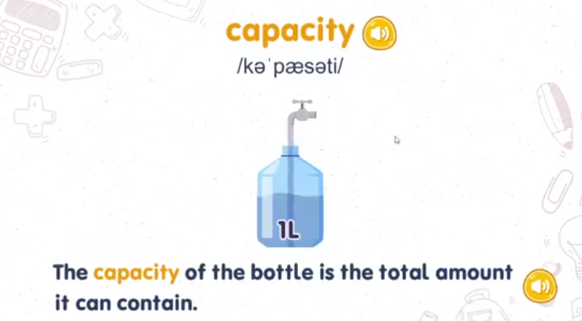
Presentation

Slide 23
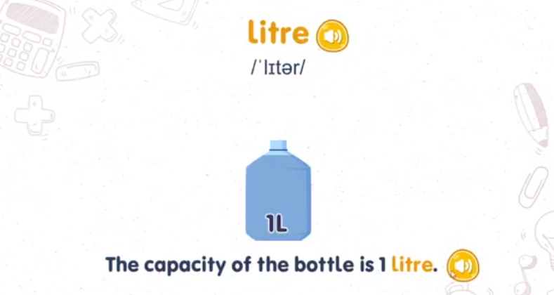
Presentation

