Slide 1

Presentation
Unit 2 – Lesson 1
Measuring mass

Slide 2
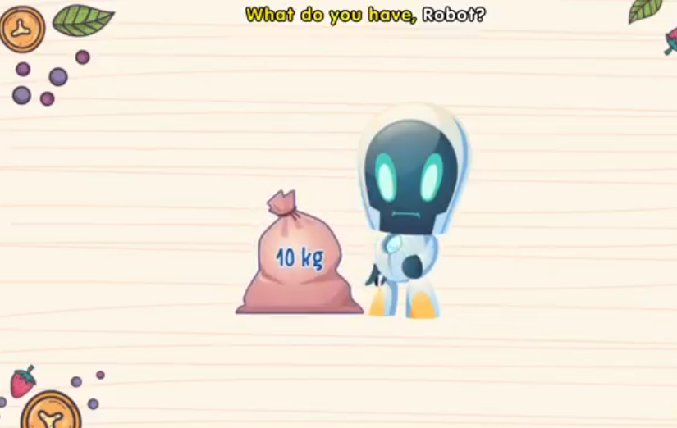
Measuring mass

Slide 3
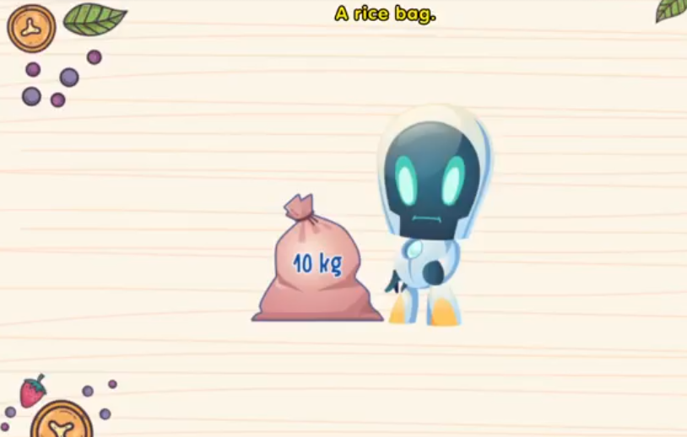
Measuring mass

Slide 4
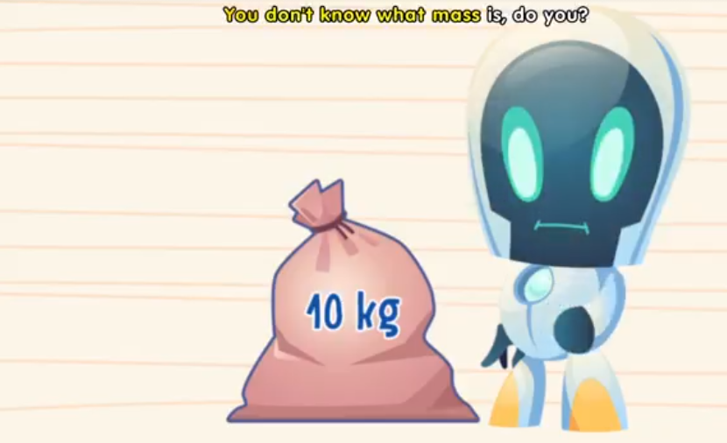
Measuring mass

Slide 5
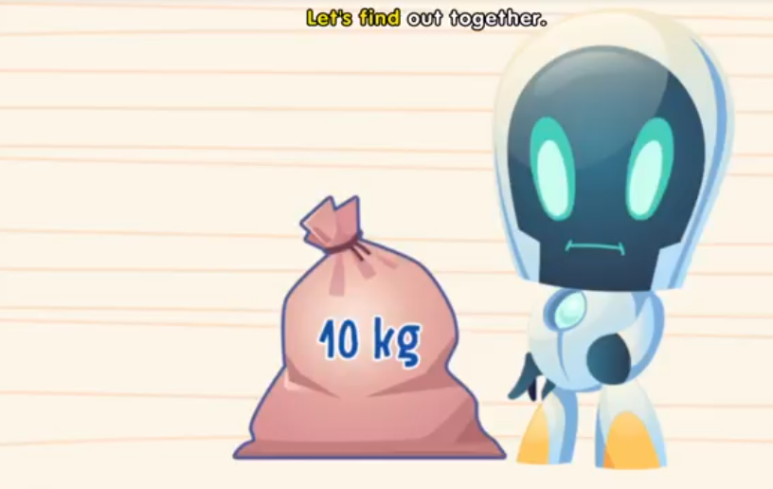
Measuring mass

Slide 6
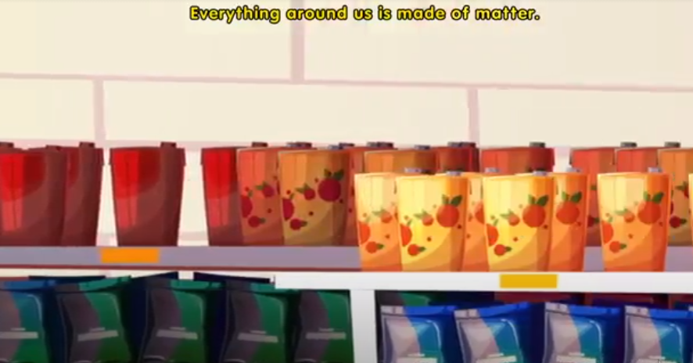
Measuring mass

Slide 7
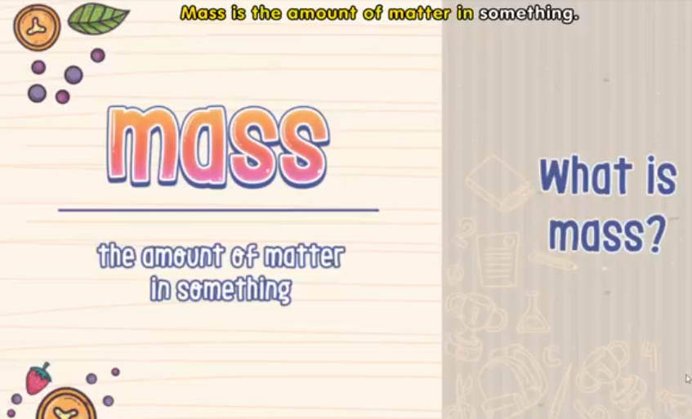
Measuring mass

Slide 8
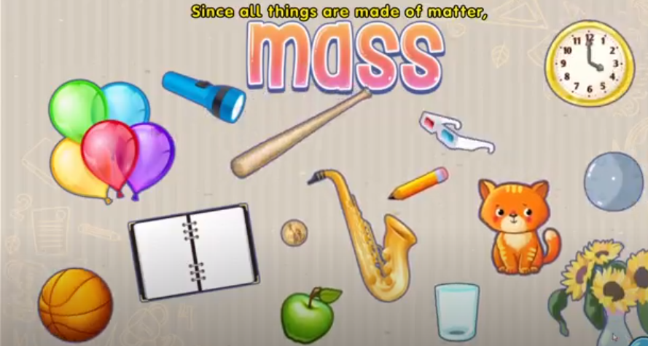
Measuring mass

Slide 9
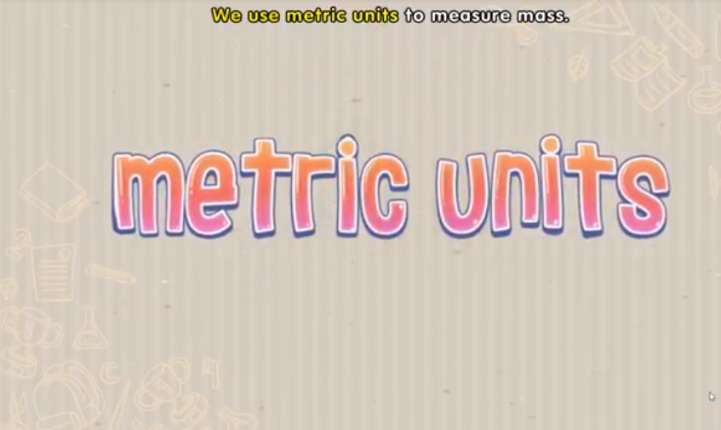
Measuring mass

Slide 10
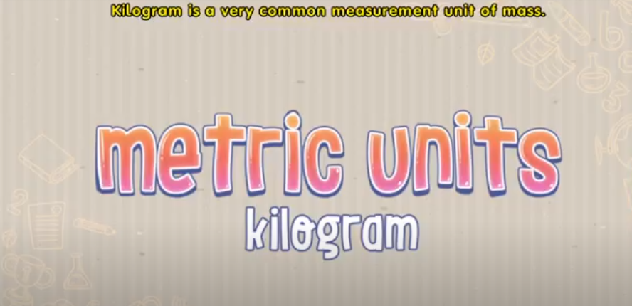
Measuring mass

Slide 11
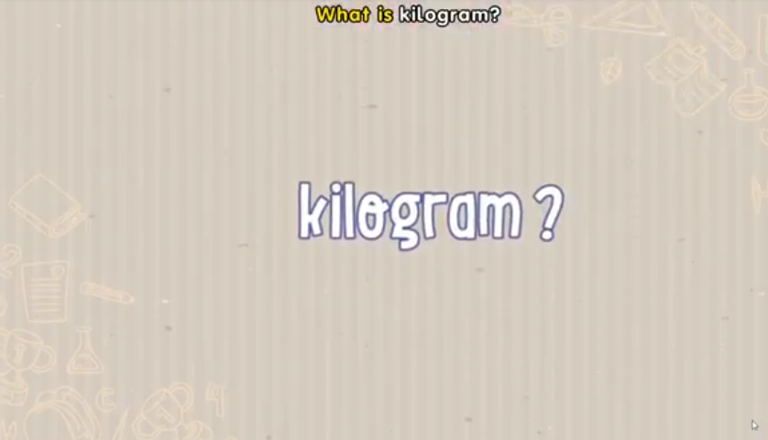
Measuring mass

Slide 12

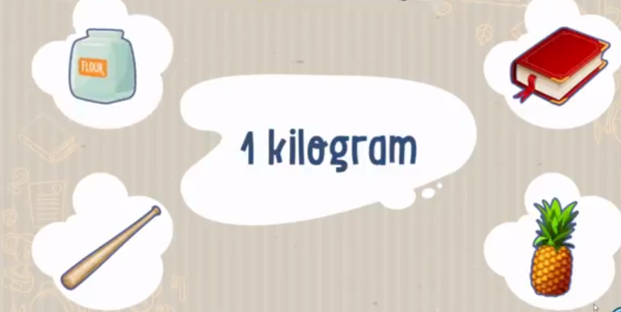
Measuring mass

Slide 13

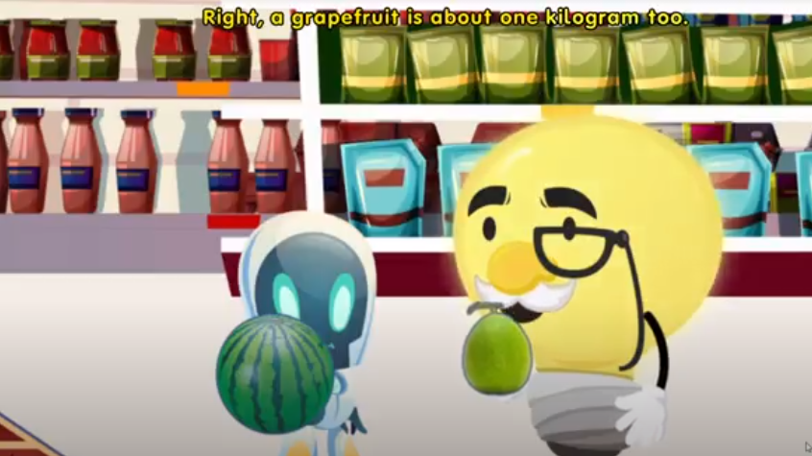
Measuring mass

Slide 14
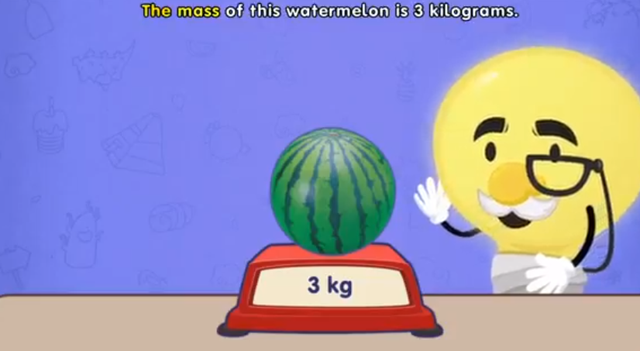
Measuring mass

Slide 15
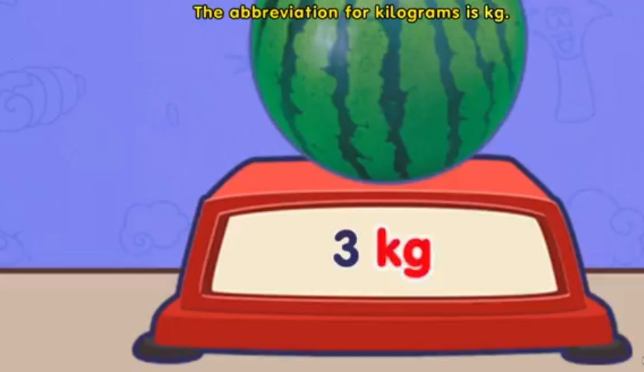
Measuring mass

Slide 16
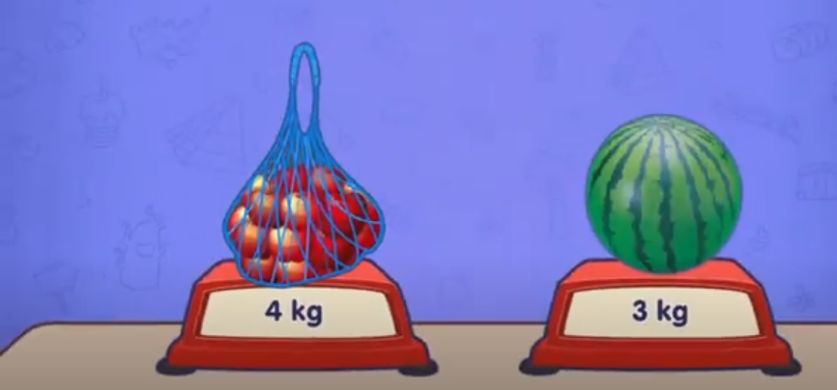
Measuring mass
Let’s compare mass of apples and mass of a watermelon

Slide 17
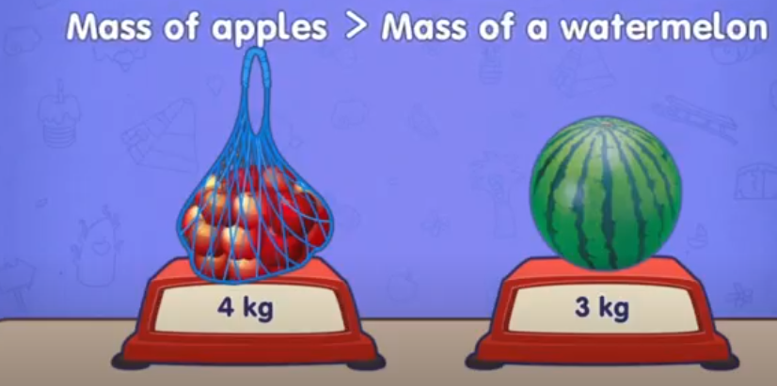
Measuring mass

Slide 18
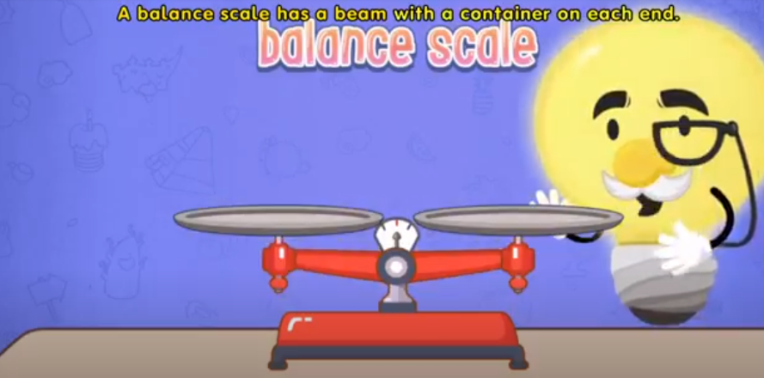
Measuring mass

Slide 19
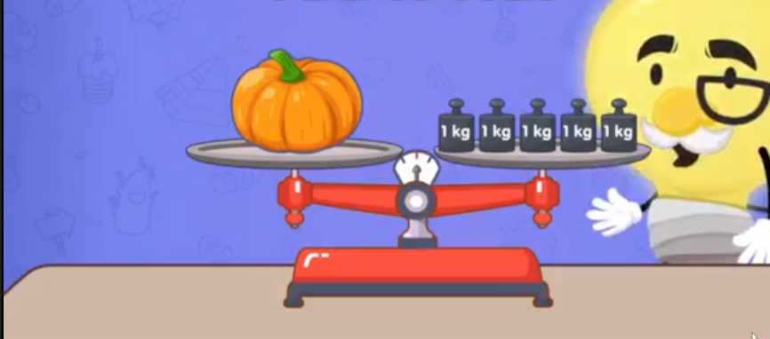
Measuring mass

Slide 20
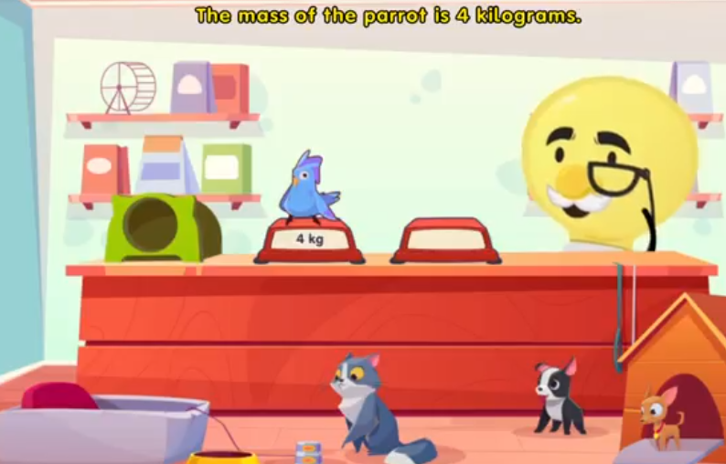
Measuring mass

Slide 21
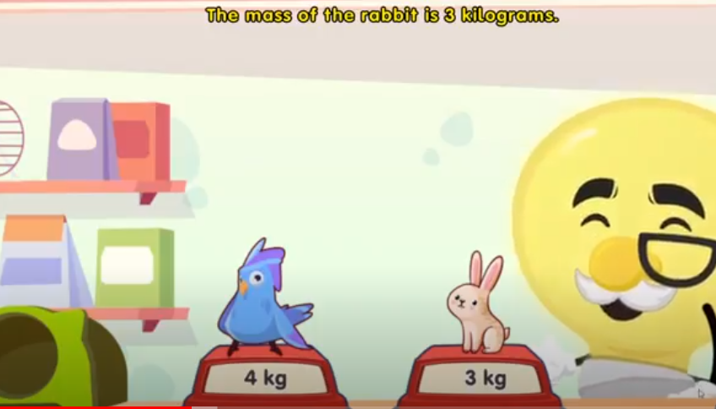
Measuring mass
Let’s compare mass of a parrot and mass of a rabbit

Slide 22
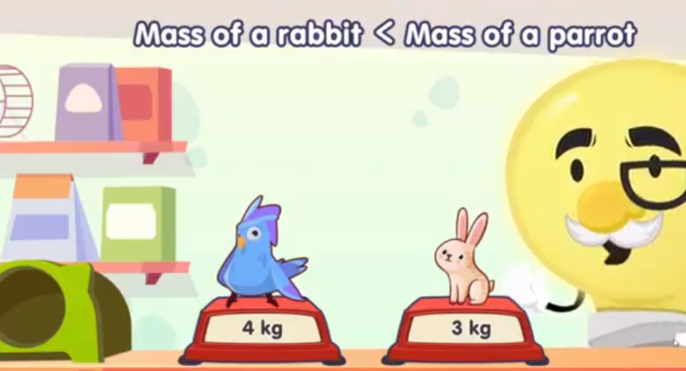
Measuring mass

Slide 23
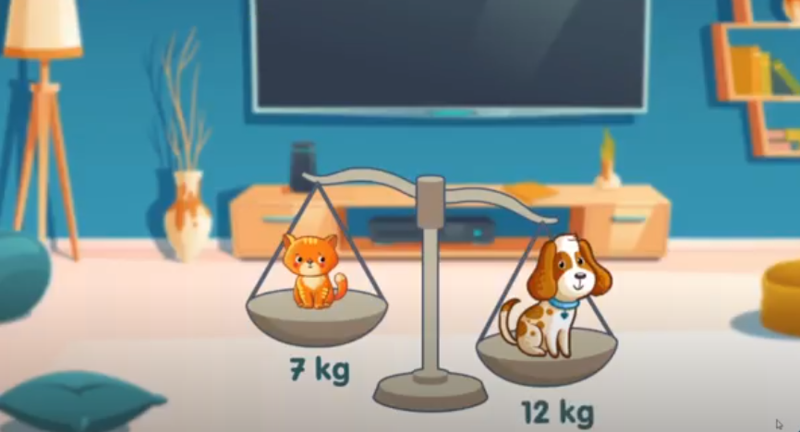

Measuring mass
Let’s compare mass of a cat and mass of a dog

Slide 24
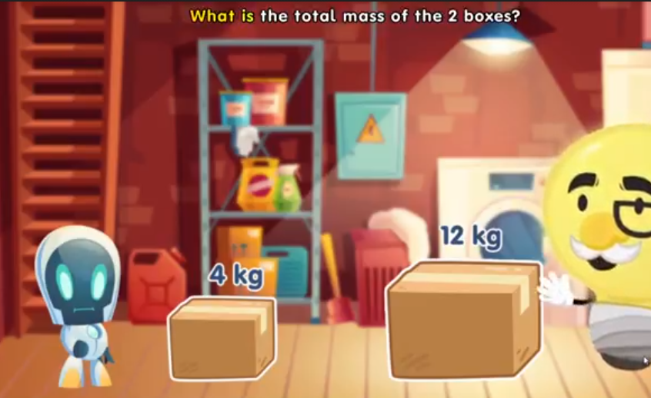
Measuring mass

Slide 25

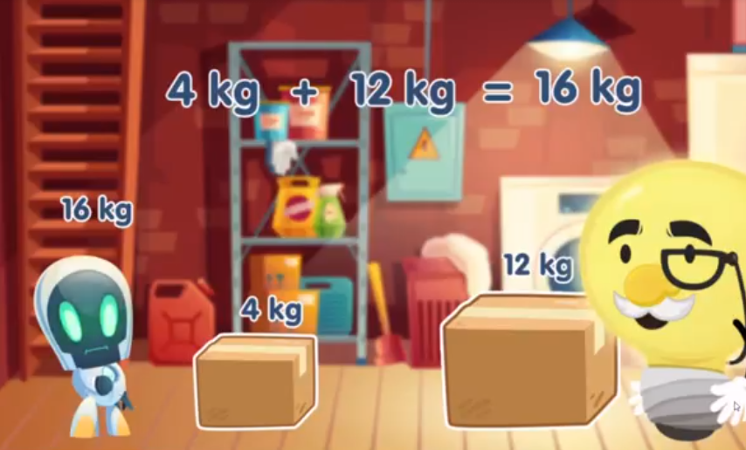
Measuring mass

Slide 26
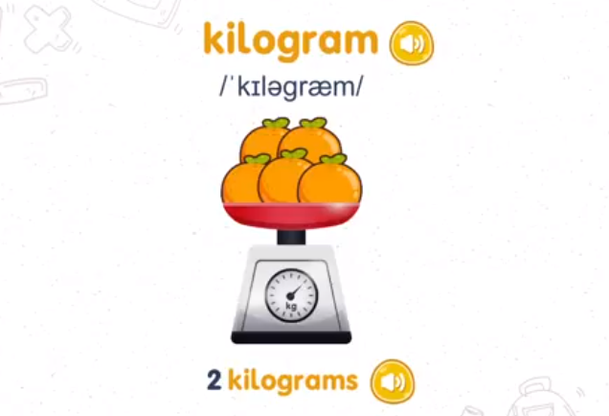
Presentation

Slide 27
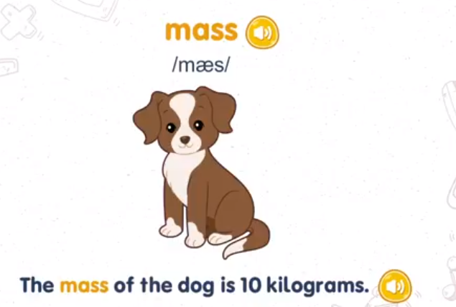
Presentation

Slide 28
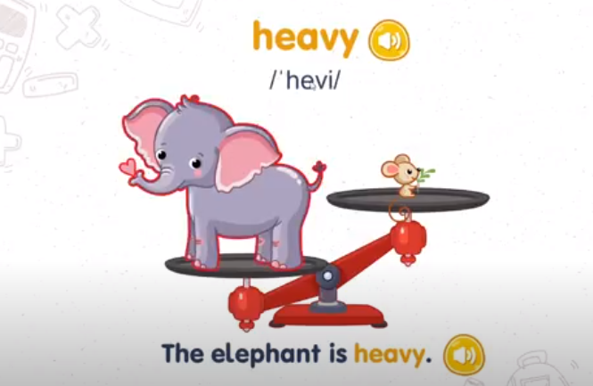
Presentation

Slide 29
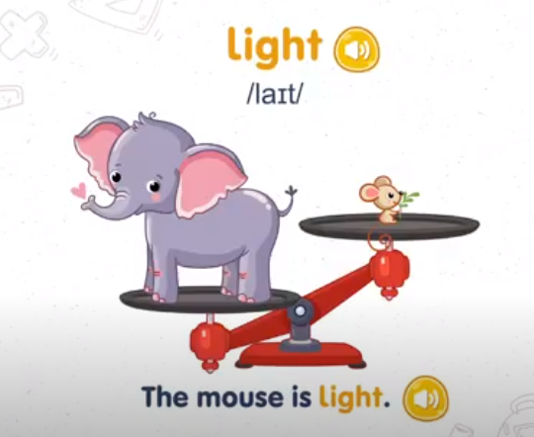
Presentation

