Slide 1

Presentation
Unit 3 – Lesson 2:
Cylinder and Sphere

Slide 2
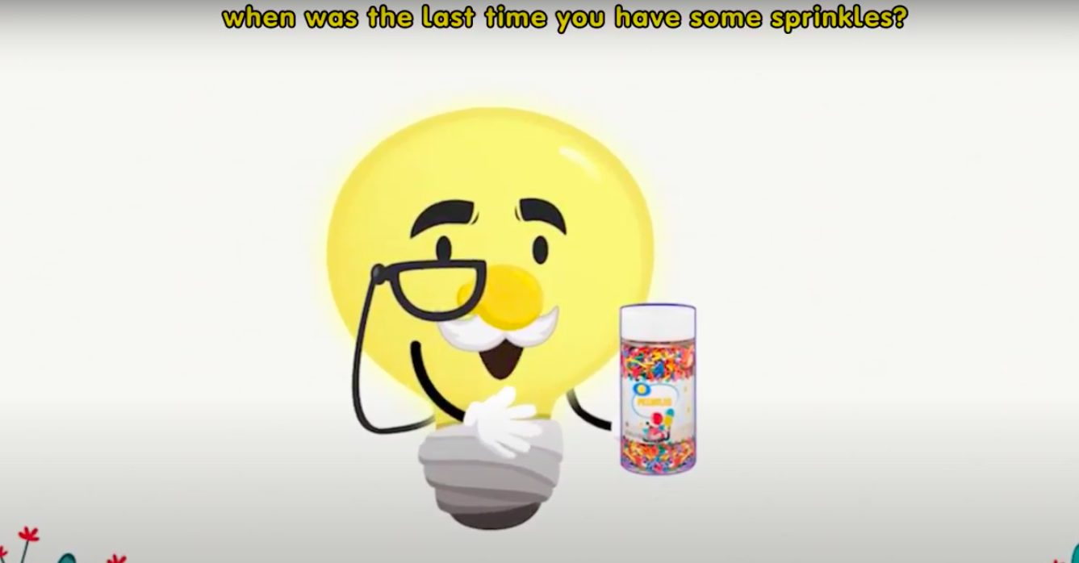
Cylinder and Sphere

Slide 3
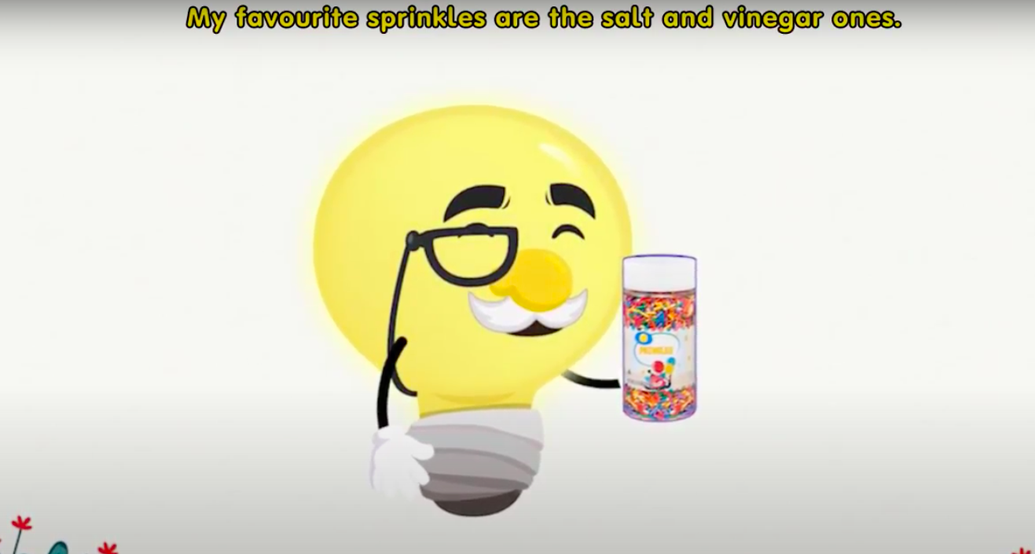
Cylinder and Sphere

Slide 4
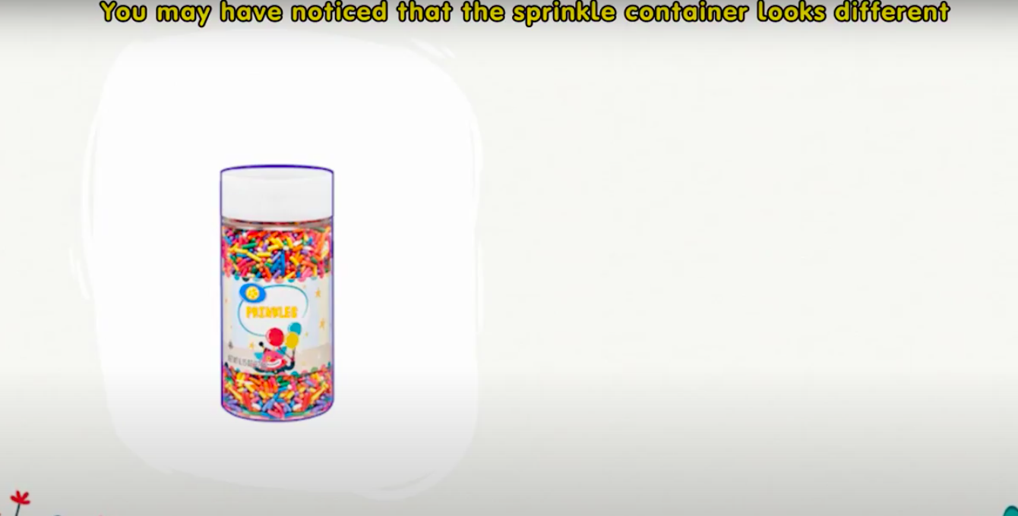
Cylinder and Sphere

Slide 5
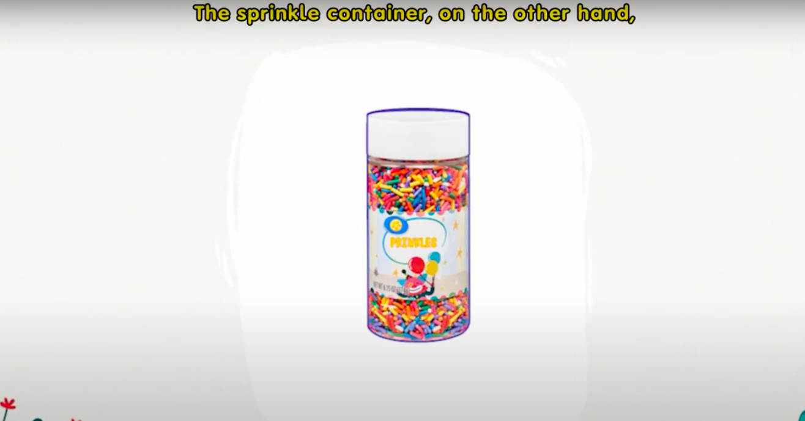
Cylinder and Sphere

Slide 6
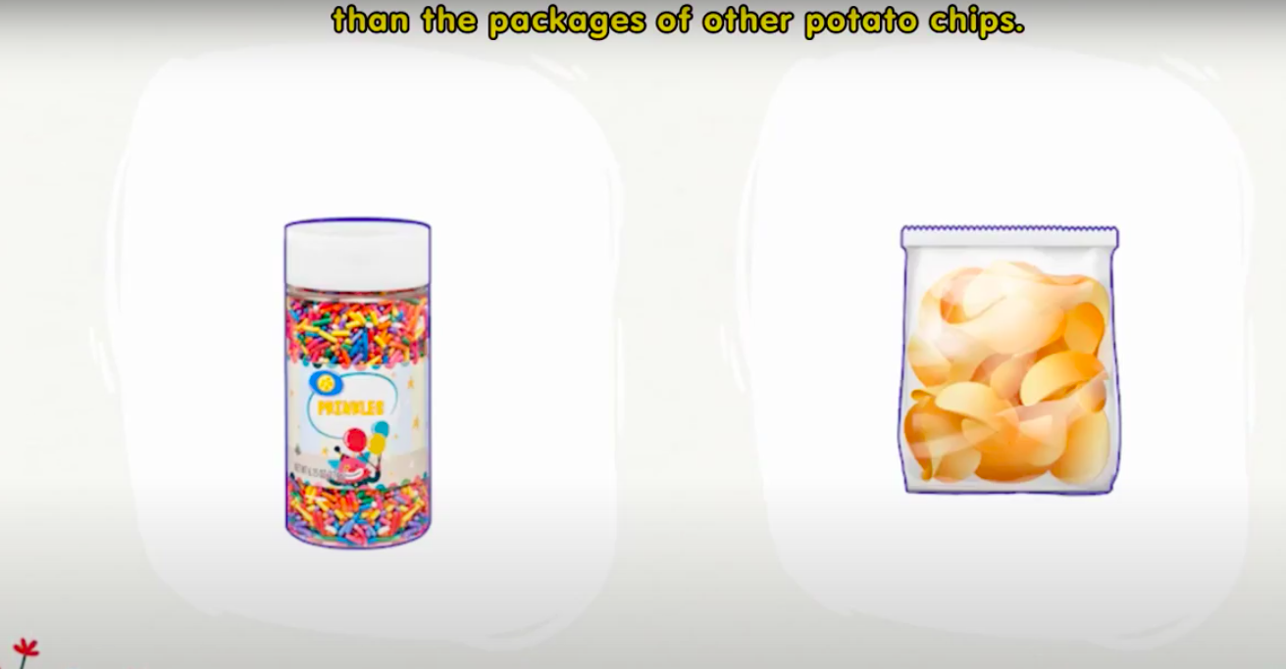
Cylinder and Sphere

Slide 7
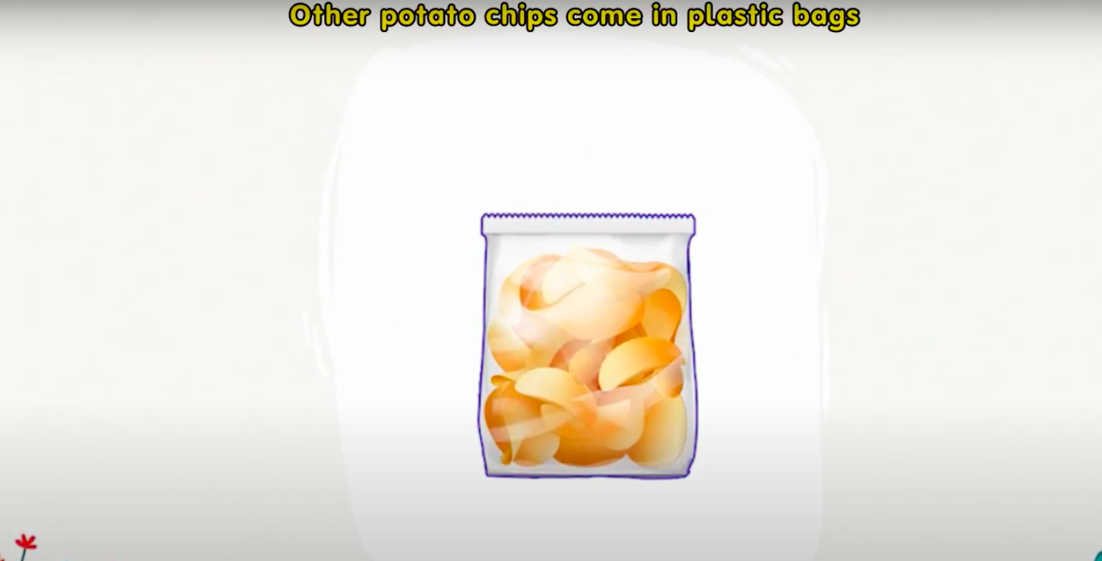
Cylinder and Sphere

Slide 8
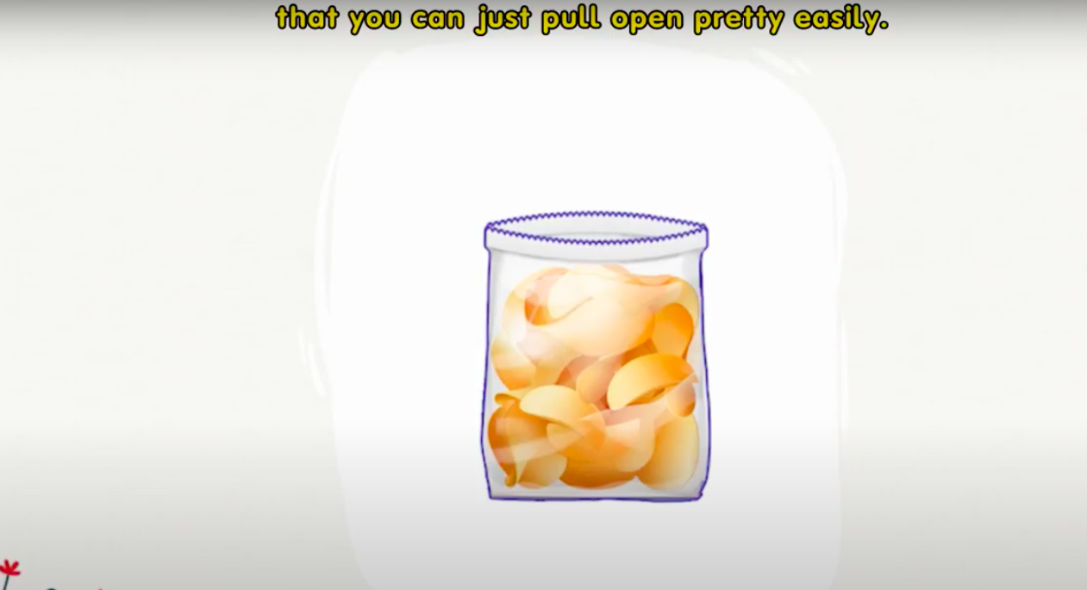
Cylinder and Sphere

Slide 9
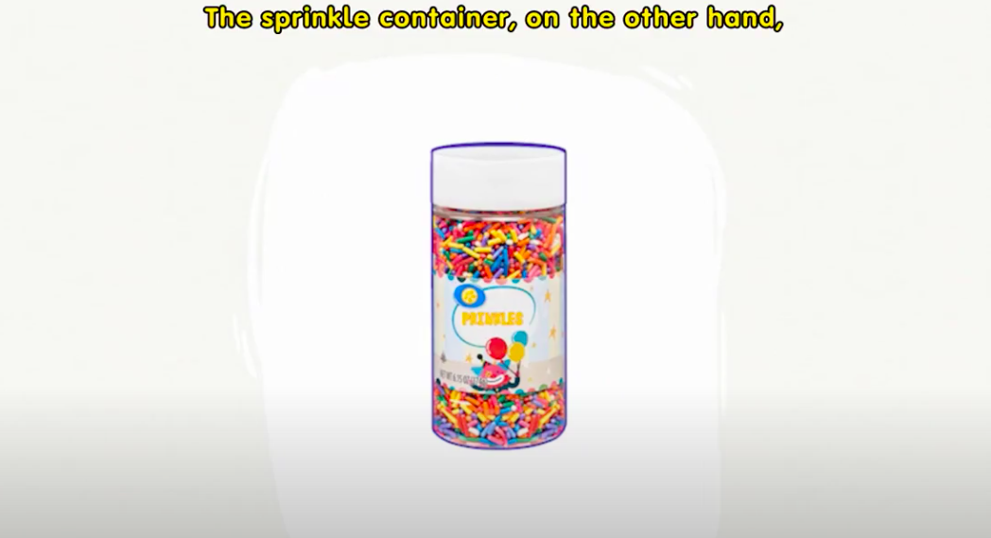
Cylinder and Sphere

Slide 10
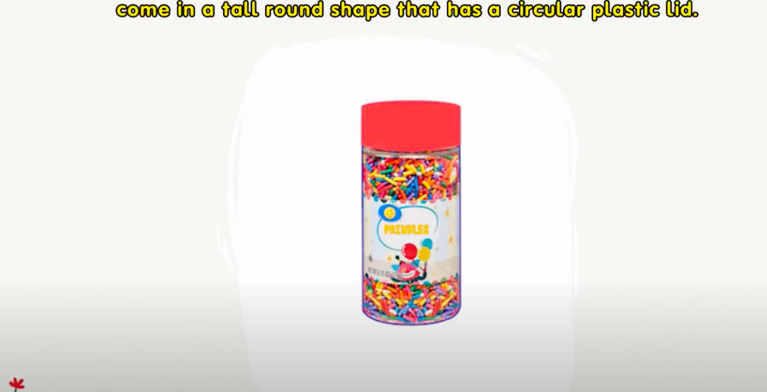
Cylinder and Sphere

Slide 11
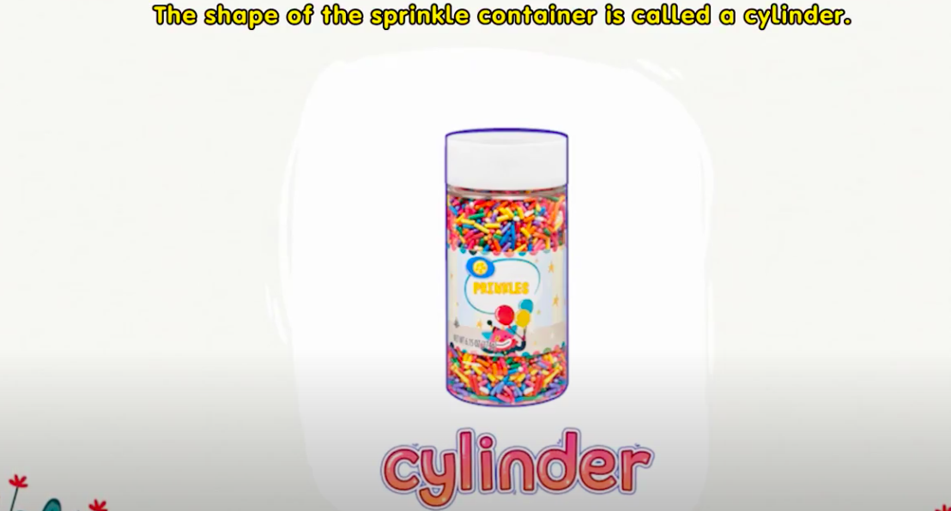
Cylinder and Sphere

Slide 12

Cylinder and Sphere

Slide 13
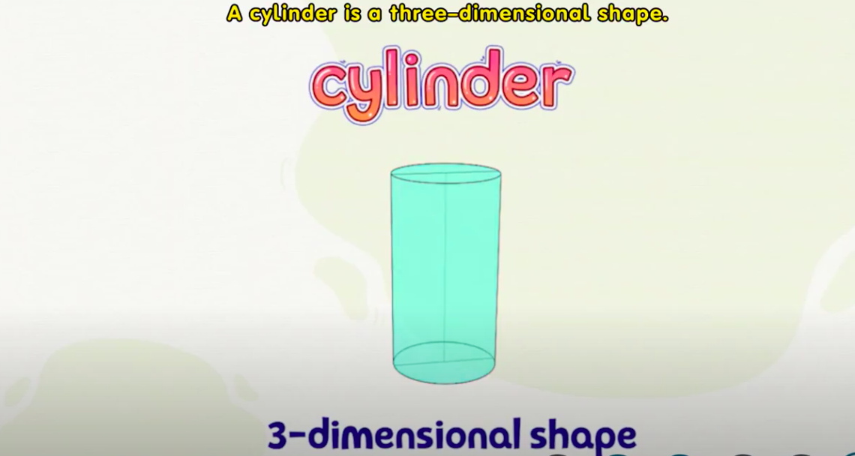
Cylinder and Sphere

Slide 14
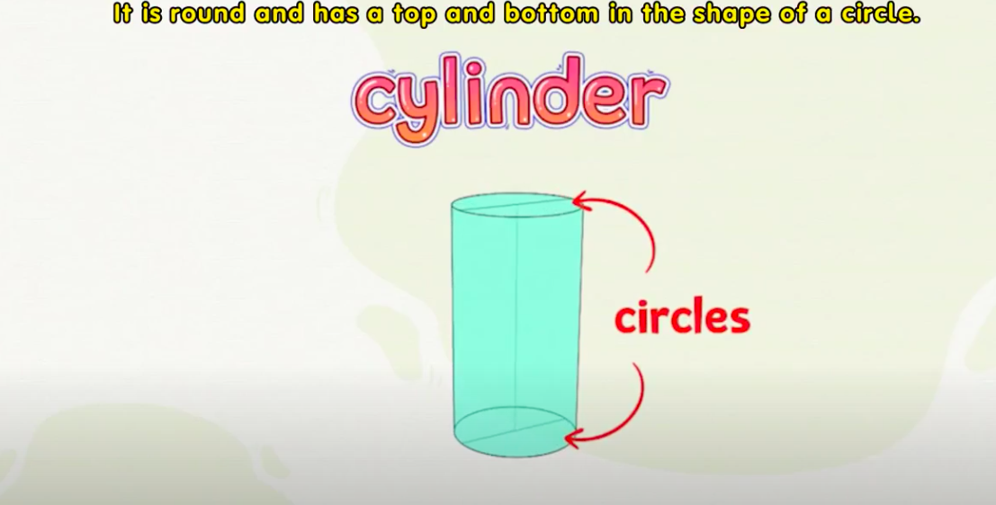
Cylinder and Sphere

Slide 15
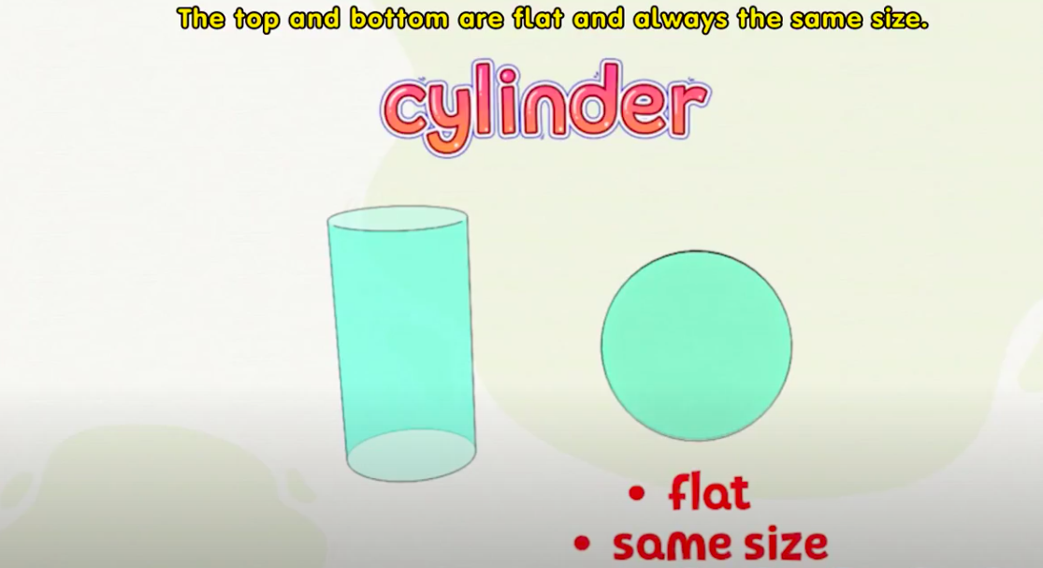
Cylinder and Sphere

Slide 16
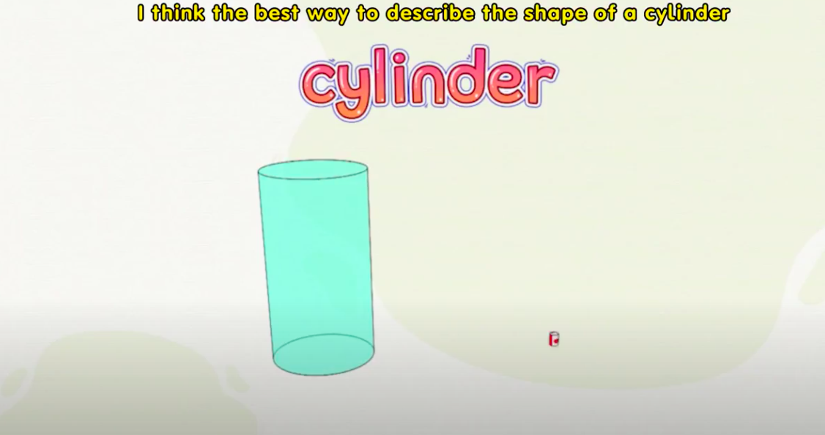
Cylinder and Sphere

Slide 17
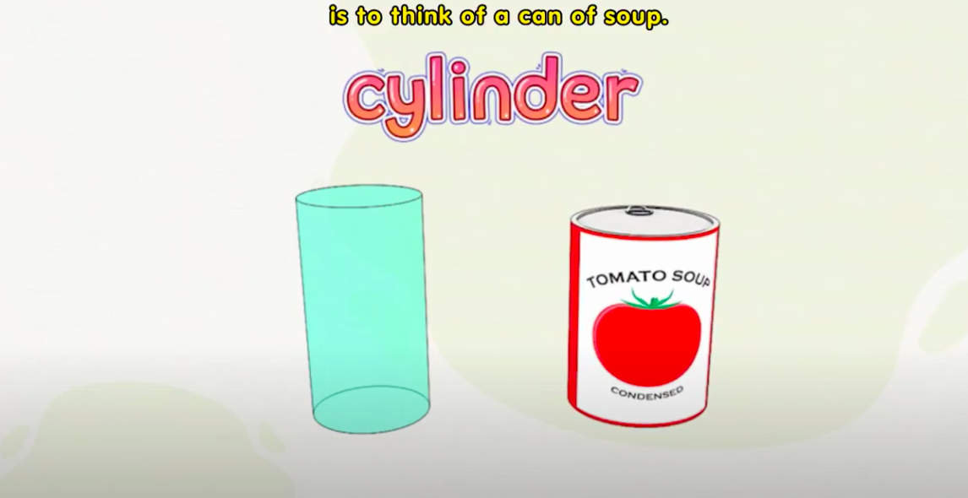
Cylinder and Sphere

Slide 18
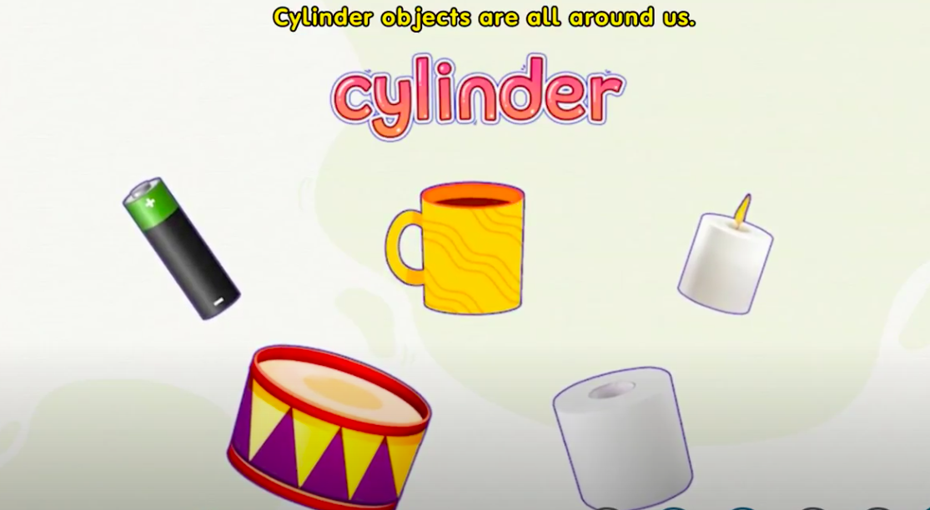





Cylinder and Sphere

Slide 19
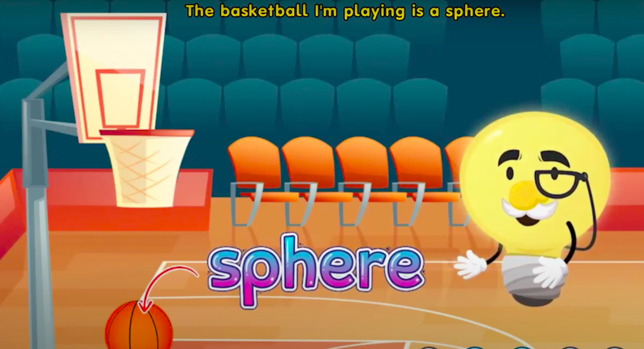
Cylinder and Sphere

Slide 20
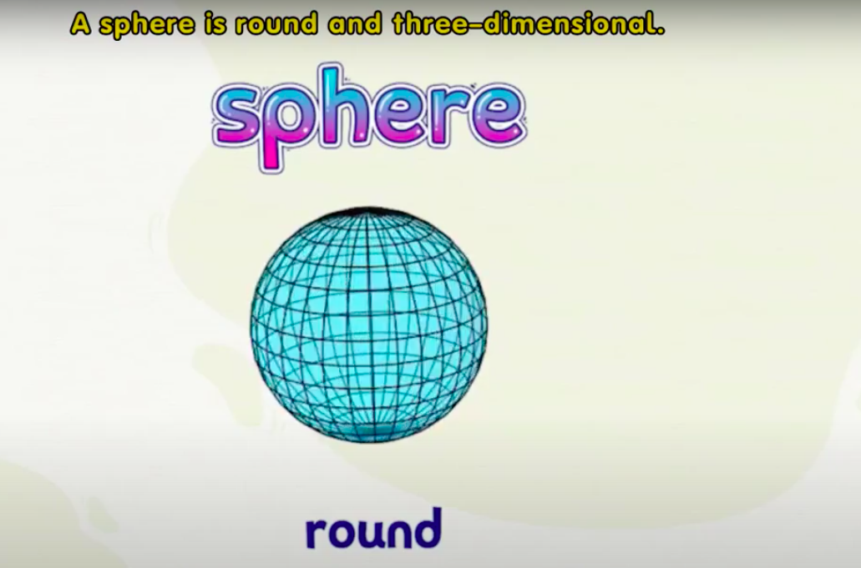
Cylinder and Sphere

Slide 21
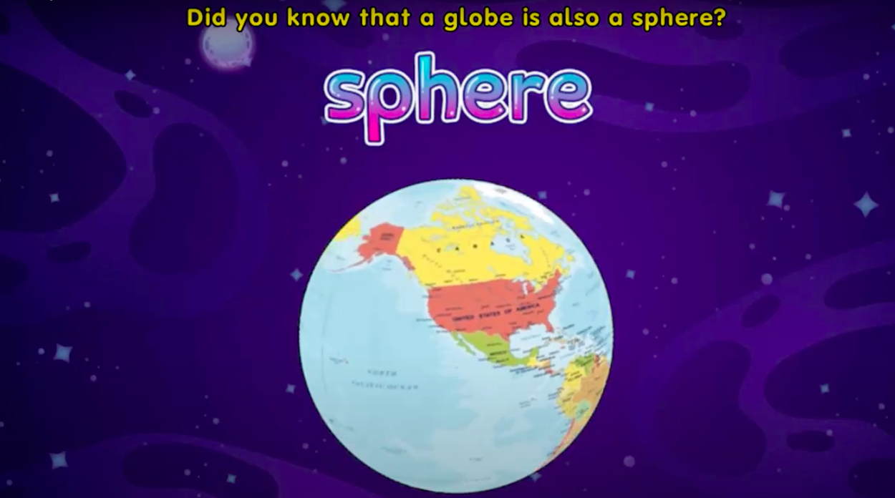
Cylinder and Sphere

Slide 22
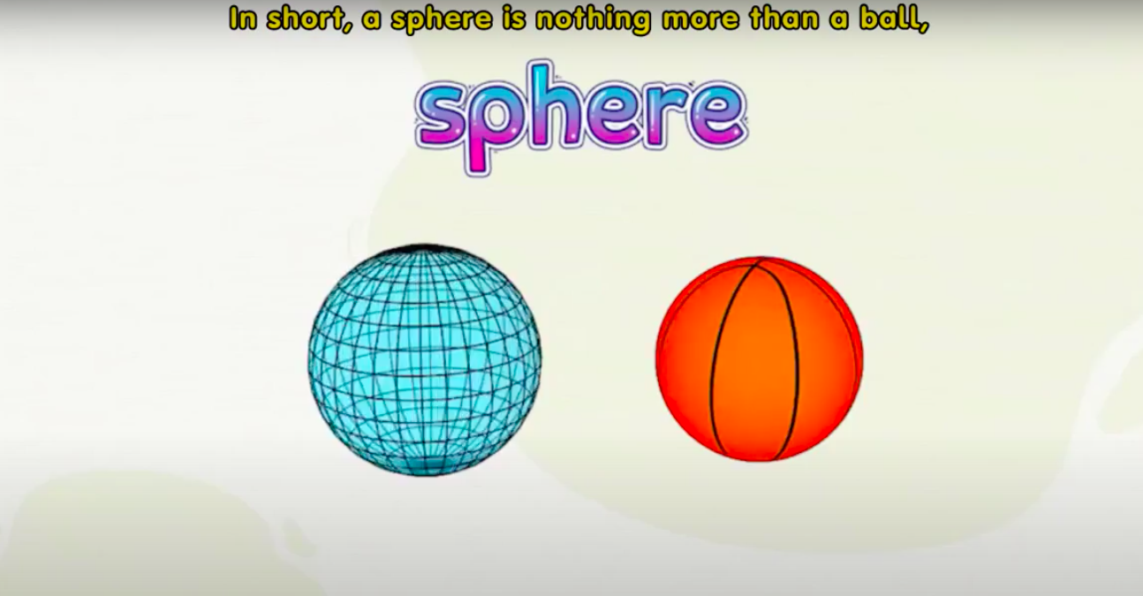
Cylinder and Sphere

Slide 23
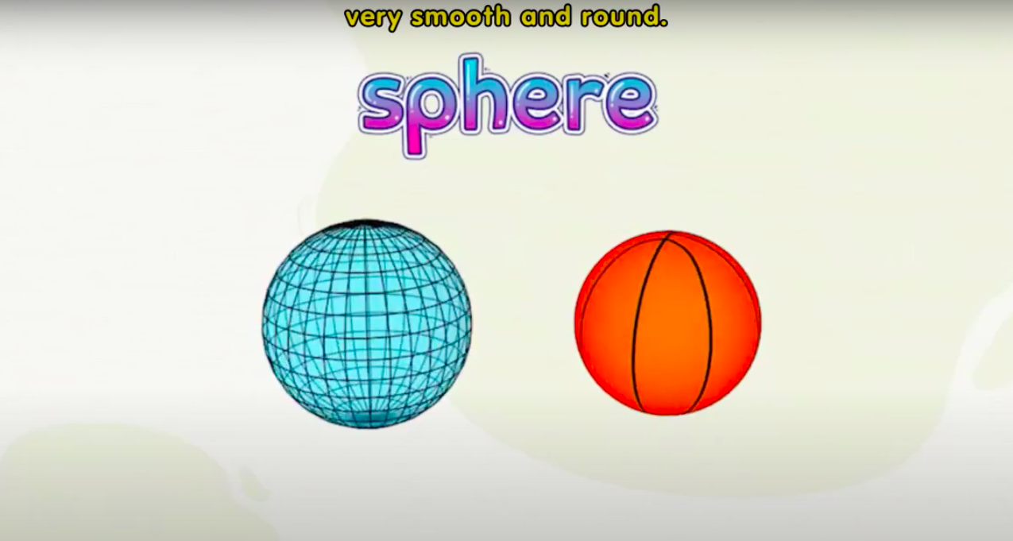
Cylinder and Sphere

Slide 24
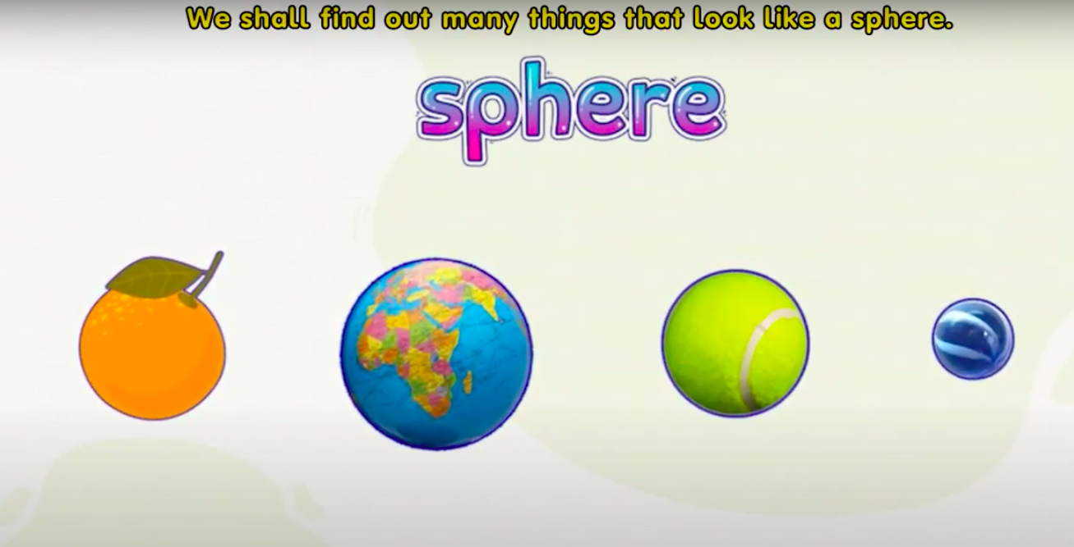
Cylinder and Sphere

Slide 25
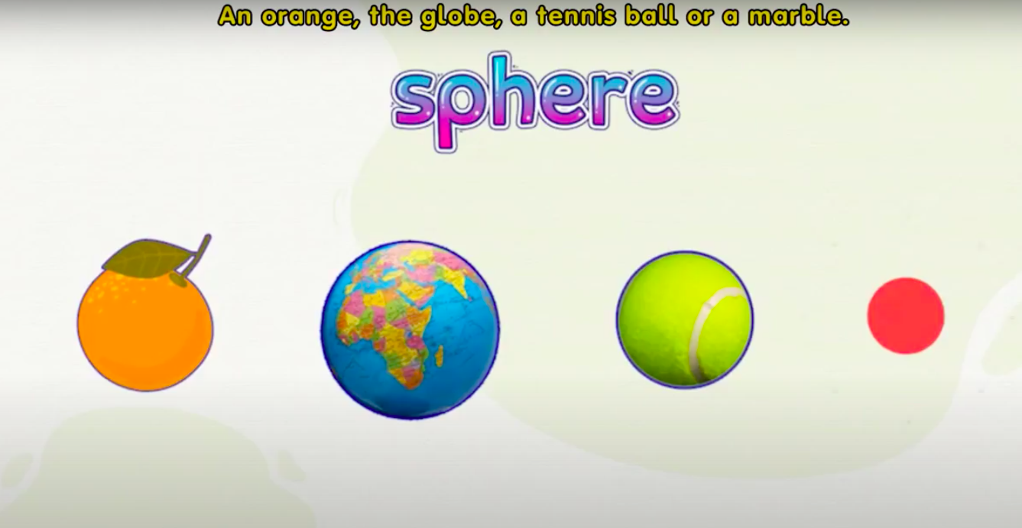
Cylinder and Sphere

Slide 26

Cylinder and Sphere

Slide 27
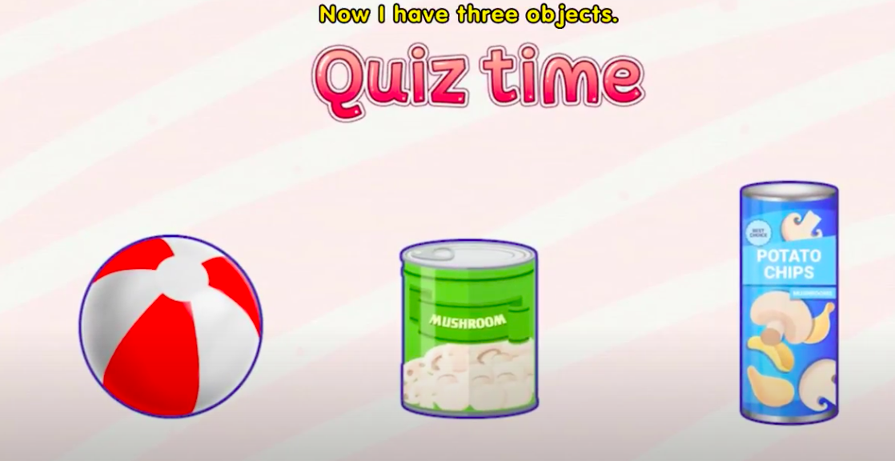
Cylinder and Sphere

Slide 28
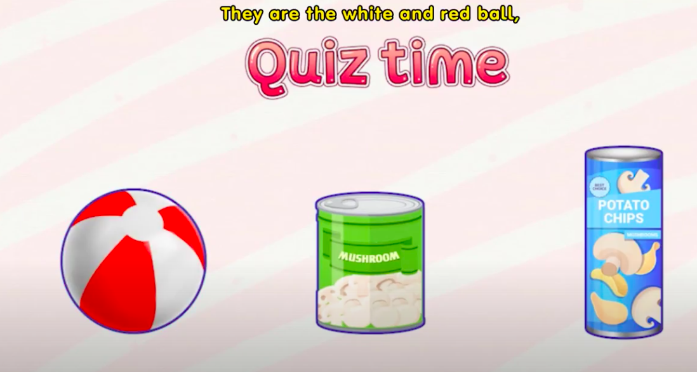
Cylinder and Sphere

Slide 29
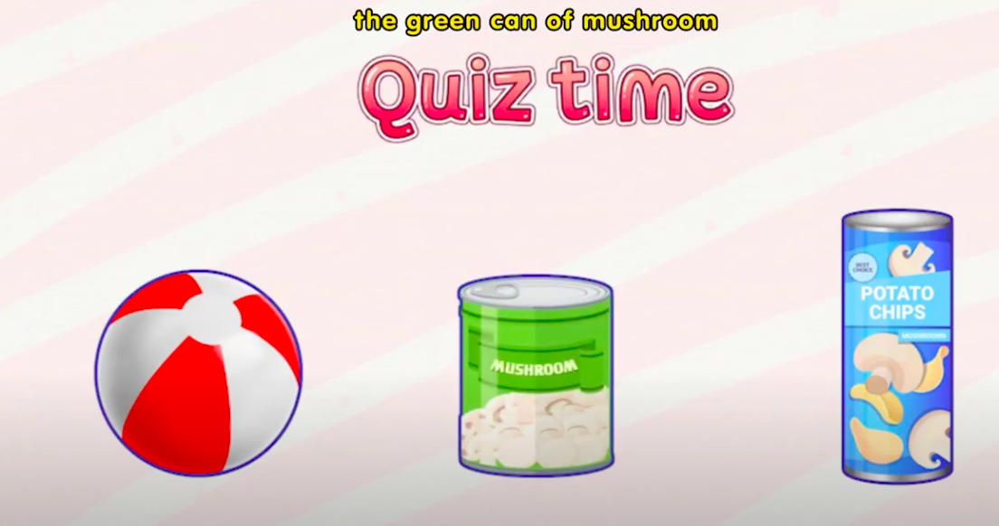
Cylinder and Sphere

Slide 30
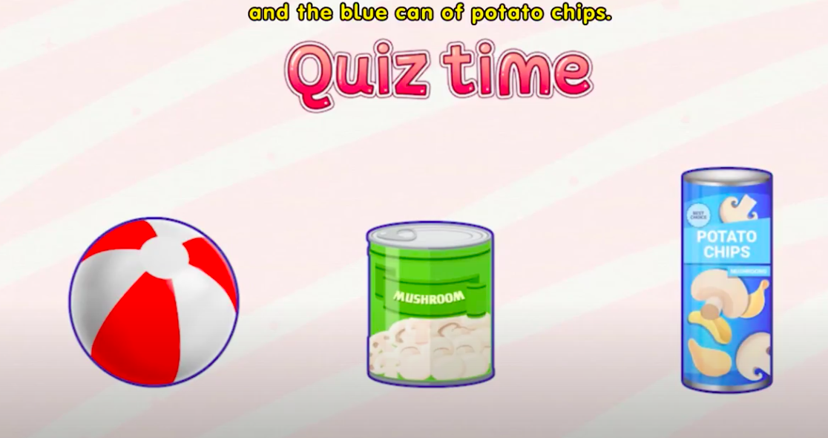
Cylinder and Sphere

Slide 31
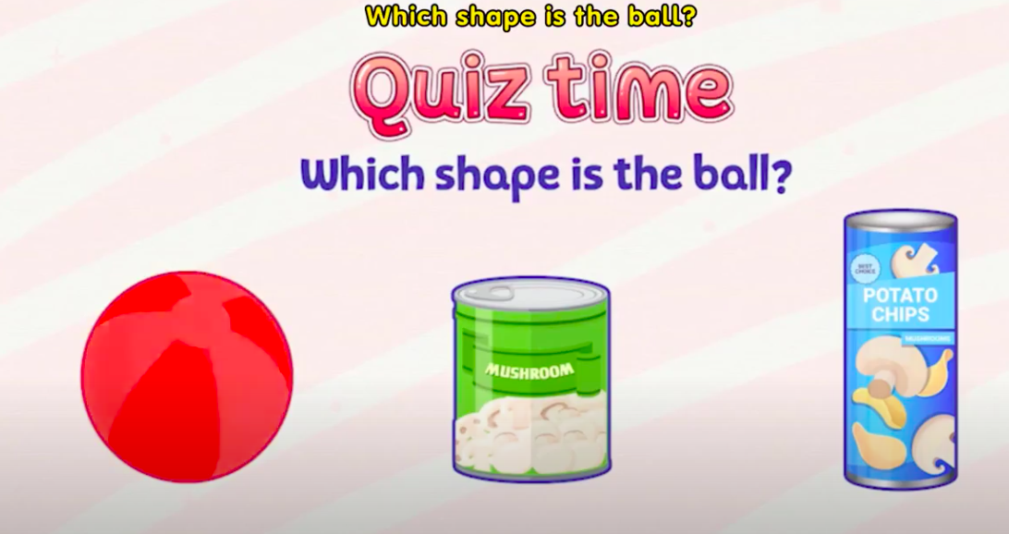

Cylinder and Sphere

Slide 32
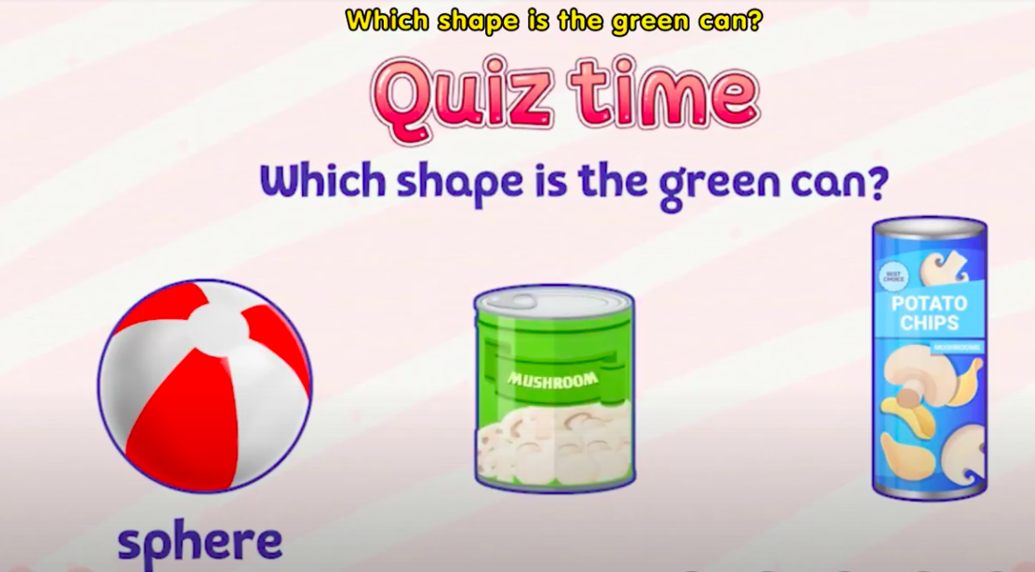

Cylinder and Sphere

Slide 33

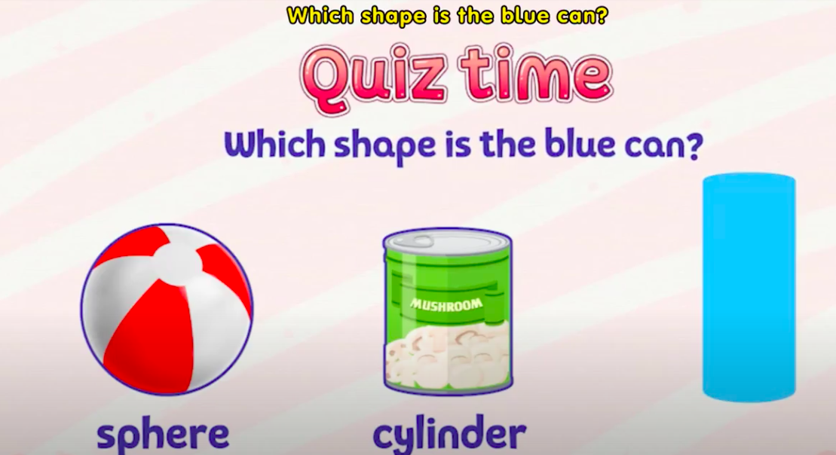

Cylinder and Sphere

Slide 34
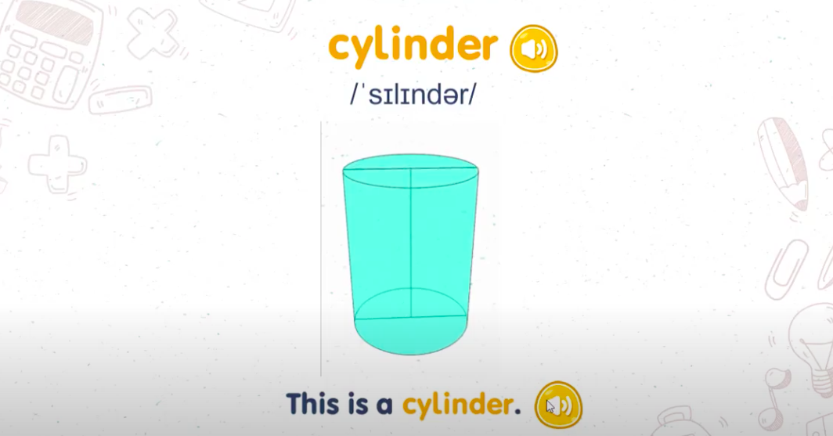
Cylinder and Sphere

Slide 35
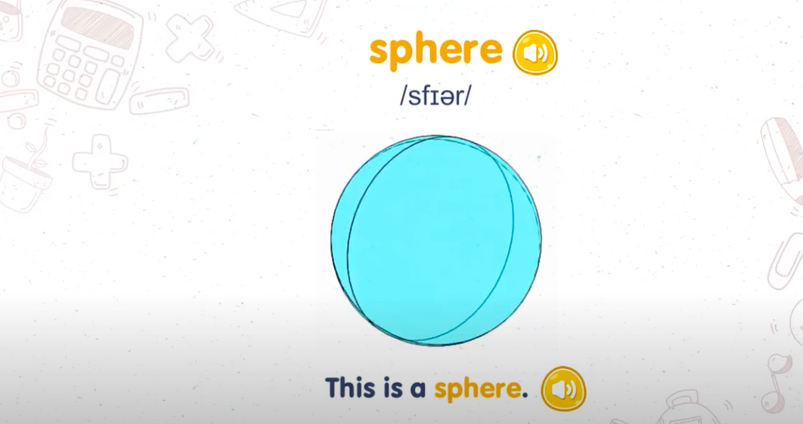
Cylinder and Sphere

