Slide 1
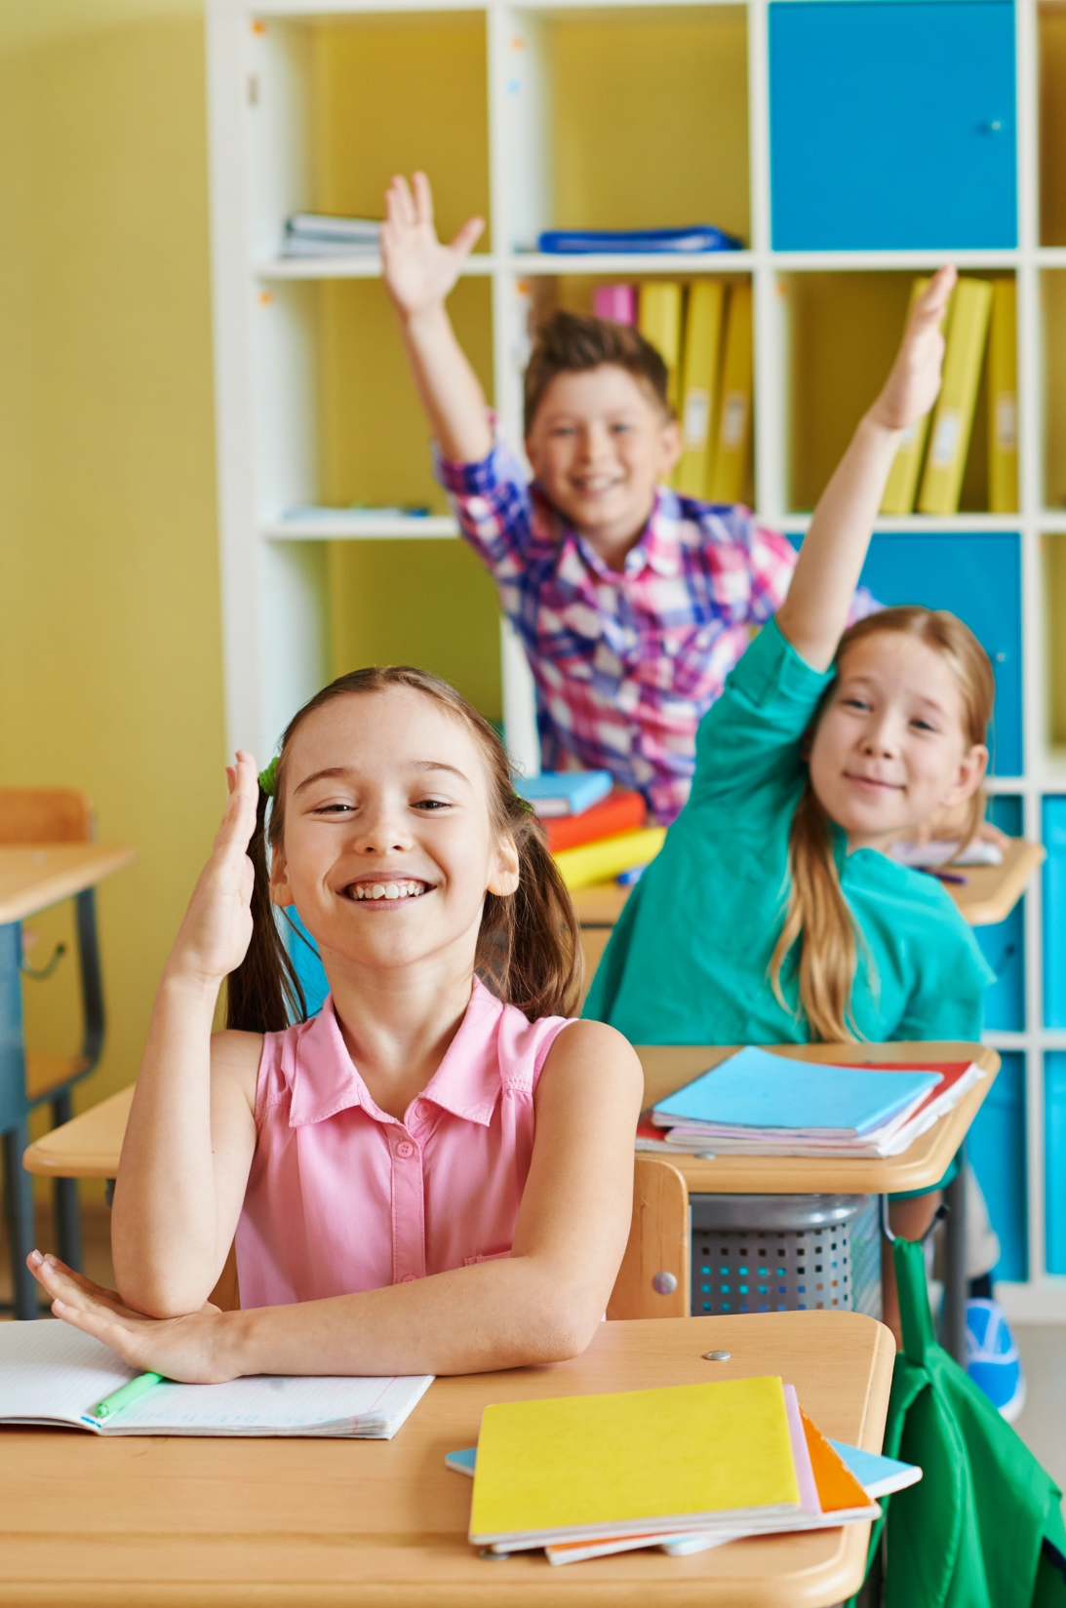

GRADE 1 - SCIENCE
UNIT 2: ANIMAL WORLD
Lesson 1: Wild animals

Slide 2
OBJECTIVES
Recognize some wild animals.
Discuss some wild animals in daily conversation.

Slide 3
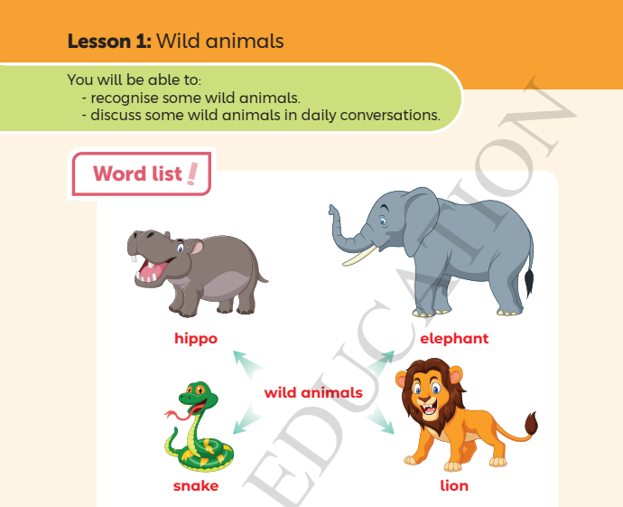
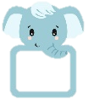
Page 16

Slide 4



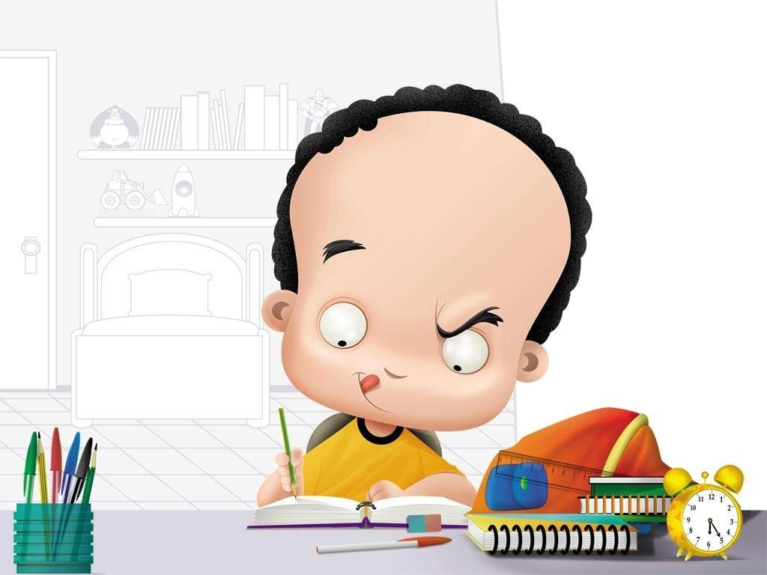
Workbook
Open your book Page 16, 17
5 minutes to finish
My Body

Slide 5
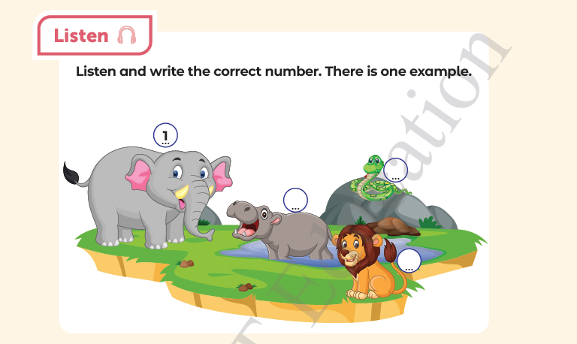

3
4
2
Page 17

Slide 6
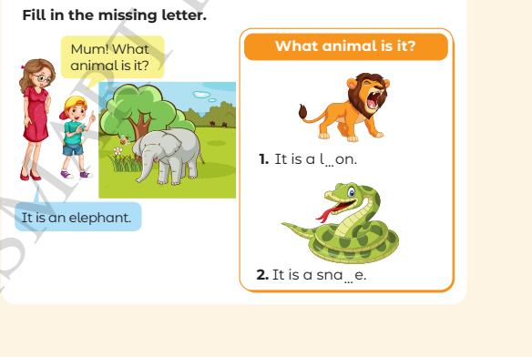
i
k
Page 16

Slide 7
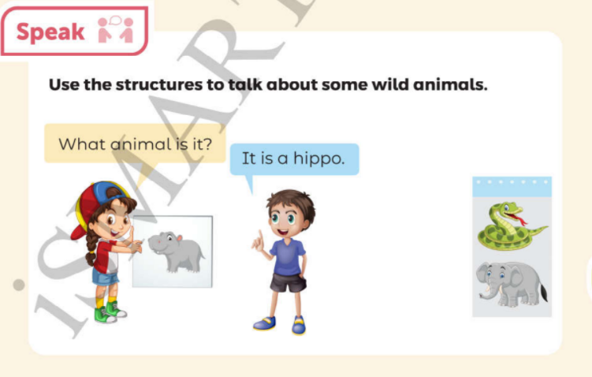
Page 17

