Slide 1
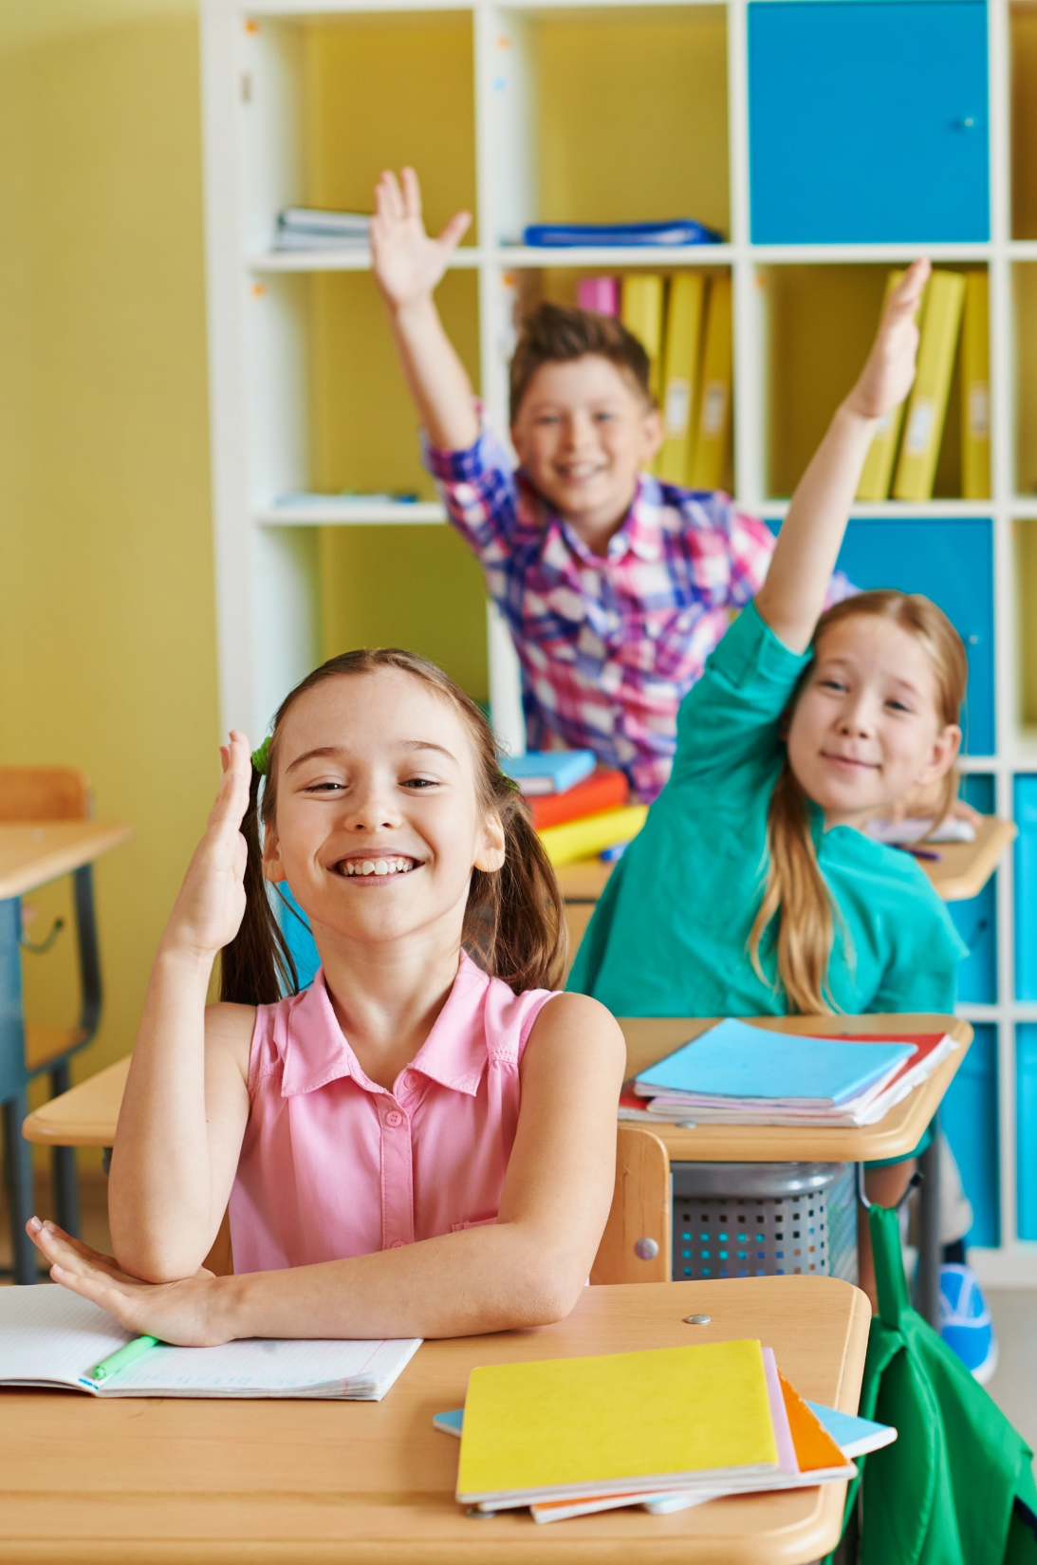

GRADE 1 - SCIENCE
UNIT 1: EXPLORING PLANTS
Revision

Slide 2
OBJECTIVES
Recognize some common flowers and fruits.
Describe flowers and fruits in daily conversations.

Slide 3



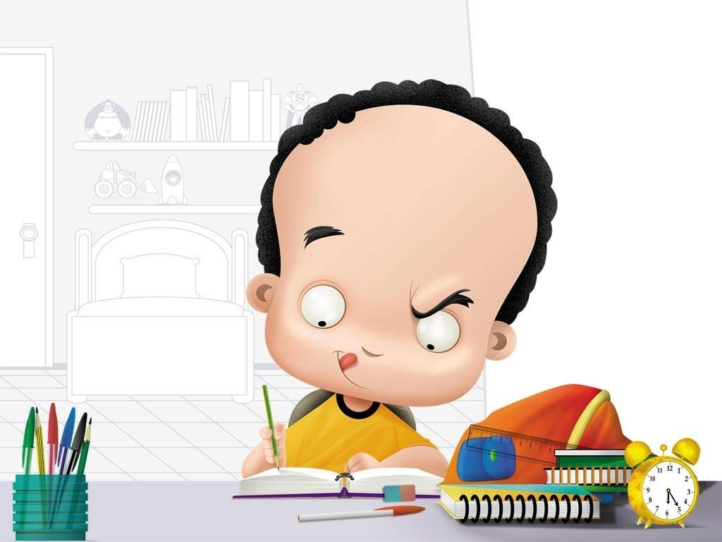
Do the exercises
Open your book Page 12, 13
5 minutes to finish
My Body

Slide 4
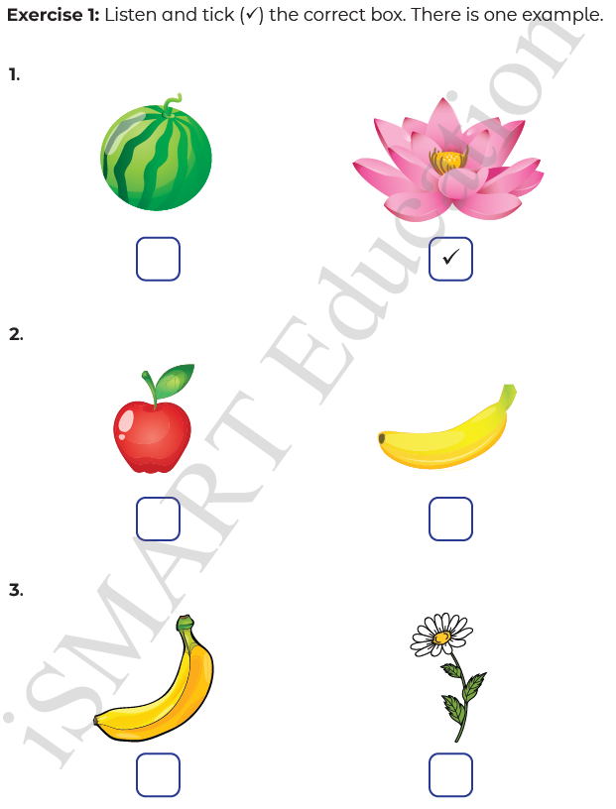

Page 12
✔
✔

Slide 5

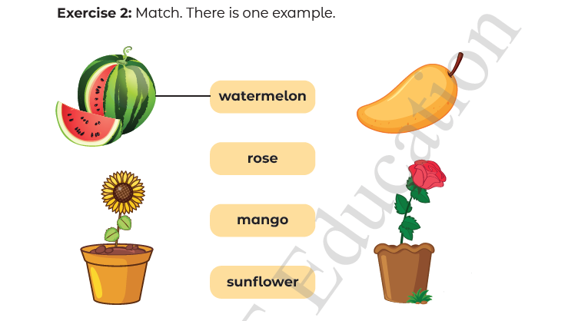
Page 13

Slide 6
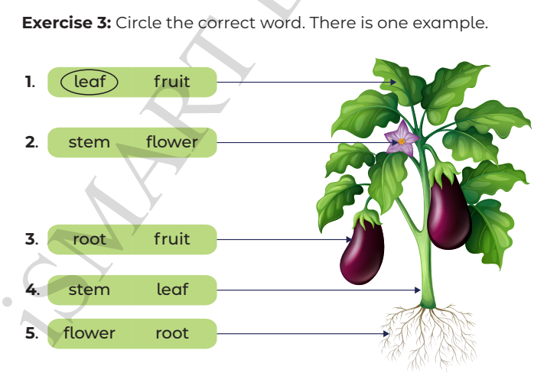
Page 13

