Slide 1



















Unit 2: My Home
Lesson 1 – Period 1

Slide 2
1 WARM UP
Notes:
Warm up
Guessing game cho 1 dòng

Slide 3


Look at the photo. Tick what you see.
a house a desk
a garden a chair
✓
✓

Slide 4
Presentation
Task 1 Listen and point.
Notes:
Dấu câu

Slide 5
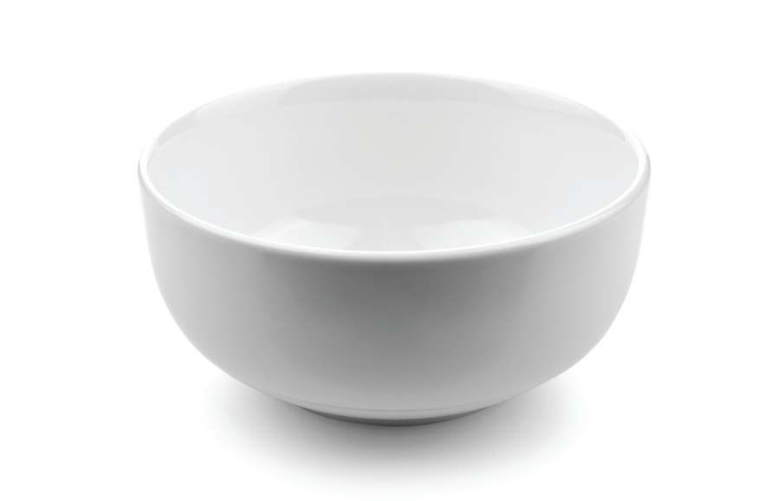
1 Listen and point.
Bowl
What is it?

Slide 6
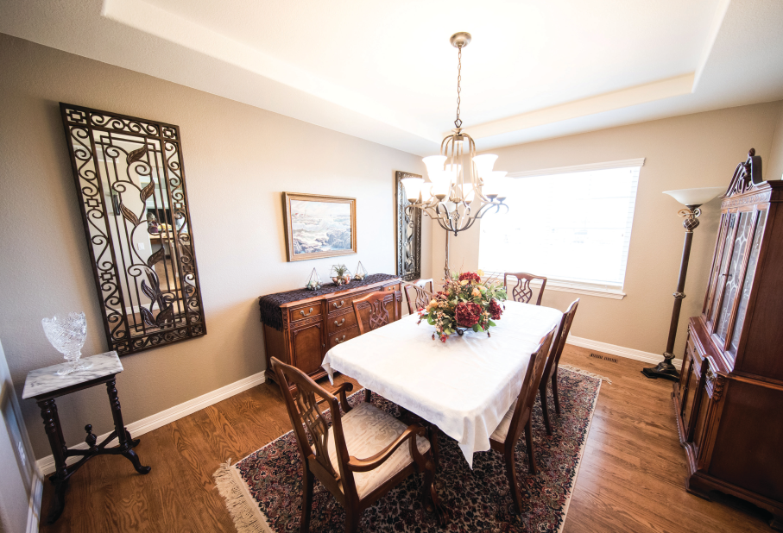
Dining room
What is it?

Slide 7
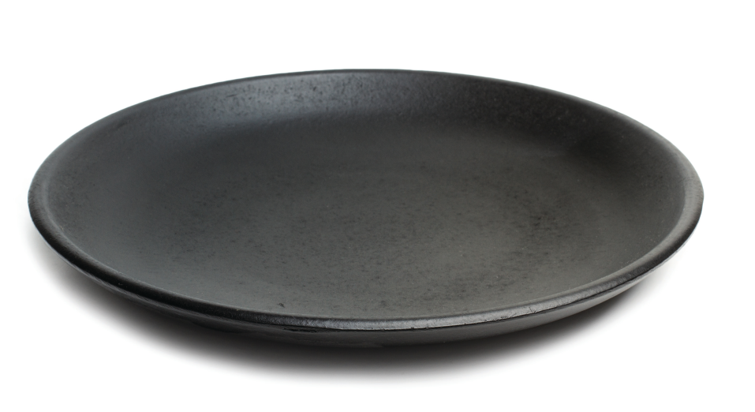
Plate
What is it?

Slide 8
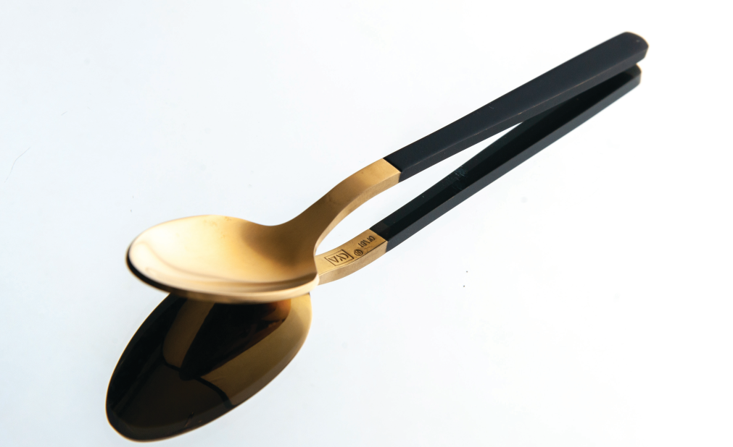
Spoon
What is it?

Slide 9
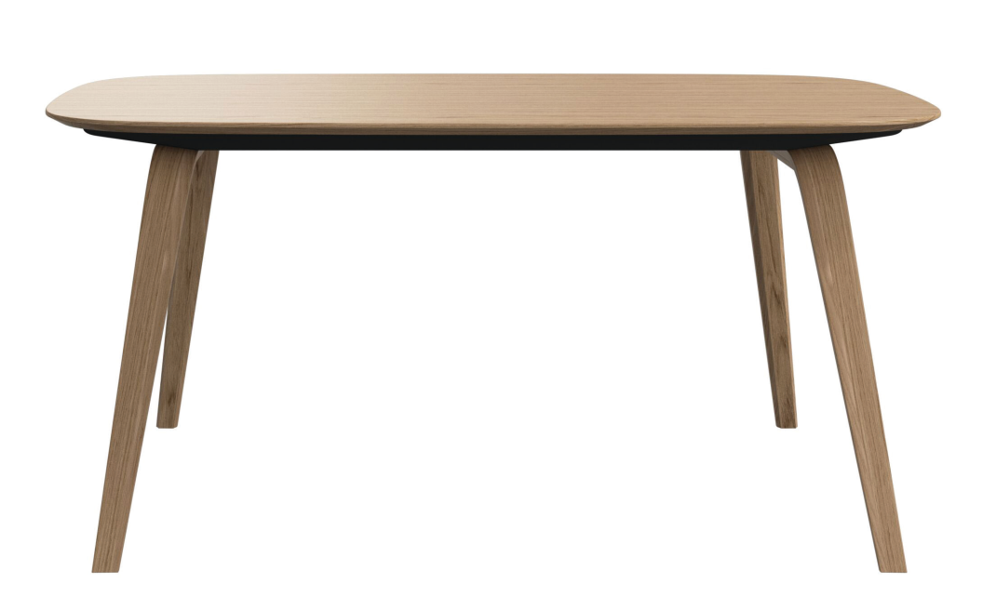
Table
What is it?

Slide 10
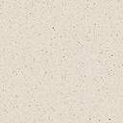
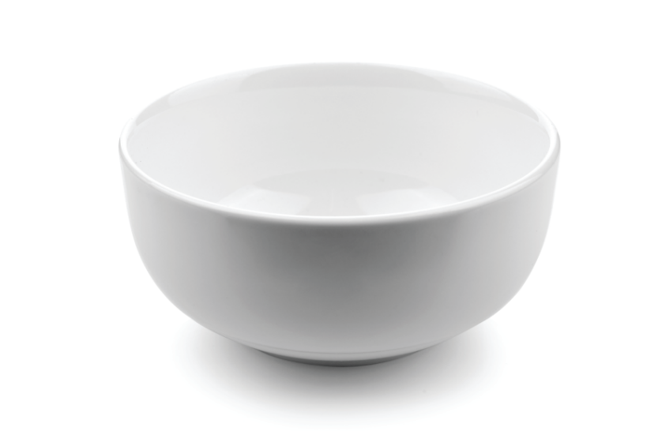

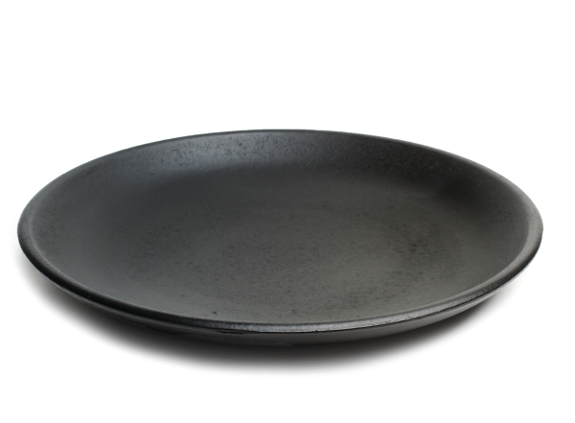

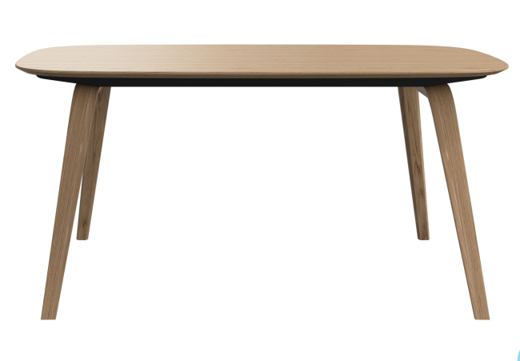
1 Listen and point. Repeat.
bowl
spoon
plate
dining room
table

Slide 11
Practice
Task 2 Listen and read.Tick.
Notes:
Dấu câu

Slide 12

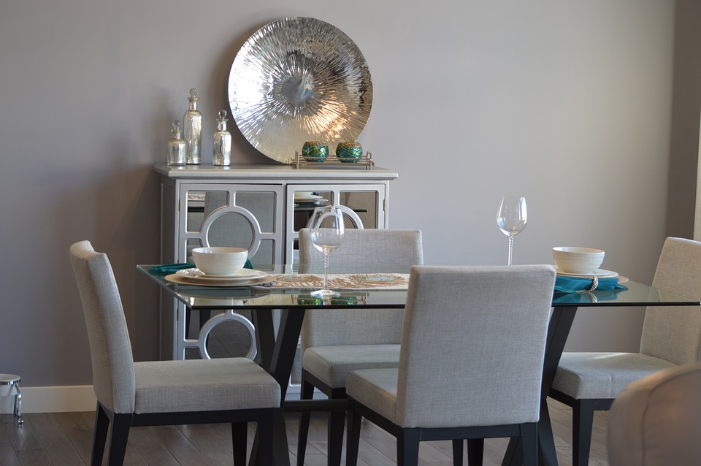
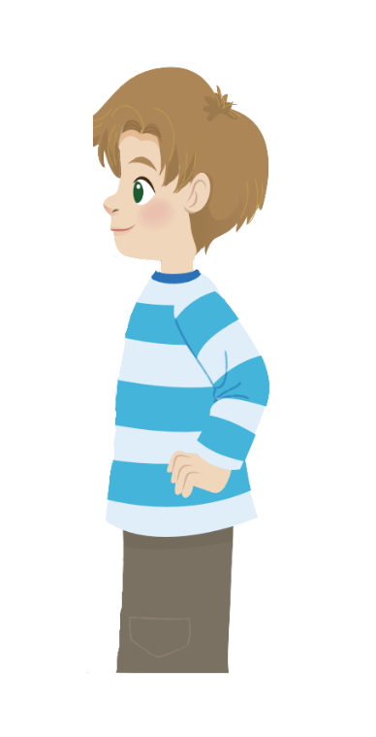
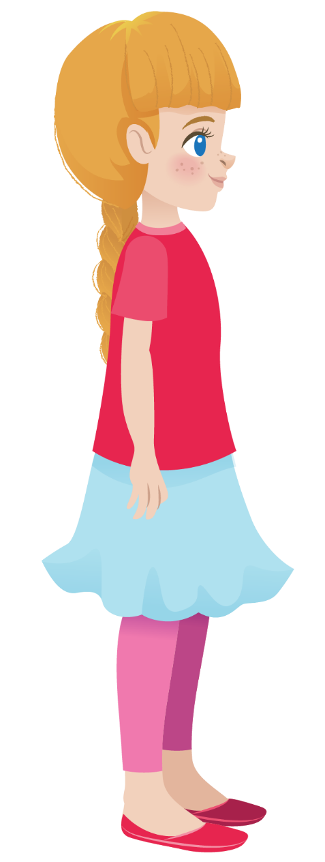
2
Listen and read. Tick.
Your dining room is big. There are many bowls and plates on the table.
It’s my spoon.
Sophie
Alex
Look! There’s a spoon. Whose spoon is it?

Slide 13

2
Listen and read. Tick.
Your dining room is big. There are many bowls and plates on the table.
Sophie
Alex
The dining room is small.
Yes
✓
No

Slide 14
2
Listen and read. Tick.
Your dining room is big. There are many bowls and plates on the table.
Sophie
Alex
2. There are plates and bowls on the table.
✓
Yes
No

Slide 15
2
Listen and read. Tick.
It’s my spoon.
Sophie
Look! There’s a spoon. Whose spoon is it?
Alex
3. Alex’s got a spoon.
✓
Yes
No

Slide 16
Practice
Task 3 Look and say.
Notes:
Dấu câu

Slide 17
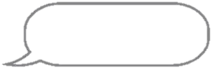


3
Look and say. Use the words in 1.
There’s a
dining room
in my house.
There are two
plates in our
dining room.

Slide 18
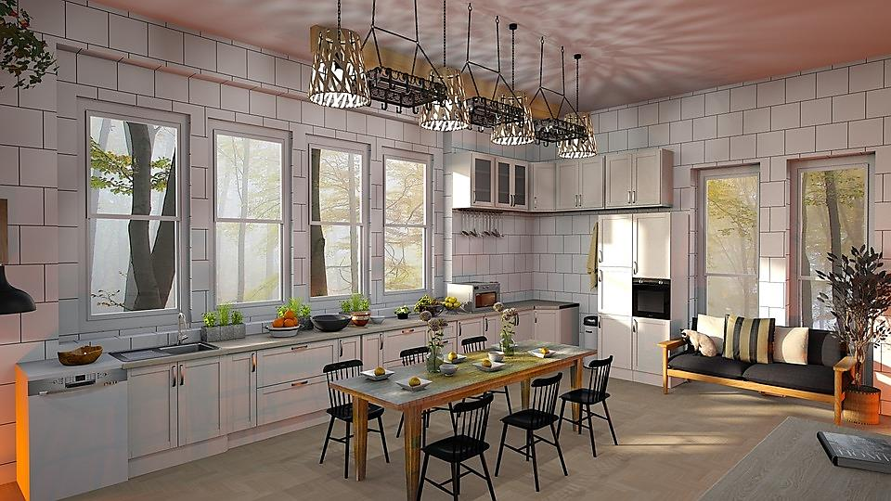
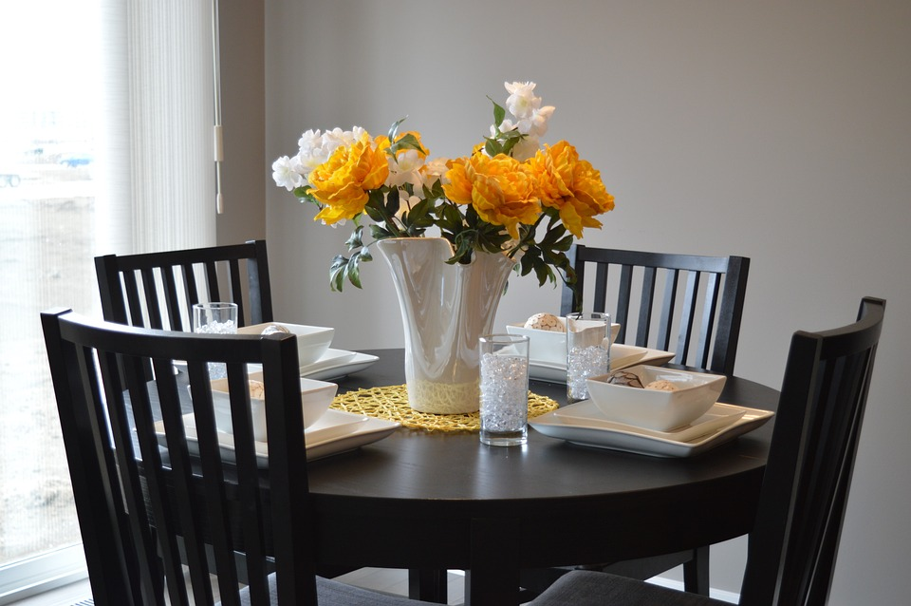
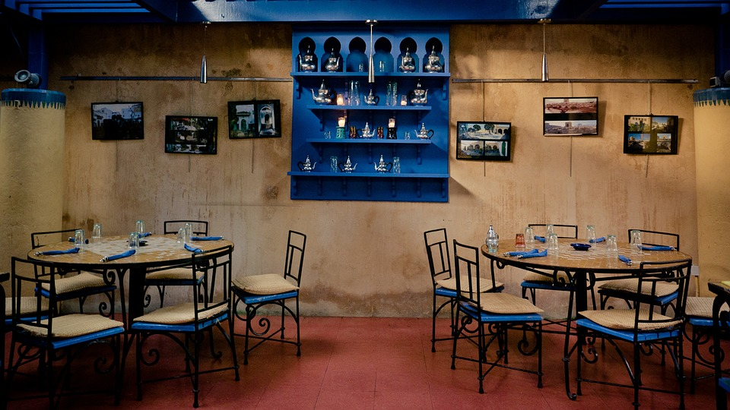
Click to the picture to get the dialogue
1
2
3
NEXT

Slide 19



HOME
Your dining room
is so big!
How many chairs
and plates here?
There are
___ plates
and __ chairs in
my dining room.
6
6
Notes:
Trình bày lại chữ

Slide 20
HOME
How many
bowls are
there?
There are
___ bowls in
our dining room.
4
Notes:
Trình bày lại chữ

Slide 21

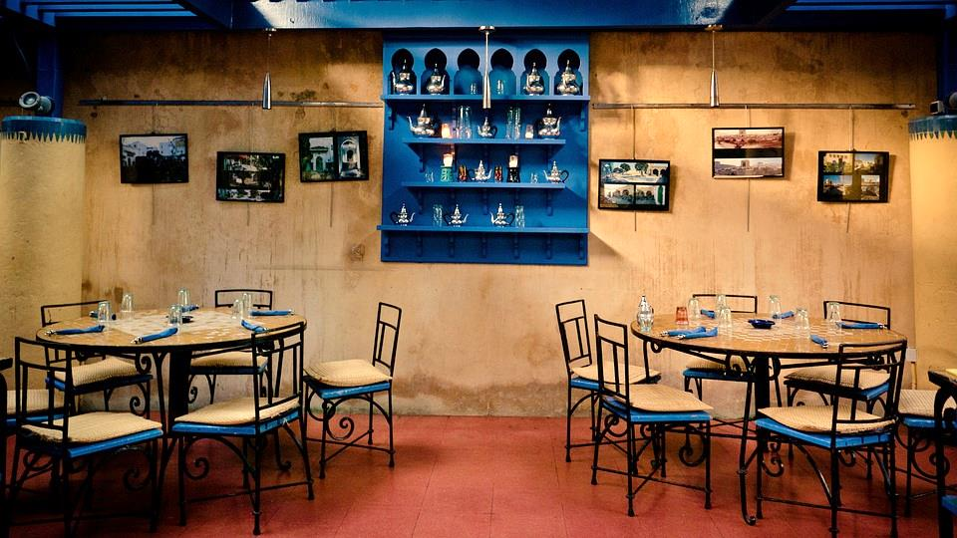
HOME
How many
tables are
there?
My dining room
has ___ tables.
2
Notes:
Trình bày lại chữ

Slide 22
Production
Notes:
Đây k phải là extra, đây là hđ 3 của bài

Slide 23
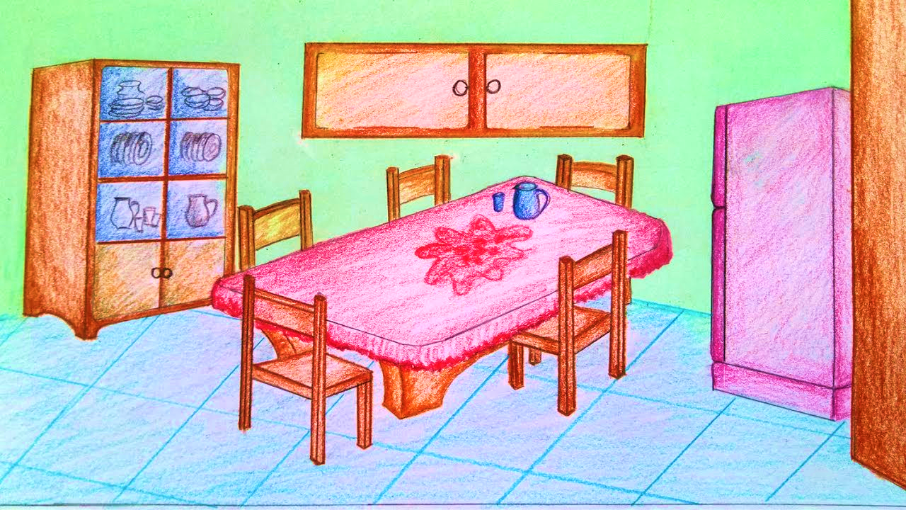
Let’s draw a picture of a dining room!

Slide 24
Assessment
Notes:
Đây k phải là extra, đây là hđ 3 của bài

Slide 25
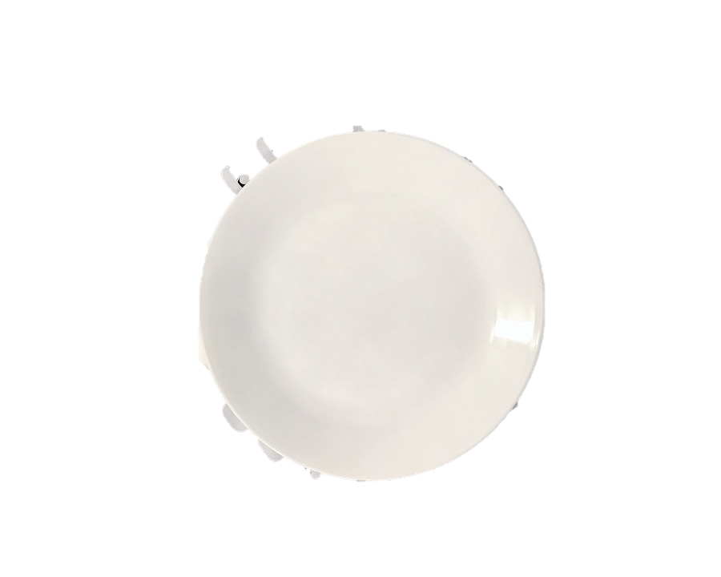
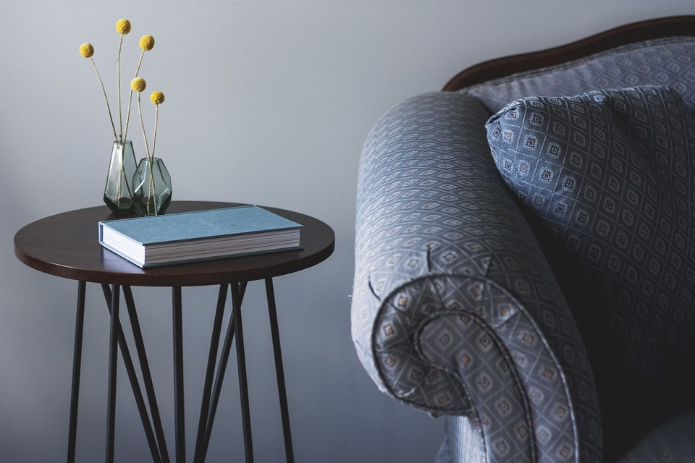
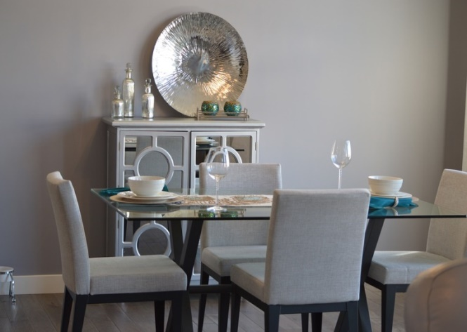
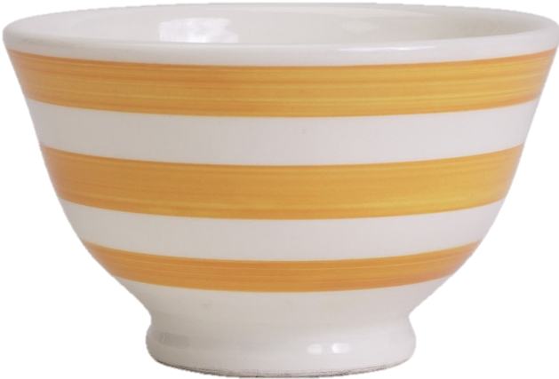
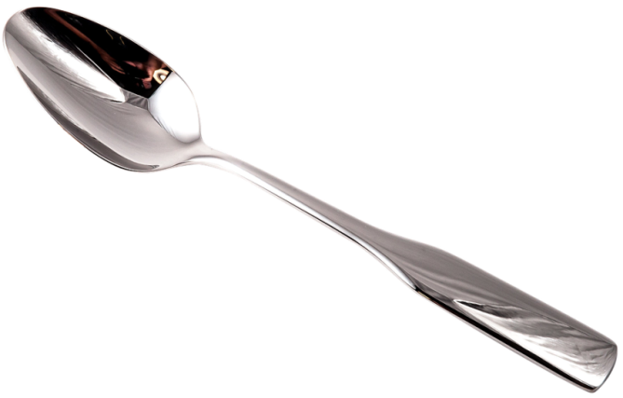
Matching Game
bowl
spoon
1
4
plate
2
table
dining room
3
5

Slide 26
Wrap up
Notes:
Đây k phải là extra, đây là hđ 3 của bài

Slide 27



Vocabulary
Structure
bowl: bát
spoon: thìa
plate: đĩa
table: bàn
dining room: phòng ăn
There is a ....
There are ….

Slide 28




Thank you & goodbye!

