Slide 1








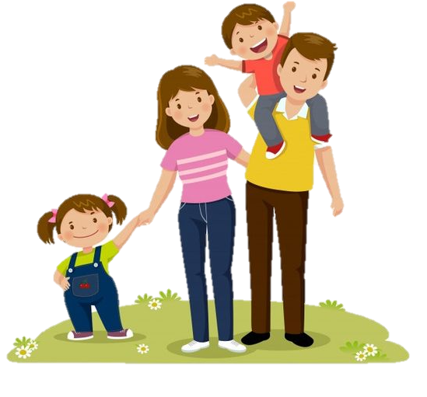
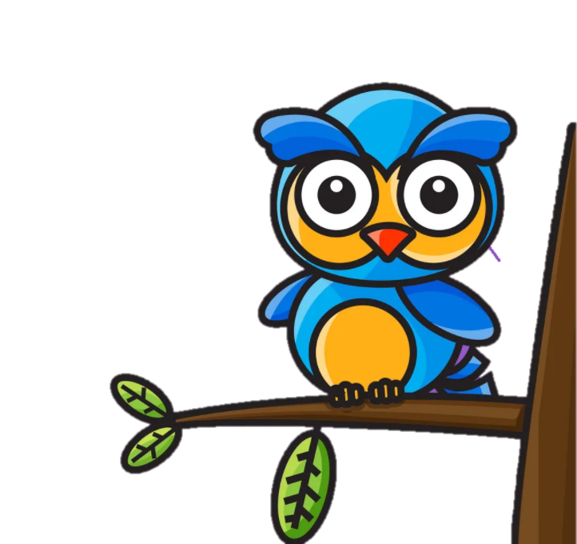
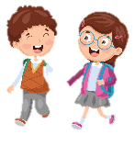

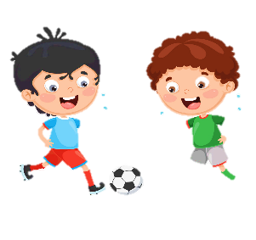


Unit 1:
MY FAMILY
AND FRIENDS
Lesson 3 – Task 4, 5, 6

Slide 2


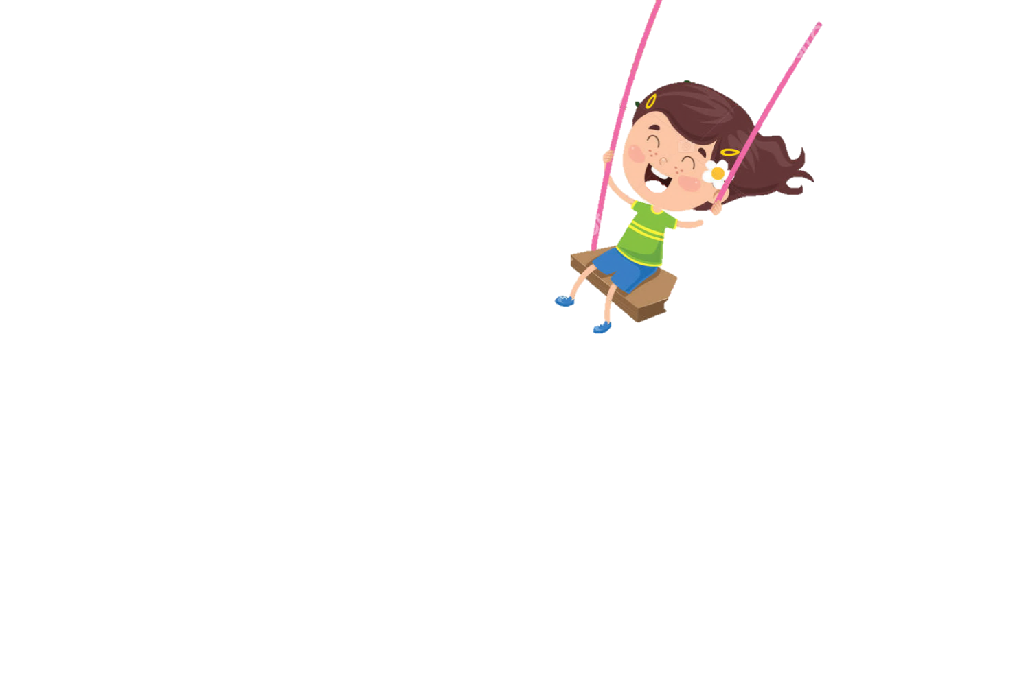
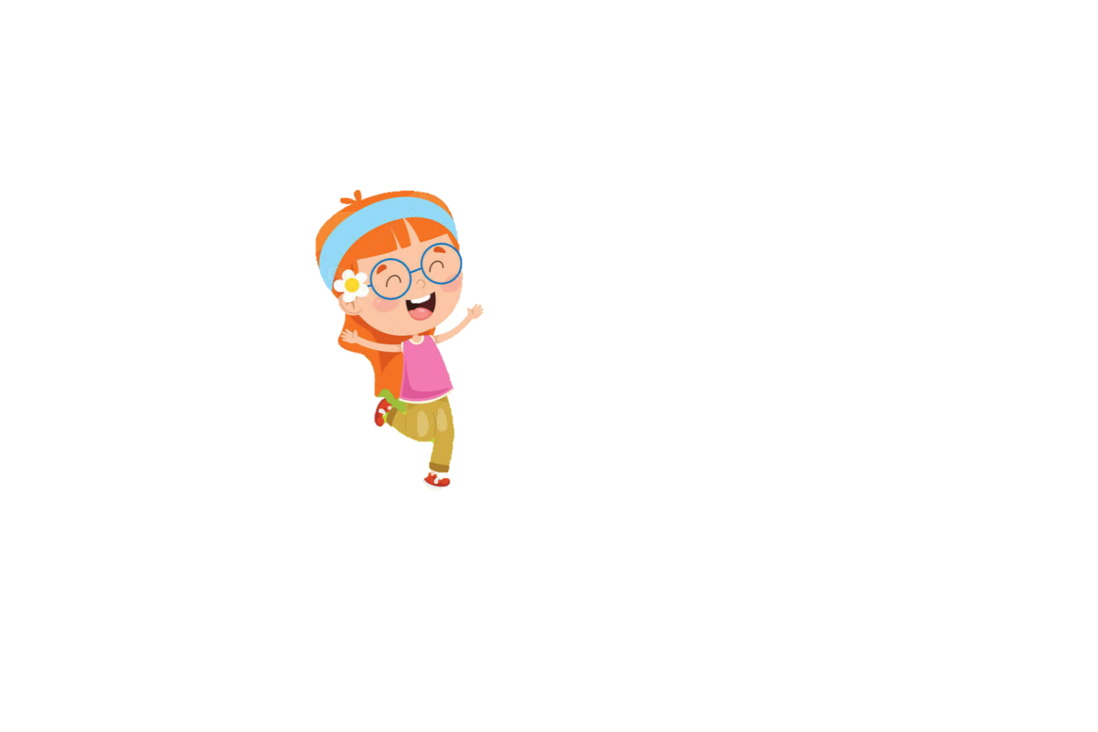
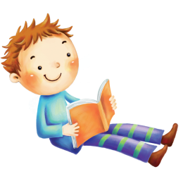


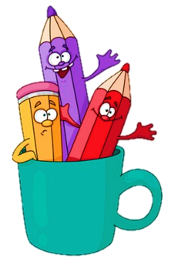
1
Warm Up

Slide 3
2
Presentation
Task 4: Listen and repeat.

Slide 4
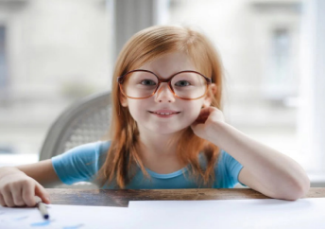
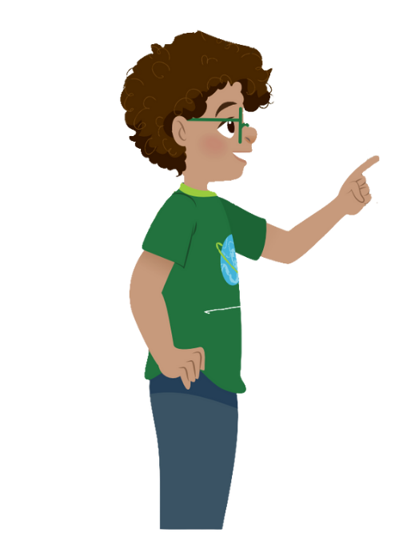
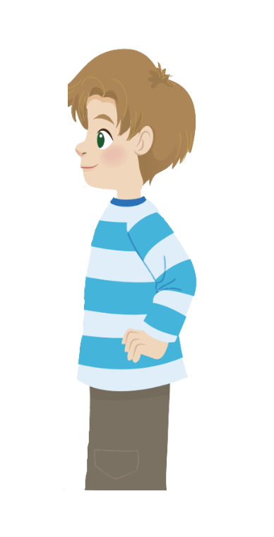
What is your sister like?
She’s hard-working.

Slide 5
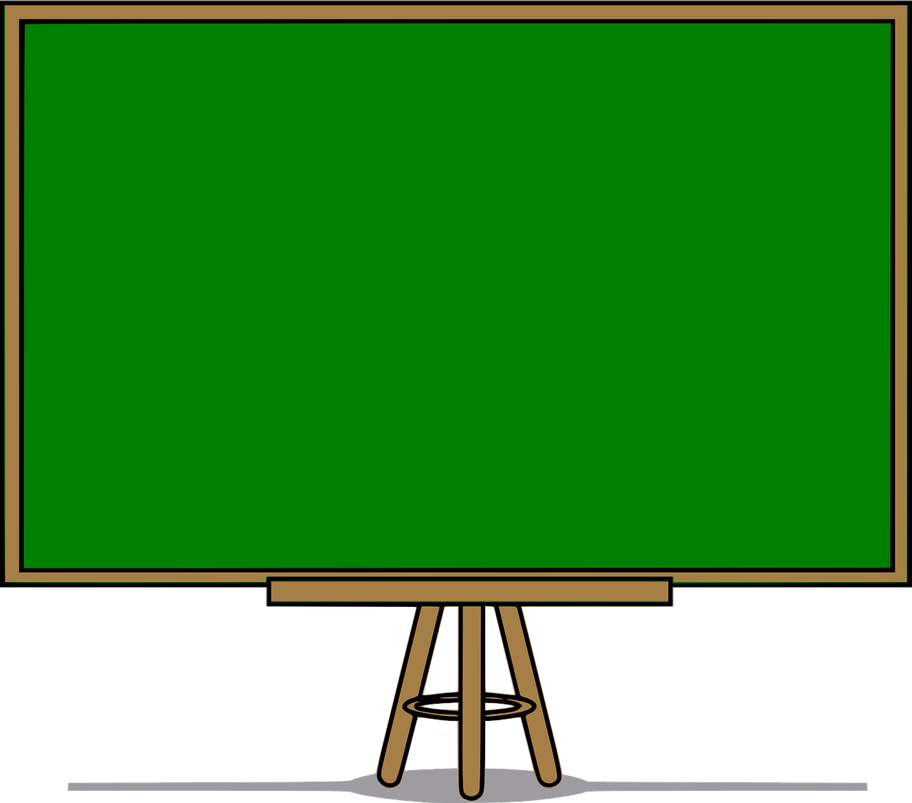
Structure
What is ………………like?
- She’s/ He’s ……… .

Slide 6
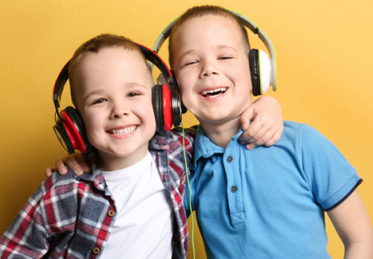
Listen and repeat.
1. Whαt is your sister like? - She's hαrd-working αnd pleαsαnt.
2. Whαt is his twin brother like?
- He's clever αnd friendly.

Slide 7
3
Practice
Task 5: Look. Ask and answer.

Slide 8

Look. Ask and answer.
1. Your cousin / hαrd-working / clever
What is your cousin like?
She’s hard-working
and clever.

Slide 9
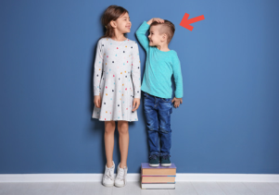
2. Her brother / short / cute
What is her brother
like?
He’s short
and cute.

Slide 10
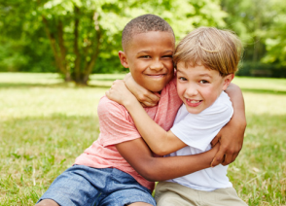
3. His friend / cheerful / friendly
What is his friend
like?
He’s cheerful
and friendly.

Slide 11
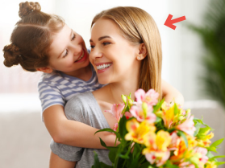
4. Her mother / pleαsαnt / kind
What is her mother
like?
She’s pleasant
and kind.

Slide 12
4
Production
Task 6: Draw. Ask and answer.

Slide 13

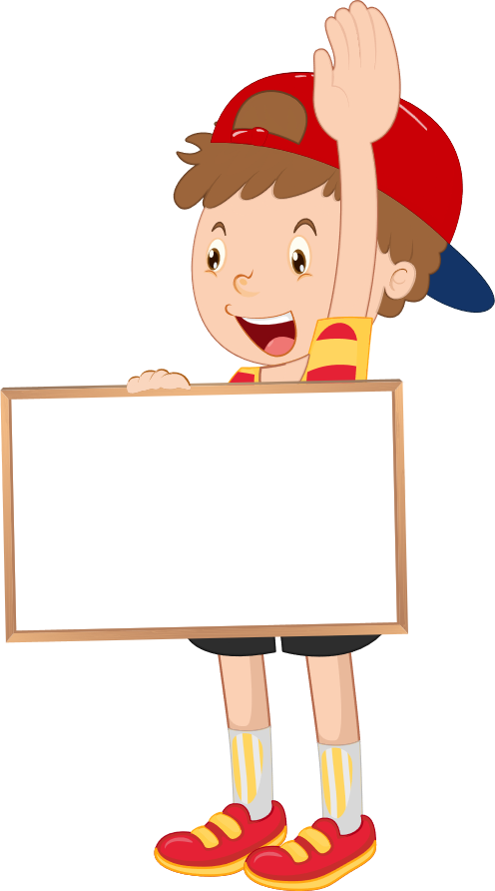
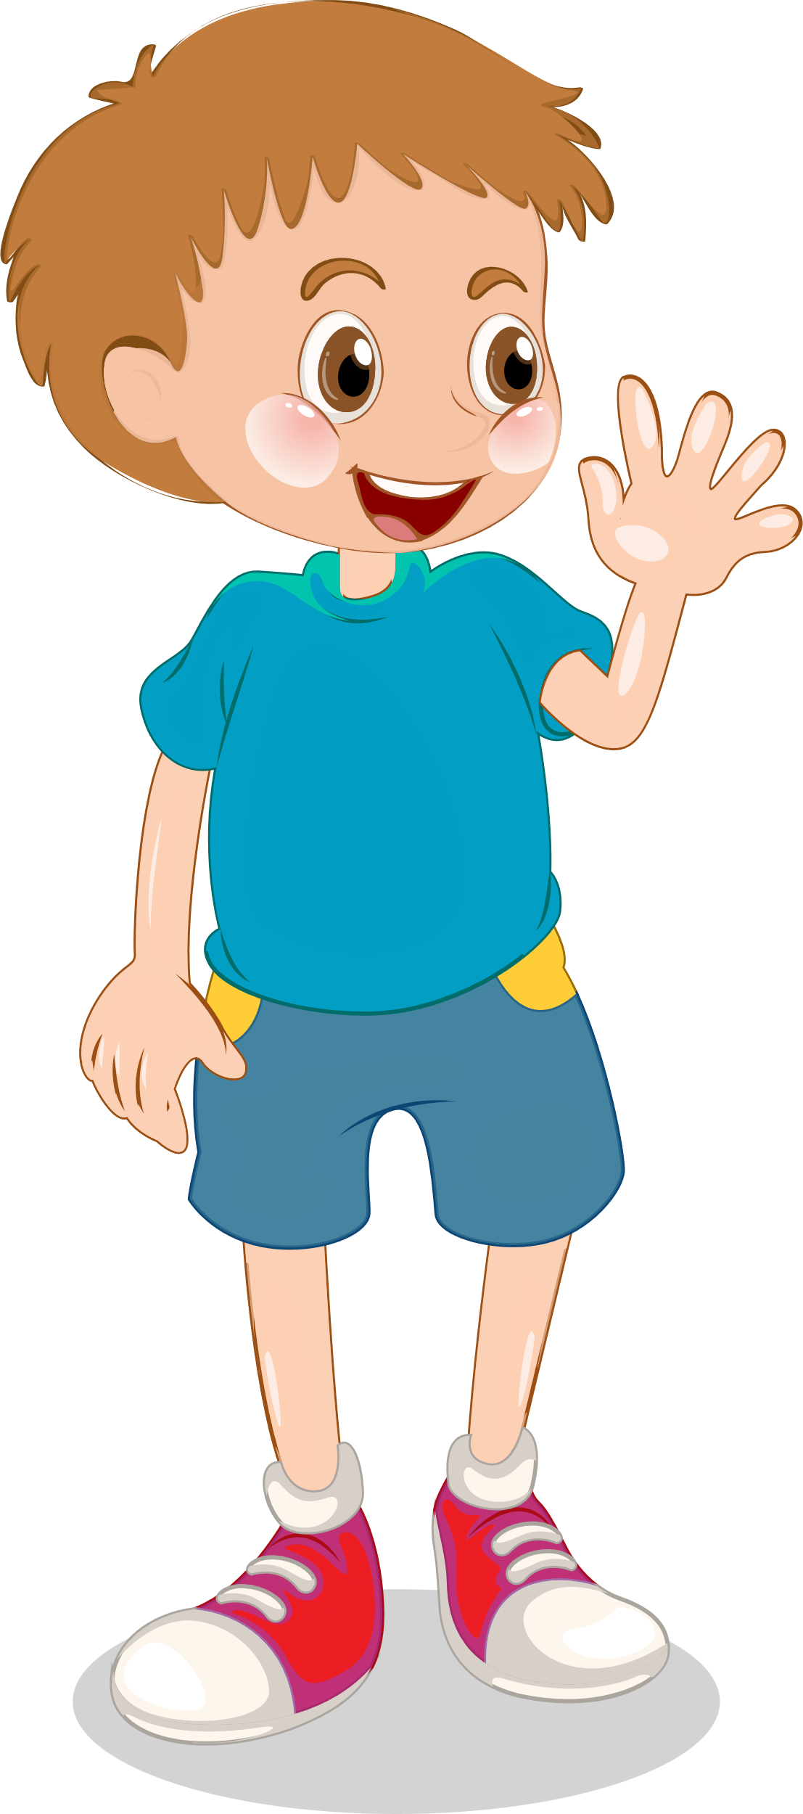
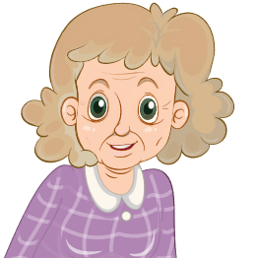
Drαw. Αsk αnd αnswer.
Who is she?
She’s my grandmother.
What is your
grandmother like?
She’s old
and kind.

Slide 14
5
Assessment

Slide 15
Look and match.
1. Who is this?
a. He’s nine years old.
2. How old is he?
b. They are friendly.
3. What is your aunt like?
c. She’s my sister.
4. What is your brother like?
d. He’s cheerful.
5. What are your cousins like?
e. She’s pleasant.

Slide 16
UNIT 1: Family and Friends
LESSON 3 – PERIOD 2- TASK 4,5,6
What we learnt today
Review vocabulary
cheerful
friendly
hard-working
pleasant
What is your father like?
My fαther is kind αnd cool.
Structure

Slide 17


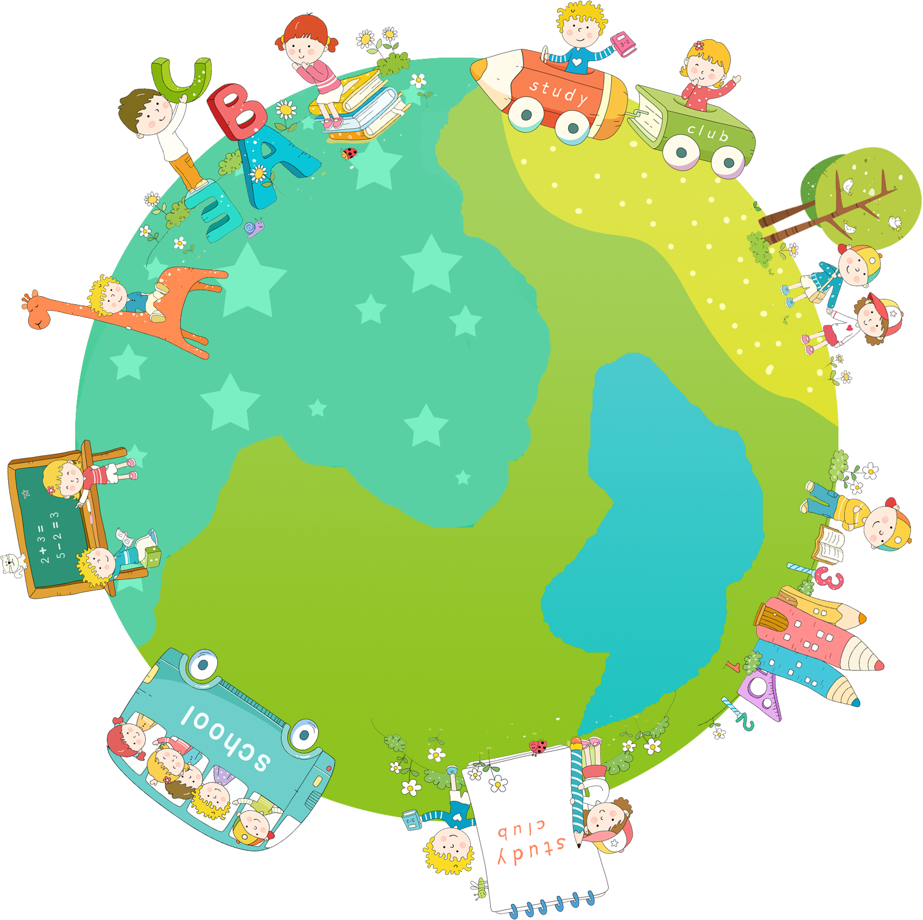
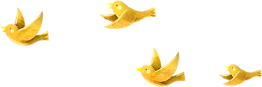
Thank you & goodbye!

