Slide 1




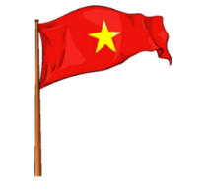


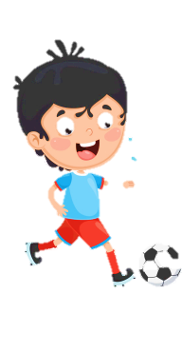






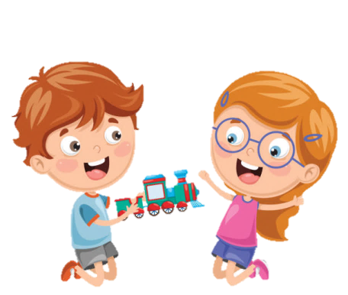





Slide 2






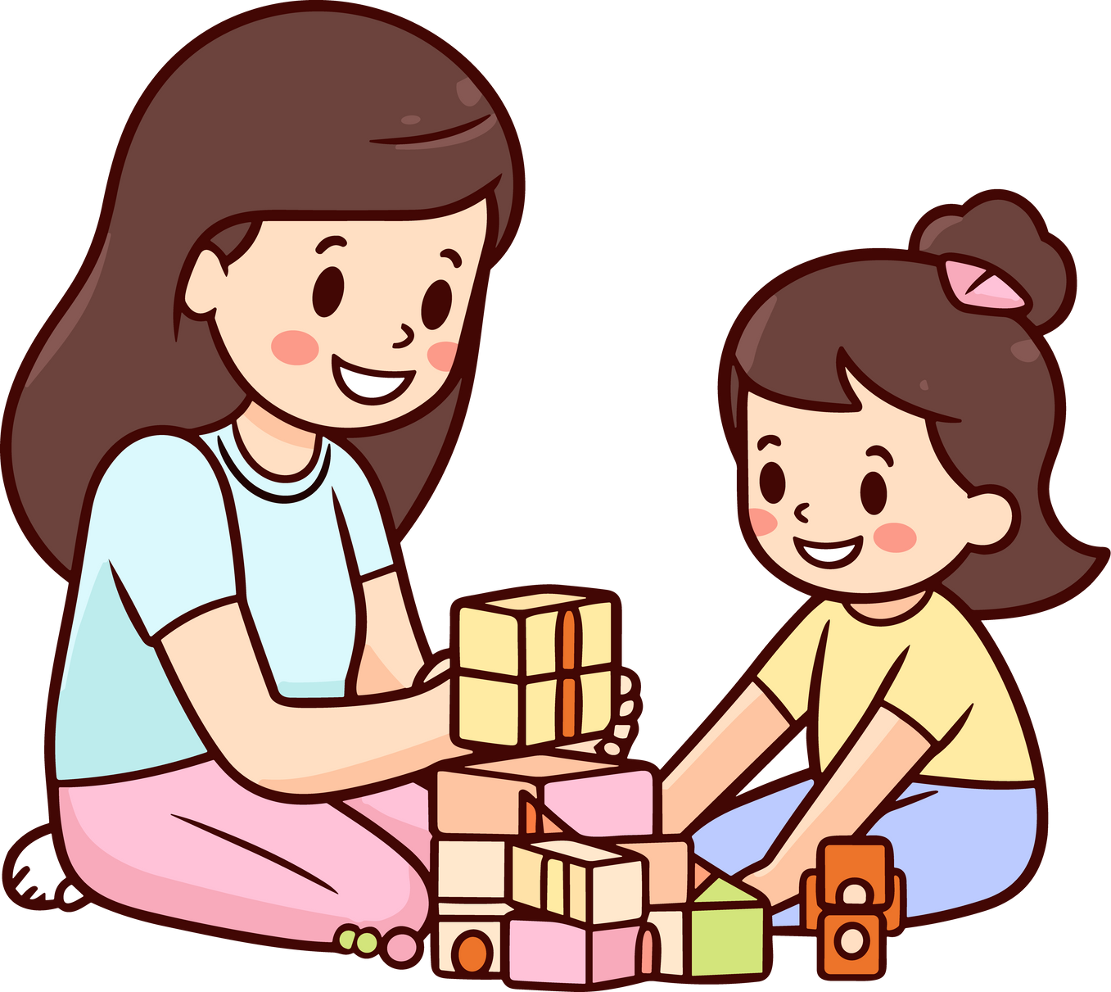

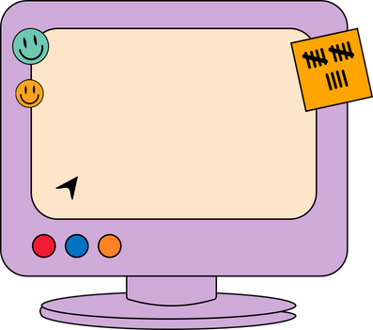
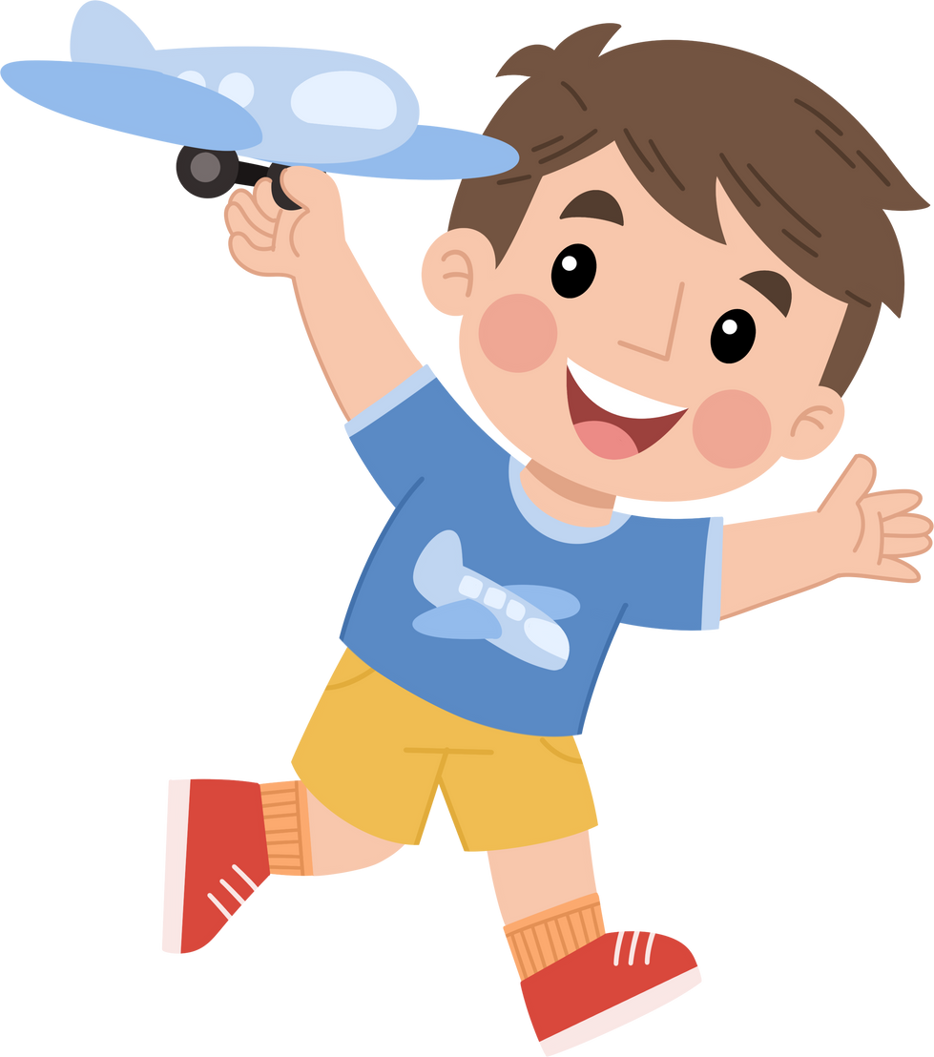

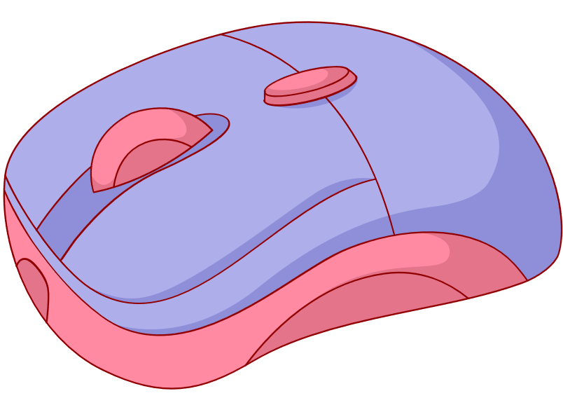
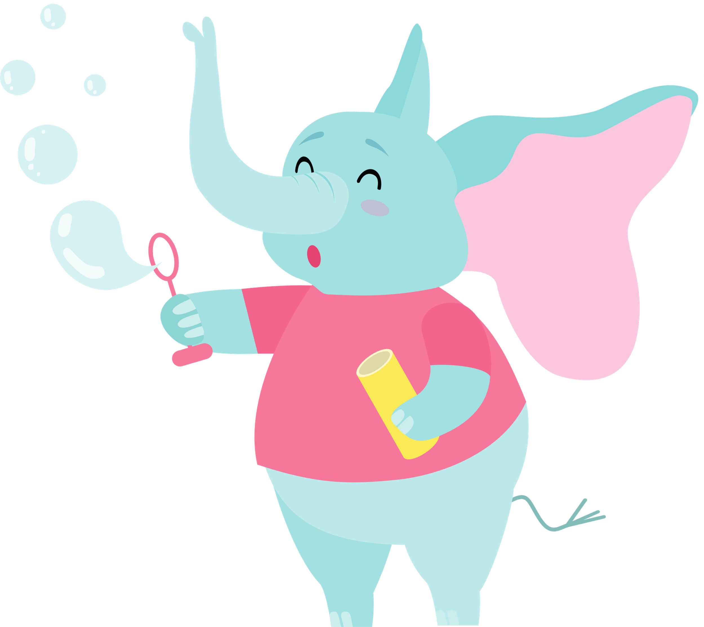



Unit 2
My Favourite Things
Lesson 3: Activity 7-8-9-10

Slide 3












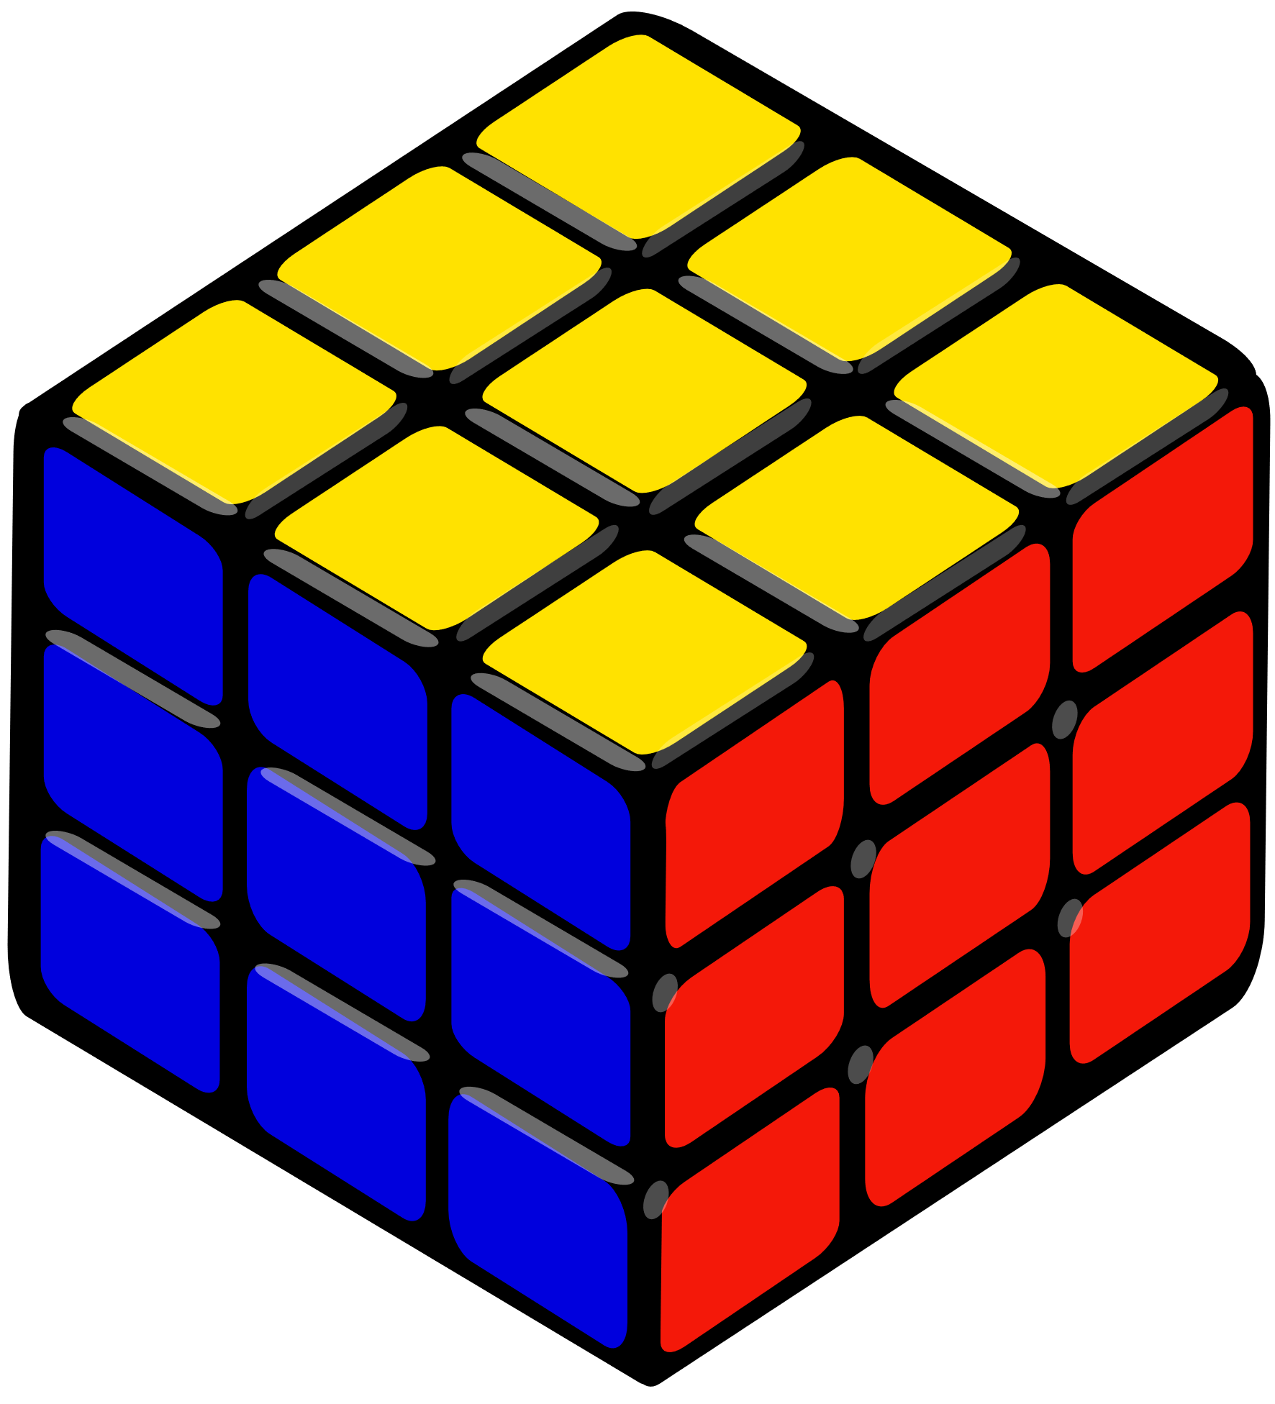

1
Warm Up
2
Presentation
3
Practice
Tables
of content
5
Wrap-up & Assessment
4
Production

Slide 4

Warm Up
1

Slide 5
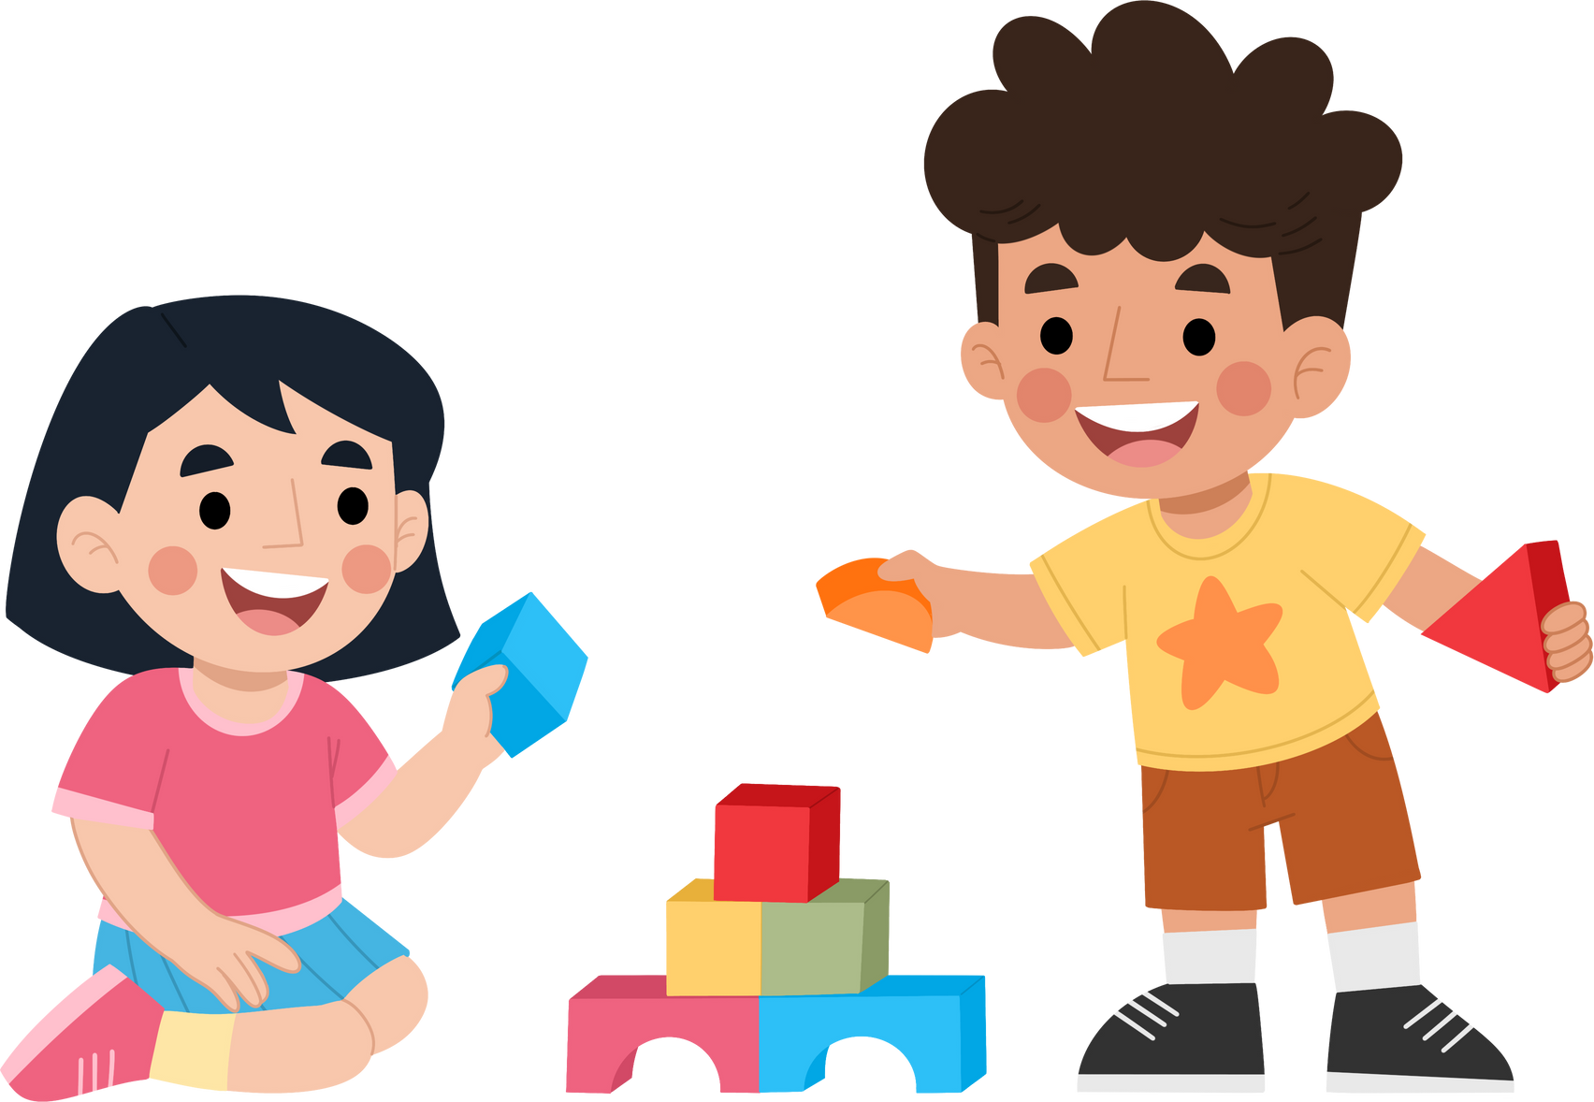





Guessing game
Notes:
Look the letters on the blocks to make the correct words

Slide 6


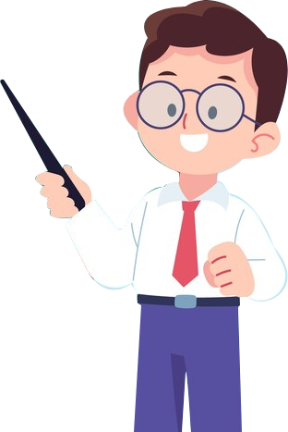

What is this?
It’s a book.

Slide 7


What is this?
It’s a boat.

Slide 8


What is this?
It’s a violin.

Slide 9


What is this?
It’s a globe.

Slide 10



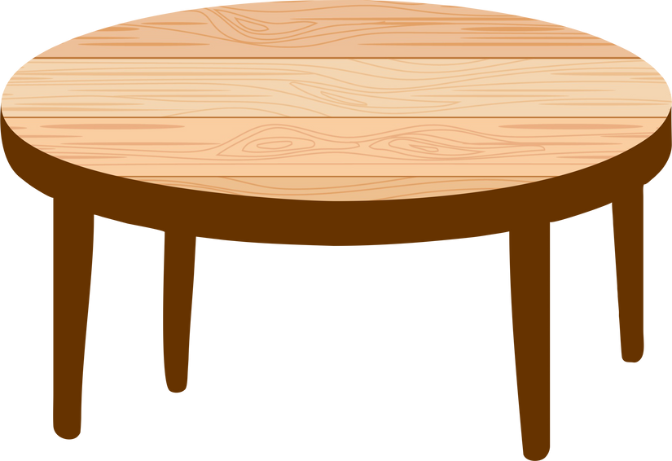

2
Presentation

Slide 11

expensive
/ɪkˈspen.sɪv/
computer
/kəmˈpjuː.tər/
fantastic
/fænˈtæs.tɪk/
banana
/bəˈnɑː.nə/
develop
/dɪˈvel.əp/

Slide 12


7. Listen, point, and repeat.
expensive
computer
fantastic
develop
projector
banana

Slide 13
Practice
3

Slide 14


8. Circle the word which is stressed differently. Then read aloud.
expensive fantastic funny
banana mother projector
develop fantastic country
favourite computer expensive
funny
mother
country
favourite

Slide 15

9. Listen and chant.
Expensive, computer, fantastic,
Banana, projector, develop!
Keep practising, do your best,
And soon you’ll know where to stress!

Slide 16
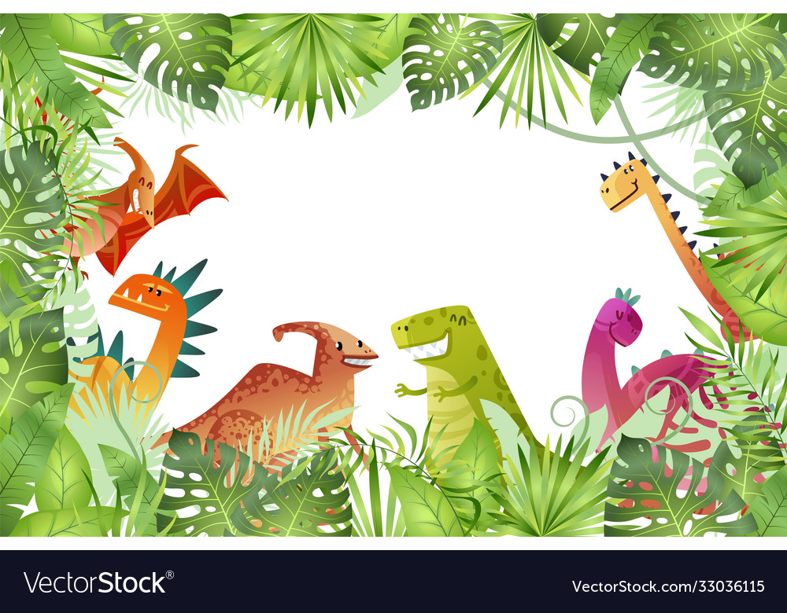





LUCKY
WHEEL
3
2
1
2
3
4
1
5
8
4
5
6
6
7
7
8
9
NEXT
SPIN
Notes:
Click vào số để di chuyển tới câu hỏi
Nếu câu trả lời đúng, click nút spin để quay, sau đó click lên vòng quay để dừng và check điểm số
Nếu muốn kết thúc trò chơi, click nút next để sang phần tiếp theo

Slide 17






Listen and choose the word.
A. expensive
B. experience
C. exercise
D. experiment
BACK
Notes:
Click nút Back để quay về màn hình chọn câu hỏi

Slide 18
Listen and choose the word.
A. develop
B. development
C. envelop
D. deploy
BACK

Slide 19
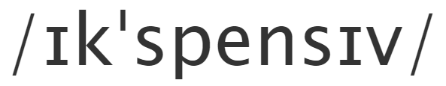

Which word is pronounced
A. expansive
B. explain
C. expensive
D. expression
BACK

Slide 20
Listen and choose the word.
A. contact
B. computer
C. composer
D. compact
BACK

Slide 21

Which word is pronounced
A. factory
B. fantasy
C. pharmacy
D. fantastic
BACK

Slide 22
Listen and choose the word
A. bat man
B. banana
C. banned
D. banner
BACK

Slide 23
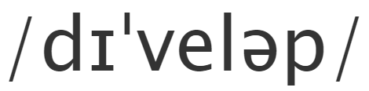
Which word is pronounced
A. develop
B. deploy
C. detect
D. defeat
BACK

Slide 24
5
Assessment

Slide 25


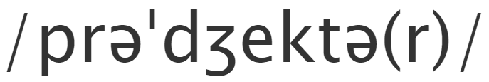
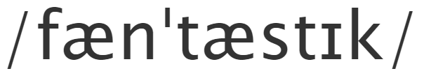


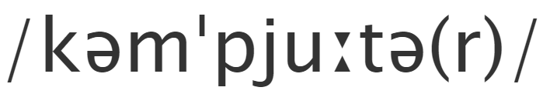


Match the word with its pronunciation
expensive
computer
fantastic
projector

Slide 26


Wrap-Up
STRESS
expensive
computer
fantastic
banana
projector
develop
Unit 2: My favourite things Lesson 3 – Part 7,8,9
What have we learnt today?

Slide 27

Thank you
for your attention

