Slide 1





















Notes:
Để nguyên trang bìa như này, chỉ thay đổi tên bài trong quá trình làm. Logo của sách Wonderful World

Slide 2




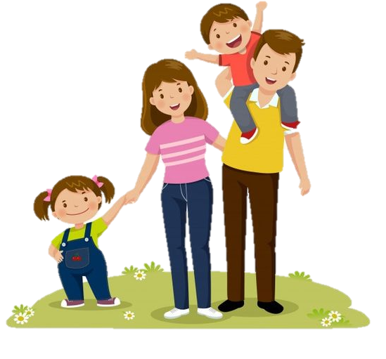
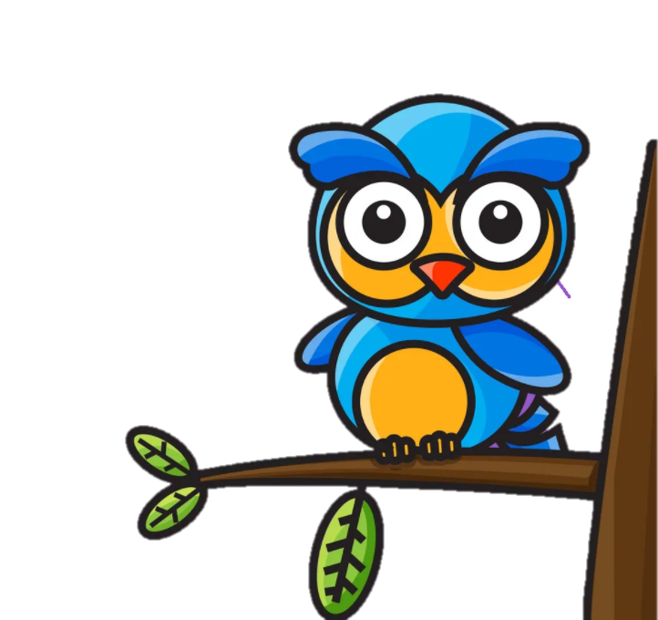

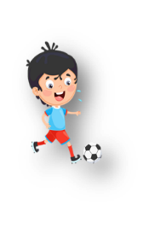



Unit 4: Food and Drinks
Lesson 3: Task 4 5 6

Slide 3

1
Warm up
Notes:
Warm-up: Play a small game “ Puzzle game”
The teacher asks SS to identify different colors and choose a color to guess the image behind the puzzles.
T calls Ss to answer and check their answers.
T asks Ss to repeat names of objects in the image.
Answer keys:
1. rope
2. horse
3. seesaw
4. hide-and-seek

Slide 4
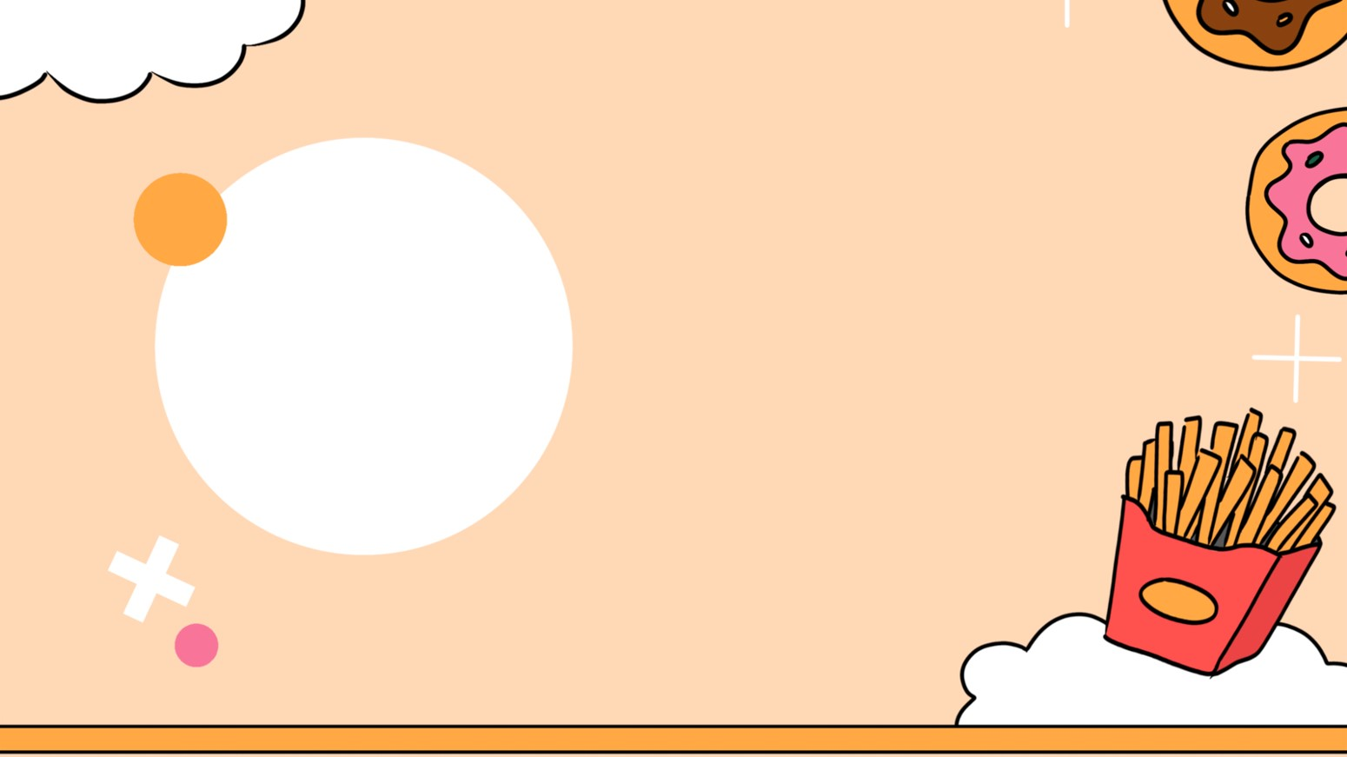


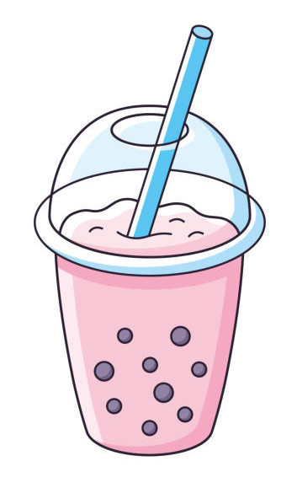
1
2
Bubble tea
6 stars
3
4

Slide 5
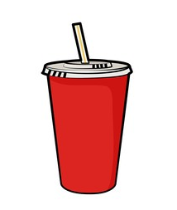
1
2
Soft drink
3 stars
3
4

Slide 6
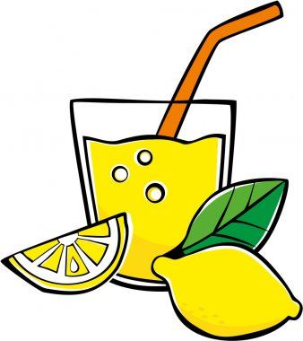
1
2
Lemonade
9 stars
3
4

Slide 7
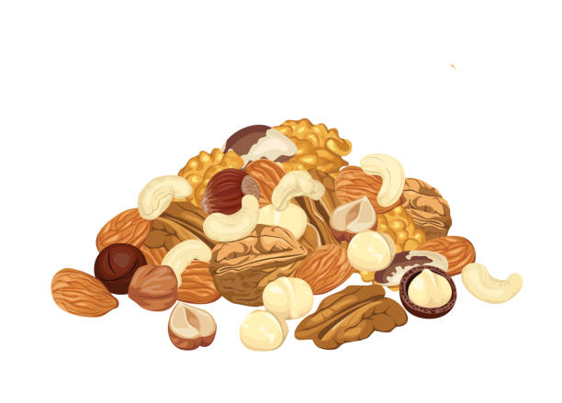
1
2
Nuts
3 stars
3
4

Slide 8
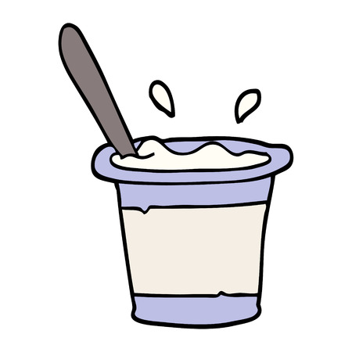
1
2
Yoghurt
5
stars
3
4

Slide 9
2
Presentation

Slide 10
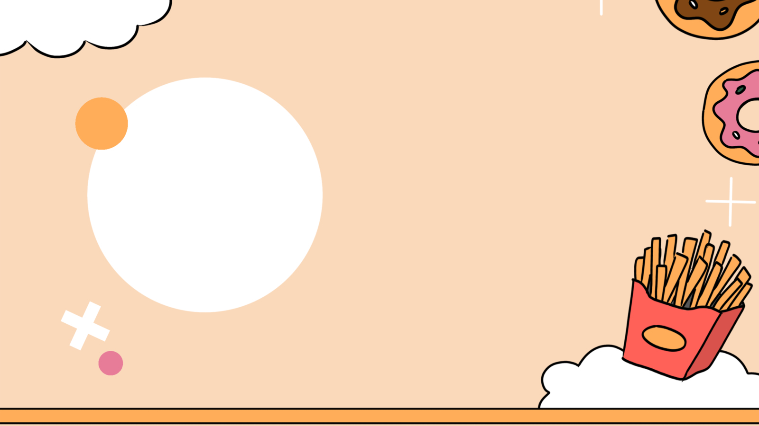
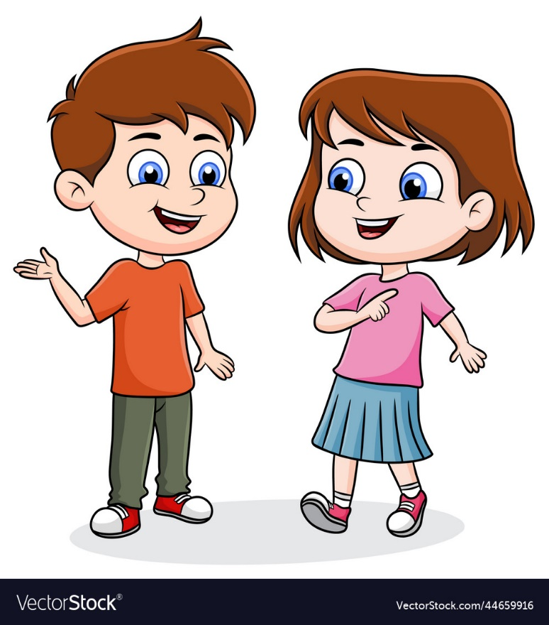

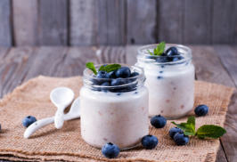
4. Listen and repeat.(track 4.11)
What’s your favourite food?
My fαvourite food is yoghurt.

Slide 11
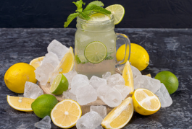
4. Listen and repeat.(track 4.11)
What’s your favourite drink?
My fαvourite drink is lemonade.

Slide 12
3
Practice

Slide 13
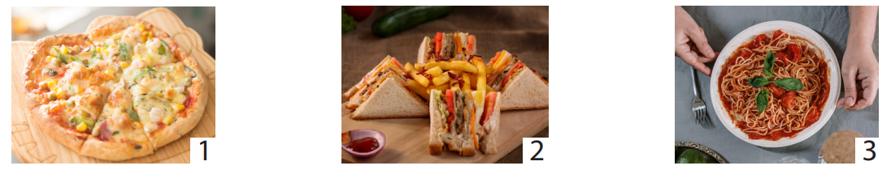
5. Look and say.
What’s your favourite food?
My favourite food is ….

Slide 14
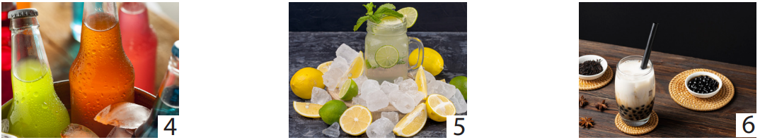
5. Look and say.
What’s your favourite drink?
My favourite drink is ….

Slide 15
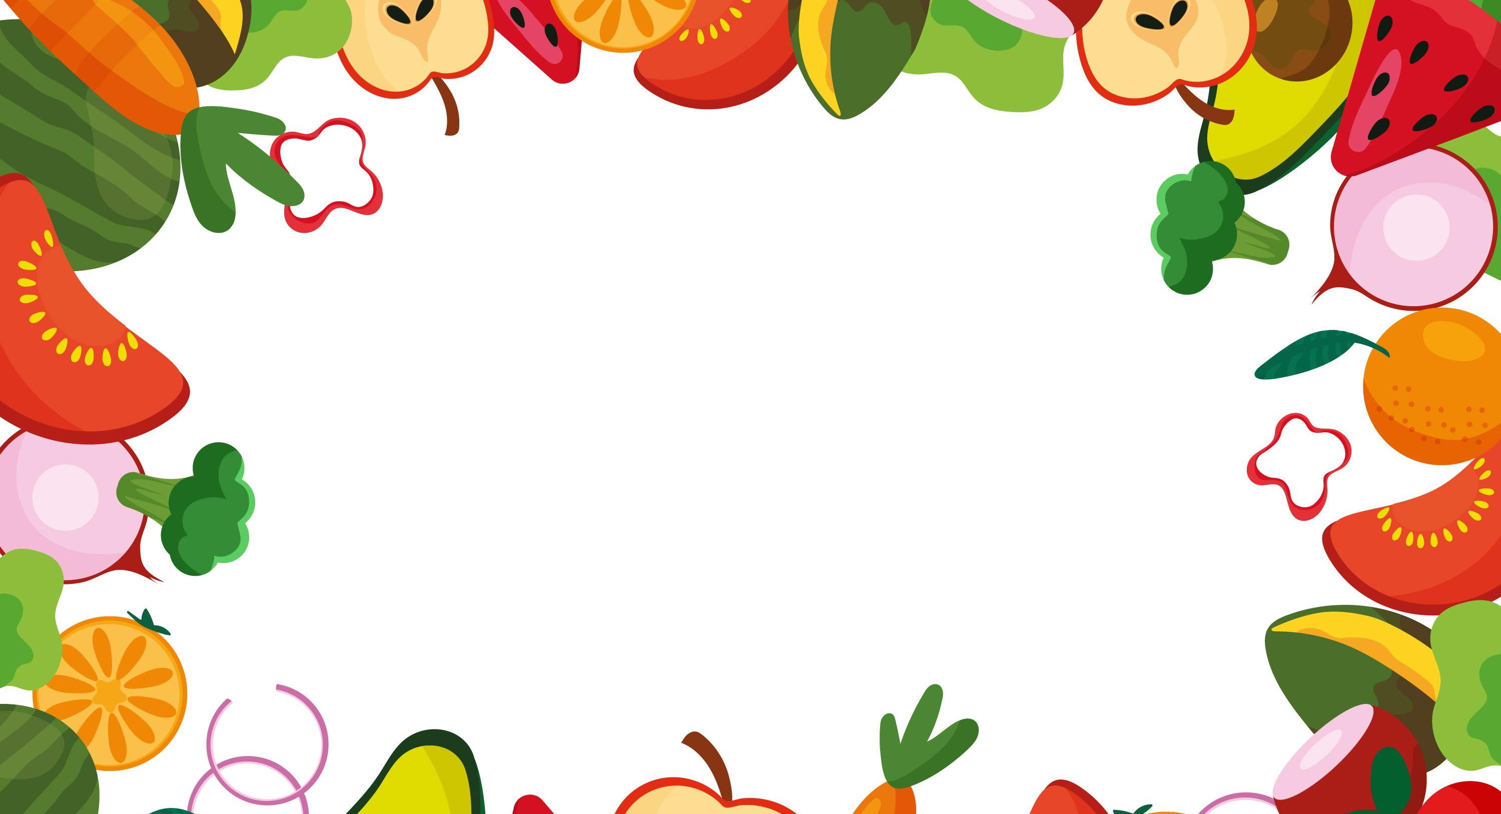
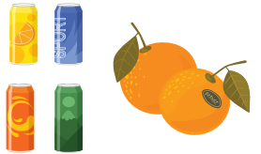
6. Drαw αnd write. Sαy.
My fαvourite food is...
And my fαvourite drink is...

Slide 16
4
Production

Slide 17

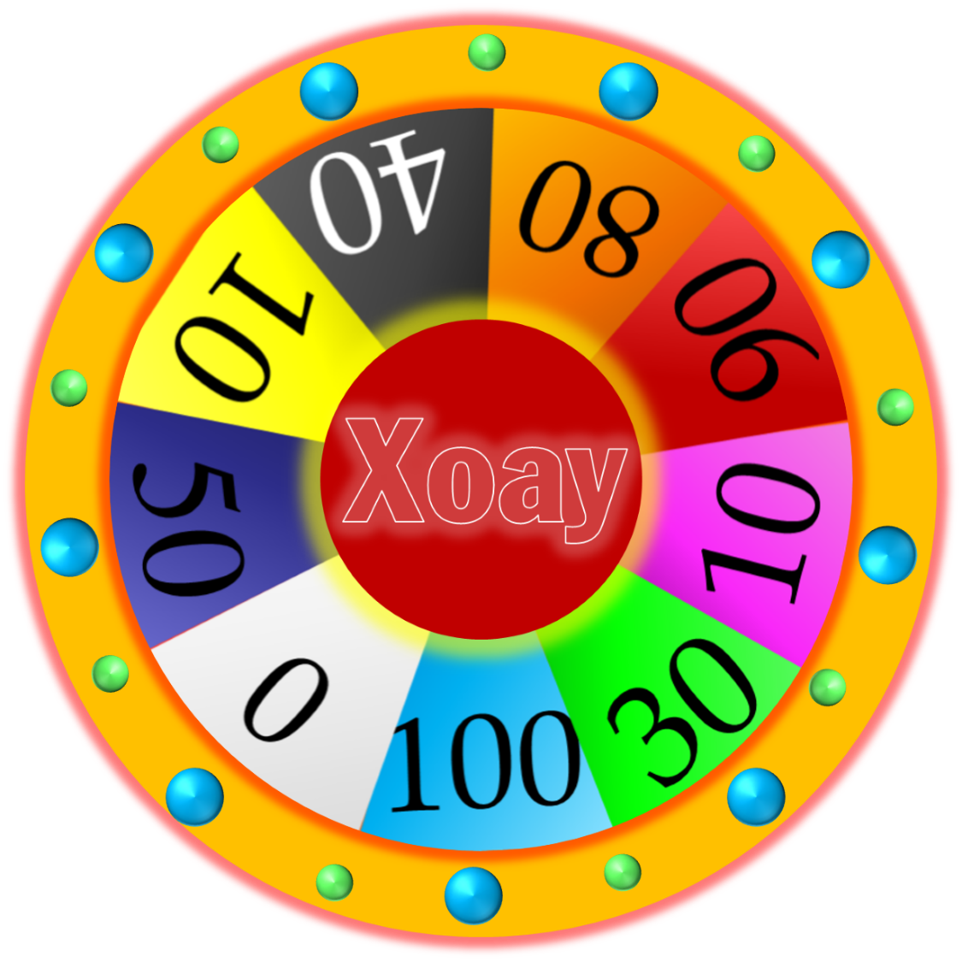

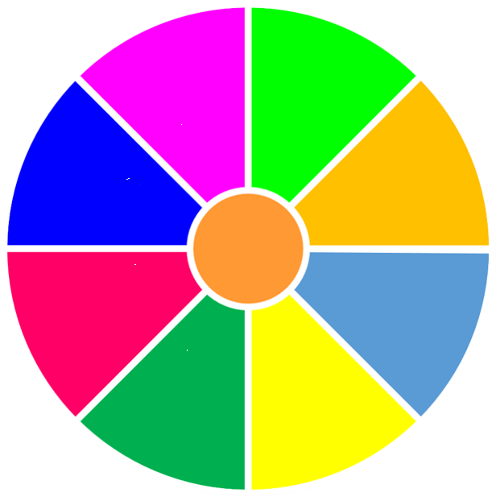



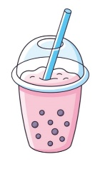
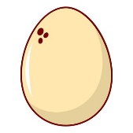

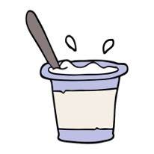
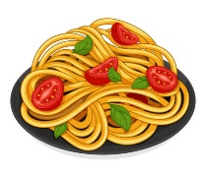


Let’s say.
What’s your favourite food/ drink?
My favourite food/ drink is….
START
STOP

Slide 18



ASSESSMENT
TEAM 1
TEAM 2
TEAM 3
TEAM 4
Vận dụng xuất sắc những kiến thức đã học vào thực hành
Vận dụng tốt những kiến thức đã học vào thực hành
Biết cách vận dụng những kiến thức đã học vào thực hành

Slide 19



5
Assessment

Slide 20
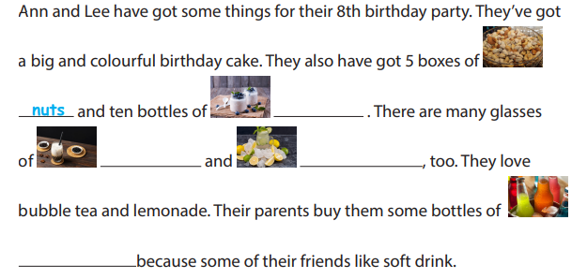
Write.
yoghurt
bubble tea
lemonade
soft drink

Slide 21

UNIT 4: Food and Drinks
LESSON 3: task 4 5 6
What we learnt today
Review vocabulary: bubble tea, lemonade, soft drink, nuts, yoghurt
Structure: What’s your favourite food/drink?
- My favourite food/ drink is…… .

Slide 22
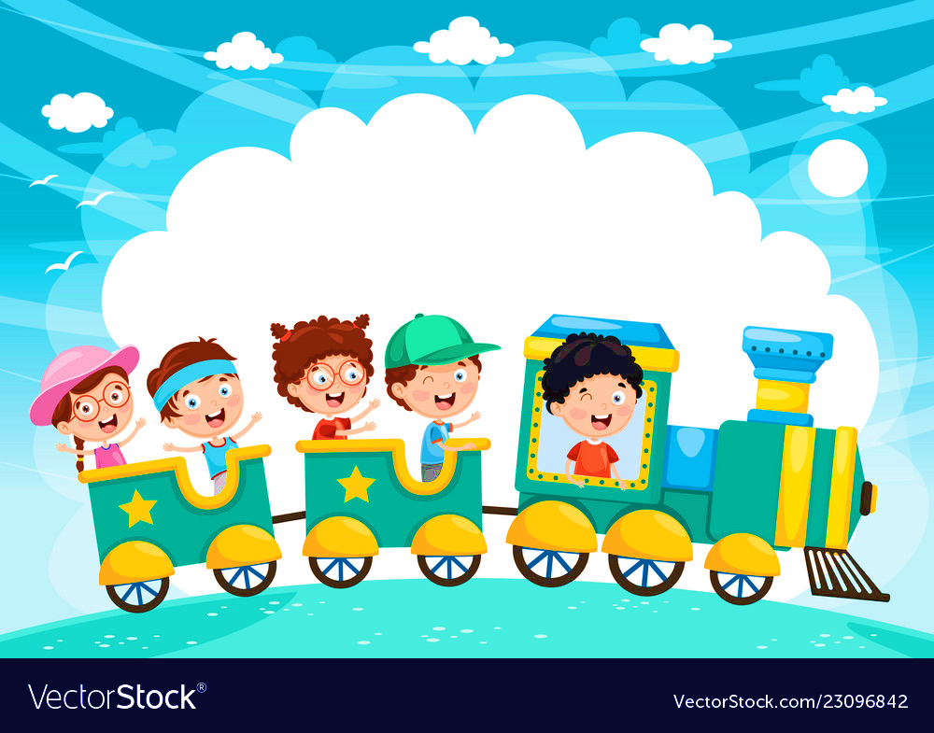







and

