Slide 1





















Notes:
Để nguyên trang bìa như này, chỉ thay đổi tên bài trong quá trình làm. Logo của sách Wonderful World

Slide 2


Unit 2 - My Home
Lesson 3 – Period 2

Slide 3










1 Warm-up
Unscramble the word

Slide 4





Question 1
BOOKSHELF
Reorder the letters to make the correct word.
BKOSOHLEF
Answer
Next

Slide 5

Question 2
FLOOR
Reorder the letters to make the correct word.
ROLFO
Answer
Next

Slide 6
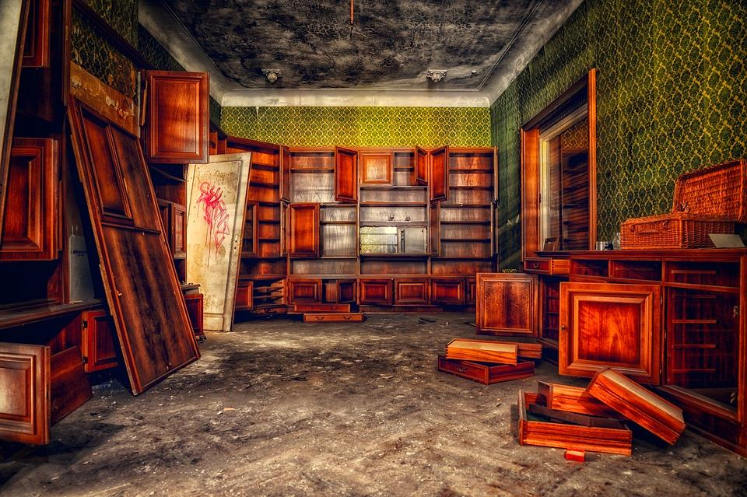
Question 3
MESSY
Reorder the letters to make the correct word.
SSMEY
Answer
Next

Slide 7

Question 4
TIDY
Reorder the letters to make the correct word.
YTID
Answer
Next

Slide 8
2 Presentation
Listen and repeat

Slide 9

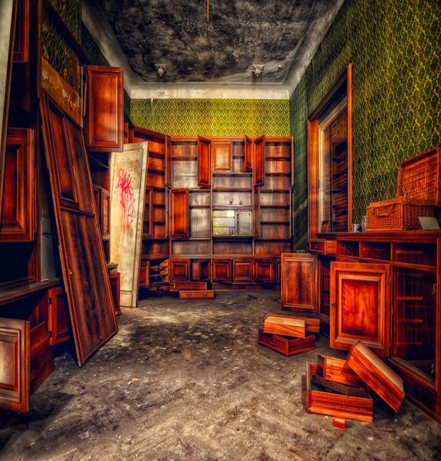

Circle and say.
dbookshelffvdroom
floorrsstidyrademessytf
1
2
3
4
room
bookshelf
messy
tidy

Slide 10


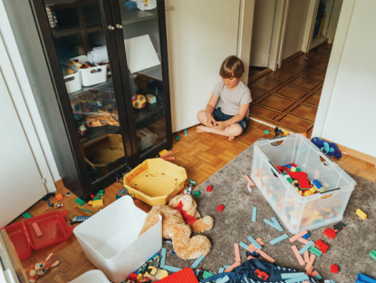
4
Listen and repeat.
1. How messy is his room?
- It’s very messy
Notes:
Không có hình loa để giáo viên click vào

Slide 11

2. How tidy is her bookshelf?
It’s very tidy.

Slide 12
3 Practice
Look and say

Slide 13

CANDY CATCHER

Slide 14



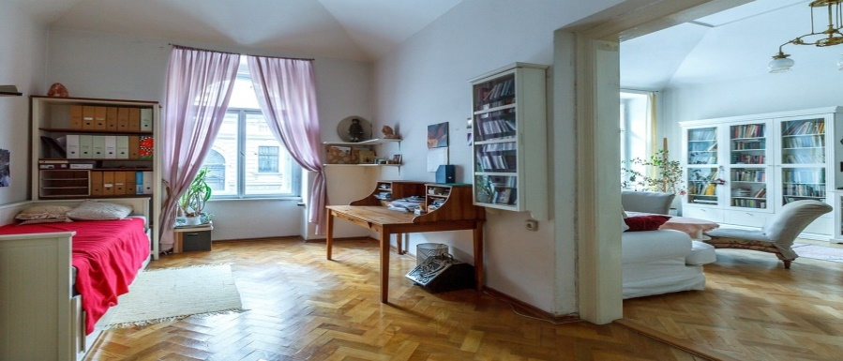




Her room is very ______.
A. big
01
B. small

Slide 15


Listen and choose.
A. Her bookshelf is tidy.
02
B. Her bookshelf is messy.

Slide 16
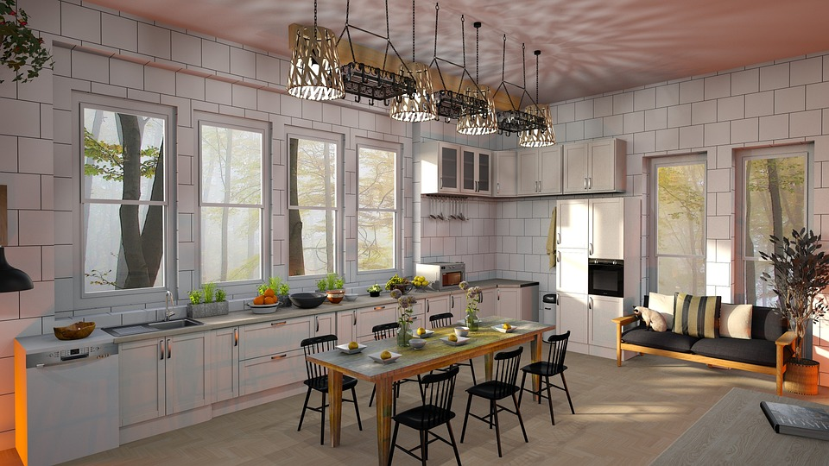
Choose the correct answer.
A. Our dining room is very old.
03
B. Our dining room is very new.

Slide 17
Fill in the blank.
Our _____ is small.
A. toyybox
B. toy bok
04
C. toy box

Slide 18




5
Look and say.
1. His/ bookshelf/ tidy
How tidy is his bookshelf?
It’s very tidy.

Slide 19

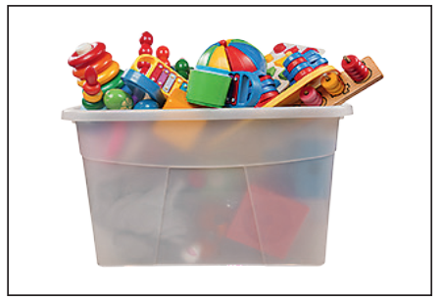
2. Our/ toy box/ big
How big is
our toy box?
Our toy box is very big.

Slide 20
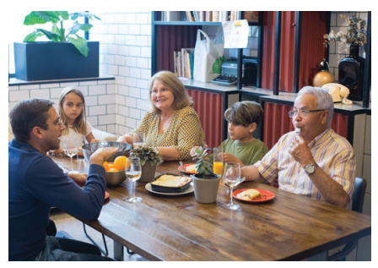


3 Our/ dining room/ new
How new is our dining room?
Our dining room is very new.

Slide 21

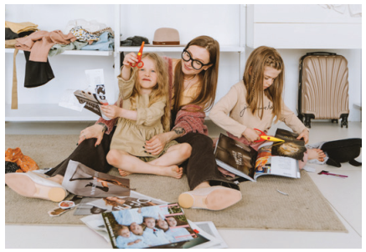
4 Their/ bedroom/ messy
Their bedroom is very messy.
How messy is their bedroom?

Slide 22
4 Production

Slide 23



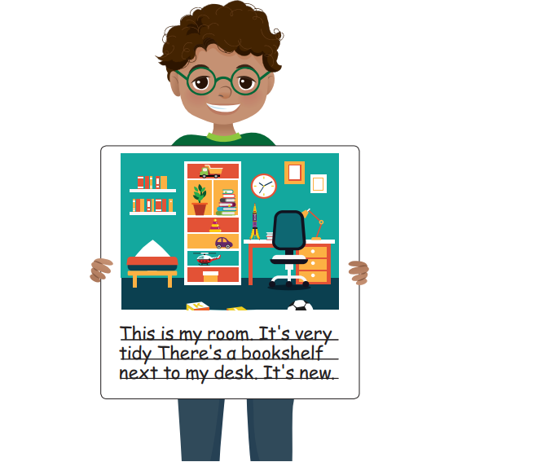
Draw and write. Say
This is my room…
This is my room. It’s very tidy. There’s a bookshelf next to my desk. It’s new.

Slide 24
5 Assessment

Slide 25
Order the words to make complete sentences
1. books/ good/ We/ have/.
We have good books.
__________________
2. new/ sofa/ in front of/ table/ The/ the/ is/.
The new table is in front of the sofa.
____________________________
3. Our/ new/ nice/ fridge/ and/ is/.
Our fridge is new and nice.
_________________________
4. our/ dining room/ tidy/ is/ How/?
How tidy is our dining room?
_________________________

Slide 26
6 Wrap-up

Slide 27

REMEMBER
Vocabulary:
-bookshelf, floor, toy box, messy, tidy
Structure:
How messy is his room?
It’s very messy.
How tidy is her bookshelf?
- Her bookshelf is very tidy.

Slide 28




Thank you & goodbye!

