Slide 1



WELCOME TO ALL TEACHERS
Teacher: Vu Thi Thu Ha

Slide 2
REVISION FOR
THE ENTRANCE EXAMINATION
READING SKILLS

Slide 3

After this lesson, students will be able to:
Recognize the types of questions in this exercise.
Apply what they have learnt to do this kind of exercise.

Slide 4
Assignment

Slide 5


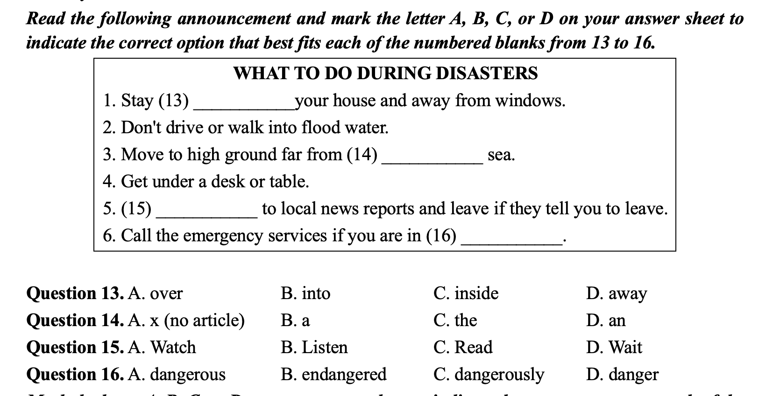


Reading skills

Slide 6
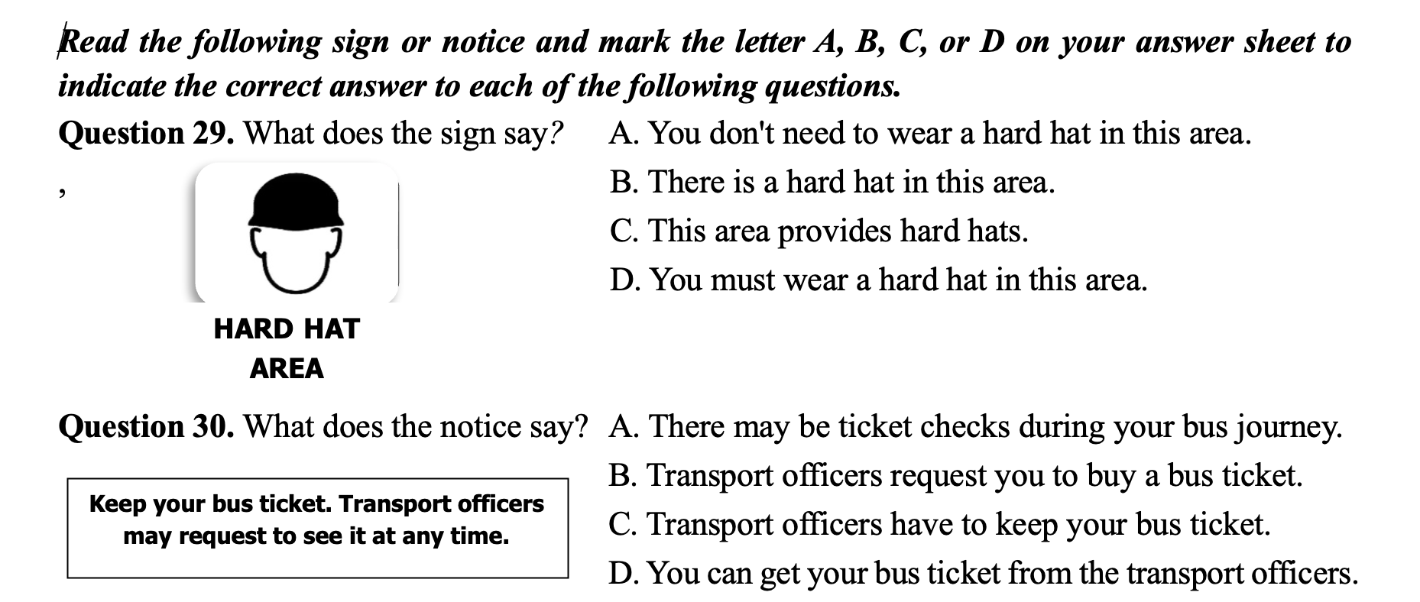

Slide 7
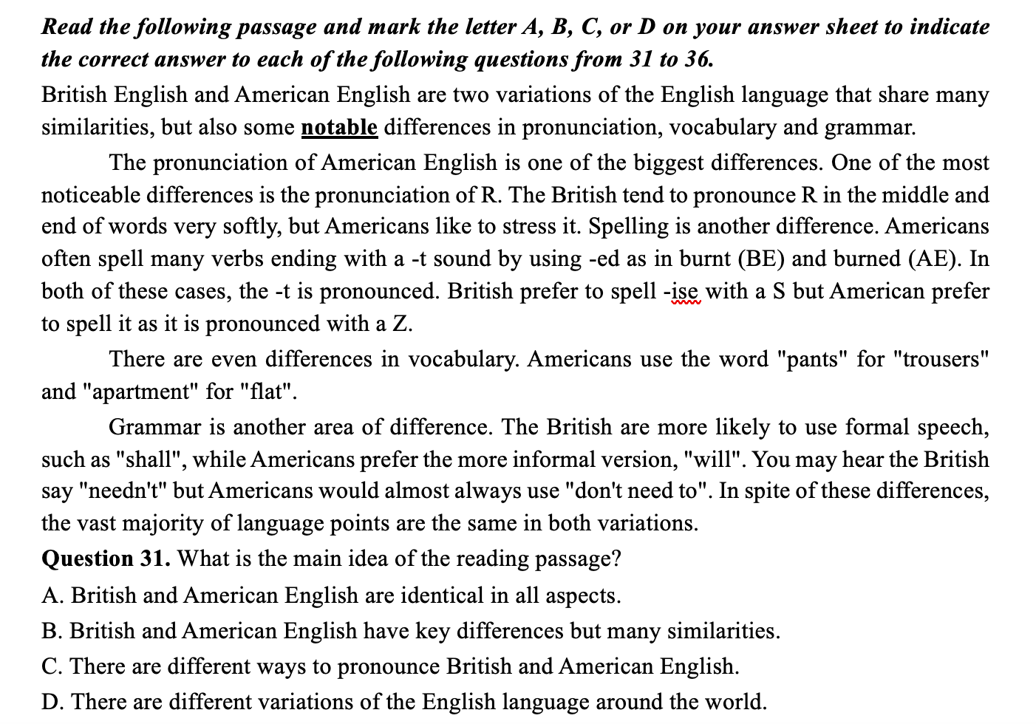

Slide 8
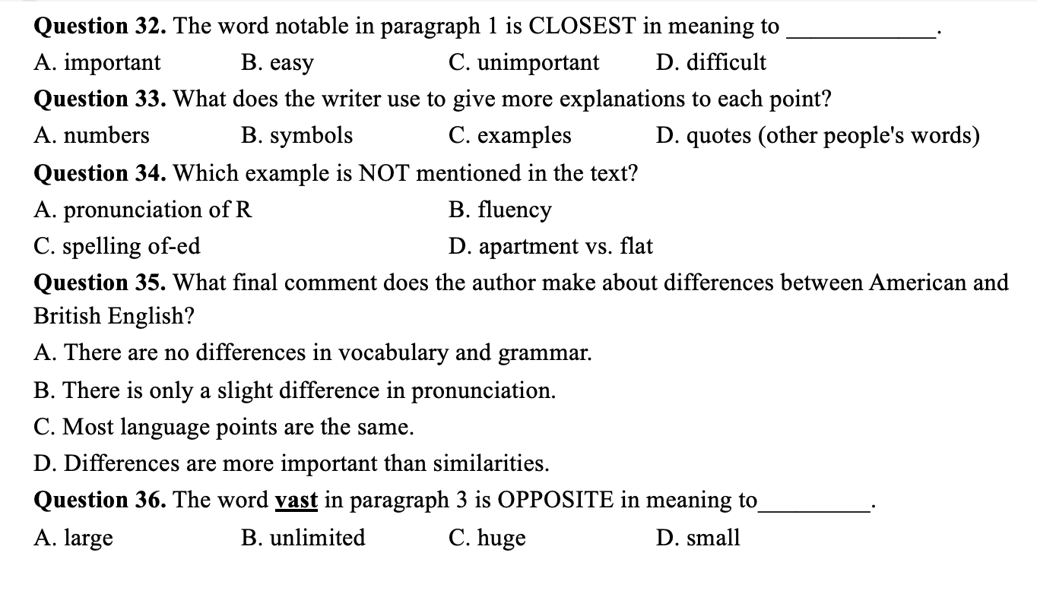

Slide 9
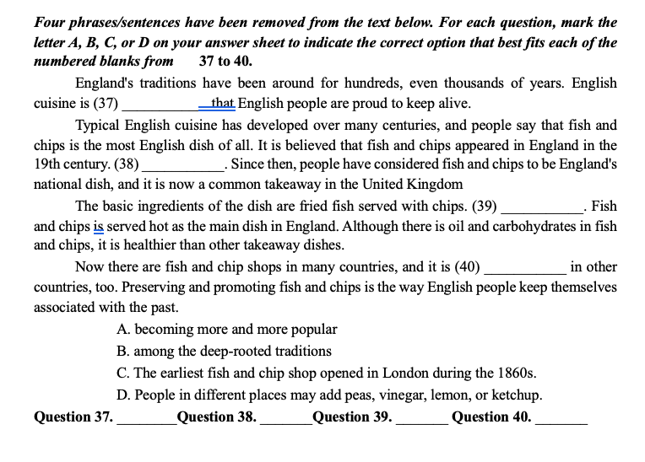

Slide 13

SKIMMING & SCANNING

Slide 14
Skimming
Scanning
Đọc lướt ý chính, tìm ý chung của đoạn văn, hiểu sơ lược nội dung được đề cập
Tìm đáp án chi tiết, chú ý theo từ khoá và thông tin được cho
Đọc kỹ câu hỏi để biết được từ chìa khoá xuất hiện và tìm kiếm trong đoạn văn
Đọc tiêu đề nếu có
- Sử dụng 1 ngón tay để di chuyển theo các câu văn để tập trung hơn nhằm biết được các từ khoá ở đâu, tránh bỏ sót từ đồng nghĩa hoặc cách diễn đạt tương đương về nghĩa
- Khi thấy từ chìa khoá, dừng lại và đọc phần văn bản xung quanh để tìm ra câu trả lời
Đọc tiêu đề nếu có
Đọc vài câu đầu tiên và những câu cuối cùng của đoạn để lướt nắm ý chính
Đọc tiêu đề nếu có
Đọc câu đầu tiên của các đoạn còn lại

Slide 15
QUESTION TYPES
01
02
03
04
Main idea questions
Stated detail questions
Unstated detail questions
Vocabulary in context questions

Slide 16
Main idea question

Slide 17
Vocabulary in context questions
Stated detail question
Unstated detail question
Stated detail question
Vocabulary in context questions

Slide 18
MAIN IDEA QUESTIONS
What is the topic of the passage?
What is the subject of the passage?
What is the main idea of the passage?
What is the author's main point in the passage?
Which of the following would be the best tittle?
What is the author's main purpose in the passage?
Các câu hỏi thường gặp
Thường nằm ở câu chủ đề ở đầu hoặc cuối một đoạn văn.
Nếu ý chính không nằm cụ thể trong một câu nào, người làm nên trả lời câu hỏi này sau cùng, sau khi đã trả lời các câu hỏi chi tiết.
Câu trả lời
- Đọc câu đầu tiên và câu cuối của mỗi đoạn và tìm ý chung giữa chúng.
- Để ý tới các từ khóa được lặp đi lặp lại.
- Dùng phương pháp loại trừ, bỏ đi những phương án chắc chắn sai. (Thông thường các ý chính sẽ không quá chung chung hoặc quá chi tiết và cũng không thể không được nhắc đến trong bài).
Cách làm

Slide 19
TEENTECH Forum
Thomson@2005: I always read about teens and how much time they spend on their electronic devices.
Is it a good idea for teens to have a lot of electronic devices? What do you think?
Dan@14: Of course it is! Having a device like a smartphone is a great way for me to contact friends
and family members - especially the ones I don't see very often. I share photos and send them text
messages on a messaging app all the time. I also use my laptop and my tablet to do research and improve my computer skills.
Harrison@008: Electronic devices can have some negative effects on teens. I had a tablet, a
smartphone and a games console. I spent too much time playing video games and going on social media.
My parents said it would reduce my attention span and make me lack social skills. My doctor told me I
was gaining weight, too. Now, I just have a smartphone and I only use it after I finish my homework. I'm
glad I stopped wasting so much time on electronic devices.
Question 1. What is the main topic of the forum discussion?
A. Several benefits of social media for teenagers.
B. Some effects of electronic devices on teens.
C. Different ways to contact friends and family members.
D. Different ways to improve computer skills.
(Câu 21-Đề thi tuyển sinh vào 10 năm học 2024 -2025)

Slide 20
British English and American English are two variations of the English language that share many similarities, but also some notable differences in pronunciation, vocabulary and grammar.
The pronunciation of American English is one of the biggest differences. One of the most noticeable differences is the pronunciation of R. The British tend to pronounce R in the middle and end of words very softly, but Americans like to stress it. Spelling is another difference. Americans often spell many verbs ending with a -t sound by using -ed as in burnt (BE) and burned (AE). In both of these cases, the -t is pronounced. British prefer to spell -ise with a S but American prefer to spell it as it is pronounced with a Z.
There are even differences in vocabulary. Americans use the word "pants" for "trousers" and "apartment" for "flat".
Grammar is another area of difference. The British are more likely to use formal speech, such as "shall", while Americans prefer the more informal version, "will". You may hear the British say "needn't" but Americans would almost always use "don't need to". In spite of these differences, the vast majority of language points are the same in both variations.
Question 2. What is the main idea of the reading passage?
A. British and American English are identical in all aspects.
B. British and American English have key differences but many similarities.
C. There are different ways to pronounce British and American English.
D. There are different variations of the English language around the world.
( Câu 31- Đề minh hoạ của Sở GD&ĐT Hà nội)

Slide 21
STATED DETAIL QUESTIONS
According to the passage, ...................
It is stated in the passage ....................
Which of the following is true ...................
What is the author's main purpose in the passage?
Các câu hỏi thường gặp
Câu trả lời nằm trong bài đọc, thường đã được diễn đạt bằng một cách khác tương đương về nghĩa
Câu trả lời
- Gạch chân từ chính (keywords), ý quan trọng trong câu hỏi.
- Đọc quét (Scan) để tìm ra câu chứa thông tin và keywords trong đoạn.
- Đọc kỹ câu chứa keywords và ý trong câu đó một cách cẩn thận.
- Dùng phương pháp loại trừ, bỏ đi các phương án chắc chắn sai.
Cách làm

Slide 22
TEENTECH Forum
Thomson@2005: I always read about teens and how much time they spend on their electronic devices.
Is it a good idea for teens to have a lot of electronic devices? What do you think?
Dan@14: Of course it is! Having a device like a smartphone is a great way for me to contact friends
and family members - especially the ones I don't see very often. I share photos and send them text
messages on a messaging app all the time. I also use my laptop and my tablet to do research and improve my computer skills.
Harrison@008: Electronic devices can have some negative effects on teens. I had a tablet, a
smartphone and a games console. I spent too much time playing video games and going on social media.
My parents said it would reduce my attention span and make me lack social skills. My doctor told me I
was gaining weight, too. Now, I just have a smartphone and I only use it after I finish my homework. I'm
glad I stopped wasting so much time on electronic devices.
Question 3. Where does Dan@14 share photos and send messages?
A. On a games console.
B. On a computer website.
C. On a messaging app.
D. On TeenTech forum.
(Câu 23- Đề thi tuyển sinh vào 10 năm học 2024 -2025)

Slide 23
British English and American English are two variations of the English language that share many similarities, but also some notable differences in pronunciation, vocabulary and grammar.
The pronunciation of American English is one of the biggest differences. One of the most noticeable differences is the pronunciation of R. The British tend to pronounce R in the middle and end of words very softly, but Americans like to stress it. Spelling is another difference. Americans often spell many verbs ending with a -t sound by using -ed as in burnt (BE) and burned (AE). In both of these cases, the -t is pronounced. British prefer to spell -ise with a S but American prefer to spell it as it is pronounced with a Z.
There are even differences in vocabulary. Americans use the word "pants" for "trousers" and "apartment" for "flat".
Grammar is another area of difference. The British are more likely to use formal speech, such as "shall", while Americans prefer the more informal version, "will". You may hear the British say "needn't" but Americans would almost always use "don't need to". In spite of these differences, the vast majority of language points are the same in both variations.
Question 4. What does the writer use to give more explanations to each point?
A. numbers B. symbols
C. examples D. quotes (other people's words)
(Câu 33- Đề minh hoạ của Sở GD&ĐT Hà Nội )

Slide 24
British English and American English are two variations of the English language that share many similarities, but also some notable differences in pronunciation, vocabulary and grammar.
The pronunciation of American English is one of the biggest differences. One of the most noticeable differences is the pronunciation of R. The British tend to pronounce R in the middle and end of words very softly, but Americans like to stress it. Spelling is another difference. Americans often spell many verbs ending with a -t sound by using -ed as in burnt (BE) and burned (AE). In both of these cases, the -t is pronounced. British prefer to spell -ise with a S but American prefer to spell it as it is pronounced with a Z.
There are even differences in vocabulary. Americans use the word "pants" for "trousers" and "apartment" for "flat".
Grammar is another area of difference. The British are more likely to use formal speech, such as "shall", while Americans prefer the more informal version, "will". You may hear the British say "needn't" but Americans would almost always use "don't need to". In spite of these differences, the vast majority of language points are the same in both variations.
Question 5. What final comment does the author make about differences between American
and British English?
A. There are no differences in vocabulary and grammar.
B. There is only a slight difference in pronunciation.
C. Most language points are the same.
D. Differences are more important than similarities.
(Câu 35- Đề minh hoạ của Sở GD&ĐT Hà Nội)

Slide 25
British English and American English are two variations of the English language that share many similarities, but also some notable differences in pronunciation, vocabulary and grammar.
The pronunciation of American English is one of the biggest differences. One of the most noticeable differences is the pronunciation of R. The British tend to pronounce R in the middle and end of words very softly, but Americans like to stress it. Spelling is another difference. Americans often spell many verbs ending with a -t sound by using -ed as in burnt (BE) and burned (AE). In both of these cases, the -t is pronounced. British prefer to spell -ise with a S but American prefer to spell it as it is pronounced with a Z.
There are even differences in vocabulary. Americans use the word "pants" for "trousers" and "apartment" for "flat".
Grammar is another area of difference. The British are more likely to use formal speech, such as "shall", while Americans prefer the more informal version, "will". You may hear the British say "needn't" but Americans would almost always use "don't need to". In spite of these differences, the vast majority of language points are the same in both variations.
Question 6. Which example is NOT mentioned in the text?
A. pronunciation of R B. fluency
C. spelling of-ed D. apartment vs. flat
(Câu 34-Đề minh hoạ của Sở GD&ĐT Hà Nội)

Slide 26
UNSTATED DETAIL QUESTIONS
Which of the following is not stated ... ?
Which of the following is not mentioned ... ?
Which of the following is not diseussed ... ?
Which of the following are false ... ?
All of the following are true except ... ?
Các câu hỏi thường gặp
Sẽ không xuất hiện trong bài hoặc là một câu trả lời sai so với bài
trả lời câu hỏi này sau cùng, sau khi đã trả lời các câu hỏi chi tiết.
Câu trả lời
- Đọc kỹ câu hỏi và các phương án lựa chọn, gạch chân các keyword.
- Đọc lướt nhanh để khoanh vùng thông tin phù hợp với từng keyword.
- Đánh dấu vào những phương án phù hợp với thông tin trong bài đọc.
- Loại bỏ những phương án được đề cập hoặc đúng với bài đọc, đồng thời chọn phương án còn lại (là phương án không tìm được thông tin hoặc thông tin sai)
Cách làm

Slide 27
Tickets are available at the box office.
(Vé có thể mua được ở quầy bán vé)
I’m available in the afternoon.
(Tôi rỗi vào buổi chiều)

Slide 28
VOCABULARY IN CONTEXT QUESTIONS
What is the meaning of "A" in the line "B" ?
The word "A" in the line "B" could be replaced by...?
Which of the following word has the closest meaning with the word
"A" in the line "B"?
Which of the following has the opposite meaning with the word
"A" in the line "B"?
Các câu hỏi thường gặp
Dựa vào các thông tin xung quanh từ được đưa ra để đoán nghĩa của từ
Câu trả lời
- Tìm từ đó trong bài dọc
- Đọc kỹ câu chứa từ đó
- Tìm các manh mối trong ngữ cảnh để giúp hiểu ý nghĩa của từ
- Chọn đáp án mà ngữ cảnh thể hiện
Cách làm

Slide 29
British English and American English are two variations of the English language that share many similarities, but also some notable differences in pronunciation, vocabulary and grammar.
The pronunciation of American English is one of the biggest differences. One of the most noticeable differences is the pronunciation of R. The British tend to pronounce R in the middle and end of words very softly, but Americans like to stress it. Spelling is another difference. Americans often spell many verbs ending with a -t sound by using -ed as in burnt (BE) and burned (AE). In both of these cases, the -t is pronounced. British prefer to spell -ise with a S but American prefer to spell it as it is pronounced with a Z.
There are even differences in vocabulary. Americans use the word "pants" for "trousers" and "apartment" for "flat".
Grammar is another area of difference. The British are more likely to use formal speech, such as "shall", while Americans prefer the more informal version, "will". You may hear the British say "needn't" but Americans would almost always use "don't need to". In spite of these differences, the vast majority of language points are the same in both variations.
Question 7. The word “notable” in paragraph 1 is CLOSEST in meaning to ____________.
A. important B. easy C. unimportant D. difficult
(Câu 32- Đề minh hoạ của Sở GD&ĐT Hà Nội)

Slide 30
British English and American English are two variations of the English language that share many similarities, but also some notable differences in pronunciation, vocabulary and grammar.
The pronunciation of American English is one of the biggest differences. One of the most noticeable differences is the pronunciation of R. The British tend to pronounce R in the middle and end of words very softly, but Americans like to stress it. Spelling is another difference. Americans often spell many verbs ending with a -t sound by using -ed as in burnt (BE) and burned (AE). In both of these cases, the -t is pronounced. British prefer to spell -ise with a S but American prefer to spell it as it is pronounced with a Z.
There are even differences in vocabulary. Americans use the word "pants" for "trousers" and "apartment" for "flat".
Grammar is another area of difference. The British are more likely to use formal speech, such as "shall", while Americans prefer the more informal version, "will". You may hear the British say "needn't" but Americans would almost always use "don't need to". In spite of these differences, the vast majority of language points are the same in both variations.
Question 8. The word “vast” in paragraph 3 is OPPOSITE in meaning to_________.
A. large B. unlimited C. huge D. small
(Câu 36- Đề minh hoạ của Sở GD&ĐT Hà Nội)

Slide 31
FURTHER PRACTICE

Slide 32
Read the following passage and mark the letter A, B, C, or D on your answer sheet to indicate the correct answer to each of the following questions from 31 to 36.
In September 2024, Typhoon Yagi hit Hanoi, bringing strong winds and causing serious damage across the city. With wind speeds of up to 102 kilometers per hour, it was the strongest typhoon to hit Vietnam in the last 30 years. Streets were filled with fallen trees, with over 40,000 reported, mainly in central areas. This made daily life difficult for many residents.
To help clean up the city, local organizations called for volunteers. Arnaud Dubrac, a Frenchman living near West Lake, was one of many who joined the effort. He had recently returned from France and was shocked to see the damage. He worked alongside others to clear branches and debris from the streets.
Duncan Withers, from New Zealand, has lived in Hanoi for two years and was sad to see the trees he loved broken. He and his girlfriend spent a full day near the Opera House, helping to clear the streets and make the city look better.
Joanna Chilicka, from Poland, has lived in Hanoi for eight years. She said she had never seen such serious damage in the city. She was determined to help because she saw many volunteers working hard.
This cleanup program, organized by the Hoan Kiem Youth Union and a tourism company, attracted over 200 volunteers, including more than 100 foreigners. Thanh Mai, a Vietnamese resident, was touched by the international support. "As a Vietnamese, I thank our international friends who helped. Their support means a lot to us," she said.
Question 31. What is the main idea of the passage?
A. Typhoon Yagi's damage to Hanoi and the volunteers' response.
B. The challenges of recovering from natural disasters in Hanoi
C. Typhoon Yagi's impact on Hanoi's tourism and attractions.
D. The contribution of the Hoan Kiem Youth Union to volunteer work.

Slide 33
Read the following passage and mark the letter A, B, C, or D on your answer sheet to indicate the correct answer to each of the following questions from 31 to 36.
In September 2024, Typhoon Yagi hit Hanoi, bringing strong winds and causing serious damage across the city. With wind speeds of up to 102 kilometers per hour, it was the strongest typhoon to hit Vietnam in the last 30 years. Streets were filled with fallen trees, with over 40,000 reported, mainly in central areas. This made daily life difficult for many residents.
To help clean up the city, local organizations called for volunteers. Arnaud Dubrac, a Frenchman living near West Lake, was one of many who joined the effort. He had recently returned from France and was shocked to see the damage. He worked alongside others to clear branches and debris from the streets.
Duncan Withers, from New Zealand, has lived in Hanoi for two years and was sad to see the trees he loved broken. He and his girlfriend spent a full day near the Opera House, helping to clear the streets and make the city look better.
Joanna Chilicka, from Poland, has lived in Hanoi for eight years. She said she had never seen such serious damage in the city. She was determined to help because she saw many volunteers working hard.
This cleanup program, organized by the Hoan Kiem Youth Union and a tourism company, attracted over 200 volunteers, including more than 100 foreigners. Thanh Mai, a Vietnamese resident, was touched by the international support. "As a Vietnamese, I thank our international friends who helped. Their support means a lot to us," she said.
Question 32. Why did Arnaud Dubrac feel the need to volunteer in the cleanup effort?
﻿ A. He wanted to do volunteer work with other people near West Lake.
﻿. B. He had just returned from France and wanted to see the city again.
﻿ C. He was hired by local organizations to help clear the streets.
﻿ D. He was shocked by the damage to his neighborhood near West Lake.

Slide 34
Read the following passage and mark the letter A, B, C, or D on your answer sheet to indicate the correct answer to each of the following questions from 31 to 36.
In September 2024, Typhoon Yagi hit Hanoi, bringing strong winds and causing serious damage across the city. With wind speeds of up to 102 kilometers per hour, it was the strongest typhoon to hit Vietnam in the last 30 years. Streets were filled with fallen trees, with over 40,000 reported, mainly in central areas. This made daily life difficult for many residents.
To help clean up the city, local organizations called for volunteers. Arnaud Dubrac, a Frenchman living near West Lake, was one of many who joined the effort. He had recently returned from France and was shocked to see the damage. He worked alongside others to clear branches and debris from the streets.
Duncan Withers, from New Zealand, has lived in Hanoi for two years and was sad to see the trees he loved broken. He and his girlfriend spent a full day near the Opera House, helping to clear the streets and make the city look better.
Joanna Chilicka, from Poland, has lived in Hanoi for eight years. She said she had never seen such serious damage in the city. She was determined to help because she saw many volunteers working hard.
This cleanup program, organized by the Hoan Kiem Youth Union and a tourism company, attracted over 200 volunteers, including more than 100 foreigners. Thanh Mai, a Vietnamese resident, was touched by the international support. "As a Vietnamese, I thank our international friends who helped. Their support means a lot to us," she said.
Question 33. The word “debris” in paragraph 2 is CLOSEST in meaning to ........... .
A. trash produced by the local people
B. broken pieces of trees and branches
C. tools used by volunteers to clean up
D. equipment needed to clear the roads

Slide 35
Read the following passage and mark the letter A, B, C, or D on your answer sheet to indicate the correct answer to each of the following questions from 31 to 36.
In September 2024, Typhoon Yagi hit Hanoi, bringing strong winds and causing serious damage across the city. With wind speeds of up to 102 kilometers per hour, it was the strongest typhoon to hit Vietnam in the last 30 years. Streets were filled with fallen trees, with over 40,000 reported, mainly in central areas. This made daily life difficult for many residents.
To help clean up the city, local organizations called for volunteers. Arnaud Dubrac, a Frenchman living near West Lake, was one of many who joined the effort. He had recently returned from France and was shocked to see the damage. He worked alongside others to clear branches and debris from the streets.
Duncan Withers, from New Zealand, has lived in Hanoi for two years and was sad to see the trees he loved broken. He and his girlfriend spent a full day near the Opera House, helping to clear the streets and make the city look better.
Joanna Chilicka, from Poland, has lived in Hanoi for eight years. She said she had never seen such serious damage in the city. She was determined to help because she saw many volunteers working hard.
This cleanup program, organized by the Hoan Kiem Youth Union and a tourism company, attracted over 200 volunteers, including more than 100 foreigners. Thanh Mai, a Vietnamese resident, was touched by the international support. "As a Vietnamese, I thank our international friends who helped. Their support means a lot to us," she said.
Question 34. Which of the following statements is true according to the text?
﻿ A. Typhoon Yagi was the first typhoon to hit Hanoi in 30 years.
﻿ B. Arnaud Dubrac organized the cleanup efforts near West Lake.
﻿ C. Thanh Mai felt grateful to the international volunteers.
﻿ D. The local government paid all volunteers for their work.

Slide 36
Read the following passage and mark the letter A, B, C, or D on your answer sheet to indicate the correct answer to each of the following questions from 31 to 36.
In September 2024, Typhoon Yagi hit Hanoi, bringing strong winds and causing serious damage across the city. With wind speeds of up to 102 kilometers per hour, it was the strongest typhoon to hit Vietnam in the last 30 years. Streets were filled with fallen trees, with over 40,000 reported, mainly in central areas. This made daily life difficult for many residents.
To help clean up the city, local organizations called for volunteers. Arnaud Dubrac, a Frenchman living near West Lake, was one of many who joined the effort. He had recently returned from France and was shocked to see the damage. He worked alongside others to clear branches and debris from the streets.
Duncan Withers, from New Zealand, has lived in Hanoi for two years and was sad to see the trees he loved broken. He and his girlfriend spent a full day near the Opera House, helping to clear the streets and make the city look better.
Joanna Chilicka, from Poland, has lived in Hanoi for eight years. She said she had never seen such serious damage in the city. She was determined to help because she saw many volunteers working hard.
This cleanup program, organized by the Hoan Kiem Youth Union and a tourism company, attracted over 200 volunteers, including more than 100 foreigners. Thanh Mai, a Vietnamese resident, was touched by the international support. "As a Vietnamese, I thank our international friends who helped. Their support means a lot to us," she said.
Question 35. The word “determined” in paragraph 4 is OPPOSITE in meaning to ........... .
A. confident to help others B. uncertain about helping
C. interested in working hard D. ready

Slide 37
Read the following passage and mark the letter A, B, C, or D on your answer sheet to indicate the correct answer to each of the following questions from 31 to 36.
In September 2024, Typhoon Yagi hit Hanoi, bringing strong winds and causing serious damage across the city. With wind speeds of up to 102 kilometers per hour, it was the strongest typhoon to hit Vietnam in the last 30 years. Streets were filled with fallen trees, with over 40,000 reported, mainly in central areas. This made daily life difficult for many residents.
To help clean up the city, local organizations called for volunteers. Arnaud Dubrac, a Frenchman living near West Lake, was one of many who joined the effort. He had recently returned from France and was shocked to see the damage. He worked alongside others to clear branches and debris from the streets.
Duncan Withers, from New Zealand, has lived in Hanoi for two years and was sad to see the trees he loved broken. He and his girlfriend spent a full day near the Opera House, helping to clear the streets and make the city look better.
Joanna Chilicka, from Poland, has lived in Hanoi for eight years. She said she had never seen such serious damage in the city. She was determined to help because she saw many volunteers working hard.
This cleanup program, organized by the Hoan Kiem Youth Union and a tourism company, attracted over 200 volunteers, including more than 100 foreigners. Thanh Mai, a Vietnamese resident, was touched by the international support. "As a Vietnamese, I thank our international friends who helped. Their support means a lot to us," she said.
Question 36. Which of the following statements is false according to the text?
﻿A. Duncan Withers and his girlfriend volunteered at the Opera House.
﻿B. Joanna Chilicka had never seen such severe damage in Hanoi.
﻿C. Typhoon Yagi caused serious damage across Hanoi's streets.
D. The cleanup program only involved volunteers from Hanoi.

Slide 38
WRAP-UP

Slide 39

HOMEWORK
Do practice test 15, 16
( question from 31 to 36)

