Slide 2


Unit
5
OUR EXPERIENCES
LESSON 1: GETTING STARTED
Experiences in Da Lat
1

Slide 3
LESSON 1: GETTING STARTED
LESSON 1: GETTING STARTED
WARM-UP
Asking questions
Vocabulary
PRESENTATION
Task 1: Listen and read.
Task 2: Read the conversation again and tick (√) T (True) or F (False).
Task 3: Write activities under the pictures.
Task 4: Read the conversation again and match the activities with the adjectives.
PRACTICE
Task 5: Work in groups. Carry out a survey. Then report your group’s findings to the class.
PRODUCTION
CONSOLIDATION
Wrap-up
Homework

Slide 4
WARM-UP
Answer the questions:
1. Work in 2 teams.
2. Look through the conversation and the picture in page 50 in 30 seconds and try to remember as many details as possible.
3. Answer the questions.
4. 10 points / correct answer.
Memorizing game

Slide 5
WARM-UP
Answer the questions:
1. How many people can you see in the picture?
2. What type of vehicle are they riding?
3. Where are they?
6 people
Memorizing game
A jeep
Da Lat / Langbiang mountain

Slide 6


PRESENTATION
experience (n)
/ɪkˈspɪəriəns/
sự trải nghiệm

Slide 7

PRESENTATION
eco-tour (n)
/ˈiːkəʊ ˌtʊə/
du lịch sinh thái

Slide 8
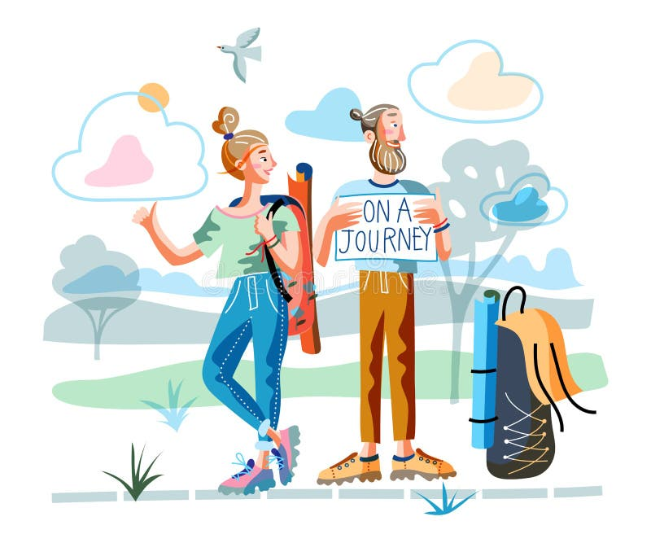
PRESENTATION
memorable (adj)
/ˈmemərəbl/
đáng nhớ

Slide 9

PRESENTATION
brilliant (adj)
/ˈbrɪliənt/
rất ấn tượng,
rất thông minh

Slide 10

PRESENTATION
flora (n)
/ˈflɔːrə/
tất cả thực vật của một khu vực

Slide 11
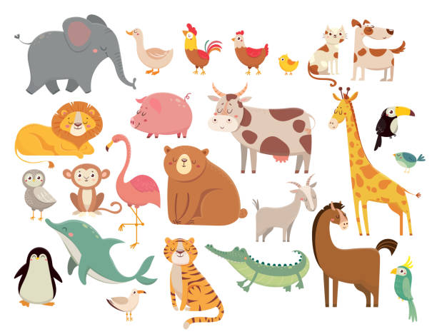
PRESENTATION
fauna (n)
/ˈfɔːnə/
tất cả động vật của một khu vực

Slide 12
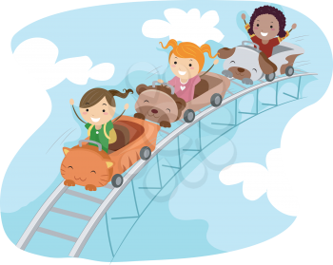
PRESENTATION
thrilling (adj)
/ˈθrɪlɪŋ/
phấn khích

Slide 13
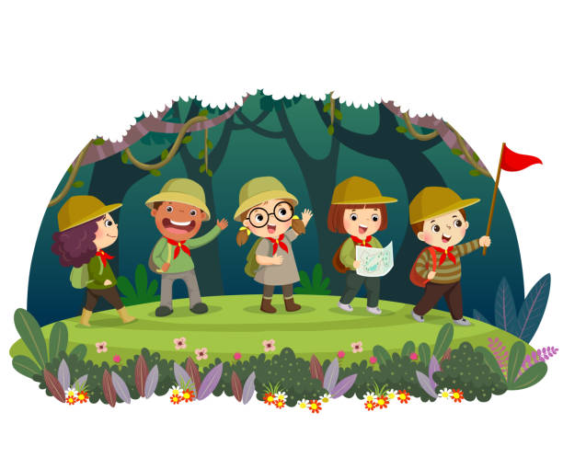
PRESENTATION
explore (V)
/ɪkˈsplɔː/
khám phá, tìm tòi và học hỏi

Slide 14

PRESENTATION
seabed (n)
/ˈsiːbed/
đáy biển

Slide 15
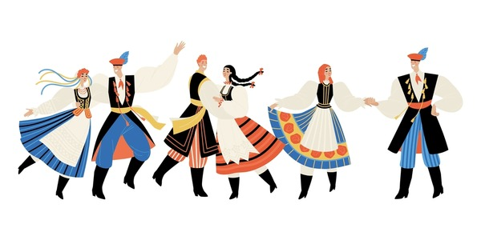
PRESENTATION
tribal dance
/ˈtraɪbl dɑːns/
điệu múa của bộ tộc

Slide 16
PRESENTATION
New words | Pronunciation | Meaning
1. experience (n) | /ɪkˈspɪəriəns/ | sự trải nghiệm
2. eco-tour (n) | /ˈiːkəʊ ˌtʊə/ | du lịch sinh thái
3. memorable (adj) | /ˈmemərəbl/ | đáng nhớ
4. brilliant (adj) | /ˈbrɪliənt/ | rất ấn tượng
5. flora (n) | /ˈflɔːrə/ | tất cả thực vật của một khu vực

Slide 17
PRESENTATION
New words | Pronunciation | Meaning
6. fauna (n) | /ˈfɔːnə/ | tất cả động vật của một khu vực
7. thrilling (adj) | /ˈθrɪlɪŋ/ | phấn khích
8. explore (v) | /ɪkˈsplɔː/ | khám phá, tìm tòi và học hỏi
9. seabed (n) | /ˈsiːbed/ | đáy biển
10. tribal dance | /ˈtraɪbl dɑːns/ | điệu múa của bộ tộc

Slide 18
LESSON 1: GETTING STARTED
LESSON 1: GETTING STARTED
WARM-UP
Asking questions
Vocabulary
PRESENTATION
Task 1: Listen and read.
Task 2: Read the conversation again and tick (√) T (True) or F (False).
Task 3: Write activities under the pictures.
Task 4: Read the conversation again and match the activities with the adjectives.
PRACTICE

Slide 19
PRACTICE
1
Listen and read.
Tom: Hi Mi, I’m back from Da Lat now. I have some local specialities for you.
Mi: Thanks Tom. I guess you and your family had a great time there.
Tom: Yeah. We visited LangBiang Mountain, and Cu Lan Village. We saw a gong show in the evening.
Mi: What did you do on LangBiang Mountain?
Tom: We rode a jeep to the top. It was a thrilling ride up there. Then we took an eco-tour of LangBiang Mountain. They said that the area is rich in flora and fauna with more than 150 plant and animal species.

Slide 20
PRACTICE
1
Listen and read.
Mi: Sounds amazing! What did you do then?
Tom: We took pictures of the magnificent scenery. It was really enjoyable!
Mi: Then did you explore Cu Lan Village?
Tom: Yes. We had a brilliant tour around the village. We also rode horses and a jeep along a stream.
Mi: That must have been exciting, Tom.
Tom: It definitely was. In the evening we saw an interesting gong show. We danced and sang with the locals. And we tried grilled pork. It was a really memorable evening. I’ll show you some pictures I took there.
Mi: Cool!

Slide 21
PRACTICE
2
Read the conversation again and write T (true) or F (False).
F
1. Mi and Tom had a great time in Da Lat. ______
2. Tom had an eco-tour of Langbiang Mountain. ______
3. There are more than 150 plant and animal species ______
on Langbiang Mountain.
4. Tom didn’t like his experiences in Cu Lan Village. ______
5. Tom danced and sang with the local people ______
at a gong show.
T
T
F
T

Slide 22
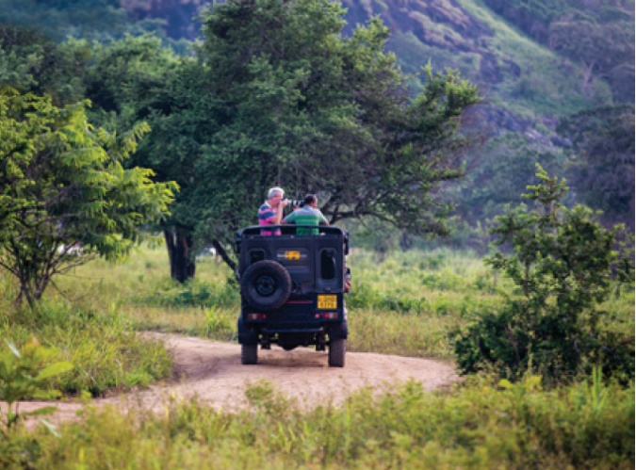
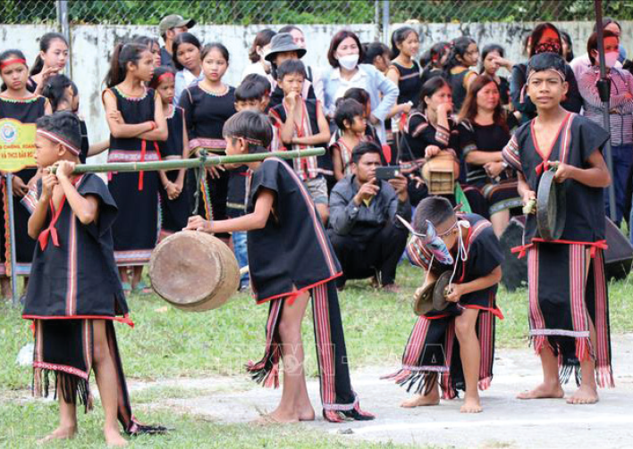
PRACTICE
3
Write activities under the pictures.
taking photos dancing with local people exploring a site taking an eco-tour
riding a jeep seeing a gong show
riding a jeep
1. ____________
seeing a gong show
2. ________________

Slide 23
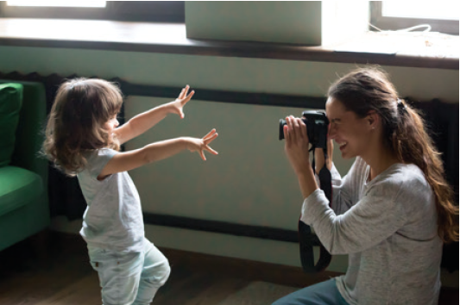
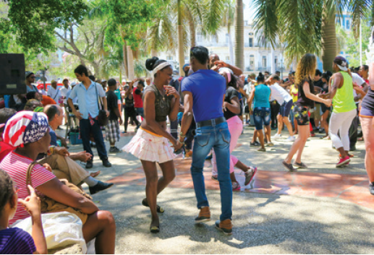
PRACTICE
3
Write activities under the pictures.
taking photos dancing with local people exploring a site taking an eco-tour
riding a jeep seeing a gong show
3. ____________
taking photos
dancing with local people
4. ______________________

Slide 24
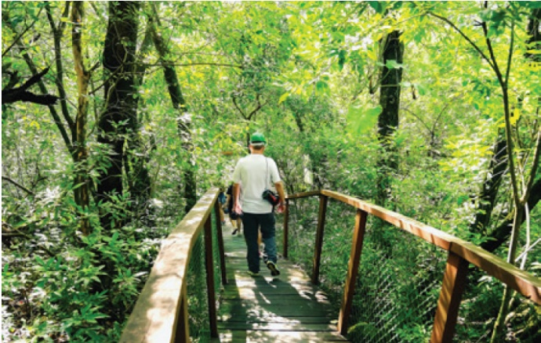
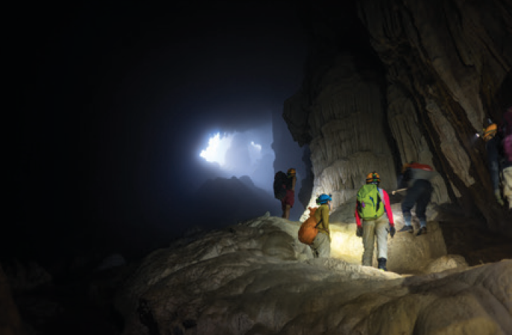
PRACTICE
3
Write activities under the pictures.
taking photos dancing with local people exploring a site taking an eco-tour
riding a jeep seeing a gong show
taking an eco-tour
exploring a site
5. _______________
6. _______________

Slide 25
PRACTICE
4
Read the conversation again and match the activities with the adjectives.
1. riding a jeep | a. enjoyable
2. seeing a gong show | b. thrilling
3. taking an eco-tour | c. amazing
4. exploring a site | d. interesting
5. taking pictures | e. brilliant

Slide 26
LESSON 1: GETTING STARTED
LESSON 1: GETTING STARTED
WARM-UP
Asking questions
Vocabulary
PRESENTATION
Task 1: Listen and read.
Task 2: Read the conversation again and tick (√) T (True) or F (False).
Task 3: Write activities under the pictures.
Task 4: Read the conversation again and match the activities with the adjectives.
PRACTICE
Task 5: Work in groups. Carry out a survey. Then report your group’s findings to the class.
PRODUCTION

Slide 27
PRODUCTION
5
Work in groups. Carry out a survey. Then report your group’s findings to the class.
 | YES | NO
1. climbing a mountain
2. taking an eco-tour
3. exploring the seabed
4. taking photos from a mountain top
5. seeing a tribal dance show
Example:
I did a survey with 3 peers. Two like climbing a mountain, 3 like taking eco-tours, nobody likes exploring the seabed….

Slide 28
LESSON 1: GETTING STARTED
LESSON 1: GETTING STARTED
WARM-UP
Asking questions
Vocabulary
PRESENTATION
Task 1: Listen and read.
Task 2: Read the conversation again and tick (√) T (True) or F (False).
Task 3: Write activities under the pictures.
Task 4: Read the conversation again and match the activities with the adjectives.
PRACTICE
Task 5: Work in groups. Carry out a survey. Then report your group’s findings to the class.
PRODUCTION
CONSOLIDATION
Wrap-up
Homework

Slide 29

CONSOLIDATION
1
Wrap-up
What have we learnt in this lesson?
identify the topic of the unit;
use lexical items related to experiences;
identify the language features that are covered in the unit.

Slide 30

CONSOLIDATION
2
Homework
Do exercises in the workbook;
Make a list of adjectives to describe experience;
Start preparing for the Project of the unit 5.

Slide 31
Website: hoclieu.vn
Fanpage: facebook.com/www.tienganhglobalsuccess.vn/

