Slide 2


Unit
5
NATURAL WONDERS OF VIET NAM
LESSON 3: A CLOSER LOOK 2
1

Slide 3
LESSON 3: A CLOSER LOOK 2
LESSON 1: GETTING STARTED
WARM-UP
Sing a song
Task 1: Write C or U
Task 2: Choose the correct option.
Task 3: Fill in the blanks.
COUNTABLE AND UNCOUNTABLE NOUNS
Task 4: Fill in the blanks.
Task 5: Write rules.
MUST / MUSTN’T
CONSOLIDATION
Wrap-up
Homework

Slide 4
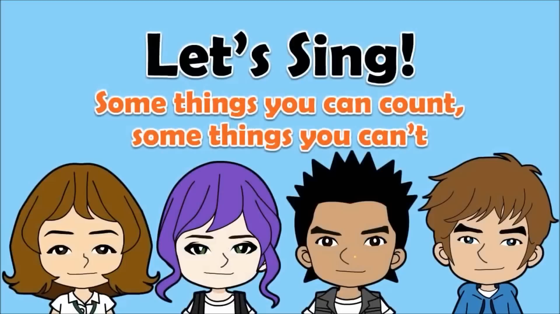
Notes:
https://youtu.be/OqVueNN2GQo?si=XchIAtHYImZvHpEC

Slide 5
PRESENTATION
Countable and uncountable nouns
- Countable nouns are for the people and things we can count using numbers.
Countable nouns can be singular: a rock, an island ..., or plural: rocks, islands ...
- Uncountable nouns are for the things that we cannot count with numbers.
They usually do not have a plural form: cream, chocolate ...

Slide 6

PRACTICE
Is the underlined noun countable or uncountable? Write C (countable) or U (uncountable).
1. The children are very tired after a day of fun.
2. Be careful! The water is deep.
3. My mother uses real butter in the cakes she bakes.
4. Remember to bring the necessary travel items.
5. – How about meeting in the canteen for some tea? – Sure. What time?
C
U
U
C
U

Slide 7
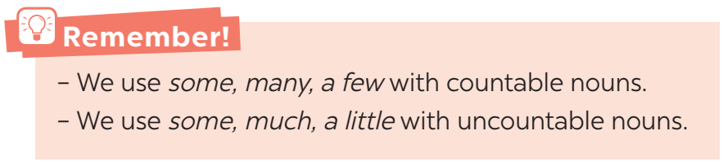
PRESENTATION
Countable and uncountable nouns

Slide 8

PRACTICE
Choose the correct option for each sentence.
1. I have _______ questions to ask you.
A. a few B. a little
2. Australia is very nice. It has _______ natural wonders.
A. much B. many
3. This is a difficult lesson, so only _______ students can understand it.
A. a few B. many

Slide 9
PRACTICE
Choose the correct option for each sentence.
4. It is a very dry area. There isn’t _______ rain in summer.
A. a little B. much
5. We’ve got very _______ time before our train leaves. We must hurry up!
A. little B. much

Slide 10

PRACTICE
Fill each blank with a, any, some, much or many.
1. How _______ books are there in your bag?
2. There isn’t _______ milk in the fridge. It’s empty.
3. How _______ sugar do you need for your tea, Mum?
4. We need to buy _______ new furniture for the house.
5. There is _______ big cave in this area.
many
any
much
some
a

Slide 11
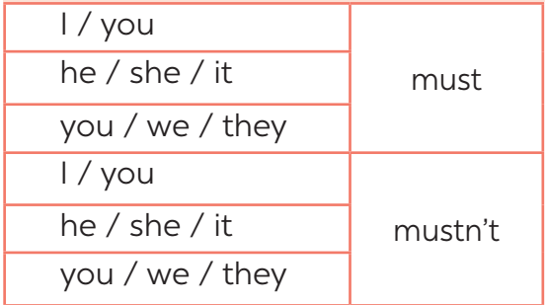
PRESENTATION
must / mustn’t
- We use must to say that something is very necessary or very important.
- We use mustn’t to say that doing something is not allowed.
Notes:
For more examples and grammar point breakdown, let students watch the video: http://learnenglishkids.britishcouncil.org/grammar-videos/school-rules

Slide 12

PRACTICE
Fill each blank with must or mustn’t.
1. You _______ leave the hotel room before 12 o’clock.
2. You _______ make lots of noise in the museum.
3. My mum says you _______ always tell the truth.
4. You know you _______ go to bed with your shoes on.
5. I want to speak English better. I _______ practise more.
must
mustn’t
must
mustn’t
must

Slide 13

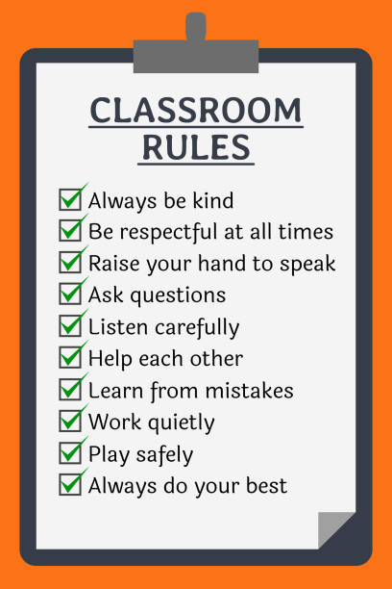

PRACTICE

Slide 14

PRODUCTION
Write some more rules for you and your classmates.
1. We must arrive on time.
2. We mustn’t pick flowers in the school garden.
3. We must ______________________.
4. We mustn’t ____________________.
5. ______________________________.

Slide 15

CONSOLIDATION
1
Wrap-up
What have we learnt in this lesson?
Grammar 1: Countable nouns and Uncountable Nouns
Grammar 2: How to use the modal verbs: must and mustn’t

Slide 16

CONSOLIDATION
2
Homework
- Do exercises in the workbook.
- Make sentences using must / mustn’t

Slide 17






Website: hoclieu.vn
Fanpage: facebook.com/www.tienganhglobalsuccess.vn/

