Slide 2




Unit
12
ROBOTS
LESSON 5: SKILLS 1

Slide 3


LESSON 5: SKILLS 1
LESSON 1: GETTING STARTED
WARM-UP
Quiz: What type of robot is this?
Task 1: Look and discuss the questions.
Vocabulary
Task 2: Read and choose the best answer.
Task 3: Read and fill the table.
READING
SPEAKING
Task 4: Discussion.
Task 5: Talk about robots.
CONSOLIDATION
Wrap-up
Homework

Slide 4

WARM-UP
QUIZ TIME

Slide 5
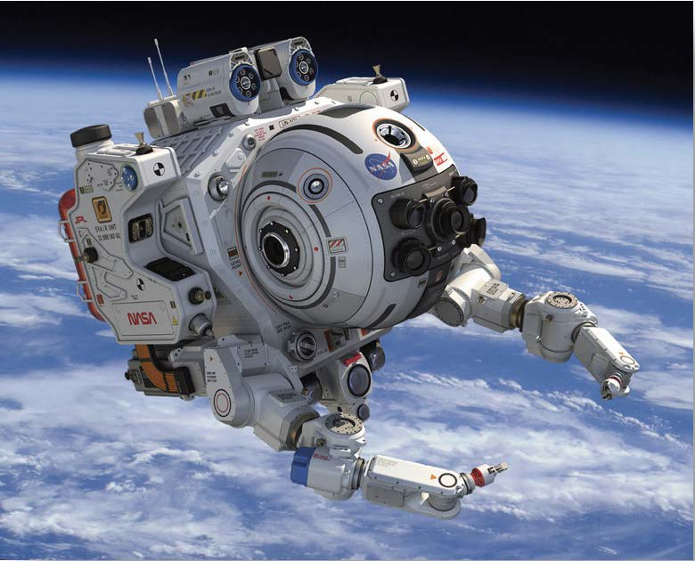
1. What type of robot is this?
WARM-UP
Home robot
Space robot
Teacher robot
Doctor robot

Slide 6
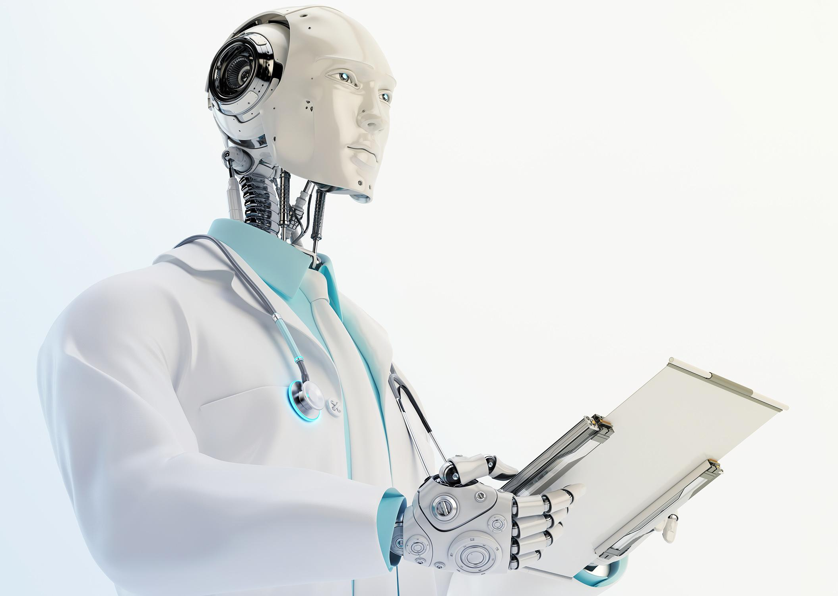
2. What type of robot is this?
WARM-UP
Worker robot
Space robot
Teacher robot
Doctor robot

Slide 7
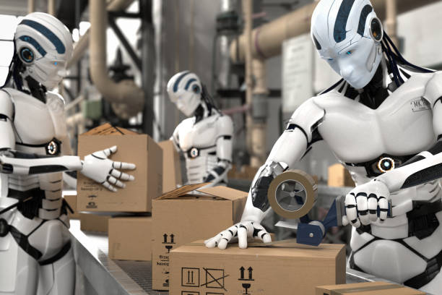
3. What type of robot is this?
WARM-UP
Home robot
Worker robot
Teacher robot
Doctor robot

Slide 8
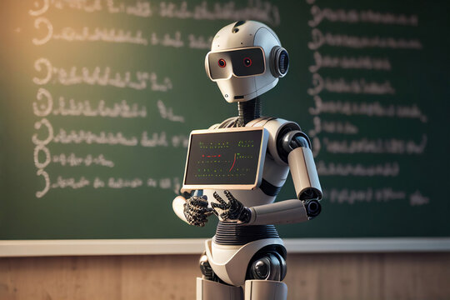
4. What type of robot is this?
WARM-UP
Home robot
Space robot
Teacher robot
Doctor robot

Slide 9
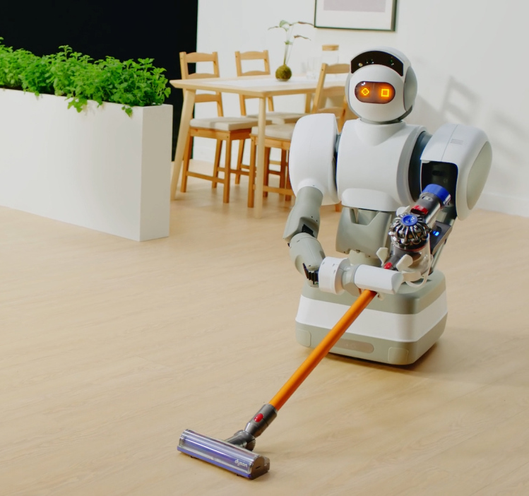
5. What type of robot is this?
WARM-UP
Home robot
Space robot
Teacher robot
Doctor robot

Slide 10
What robots are you interested in? Why?
WARM-UP
Example:
I am interested in home robots because they can help my mom do the housework.

Slide 11
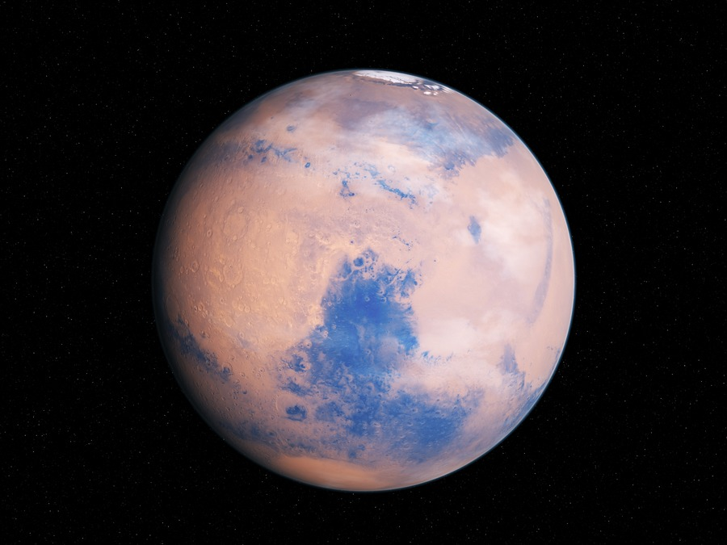

`
VOCABULARY
planet (n)
/ˈplænɪt/
a large round object in space that moves around a star (such as the sun) and receives light from it

Slide 12



VOCABULARY
subject (n)
/ˈsʌbdʒekt/
an area of knowledge studied in a school, college, etc.

Slide 13
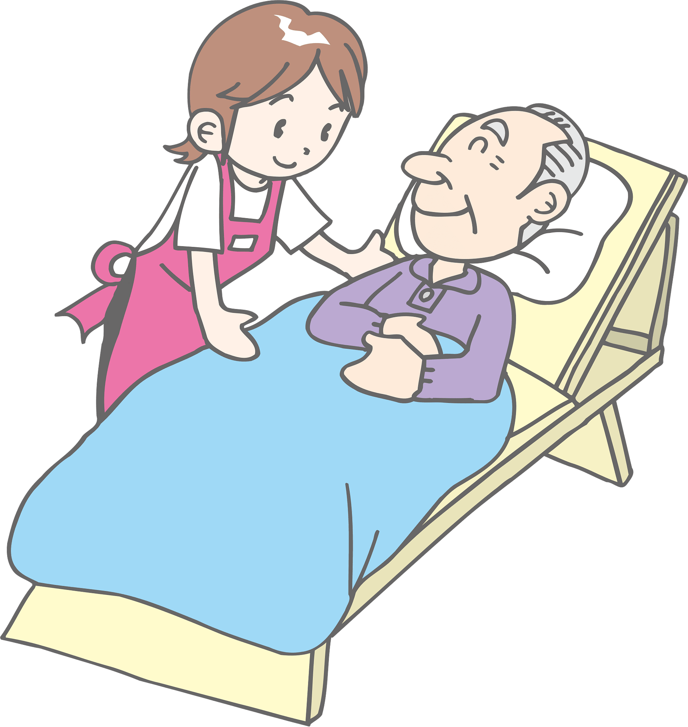
`
VOCABULARY
look after (v)
/ˈlʊk æftər/
to take care of or be in charge of something

Slide 14
`
VOCABULARY
space station (n)
/ˈspeɪs steɪʃn/
a large structure that is sent into space and remains above the earth as a base for people working and travelling in space

Slide 15
`
VOCABULARY
New words | Pronunciation | Meaning
1. planet (n) | /ˈplænɪt/ | hành tinh
2. subject (n) | /ˈsʌbdʒekt/ | môn học
3. look after (v) | /ˈlʊk æftər/ | trông nom, chăm sóc
4. space station | /ˈspeɪs steɪʃn/ | trạm vũ trụ

Slide 16

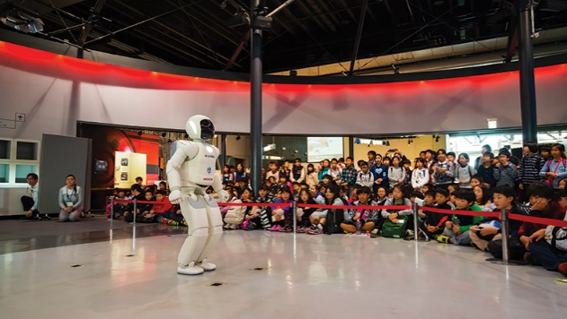
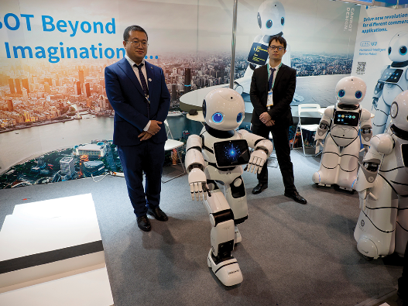
READING
Work in pairs. Discuss the following questions.
1. What types of robots are there?
2. What robots are children interested in?

Slide 17

READING
Today there is an international robot show in Ha Noi. People can see many types of robots there.
Home robots are useful for housework. They can do most of the housework: cook meals, clean the house, do the washing, and iron clothes.
Teacher robots are the best choice for children. They can help them to study. They can teach them English, literature, maths and other subjects. They can also help children to improve their English pronunciation.
People are also interested in other types of robots at the show. Worker robots can build houses and move heavy things; doctor robots can look after sick people
and space robots can build space stations on the Moon and on planets.
Read the text and choose the best answer to each of the questions.

Slide 18
READING
Read the text and choose the best answer to each of the questions.
1.
What show is on in Ha Noi now?
A.
B.
A robot show
A fashion show
C.
A pet show
2.
Which type of robots can help children in their study?
A.
Home robots
B.
C.
Teacher robots
Worker robots

Slide 19
READING
Read the text and choose the best answer to each of the questions.
3.
Doctor robots can _______.
A.
help children to study
B.
build houses
C.
take care of sick people
4.
Which of the following sentences is NOT true according to the passage?
A.
Worker robots can build houses and move heavy things.
B.
Space robots can build space stations on the Moon.
C.
Home robots can’t do much of the housework.

Slide 20

READING
Today there is an international robot show in Ha Noi. People can see many types of robots there.
Home robots are useful for housework. They can do most of the housework: cook meals, clean the house, do the washing, and iron clothes.
Teacher robots are the best choice for children. They can help them to study. They can teach them English, literature, maths and other subjects. They can also help children to improve their English pronunciation.
People are also interested in other types of robots at the show. Worker robots can build houses and move heavy things; doctor robots can look after sick people and space robots can build space stations on the Moon and on planets.
Read the text again and fill the table below.

Slide 21
READING
Read the text again and fill the table below.
Types of robots | What they can do
Home robots
Teacher robots
Worker robots
Doctor robots
Space robots
cook meals, clean the house, do the washing and iron clothes
help children study, teach English, literature, maths and other subjects, help children improve English pronunciation
build houses, move heavy things
look after sick people
build space stations on the Moon and on planets

Slide 22

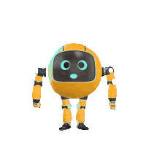
SPEAKING
Places | What robots can do
Home
Schools
Factory
Hospital
Garden
Discuss what you think robots can do in the following places.
Example:
A: What can robots do at home?
B: They can take care of children.

Slide 23

SPEAKING
Take turns to talk about robots and what you think they can do. Can you think of other types of robots?
- Share your discussion.
- Think about any types of robots you want
- Tell me what they can do, and where they work.

Slide 24

CONSOLIDATION
1
Wrap-up
What have we learnt in this lesson?
Read for general and specific information
Identify different features of different types of robots
Describe what a robot can do

Slide 25

CONSOLIDATION
2
Homework
- Choose a type of robot in reading text and write about what they can do.
- Prepare for the next lesson.

Slide 26






Website: hoclieu.vn
Fanpage: facebook.com/www.tienganhglobalsuccess.vn/

