Slide 1
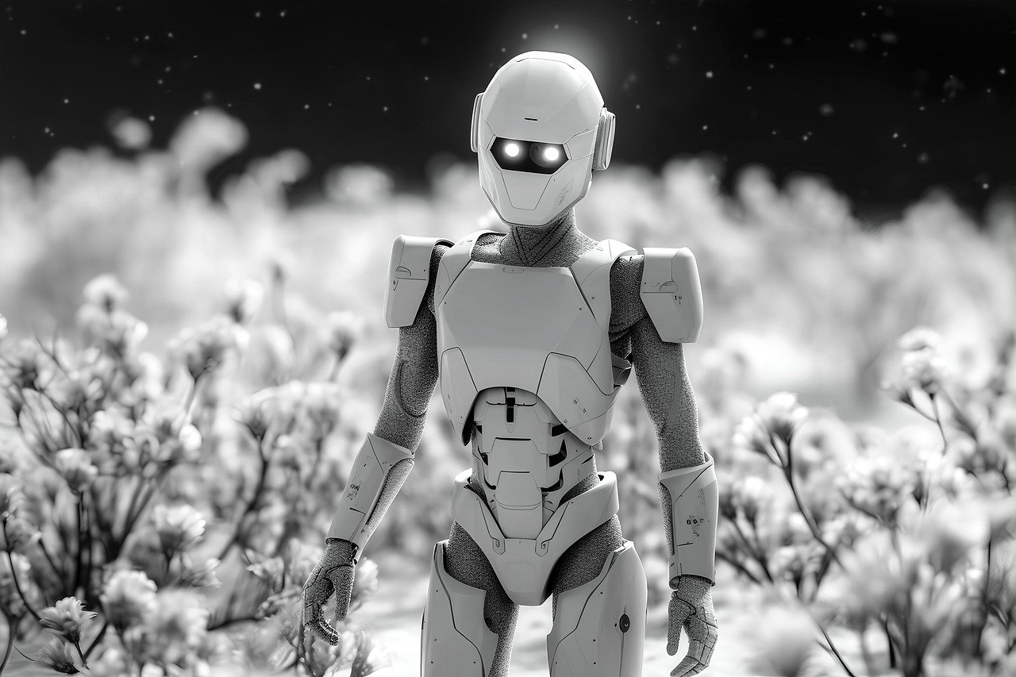


Slide 2


Unit
12
ROBOTS
LESSON 4: COMMUNICATION

Slide 3


LESSON 4: COMMUNICATION
LESSON 1: GETTING STARTED
WARM-UP
Game: Who’s the fastest?
Task 1: Listen and read the dialogues.
Task 2: Express your opinions.
EVERYDAY ENGLISH
Task 3: Listen and fill in the blanks.
Task 4: Interview classmates.
Task 5: Report your results.
MY ROBOT’S ABILITIES
CONSOLIDATION
Wrap-up
Homework

Slide 4

WARM-UP
Who’s the fastest?

Slide 5


EVERYDAY ENGLISH
Listen and read the dialogues.
A: I think robots can help us a lot in our daily life.
B: I agree with you.
A: Peter says robots can do everything like humans.
B: I don’t agree with him.

Slide 6
EVERYDAY ENGLISH
Agreement and disagreement expressions
Express agreement | Express disagreement
That’s right! Absolutely! Exactly! Me too! Yes, I agree! I totally agree! I couldn’t agree more! I see exactly what you mean! You're right. That's a good point. | I don’t agree! I totally disagree! Absolutely not! That’s not right! I’m not sure about that.

Slide 7

EVERYDAY ENGLISH
Express your opinions about the following statements. Use the highlighted phrases in the dialogues above.
Home robots are the most useful of all types of robots.
Some people can use robots to do bad things.
Robots will use too much electricity in the future.

Slide 8

MY ROBOT’S ABILITIES
Listen to the radio programme from 4Teen News. Fill the blanks with the words you hear.
Speaker: Today we ask our friends: Tom from Australia, Linh from Viet Nam and Nobita from Japan to tell us about their robots. Tom, would you like to start?
Tom: Well, my robot can (1) __________ what I say. It can also understand my feelings. It’s the (2) ________ robot.
Speaker: Linh?
Linh: My robot is my best friend. It does a lot for me: clean the floor, (3) _______ my toys away, and ...
Speaker: And Nobita?
Nobita: My robot is very useful. It helps me a lot. It can (4) _______ my plants and even work as a (5) _______.
understand
smartest
put
water
guard

Slide 9


MY ROBOT’S ABILITIES
Interview three friends about what abilities they want their robots to have. Note their answers in the table below.
- Move around and asks three classmates what abilities they want their robots to have.
- Remember to write the names of your friends who you interview and note the answers in the table.

Slide 10
MY ROBOT’S ABILITIES
Interview three friends about what abilities they want their robots to have. Note their answers in the table below.
Friends |  | Abilities he / she wants his / her robot to have
1.
2.
3.

Slide 11

REPORT TIME
MY ROBOT’S ABILITIES

Slide 12

CONSOLIDATION
1
Wrap-up
What have we learnt in this lesson?
Express agreement and disagreement
Talk about what a robot can do

Slide 13

CONSOLIDATION
2
Homework
- Write a paragraph about 50 words to describe a robot you want to have.
- Prepare for the next lesson (Lesson 5 - Skills 1).

Slide 14






Website: hoclieu.vn
Fanpage: facebook.com/www.tienganhglobalsuccess.vn/

