Slide 1

NGUYEN BINH KHIEM SECONDARY SCHOOL
Hello every one !!!

Slide 2
Game: Brainstorming
apartment
Villa
Smart TV
skyscraper
types of houses and appliances in house
washing machine
dishwasher
houseboat
smart clock
castle
fridge
palace
computer
UFO
robot
Stilt
vacuum cleaner

Slide 3



LESSON 1
My future house

Slide 4
LESSON 1
OBJECTIVES:
- use lexical items about types of houses,
- talk about different houses in the future.

Slide 5
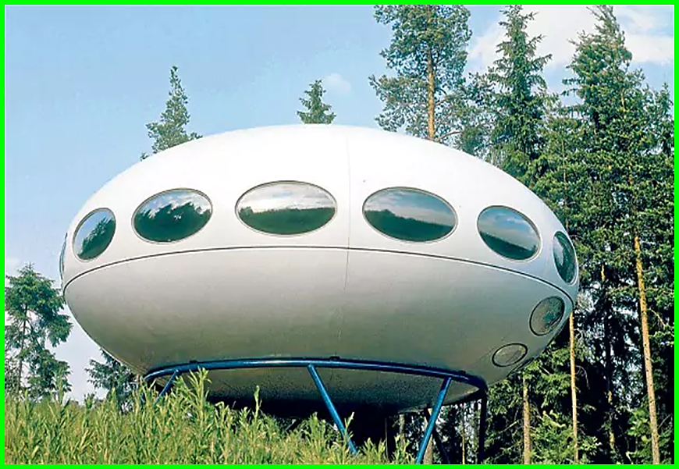


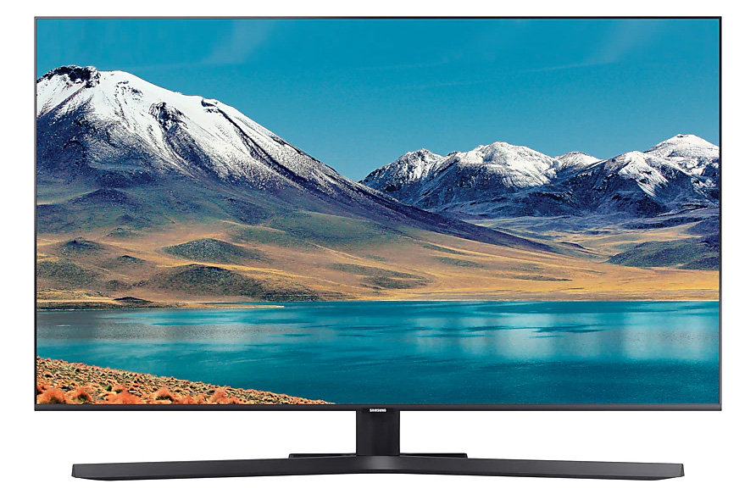
Unit 10: Houses in the future
Lesson 1: Getting started
* Vocabulary
UFO (n):
( unidentified Flying object):
vât thể bay, đĩa bay.
- Solar energy (n):
năng lượng mặt trời.
- appliance [ə'plaiəns] (n):
thiết bị, dụng cụ.
- Smart TV (n):
Tivi thông minh

Slide 6
* Checking Vocab.
Look and say
Đĩa bay
TV
thông minh
UFO
Smart TV
Năng lượng mặt trời
Thiết bị
Solar energy
appliance

Slide 7



Listen and read.
My future house
1.Who are they?
2. What is Phong doing?
3. What are they talking about?
1→They are Phong and Nick.
2→He is painting/ drawing…
3→ They are talking about…

Slide 8
My future house
Nick: What are you doing, Phong?
Phong: I’m painting a picture of my house.
Nick: Your house! That’s a UFO.
Phong: It looks like a UFO but it’s my house in the future.
Nick: Where will it be?
Phong: It’ll be in the mountains.
Nick: What will it be like?
Phong: It’ll be a large house. It’ll have twenty rooms.
Nick: Twenty rooms!
Phong: Yes, and it’ll have solar energy.
Nick: Fantastic! Which room will you like best?
Phong: My bedroom, of course.
Nick: What appliances might the house have?
Phong: My house might have some smart TVs and ten robots.
Nick: Sounds great! And how much will ...

Slide 9

Read the conversation again. Find and write down the words or phrases that show:
Type of house
Location
Appliances in the house
UFO
in the mountains
some smart TVs and ten robots

Slide 10
My future house
Nick: What are you doing, Phong?
Phong: I’m painting a picture of my house.
Nick: Your house! That’s a UFO.
Phong: It looks like a UFO but it’s my house in the future.
Nick: Where will it be?
Phong: It’ll be in the mountains.
Nick: What will it be like?
Phong: It’ll be a large house. It’ll have twenty rooms.
Nick: Twenty rooms!
Phong: Yes, and it’ll have solar energy.
Nick: Fantastic! Which room will you like best?
Phong: My bedroom, of course.
Nick: What appliances might the house have?
Phong: My house might have some smart TVs and ten robots.
Nick: Sounds great! And how much will ...

Slide 11

Read the conversation again. Tick () T (True) or F (False).
 | T | F
1. Phong’s house will be in the mountains.
2. His house will be large.
3. There’ll be a lot of rooms in his house.
4. He might have a smart TV and five robots.





Slide 12

Order the words to make a phrase about a place.
Each group has one extra word.
Example: ocean / in / on / the
=> in t he ocean
1. sea/ a/ in/ the
...........................................
2. on/ in/ the / city
............................................
3. the / in/ at / town
..........................................
4 the/ on/ in/ mountains
...........................................
5. countryside / a/ the / in
.............................................
6. Moon / in / the / on
............................................
7. in / at/ the / sky
...........................................

Slide 13

LUCKY NUMBER!
1
2
3
4
5
6
7
8

Slide 14
Order the words to make a phrase about a place.
Each group has one extra word.
1. sea/ a/ in/ the
...........................................
→ in the sea

Slide 15
Order the words to make a phrase about a place.
Each group has one extra word.
2. on/ in/ the / city
............................................
→ in the city

Slide 16
Order the words to make a phrase about a place.
Each group has one extra word.
3. the / in/ at / town
..........................................
→ in the town

Slide 17

LUCKY NUMBER!

Slide 18
Order the words to make a phrase about a place.
Each group has one extra word.
4 the/ on/ in/ mountains
...........................................
→ in the mountains

Slide 19
Order the words to make a phrase about a place.
Each group has one extra word.
5. countryside / a/ the / in
.............................................
→in the countryside

Slide 20
Order the words to make a phrase about a place.
Each group has one extra word.
6. Moon / in / the / on
............................................
→ on the Moon

Slide 21
Order the words to make a phrase about a place.
Each group has one extra word.
7. in / at/ the / sky
...........................................
→ in the sky

Slide 22
Order the words to make a phrase about a place.
Each group has one extra word.
* Answer key:
1. in the sea
2. in the city
3. in the town
4. in the mountains
5. in the countryside
6. on the Moon
7. in the sky

Slide 23

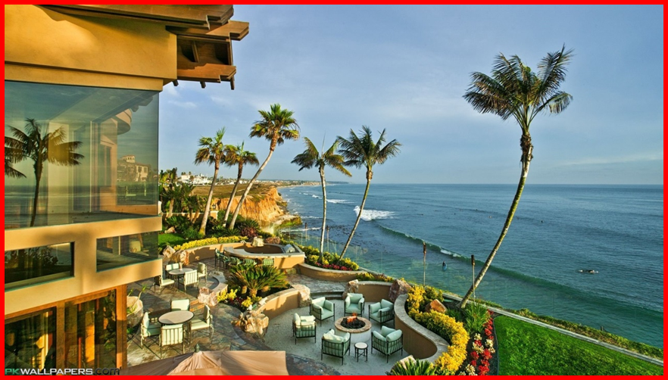
In groups, describe to your classmates what you can see outside the window of your future house. Your group tries to guess where your house is.
Example:
A: Outside my window I can see the beach and the water. Where’s my house?
B: It’s in the sea.
A: Correct!

Slide 24
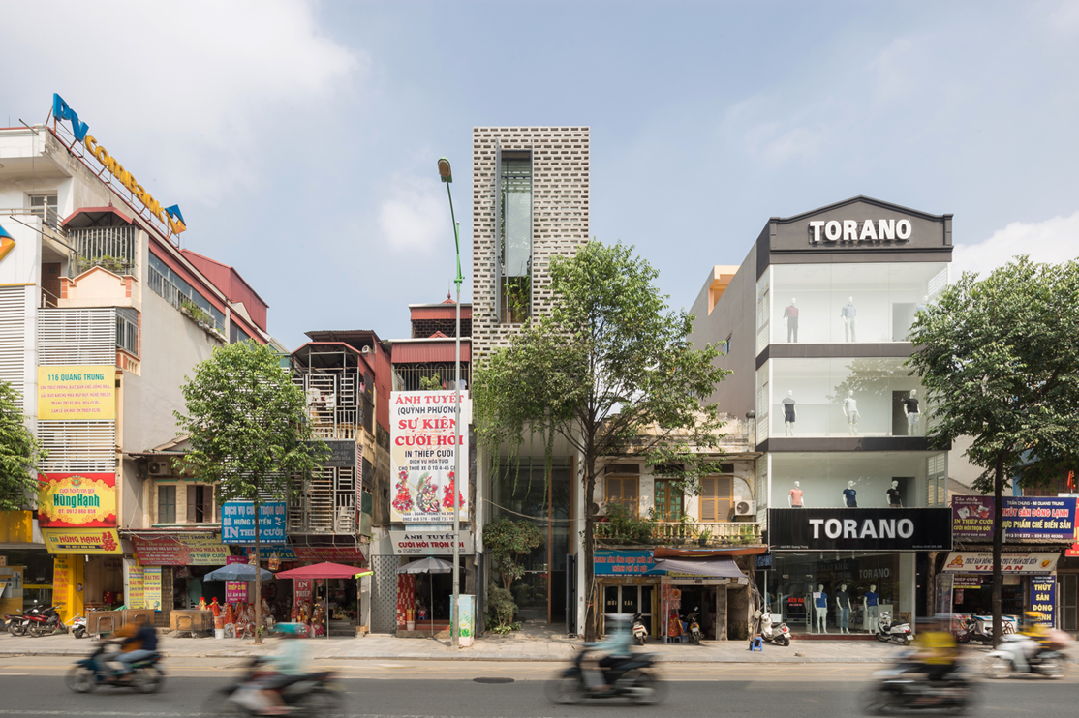
A : Outside my window I can see the building office and shopping center. Where's my house?
B: It's in the city.
A: Correct.

Slide 25
WRAP-UP
- Learn some new words.
- Read and understand content of the conversation.

Slide 26
HOMEWORK
- Learn by heart all the new words.
- Read the dialogue again.
- Prepare lesson 2 (A closer look 1).

Slide 27

Goodbye!
See you again
Thank you!
Have a nice day!

