Slide 1
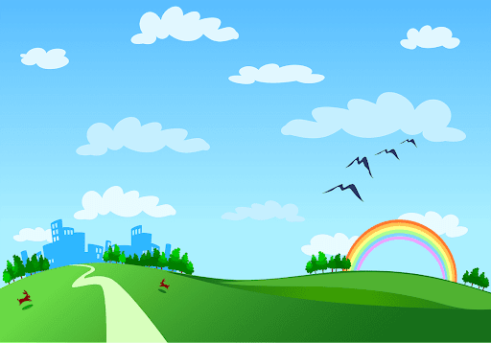
Nguyen Binh Khiem secondary school
Good morning class!!!

Slide 2
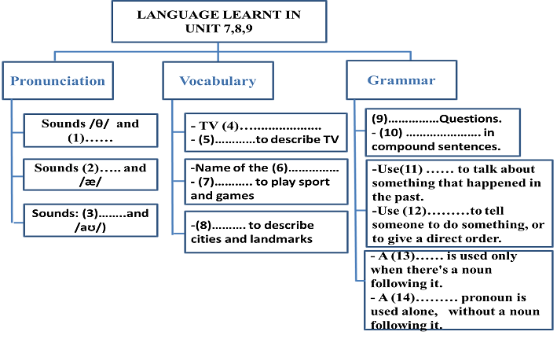
* Game:
Memory game

Slide 3
* WARM –UP :
Memory game
LANGUAGE LEARNT IN
UNIT 7,8,9
Pronunciation
Vocabulary
Grammar
- TV programmes
- Adjectives to describe
TV
- WH- Questions.
- Conjunctions in compound sentences .
Sounds /θ/ and /ð/
Sounds /e/ and /æ/
- Name of the sports and games
-Things/ equipment to play sports and games
- Use past simple to talk about something that happened in the past.
- Use imperative tell so to do st, or to give a direct order.
Sounds /əʊ/and /aʊ/
- Adjectives to describe cities and landmarks
- A possessive is used only when there is a noun following it.
- A possessive pronoun is used a lone, without a noun following it.

Slide 4



REVIEW 3
( UNITS 7 – 8 – 9)
Pronunciation
Vocabulary
Grammar

Slide 5
REVIEW 3
( UNITS 7 – 8 – 9)
OBJECTIVES:
- revise the language they have learnt and the skills they have practised in Units 7,8,9

Slide 6



Pronunciation
Circle the word with the different underlined sound. Listen and check.
1.
A.
tower
B.
how
C.
snow
2.
A.
symbol
B.
opening
C.
postcard
3.
A.
father
B.
earth
C.
both
4.
A.
Saturday
B.
racket
C.
game
5.
A.
tennis
B.
prepare
C.
chess

Slide 7

Vocabulary
Choose A, B, or C to fill the gaps in the passage.
Most children love (1) ........... activities when the weather is good. They play football, go skateboarding or go (2)........ . In countries with a lot of snow like (3) ........... , children go skiing with their parents to practise skiing. When they are not skiing, they can stay at home and watch interesting (4) .......... on TV or visit (5) ........... in the area.
1.
A.
outdoor
B.
indoor
C.
school
2.
A.
tennis
B.
karate
C.
swimming
3.
A.
Sweden
B.
India
C.
Brazil
4.
A.
characters
B.
viewers
C.
programmes
5.
A.
sports
B.
city
C.
landmarks

Slide 8

Complete the sentences with the words / phrase in the box.
football
city
landmark
television
summer sports
1. The Eiffel Tower is a famous ............ in Paris.
2. Pelé is a great ............ player from Brazil.
3. There are many educational programmes on ........... .
4. I think no other ........... in the world is more interesting than Los Angeles.
5. ............... are very popular in counties with a lot of sunshine like Australia.
Game:
Lucky number

Slide 9
Lucky number Game
1
8
2
Team A
Team B
3
8
7
2
8
10
4
4
6
2
10
6
6
4
5
TIẾP

Slide 10
Complete the sentences with the words / phrase in the box.
football
city
landmark
television
summer sports
landmark
1. The Eiffel Tower is a famous ..……............in Paris.

Slide 11
Complete the sentences with the words / phrase in the box.
football
city
landmark
television
summer sports
football
2. Pelé is a great .............. player from Brazil.

Slide 12

LUCKY NUMBER
YOU GET A GIFT

Slide 13
Complete the sentences with the words / phrase in the box.
football
city
landmark
television
summer sports
television.
3. There are many educational programmes on .............. .

Slide 14
Complete the sentences with the words / phrase in the box.
football
city
landmark
television
summer sports
city
4. I think no other .............in the world is more interesting than Los Angeles.

Slide 15
Complete the sentences with the words / phrase in the box.
football
city
landmark
television
summer sports
Summer sports
5…….. ..................are very popular in counties with a lot of sunshine like Australia.

Slide 16


LUCKY NUMBER!
you get 2 plus points

Slide 17
LUCKY NUMBER!
you get 2 plus points

Slide 18
Complete the sentences with the words / phrase in the box.
football
city
landmark
television
summer sports
1.
The Eiff el Tower is a famous
landmark in Paris.
2.
Pelé is a great
football player from Brazil.
3.
There are many educational programmes on
_______.
television.
4.
I think no other
than Los Angeles.
city in the world is more interesting
5.
Summer sports are very popular in countries with a lot of sunshine like Australia.

Slide 19

Grammar
Choose the correct answer A, B, or C.
1. John, you are late. The match .......... ten minutes ago.
A. starts B. started C. is starting
2. Ben wrote his parents a postcard ............... he was on holiday.
A. because B. and C. while
3. Hong Kong is famous for............... double-decker buses.
A. its B. it C. it’s
4. Sports and games ............ an important part in our lives.
A. play B. plays C. played
5. The USA ..... first colour TV in 1953.
A. has B. have C. had
6. We are now in the city museum. ......... any objects on display.
A. Not touch B. Don't touch C. Don’t touching

Slide 20


5
4
1
1. John, you are late. The match .......... ten minutes ago..
3
2
a. starts
b. started
c. is starting

Slide 21
5
2. Ben wrote his parents a postcard ............... he was on holiday.
4
1
3
2
a. because
b. and
c. while

Slide 22
5
3. Hong Kong is famous for ............
double-decker buses.
4
1
3
2
a. its
b. it
c. It’s

Slide 23
5
4. Sports and games _______ an important part in our lives.
4
1
3
2
a. play
b. plays
c. played

Slide 24
5
5. The USA first _______ colour TV in 1953.
4
1
3
2
a. has
b. have
c. had

Slide 25
5
4
1
6. We are now in the city museum. _______ any objects on display.
3
2
a. Not touch
b. Don’t touch
c. Don’t touching

Slide 26
Grammar
Choose the correct answer A, B, or C.
1.
John, you are late. The match _______ ten minutes ago.
A.
starts
B.
started
C.
is starting
2.
Ben wrote his parents a postcard _______ he was on holiday.
A.
because
B.
and
C.
while
3.
Hong Kong is famous for _______ double-decker buses.
A.
B.
it
its
C.
it’s
4.
Sports and games _______ an important part in our lives.
A.
B.
plays
C.
played
play
5.
The USA first _______ colour TV in 1953.
A.
B.
have
C.
had
has
6.
We are now in the city museum. _______ any objects on display.
A.
B.
Don’t touch
C.
Don’t touching
Not touch

Slide 27

Correct the underlined question word(s) if needed.
1.
Who
sports do you like?
What
2.
What time
do you have English class?
3.
What
do you like Hoi An?
Why
4.
What tall
are the Twin Towers in Kuala Lumpur?
How
5.
When
is the Great Wall: in China or in Korea?
Where
Liên hệ Côi Nguyễn nha

Slide 28


WRAP-UP
- Review vocabulary and grammar in the lesson.

Slide 29
homework
- Do exercise in workbook.
- Prepare for the next lesson: Review (SKILLS).

Slide 30



