Slide 2

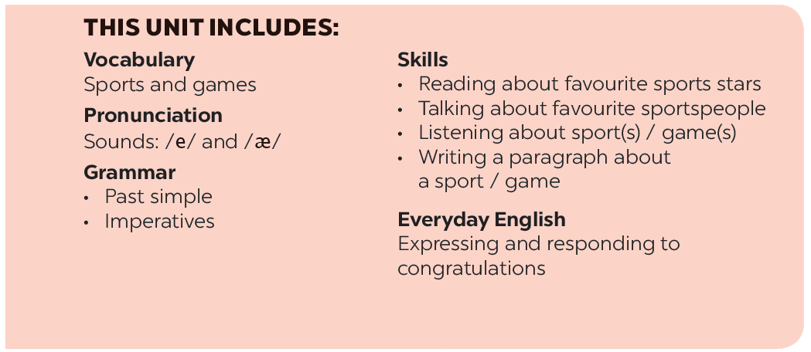

Slide 3







Grammar
The past simple
Imperatives
Choose the correct answer A, B, or C.
Look at each picture and choose the correct answer.
Write the correct form of the verbs to complete the conversation.
Tell your friends what to do and what not to do at the gym.
Work in groups. Ask and answer questions about your last weekend.

Slide 4
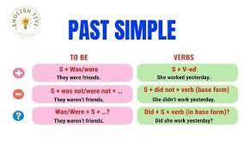
Grammar

Slide 5

Grammar
The past simple
We use the past simple to talk about something that happened in the past.
Example:
I played badminton with Phong yesterday.

Slide 6


Choose the correct answer A, B, or C.
1.
There _______ an interesting match on TV last night.
A.
is
B.
were
C.
were
2.
My dad _______ a lot of tennis some years ago.
A.
plays
B.
played
C.
is playing
3.
I was at the gym last Sunday, but I _______ you there.
A.
B.
don’t see
C.
didn’t see
not saw
4.
The teacher _______ us about our homework this morning.
A.
B.
not asking
C.
doesn’t ask
didn’t ask
5.
_______ sleep well last night?
A.
B.
Did you
C.
Were you
Do you

Slide 7

Write the correct form of the verbs to complete the conversation.
Nick: Hi, there.
Sonny: Hello, Nick. Did you have a nice weekend?
Nick: Yeah, it was OK. On Sunday, I (1. go) _______ fishing with my dad. How about you?
Sonny: Oh, I (2. have) _______ a good weekend, too.
Nick: Really? What _______ you (3. do) _______?
Sonny: I (4. visit) _______ the museum with my family, then we (5. eat) _______ at my favourite restaurant.
Nick: Did you watch football last Sunday
Sonny: Oh, yeah! My favourite team (6. score) _______ a fantastic goal!

Slide 8
Write the correct form of the verbs to complete the conversation.
Nick: Hi, there.
Sonny: Hello, Nick. Did you have a nice weekend?
Nick: Yeah, it was OK. On Sunday, I (1. go) went fishing with
my dad. How about you?
Sonny: Oh, I (2. have) had a good weekend, too.
Nick: Really? What did you (3. do) do?
Sonny: I (4. visit) visited the museum with my family, then we
(5. eat) ate at my favourite restaurant.
Nick: Did you watch football last Sunday
Sonny: Oh, yeah! My favourite team (6. score) scored a
fantastic goal!

Slide 9

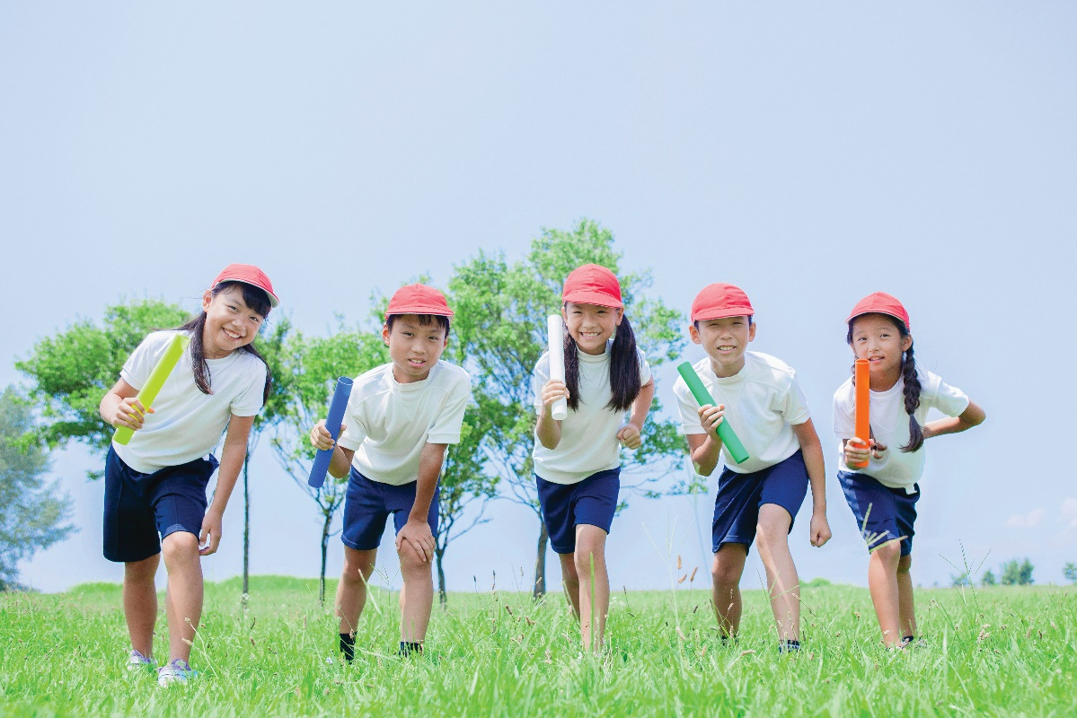
Work in groups. Ask and answer questions about your last weekend.
Example:
A: Did you do any sport last weekend?
B: Oh yes, and I was exhausted.
C: Really? What did you do?
…

Slide 10
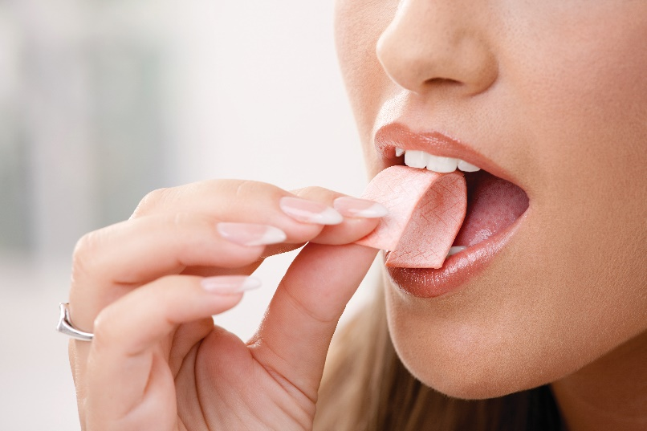
Grammar
Imperatives
We use imperatives to tell someone to do something, or to give a direct order.
It’s a chewing gum.
Chew it.
Don’t swallow it.
Positive: V
Negative: Don’t + V

Slide 11


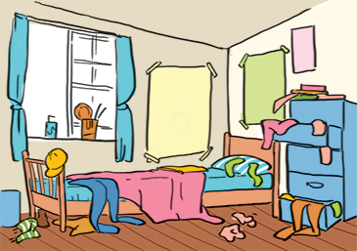


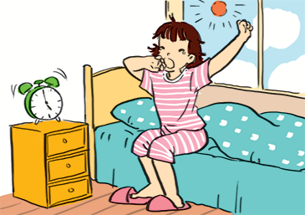
Look at each picture and choose the correct answer.

Slide 12
1.
(Park / Don’t park) here.
1. Don’t park here.

Slide 13
2.
(Close / Open) the window. It’s windy outside.
2. Close the window.
It’s windy outside.

Slide 14
3. Tidy up your room.
3.
(Tidy up / Don’t tidy up) your room.

Slide 15
4.
(Use / Don’t use) the lift when there is ﬁre.
4. Don’t use the flit
when there is fire.

Slide 16
5. Try to get up early
to do some exercise.
5.
(Try / Don’t try) to get up early to do some exercise.

Slide 17


Tell your friends what to do and what not to do at the gym.
GYM RULES
Example:
Change your clothes.
Don’t speak loudly.
_______
_______
_______

Slide 18
Homework
Review the past simple tense and imperative form.
Do exercises in the Workbook.
Make 3 imperatives in the class situation.

Slide 19







