Slide 2

WARM UP
Names of some sports

Slide 3
Aerobics
Cycling
Table tennis
Name of some sports
chess
Badminton
volleyball
football
Swimming

Slide 4

UNIT 8: Sports and Games
Lesson 2: A closer look 1
0

Slide 5








Vocabulary
Pronunciation
/e/ and /æ/
Write the right words under the pictures.
Listen and repeat. Pay attention Track to the sounds /e/ and /æ/.
What sports are these things for? Match each thing in column A with a sport in column B.
Listen and repeat. Underline the words having the sounds /e/ and /æ/.
Fill each blank with one of the words from the box.

Slide 6
Vocabulary

Slide 7
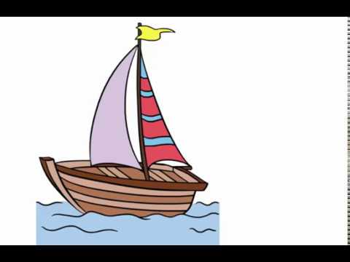

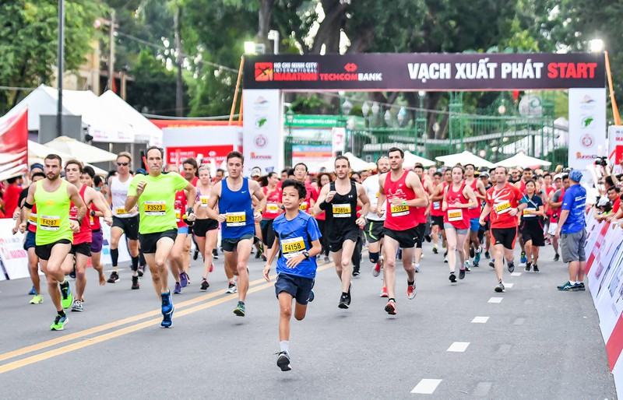
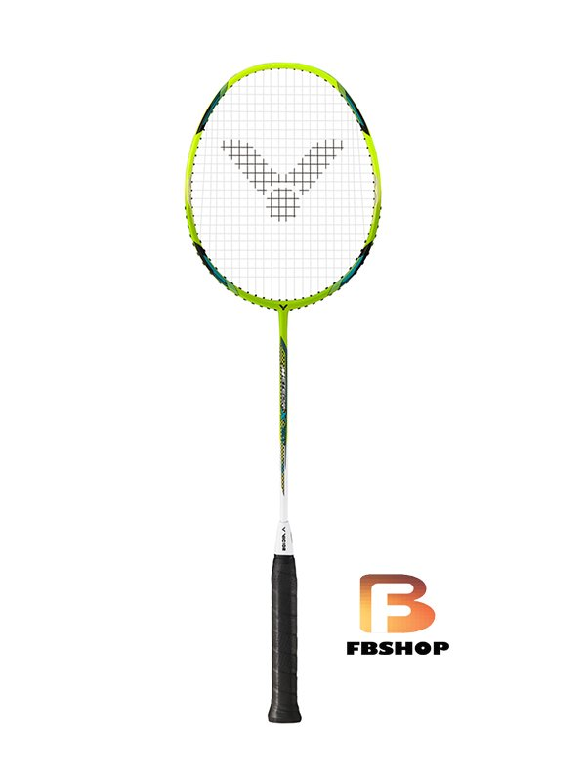
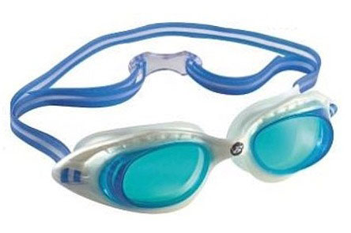
* Vocabulary:
01
02
03
04
Boat /bəʊt/ (n)
thuyền
Marathon ['mærəθən](n)
chạy đua ma ra tông
racket ['rækit](n)
cái vợt
competition[,kɔmpi'ti∫n](n)
cuộc thi tài
05
goggles ['gɔglz] (n)
kính bơi

Slide 8



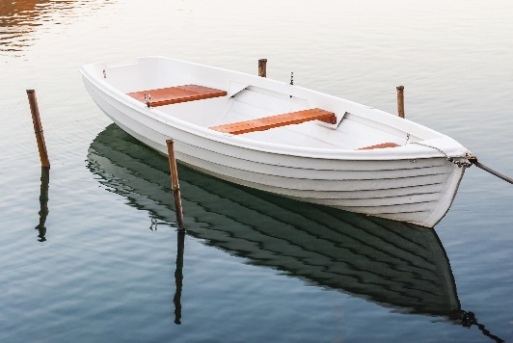
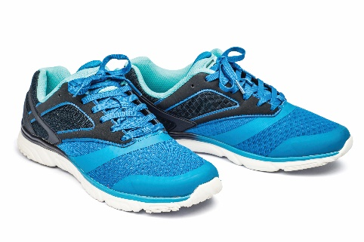
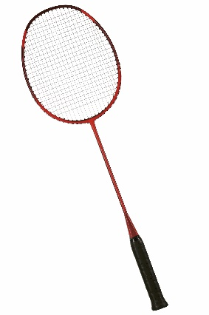
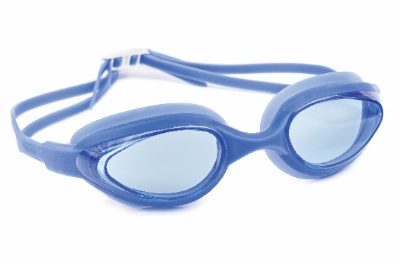
Write the right words under the pictures.
ball
racket
sports shoes
boat
goggles
1. ball
2. sports shoes
3.
1.
2.
3. boat
4. racket
5. goggles
4.
5.

Slide 9

What sports are these things for? Match each thing in column A with a sport in column B.
A
B
1.
bicycle
a.
boating
2.
ball
b.
Swimming
3.
boat
c.
Cycling
4.
goggles
d.
ball game
5.
racket
e.
badminton

Slide 10
What sports are these things for? Match each thing in column A with a sport in column B.
A
B
1.
c.
bicycle
a.
cycling
boating
2.
d.
ball
b.
ball games
swimming
c.
a.
cycling
3.
boat
boating
b.
swimming
4.
goggles
d.
ball games
e.
e.
badminton
5.
racket
badminton

Slide 11

Fill each blank with one of the words from the box.
champion
competition
sporty
marathon
congratulations
competition.
1.
She won an international sports
_______.
2.
He became the world tennis
_______ when he was very young.
champion when he was very young.
“Can you send my
_______ to the winner of the contest?”
3.
congratulations to the winner of the contest?”
_______. He does exercise every day.
4.
My friend David is very
sporty. He does exercise every day.
5.
The first
_______ took place in 1896.
marathon took place in 1896.

Slide 12
Pronunciation
/e/ and /æ/

Slide 13


Listen and repeat the words. Pay attention to the sounds /e/ and /æ/.
/e/ | /æ/
chess tennis exerise contest | racket match marathon active

Slide 14

Listen and repeat. Underline the words having the sounds /e/ and /æ/.
1.
They cannot take part in this contest.
2.
They began the match very late.
3.
Please get the racket for me.
4.
We play chess every Saturday.
5.
My grandpa is old, but he’s active.

Slide 15
Homework:
- Learn new words.
- Prepare for the new lesson: A closer look 2.

Slide 16







