Slide 2

WARM-UP: Spider web completion
...
TELEVISION

Slide 3

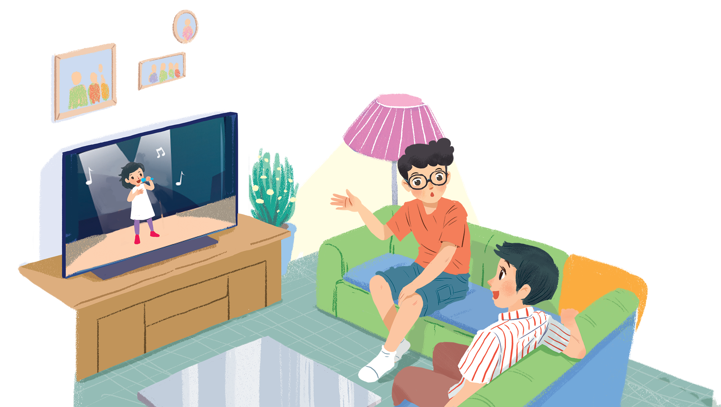
1. What do you think they are talking about?
2. Do you like watching TV? Why/ Why not?
3. How many hours a day do you watch TV?
4. What channel do you like best?

Slide 4



VOCABULARY
talent (n)
/ˈtælənt/
tài năng

Slide 5

VOCABULARY
programme (n)
/ˈprəʊɡræm/
chương trình

Slide 6
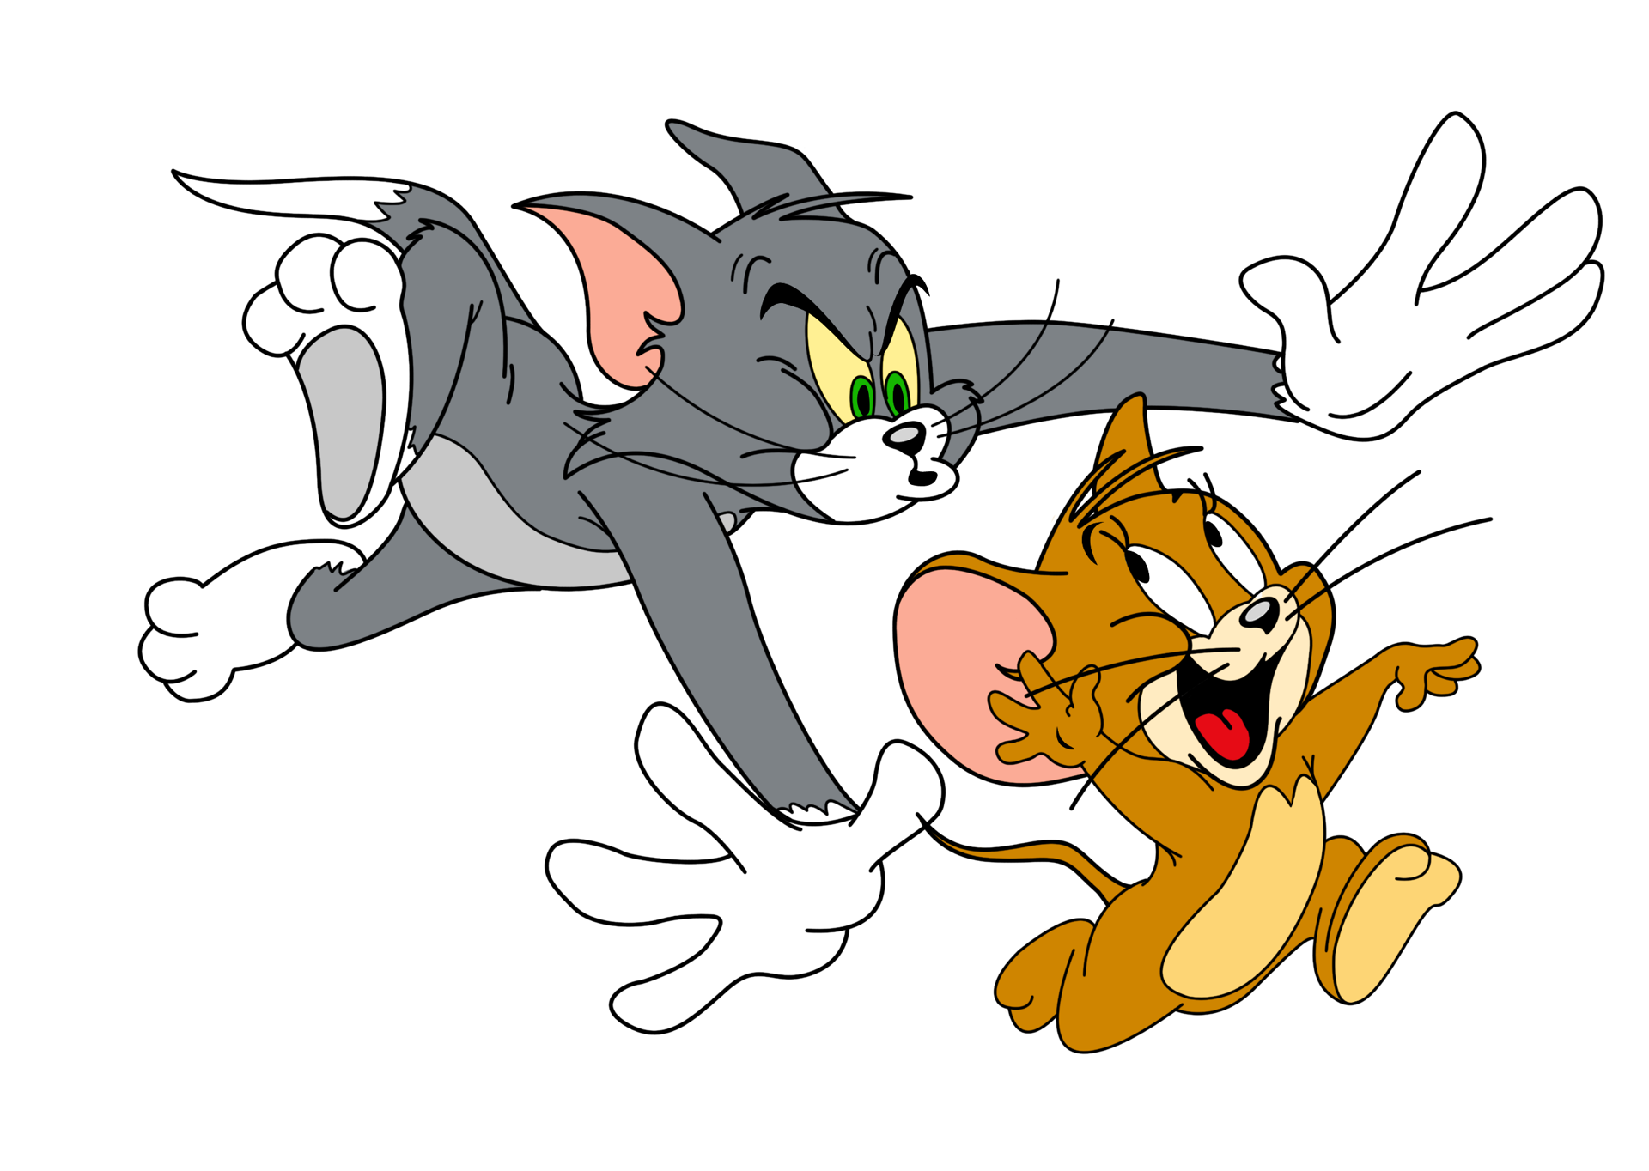
VOCABULARY
animated film (n)
/ˈænɪmeɪtɪd fɪlm/
phim hoạt hình
= cartoon /kɑːˈtuːn/

Slide 7

VOCABULARY
channel (n)
/ˈtʃænl/
kênh (truyền hình)

Slide 8

VOCABULARY
music talent show (n)
chương trình tài năng âm nhạc

Slide 9
VOCABULARY
character (n)
/ˈkærəktə(r)/
nhân vật

Slide 10
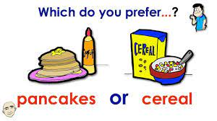
VOCABULARY
prefer (v)
/prɪˈfɜː(r)/
thích

Slide 11

VOCABULARY
educational
programme (n)
/ˌedʒuˈkeɪʃənl ˈprəʊɡræm/
chương trình giáo dục

Slide 12







What’s on today?
Listen and read.
Find and write the adjectives in the conversation which describe the programmes and characters below.
Choose the correct answer A, B, or C.
Work in groups. Interview your partners about their favourite TV programmes and report to the class.
Read the conversation again and match 1-5 with a-e.

Slide 13


Listen and read.
What’s on today?

Slide 14
What’s on today?
Phong: What are you watching, Hung?
Hung: The Voice Kids.
Phong: That music talent show is very interesting.
Hung: It is. What programme do you often watch, Phong?
Phong: Films. I like animated films like The Lion King.
Hung: I love them, too. They’re wonderful.
Phong: I often watch them with my little brother, but he prefers cartoons.
Hung: Tom and Jerry?
Phong: Ha ... ha ... Yes, he loves Jerry the mouse.
Hung: Jerry’s a clever character. Do you know any English programmes for children?
Phong: Yes. I watch English in a Minute on VTV7.
This channel has many educational programmes.
Hung: Great. I’ll watch it, too.

Slide 15

Choose the correct answer A, B, or C.
1.
Phong and Hung are talking about _______.
A.
The Voice Kids programme
B.
English in a Minute programme
C.
different TV programmes
2.
Phong likes _______.
A.
animated films
B.
cartoons
C.
talent shows
3.
When you’re viewing a TV programme, you say: “I’m _______ TV.”
B.
C.
looking
A.
watching
seeing
4.
When a programme teachesyou something, it’s _______.
A.
educational
B.
funny
C.
clever

Slide 16

Read the conversation again and match 1-5 with a-e.
1. The Voice Kids
2. The Lion King
3. Tom and Jery
4. VTV7
5. English in a Minute
c. music talent show
a. animated film
a. animated film
b. channel
e. cartoon
c. music talent show
b. channel
d. educational programme
e. cartoon
d. educational programme

Slide 17

Find and write the adjectives in the conversation which describe the programmes and characters below.
1.
The Voice Kids
interesting
2.
animated films
wonderful
3.
Jerry the mouse
clever
4.
programmes on VTV7
educational

Slide 18

Work in groups. Interview your partners about their favourite TV programmes and report to the class.
Example:
In our group, Mai likes sports programmes on TV. Binh likes ...
Ask other students | Name(s)
1.… like sports programmes on TV. | …Hung…
Question: Do you like sports programmes on TV?
2. … like music talent shows. | …Lan…
3. … like animated films. | …Binh…
4. … like cartoons. | …Khoi…
5. … like English programmes. | …Hoa…
Now present your information about five students to the whole class. e.g. Hung likes sports programmes on TV. Lan likes music talent shows. Binh likes animated films and Khoi likes cartoons. Hoa likes English programmes.

Slide 19
WRAP- UP
- Gain an overview of the topic Television
- Use lexical items related to the topic, including TV programmes and people

Slide 20

HOMEWORK
Write new words 2 lines.
Learn new words by heart.
Do exercise in Workbook.

Slide 21







