Slide 2

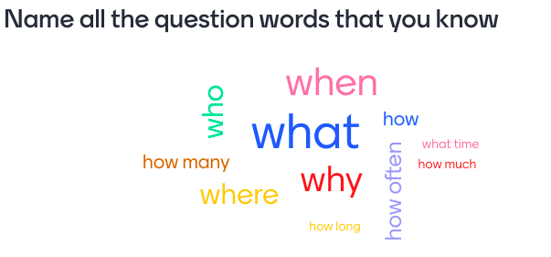
Warm-up: Word cloud
Name all the question words that you know

Slide 3








Grammar
Wh – questions
Conjunctions in compound sentences
Read the conversation and underline the question words.
Match the beginnings with the endings.
Match each question word with the information it needs.
Use and, but or so to complete the sentences.
Use the question words in the box to complete the conversations. Then listen Track and check your answers.

Slide 4


Vocabulary
book exhibition (n)
/bʊk ˌeksɪˈbɪʃn/
triển lãm sách

Slide 5
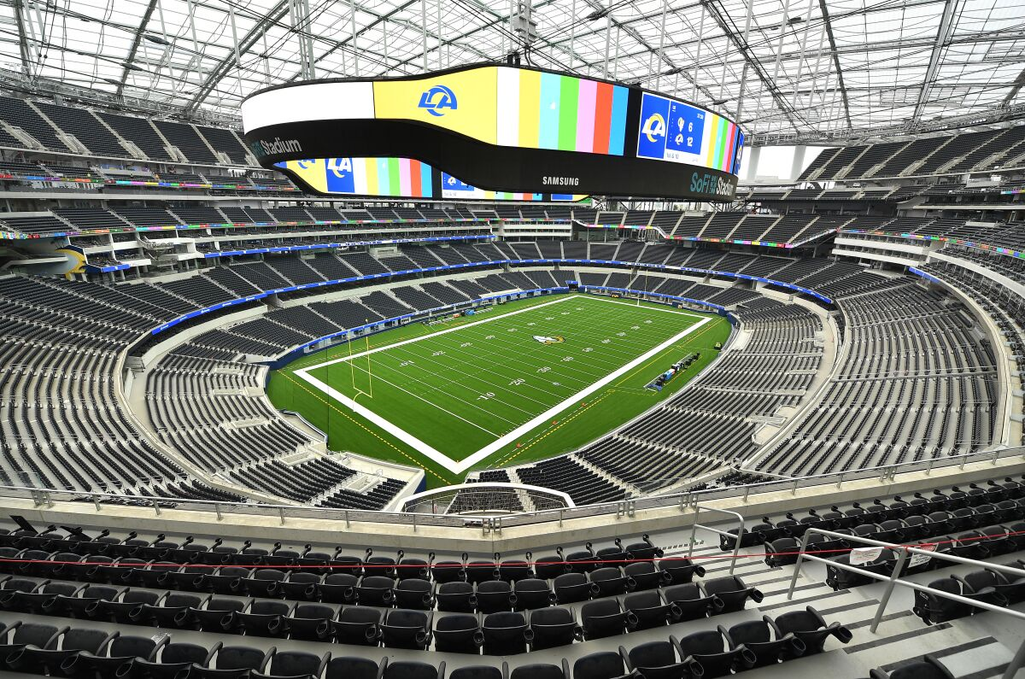
Vocabulary
stadium (n)
/ˈsteɪdiəm/
sân vận động

Slide 6

Vocabulary
train (v)
/treɪn/
tập luyện

Slide 7

Vocabulary
instruction (n)
/ɪnˈstrʌkʃn/
sự hướng dẫn

Slide 8

Vocabulary
follow (v)
/ˈfɒləʊ/
làm theo

Slide 9
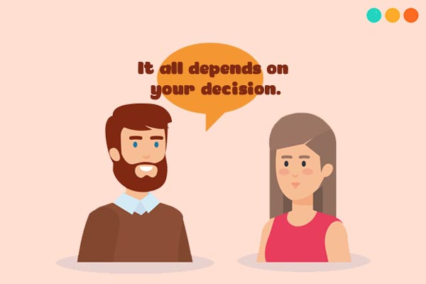
Vocabulary
depend (v)
/dɪˈpend/
phụ thuộc

Slide 10
Grammar
WH – questions

Slide 11

Grammar
WH – questions
Each question word is used for a specific piece of information.

Slide 12
Grammar
WH – questions
When | Khi nào
How many | Bao nhiêu (số lượng)
How often | Có thường xuyên
How long | Bao lâu
What | Cái gì
Where | Ở đâu
Who | Ai
Why | Vì sao

Slide 13


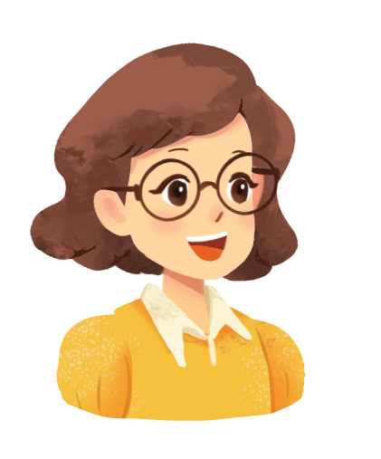



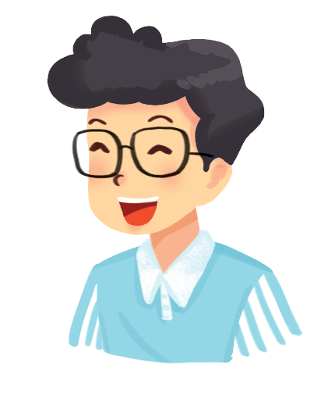



Read the conversation and underline the question words.
Hi, Phong. What are you doing tomorrow?
I’m going to a book exhibition.
Where is it?
It’s in Van Ho street.
How long is it on?
From the 4th to the 7th January.

Slide 14

Match each question word with the information it needs.
Question word
When
How many
How often
What
Where
Who
Why
The information it needs
time
number
repetition
thing
place
people
reason
The information it needs
thing
time
people
reason
repetition
number
place

Slide 15

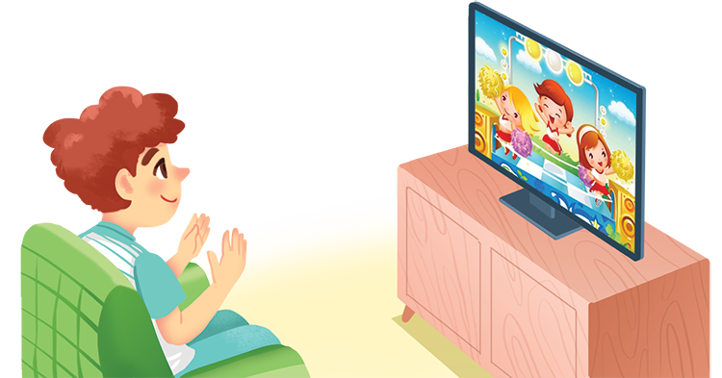
Use the question words in the box to complete the conversations. Then listen Track and check your answers.
When
Who
What
Where
How often

Slide 16
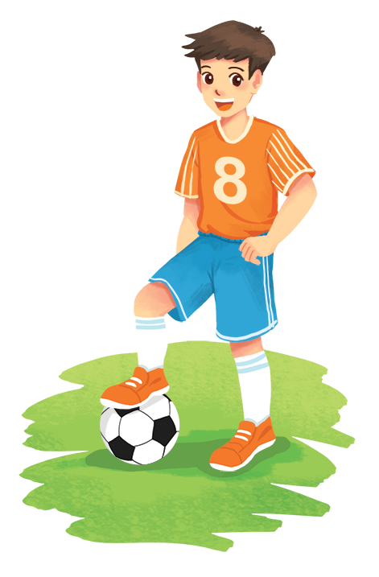

When
What
Who
Where
How often
Conversation 1
A:
B: Not very often. Two or three times a week.
A:
B: It depends. But I like talent shows the most.
_______ do you watch TV?
How often do you watch TV?
What do you watch?
_______ do you watch?
Conversation 2
_______ do you like the most in Doraemon?
Who do you like the most in Doraemon?
A:
B: Nobita. He’s so funny.
Conversation 3
A:
B: Usually on Saturday or Sunday.
A:
B: In the yard.
When do you play football?
_______ do you play football?
Where do you play?
_______ do you play?

Slide 17

Grammar
Conjunctions in compound sentences

Slide 18
Grammar
Conjunctions in compound sentences
We use conjunctions to combine two clauses into a compound sentence.
Examples:
I like watching cartoons, but my brother likes watching sports.
I enjoy sports, so I spend a lot of time outdoors.
I’m helping decorate the house, and my brother is busy cooking.

Slide 19

Match the beginnings with the endings.
Beginnings | Endings
1. I like animal programmes, | a. so I can be at the stadium on time.
2. I’ll get up early tomorrow, | b. but he can’t draw.
3. Sometimes we read books, | c. and my brother likes them, too.
4. My little brother can colour pictures, | d. so we spend every Saturday playing sports.
5. We love outdoor activities, | e. and sometimes we play sports.

Slide 20
Match the beginnings with the endings.
Beginnings | Endings
1. I like animal programmes, | c. and my brother likes them, too.
2. I’ll get up early tomorrow, | a. so I can be at the stadium on time.
3. Sometimes we read books, | e. and sometimes we play sports.
4. My little brother can colour pictures, | b. but he can’t draw.
5. We love outdoor activities, | d. so we spend every Saturday playing sports.

Slide 21

Use and, but or so to complete the sentences.
1.
I’m tired,
so I’ll go to bed early.
_______ I’ll go to bed early.
2.
_______ I’m not.
My sister is good at school,
but I’m not.
so we won the game.
3.
We trained hard,
_______ we won the game.
4.
The programme is interesting,
_______ it’s too long.
but it’s too long.
and I hope he’ll follow them.
5.
I’ll write him some instructions,
_______ I hope he’ll follow them.

Slide 22
WRAP- UP
- Use the lexical items related to the topic Television
- Use Wh-questions and conjunctions in compound sentences: and, but, so correctly.

Slide 23

HOMEWORK
Write new words 2 lines.
Learn new words by heart.
Do exercise in Workbook.

Slide 24







