Slide 2

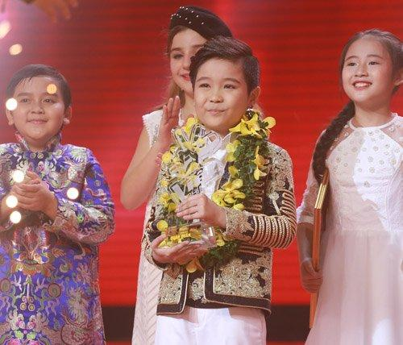
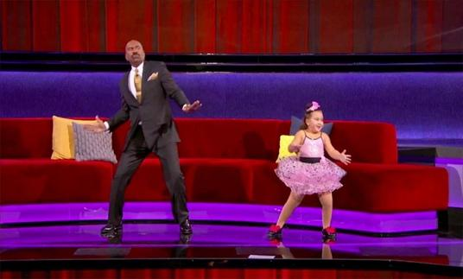
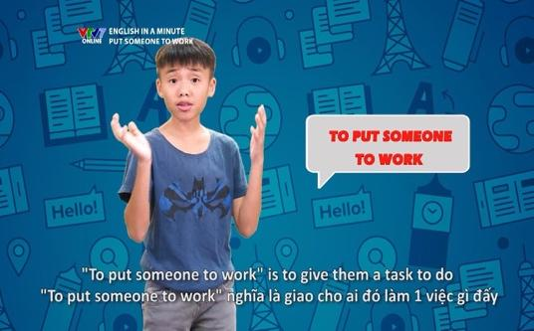
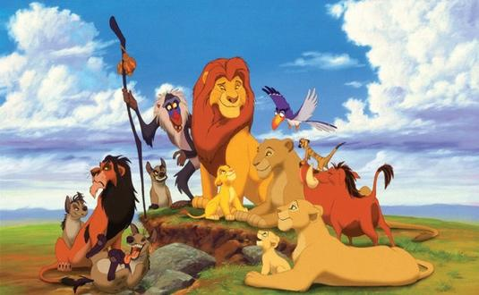
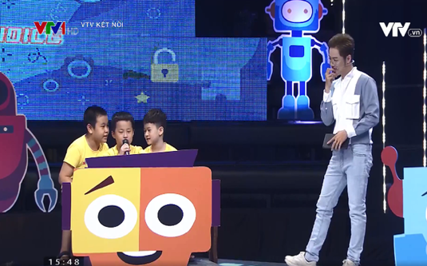
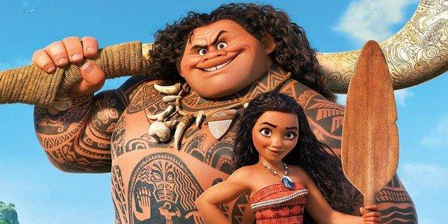
Warm-up: Matching
English in a Minute
The Lion King
The Voice Kids
Alo English
Moana
Little Big Shots

Slide 3








Vocabulary
Pronunciation
/θ/and /ð/
Write the words / phrases in the box next to the definition.
Listen and repeat the words.
Complete the sentences with the words / phrases in the box.
Tongue Twister Take turns to read the sentences quickly and correctly.
Complete the sentences with the adjectives in the box.

Slide 4
Vocabulary

Slide 5

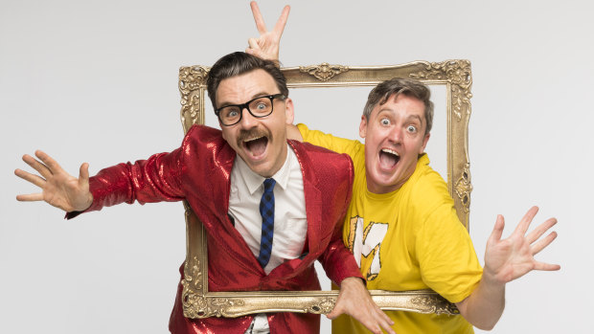

Vocabulary
comedy (n)
/ˈkɑːmədi/
hài kịch, phim hài

Slide 6
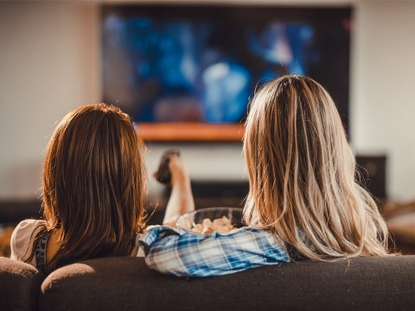
Vocabulary
viewer (n)
/ˈvjuːər/
người xem

Slide 7
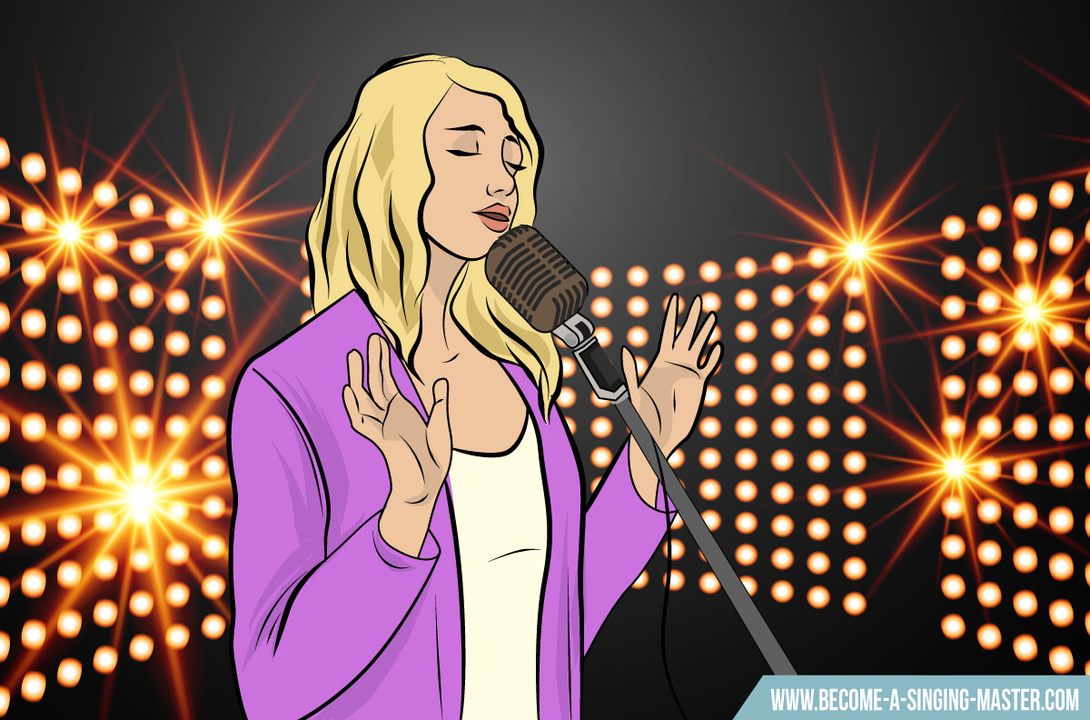
Vocabulary
performer (n)
/pərˈfɔːrmər/
người biểu diễn

Slide 8

Vocabulary
popular (adj)
/ˈpɑːpjələr/
phổ biến, được yêu thích

Slide 9
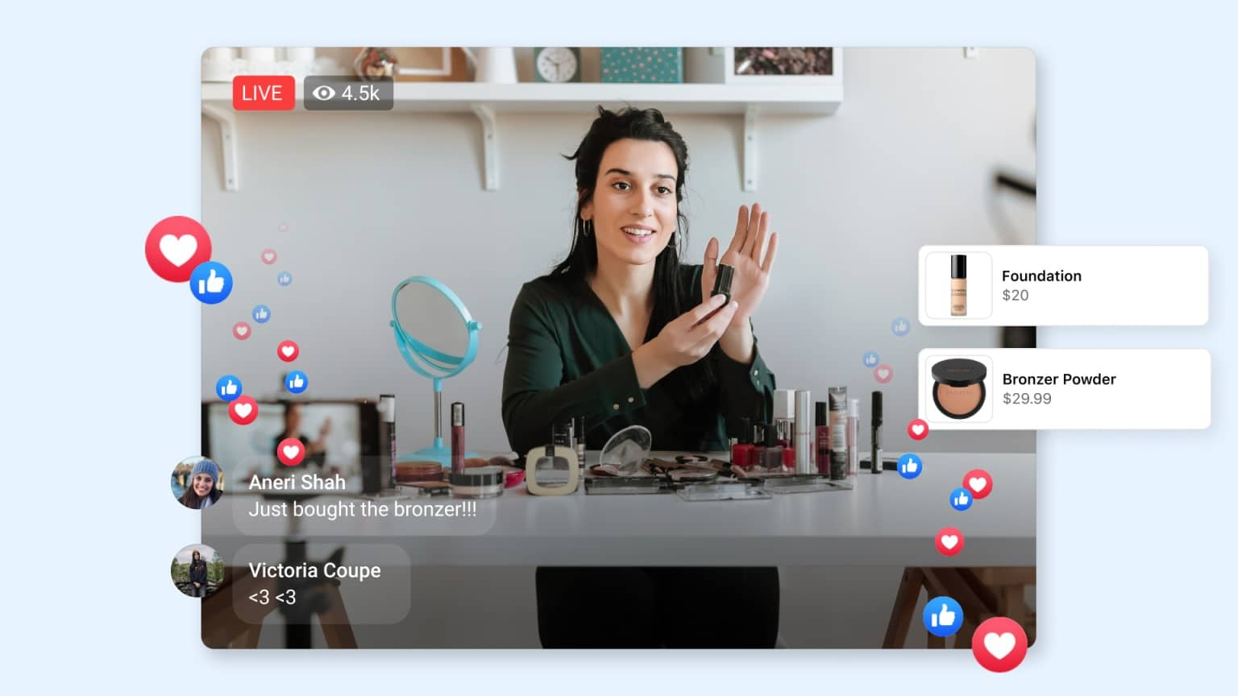
Vocabulary
live (adj)
/laɪv/
trực tiếp

Slide 10

Vocabulary
boring (adj)
/ˈbɔːrɪŋ/
chán, không hấp dẫn

Slide 11


Write the words / phrases in the box next to the definition.
talent show
comedy
educational programme
viewer
character
1.
an animal or person in a film
character
2.
a programme which teaches maths, English, etc.
educational programme
3.
a film / show which makes people laugh
comedy
4.
a competition to choose the best performer
talent show
5.
a person who watches TV
viewer

Slide 12

Complete the sentences with the words / phrases in the box.
character
viewers
game show
animated films
comedies
channel
Do you watch Bibi, the popular for children?
1.
channel
2.
Which do you prefer: Jerry the mouse or Tom the cat?
character
I love
animated films like Happy Feet and Coco.
3.
like Happy Feet and Coco.
I love Children are Always Right, a
game show for kids.
4.
for kids.
5.
My father often watches
comedies. They’re so funny.
. They’re so funny.
6.
A popular programme has a lot of .
viewers

Slide 13

Complete the sentences with the adjectives in the box.
popular
educational
cute
boring
live
funny
popular
1.
The most channel for children is the Cartoon Network.
2.
. I don’t want to watch it.
This film is very
boring. I don’t want to watch it.
Cat Kitty is a very
cute character. Children love her.
3.
character. Children love her.
4.
You can watch this programme at the same time it happens. It’s
live.
.
5.
Comedies are
funny. People laugh a lot when they watch them.
. People laugh a lot when they watch them.
6.
We learn a lot from Discovery Channel. This channel is
educational.
.

Slide 14
Pronunciation
/θ/and /ð/

Slide 15


Listen and repeat the words.
/θ/ | /ð/
theatre earth anything both through | there them neither weather than

Slide 16


Tongue Twister. Take turns to read the sentences quickly and correctly.
1.
They are thinking about the weather there.
2.
The new theatre opens on Thursday the third.

Slide 17
WRAP- UP
- Use the lexical items related to the topic Television
- Use the vocabulary and structures to talk about TV programmes
- Pronounce and recognize the sounds /θ/ and /ð/.

Slide 18

HOMEWORK
Write new words 2 lines.
Learn new words by heart.
Do exercise in Workbook.

Slide 19







