Slide 2


Objectives
- Remember some lexical items related to the topic Tet holiday in Viet Nam.
- Identify some collocations of some verbs and some nouns.
- Identify how to pronounce the sounds /s/ and /∫/ correctly.

Slide 3







Vocabulary
Pronunciation
/s/ and /ʃ/
Write the words / phrases in the box under the pictures.
Listen and repeat the words.
Match the verbs with the nouns.
Listen and repeat the poem. Pay attention to the sounds /s/ and /ʃ/ in the underlined words.
Complete the sentences with the words in the box.

Slide 4
Vocabulary

Slide 5


VOCABULARY
wish (v)
/wɪʃ/
ước

Slide 6

VOCABULARY
firework (n)
/ˈfaɪəwɜːk/
pháo hoa

Slide 7
VOCABULARY
special (adj)
not ordinary or usual; different from what is normal
/ˈspeʃl/
đặc biệt

Slide 8
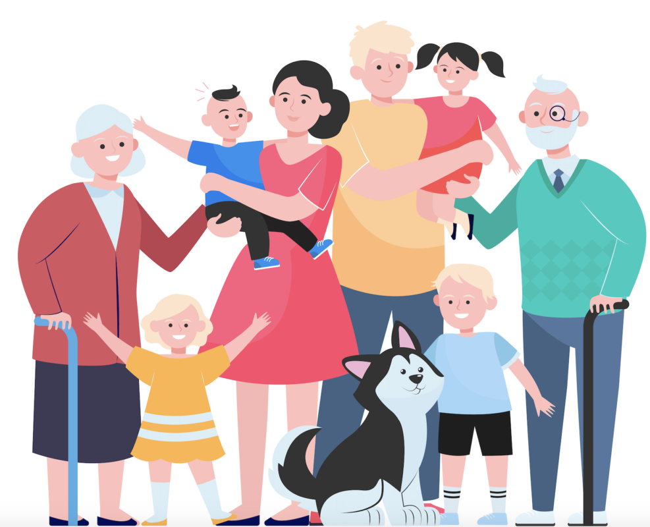
VOCABULARY
relative (n)
/ˈrelətɪv/
người thân

Slide 9
VOCABULARY
relative (n)
/ˈrelətɪv/
người thân

Slide 10

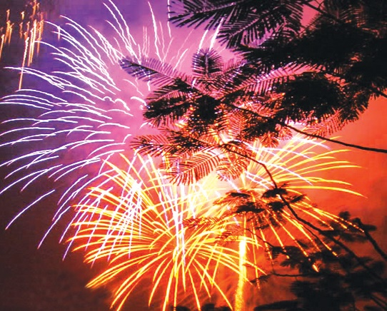
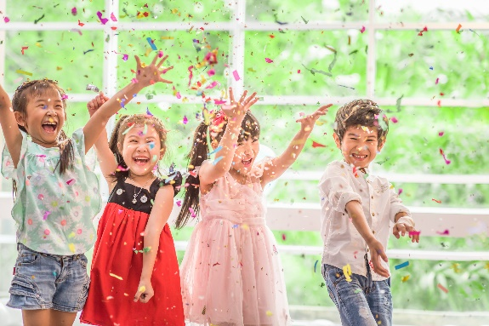
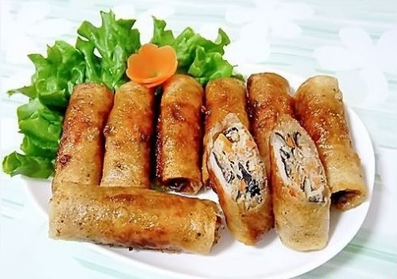
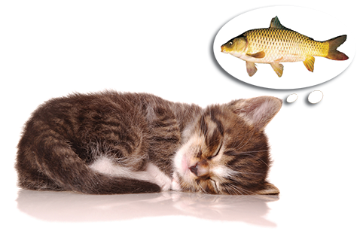
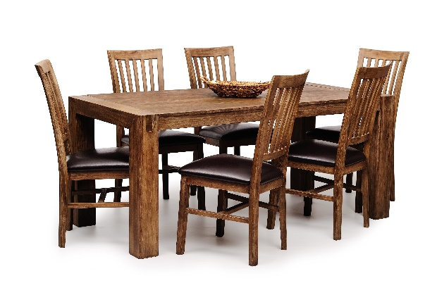
Write the words / phrases in the box under the pictures.
wish
fun
fireworks
special food
furniture
1. fireworks
2. special food
3. fun
1.
2.
3.
4.
4. wish
5. furniture
5.

Slide 11

Match the verbs with the nouns.
Verbs
Nouns
a. a wish
1. have
f. fun
e. relatives
2. visit
b. fireworks
d. lucky money
3. give
c. the furniture
4. make
d. lucky money
a. a wish
5. clean
e. relatives
c. the furniture
f. fun
6. watch
b. fireworks

Slide 12

Complete the sentences with the words in the box.
shopping
celebrate
clean
food
peach
1.
In Viet Nam, we
celebrate Tet in January or February.
Tet in January or February.
At Tet, we decorate our houses with
peach flowers.
2.
flowers.
3.
Children should help their parents to
clean their houses.
their houses.
before Tet.
4.
People do a lot of
shopping before Tet.
5.
My mother usually cooks special
during Tet.
food during Tet.

Slide 13
Pronunciation
/s/ and /ʃ/

Slide 14


Listen and repeat the words.
shopping
special
rice
spring
wish
celebrate

Slide 15


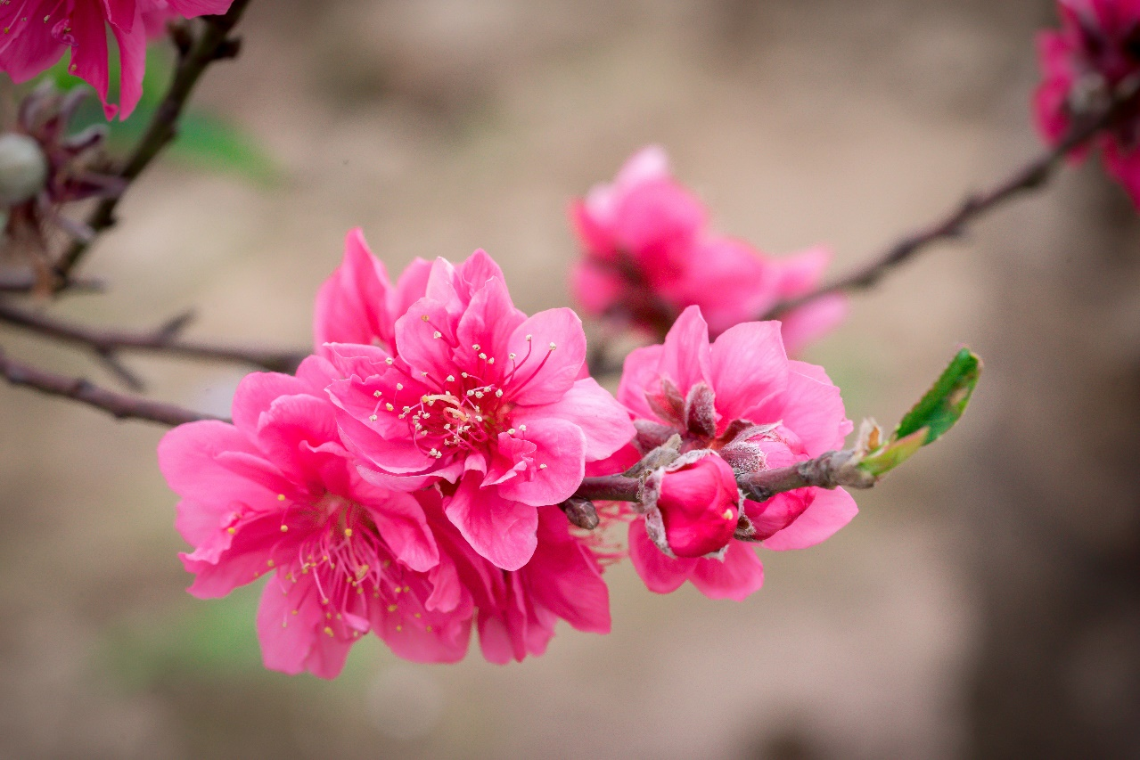
Listen and repeat the poem. Pay attention to the sounds /s/ and /ʃ/ in the underlined words.
Spring is coming!
Tet is coming!
She sells peach flowers.
Her cheeks shine.
Her eyes smile.
Her smile is shy.
She sells peach flowers.

Slide 16
Wrap- up
- Get an overview about the topic Our Tet holiday
- Use the lexical items related to “Tet”
- Use the vocabulary and structures to describe things and activities at Tet

Slide 17
Homework
- Write new words 2 lines.
- Do more exercises in workbook.
- Prepare new lesson: U6 - A closer look 2.

Slide 18







