Slide 1


ENGLISH 9
Hello everyone !!!

Slide 2


WARM-UP
* REPORTED SPEECH
The teacher asks students to repeat the form and how to change it to reported speech with statements and Wh questions.

Slide 3
WARM-UP
* REPORTED SPEECH
1. Change the verb form | Present simple
 | Present continuous
 | Will
2. Change time and place expressions | now
 | Today/ this week
 | tomorrow
 | here
3. Change pronouns | I
 | we
 | me
Past simple
Past continuous
would
Then
That day/ that week
The following day
There
He/ She
They
him/her

Slide 4
* REPORTED SPEECH
Form:
S + said (that) + S + V(lùi thì)
say
told
tell
Statements:
Wh questions:
S + asked + Wh- Q + S + V (lùi thì)

Slide 5
“I like singing this song.”
=> Minh said ……………………………………………………….
2. “Mai will take an online course to improve her speaking.”
=> Nam said ………………………………………………………………………..
that he liked singing that song.
Mai would take an online course to improve her speaking.
3. “What time does the train leave?”
He asked me …………………………………………….
4. “Where is he going ?”
She wanted to know……………………………………..
5. The pupils asked the teacher, “Where can we find information about the solar system?”
 The pupils asked the teacher…………………………………………………….
what time the train left.
where he was going.
where they could find information about the solar system.

Slide 6
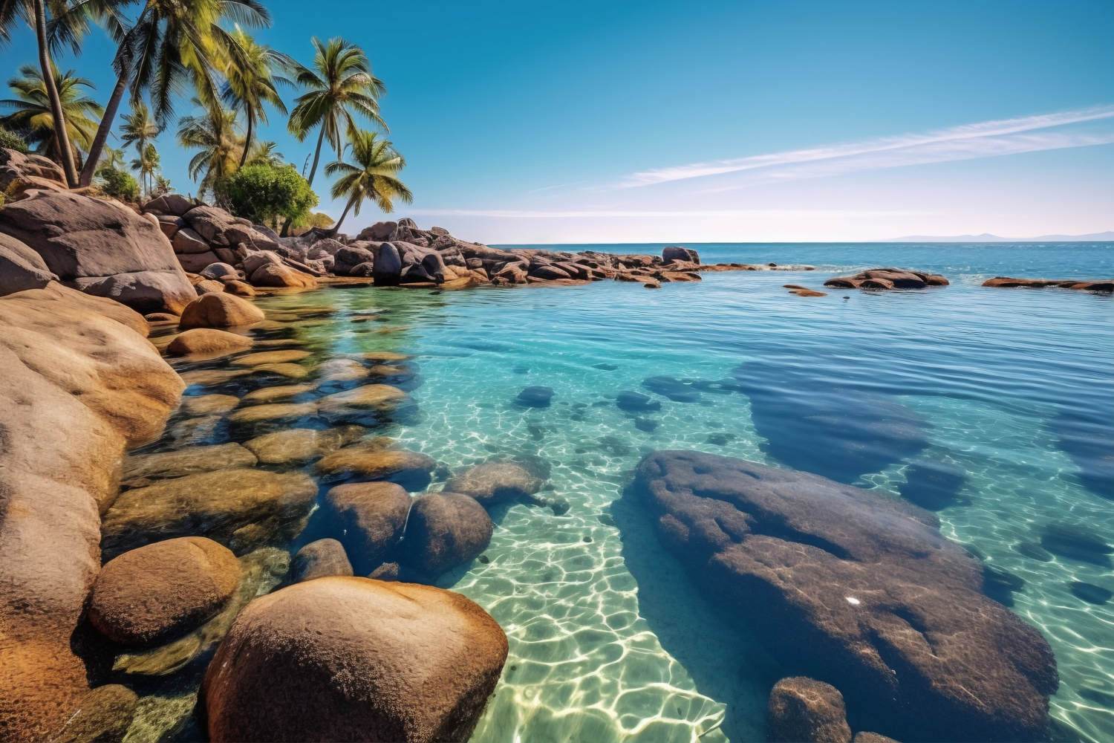
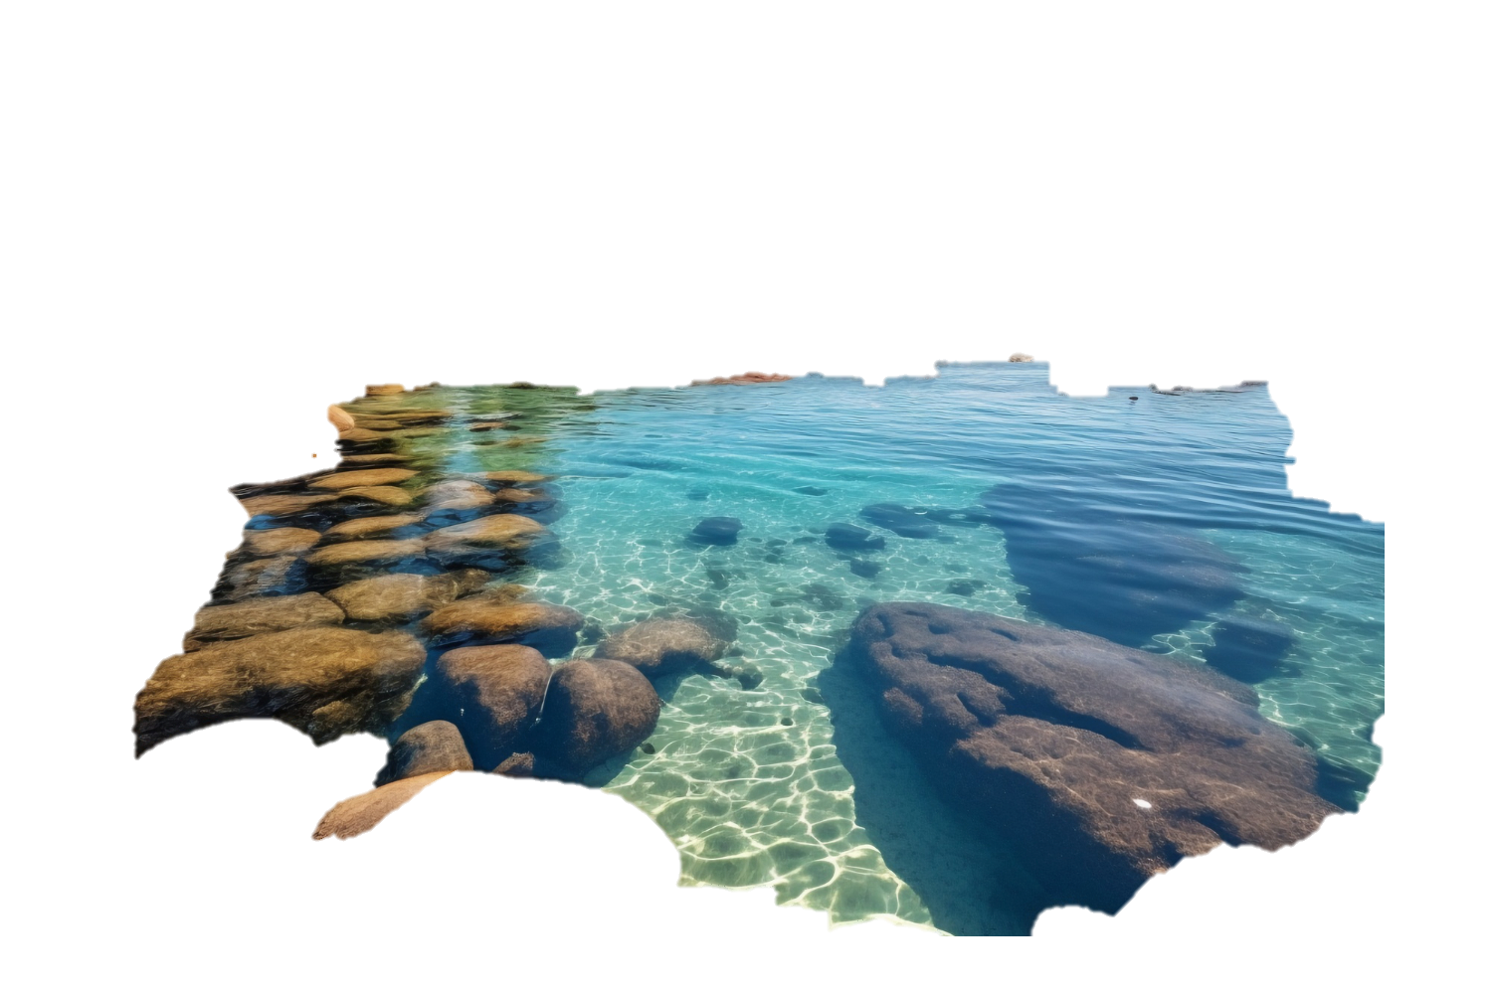


Unit
NATURAL WONDERS
7
LESSON 3: A CLOSER LOOK 2

Slide 7

PRESENTATION
In reporting Yes / No questions, we often use the verb ask or want to know; we use the word order of statements.
In reporting Yes / No questions, we normally use if / whether + clause.
Example:
Anna: “Do you plan to climb any mountains this summer, Joe?”
→ Anna asked Joe if / whether he planned to climb any mountains that summer.

Slide 8
Reported speech - (Yes/No questions)
(Câu tường thuật – câu hỏi yes/ no)
Khi tường thuật câu hỏi Yes/No, chúng ta thường sử dụng động từ ask (hỏi) hoặc want to know (muốn biết), chúng ta sử dụng trật tự từ của các câu trần thuật.
Form: S + asked/ wanted to know + IF/ WHETHER + S + V (lùi thì)
* Eg: Anna: “Do you plan to climb any mountains this summer, Joe?
→ Anna asked Joe if/whether he planned to climb any mountains that summer

Slide 9
1
Choose the correct answer A, B, C, or D to complete each question
1. “Will pollution endanger the wildlife here?” Kate asked.
→ Kate ______ if pollution would endanger the wildlife there.
A. told me
C. wanted to know
B. said to me
D. questions me
2. “Are you enjoying your flight?” the stewardess asked me.
→ The stewardess asked me if I ______my flight.
A. am enjoying
C. enjoyed
B. was enjoying
D. would enjoy

Slide 10
1
Choose the correct answer A, B, C, or D to complete each question
3. “Is Ganh Da Dia in Phu Yen Province, Phong?”
→ She asked Phong ______ in Phu Yen Province.
A. was Ganh Da Dia
C. whether Ganh Da Dia was
B. if Ganh Da Dia is
D. if it is Ganh Da Dia
4. “Can I take a photo inside the cave?” he said to the guide.
→ He ______ the guide if he could take a photo inside the cave.
A. asked
C. advised
B. said
D. ordered

Slide 11
1
Choose the correct answer A, B, C, or D to complete each question
5. “Is the weather good in Sa Pa in the winter?”
→ She wanted to know_____________________
A. was the weather good in Sa Pa in the winter?
B. if the weather is good in Sa Pa in the winter.
C. whether was the weather good in Sa Pa in the winter.
D. if the weather was good in Sa Pa in the winter.

Slide 12
2
Complete the following reported questions.
1. “Are you excited about your upcoming trip to Mui Ne?”
excited about their up-coming trip to
Mui Ne
He asked the children if they were ______________________________
____.
2. “Do you often meet Angela at school?”
often met Angela at school.
She asked us whether we ____________________________.
3. “Will you visit Giang Dien Waterfall next week?”
She wanted to know if Mark_____________________________
________.
would visit Giang Dien Waterfall the
following week.

Slide 13
PRACTICE
2
Complete the following reported questions.
4. “Is Con Dao National Park rich in flora and fauna?”
I asked the teacher ___________________________________.
if / whether Con Dao National Park was rich in flora and fauna.
5. “Can we go to the campsite by bike?”
Arthur wanted to know ______________________________.
if / whether they could go to the camp site by bike.

Slide 14
3
Rewrite the sentences in reported questions.
1. “Are you still working from home?” I asked my dad.
I asked my dad if / whether he was still working from home.
2. “Do you have to pack your suitcase, Anne?” said Mark.
Mark asked Anne if / whether she had to pack her suitcase.
3. Lan: “Are you interested in visiting Phu Quoc Island, Tom?”.
Lan asked / wanted to know if / whether Tom was interested
in visiting Phu Quoc Island.
4. “Can we afford to go to Niagara Falls, Mum?” said Kay.
Kay asked her mum if / whether they could afford to go to
Niagara Falls.
5. . “Will they visit Sa Pa and climb Mount Fansipan this summer?”
I asked / wanted to know if/ whether they would visit Sa Pa and
climb Fansipan that summer.Ư
______________________________________________________________________________________________________.

Slide 15
4
Read the passage and underline the Yes/No questions. Then write them in reported questions.
1. The guide said to them: “Is it your first time here?”
A tour guide is taking a group of tourists to visit Tonle Sap Lake in Cambodia. The guide said to them: “Is it your first time here?” Some said yes and some said no. Olivia asked the guide: “Do the people live on fishing?” He said most of them did. Then Mark said: “Do their children go to school on land?” “Yes, they do,” said the guide. ...
______________________________________________________________________________________________________.
2. Olivia asked the guide: “Do the people live on fishing?”
______________________________________________________________________________________________________.

Slide 16
4
Read the passage and underline the Yes/No questions. Then write them in reported questions.
1. The guide said to them: “Is it your first time here?”
______________________________________________________________________________________________________.
The guide asked them / wanted to know if / whether
it was their first time there.
2. Olivia asked the guide: “Do the people live on fishing?”
______________________________________________________________________________________________________.
Olivia asked / wanted to know if / whether the people
there lived on fishing.
3. Mark said: “Do their children go to school on land?”
______________________________________________________________________________________________________.
Mark asked / wanted to know if / whether their children
went to school on land.

Slide 17
PRODUCTION
5
Work in two groups. Take turns to give and change the Yes/No questions into reported speech.
- Work in 2 groups.
Group A:
“Is the Atacama Desert in Chile?”
Group B:
She asked if the Atacama Desert was in Chile.

Slide 18
PRODUCTION
5
Work in two groups. Take turns to give and change the Yes/No questions into reported speech.
- Work in 2 groups.
Group A:
“Is the Red River the longest river in Viet Nam?”
Group B:
He asked if the Red River was the longest river in Viet Nam

Slide 19
EXTRA ACTIVITY
Reported questions into direct questions
Example:
A: She asked me if / whether I lived near the sea.
B: “Do you live near the sea?”

Slide 20

CONSOLIDATION
What have we learnt in this lesson?
Change Yes / No questions into reported speech

Slide 21



Homework
- Do exercises in the workbook.
- Make 5 sentences by using Yes/No questions in Reported Speech

Slide 22

Thanks for your atendance!
Goodbye. See you again
Notes:
22

Slide 23
Website: hoclieu.vn
Fanpage: facebook.com/www.tienganhglobalsuccess.vn/

Slide 24
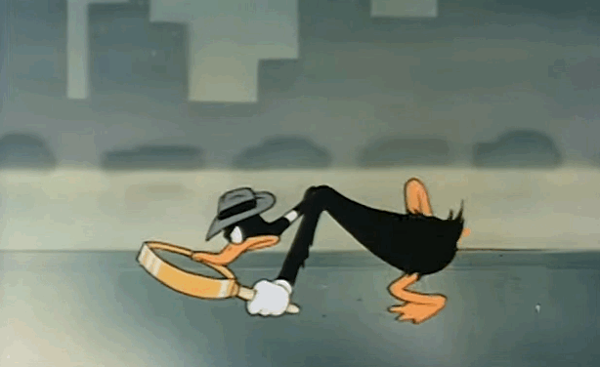
WARM-UP
OPTION 2
Rumour Detective

Slide 25
WARM-UP
OPTION 2
- Work in teams
- One team prepares a short story with several characters and events
- The other team act as “rumor detectives” who listen to the story and then ask questions using Wh- questions using reported speech to clarify the details.
HOW TO PLAY
- The storytelling team can only answer using reported speech
Ex: He said that she had gone to the store.

