Slide 1


Slide 2
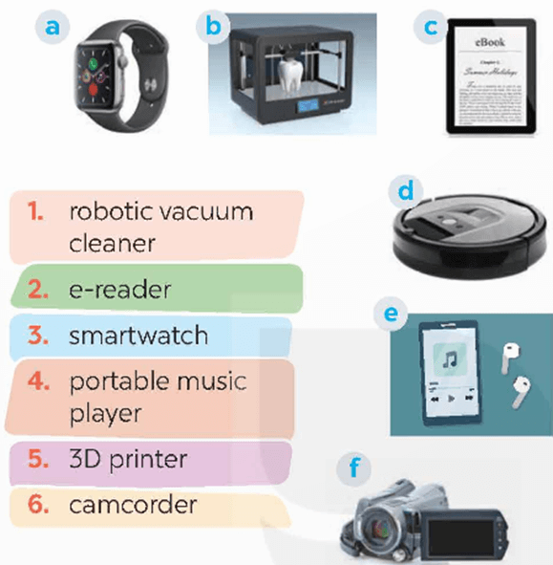
WARM UP
1
Match the electronic devices with the correct pictures.
1 - robotic vacuum cleaner
2. e-reader
3 - smartwatch
4 - portable music player
5 - 3D printer
6 - camcorder

Slide 3
WARM UP
1
Match the electronic devices with the correct pictures.
3 - smartwatch
5 - 3D printer
2. e-reader
1 - robotic vacuum cleaner
4 - portable music player
6 - camcorder
1 - d. robotic vacuum cleaner (máy hút bụi robot)
2 - c. e-reader (máy đọc sách điện tử)
3 - a. smartwatch (đồng hồ thông minh)
4 - e. portable music player (máy nghe nhạc cầm tay)
5 - b. 3D printer (máy in 3D)
6 - f. camcorder (máy quay phim)

Slide 4


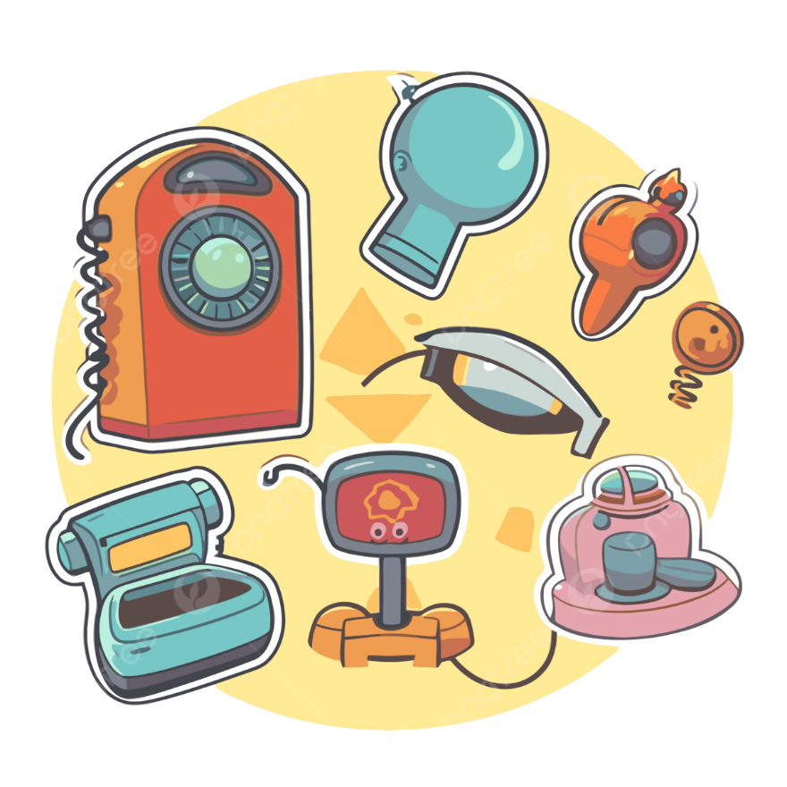
Unit
11
ELECTRONIC DEVICES
LESSON 2: A CLOSER LOOK 1
1

Slide 5

VOCABULARY

Slide 6


Vocabulary
robotic vacuum cleaner (n)
/roʊˈbɑː.t̬ɪk ˈvæk.juːm ˈkliː.nɚ/
robot hút bụi tự động

Slide 7

Vocabulary
camcorder (n)
/ˈkæmˌkɔːr.dɚ/
máy quay điện tử

Slide 8

Vocabulary
cooper (n)
/ˈkuː.pɚ/
đồng

Slide 9
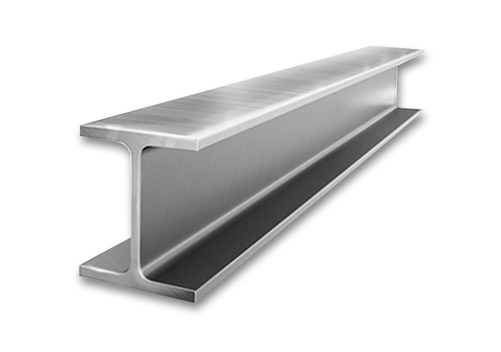
Vocabulary
steel (n)
/stiːl/
thép

Slide 10
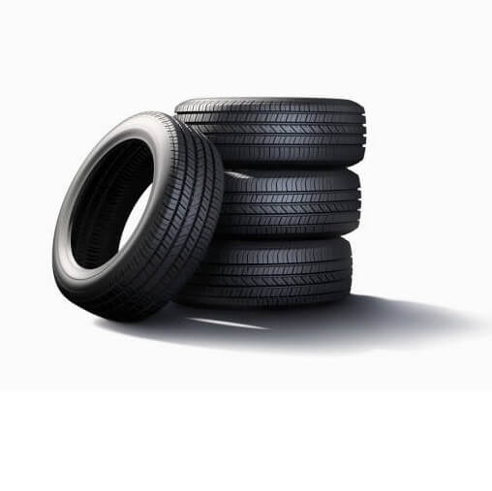
Vocabulary
rubber (n.)
/ˈrʌb.ə/
cao su

Slide 11
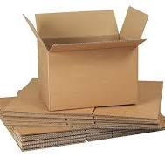
Vocabulary
cardboard (n.)
/ˈkɑːd.bɔːd/
bìa cứng, các tông

Slide 12
Vocabulary
New words | Pronunciation | Meaning
1. robotic vacuum cleaner (n) | /roʊˈbɑː.t̬ɪk ˈvæk.juːm ˈkliː.nɚ/ | robot hút bụi tự động
2. camcorder (n) | /ˈkæmˌkɔːr.dɚ/ | máy quay điện tử
3. cooper (n) | /ˈkuː.pɚ/ | đồng
4. steel (n) | /stiːl/ | thép
5. rubber(n) | /ˈrʌb.ə/ | cao su
6. cardboard(n) | ˈkɑːd.bɔːd/ | bìa cứng, các tông

Slide 13
Checking Vocabulary
New words | Meaning
 | robot hút bụi tự động
 | máy quay điện tử
 | đồng
 | thép
 | cao su
 | bìa cứng, các tông
1. robotic vacuum cleaner (n)
2. camcorder (n)
3. cooper (n)
4. steel (n)
5. rubber(n)
6. cardboard(n)

Slide 14
2
Complete the sentences with the material words from the box.
cooper
1. We often use _______________________, which is a soft reddish-brown metal, to make electric wire, pipes, and coins.
2. Today, ____________________ is often used to make cases of electric devices because it doesn’t conduct electricity and it is light,
and easily be shaped into many different forms.
3. We often use _____________________ in the construction industry because it is a strong and hard metal.
4. We use _______________________, which comes from rubber trees, for making tyres, boots, etc.
5. The kids need a piece of ______________________ to easily cut shapes and make toys.
plastic
steel
plastic
cardboard

Slide 15
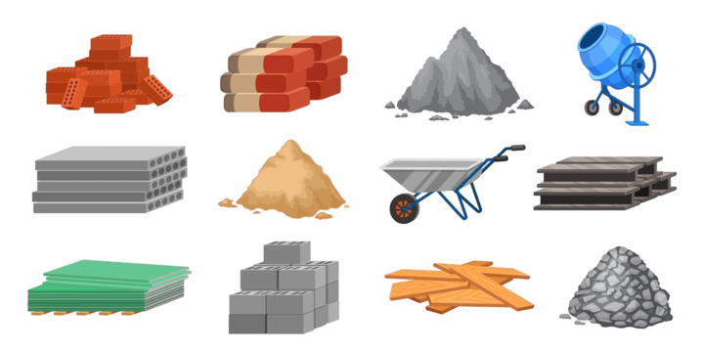
What do you call these materials in Vietnamese?

Slide 16
3
Circle the correct words or phrases to complete the following sentences.
1. The most common use for rubber / iron is for producing tyres for cars, motorbikes, bicycles, etc.
2. The most popular material for the construction of buildings and bridges is plastic / steel because it is strong enough to support heavy loads.
3. Today 3D printers / photocopiers allow us to create three-dimensional objects, e.g. medical implants, clothes, cars, etc.
4. We use copper / cardboard to make food packaging such as cereal and pasta boxes, as it is food-safe and not harmful to the environment.
5. They use camcorders / portable music players for live-streaming video content such as concerts, live events, and webinars.

Slide 17

PRONUNCIATION
Stress on all words in sentence

Slide 18

PRONUNCIATION

Slide 19
PRONUNCIATION
4
Listen and repeat the sentences. Pay attention to the stress pattern of each sentence.
1. Don’t talk! 2. Don’t worry!
3. Keep silent! 4. Look out!
5. Remember!

Slide 20
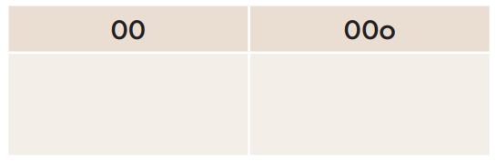
5
Write each sentence in the suitable box. Then listen, check, and repeat.
1. I see!
2. Be quiet!
3. Say sorry!
4. Watch out!
5. That long?
6. Speak louder!
1. I see!
2. Be quiet!
4. Watch out!
3. Say sorry!
6. Speak louder!
5. That long?

Slide 21

CONSOLIDATION
What have we learnt in this lesson?
Use the lexical items related to the topic Local community;
Pronounce the sentence stress correctly;

Slide 22

HOMEWORK
Do exercises in the workbook.
Prepair lesson 3 - A closer look 2

Slide 23


Thank you!
Goodbye!

Slide 24
2
Homework
- Do exercises in the Workbook.

Slide 25
WARM-UP
1 - d. robotic vacuum cleaner (máy hút bụi robot)
2 - c. e-reader (máy đọc sách điện tử)
3 - a. smartwatch (đồng hồ thông minh)
4 - e. portable music player (máy nghe nhạc cầm tay)
5 - b. 3D printer (máy in 3D)
6 - f. camcorder (máy quay phim)
BRAIN
STORMING

