Slide 1

Hello everyone !!!

Slide 2
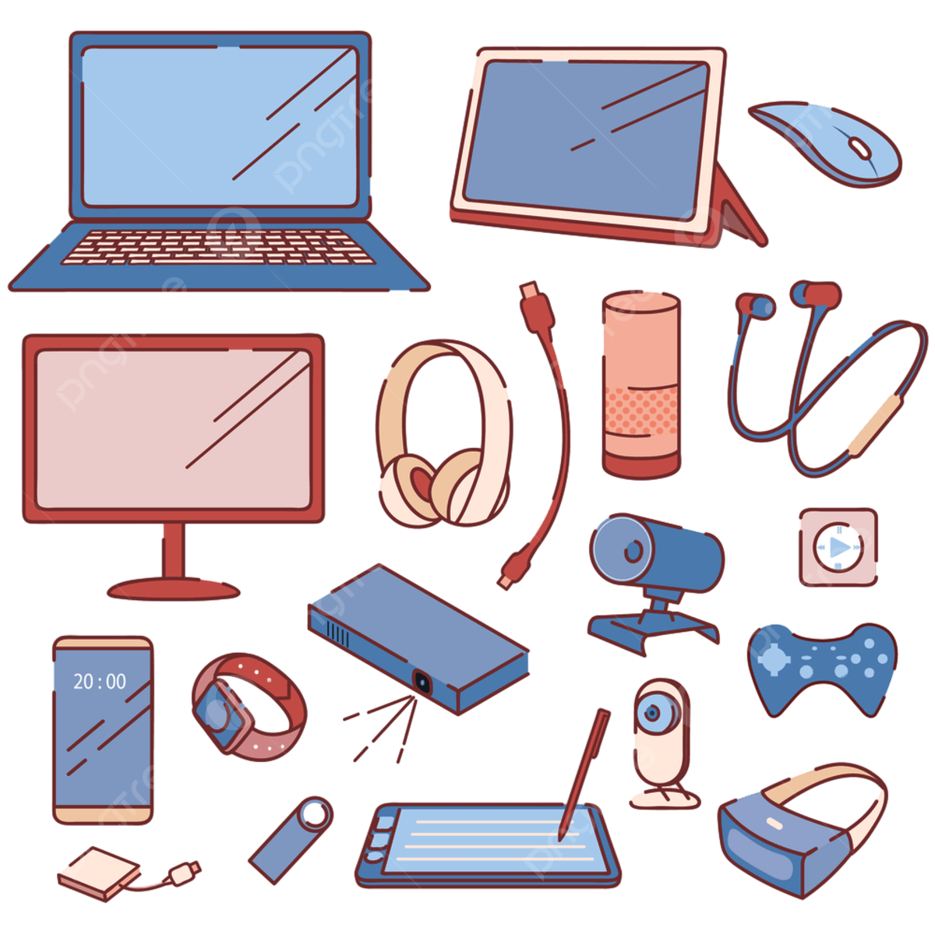
WARM-UP
what can you see in the picture?
TV
computer
snartphone
headphones
computer mouse
flashlight
rechargeable
socket
USB
Electronic devices

Slide 3
WARM-UP
what are electronic devices?
Electronic devices are devices that are powered by electricity.
Refrigerator.
Television.
Air conditioner.
Electric fan.
Lighting.
Microwave.
Water heater.

Slide 4


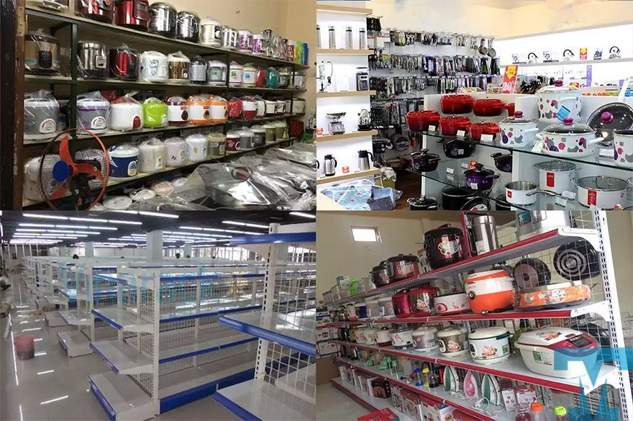
Unit
11
ELECTRONIC DEVICES
LESSON 1: GETTING STARTED
In an electronic shop.

Slide 5

Unit
11
ELECTRONIC DEVICES
LESSON 1: GETTING STARTED
VOCABULARY

Slide 6
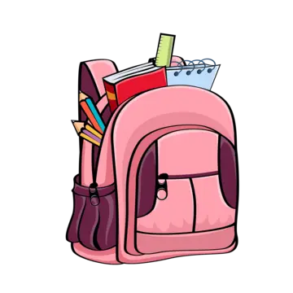

Vocabulary
portable (adj)
/ˈpɔːr.t̬ə.bəl/
di động,
có thể mang theo

Slide 7
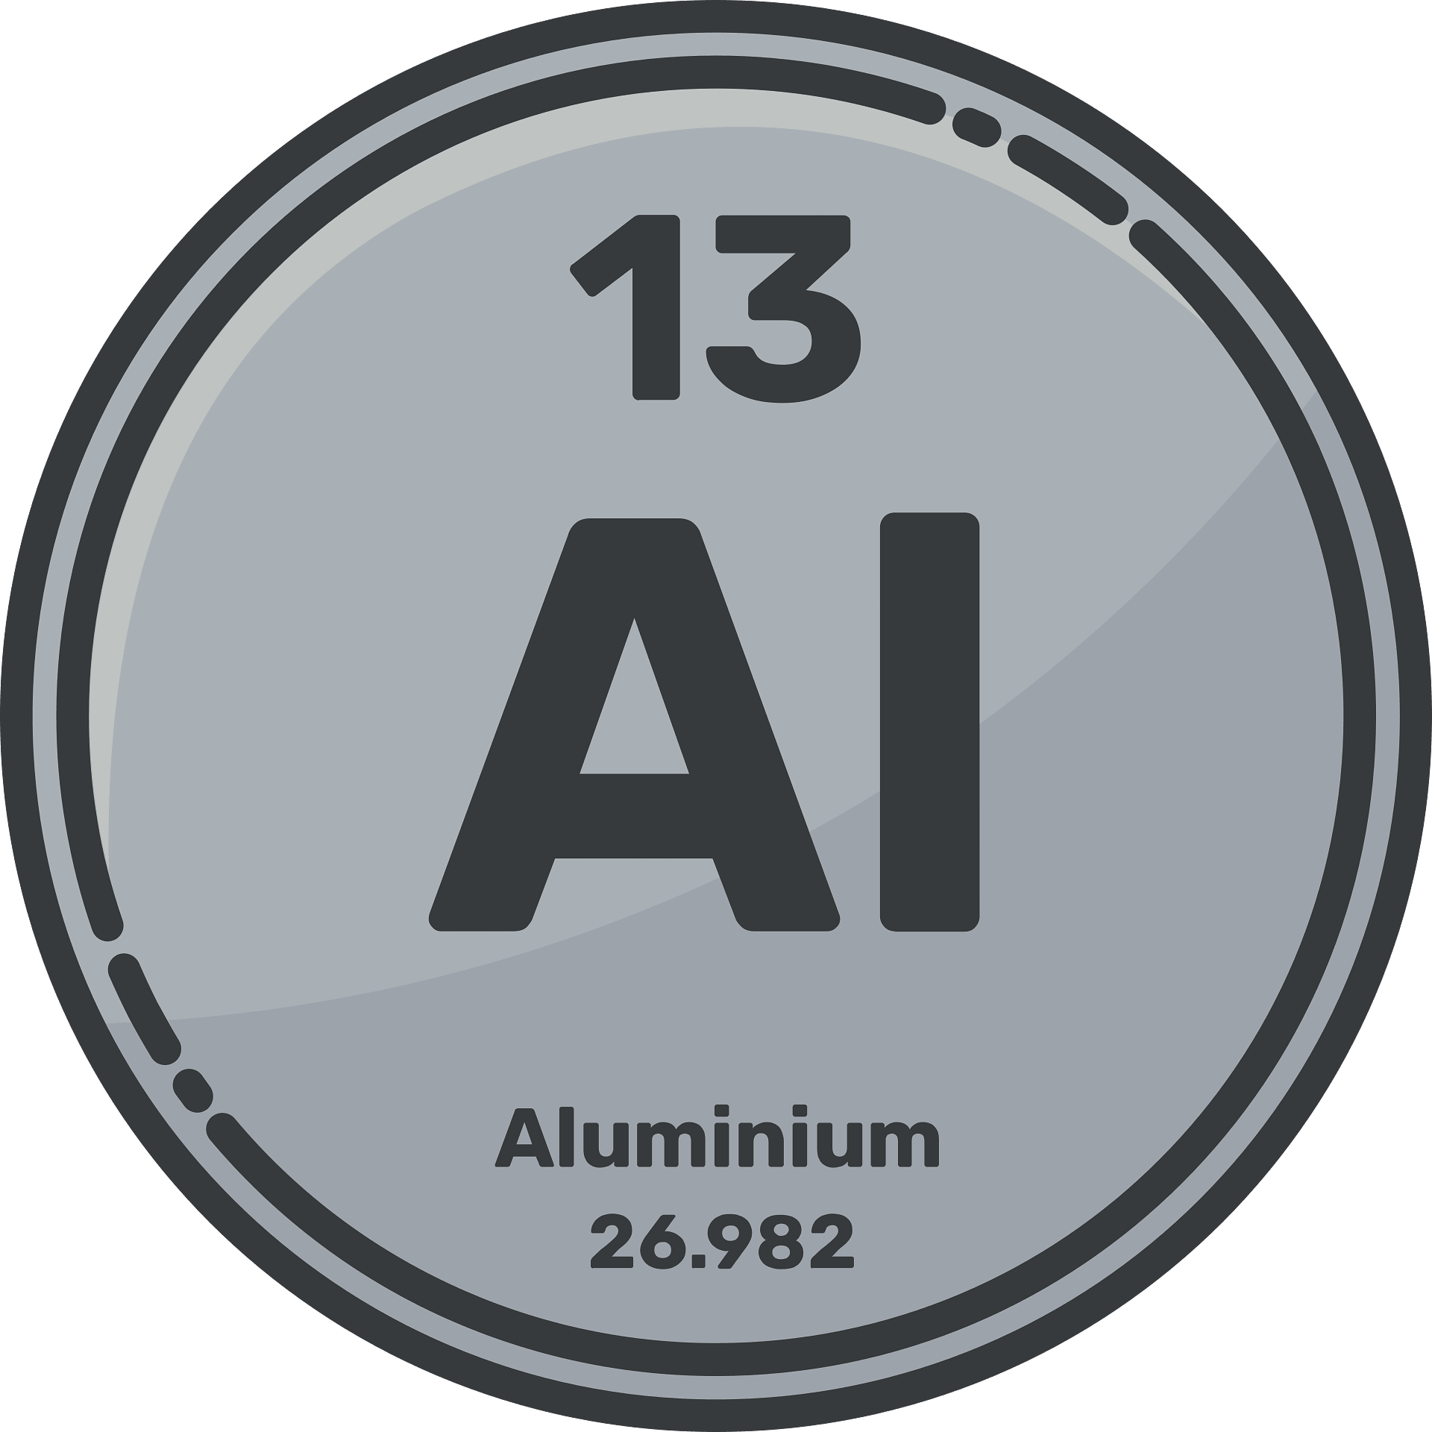
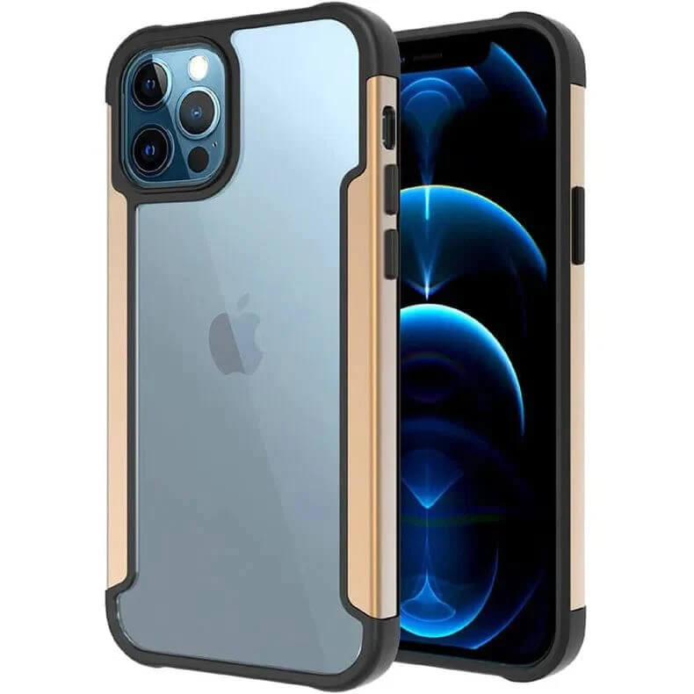
Vocabulary
aluminium (n)
ˌæl.jəˈmɪn.i.əm/
nhôm
Many electronic devices use aluminium for their cases because it is light.

Slide 8
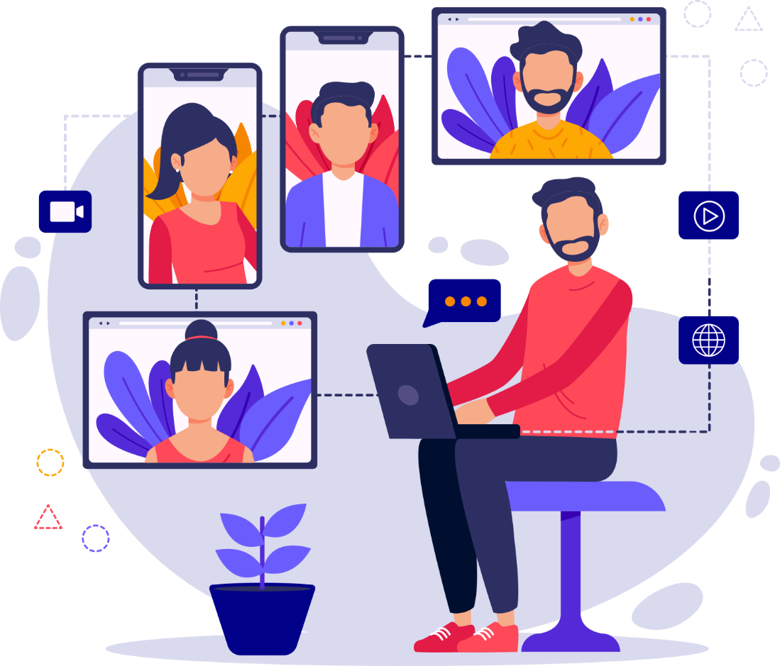
Vocabulary
virtual (adj)
/ˈvɝː.tʃu.əl/
ảo

Slide 9
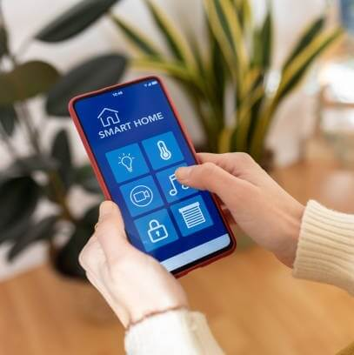
Vocabulary
touchscreen (n)
/ˈtʌtʃ.kriːn/
màn hình cảm ứng

Slide 10

diagram (n)
/ˈdaɪ.ə.ɡræm/
biểu đồ

Slide 11
Vocabulary
New words | Pronunciation | Meaning
1. portable (adj) | /ˈpɔːr.t̬ə.bəl/ | có thể bỏ túi
2. aluminium (n) | ˌæl.jəˈmɪn.i.əm/ | hợp kim nhôm
3. virtual (adj) | /ˈvɝː.tʃu.əl/ | ảo
4. touchscreen (n) | /ˈtʌtʃ.kriːn/ | màn hình cảm ứng
5. diagram (n) | /ˈdaɪ.ə.ɡræm/ | Biểu đồ

Slide 12
1
Listen and read.
Shop assistant: Good morning! What can I do for you?
Customer: Good morning! I’d like to buy a computer for my son.
Shop assistant: We have desktops, laptops, and tablets. Which one are you interested in?
Customer: I want to buy one for my son that is portable and can be used for studying and entertainment.
Shop assistant: Ah, in this case I suggest you should buy a tablet. Look at this grey tablet. It can work as effectively as a laptop. But it’s the size of a book. And it’s much lighter than a laptop because it’s smaller. It also has a lightweight aluminium case.
Customer: Sounds good.
Shop assistant: It also has two cameras to take photos, shoot videos, and scan documents. It has a touchscreen, so you can do everything with your fingers.
Customer: Is it easy to type on?
Shop assistant: Yes, it is. There is a virtual keyboard. If you don’t want to use it, you can use the wireless hardware keyboard.
Customer: Can I write and draw on it?
Shop assistant: You can use its pencil to take notes, draw pictures or diagrams, and make 3D designs.

Slide 13
2
Read the conversation again and answer the following questions.
What does the customer want to buy?
The customer wants to an electronic device for her son.
2. What kind of electronic device does the shop assistant suggest the customer should buy?
The shop assistant suggests the customer should buy a tablet.
3. What is the tablet's case made of?
It is made of aluminum.
4. What is the tablet's pencil used for?
It is used for taking notes, drawing, and making 3D designs.

Slide 14
3
Match each word or phrase with its definition.
1. aluminium | a. a screen of a laptop or a tablet that enables the user to interact directly with what is displayed
2. portable | b. made to appear to exist by the use of computer software, rather than in the real world
3. touchscreen | c. not needing wires to make a connection or to communicate
4. wireless | d. a light, silver-grey metal
5. virtual | e. easy to carry or to move
keys
1. d | 2. e | 3. a | 4. c | 5. b

Slide 15
4
Complete each sentence with a word or phrase from 3.
1. The website allows you to take a ___________ tour of the art gallery.
2. You can carry your _____________ laptop with you from class to class because it’s small and light.
3. Nowadays we often use _____________ keyboards because they are portable.
4. We often use _____________ to make vehicles like aircraft or cars because of its strength and lightweight.
5. Most smartphones today have a ______________ which allows us to navigate, type, and interact with apps and games easily.
virtual
portable
wireless
aluminium
touchscreen

Slide 16
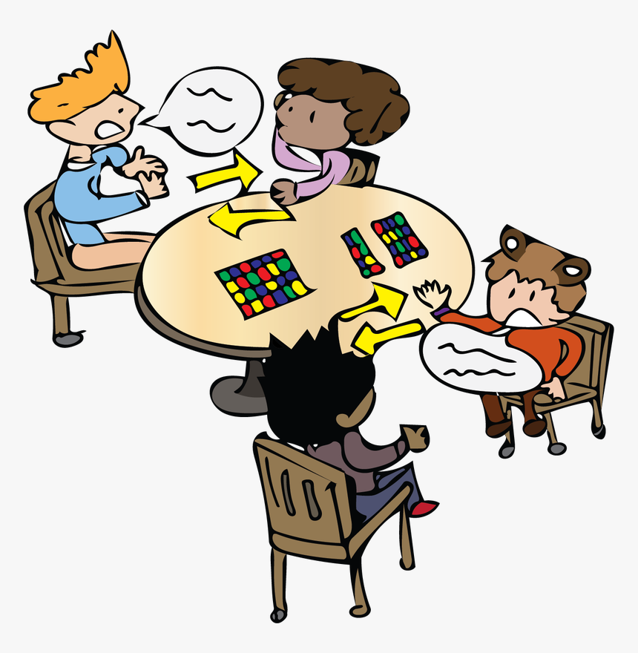
PRODUCTION
5
Work in pairs. Think of an electronic device and describe it to your partner. Can your partner guess what you are describing?
Example:
A: It’s a small, flat computer. We can
control it by touching its screen or by using a special pen.
B: Is that a portable music player?
A: No. Try again

Slide 17

CONSOLIDATION
What have we learnt in this lesson?
identify the topic of the unit
use lexical items related to local community
identify the language features that are covered in the unit

Slide 18

Homework
- Do exercises in the Workbook.
Start preparing for the Project
Prepair lesson 2: A clser look 1

Slide 19

Thank you!
Goodbye!

