Slide 1


Song Ve secondary school.
ENGLISH 9
Hello everyone !!!

Slide 2
WARM-UP
* Matching
A | B
1. The book, | a. who teaches English at my school is very helpful.
2. The teacher | b. which offers language resources is user-friendly.
3.The website | c. whose birthday is next week, is throwing a party.
4. My friend Sarah, | d. which I borrowed from the library, is fascinating.
* Keys: 1 d 2a 3b 4c

Slide 3

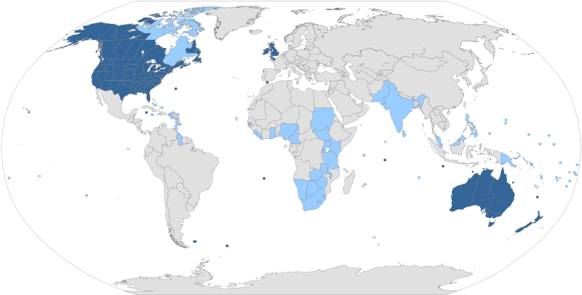
UNIT 9: WORLD ENGLISHES
www.hoclieu.vn
THE WORLD’S FAVOURITE NEWSPAPER
- Since 2021
LESSON 3: THE CLOSER LOOK 2

Slide 4
WARM-UP
1. The book, which I borrowed from the library, is fascinating.
2. The teacher who teaches English at my school is very helpful.
3.The website which offers language resources is user-friendly.
4. My friend Sarah, whose birthday is next week, is throwing a party.
Relative clauses

Slide 5
PRESENTATION
Questions:
+ What is a relative clause?
+ What does it usually start with?
+ Why is a defining relative clause important?

Slide 6

grammar
A relative clause tells us more about people and things. It usually starts with a relative pronoun.
Defining relative clauses give us essential information. Without this information, people are not clear which person(s) or thing(s) we are talking about.
Example:
– The teacher who taught me my first words in English is Mr Vinh.
– He gave me the dictionary which you suggested.

Slide 7
grammar
Mệnh đề quan hệ cho chúng ta biết thêm về người và sự vật. Nó thường bắt đầu bằng một đại từ quan hệ.
Việc xác định mệnh đề quan hệ cung cấp cho chúng ta những thông tin cần thiết. Nếu không có thông tin này, mọi người sẽ không rõ chúng ta đang nói đến (những) người hoặc (những) vật nào.
Example:
– The teacher who taught me my first words in English is Mr Vinh.
– He gave me the dictionary which you suggested.

Slide 8
grammar
The relative pronoun who or which can be the subject or the object of the relative clause. We must use it when it is the subject of the relative clause. We can omit it if it is the object.
Example:
– The man who is talking to the girl is bilingual in English and French.
→must use who
– The man who you met this morning is bilingual in English and French.
→can omit who
S
O

Slide 9
grammar
Đại từ quan hệ who hoặc which có thể làm chủ ngữ hoặc tân ngữ của mệnh đề quan hệ. Chúng ta phải sử dụng nó khi nó là chủ ngữ của mệnh đề quan hệ. Chúng ta có thể bỏ qua nó nếu nó là tân ngữ
Example:
– The man who is talking to the girl is bilingual in English and French.
→must use who
– The man who you met this morning is bilingual in English and French.
→can omit who

Slide 10
Notes
who
which
whose
: refer people.
Ex: The teacher, who always wears a bowtie, is my favorite.
: refer things or animals.
Ex: The book, which I borrowed from the library, is fascinating.
: indicate possession for people or things.
Ex: My friend Sarah, whose birthday is next week, is throwing a party.

Slide 11
1
Choose the correct answer A, B, C, or D to complete each question
1. English is the language ______ is known as a global language.
A. who
C. whose
B. which
D. that
2. People ______ speak English well can find jobs in international companies more easily
A. who
C. whose
B. which
D. why

Slide 12
1
Choose the correct answer A, B, C, or D to complete each question
3. People from countries ______ do not share a common language use English to work together effectively.
A. who
C. whose
B. which
D. where
4. The woman ______ son won the English speaking contest felt very proud
A. who
C. whose
B. which
D. when

Slide 13
1
Choose the correct answer A, B, C, or D to complete each question
5. I met a man ______ first language is Arabic at the conference.
A. who
C. what
B. which
D. whose

Slide 14
PRACTICE
2
Underline the relative clause in each sentence. Decide if the relative pronoun is the subject (S) object (O) of the relative clause and if we can or cannot omit it.
1. The new vocabulary items which we learnt yesterday are difficult to remember
O -> omit
2. I don’t like the grammar exercises which are in this book.
S
3. The man who translated this novel into Vietnamese must be proficient in English
S

Slide 15
PRACTICE
2
Underline the relative clause in each sentence. Decide if the relative pronoun is the subject (S) object (O) of the relative clause and if we can or cannot omit it.
4. The students who love languages can join our Reading Club.
S
5. The teacher who we admire can speak three languages
O -> omit

Slide 16
3
Are these sentences right or wrong? Correct them if necessary.
Ex:
1. My sister doesn’t like films have unhappy endings.
which have
2. What is the name of the man who is the director of the language centre?
√
3. One of the four official languages people use in Singapore is English.
√

Slide 17
3
Are these sentences right or wrong? Correct them if necessary.
√
4. I like the English lesson which Ms Oanh taught yesterday.
5. Students who grades are high can compete in this contest.
whose
Whose + N

Slide 18
4
Combine the two sentences into one, using a relative pronoun.
Ex:
1. The guide said to them: “Is it your first time here?”
1. I met a woman. Her husband is a famous linguist
I met a woman whose husband is a famous linguist.
______________________________________________________________________________________________________.
=>................................................................................
2. Olivia asked the guide: “Do the people live on fishing?”
2. My friend’s father gave us the tickets. He owns a travel agency
My friend's father who owns a travel agency gave us the tickets.
=>................................................................................
______________________________________________________________________________________________________.

Slide 19
4
Combine the two sentences into one, using a relative pronoun.
3. The grammar exercise was very complicated. Nobody could do it.
1. The guide said to them: “Is it your first time here?”
______________________________________________________________________________________________________.
The grammar exercise (which) nobody could do was very complicated.
=>................................................................................
2. Olivia asked the guide: “Do the people live on fishing?”
4. I study English in a language school. It is in the centre of the city.
______________________________________________________________________________________________________.
I study English in a language centre which is in the centre of the city.
=>................................................................................

Slide 20
4
Combine the two sentences into one, using a relative pronoun.
5. The student completed the quiz the fastest. The teacher praised him
1. The guide said to them: “Is it your first time here?”
______________________________________________________________________________________________________.
The teacher praised the student who completed the quiz the fastest.
=>................................................................................
2. Olivia asked the guide: “Do the people live on fishing?”
The student (who) the teacher praised completed the quiz the fastest
=>................................................................................
______________________________________________________________________________________________________.

Slide 21


PRODUCTION
5
Game: Clues for you. Work in two teams. A student from each team gives clues about an object or a person in class, using a relative clause. Students from the other team guess which object or person it is.
- Work in teams
- A student from each team gives clues about an object or a person in class, using relative clauses.
- Students from the other team guess which object or person it is.

Slide 22
PRODUCTION
5
Example:
This is something which we write with
Is it a pen?
Yes, it is.

Slide 23
EXTRA ACTIVITY
bilingual (n)
Example:
Definition: A bilingual is a person who can speak two languages equally well.

Slide 24

CONSOLIDATION
What have we learnt in this lesson?
Defining relative clauses

Slide 25


Homework
- Do exercises in the workbook.
- Make 5 sentences by using defining relative clauses.

Slide 26




Slide 27


LESSON 3: A CLOSER LOOK 2
LESSON 1: GETTING STARTED
WARM-UP
Brainstorm
Grammar Explanation
Task 1: Choose the correct answer A, B, C, or D to complete each question
PRESENTATION
Task 2: Underline the relative clause in each sentence. Decide if the relative pronoun is the subject (S) object (o) of the relative clause and if we can or cannot omit it.
Task 3: Are these sentences right or wrong? Correct them if necessary.
Task 4: Combine the two sentences into one, using a relative pronoun
PRACTICE
Task 5: Game: Clues for you. Work in two teams. A student from each team gives clues about an object or a person in class, using a relative clause. Students from the other team guess which object or person it is.
PRODUCTION

Slide 28
Website: hoclieu.vn
Fanpage: facebook.com/www.tienganhglobalsuccess.vn/

Slide 29
EXTRA ACTIVITY
Relative clauses challenge
- Work in groups.
- Each group has some words related to places, animals, things, etc.
- Write definitions of the words
-Read out their definitions and vote for the best one(s) (you can’t vote for your own definition).

Slide 30
LESSON 3: A CLOSER LOOK 2
LESSON 1: GETTING STARTED
WARM-UP
Brainstorm
Grammar Explanation
Task 1: Choose the correct answer A, B, C, or D to complete each question
PRESENTATION
Task 2: Underline the relative clause in each sentence. Decide if the relative pronoun is the subject (S) object (o) of the relative clause and if we can or cannot omit it.
Task 3: Are these sentences right or wrong? Correct them if necessary.
Task 4: Combine the two sentences into one, using a relative pronoun
PRACTICE
Task 5: Game: Clues for you. Work in two teams. A student from each team gives clues about an object or a person in class, using a relative clause. Students from the other team guess which object or person it is.
PRODUCTION
CONSOLIDATION
Wrap-up
Homework

