Slide 1
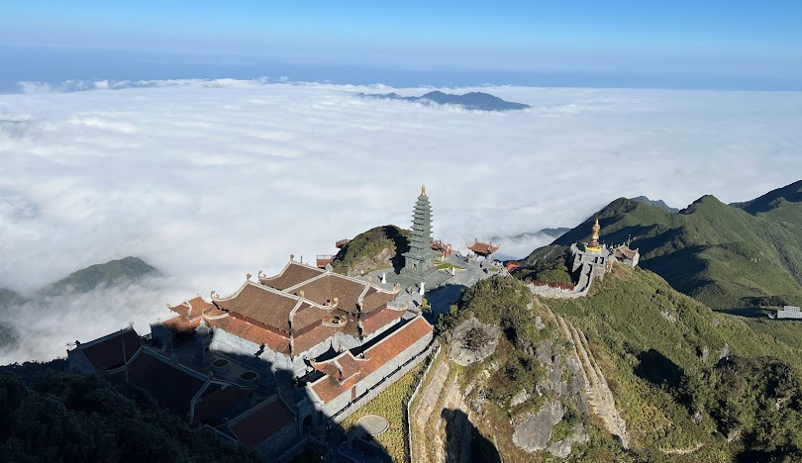
Unit 8 - TOURISM

Slide 2

Game: UNSCRAMBLE
Play in 2 teams
Write unscrambled words in notebook
Raise hand and say out “FINISH”
LET’S PLAY!

Slide 3

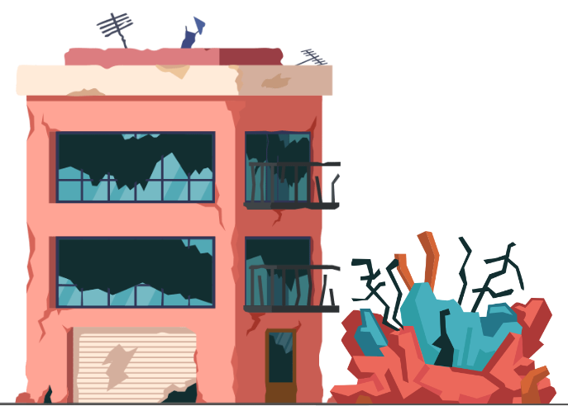
UNSCRAMBLE THE WORD
RUNSIOU
RUINOUS

Slide 4
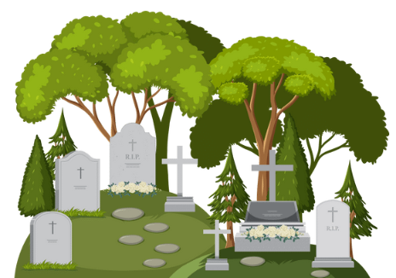
UNSCRAMBLE THE WORD
REVDYAAGR
GRAVEYARD

Slide 5

UNSCRAMBLE THE WORD
HHGI RTTESE
HIGHSTREET

Slide 6

UNSCRAMBLE THE WORD
NDWEAR
WANDER

Slide 7

UNSCRAMBLE THE WORD
GETTOAC
COTTAGE

Slide 8
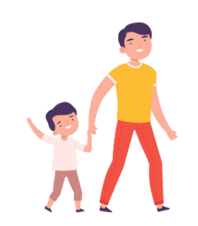
UNSCRAMBLE THE WORD
COPMCYANA
ACCOMPANY

Slide 9
UNSCRAMBLE THE WORD
RUINOUS
GRAVEYARD
HIGH STREET
WANDER
COTTAGE
ACCOMPANY

Slide 10


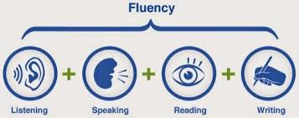
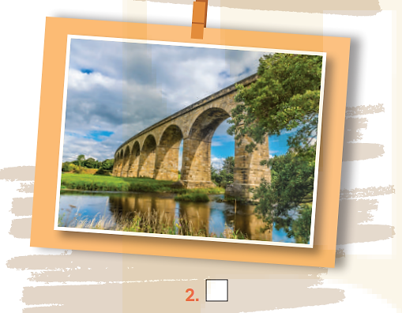
Unit
8
TOURISM
LESSON 6: SKILLS 2

Slide 11

VOCABULARY
graveyard (n)
.
/ˈɡreɪv.jɑːd/
nghĩa địa
a place, often next to a church, where dead people are buried

Slide 12
VOCABULARY
wander (v)
.
/ˈwɒn.dər/
đi lang thang
Notes:
to walk around slowly in a relaxed way or without any clear purpose or direction:

Slide 13
VOCABULARY
- accompany (v)
/əˈkʌm.pə.ni/
.
đồng hành
to go with someone or to be provided or exist at the same time as something:

Slide 14
VOCABULARY
New words | Pronunciation | Meaning
1. graveyard (n) | /ˈɡreɪv.jɑːd/ | nghĩa địa
2. wander (v) | /ˈwɒn.dər/ | đi lang thang
3. accompany (v) | /əˈkʌm.pə.ni/ | đồng hành

Slide 15




listening

Slide 16
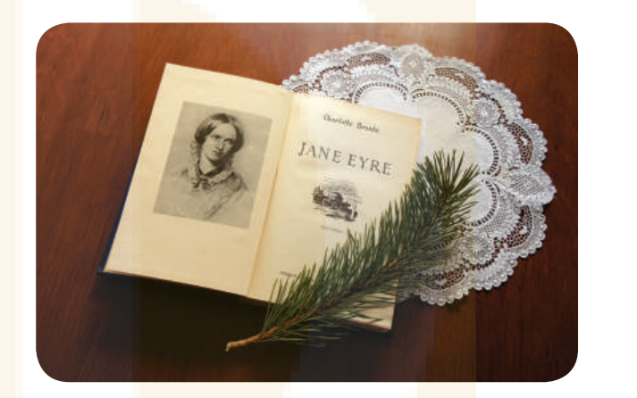

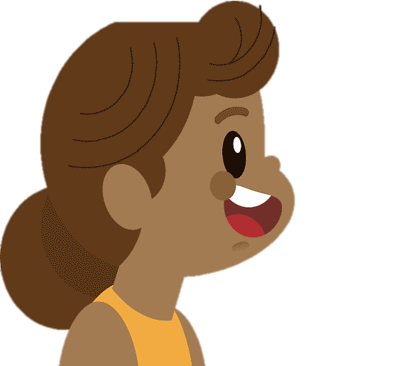

I. SPEAKING
1
Work in pairs. Discuss if these statements are true.
1. The Brontes is a family of world-famous writers.
2. Together, the three sisters wrote Jane Eyre.
3. You can read some of their novels in Vietnamese.

Slide 17
2
A tour guide is announcing the schedule for a one-day trip to the home of the Brontes. Listen and complete the missing information.
DAY TRIP Haworth and the Brontes
Trip will take: | (1) ___________ hours
Jane Eyre: | (2) a _______________ book
At Haworth, we see: | the Brontes’ house, school, and (3) ________
The tour includes | (4) ___________ ticket to the house
The Brontes lived in Haworth: | (5) ___________ years ago
The main street of the village: | has witnessed little (6) ___________
9 / nine
world-famous
graveyard
entrance
150
hardly

Slide 18
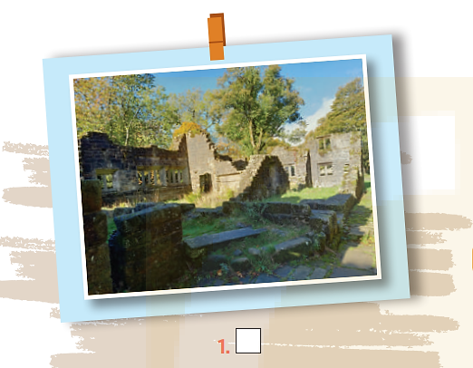
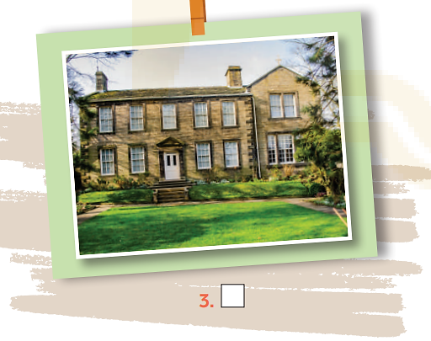

3
Look at the pictures, listen again and tick the two which illustrate the ideas of the listening passage.
Notes:
1 and 3

Slide 19

WRITing

Slide 20

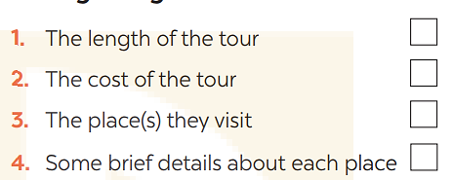
4
Work in pairs. Discuss and tick the thing(s) that the tour guide in the listening passage mentions in her announcement at the beginning of the tour.
Notes:
Key: 1. c 2. a 3. b

Slide 21
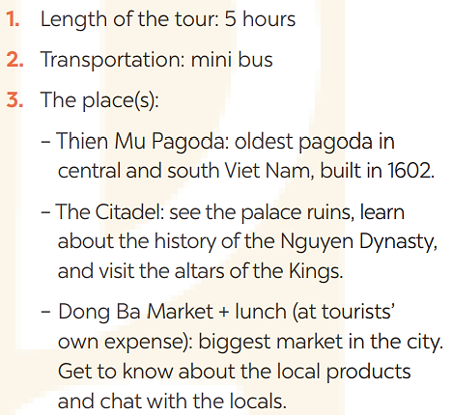
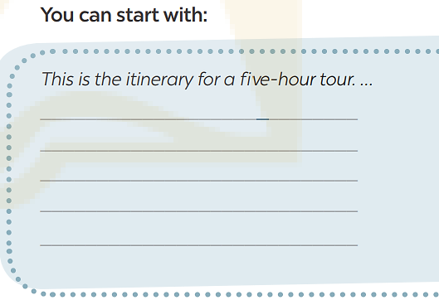
5
Write a paragraph (100 - 120 words) introducing this half day tour in Hue. Use the clues below.

Slide 22
5
Write a paragraph (100 - 120 words) introducing this half day tour in Hue. Use the clues below.
* Sample
Hi, my name is Nam and I’m going to be with you on a five-hour tour of Hue city. Our first visit is Thien Mu Pagoda. It’s the oldest pagoda in central and south Viet Nam and built in 1602. Then we drive on to the Citadel, where we can see the palace ruins, learn about the local history of the Nguyen dynasty, and visit the altars of the Kings. The last visit is to Dong Ba market. It’s the biggest market in the city, where you’ll see local products and chat with the locals. You can have lunch in or around the market before the tour ends.

Slide 23

CONSOLIDATION
What have we learnt in this lesson?
Listening for specific/general information
Writing a paragraph introducing a half day tour in Hue.

Slide 24

Homework
Do exercises in the workbook.
Prepair lesson 7 – Looking back

Slide 25




