Slide 1

ENGLISH 9
Hello everyone !!!

Slide 2

WARM-UP
- Work in teams.
2 minutes to start
Each team has a list of Vietnamese lifestyle activity from either the past or present.
- Take turns to act out the lifestyle activity they were given. The other team must try to guess the activity
FLASHBACK
- The first team to guess correctly the activity
- The team with the most points at the end of the game wins.

Slide 3
WARM-UP
- Work in teams.
Past: playing folk games, wearing ao dai, riding a cyclo, eating pho, living in a traditional village.
Present: using modern technology, living in a modern apartment, eating fast food, shopping at a mall, watching movies at a cinema.
LIST

Slide 4


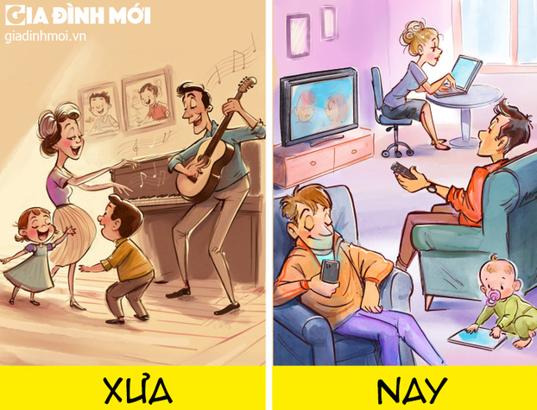
Monday, January 20, 2025
Period 41: Unit 6:
VIETNAMESE LIFESTYLE: THEN AND NOW
LESSON 3: A CLOSER LOOK 1 (P. 62)

Slide 5
I. OBJECTIVES
By the end of this lesson, Ss will be able to:
1. Knowledge
- Use the lexical items related to the topic VIETNAMESE LIFESTYLE: THEN AND NOW
- Pronounce the cluster /fl/ and /fr/ in words and sentences correctly.

Slide 6

VOCABULARY

Slide 7


VOCABULARY
to write something down or remember it carefully
take note
/teɪk nəʊt/
ghi chép

Slide 8

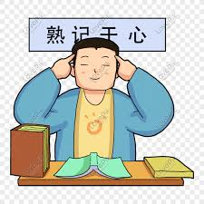
VOCABULARY
to learn something so that you remember it exactly
memorise (v)
/ˈmeməraɪz/
ghi nhớ

Slide 9


VOCABULARY
to follow someone or something
pursue (v)
/pəˈsjuː/
theo đuổi

Slide 10
VOCABULARY
based on the principles of democracy.
democratic (adj)
/ˌdeməˈkrætɪk/
thuộc dân chủ
EX: We must accept the results of a democratic election (= an election in which all people can vote).

Slide 11
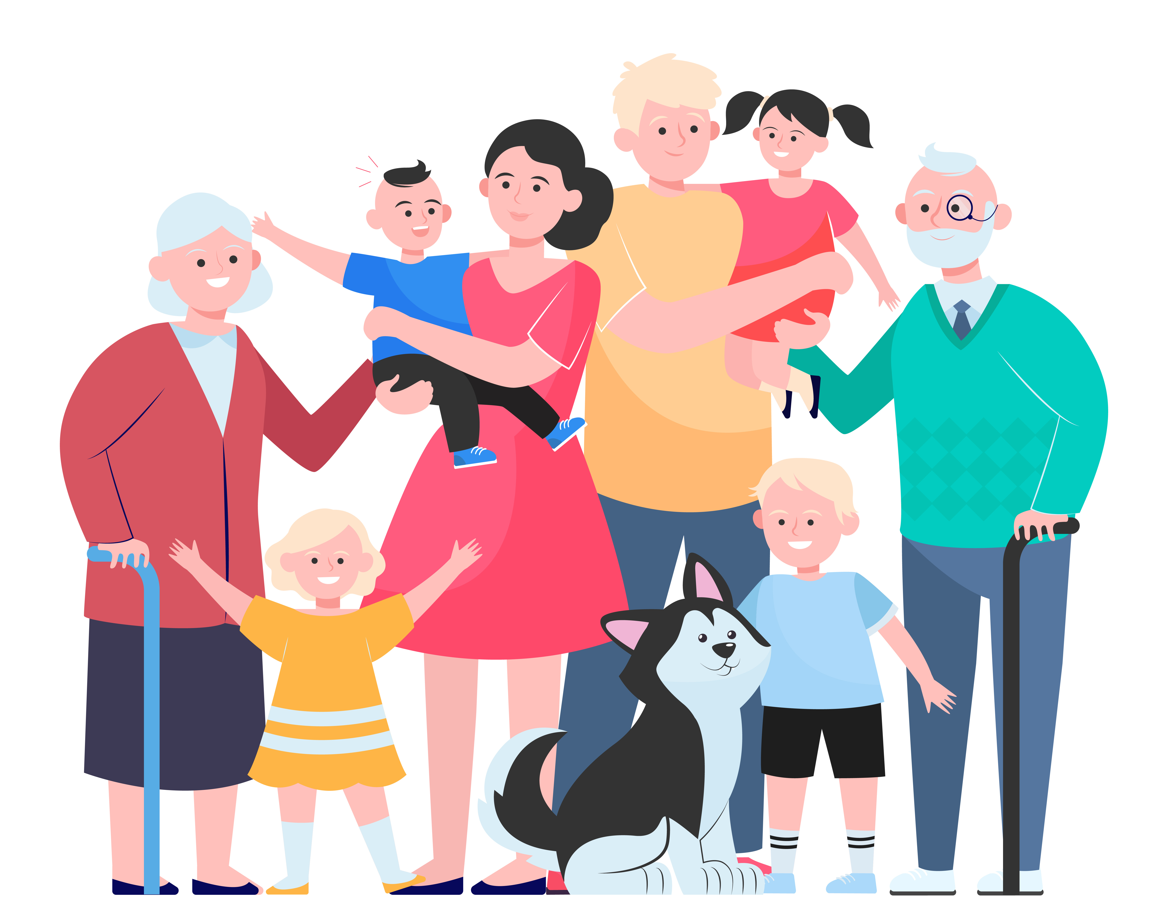
VOCABULARY
a family that includes many generations.
- extended (adj)
/ɪkˈstendɪd/
nhiều thế hệ (trong 1 gia đình)

Slide 12

VOCABULARY
family-oriented (adj)
/ˈfæməli ˈɔrientɪd/
hướng về, coi trọng gia đình

Slide 13
VOCABULARY
New words | Pronunciation | Meaning
1. take note | /teɪk nəʊt/ | ghi chép
2. memorise (v) | /ˈmeməraɪz/ | ghi nhớ
3. pursue (v) | /pəˈsjuː/ | theo đuổi
4. democratic (adj) | /ˌdeməˈkrætɪk/ | thuộc dân chủ
5. extended (adj) | /ɪkˈstendɪd/ | nhiều thế hệ (trong 1 gia đình)
6. family-oriented (adj) | /ˈfæməli ˈɔrientɪd/ | hướng về, coi trọng gia đình.
A | B
1. take notes | a. learn something carefully so that you can remember it exactly. | 1.
2. depend on | b. take the position of something / somebody | 2.
3. memorise | c. write down some key information when listening to a talk, a lecture. | 3.
4. pursue | d.rely on something /somebody | 4.
5. replace | e. try to achieve something over a period of time | 5.

Slide 14
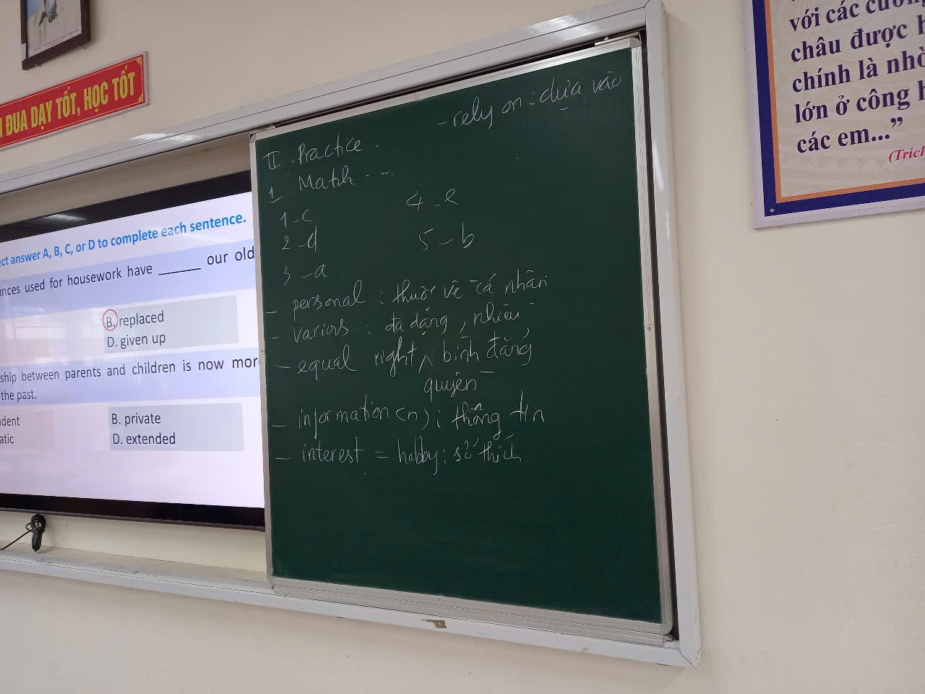
Bổ sung them từ mới này nữa nhé

Slide 15
VOCABULARY
New words | Meaning
1. | ghi nhớ
2. | ghi chép
3. | nhiều thế hệ (trong 1 gia đình)
4. | thuộc dân chủ
5. | theo đuổi
6. | hướng về, coi trọng gia đình.
memorise (v)
take note
extended (adj)
democratic (adj)
pursue (v)
family-oriented (adj)
A | B
1. take notes | a. learn something carefully so that you can remember it exactly. | 1.
2. depend on | b. take the position of something / somebody | 2.
3. memorise | c. write down some key information when listening to a talk, a lecture. | 3.
4. pursue | d.rely on something /somebody | 4.
5. replace | e. try to achieve something over a period of time | 5.

Slide 16
1
Match the verbs or phrasal verbs with their meanings.
A | B
1. take notes | a. learn something carefully so that you can remember it exactly. | 1.
2. depend on | b. take the position of something / somebody | 2.
3. memorise | c. write down some key information when listening to a talk, a lecture. | 3.
4. pursue | d.rely on something /somebody | 4.
5. replace | e. try to achieve something over a period of time | 5.
c
d
a
e
b

Slide 17
2
Work in pairs. Discuss and fill each blank with an adjective from the box.
democratic
personal
various
extended
family-oriented
1. Four generations live in my house: my great grandparents, my grandparents, my parents, and me. It’s a(n) ____________family.
2. In our group, everybody has equal rights to speak and work.
We have a(n)____________relationship
3. Children in the past played a lot of traditional outdoor games such as hide-and-seek, tug of war, and marbles.
There were ____________outdoor games for children.
4. I don’t make public my telephone number, home address, or birthday
They are my ____________ information.
5. He values his family and spends a lot of time with them.
He’s a(n)________________ person

Slide 18
3
Circle the correct answer A, B, C, or D to complete each sentence.
1. Most of the events at the fair are ______, i.e. they are designed for the family.
A. family-oriented
C. democratic
B. exciting
D. various
2. In the past, girls had little opportunity to ______ their interests.
A. know
C. pursue
B. replace
D. promise

Slide 19
3
Circle the correct answer A, B, C, or D to complete each sentence.
3. Hi-tech appliances used for housework have ______ our old-fashioned tools.
A. made
C. stopped
B. replaced
D. given up
4. The relationship between parents and children is now more ______ than in the past.
A. independent
C. democratic
B. private
D. extended

Slide 20
3
Circle the correct answer A, B, C, or D to complete each sentence.
5. Protect your personal ______ online by using strong and unique passwords.
A. taste
C. opinions
B. experience
D. privacy

Slide 21
EXTRA ACTITIVTY
Use the words in brackets in their correct forms to complete the sentences.
memorise
1. How could you _______________ so much information after listening to the news just once? (memory)
democratic
2. I highly appreciate the _______________ teacher-student relation in our class. We feel free to discuss things with our teachers. (democracy)
extended
3. I prefer to live in an _______________ family where I can live with my grandparents, too. (extend)
Notes:
wish → wish
know → knowledge
decide → decision
damage → damage

Slide 22
Use the words in brackets in their correct forms to complete the sentences.
pursue
4. My parents let me_______________ my passion for acting even though they do not like it. (pursuing)
replaced
5. Emails have _______________ letters by post for tens of years. (replacement)
Notes:
wish → wish
know → knowledge
decide → decision
damage → damage

Slide 23

PRONUNCIATION
Listen and repeat:
Review the cluster /fl/ and /fr/
/fl/
/fr/

Slide 24


Slide 25
4
Listen and tick (√) the words you hear. Then listen again and repeat.
√
1. 2. 3. 4. 5. 6. | a. fruit a. frame a. free a. fright a. fresh a. frog | b. flute b. flame b. flea b. flight b. flesh b. flog
√
√
√
√
√
1. The photos of their fight for freedom are on the second floor.
2. Who suffers most from generation conflicts?
3. The man is reflecting on his frightening trip.
4. How does the past influence your friends?
5. When I was small, I caught the flu frequently.

Slide 26
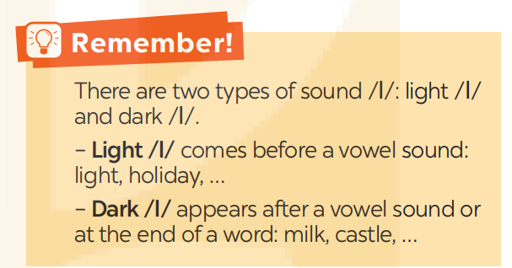
5
Listen and repeat the sentences. Pay attention the underlined words.
1. The photos of their fight for freedom are on the second floor.
2. Who suffers most from generation conflicts?
3. The man is reflecting on his frightening trip.
4. How does the past influence your friends?
5. When I was small, I caught the flu frequently.

Slide 27

CONSOLIDATION
What have we learnt in this lesson?
Use the lexical items related to the topic VIETNAMESE LIFESTYLE: THEN AND NOW
Pronounce the cluster /fl/ and /fr/ in words and sentences correctly.

Slide 28

Homework
- Do ex A1,2 B3,4 (P. 48,49) in the workbook.
- Find 3 more words that have the cluster /fl/ and /fr/

Slide 29

Thank you!
Goodbye!

