Slide 1
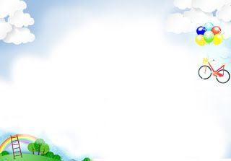



Slide 2
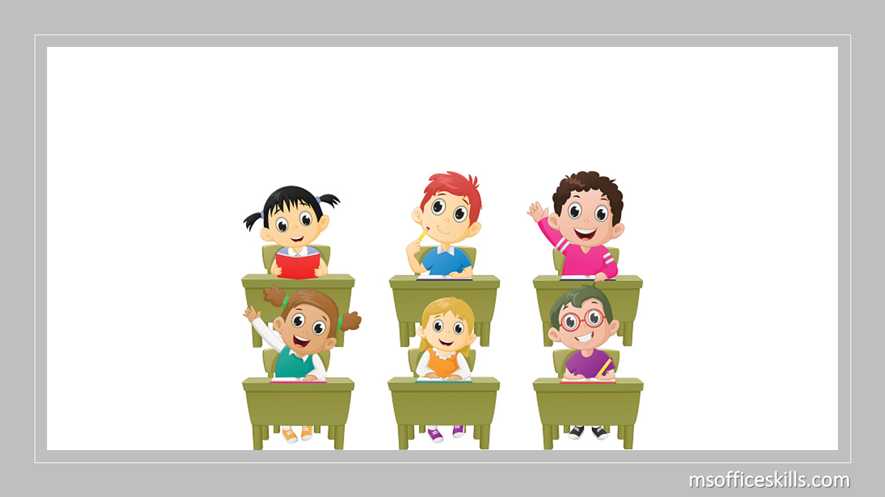

* WARM-UP

Slide 3
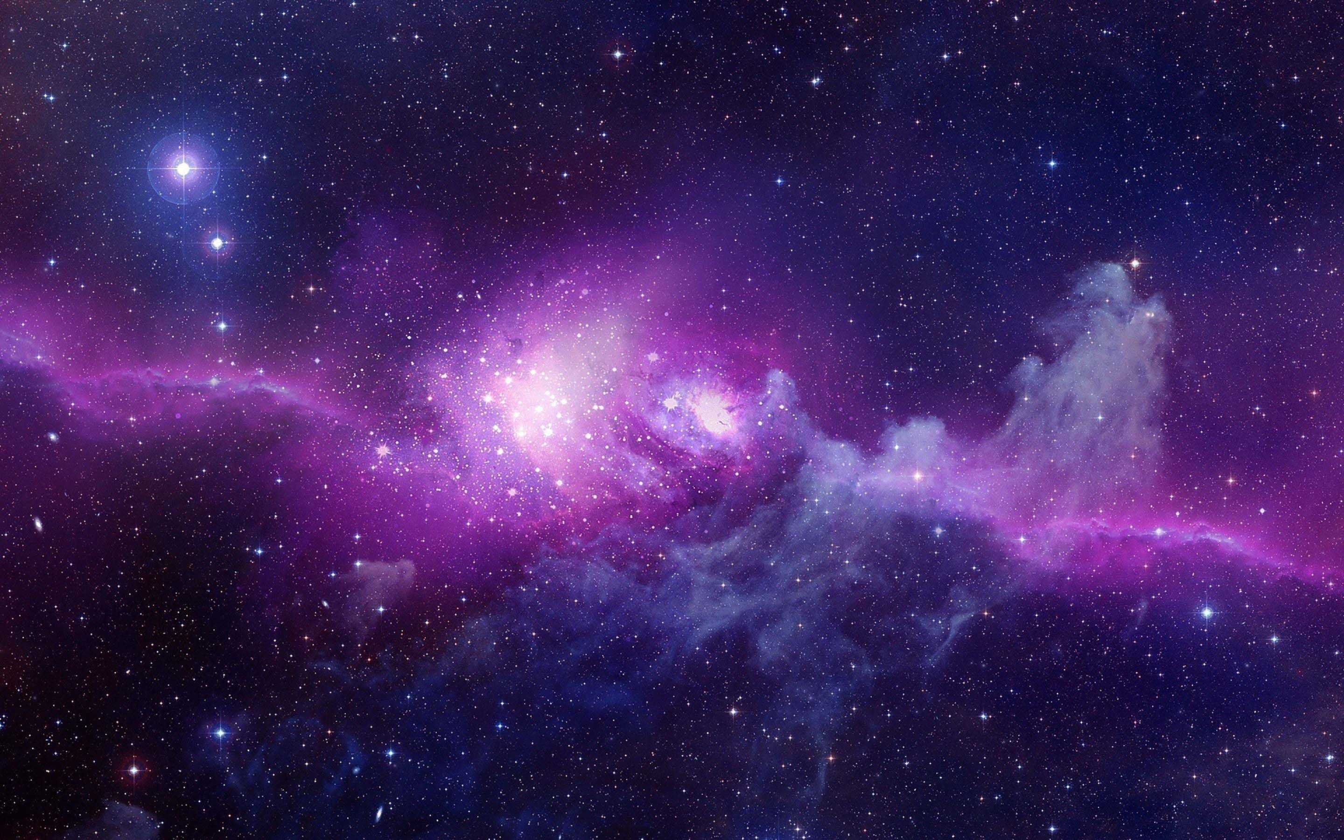
1
Work in pairs. Discuss the following questions.
1. What do you know about other planets?
2. Would you like to live on another planet? Why / Why not?
→ Some other planets orbit around the sun or other stars.
(Mars, Neptune, Jupiter.......)
→ No, I don’t think it is a good idea for me because I’m afraid I cannot go back to Earth

Slide 4



Unit
12
LIFE ON OTHER PLANETS
LESSON 5: SKILLS 1
READING
SPEAKING

Slide 5
I. READING

Slide 6
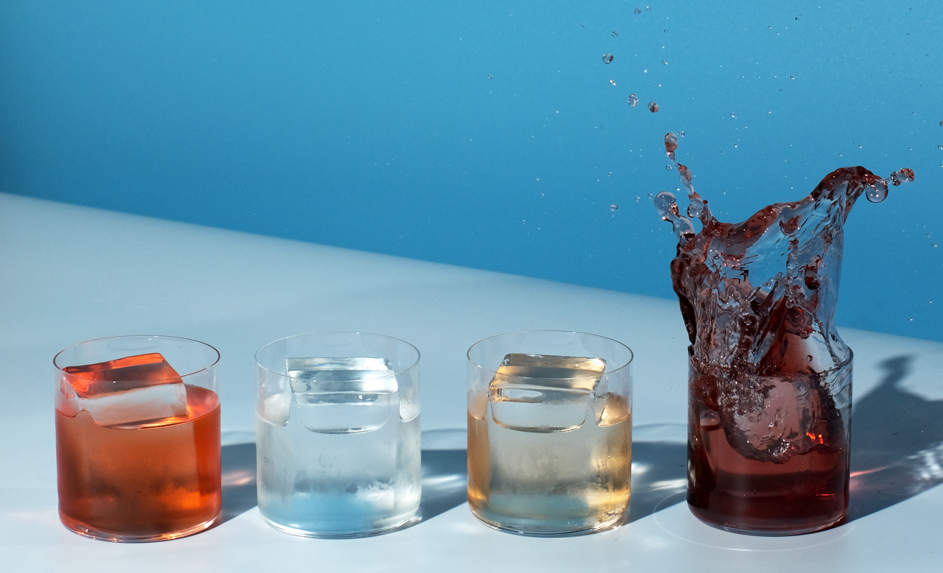

* VOCABULARY
liquid (n)
/ˈlɪkwɪd/
chất lỏng

Slide 7
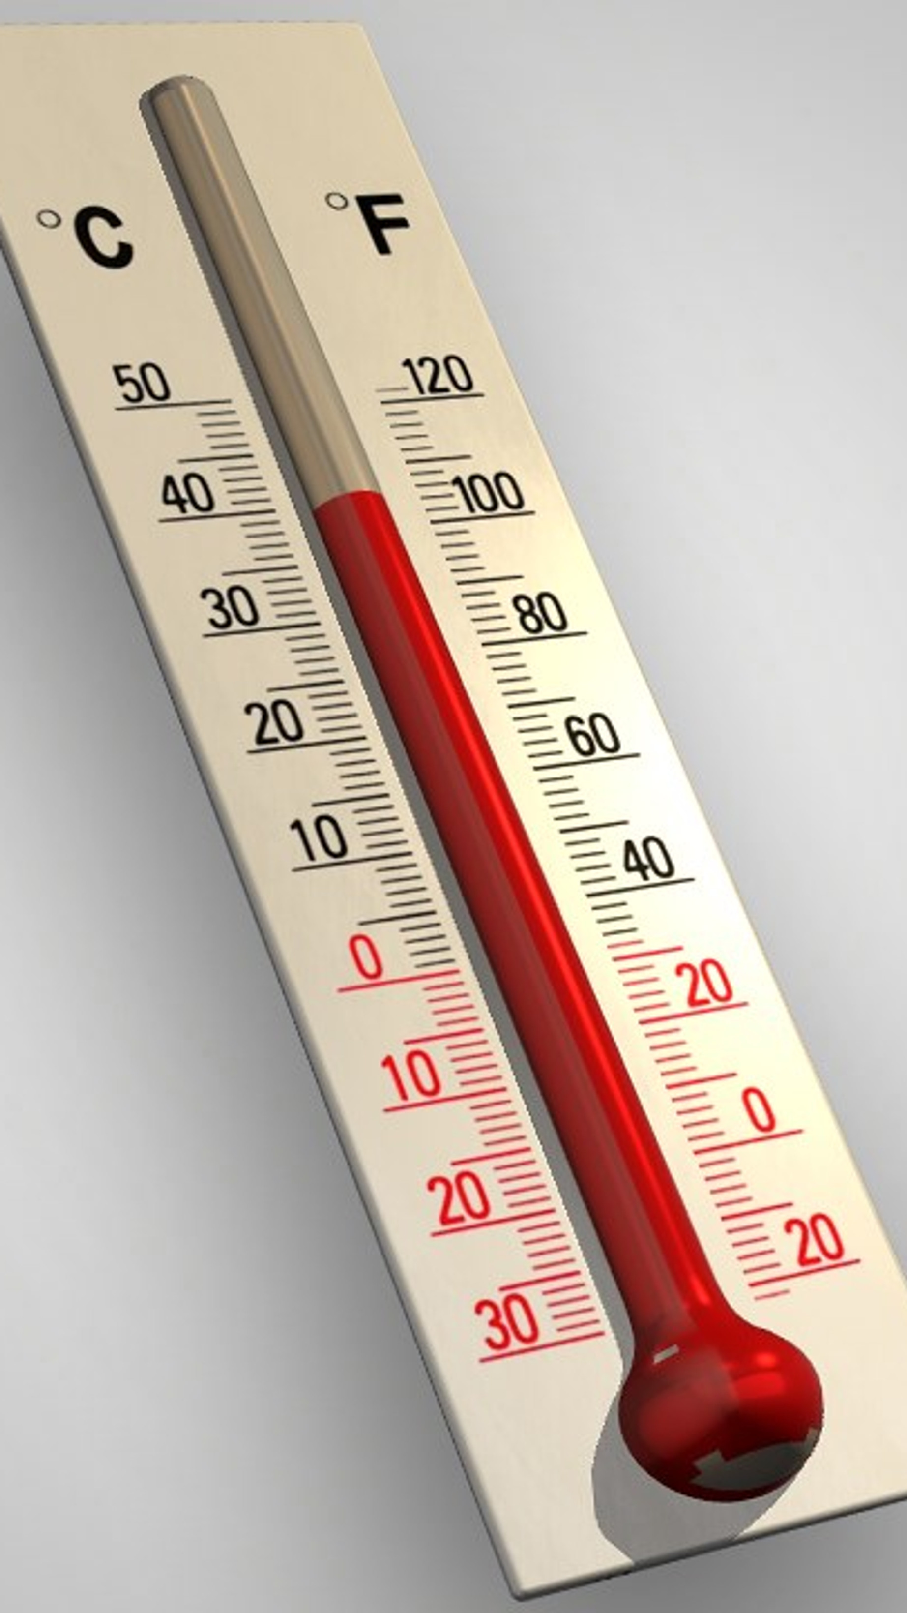
* VOCABULARY
temperature (n)
/ˈtemprətʃə/
nhiệt độ

Slide 8
* VOCABULARY
atmosphere (n)
The mixture of
gases around
the earth
/ˈætməsfɪə/
khí quyển

Slide 9
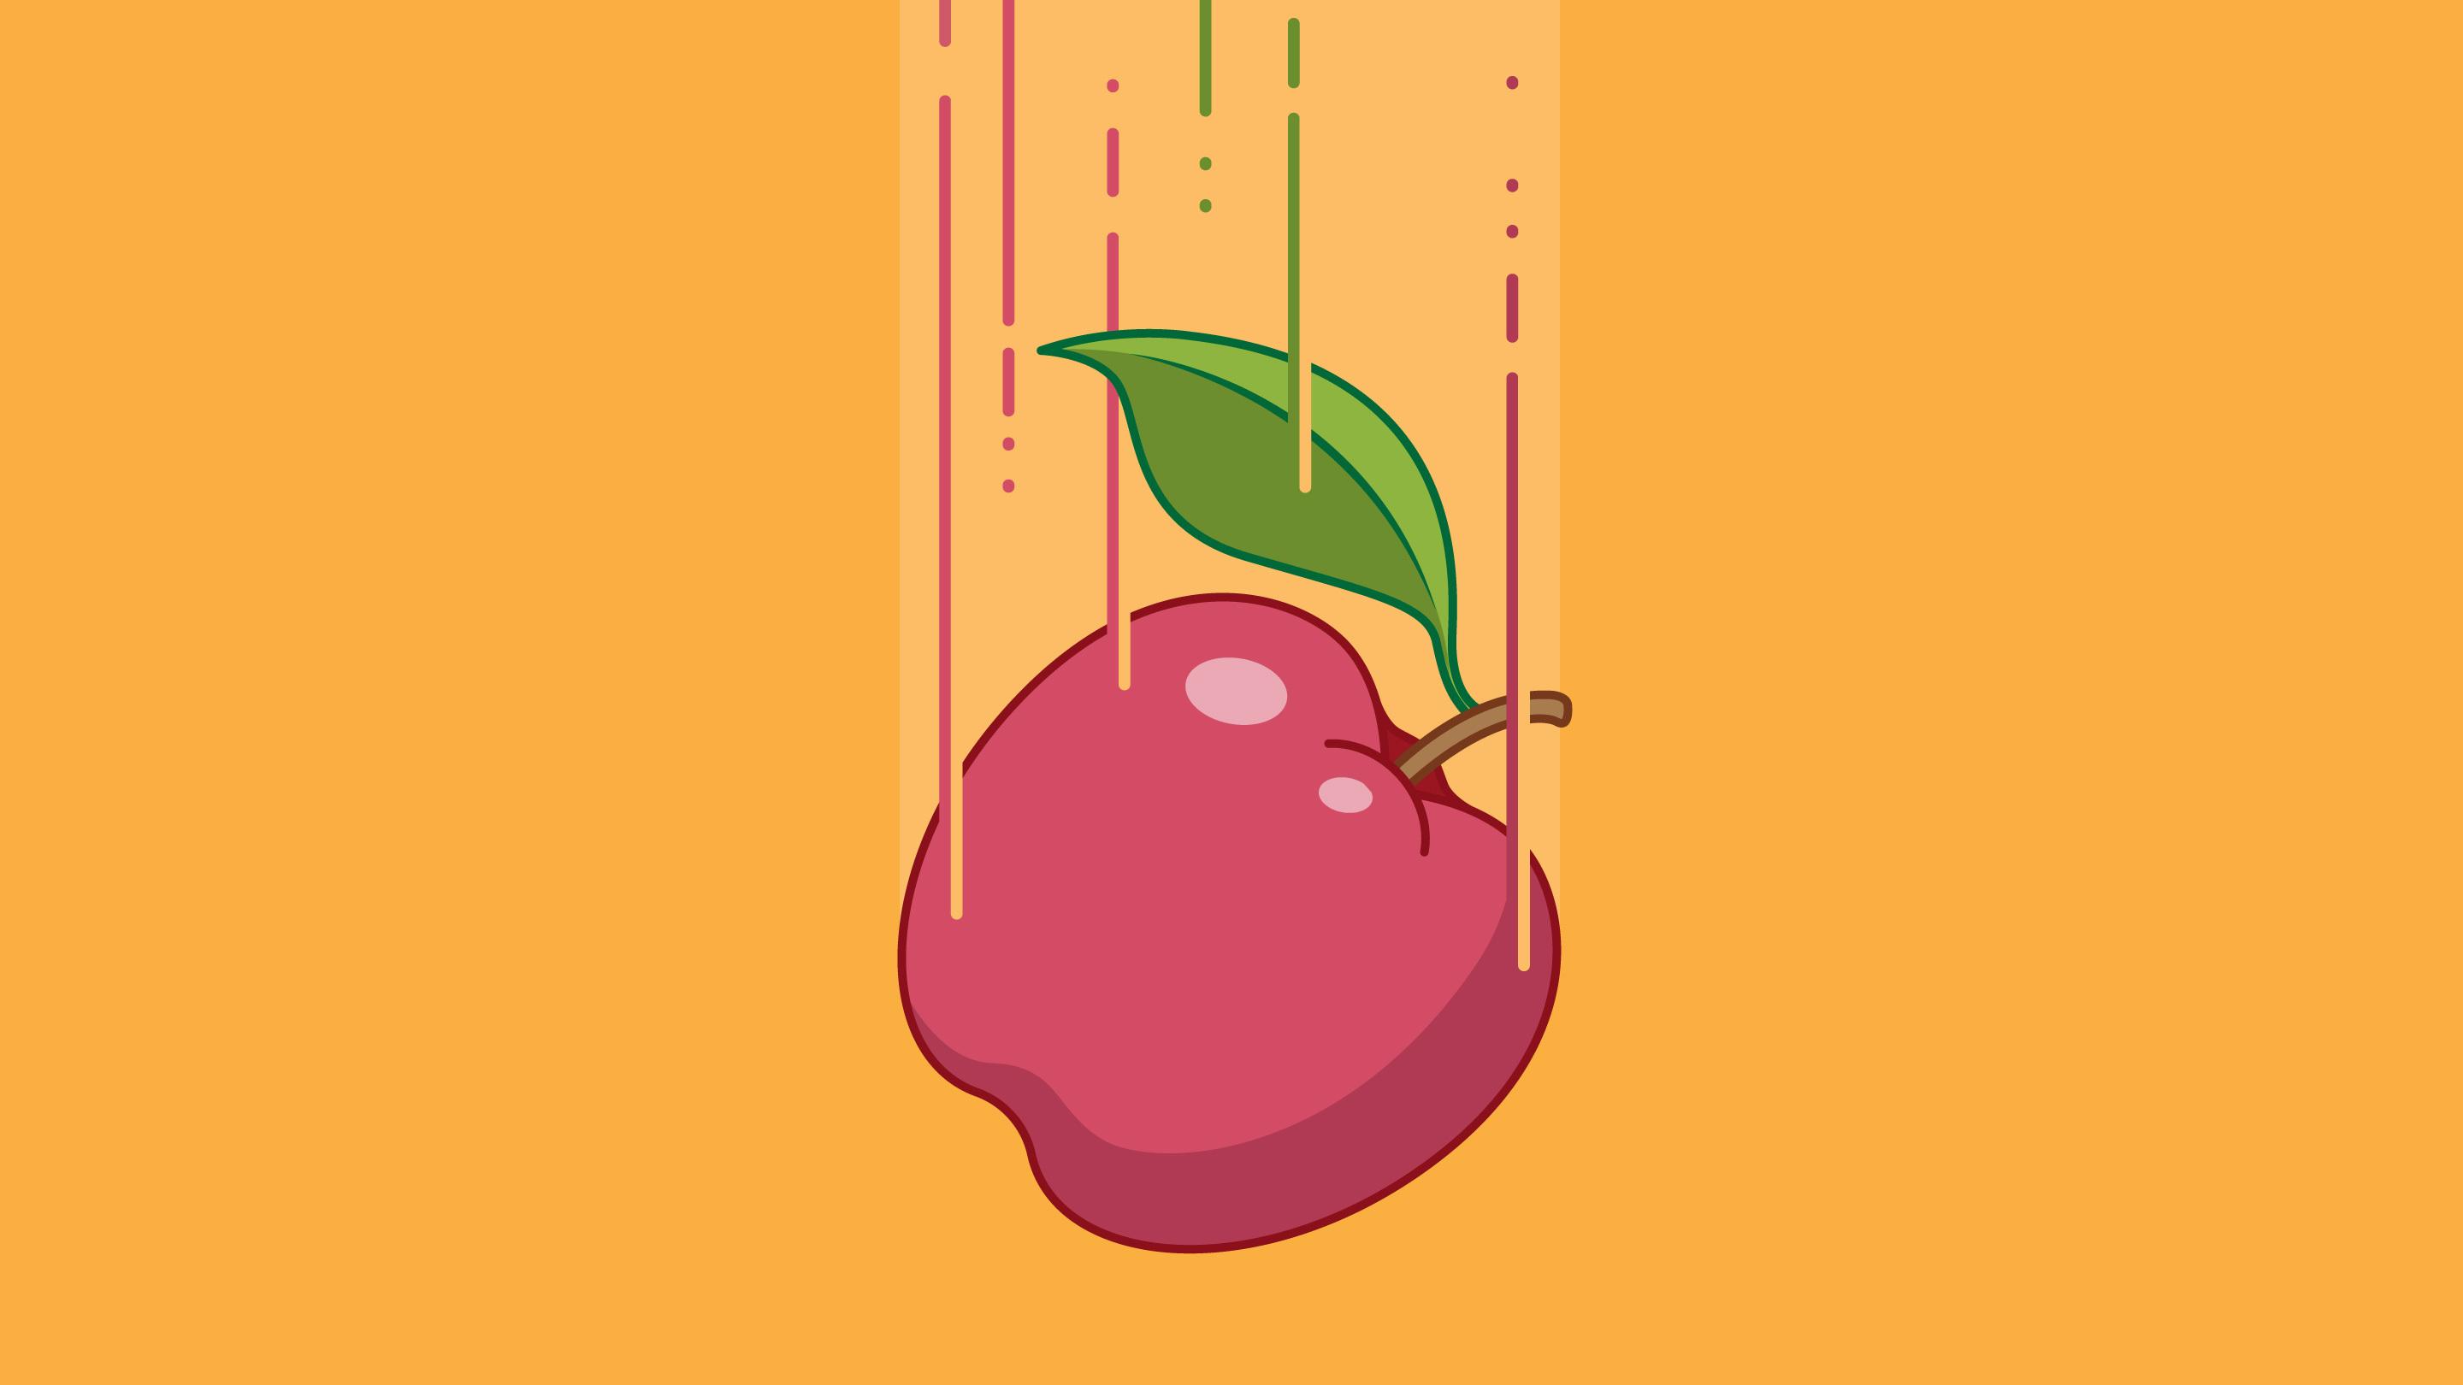
* VOCABULARY
gravity (n)
/ˈɡrævəti/
trọng lực,
lực hút trái đất

Slide 10
habitable (adj)
providing conditions that are good enough to live in or on
/ˈhæbɪtəbl/
có thể ở được, phù hợp để ở

Slide 11
* VOCABULARY
promising (adj)
signs that it is going to be successful or enjoyable
/ˈprɒmɪsɪŋ/
đầy hứa hẹn, triển vọng

Slide 12
* VOCABULARY
trace (n)
a sign that something has happened or existed
/treɪs/
dấu hiệu, dấu vết, vết tích

Slide 13
* VOCABULARY
New words | Pronunciation | Meaning
1. liquid (n) | /ˈlɪkwɪd/ | chất lỏng
2 temperature (n) | /ˈtemprətʃə/ | nhiệt độ
3. atmosphere (n) | /ˈætməsfɪə/ | không khí
4. gravity (n) | /ˈɡrævəti/ | trọng lực, lực hút trái đất
5. habitable (adj) | /ˈhæbɪtəbl/ | có thể ở được, phù hợp để ở
6. promising (adj) | /ˈprɒmɪsɪŋ/ | đầy hứa hẹn, triển vọng
7. trace (n) | /treɪs/ | dấu hiệu, dấu vết, vết tích

Slide 14
* Checking Vocabulary
New words | Meaning
1. | chất lỏng
2. | nhiệt độ
3. | không khí
4. | trọng lực, lực hút trái đất
5. | có thể ở được, phù hợp để ở
6. | đầy hứa hẹn, triển vọng
7. | dấu hiệu, dấu vết, vết tích
liquid (n)
temperature (n)
atmosphere (n)
gravity (n)
habitable (adj)
promising (adj)
trace (n)

Slide 15
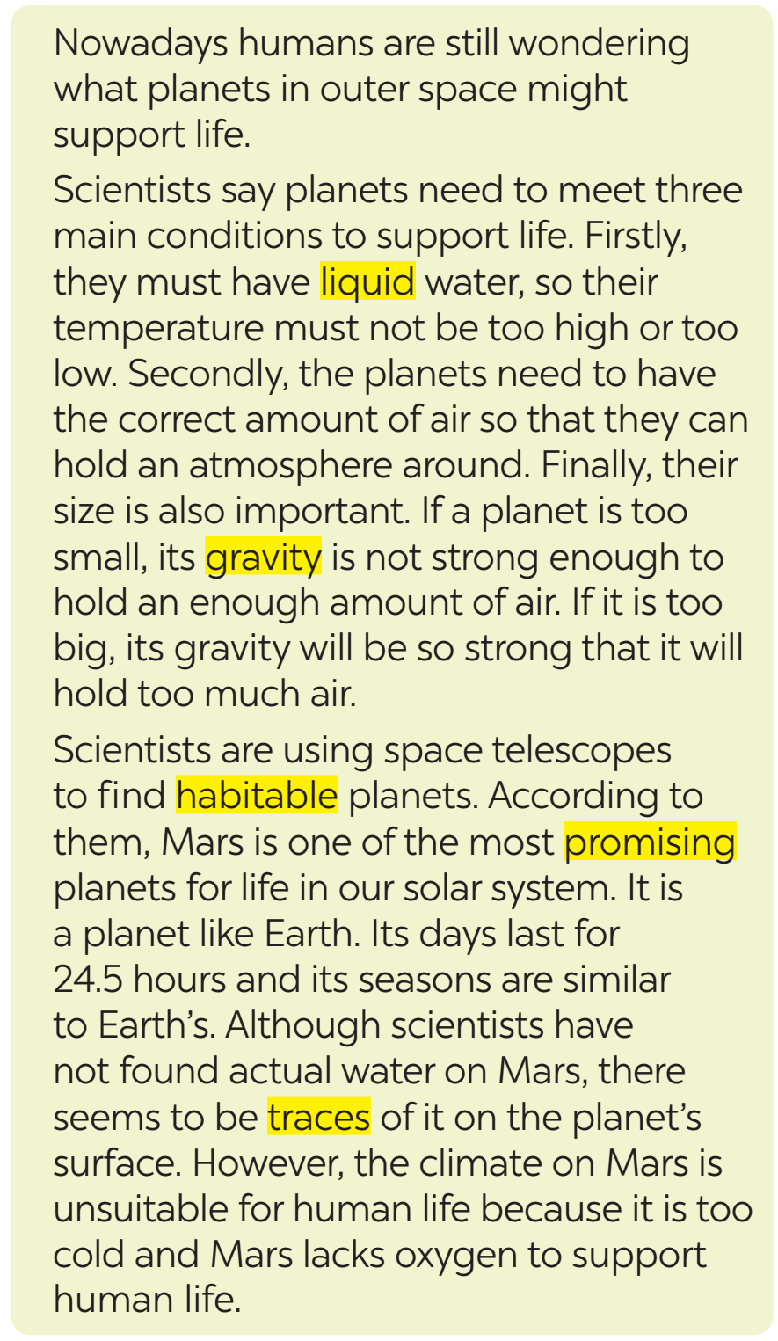
I. READING
2
Read the text and match the highlighted words in the text with their meanings.

Slide 16
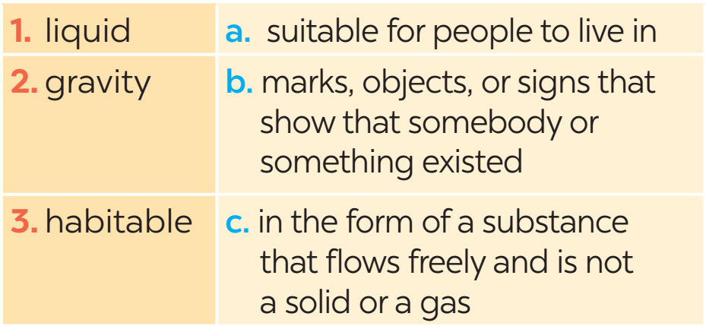
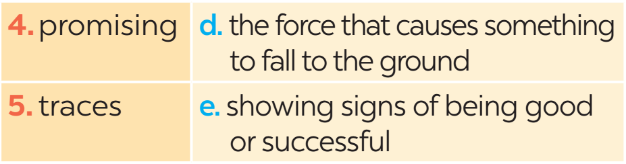
2
Read the text and match the highlighted words in the text with their meanings.

Slide 17
3
Read the text again and answer the following questions.
1. What are humans still wondering nowadays?
2. Why does a habitable planet need to have the correct amount of air?
Humans are still wondering what planets in outer space might support life.
It needs to have the correct amount of air to hold an atmosphere around it.

Slide 18
3
Read the text again and answer the following questions.
3. What happens if a planet is too small?
4. How long does a day on Mars last?
5. Why can we not live on Mars?
Its gravity is not strong enough to hold an enough amount of air.
A day on Mars lasts for 24.5 hours.
Because it is too cold and lacks oxygen to support human life.

Slide 19
II. SPEAKING
4
Work in pairs. Tick the boxes to show what conditions a planet needs to support human life.
1. There must be enough liquid water on the planet.
2. The planet must have craters on its surface.
3. The planet must hold an atmosphere.
4. The planet must have at least two moons.
5. The planet must have enough oxygen in the air.
X
X
X

Slide 20
II. SPEAKING
4
Can you add other conditions for a habitable planet?
* Suggested ideas:
– The planet's temperature of the planet must be suitable for humans to live on it.
– There must be enough sources of energy on the planet.
– The planet must be a comfortable distance away from a star.
– The planet must hold an atmosphere.
– The stars around the planet must be stable.
– The planet must have carbon that is found in all living things.

Slide 21
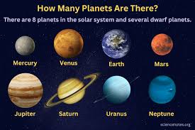
5
Work in groups. Take turns to talk about the conditions you think are required for a planet to support human life. Use the information in and your own ideas.
4
Example:
There are some conditions planets must have to support human life on them. First, the most important condition is that ...

Slide 22
5
Work in groups. Take turns to talk about the conditions you think are required for a planet to support human life. Use the information in and your own ideas.
4
Example:
There are some conditions planets must have to support human life on them. First, the most important condition is that there must be enough liquid water on the planet. Second, the planet must hold an atmosphere. And the planet must have enough oxygen in the air for people to survive.

Slide 23

* CONSOLIDATION
What have we learnt in this lesson?
Read about the possibility of life on other planets.
Talk about the conditions needed for planets to support human life.

Slide 24

* Homework
Do the exercises in the workbook.
Prepare lesson 6: Skills 2

Slide 25




