Slide 1

ENGLISH 8
Hello everyone !!!

Slide 2


* WARM-UP

Slide 3
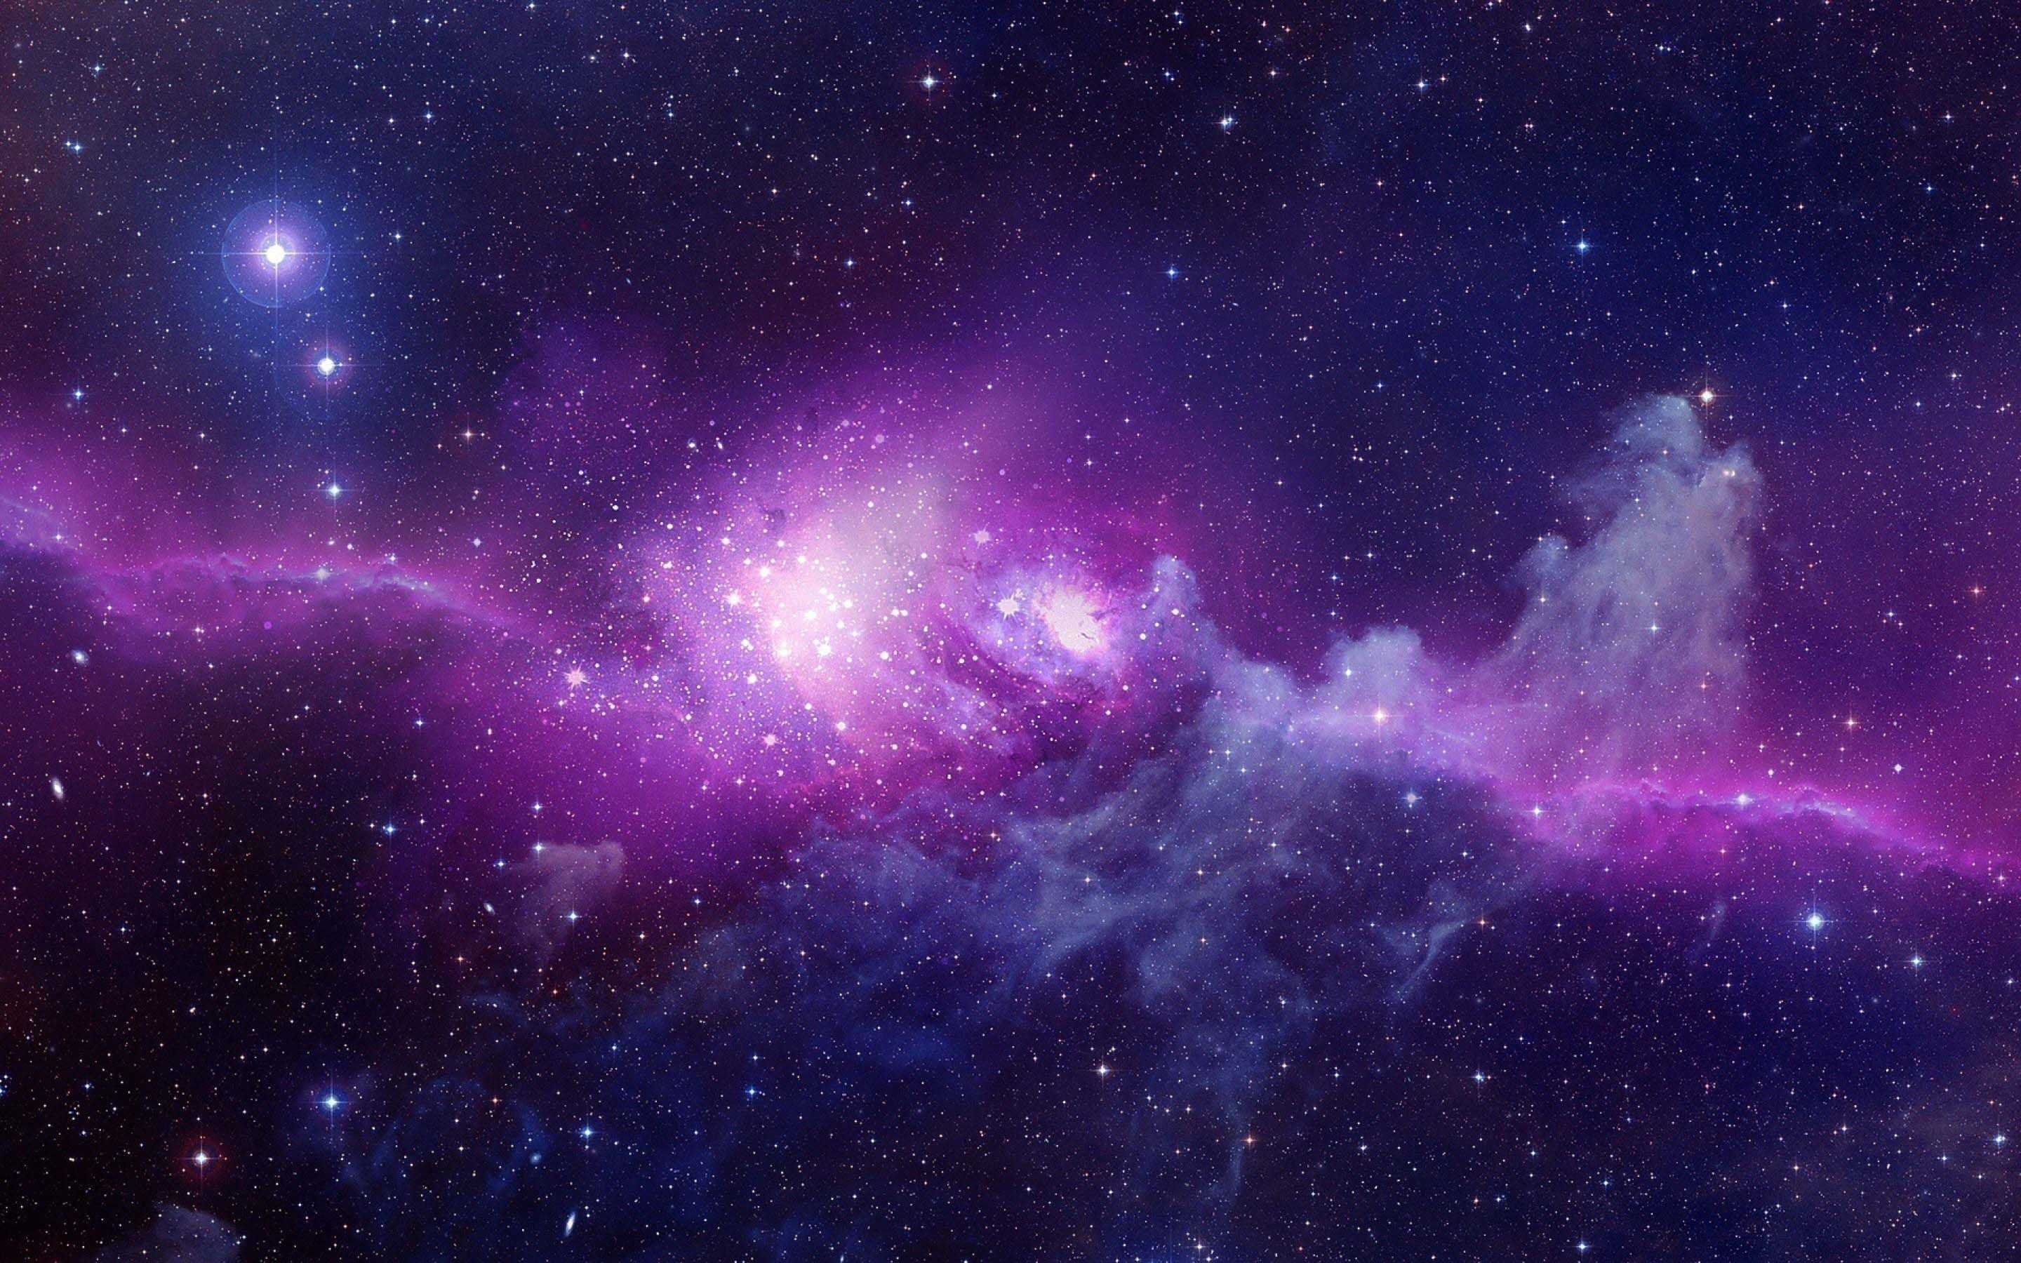
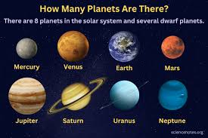
* WARM-UP
QUIZ TIME
1. How many planets do we have in our solar system?
8 planets

Slide 4
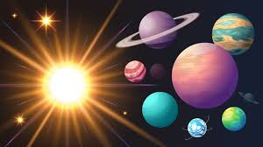
* WARM-UP
QUIZ TIME
2. Is the sun a planet or a star?
A star

Slide 5
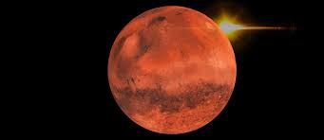
* WARM-UP
QUIZ TIME
3. Have humans ever walked on Mars?
No/ Not yet

Slide 6
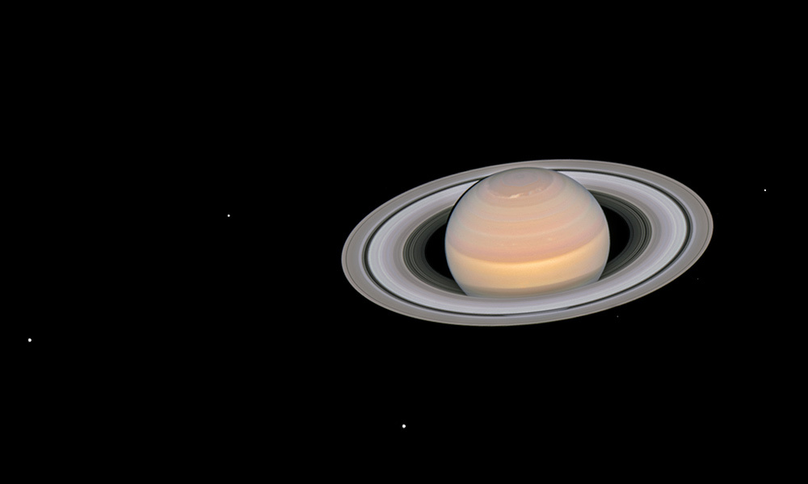
* WARM-UP
QUIZ TIME
4. How many moons (including moonlets) does Saturn have?
Sao Thổ có bao nhiêu mặt trăng (bao gồm cả các mặt trăng nhỏ)?
150

Slide 7
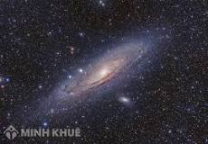
* WARM-UP
QUIZ TIME
5. Which galaxy is the Earth found in?
Trái đất nằm trong thiên hà nào?
Milky Way Galaxy
Ngân Hà

Slide 8

Unit
12
LIFE ON OTHER PLANETS
LESSON 2: A CLOSER LOOK 1
VOCABULARY
PRONUNCIATION
1

Slide 9
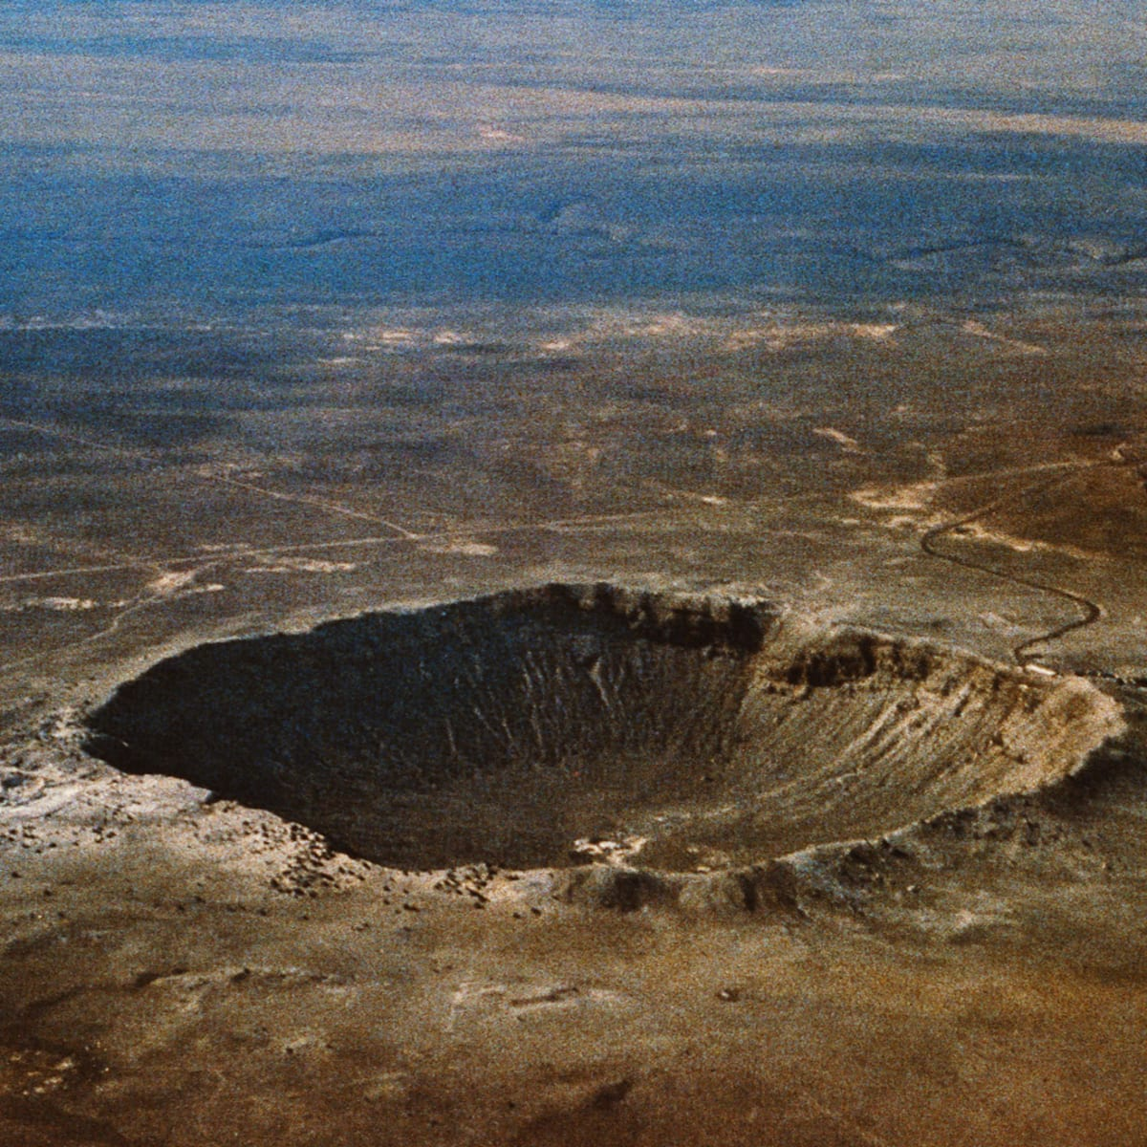

* VOCABULARY
crater (n)
/ˈkreɪtə/
miệng núi lửa

Slide 10
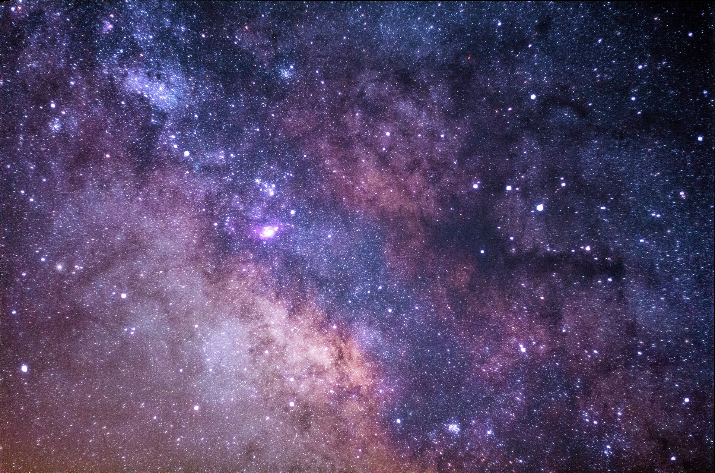
* VOCABULARY
galaxy (n)
/ˈɡæləksi/
thiên hà

Slide 11
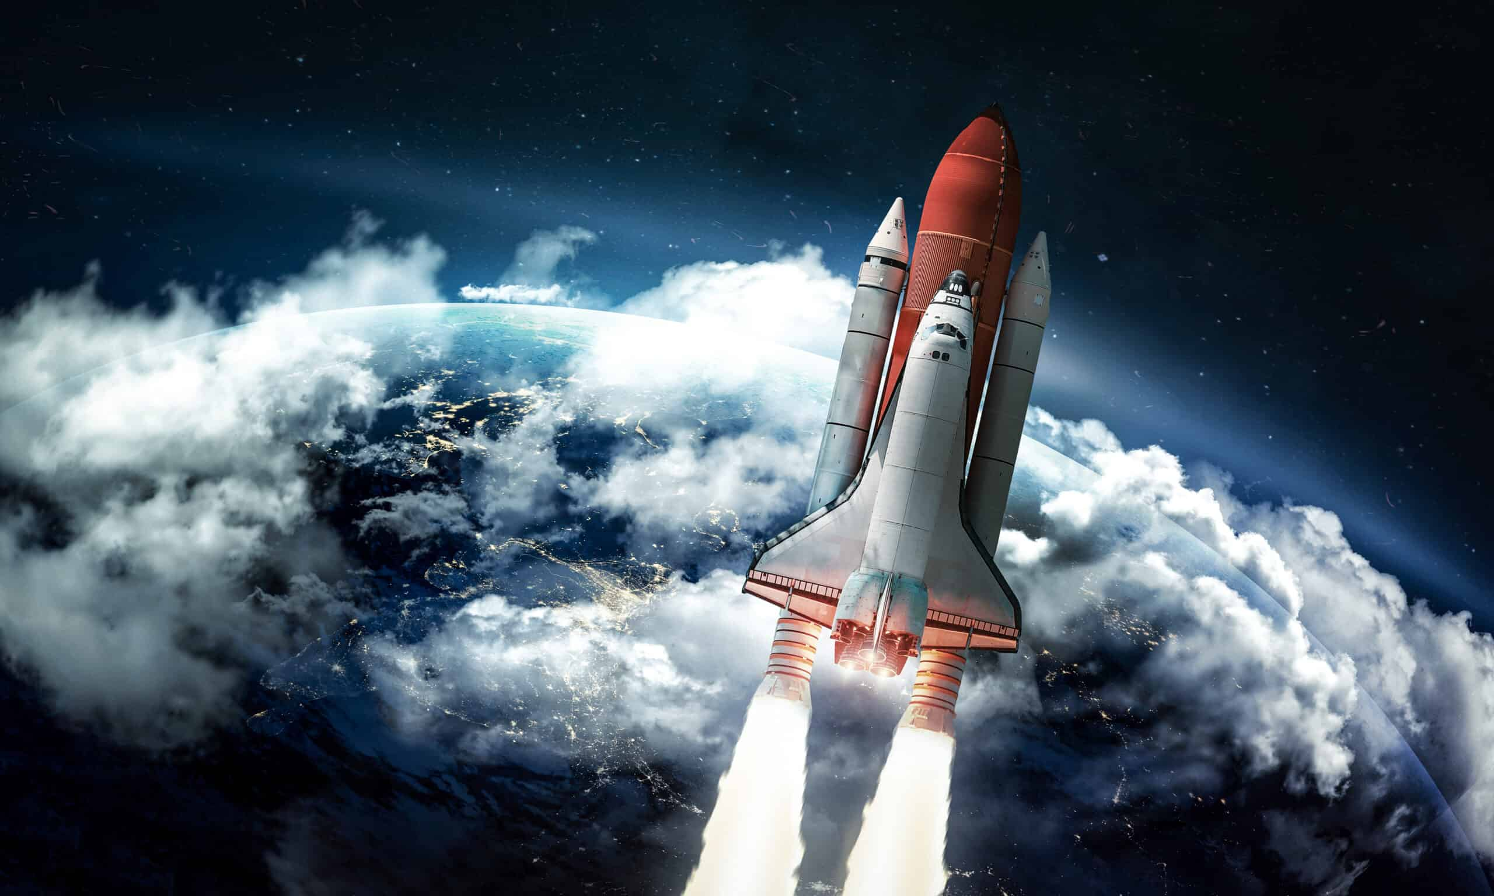
* VOCABULARY
rocket (n)
/ˈrɒkɪt/
tàu vũ trụ con thoi

Slide 12
* VOCABULARY
telescope (n)
/ˈtelɪskəʊp/
kính thiên văn

Slide 13
* VOCABULARY
UFO (n)
/ˈjuːfəʊ/
/ˌjuː ef ˈəʊ/
vật thể bay không xác định

Slide 14
* VOCABULARY
Jupiter (n)
/ˈdʒuːpɪtə/
sao Mộc

Slide 15
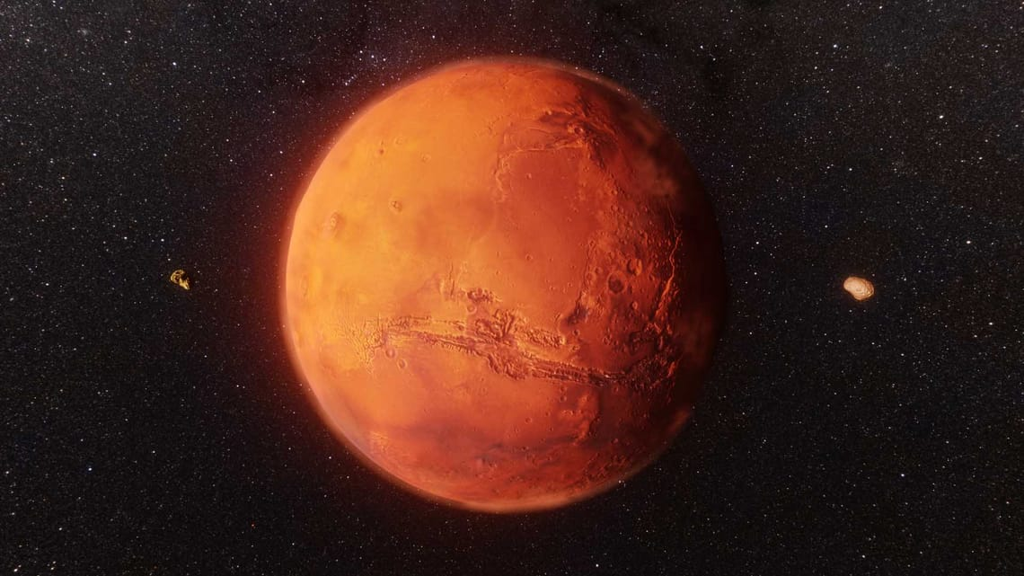
* VOCABULARY
Mars (n)
/mɑːz/
sao Hỏa

Slide 16
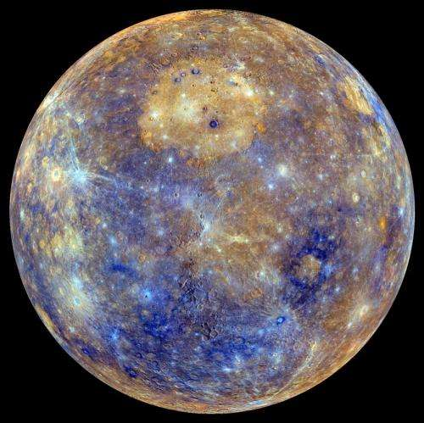
* VOCABULARY
Mercury (n)
/ˈmɜːkjəri/
sao Thủy

Slide 17
* VOCABULARY
Neptune (n)
/ˈneptjuːn/
sao Hải Vương

Slide 18
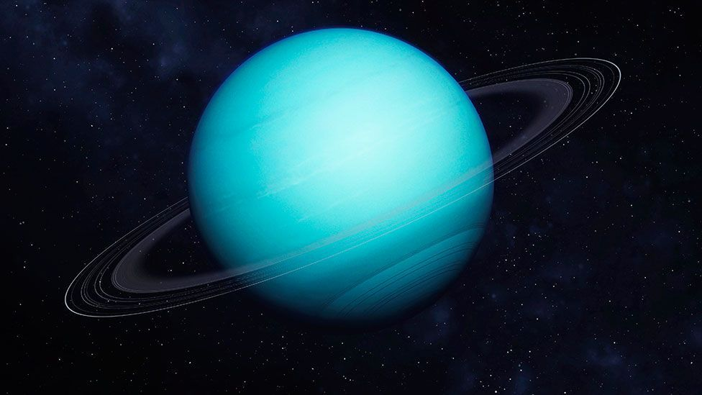
* VOCABULARY
Uranus (n)
/ˈjʊərənəs/
sao Thiên Vương

Slide 19
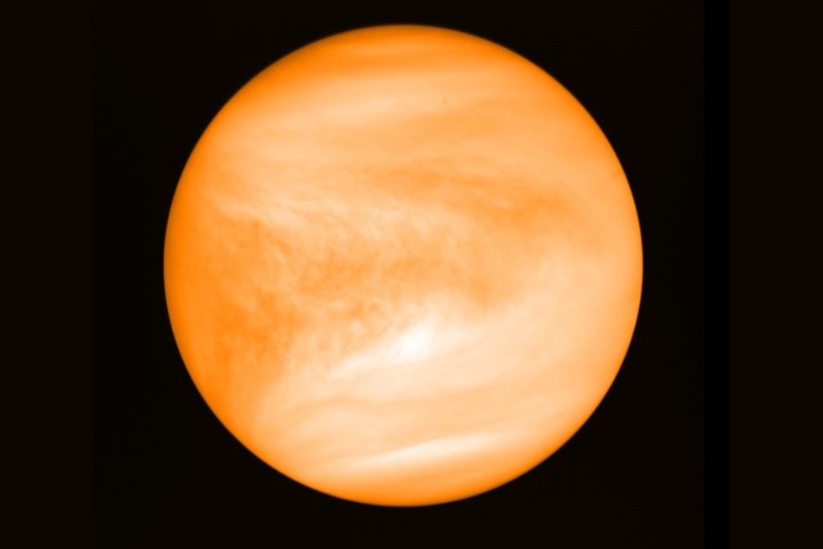
* VOCABULARY
Venus (n)
/ˈviːnəs/
sao Kim

Slide 20
* VOCABULARY
New words | Pronunciation | Meaning
1. crater (n) | /ˈkreɪtə/ | miệng núi lửa
2. galaxy (n) | /ˈɡæləksi/ | thiên hà
3. rocket (n) | /ˈrɒkɪt/ | tàu vũ trụ con thoi
4. telescope (n) | /ˈtelɪskəʊp/ | kính thiên văn
5. UFO (n) | /ˈjuːfəʊ/ /ˌjuː ef ˈəʊ/ | vật thể bay không xác định
6. Jupiter (n) | /ˈdʒuːpɪtə/ | sao Mộc

Slide 21
New words | Pronunciation | Meaning
7. Mars (n) | /mɑːz/ | sao Hỏa
8. Mercury (n) | /ˈmɜːkjəri/ | sao Thủy
9. Neptune (n) | /ˈneptjuːn/ | sao Hải Vương
10. Uranus (n) | /ˈjʊərənəs/ | sao Thiên Vương
11. Venus (n) | /ˈviːnəs/ | sao Kim

Slide 22
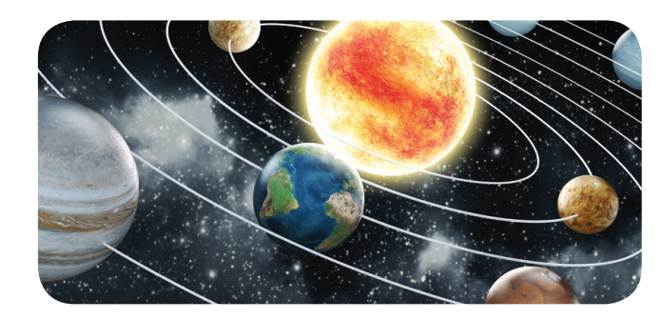
1
The following are the eight planets that go around the sun. Put them in order from the closest to the farthest from the sun.
Earth Jupiter Mars Venus
Mercury Neptune Saturn Uranus
My Very Excellent Mother Just Served Us Noodles
My Very Excellent Mother Just Served Us Noodles.
4. _________
2. _________
3. _________
Mars
1. _________
Venus
Earth
Mercury
8. _________
5. _________
6. _________
7. _________
Neptune
Jupiter
Saturn
Uranus

Slide 23
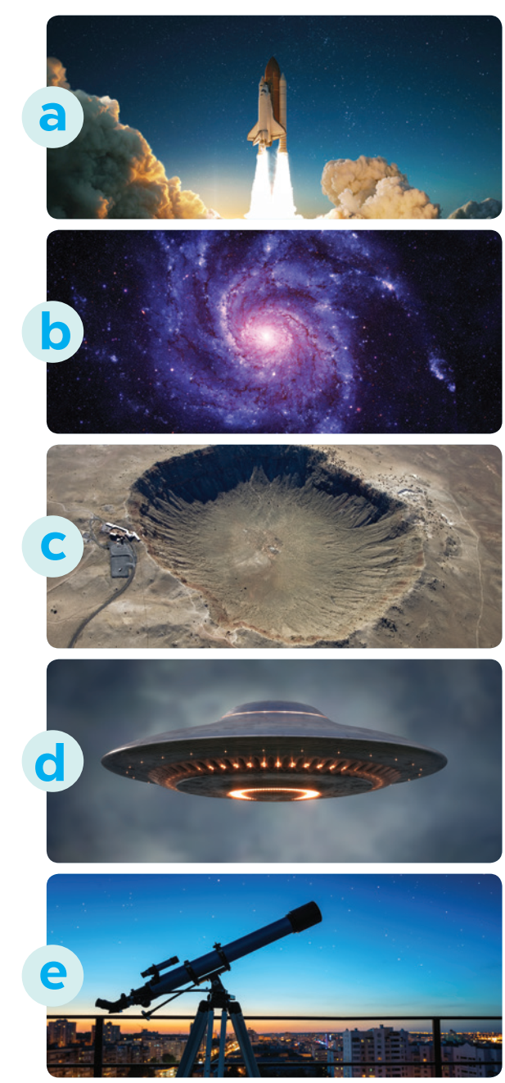
2
Match the words (1 - 5) with the pictures (a - e).
1. telescope
2. UFO
3. rocket
4. galaxy
5. crater

Slide 24
3
Complete the following sentences with the words from the box.
Venus telescope craters rocket galaxy
1. There are many ______ on the surface of the moon.
2. We use a ______, which is in the shape of a big tube, for travelling or carrying things into space.
3. We need to use a ________ to clearly see the surface of the moon.
4. The planet which is the second closest to the sun is ______.
5. The Milky Way is the ______ that includes our solar system.
craters
rocket
telescope
Venus
galaxy

Slide 25

* PRONUNCIATION
INTONATION FOR MAKING LIST
Ngữ điệu trong câu liệt kê

Slide 26
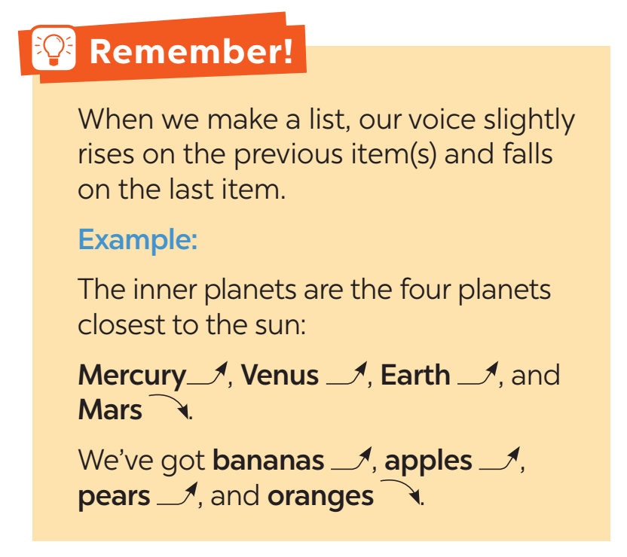
* PRONUNCIATION
Khi chúng ta liệt kê, giọng của chúng ta hơi cao lên ở những đồ vật trước và hạ giọng vào mục cuối cùng

Slide 27
* PRONUNCIATION
Intonation for making lists - Ngữ điệu trong câu liệt kê
Trong câu liệt kê, ngữ điệu sẽ lên cao ở những từ đầu và xuống thấp vào từ cuối để chỉ ra rằng danh sách hoặc sự liệt kê đã kết thúc.
E.g. We like playing football, basketball, volleyball and tennis.
(Chúng tôi thích chơi bóng đá, bóng rổ, bóng chuyền và quần vợt.)

Slide 28
4
Listen and repeat the sentences. Pay attention to the tones of the underlined words in each sentence.
1. I’d like some eggs, some milk, some cheese, and some bread, please.
2. My father can speak four languages: English, French, Russian, and Spanish.
3. My favourite sports are football, tennis, basketball, and volleyball.
4. My kitten is cute, smart, playful, and noisy.
5. The outer planets, which are made up mostly of gas, include Jupiter, Saturn, Uranus, and Neptune.

Slide 29
5
Listen to the conversations. Do you think the voice goes up or down on the underlined words in each second sentence? Draw a suitable arrow (↗ or ↙ ) on each underlined word.
1. A: Good evening! What can I get you, sir?
B: I’d like some pork, some chicken, some tofu, and some vegetables.
2. A: What did you buy at the clothing store yesterday?
B: I bought a T-shirt, a jumper, a tie, and a cap.
3. A: What music do you like?
B: I like pop, blues, country, and jazz.
4. A: What do you think we should bring with us to Mars?
B: I think we should bring food, water, clothes, and a tent.

Slide 30

* CONSOLIDATION
What have we learnt in this lesson?
identify the topic of the unit
use the lexical items related to outer space
use intonation for making lists correctly
Can you tell me some words in this lesson?

Slide 31


* Homework
- Learn the new words by heart.
- Practise using intonation.
- Do the exercises in the workbook.

Slide 32


Thank you!
Goodbye!

