Slide 1


SONG VE SECONDARY SCHOOL
Hello every one !!!
love
NGUYỄN THỊ THU BA

Slide 2
* Game: Kim’s game
Write the names of shops (stores)

Slide 3

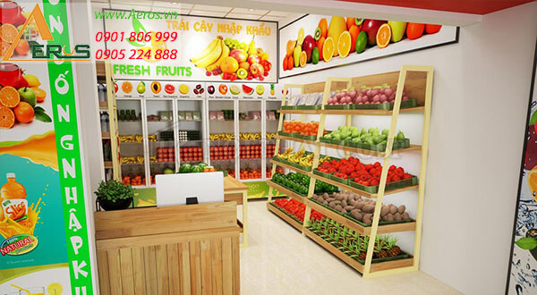

Slide 4
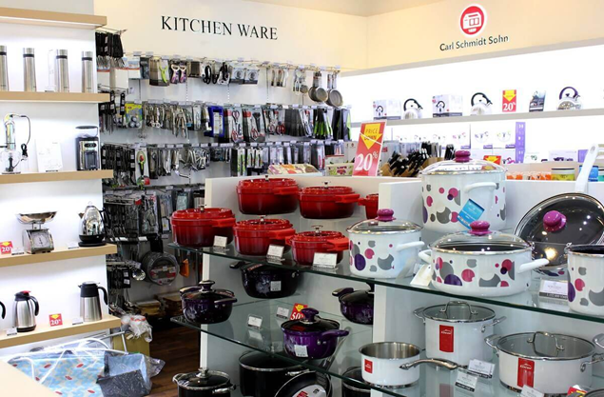

Slide 5
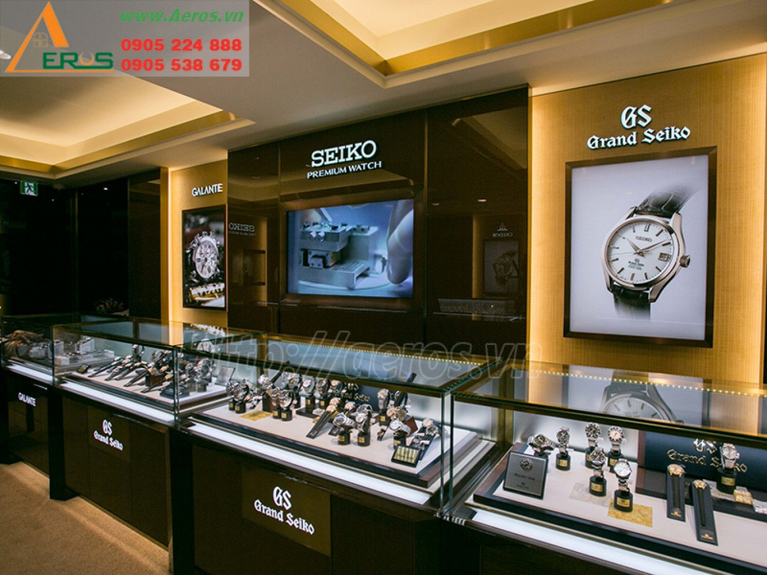

Slide 6
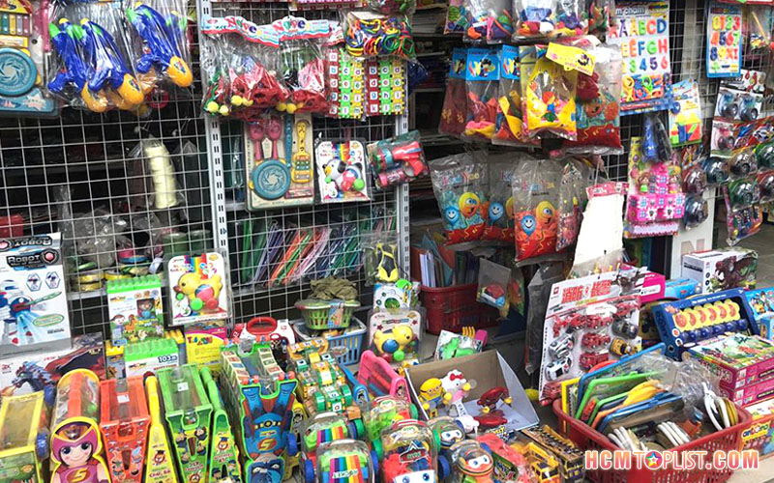

Slide 7
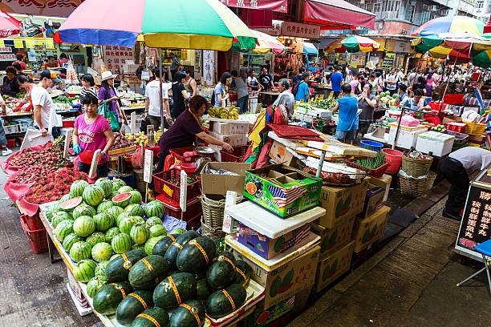

Slide 8
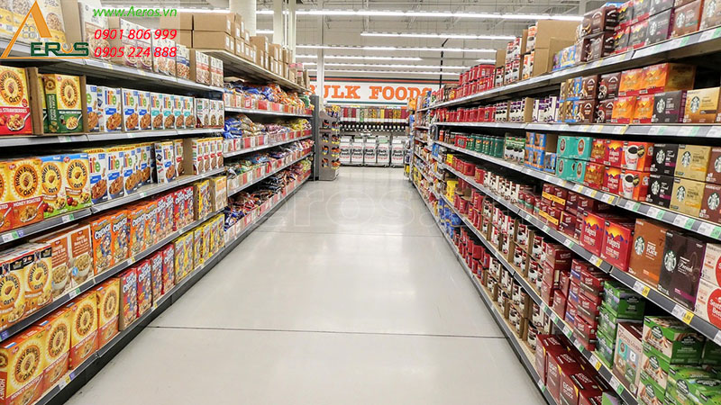

Slide 9
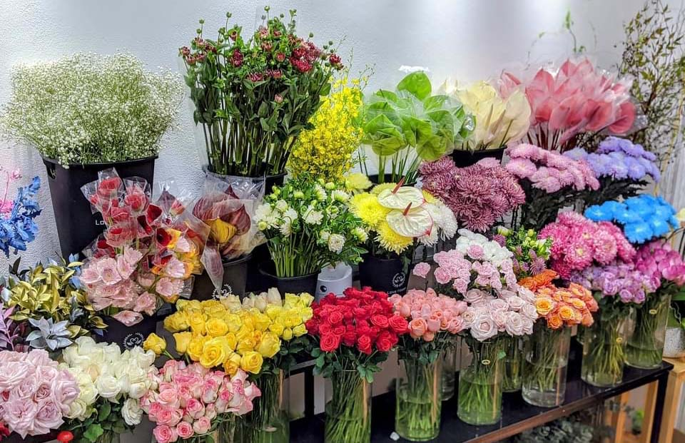

Slide 10
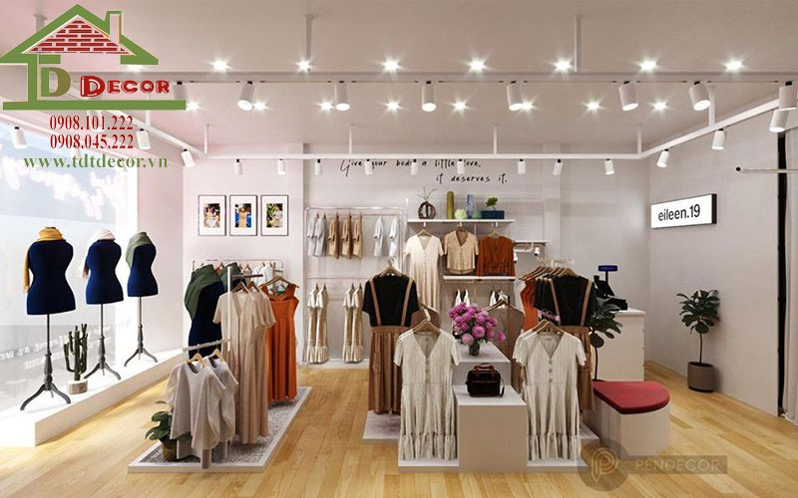

Slide 11
The end

Slide 12
Supermarket | Toy shop
Fruit store | Flower shop
Clothes shop | Market
electronics shop | Watch shop

Slide 13

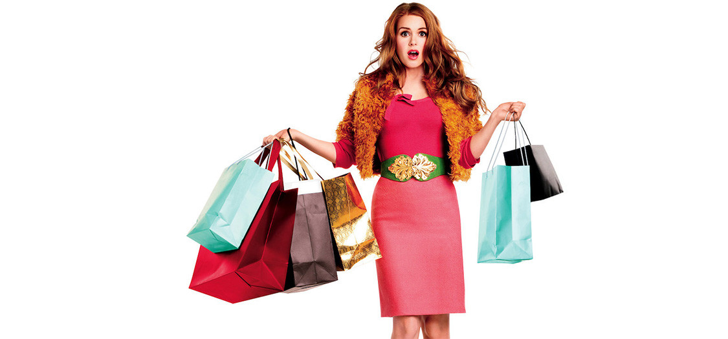
Unit
8
SHOPPING
LESSON 2: A closer look 1
1

Slide 14

* Vocabulary
- shopaholic (n)
/ˌʃɒpəˈhɒlɪk/
người nghiện mua sắm

Slide 15
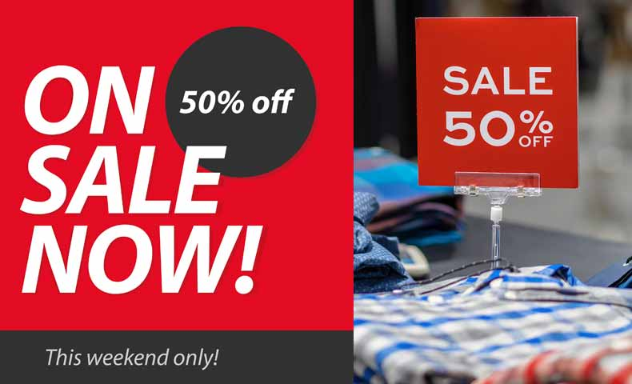
on sale
/ɒn seɪl/
đang (được bán) hạ giá

Slide 16

* Vocabulary
discount shop (n)
/ˈdɪskaʊnt ʃɒp/
cửa hàng hạ giá

Slide 17
* VOCABULARY
New words | Pronunciation | Meaning
1. shopaholic (n) | /ˌʃɒpəˈhɒlɪk/ | người nghiện mua sắm
2. on sale | /ɒn seɪl/ | đang (được bán) hạ giá
3. discount shop(n) | /ˈdɪskaʊnt ʃɒp/ | cửa hàng hạ giá

Slide 18
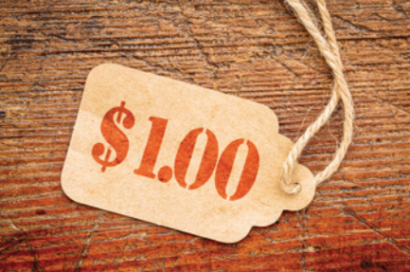
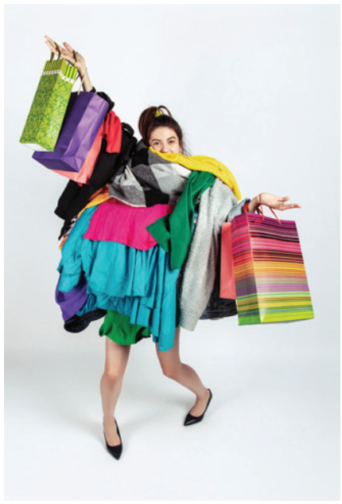
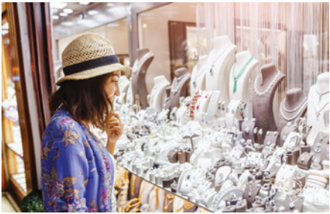


* VOCABULARY
1
Write the words and phrases under the correct pictures
shopaholic
browsing
price tag
Internet access
on sale
1. _____________
4. _____________
2. _____________
5. _____________
3. _____________

Slide 19
* VOCABULARY
2
Match the shopping places with their characteristics.
1. a speciality shop |  | a. It offers lower prices on all products.
2. a discount shop |  | b. It uses the Internet to sell goods and services.
3. a supermarket |  | c. It is often outdoor and offers a wide range of goods. Buyers can bargain.
4. an online shop |  | d. It is a large indoor shopping place with mixed prices for all the items offered.
5. an open-air market |  | e. It offers one or two specific kinds of goods.

Slide 20
* VOCABULARY
3
Complete the sentences with the words and phrases from the box.
shopaholic
bargain
speciality shops
browsing
range of products
1. There are many _____________ in a shopping centre.
2. I spent the whole morning just ________online for clothes, but I didn’t buy anything.
3. Alice doesn’t know how to _______, so she paid too much for her
T-shirt.
4. Both online and offline supermarkets offer a wide ______________.
5. She’s a __________. She spends too much time and money shopping.

Slide 21

PRONUNCIATION
How to pronounce words that contain the sounds:
/sp/ and /st/

Slide 22
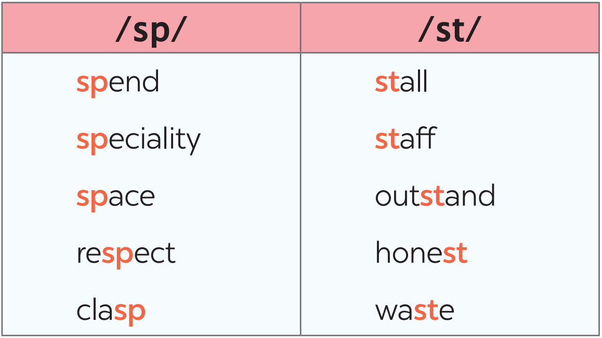
* PRONUNCIATION
4
Listen and repeat the words. Pay attention to the sounds /sp/ and /st/.

Slide 23
* PRONUNCIATION
5
Listen and repeat the sentences. Pay attention to the underlined words.
1. There is a three-storey sports centre in my neighbourhood.
2. The assistant at her shop always gives us special attention.
3. The shop owner treats his customers with a lot of respect.
4. The food at that restaurant is too spicy for me.
5. Tom spent half of his savings in that music store.

Slide 24

CONSOLIDATION
1
Wrap-up
What have we learnt in this lesson?
Shopping places and their characteristics.
2 sounds /sp/ vs /st/

Slide 25

* Homework
Name a list of shopping places
Find 5 more words with the sounds /st/ and /sp/
Do exercise in the Workbook

Slide 26

Thanks for your atendance!
Goodbye. See you again
Notes:
26

Slide 27
CLIP WATCHING
WARM-UP
Do you know the film?
It’s Confessions of a Shopaholic.
What is it about?
It’s about a girl who is addicted to shopping
SHOPAHOLIC
Notes:
Link video: https://www.youtube.com/watch?v=d-jE5WJ7J28

