Slide 1
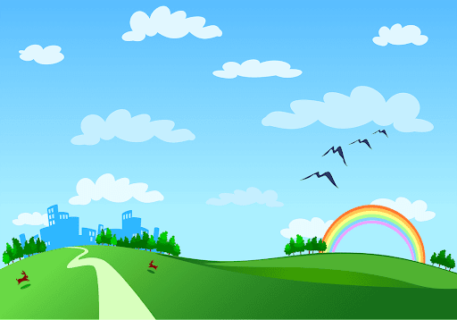
Phu Thi Secondary school.
Good morning class!!!

Slide 2

* Warm up:
Puzzle pieces game
* Write and match conditional sentences.
- Each student has a small piece of paper.
- Each student in group A writes half of the sentence "If..."
- Each student in group B writes half of the sentence "I will..."
=> if the structure and meaning are correct, those 2 students will score 1 plus point

Slide 3
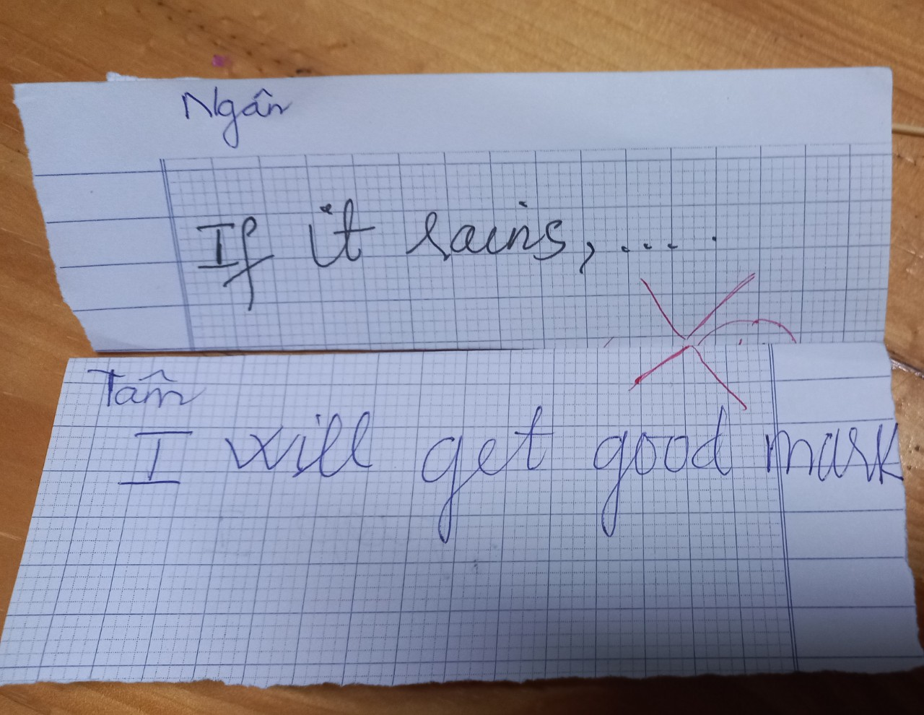
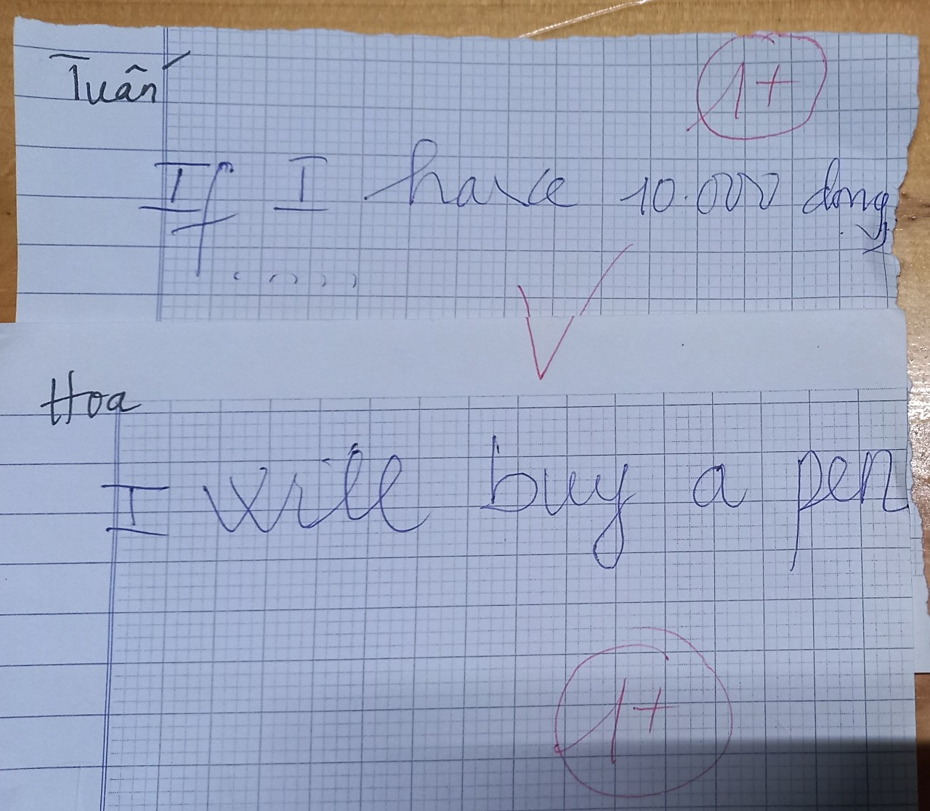


* Warm up:
* Game – Write and match conditional sentences.
Give example:

Slide 4


Monday, July 22, 2024
Period 46. Unit 6
LIFESTYLES
LESSON 7: LOOKING BACK & PROJECT (P. 68)
1

Slide 5
I. OBJECTIVES:
By the end of this lesson, Ss will be able to:
1. Knowledge
-Revise more vocabulary items they have learnt in the unit in different contexts.
- Revise the forms and uses of future simple and first conditional apply what they have learnt (vocabulary and grammar) into practice through a project.
-Practice making their own poster about an interesting way of life around the world.

Slide 6
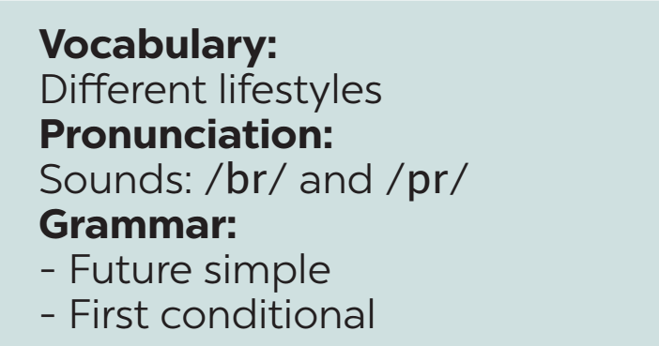
Monday, July 22, 2024
Period 46. Unit 6.
LIFESTYLES
REVISION

Slide 7
* VOCABULARY
1
﻿Match each word or phrase with its meaning.
1. lifestyle | a. making things with one’s hands, using skills
2. common practice | b. a vehicle/ˈviːəkl/ pulled by dogs (usually over snow)
3. street food | c. the way in which individuals or groups of people live and work
4. making crafts | d. the usual way of doing something
5. dogsled | e. ready-to-eat food or drink sold in a street or other public places
1. C 2. d 3. e 4. a 5. b

Slide 8
2
﻿Complete each sentence with a word or phrase from the box.
maintain
﻿ in the habit of
greeted
lifestyle
online lessons
1. My younger sister is _____________ listening to music while studying.
2. The native people there ________ us warmly when we arrived.
3. Many people are trying to adopt (áp dụng)a healthy ________ these days.
4. I believe that _______________ are not as interesting as offline lessons.
5. It is difficult for some villagers to __________their tradtional lifestyle.

Slide 9
I. GRAMMAR:
*THE FUTURE SIMPLE ( thì tương lai đơn)
- ﻿We use the future simple to describe future possibilities or conditions. ( Chúng ta sử dụng thì tương lai đơn để miêu tả những khả năng hoặc điều kiện trong tương lai)
+: I will buy a boat next month.
+
S + will + Vo/be + …
- : I won’t buy a boat next month.
⎯
S + won’t + Vo/be + …
?: Will you buy a a boat next month?
?
Will + S + Vo/be + …?
- soon (sắp), tomorrow (ngày mai), in the future (trong tương lai), next week/ month/ year. (tuần/ tháng/ năm tới), I think, in + thời gian …

Slide 10
*FIRST CONDITIONAL ( câu điều kiện loại 1)
﻿- We use first conditional to talk about things which are possible in the present or the future.
- Chúng ta dùng câu điều kiện loại 1 để nói về những điều có thể xảy ra ở hiện tại hoặc tương lai.
If she gets up early, she will be on time.
If + S + Vs/es + O, S + will/ can + Vo/ be
Hiện tại đơn, tương lai đơn
﻿- We can also use unless in conditional sentences. Unless means “if … not” or “except if …”.
(Chúng ta có thể sử dụng “unless” trong câu điều kiện. “Unless” có nghĩa “nếu…không…” hoặc “trừ khi…”.) Unless = if… not

Slide 11
* GRAMMAR
3
﻿Complete the sentences, using the correct tense of the verbs in brackets.
1. No worries. The organisers (send) _________ us an invitation soon.
2. Unless they behave, those children (not be) ________ welcome here.
3. Do you think online learning (become) ___________ the new mode of education?
4. If I (win) ______ the competition, I will donate half of the prize money to charity.
5. ______ we (have to) _______ keep to the left when we drive in Singapore next week?
will send
won’t be
will become
win
Will
have to

Slide 12
* GRAMMAR
4
﻿Rewrite the following sentences, so that their meaning stays the same.
﻿1. Don’t play computer games for too long. You will harm your eyes.
﻿→ If you play ___________________________________________.
2. Be careful with what you eat, or you will get overweight.
→ ﻿You will _____________________________________________.
3. We’ll go to the beach unless it rains
→ ﻿If _____________________________.
→ ﻿If _____________________________.
computer games for too long, you will harm your eyes
get overweight unless you are careful with what you eat
it doesn’t rain, we’ll go to the beach
it rains, we won’t go to the beach

Slide 13
* GRAMMAR
4
﻿Rewrite the following sentences, so that their meaning stays the same.
﻿4. If you don’t hurry up, you will be late.
﻿→ Unless ________________________.
5. Unless the teacher explains the lesson again, we won’t understand it very well.
→ ﻿If ____________________________________
__________________________.
you hurry up, you will be late
the teacher doesn’t explain the lesson again,
we won’t understand it very well

Slide 14


* PROJECT

Slide 15
* CONSOLIDATION
Vocabulary review
Grammar review
Project: Interesting lifestyle around the world

Slide 16

* Homework
Students’ workbook.
Prepare : REVIEW 2

Slide 17

Goodbye.
See you again

Slide 18
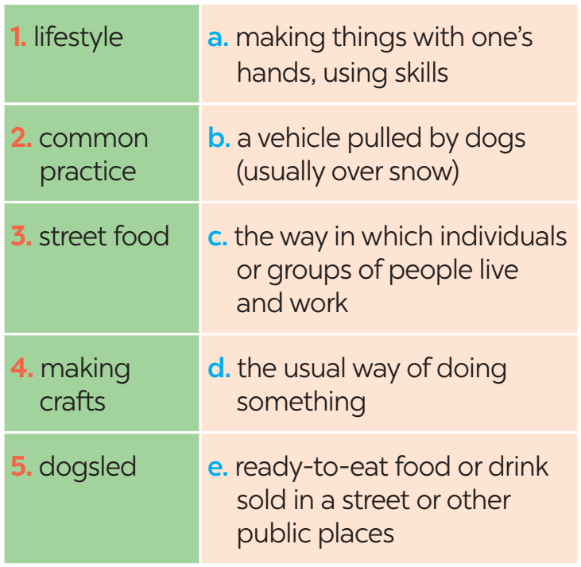
* VOCABULARY
1
﻿Match each word or phrase with its meaning.

