Slide 1

Hello everyone !!!

Slide 2

* Warm up for the first 5 minutes

Slide 3
* WARM-UP
* Work in groups
b
1. Sure. What do you want to drink?
2. Mom, could you make me a sandwich for breakfast tomorrow?
3. I’m thinking, Mom.
4. Yes, certainly. I’ll have some milk
5. How about a glass of milk? It’s your favorite drink, right?
a
c
e
JUMBLED
CONVERSATION
d

Slide 4
* WARM-UP
* Work in groups
2. Mom, could you make me a sandwich for breakfast tomorrow?
1. Sure. What do you want to drink?
3. I’m thinking, Mom.
5. How about a glass of milk? It’s your favorite drink, right?
4. Yes, certainly. I’ll have some milk.
JUMBLED
CONVERSATION

Slide 5

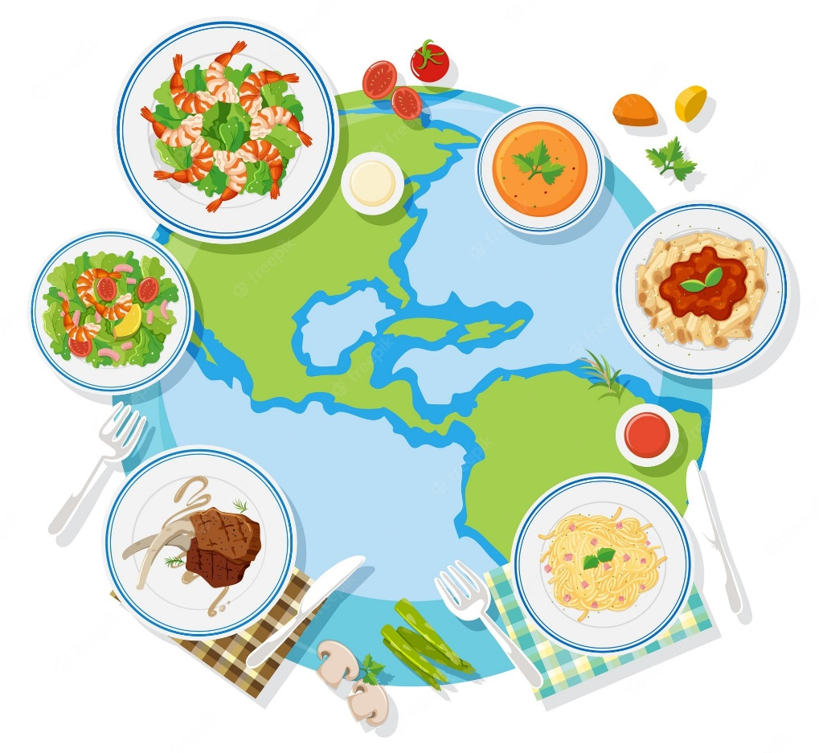
Monday, July 22, 2024
Period 43: Unit 6:
LIFESTYLES
LESSON 4: COMMUNICATION (P. 64)

Slide 6
I. OBJECTIVES
By the end of this lesson, students will be able to gain:
1. Knowledge:
- Use the lexical items related to lifestyles
- Express certainty

Slide 7

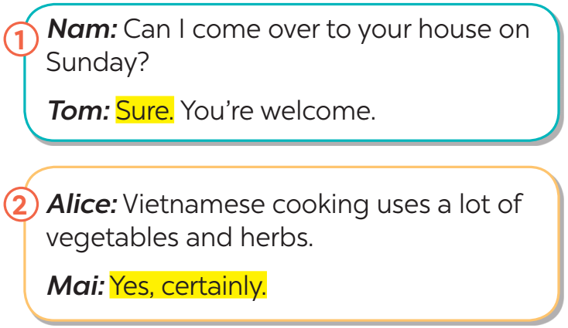

* EVERYDAY ENGLISH
1
Listen and read the conversations. Pay attention to the highlighted sentences.
Structure | Examples
How to express certainty | - Sure. (chắc chắn) - Yes, certainly. (tất nhiên, chắc chắn)

Slide 8
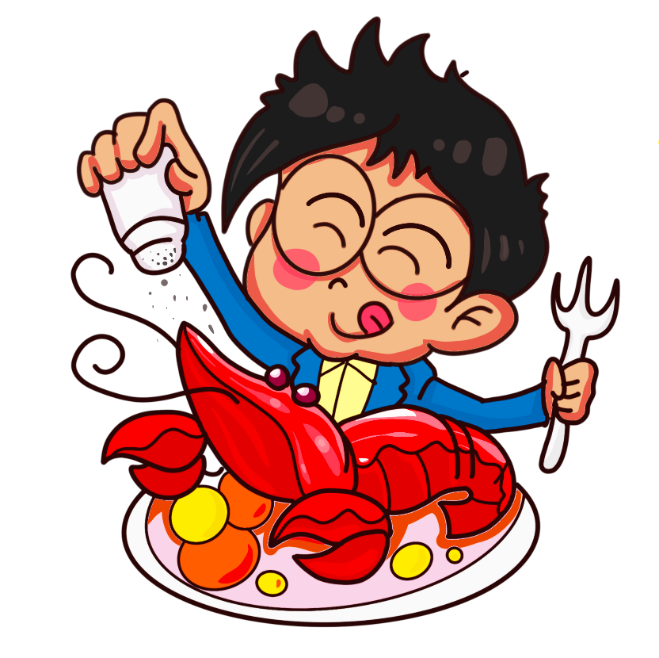

* EVERYDAY ENGLISH
2
Work in pairs. Make similar conversations to express certainty in the following situations.
1. You ask your friend to help you with your maths homework.
﻿2. You say that Vietnamese love seafood.

Slide 9
* EVERYDAY ENGLISH
2
Work in pairs. Make similar conversations to express certainty in the following situations.
1. You ask your friend to help you with your maths homework.
A: Can you help me with my maths homework?
It's very difficult.
B:
Sure. I can help you.

Slide 10
* EVERYDAY ENGLISH
2
Work in pairs. Make similar conversations to express certainty in the following situations.
﻿2. You say that Vietnamese love seafood.
A: I relized that Vietnamese love seafood.
B:
Yes, certainly.

Slide 11
﻿CUISINES AROUND THE WORLD
3
How much do you know about the cuisines of different countries?
Do the quiz to find out.
1. Which country is famous for pasta and pizza?
A. Thailand B. Italy C. Brazil
2. Which country is famous for kimchi?
A. Korea B. Portugal C. Australia
3. England is well-known for ______.
A. dim sum B. spaghetti C. fish and chips
4. Sushi comes from ______.
A. Japan B. Korea C. Taiwan
5. In which country do you think kangaroo steak is common?
A. China B. Australia C. The USA

Slide 12
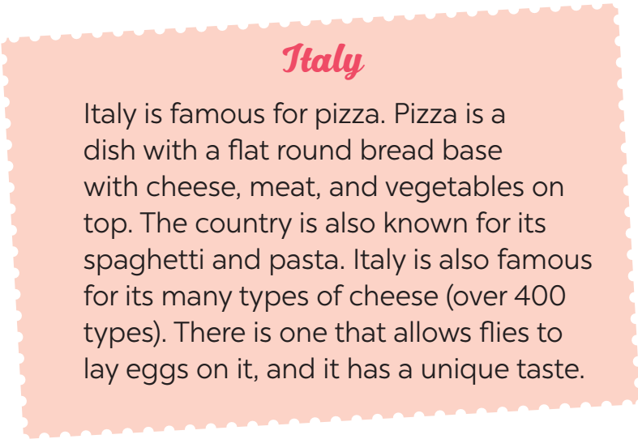
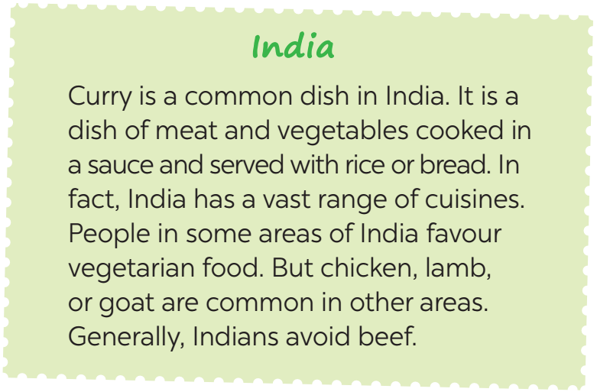
﻿CUISINES AROUND THE WORLD
4
Work in groups. Read the two passages and discuss the questions below:
Do you prefer Italian or Indian food? Why / Why not?

Slide 13
4
Work in groups. Read the two passages and discuss the questions below:
Do you prefer Italian or Indian food? Why / Why not?
→ I prefer Italian food to Indian food. It’s because I love pizza. Spaghetti and pasta are really delicious too.
→ I like the Indian cuisine /kwi'zi:n/because I enjoy the favour of curry. It’s savory (ngon) and delicious. I hope one day I will have the chance to try Italian cusine.

Slide 14

﻿CUISINES AROUND THE WORLD
5
Work in groups. Talk about the typical food in your area. Discuss the following:
﻿– staple food (lương thực)
– favourite food
– foods eaten on special occasions
* Example:﻿
A: What is the staple (chính)food in your area?
B: It’s rice.
C: Yes. We have rice with most of our meals.
…

Slide 15
* Example:
* staple food
A: What is the staple food in your area?
B: It's rice.
C: Yes. We have rice with most of our meals.
* favourite food
A: What is your favourite food in your country?
B: People in my country love all kinds of noodles and banh mi
C: They also eat a lot of seafood.
* foods eaten on special occasions
A: What do people in your area eat on special occasions?
B: We usually have banh chung, banh tet.
C: Yes. I see people eat them on Tet holiday.

Slide 16

* CONSOLIDATION
What have we learnt in this lesson?
How to express certainty
Examples
- Sure. - Yes, certainly.

Slide 17

* Homework
Do ex C1,2,3(P. 47)
Make a list of 10 popular street food in Asian.
Prepare lesson 5: Skills 1

Slide 18

Thank you!
Have a nice day!

