Slide 1


WELCOME TO OUR CLASS!!!

Slide 2
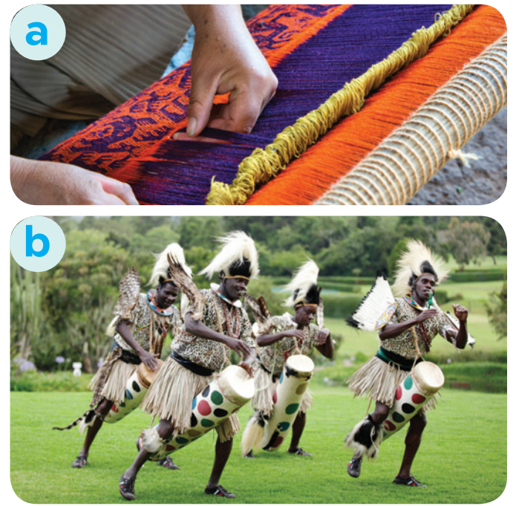
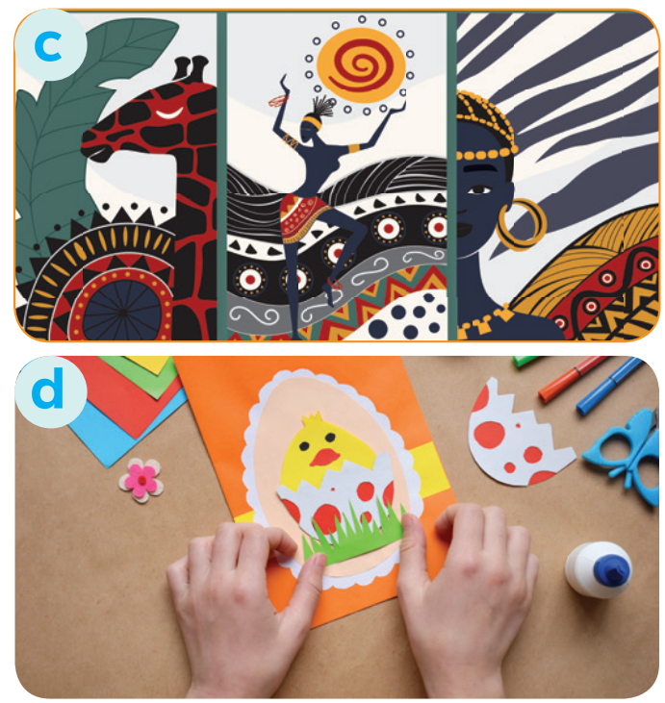
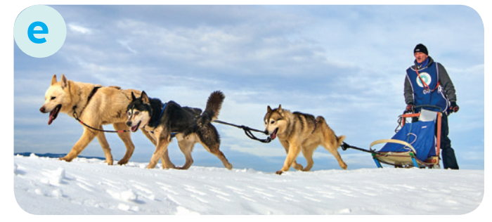
* WARM-UP:
Match the words to the suitable pictures
dogsled
make crafts
native art
weave
tribal dance

Slide 3

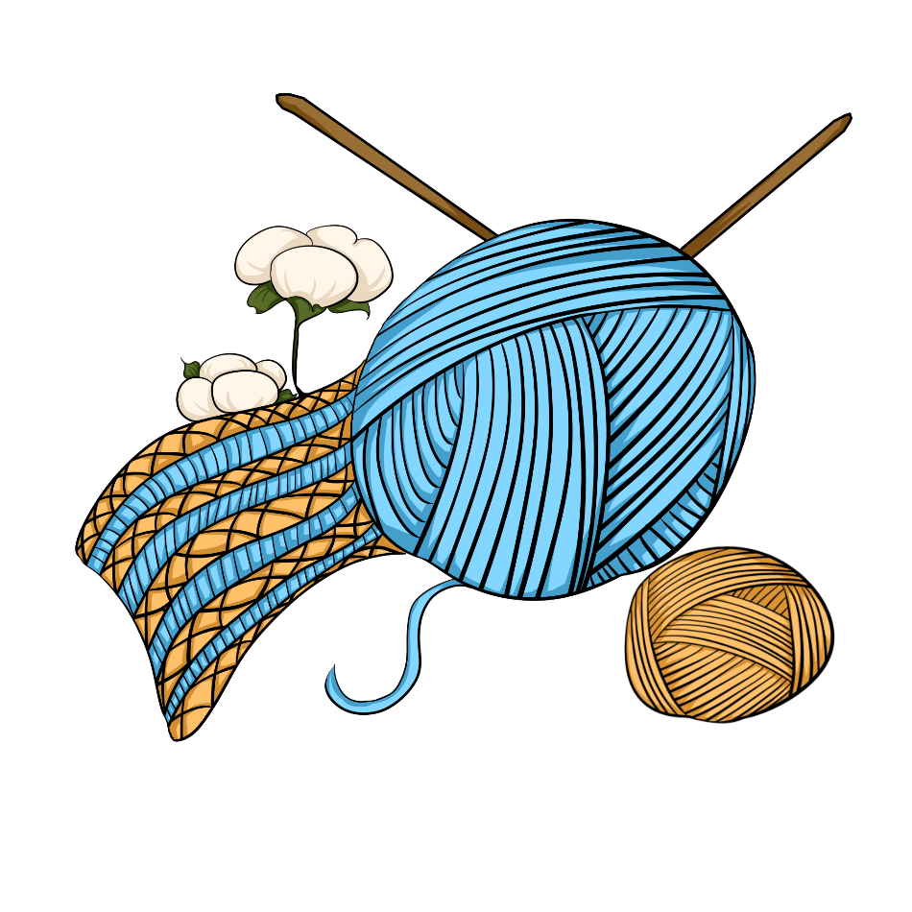
Monday, July 22, 2024
Period 41. Unit 6
LIFESTYLES
LESSON 2: A CLOSER LOOK 1 (P. 62)

Slide 4
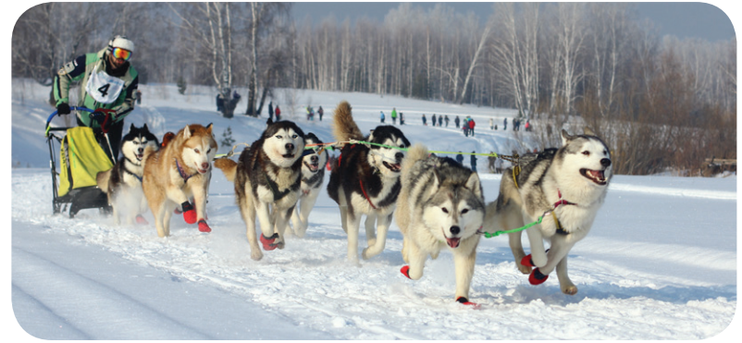

I. VOCABULARY
- dogsled (n):
xe trượt tuyết chó kéo
a sledge pulled by dogs
/ˈdɒɡsled/

Slide 5
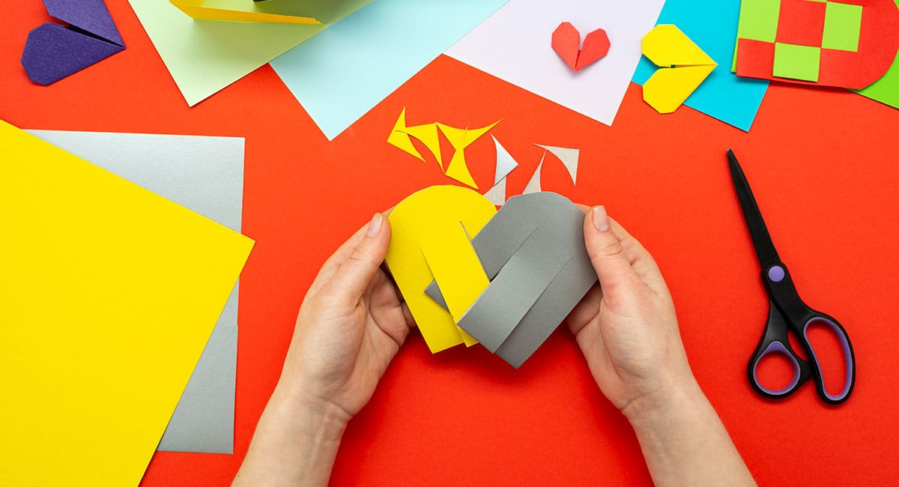
* VOCABULARY
﻿- make crafts (v):
make things with your hands in a skilled way
Làm đồ thủ công
/meɪk krɑːft/

Slide 6
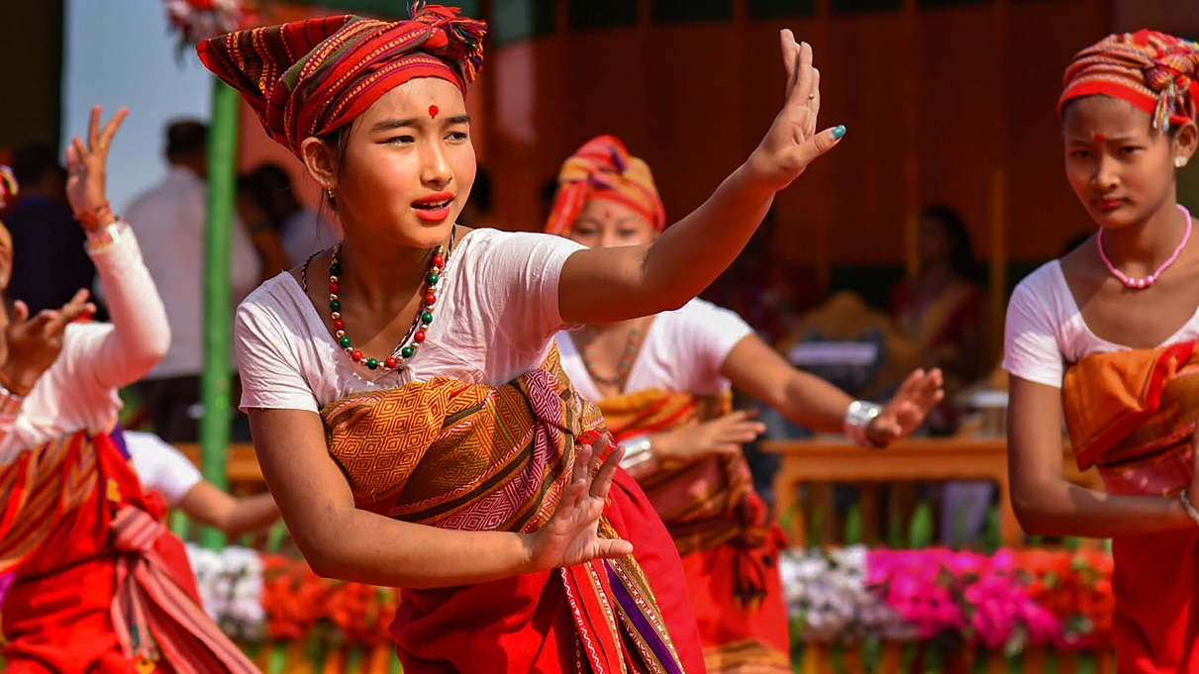
* VOCABULARY
﻿tribal dance (n)
điệu nhảy của bộ tộc, bộ lạc
/ˈtraɪbl dɑːns/
a dance performed by tribal people based on their customs and beliefs

Slide 7
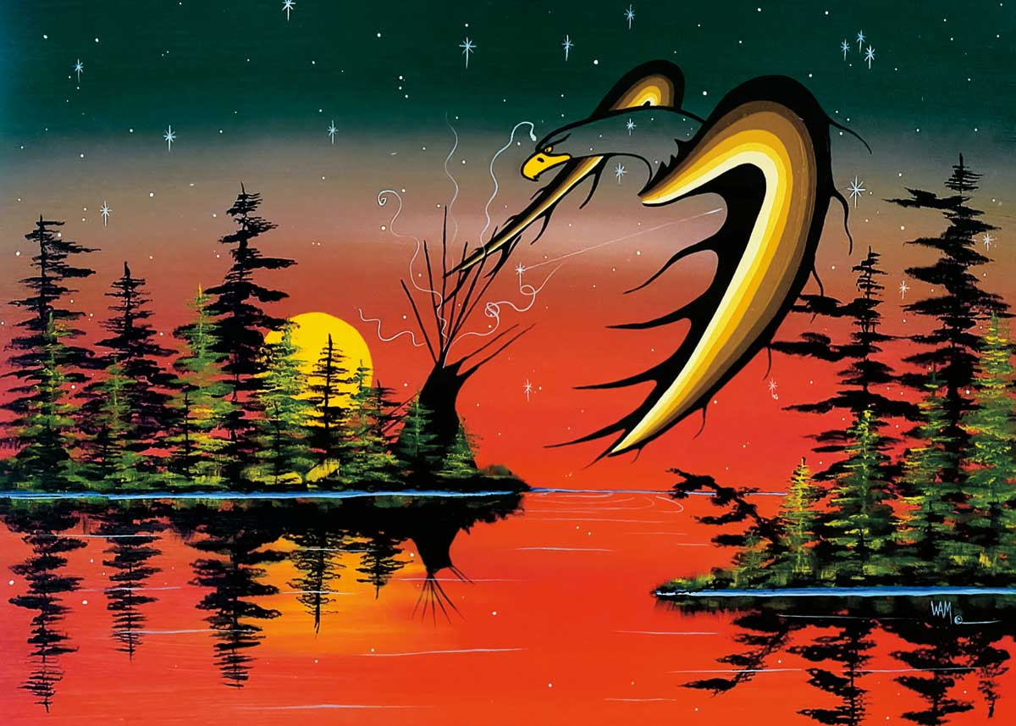
* VOCABULARY
﻿native art (n)
/ˈneɪtɪv ɑːt/
tác phẩm nghệ thuật bản địa
the artwork created by the original native people

Slide 8
* VOCABULARY
New words | Pronunciation | Meaning
1. dogsled (n) | ﻿/ˈdɒɡsled/ | ﻿xe trượt tuyết chó kéo
2. ﻿make crafts (v) | ﻿/meɪk krɑːft/ | ﻿làm đồ thủ công
3. tribal dance (n) | ﻿/ˈtraɪbl dɑːns/ | ﻿điệu nhảy của bộ tộc, bộ lạc
4. native art (n) | /ˈneɪtɪv ɑːt/ | tác phẩm nghệ thuật bản địa

Slide 9
* CHECKING VOCABULARY
New words | Pronunciation | Meaning
1. | ﻿/ˈdɒɡsled/ | ﻿
2. ﻿ | ﻿/meɪk krɑːft/ | ﻿
3. | ﻿/ˈtraɪbl dɑːns/ | ﻿
4. | /ˈneɪtɪv ɑːt/
dogsled (n)
xe trượt tuyết chó kéo
make crafts (v)
làm đồ thủ công
điệu nhảy của bộ tộc,
bộ lạc
tribal dance (n)
tác phẩm nghệ thuật
bản địa
native art (n)

Slide 10
2
Complete the sentences with the words and phrases from the box.
tribal dances
weaving
dogsled
making crafts
native art
﻿1. The traditional craft of the villagers is _________ bamboo baskets.
2. We all joined in the ______________ when we attended the local festival.
3. The gallery in the city centre has an excellent collection of ___________.
4. Hoa is very keen on _____________. She loves to knit gloves after school.
5. The _________ is still used as a means of transport in Alaska today.

Slide 11

3
﻿Choose the correct answer A, B, or C to complete each sentence.
Choose the best answer

Slide 12
3
3
﻿Choose the correct answer A, B, or C to complete each sentence.
﻿Choose the correct answer A, B, or C to complete each sentence.
1. The tribal women know how to ______ these threads into beautiful clothes.
A. weave B. make C. cut
2. She comes from Korea, so her ______ language is Korean.
A. modern B. native C. practical
3. Sticking out one’s tongue was a way of greeting in ______ Tibetan culture.
A. traditional B. leisurely C. simple
4. How do people ______ New Years in your country, Jack?
A. practise B. keep C. celebrate
5. We like that restaurant: it ______ very delicious food.
A. practises B. serves C. buys

Slide 13



The tribal women know how to ______ these threads into beautiful clothes.
The tribal women know how to ______ these threads into beautiful clothes.
The tribal women know how to ______ these threads into beautiful clothes.
The tribal women know how to ______ these threads into beautiful clothes.
1
1
1
weave
make
cut
A
A
B
B
C

Slide 14
She comes from Korea, so her ______ language is Korean.
2
native
practical
modern
A
B
C

Slide 15
Sticking out one’s tongue was a way of greeting in ______ Tibetan culture.
3
traditional
leisurely
simple
A
B
C

Slide 16
How do people ______ New Years in your country, Jack?
4
practise
keep
celebrate
A
B
C

Slide 17
We like that restaurant: it ______ very delicious food.
5
practises
serves
buys
A
B
C

Slide 18
3
3
﻿Choose the correct answer A, B, or C to complete each sentence.
﻿Choose the correct answer A, B, or C to complete each sentence.
1. The tribal women know how to ______ these threads into beautiful clothes.
A. weave B. make C. cut
2. She comes from Korea, so her ______ language is Korean.
A. modern B. native C. practical
3. Sticking out one’s tongue was a way of greeting in ______ Tibetan culture.
A. traditional B. leisurely C. simple
4. How do people ______ New Years in your country, Jack?
A. practise B. keep C. celebrate
5. We like that restaurant: it ______ very delicious food.
A. practises B. serves C. buys

Slide 19

* PRONUNCIATION
How to pronounce to the sounds /br/ and /pr/.

Slide 20
*PRONUNCIATION
4
Listen and repeat the words. Pay attention to the sounds /br/ and /pr/.
/br/ | /pr/
﻿bridge broccoli breakfast algebra celebrate | present practise precious programme express
1. /br/
bridge, broccoli, celebrate
2. /pr/
express, present, practise

Slide 21
5
Listen and practise the sentences. Underline the words with the sound /br/ and circle the words with the sound /pr/.
﻿1. My brother says online learning improves our IT skills.
2. Santa Claus brings a lot of presents to children.
3. She briefly introduced the new programme.
4. He spent a lot of time preparing for his algebra test.
5. My mum prays at the temple before breakfast on Sundays.

Slide 22

* CONSOLIDATION
What have we learnt in this lesson?
Vocabulary: The lexical items related to Lifestyles
Pronunciation: How to correctly pronounce words that contain the sounds: /br/ and /pr/

Slide 23

* Homework
Do exs A1, B6 (P. 44,46)in the workbook.
Prepare lesson 3 : A closer look 2

Slide 24

Thanks for your atendance!
Goodbye. See you again
Notes:
24

