Slide 1
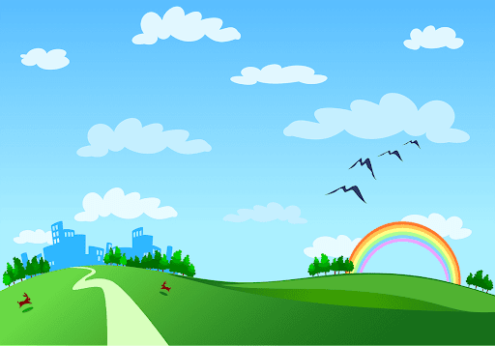
Nguyen Binh Khiem secondary school
Good morning class!!!

Slide 2
WARM-UP
Game: Bingo!
Names of some festivals
Teacher calls out the names
of some festivals
The student who has 3 words
highlighted in a row yells “Bingo”
and wins.
Notes:
Each student gets a piece of paper, draws a table with 3 rows and 3 columns, then fill in the table with names of some festivals randomly.
Teacher calls out the names of some festivals. Each time the teacher calls out a word, the students search for the right square on their paper and mark.
The student who has 3 words highlighted in a row yells “Bingo” and wins.

Slide 3


Unit
9
FESTIVALS AROUND THE WORLD
LESSON 6: SKILLS 2

Slide 4

I. LISTENING
1
Look at the animal below. Discuss the following questions with a partner.
What is it?
What festival is it a part of?

Slide 5

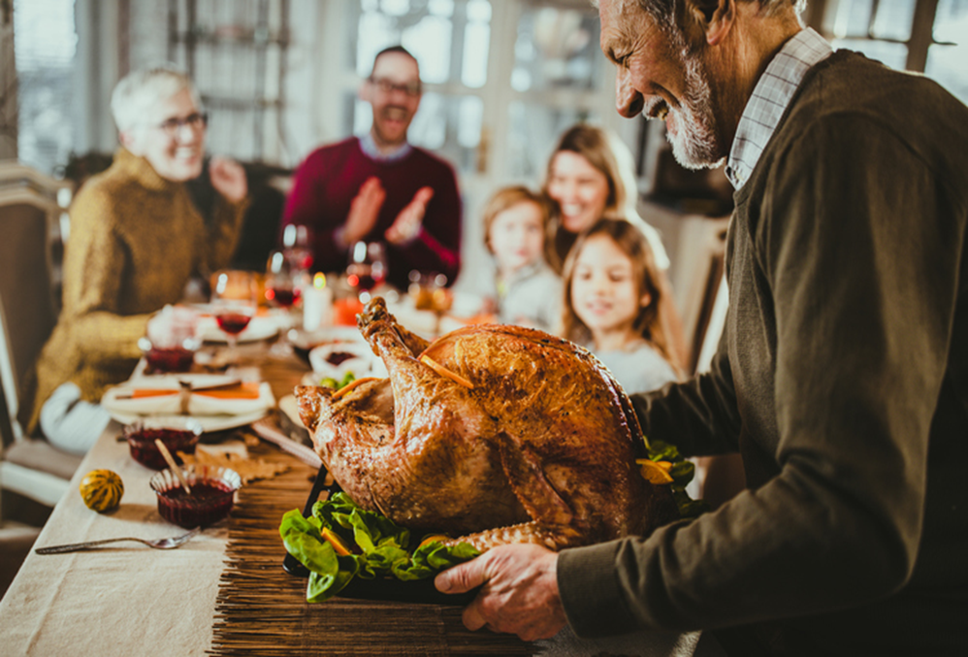
2
Listen to Mark talking about how his family celebrates a festival.
Check your answers.
1. What is it?
2. What festival is it a part of?
→ A turkey.
→Thanksgiving.

Slide 6
3
Listening again and decide whether the following statements are true or false.
 | True | False
1. Only people from the USA celebrate Thanksgiving.
2. People celebrate it on the third Thursday of November.
3. Family members and friends usually gather to have a feast.
4. In his family, only adults prepare the feast.
5. Cornbread is one of the traditional dishes.
6. After the feast, they play board games.
✓
✓
✓
✓
✓
✓

Slide 7
Audio Script:
Hello everyone. I'm Mark. Today I'm going to talk about Thanksgiving, or Turkey Day. It's a national holiday. People from Canada and the USA celebrate it every year to be thankful for successful harvests. In the USA, we celebrate it on the fourth Thursday of November. We usually prepare a feast for family and friends. Both adults and children take part in the food preparation. Some of the traditional foods are turkey, sweet potatoes, and cornbread. After the meal, we play board games together. My family usually takes this opportunity to help others. My parents volunteer to cook and serve food to homeless people. My sister and I read books to old people in a nursing home near our house.

Slide 8
II. WRITING
4
Think about a festival that your family usually celebrates. Fill in the blanks with your answers.
When do you celebrate it?
__________
What food does your family eat? __________
What festival is it?
__________
What activities does your family do?
________
Do you like the festival? Why or why not?
__________

Slide 9
4
Think about a festival that your family usually celebrates. Fill in the blanks with your answers.
A: What festival is it?
B:
A: What food does your family eat?
B:
A: When do you celebrate it?
B:
A: What activities does your family do?
B:
A: Do you like the festival? Why or why not?
B:
Mid Autumn Festival.
Moon cakes, autumn fruits.
In the middle of the eighth lunar month.
Watch lion dances and eat mooncakes.
Yes, it was funny and meaningful.

Slide 10
4
Think about a festival that your family usually celebrates. Fill in the blanks with your answers.
- What festival is it?
- When do you celebrate it?
- What activities does your family do?
- What food does your family eat?
- Do you like the festival? Why or why not?
→ The festival I love is Tet holiday.
→ We often celebrate it once every year in late January or early February
→ Before Tet, My family often cleans and decorates the house.
→ During Tet, my family families enjoys this festival by preparing traditional food such as Vietnamese square cake, dried candied fruit, etc.
→ I really like this festival because my family has a chance to reunite and I am given lucky money in red envelops.

Slide 11
5
Now write an email of about 70 words to tell Mark about the festival. Use the notes in 4.

Slide 12
5
Now write an email of about 70 words to tell Mark about the festival. Use the notes in 4.
New Message
From:
To:
Subject: Mid Autumn Festival.
Dear Mark,
How are you? I'm going to tell you about Mid Autumn Festival. It takes place in the middle of the eighth lunar month. My family and I often eat moon cakes, autumn fruits and watch lion dances. I like the festival very much because it was funny and meaningful.
I hope one day you can join the festival with us.
Cheers,

Slide 13

* PRODUCTION
Class gallery

Slide 14

* CONSOLIDATION
In this lesson, we have learnt to:
- listen for special information about a festival
- write an email to describe a festival

Slide 15
* HOMEWORK
Do exercise in the workbook.
Prepair : Looking back & Project

Slide 16

Thank you!
Have a nice day!

