Slide 1

Hello every one !!!

Slide 2
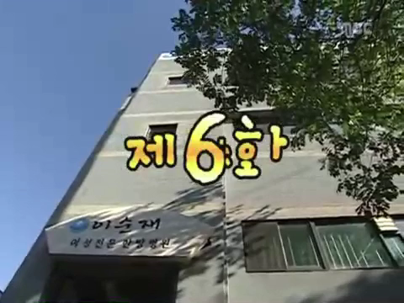
WARM-UP
Watch the video and answer some questions.

Slide 3
WARM-UP
Watch the video and answer some questions.
1. Who has seen this movie?
2. What is the name of the film?
3. What type of this film?
4. What is the film about?
The family is number 1
It’s a comedy
It's about funny situations in a family

Slide 4




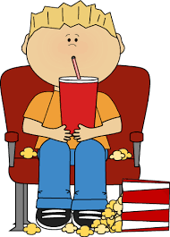

Unit
8
FILMS
LESSON 6: SKILLS 2

Slide 5



I. LISTENING
1
Work in pairs. Discuss the following question.
What do you like / dislike about a comedy?
MAKES PEOPLE LAUGH
MOSTLY NOT EDUCATIONAL
HELPS PEOPLE RELAX
SOME ARE NOT SUITABLE FOR CHILDREN
REDUCES STRESS
I like watching comedies because it's funny and helps me to reduce stress after a hard school day.

Slide 6

2
Mark and Hoa are talking about the film Naughty Twins.
Listen to their conversation. Who stars in the film?
Linda Brown and Susan Smith
Linda Smith and Susan Brown
Linda Brown and Susan Smith
Susan Linda and Brown Smith

Slide 7
* LISTENING STRATEGIES
Listen for details
Rearrange the steps to do the listening task:
Pay attention to the keywords/ related words while listening.
Find keywords -> Underline them.
(words that contain important information)
Recall all related lexical items to the topics and keywords.

Slide 8
* LISTENING STRATEGIES
STEP 1: Find keywords -> underline them.
(Words that contain important information)
STEP 2: Recall all related lexical items to the topics and keywords.
STEP 3: Pay attention to the keywords/ related words while listening.

Slide 9
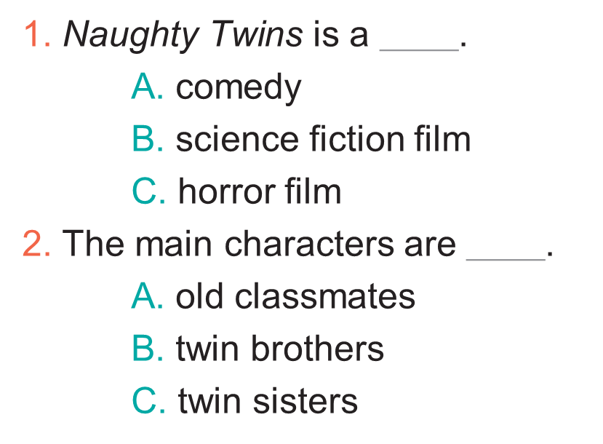
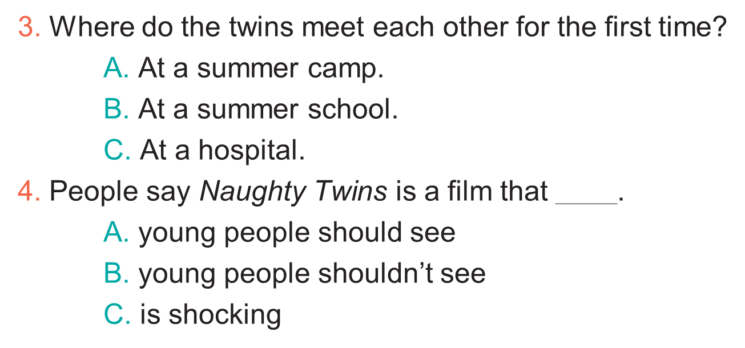
3
Listen to the conversation again. Choose the best answer to each question below.
GAME

Slide 10
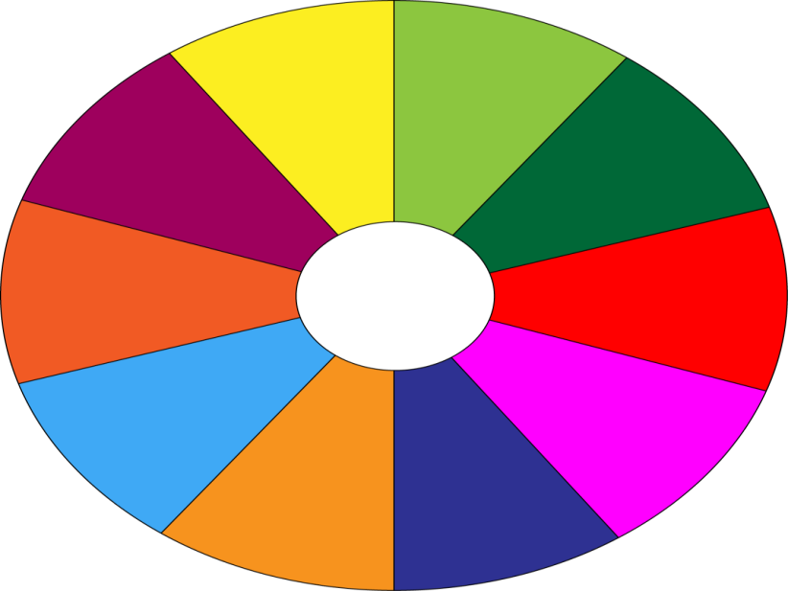
THE BIG WHEEL GAME
QUESTIONS
10
40
1
30
50
SPIN
2
20
10
3
-15
-20
05
60
4

Slide 11
3
. Choose the best answer to each question below.
1. Naughty Twins is a ______. A. comedy
B. science fiction film
C. horror film

Slide 12
3
Choose the best answer to each question below.
2. The main characters are ______. A. old classmates
B. twin brothers
C. twin sisters

Slide 13
3
Choose the best answer to each question below.
3. Where do the twins meet each other for the first time? A. At a summer camp.
B. At a summer school.
C. At a hospital.

Slide 14
3
Choose the best answer to each question below.
4. People say Naughty Twins is a film that ______. A. young people should see B. young people shouldn’t see C. is shocking

Slide 15
3
Listen to the conversation again. Choose the best answer to each question below.

Slide 16
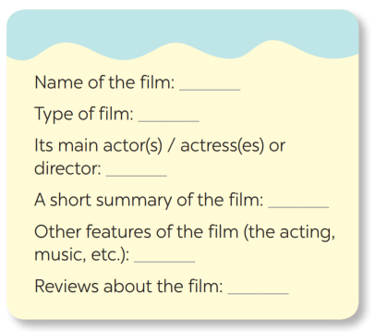
II.WRITING
4
Make notes about one of your favourite films.
Harry Potter
Fantasy / Fiction
Daniel Radcliffe, Emma Watson,
Rupert Grint
A group of teenage wizards and witches in Hogwarts fight against the Dark Lord.
Great acting, beautiful scences
Gripping, moving, funny

Slide 17


5
Write a paragraph of about 70 words about your favourite film, using the information in .
4
My favourite film is the Harry Potter series. It is based on one of the best selling novels. They are fantasy and fiction films about the wizard named Harry Potter and his friends: Ron and Hermione. Daniel Radcliffe, Emma Watson, Rupert Grint starred in this film. I like this film and I find it gripping, moving and funny, too. The scenes were set in the beautiful spots in the UK and the acting was really great.

Slide 18
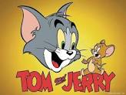
II.WRITING
4
Make notes about one of your favourite films.
Tom and Jerry
Cartoon
Tom and Jerry.
It’s about adventures of Tom – the cat and Jerry – the mouse.
the visual effect was wonderful, beautiful scences
Gripping, funny

Slide 19
5
Write a paragraph of about 70 words about your favourite film, using the information in .
4
My favorite film is Tom and Jerry. It’s an animation. The main characters are Tom and Jerry. It’s about adventures of Tom – the cat and Jerry – the mouse. I like Tom best because he is very stupid but funny, Jerry is very clever and cute. They hate each other but their adventures help them to know more about friendship. You can see it on TV program or watch it on online program. Although I’m a secondary student, I like to see it.

Slide 20

* PRODUCTION
Class gallery
Students can:
go and see other’s work
give comments to each other

Slide 21

* CONSOLIDATION
In this lesson, we have learnt to:
listen for special information about a comedy;
write a short paragraph about your favorite film.

Slide 22


* Homework
- Do exercise in the workbook.
- Prepare for the next lesson: Looking back & Project

Slide 23




