Slide 1
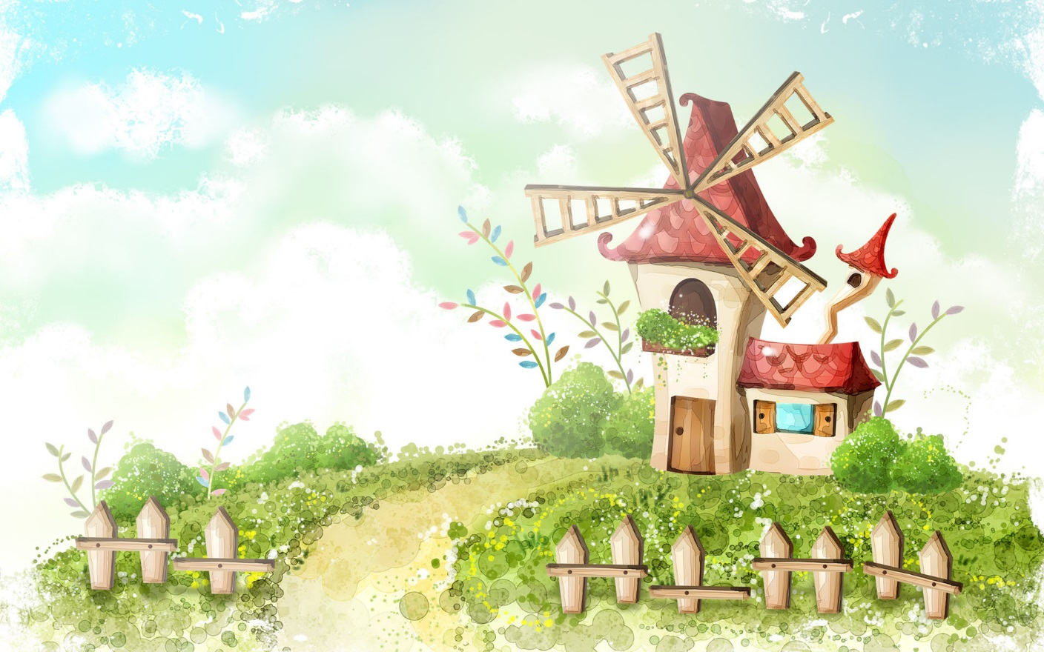
Welcome to our class!!!

Slide 2
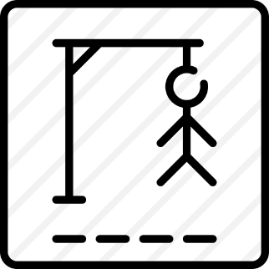


* WARM-UP
Game: Hangman
D A N G E R O U S

Slide 3


Unit
7
TRAFFIC
LESSON 5: SKILLS 1
ROAD SAFETY
READING
HOW TO AVOID TRAFFIC
ACCIDENTS
SPEAKING

Slide 4

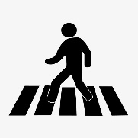
* VOCABULARY
- pedestrian (n):
/pəˈdestrēən/
người đi bộ

Slide 5
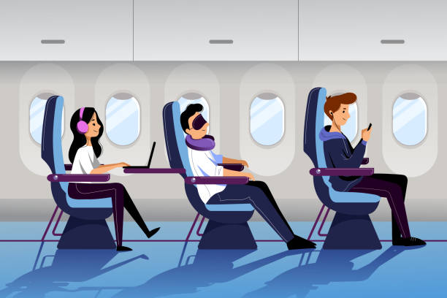
* VOCABULARY
- passenger (n):
/ˈpæs.ən.dʒɚ/
hành khách

Slide 6
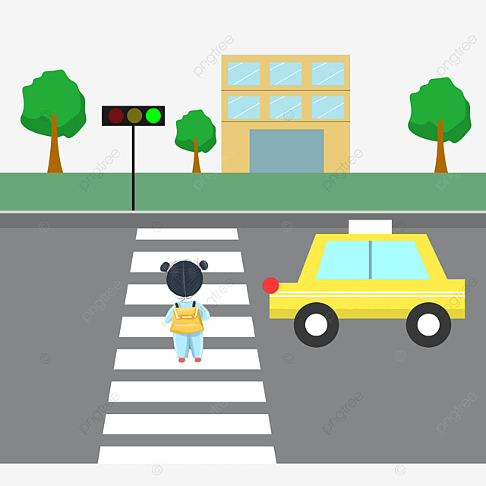
* VOCABULARY
-(to) obey
tuân thủ
/əʊˈbeɪ/

Slide 7
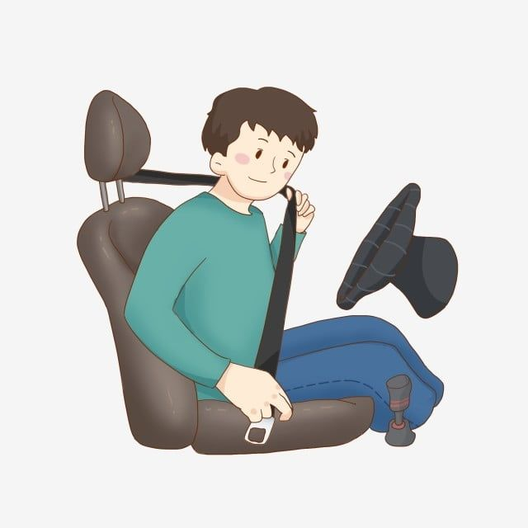
* VOCABULARY
- seat belt (n)
dây an toàn
/ˈsēt ˌbelt/

Slide 8
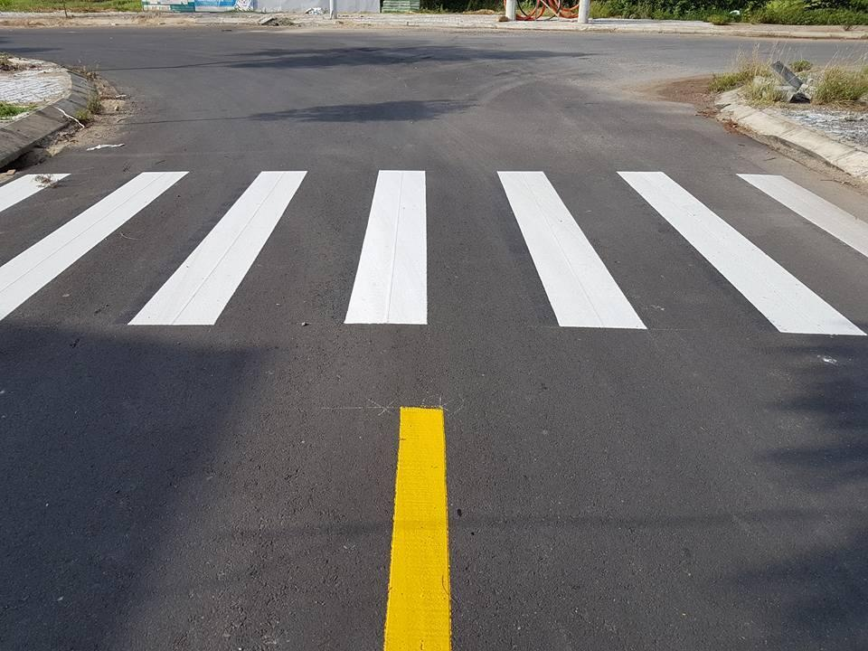
* VOCABULARY
- zebra crossing (n.phr):
vạch kẻ đường
/ˈziːbrə ˈkrɒsɪŋ/

Slide 9
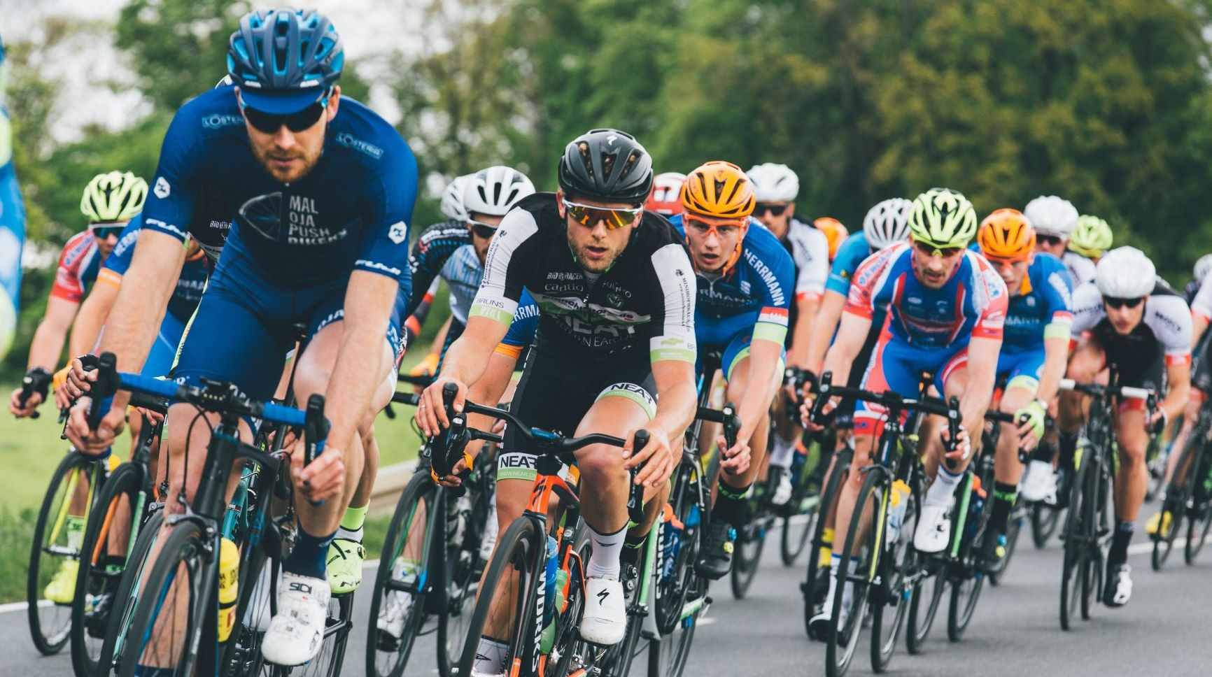
* VOCABULARY
cyclist (n):
/ˈsaɪklɪst/
người đi xe đạp

Slide 10
* VOCABULARY
New words | Pronunciation | Meaning
- pedestrian (n) | /pəˈdestrēən/ | người đi bộ
- passenger (a) | /ˈpasinjər/ | hành khách
- (to) obey | /ōˈbā/ | tuân thủ
- seat belt (n) | /ˈsēt ˌbelt/ | dây an toàn
- zebra crossing (n.phr): | /ˈziːbrə ˈkrɒsɪŋ/ | vạch kẻ đường
- cyclist (n): | /ˈsaɪklɪst/ | người đi xe đạp

Slide 11
* VOCABULARY
New words | Meaning
 | người đi bộ
 | hành khách
 | tuân thủ
 | dây an toàn
 | vạch kẻ đường
 | người đi xe đạp
- pedestrian (n)
- passenger (a)
- (to) obey
- seat belt (n)
- zebra crossing (n.phr):
- cyclist (n):

Slide 12

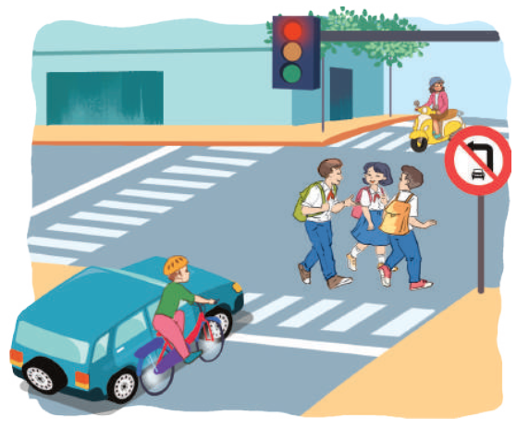
I. READING
1
Dicussion. Look at the pictures:
Can you see anything that is dangerous?
- The situation is very unsafe /dangerous.
- It’s dangerous to ride a bike so close to a car
- these students do not walk across the street at the zebra crossing

Slide 13
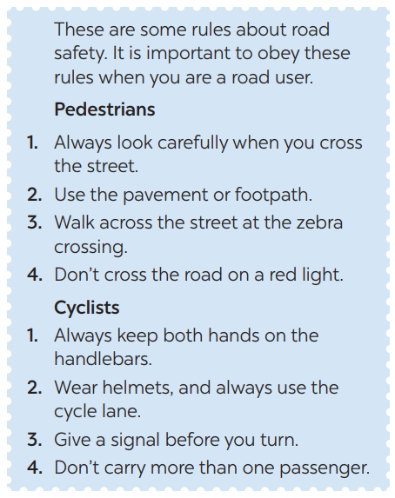
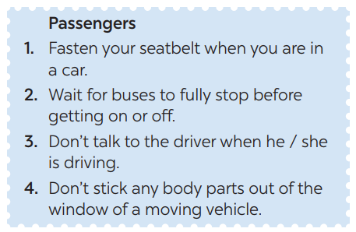
2
Read the following text and choose the correct answer.
This text is about ______.
A. rules for pedestrians
B. traffic lights
C. traffic rules

Slide 14
3
Read the passage again and choose the correct answer A, B, or C.
1. Where should pedestrians cross the street?
2. Which lane should you use when riding a bike?
3. What should you do before you turn while riding a bike?
4. What must you do when you get on or off a bus?
5. What mustn’t you do when you are in a moving vehicle?
GAME:

Slide 15
LUCKY NUMBER
1
Team A
8
2
Team B
2
8
4
6
10
3
2
8
4
6
7
10
6
4
5

Slide 16
3
Read the passage again and choose the correct answer A, B, or C.
1. Where should pedestrians cross the street?
→ They shoud cross the street at the zebra crossing.

Slide 17
3
Read the passage again and choose the correct answer A, B, or C.
2. Which lane should you use when riding a bike?
We should always use the cycle lane.

Slide 18
3
Read the passage again and choose the correct answer A, B, or C.
3. What should you do before you turn while riding a bike?
We should give a signal before we turn while riding a bike.

Slide 19
3
Read the passage again and choose the correct answer A, B, or C.
4. What must you do when you get on or off a bus?
We must wait for buses to fully stop when you get on or off a bus.

Slide 20
3
Read the passage again and choose the correct answer A, B, or C.
5. What mustn’t you do when you are in a moving vehicle?
We mustn’t stick any body parts out of the window
when you are in a moving vehicle.

Slide 21

LUCKY NUMBER!

Slide 22
LUCKY NUMBER!

Slide 23

LUCKY NUMBER
YOU GET A GIFT

Slide 24
3
Read the passage again and choose the correct answer A, B, or C.
1. Where should pedestrians cross the street?
2. Which lane should you use when riding a bike?
3. What should you do before you turn while riding a bike?
4. What must you do when you get on or off a bus?
5. What mustn’t you do when you are in a moving vehicle?
They shoud cross the street at the zebra crossing.
We should always use the cycle lane.
We should give a signal before we turn while riding a bike.
We must wait for buses to fully stop when you get on or off a bus.
We mustn’t stick any body parts out of the window
when you are in a moving vehicle.

Slide 25
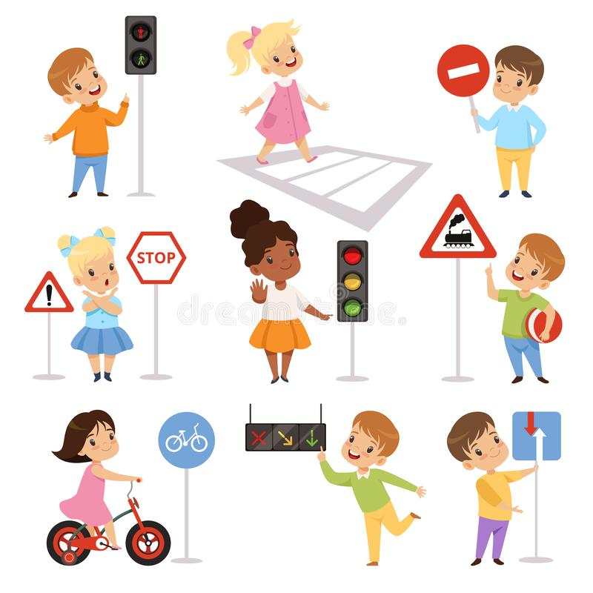
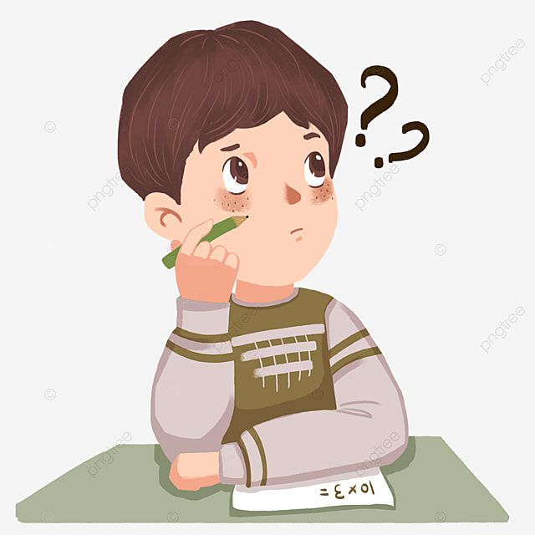
II. SPEAKING
4
Work in groups. Ask and answer the following question:
When you are a road user, what should you NOT do?
- I shouldn’t cross the road on a red light.
- I shouldn’t cycle in the pavement or footpath.
- I shouldn’t ride my bike fast.
- I shouldn’t carry a passenger in front of me.

Slide 26
5
Read the following sentences about these people.
Then work in groups. Discuss who is being safe, and who isn’t

Slide 27


5
Read the following sentences about these people.
Then work in groups. Discuss who is being safe, and who isn’t
1. Hoang is riding a bike, and he is wearing a helmet. 2. It is raining hard, but Mr. Long is driving quickly. 3. The students are standing in a line to get on the school bus. 4. Mr. Binh is taking his daughter to school on his motorbike. She is sitting in front of him. 5. Michelle is cycling to school and she is waving and shouting to her friends.

Slide 28

* CONSOLIDATION
ROAD SAFETY
SPEAKING
READING

Slide 29


HOMEWORK
Do more exercises in workbook.
Prepare: Lesson 6 ( Skills 2)

Slide 30



Slide 32
2
HOMEWORK

