Slide 1
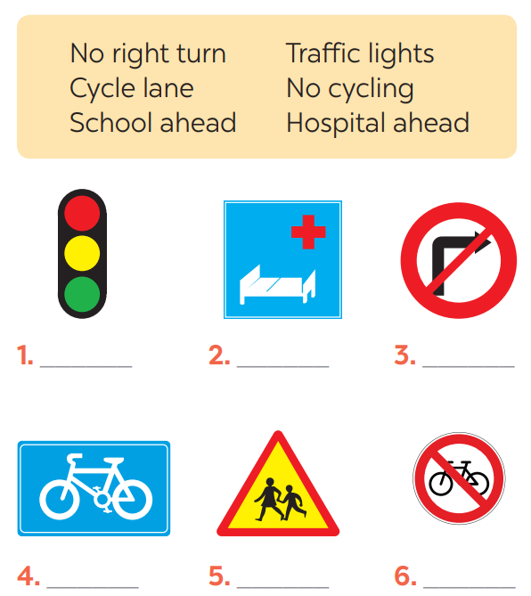
* Warm up:
Game:Pelmanism
1
2
3
4
5
8
9
Hospital ahead
No cycling
No right
turn
10
10
School ahead
Cycle lane
10

Slide 2



Unit
7
TRAFFIC
LESSON 3: A CLOSER LOOK 2
GRAMMAR:
- It to indicate distance
- should and shouldn’t

Slide 3
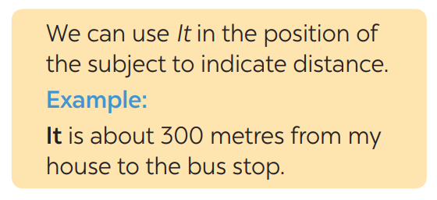

* GRAMMAR: It - INDICATING DISTANCE
What does the sentences tell us about?
→ Distance from his/her house to the bus stop
What is the structure using in the sentence?
It be (about) + distance from A to B.
- Chúng ta sử dụng đại từ “it” làm chủ ngữ của câu để chỉ khoảng cách.
- Cấu trúc: It is + (about) khoảng cách + from place 1 + to place 2.

Slide 4
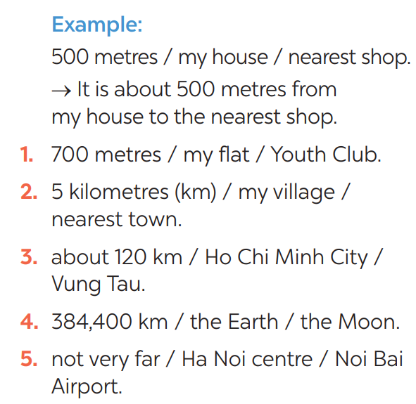

* PRACTICE
1
Write sentences with It. Use these cues.
* KEY
1- It is 700m from my house/home to the Youth club.
2- It is 5 kilometres from my village to the nearest town.
3- It is about 120 km from Ho Chi Minh city to Vung Tau.
4- It is 384,400 km from the Earth to the Moon.
5- It is not very far from Hanoi centre to Noi Bai airport.

Slide 5

*PRACTICE
2
Work in pairs. Ask and answer questions about distances in your neighbourhood
EXample: Your home - gym
How far is it from your house to the gym?
It’s about 1 km.
- your home - open market / supermarket
- your home - playground
- your home - hospital
- your home - train station

Slide 6
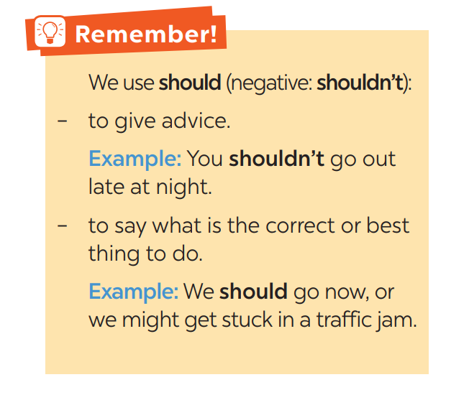
3
Choose the correct option in brackets.
1. That’s an interesting book. You (should / shouldn’t) read it. 2. You nearly fell off your bike! You really (should / shouldn’t) be more careful. 3. We (should / shouldn’t) go swimming right after eating. 4. I think that he (should / shouldn’t) eat less. He’s becoming overweight. 5. There are a lot of cars out today. He (should / shouldn’t) drive so fast.

Slide 7
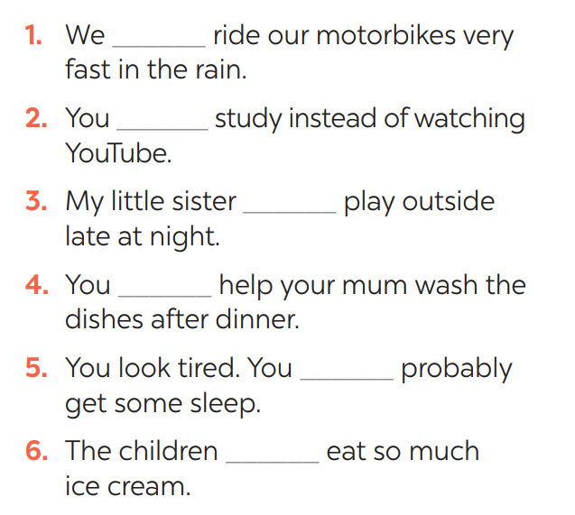
4
Complete each sentence, using should / shouldn’t.
shouldn’t
should
shouldn’t
should
should
shouldn’t

Slide 8
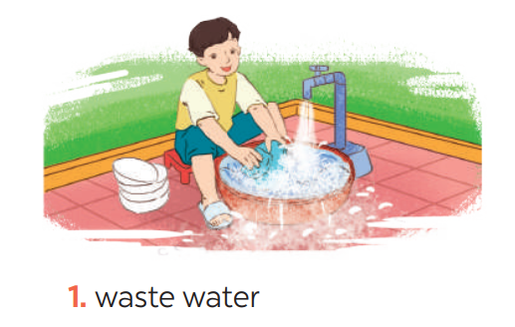
* PRODUCTION
5
Look at the pictures. Make sentences, using should / shouldn’t and the cues
He shouldn’t waste water.
GAME:

Slide 9
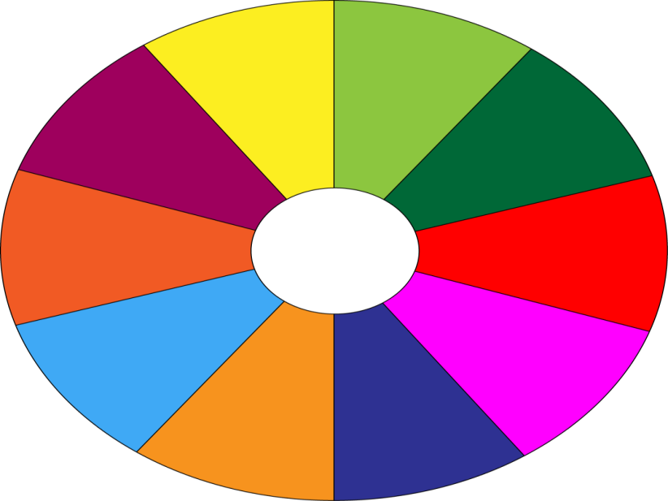
THE BIG WHEEL GAME
QUESTIONS
1
10
40
30
50
2
SPIN
20
10
3
-15
-20
05
60
4

Slide 10
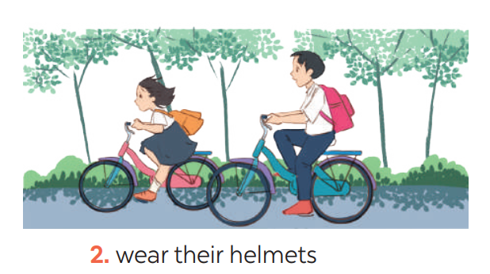
5
Look at the pictures. Make sentences, using should / shouldn’t and the cues
They should wear their helmets.

Slide 11
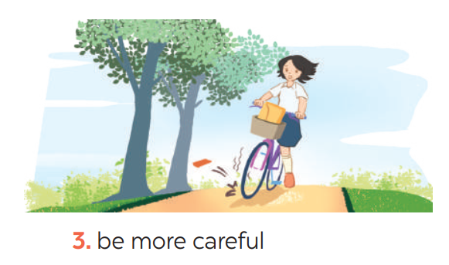
5
Look at the pictures. Make sentences, using should / shouldn’t and the cues
She should be more careful.

Slide 12
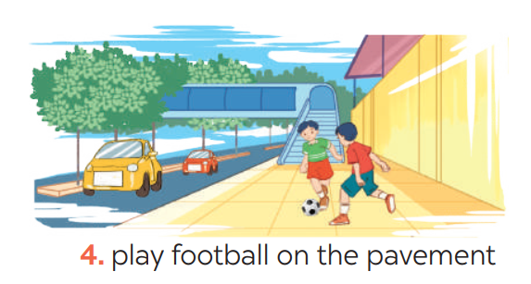
5
Look at the pictures. Make sentences, using should / shouldn’t and the cues
They shouldn’t play football on the pavement.

Slide 13
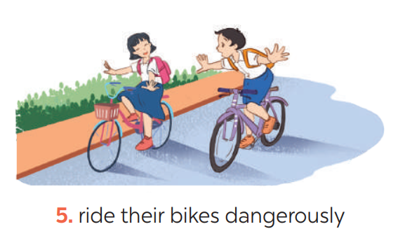
5
Look at the pictures. Make sentences, using should / shouldn’t and the cues
They shouldn’t ride their bikes dangerously.

Slide 14

* CONSOLIDATION
GRAMMAR:
- It to indicate distance
- should and shouldn’t

Slide 15
HOMEWORK
Do exercises in the workbook.
Prepare lesson 4 ( communication)

Slide 16
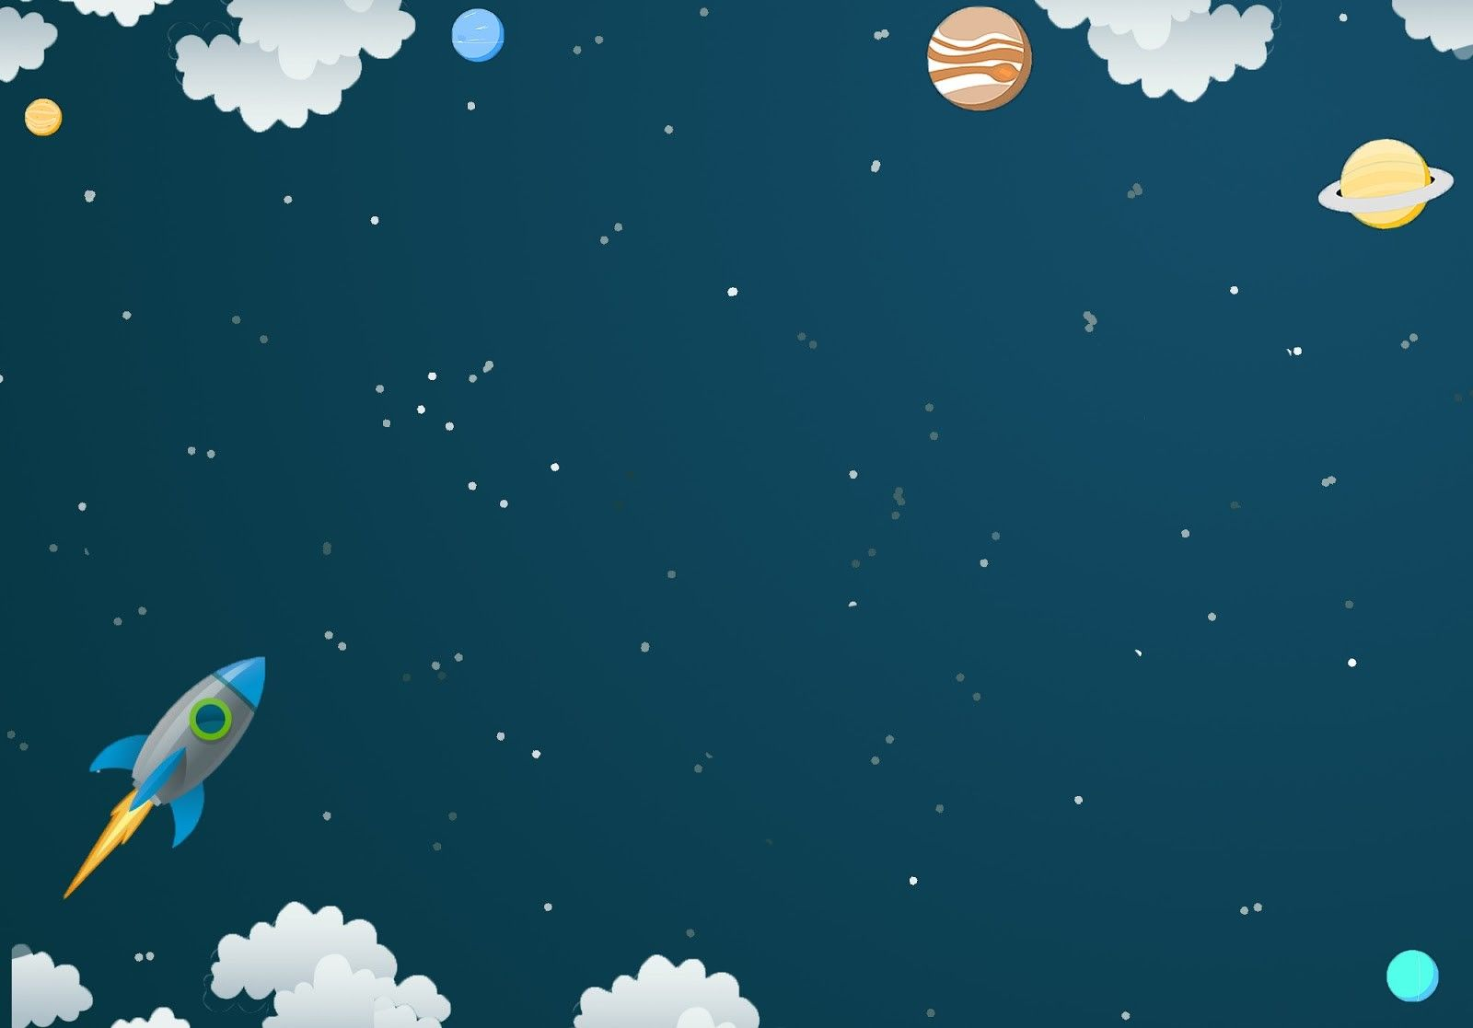
Goodbye.
See you again.

Slide 17


